Slide 1
Individual Z Overview
3,559,138
Germline SNVs
3,239,212
Common SNVs
319,925
Rare SNVs
1,800
Coding
318,125
Non-coding
733
Synonymous
1,018
Non-synonymous
271,499
Non-annotated
46,626
Annotated
15
PreMatureStop
16,097
Enhancer
3,043
Promoter
2,501
ncRNA (miRNA, lincRNA, etc)
Rare variants: MAF<0.05%
Total (PrematureStop): 97
Common+Rare
Notes:
lincRNA, miRNA, misc_RNA, Pseudogene， rRNA
snoRNA，snRNA
lof on every mutation
total of coding number
check 534 number; should be more?
annotated’s category (UTR?)
rare threshould (1/100? 1/1000; 0.5%?)
enhancer and promoter number comparison; new paper figure 1

Slide 2
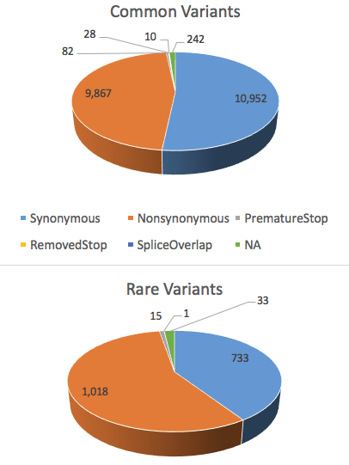
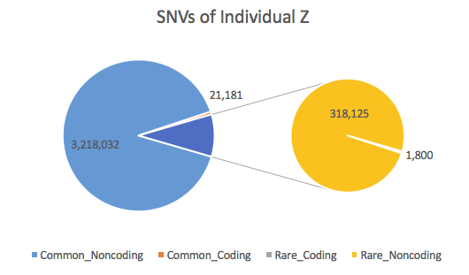
Overview & Coding Variants

Slide 3
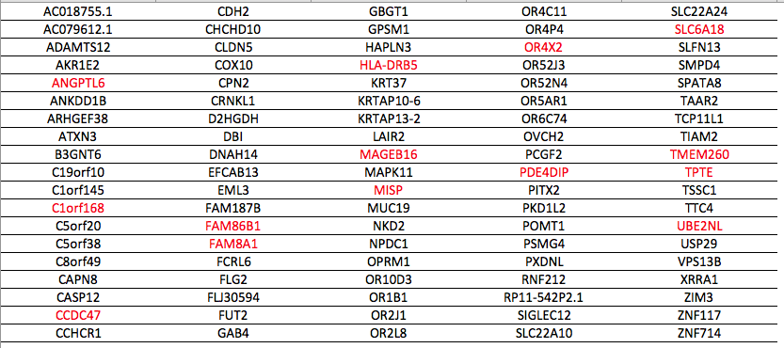
PrematureStop Coding Variants
97 variants -> 95 genes

Slide 4
PrematureStop Coding Variants
97 variants -> 95 genes
ATXN3 [DNA_repair]
Ataxin 3; Deubiquitinating enzyme
Akt signaling pathway
Machado-Joseph disease (neurologic disorder); Parkinsons disease; Ataxia
CDH2 [actionable]
Cadherin 2; calcium-dependent cell adhesion proteins
L1CAM interactions; ERK Signaling
hypoplastic left heart syndrome; pseudomyxoma peritonei; metastasis; tumor
PDE4DIP [cancer] —> Rare variants
Phosphodiesterase 4D Interacting Protein;
anchor sequestering components of the cAMP-dependent pathway
myeloproliferative disorder (MBD) associated with eosinophilia

Slide 5
Rare Non-synonymous Coding Variants
1018 SNVs -> 824 target genes
Gene Annotation | Gene Name
Cancer-related | NOTCH2; PDE4DIP; TPR; CRTC3; CDH11; MLLT6; ASXL1; HMGA1; KDM6A
DNA repair | RECQL; RAD51; PPM1D; XRCC1; AP1B1; FANCI; PTPRH; RBBP7; SLX4; POLR2A; DCLRE1C; ANKLE1
Cancer & DNA repair | ATM; PMS2; ERCC5
Actionable Gene | ATM; KDM6A; INSR; FOXP4
ATM: Serine/Threonine Kinase; Regulator of p53 and BRCA1; leukemia; ataxia-telangiectasia; breast cancer
PMS2: Direct p53 effectors; mismatch repair cancer syndrome; colorectal cancer; hereditary nonpolyposis
ERCC5: Chks in Checkpoint Regulation; DNA Repair; xeroderma pigmentosum
KDM6A: Transcriptional misregulation in cancer
INSR: Insulin Receptor; PI3K-Akt signaling pathway; GPCR Pathway; Diabetes mellitus
FOXP4: Transcriptional repressor that represses lung-specific expression

Slide 6
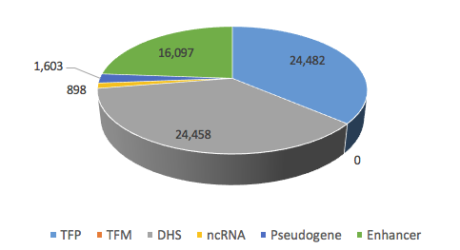
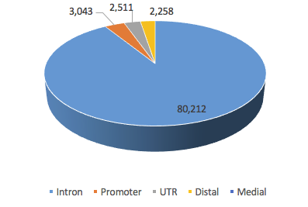
Annotation of Rare Noncoding Variants
ENCODE Annotation
Target Gene-level Analysis
promoter & distal regulatory module
TFP - transcription factor binding peak
TFM - transcription factor bound motifs in peak regions
DHS - DNase1 hypersensitive sites

Slide 7
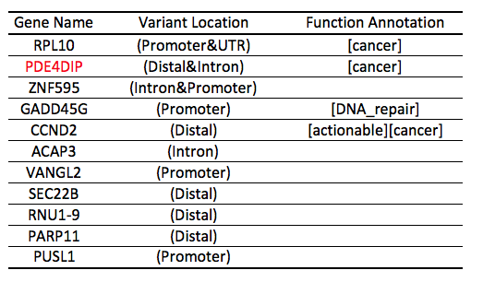
Annotation of Rare Noncoding Variants
975 (975+0)
863
63,753
9 variants -> 11 target genes
Motif change (Gain & Break)
817
14
9
374
Target gene is a hub
In sensitive regions

Slide 8
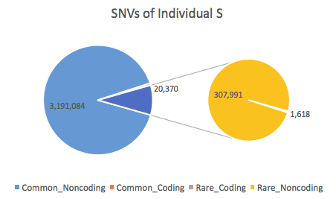
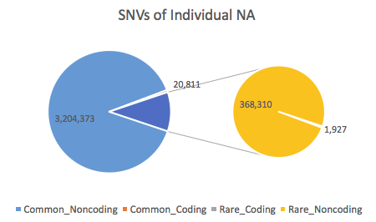
Overview

Slide 9
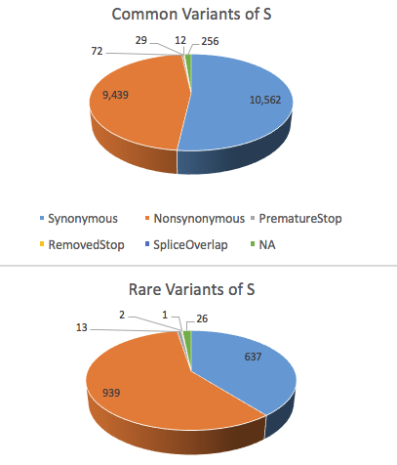
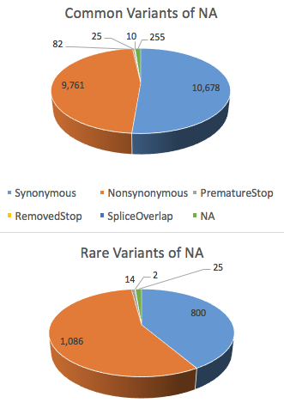
Coding Variants

Slide 10
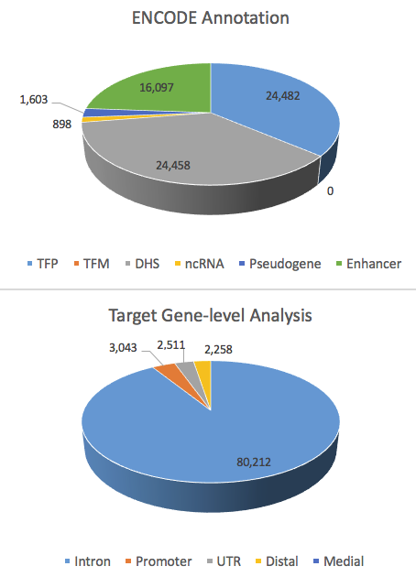
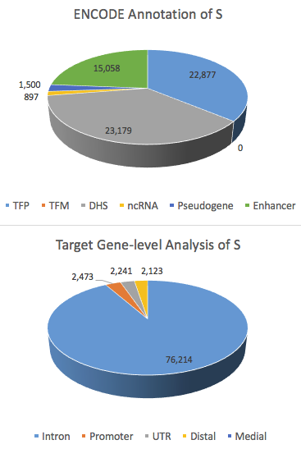
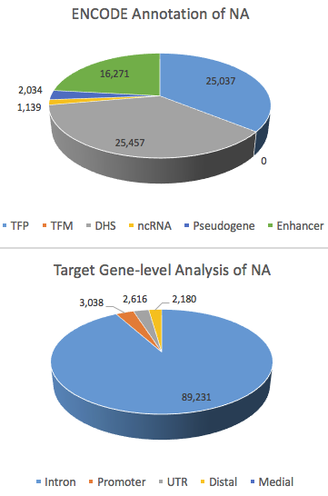
Rare Noncoding Variants

