Slide 1
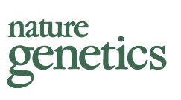
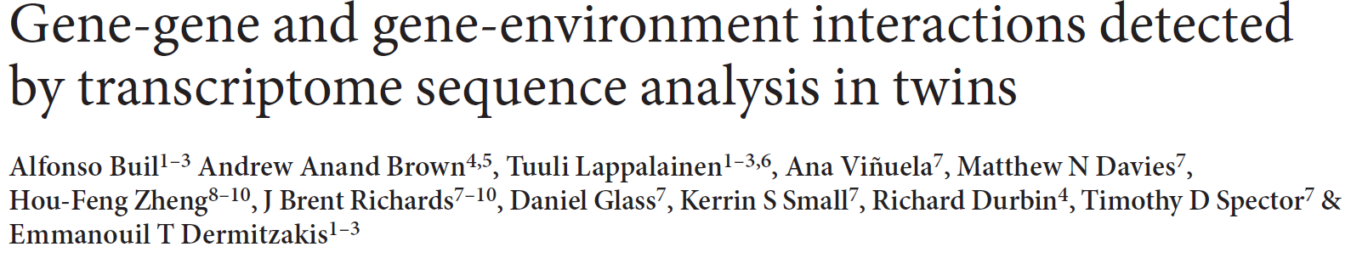
JC
JClub
Feb 18 2016

Slide 2
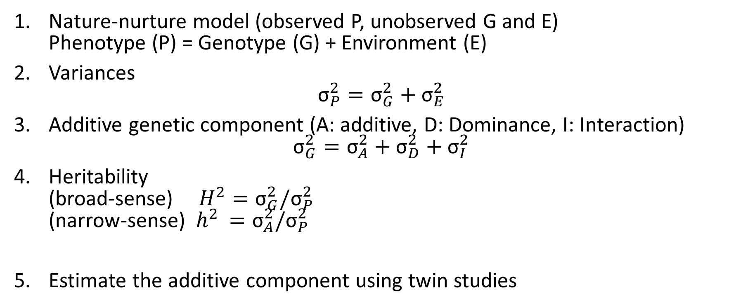
Brief intro to Heritability and Twin Studies
Nature-nurture model (observed P, unobserved G and E)
Phenotype (P) = Genotype (G) + Environment (E)
Variances
${\text{σ}}_{P}^{2}={\text{σ}}_{G}^{2}+{\text{σ}}_{E}^{2}$
Additive genetic component (A: additive, D: Dominance, I: Interaction)
${\text{σ}}_{G}^{2}={\text{σ}}_{A}^{2}+{\text{σ}}_{D}^{2}+{\text{σ}}_{I}^{2}$
Heritability
(broad-sense) $H^{2}={\text{σ}}_{G}^{2}/{\text{σ}}_{P}^{2}$
(narrow-sense) ${ h}^{2} ={\text{σ}}_{A}^{2}/{\text{σ}}_{P}^{2}$
Estimate the additive component using twin studies

Slide 3
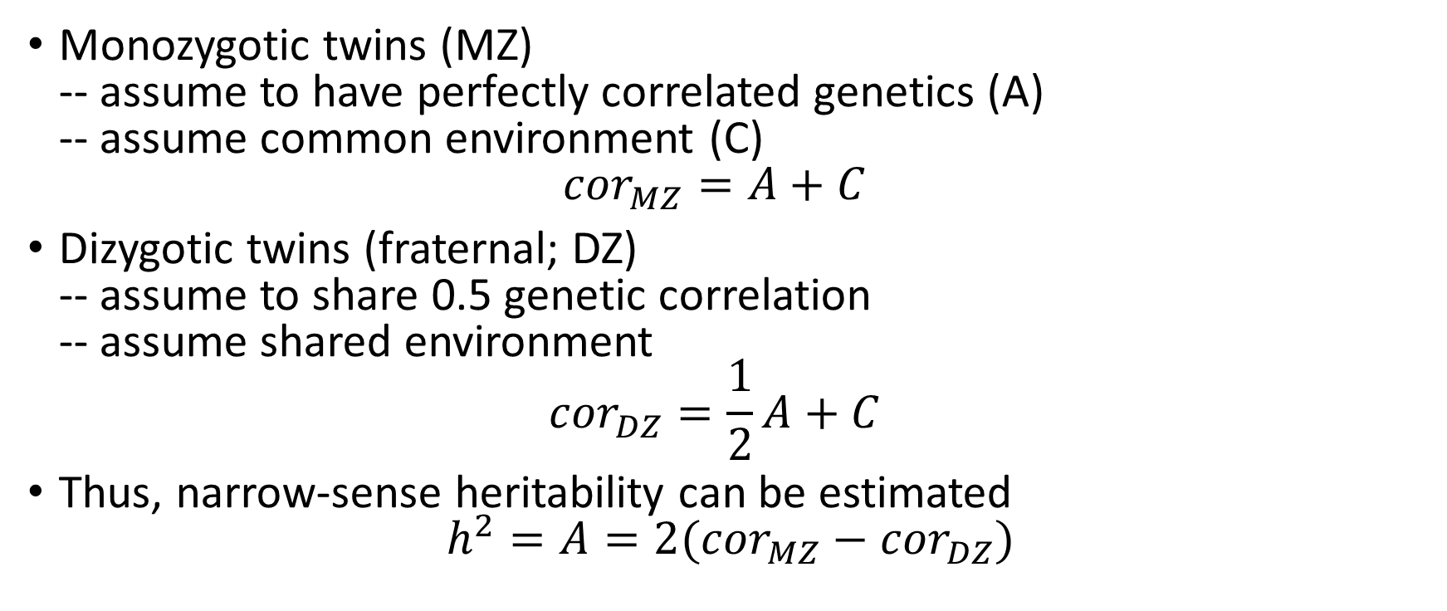
Brief Intro to Twin Studies
Monozygotic twins (MZ)
-- assume to have perfectly correlated genetics (A)
-- assume common environment (C)
${cor}_{MZ}=A+C$
Dizygotic twins (fraternal; DZ)
-- assume to share 0.5 genetic correlation
-- assume shared environment
${cor}_{DZ}=\frac{1}{2}A+C$
Thus, narrow-sense heritability can be estimated
$h^{2}=A=2({cor}_{MZ}−{cor}_{DZ})$

Slide 4
Goal of this study
~30% of the variance in allele-specific expression (ASE) can be explained by genetics
But what make up this 30%? Purely additive genetics or is this also mixed with non-additive genetic effects: genetic interactions (GxG) and/or genetic-environmental (non-genetic) (GxE) interactions?

Slide 5
Parameters of the study
428 female twin pairs (856 individuals)
--TwinsUK cohort
4 tissues
--fat, skin, blood and LCLs
49-bp paired end RNA-seq
Genotype information
--HumanHap300, HumanHap610Q, 1M-Duo, 1.2MDuo Illumina microarrays
--impute genotypes from 1KG Phase 1 reference panel (IMPUTE2)
ASE detection
--account for allelic mapping bias (simulated flipping, UCSC mappability track)
--binomial test with adjusted expected null to SNP-base-combination ratios
--reads with >= 30 reads
eQTL detection
--the main cis genetic influence on ASE
--tested for all SNPs within 1Mb window of TSS of each gene

Slide 6
ASE correlation among twin pairs: toy example
Allelic ratio
Sib 2
Sib 1
Adapted from Visscher et al. (2008) Nat Genet Reviews

Slide 7
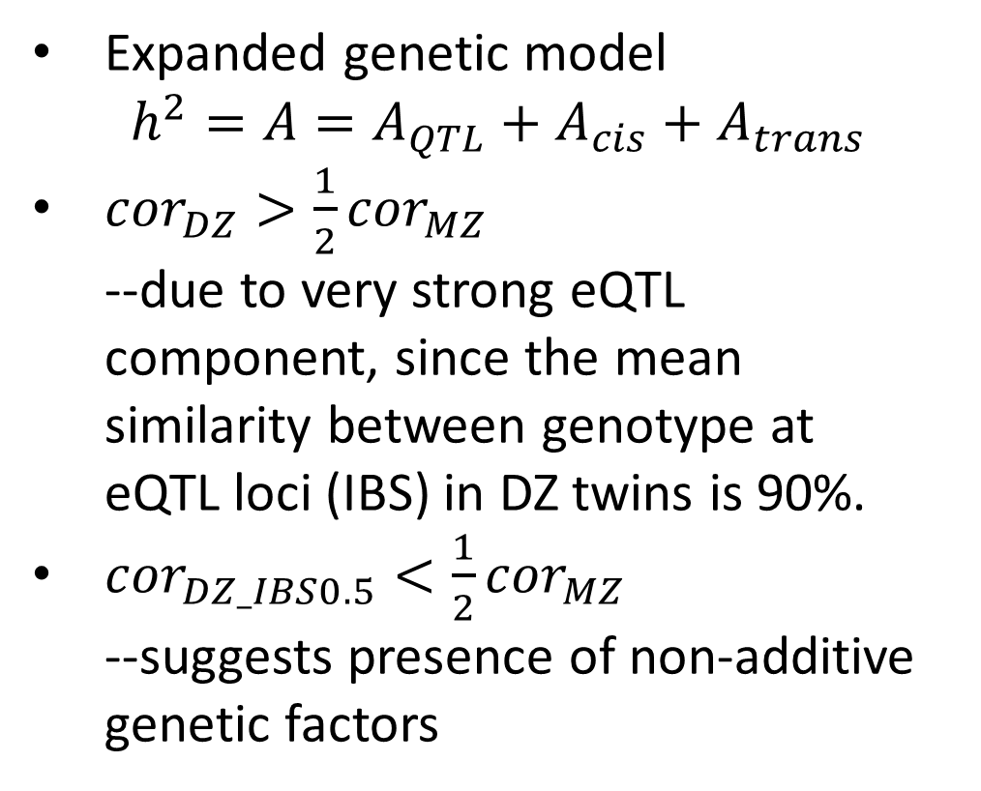
ASE correlation among MZ and DZ pairs suggest presence of non-additive genetic factors
Expanded genetic model
$h^{2}=A=A_{QTL}+A_{cis}+A_{trans}$
${cor}_{DZ}>\frac{1}{2}{cor}_{MZ}$
--due to very strong eQTL component, since the mean
similarity between genotype at
eQTL loci (IBS) in DZ twins is 90%.
${cor}_{DZ_IBS0.5}<\frac{1}{2}{cor}_{MZ}$
--suggests presence of non-additive genetic factors
(Control)
*DZ_IBS0.5 (control)
= twins that share exactly half genotype
*DZ = all DZ twins

Slide 8
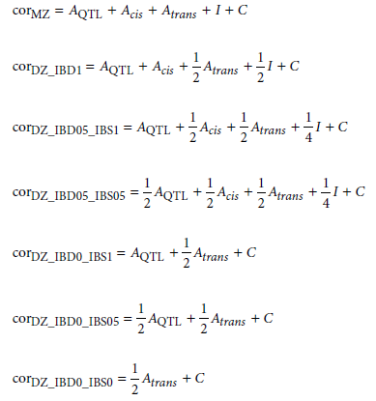
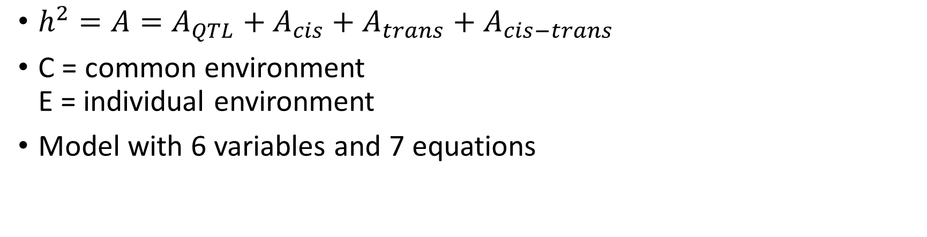
Include non-additive genetic factors in model
$h^{2}=A=A_{QTL}+A_{cis}+A_{trans}+A_{cis−trans}$
C = common environment
E = individual environment
Model with 6 variables and 7 equations

Slide 9
Variance breakdown for each tissue type
Genetic/inherited (green)
--eQTL
--all other cis sites
--cis-trans interactions
--trans
Environment (yellow)
--common environment
--individual environment
of twins

Slide 10
Variance breakdown for each tissue type
Heritability: 62-88% (green)
Nearly ½ of the variability due to most significant common eQTL in all cases
Substantial presence of GxG effects (cis-trans)

Slide 11
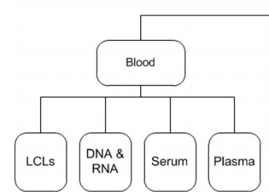
Variance breakdown for each tissue type
Blood shows shared environmental effect (C)
--due to heterogeneity of blood cell types
http://www.twinsuk.ac.uk/wp-content/uploads/2015/10/DTR_DataAccess_Policy.pdf

Slide 12
Variance breakdown for each tissue type
Environmental factors (yellow E) play a considerable role in ASE in all tissues
Environmental/epigenetic effects alone cannot create allelic imbalance
--it must exert an effect through a cis DNA sequence

Slide 13
GxE interaction at certain loci
This is adapted from classic discordant MZ twins analysis
--compare loci where each MZ twin pair differs in ASE (phenotype)

Slide 14
GxE interaction at certain loci

Slide 15
GxE interaction only in fat and LCLs
Found loci for GxE interaction in fat and LCLs but no conclusive results for skin and blood
Known examples in literature:
genes in fat tissues, adiponectin and fatty acid-CoA ligase genes, respond to fatty acid levels – response to diet and exercise in a genotype-dependent manner

Slide 16
Proposed model of ASE regulation
GxG interaction
GxE interaction
Notes:
Allelic imbalance in expression requires genetic variability in cis
Magnitude of ASE effect depends on trans genetic and environmental factors that interact with cis variants

Slide 17
Summary and Conclusion
This study provided global quantification of magnitude of genetic and environmental and their interaction effects
38-49% variance not explained additive genetic effects
Substantial amounts of GxG and GxE interaction effects
No additive trans effect – trans factors exist but work through interaction with cis factors (non-additive) – ASE is primarily a cis regulatory mechanism.
These have implications in interpreting GWAS-discovered regulatory variants

