Slide 1
Why and how multiple enhancers are used to regulate a gene in a cell
Jinrui
Feb 11th 2016

Slide 2
Multiple enhancers of a gene are active in same cell line
  Increase gene expression level?
  Reduce expression noise?

Slide 3


An experimental study
Exp12
Exp1
Exp2
On three genes
Knirps: Exp12 >= Exp1 + Exp2
Hunchback: Exp12<= Exp1 + Exp2, but > Exp1, Exp2
Snail: Exp12 < Exp2
Jacques P Bothma et al elife 2015

Slide 4
An experimental study
Exp12
Exp1
Exp2
Conclusion: extra enhancers may remain, increase or decrease gene expressions
Jacques P Bothma et al elife 2015

Slide 5
An experimental study
Exp12
Exp1
Exp2
Conclusion: extra enhancers may remain, increase or decrease gene expressions
Genome-wide study is still missing
Jacques P Bothma et al elife 2015

Slide 6
Enhancer and mean expression level
Expression level and # of enhancers are positively correlated (spearman’s rho)

Slide 7
# of enhancers may include both active enhancers and “inactive enhancers”
Use H3K27ac to classify enhancers into active and inactive ones

Slide 8
Expression level and # of active enhancers have stronger positive correlation
  Rho increases from 0.13 to 0.2

Slide 9
Expression level and # of active enhancers have negligible correlation
  Rho increases from 0.13 to 0.05

Slide 10
Enhancer and mean expression level
Conclusion (with other evidence)
  In general more active enhancers increases expressions
  A substantial fraction of identified “enhancers” are not active, but may play regulatory roles

Slide 11
Enhancer and expression noise
Expression noise is measured by coefficient variation (CV), std/mean
  The mean and std of a gene are calculated from single-cell RNA-seq data

Slide 12
CV and # of active enhancers

Slide 13
CV = std/mean
# of enhancers is positive correlated with mean
The CV-enhancer negative correlation may be solely due to increased mean

Slide 14
CV and # of active enhancers, conditional on mean

Slide 15
CV and # of inactive enhancers, conditional on mean

Slide 16
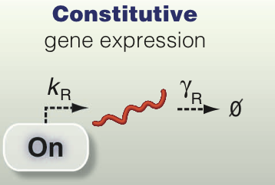
Regulatory mechanism
Constitutive gene expression model
  Promoter is always at on state, bound by TFs to start transcription
  # of transcripts follow Poisson distribution, thus var/mean = 1
Munsky et al. 2012

Slide 17
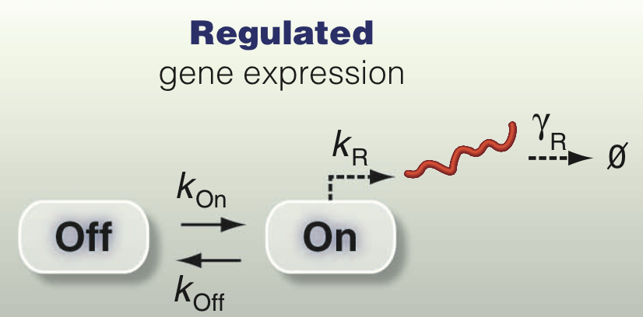
Regulatory mechanism
Regulatory gene expression model
More regulation => var/mean >> 1
Munsky et al. 2012

Slide 18
Active enhancer and Fano factor
var/mean (Fano factor, FF)

Slide 19
Inactive enhancer and Fano factor
var/mean (Fano factor, FF)

Slide 20
Conclusion
  Active enhancers influence Fano factor through changing mean expression
  “Inactive enhancers” have direct influence on Fano factor, indicative of their regulatory roles

Slide 21
Thank you!
Questions?

