Slide 1
VEP annotation -> ALoFT run
# of mutations
# of genes
 | # LOF (without flags) | Splice (without flags)
NA12878 | 80 (49) | 308 (28)
Snyder | 91 (53) | 357 (57)
Zimmer V1 | 86 (55) | 302 (24)
Zimmer V2 | 90 (57) | 310 (26)
 | # LOF (without flags) | Splice (without flags)
NA12878 | 80 (49) | 275 (29)
Snyder | 89 (51) | 319 (56)
Zimmer V1 | 85 (54) | 268 (25)
Zimmer V2 | 88 (55) | 274 (27)

Slide 2
Transcript-level Flags
LoF
 | Other
NA12878 | 89 ( 56 NMD)
Snyder | 99 (67 NMD)
Zimmer V1 | 103 (58 NMD)
Zimmer V2 | 108 (63 NMD)

Slide 3
Transcript-level Flags
Splice

Slide 4
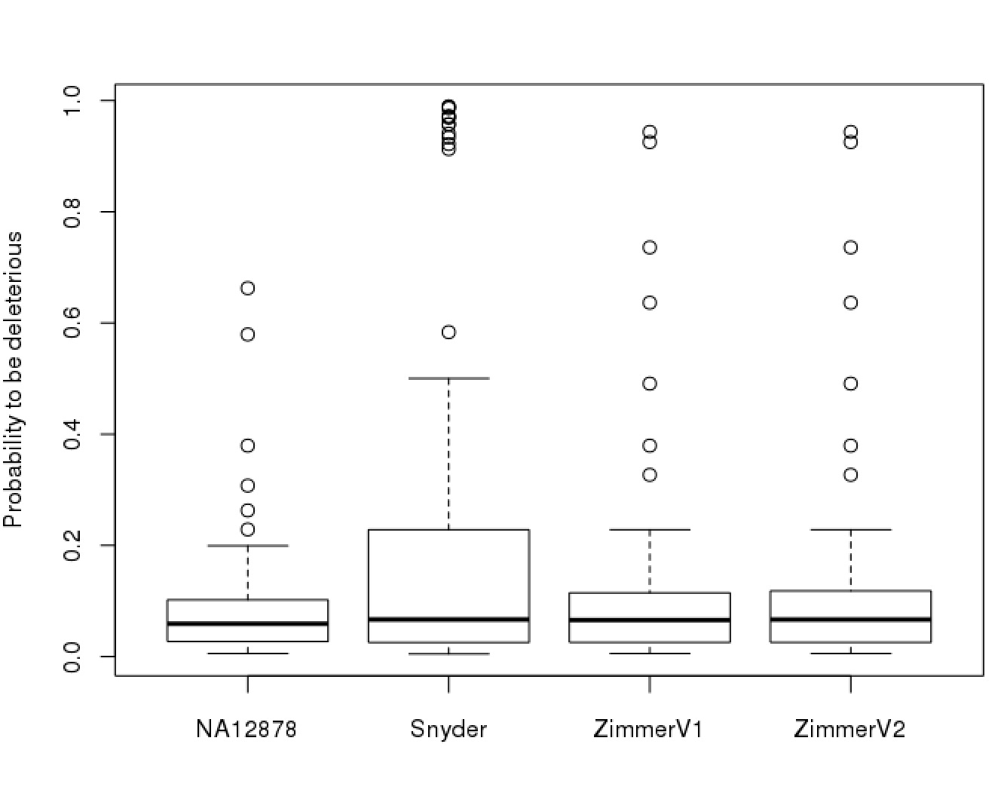
LOF variants

Slide 5
Potential deleterious variant Zimmer
chr | pos | ref | alt | gene | Score | genotype | Gene function
6 | 17606162 | C | T | FAM8A1 | 0.94365 | 0/1 | Unknown, Autism related ??? Pubmed: 22495306
6 | 155577717 | T | A | TIAM2 | 0.63655 | 0/1 | Cell migration
17 | 61829719 | A | C | CCDC47 | 0.92540 | 0/1 | unknown
19 | 759925 | C | A | MISP | 0.73605 | 0/1 | Mitotic spindle positioning
No disease associations in OMIM
CCDC47 associated with Schizophrenia

Slide 6
Potential deleterious variant Snyder …. something is wrong ... (metabolism ???)
chr | pos | ref | alt | gene | Score | genotype | OMIM
2 | 44079970 | C | A | ABCG8 | 0.92190 | 0/1 | Sitosterolemia
2 | 215854316 | T | A | ABCA12 | 0.97240 | 0/1 | Ichthyosis
2 | 216240022 | G | T | FN1 | 0.98975 | 0/1 | fibronectin deficiency
9 | 111718091 | G | T | CTNNAL1 | 0.98845 | 0/1
9 | 130635074 | G | T | AK1 | 0.96915 | 0/1 | Hemolytic anemia
10 | 29581479 | C | A | LYZL1 | 0.58365 | 0/1
11 | 64056777 | C | A | GPR137 | 0.94075 | 0/1
12 | 18800840 | G | T | PIK3C2G | 0.95735 | 0/1
12 | 122400030 | C | A | WDR66 | 0.93380 | 0/1
14 | 71570264 | C | A | PCNX | 0.98635 | 0/1
15 | 68504073 | G | T | CLN6 | 0.97080 | 0/1 | Ceroid lipofuscinosiss
15 | 93007504 | C | A | ST8SIA2 | 0.91290 | 0/1
20 | 5157344 | C | A | CDS2 | 0.95755 | 0/1

