Slide 1
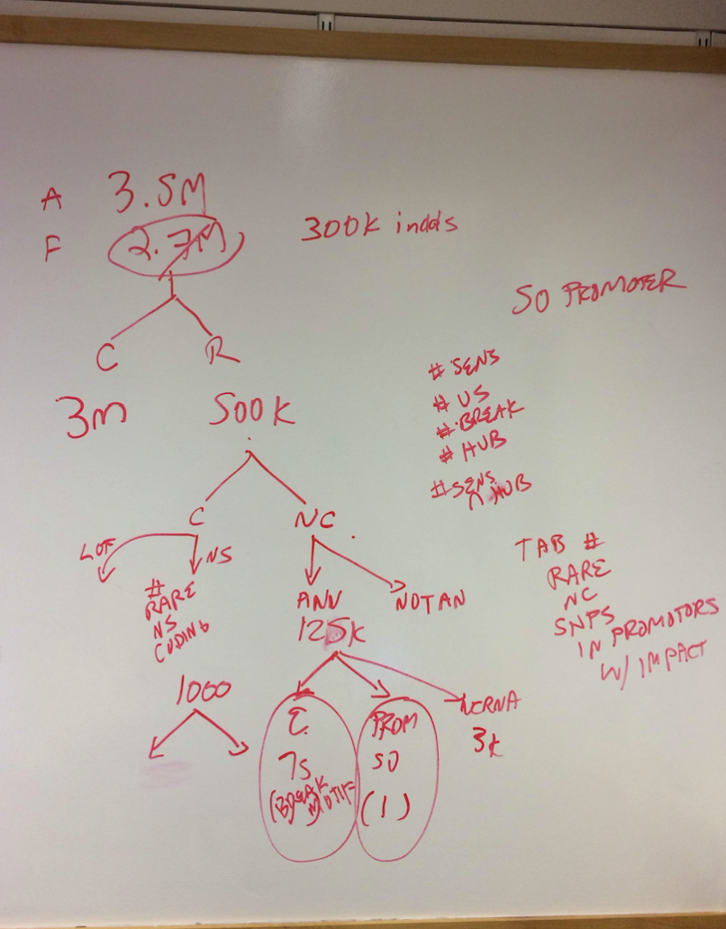

Slide 2
Zimmerome_V2_SNV
3,564,593
Germline SNPs
3,327,521
Common SNPs
237,072
Rare SNPs
894
Coding
236,178
Non-coding
332
Synonymous
534
Non-synonymous
205,200
Non-annotated
30,978
Annotated
10
LoF (PreMatureStop)
10,070
Enhancer
1,919
Promoter
2,075
ncRNA (miRNA, lincRNA, etc)
Notes:
lincRNA, miRNA, misc_RNA, Pseudogene， rRNA
snoRNA，snRNA
lof on every mutation
total of coding number
check 534 number; should be more?
annotated’s category (UTR?)
rare threshould (1/100? 1/1000; 0.5%?)
enhancer and promoter number comparison; new paper figure 1

Slide 3
Rare non-synonymous coding variants
534 SNVs -> 368 target genes
Gene Annotation | Gene Name
Cancer-related | CRTC3, NOTCH2, PDE4DIP, TPR
DNA repair | DCLRE1C, FANCI, PPM1D, RAD51, RECQL, SLX4
Cancer & DNA repair | MAP3K1
Actionable Gene | FOXP4
MAP3K1: Mitogen-Activated Protein Kinase Kinase Kinase 1, E3 Ubiquitin
Diseases associated with MAP3K1 include 46xy sex reversal 6 and 46,xy partial gonadal dysgenesis, breast cancer
Its related pathways are PI-3K cascade and MAPK signaling pathway.
FOXP4: Fork Head-Related Protein-Like A
Transcriptional repressor that represses lung-specific expression
a gene correlate with cervix uteri cancer

Slide 4
Rare PreMatureStop coding variants
Gene Name | Gene Function
ANGPTL6 | angiopoietin-like 6; blood vessel development
CCDC47 | coiled-coil domain containing 47; ER-nuclear signaling pathway
ARHGEF38 | Rho Guanine Nucleotide Exchange Factor (GEF) 38
B3GNT6 | core 3 synthase; glycosylation; O-Glycan biosynthesis
TMEM260 | chromosome 14 open reading frame 101
MISP | chromosome 19 open reading frame 21
FAM8A1 | family with sequence similarity 8; member A1
TPTE | Transmembrane Phosphatase With Tensin Homology
HLA-DRB5 | major histocompatibility complex, class II, DR beta 5; immune response; KEGG: Cell adhesion molecules (CAMs), Antigen processing and presentation, Hematopoietic cell lineage, Intestinal immune network for IgA production, Type I diabetes mellitus, Asthma, Autoimmune thyroid disease, Systemic lupus erythematosus, Allograft rejection, Graft-versus-host disease, Viral myocarditis
FAM86B1 | Methyltransferase-16
Notes:
relate with aloft results
HLA-DRB5 might be fake
split to home and hetero

Slide 5
Zimmerome_V2_SNV
3,564,593
Germline SNPs
3,327,521
Common SNPs
237,072
Rare SNPs
894
Coding
236,178
Non-coding
332
Synonymous
534
Non-synonymous
205,200
Non-annotated
30,978
Annotated
10
LoF (PreMatureStop)
10,070
Enhancer
1,919
Promoter
2,075
ncRNA (miRNA, lincRNA, etc)
Notes:
lincRNA, miRNA, miscRNA, Pseudogene， rRNA
snoRNA，snRNA
nature paper (last time showed)

Slide 6
Rare non-coding variants
Break motif?
Ultra-sensitive region?
Target gene?
Gene is a hub?
None!
 | Total | Enhancer | Promoter | ncRNA
Break motif | 0 | 0 | 0 | 0
Ultra-sensitive | 493 | 178 | 9 | 14

