Slide 1
Modeling RNA splicing from a massively parallel reporter assay
Michael Rutenberg-Schoenberg
P2-VAR
10 Feb 2016

Slide 2
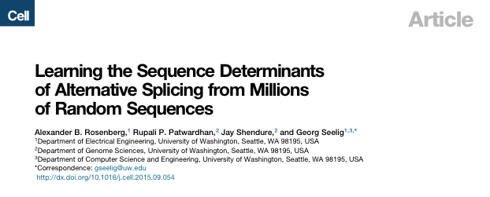
Background thoughts
SD1
Minor splice site
SD2
Major splice site
3’ barcode
25 nt random sequence
200,000 random sequences (~10⁶ for 3’ splice site).
Transfect plasmids into 293T cells
RNA-Seq with targeted primers to observe splicing patterns
Predict RNA splicing (of construct and endogenous genes)

Slide 3
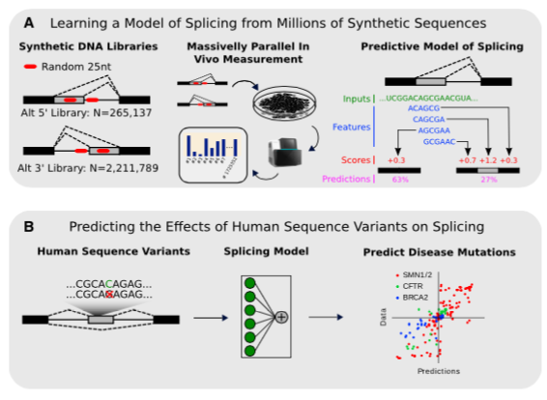
Overview
The authors suggest that the library size (as large as millions of sequences) is key.
Rosenberg et al. Cell 2015

Slide 4
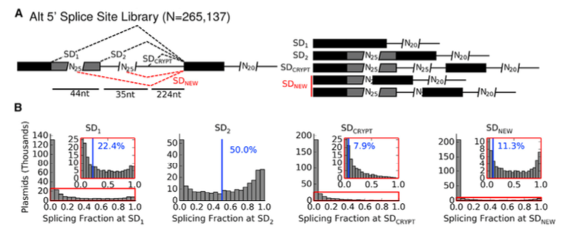
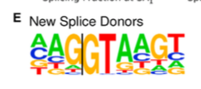
Alternative 5’ splicing library
“Constitutive” splicing
Can relearn splice donor motif from new donor sequences
Rosenberg et al. Cell 2015

Slide 5
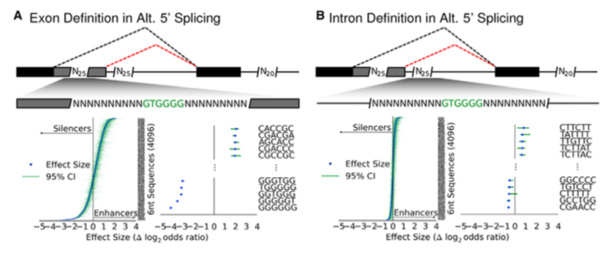
Sequence effects on splicing
Rosenberg et al. Cell 2015

Slide 6
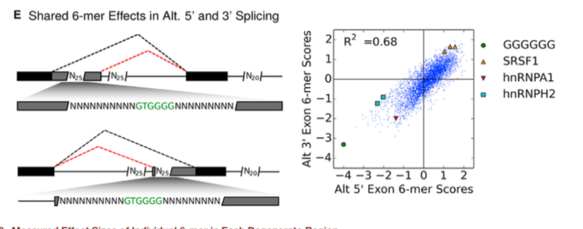
Comparison of kmer scores from 5’ and 3’ exon libraries
Rosenberg et al. Cell 2015

Slide 7
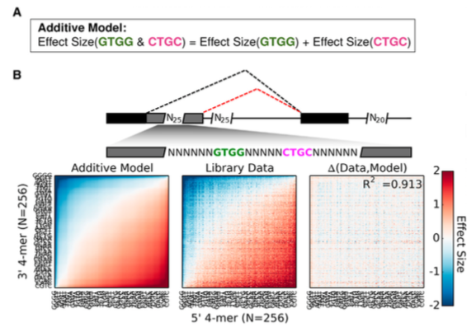
Kmer effects are additive
This is pretty surprising to me…
Rosenberg et al. Cell 2015

Slide 8
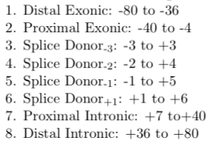
Building a predictive model
Bin sequences, count kmer frequencies.
Model splicing probability using L1-regularized softmax regression
Predicted and observed splicing probabilities
Rosenberg et al. Cell 2015

Slide 9
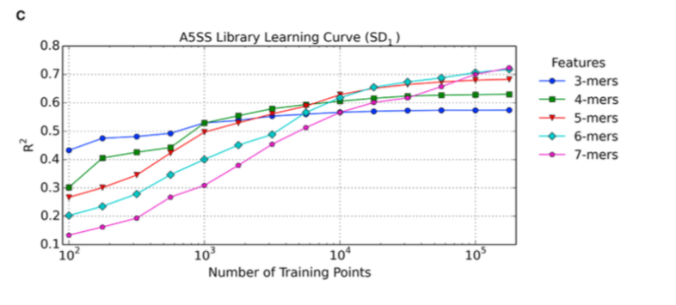
How valuable are incremental data points to modeling the splicing of the construct?
Rosenberg et al. Cell 2015

Slide 10
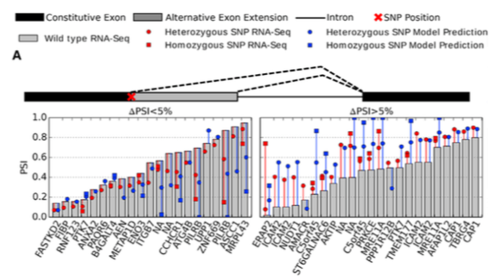
Predicting the effects of SNPs
GEUVADIS data (RNA-Seq of 1000 genomes subjects)
Correctly predict direction of splicing effect > 80% of the time

Slide 11
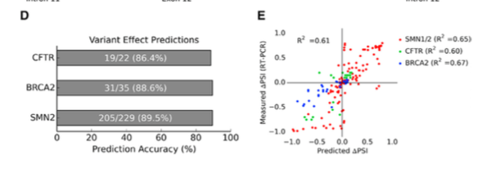
Model can also predict effects of disease-causing splicing variants
These are exon-skipping events, instead of just alternative 5’ and 3’ splice junctions
Allegedly, this is much better than the “Splicing code” from Brendan Frey et al., but hard to compare, because Frey et al. don’t share their code.

Slide 12
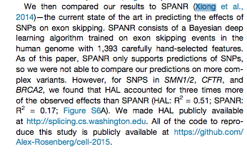
Model can also predict effects of disease-causing splicing variants
CLAIM: HAL R² = 0.51, SPANR (Brendan Frey group) R² = 0.17 for splicing variants of disease genes

Slide 13
Gapped kmers for (slightly) improved splicing prediction Better modeling through improved feature extraction?

Slide 14
Construct/Toy Prediction problem
SD1
Minor splice site
SD2
Major splice site
3’ barcode
25 nt random sequence
~200,000 random sequences tested
Use random sequences to predict usage of SD1
Count occurrence of kmers or gapped kmers
k = # of fixed letters
g = # of gaps
l = total length

Slide 15
Advantages and disadvantages of gapped kmers
Express specificity for noncontiguous nucleotides
More likely to be observed than full kmers
A–TC–G: 8 bits vs. ACTCTG: 12 bits
BUT: More total features as number of gaps increases → overfitting problems

Slide 16
Model
L1 regularized softmax regression
X is the feature matrix, and ß is a vector of weights for each feature
The scores from the regression are transformed using the Softmax function to produce a discrete probability distribution

Slide 17
Model cont.
Loss function
L1 regularization
Kullback-Leibler
Divergence

Slide 18
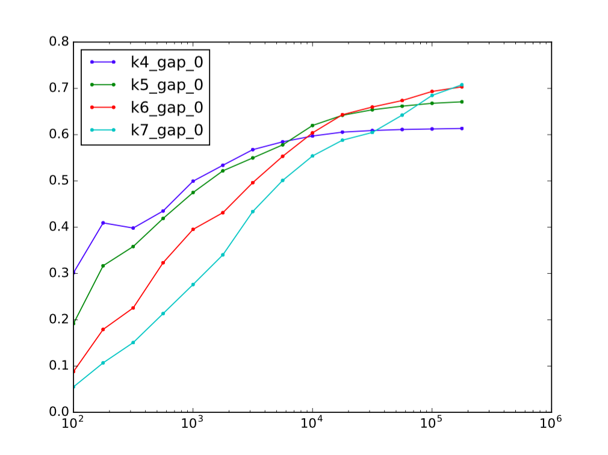
Model performance (no gaps) by # of fixed letters
R²
Training points

Slide 19
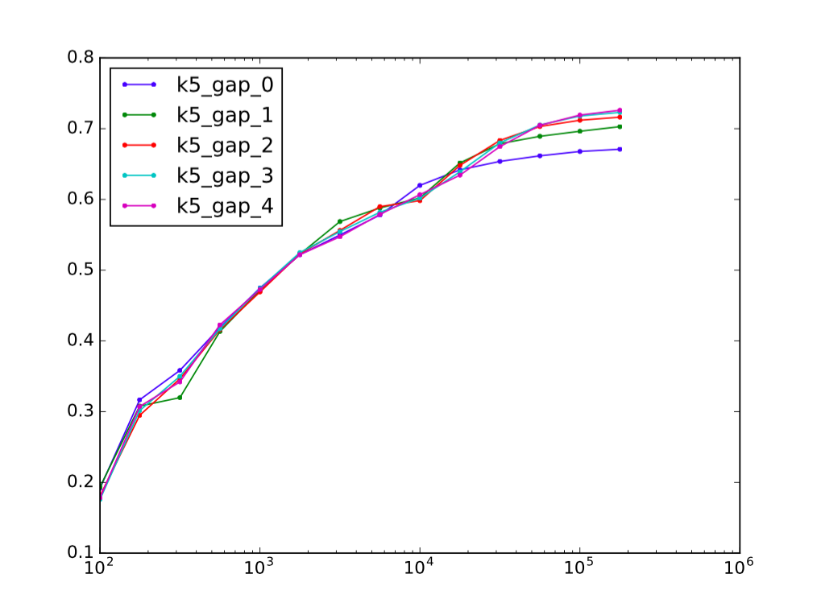
5 fixed letters, adding gaps
R²
Training points

Slide 20
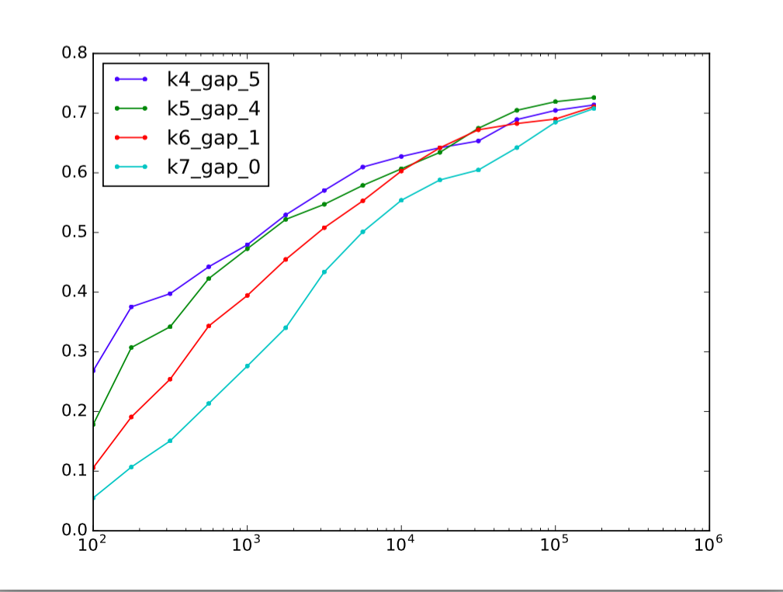
Results with optimal # of gaps, # of fixed letters = 4-7
R²
Training points

Slide 21
Going forward
For RANT: Use original Rosenberg et al. model to find potential SNPs that affect splicing, and evaluate conservation and enrichment for rare variants.
% Rare variants
Predicted ∆PSI
(percent spliced in)

Slide 22
Going forward
Evaluate gapmer splicing model for prediction of effects of SNPs on splicing and for identification of conserved nucleotides that affect splicing.
And think about new models/feature extraction methods
new model
% Rare variants
old model
Predicted ∆PSI
(percent spliced in)
Rosenberg et al. Cell 2015

Slide 23
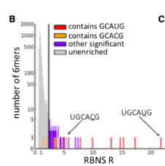
Going forward
Use new or improved model to predict effects of RBP knockdown on splicing.
RNA BindNSeq
(SELEX-style determination
of RBP sequence specificity)
Highly bound kmers (or gapmers)
for RBP of interest
Compare predicted ∆PSI
to knockdown + RNA-Seq
(possibly filtering for
CLIP-Seq binding sites)
Delete bound kmers from splicing model
(regression weight = 0)
Lambert et al. 2014 Mol. Cell

Slide 24
Going forward
Develop new reporter assays to predict other properties of RNA (and use these to prioritize disease variants in RNA).
RNA stability
RNA localization (nucleus vs. cytoplasm)
Next time: (mostly unsuccessful) RNA stability prediction using subset of Rosenberg et al. data

