Slide 1
Figure 1
A.
B.
Notes:
A. The exponential increase in the number of gigabytes per dollar in hard drive storage technology are due in part to the sequential introduction and improvement of three technologies. B. Exponential scaling in technological cost improvement is often the superposition of multiple S-curve trajectories of individual technologies. At the beginning of a technology’s life cycle, development costs keep cost reductions low. As the technology matures improvements in production are able to drive down per unit costs and establish an exponential regime. Eventually, the technology reaches maturity where technological limits are encountered and the cost improvements again slow down.

Slide 2
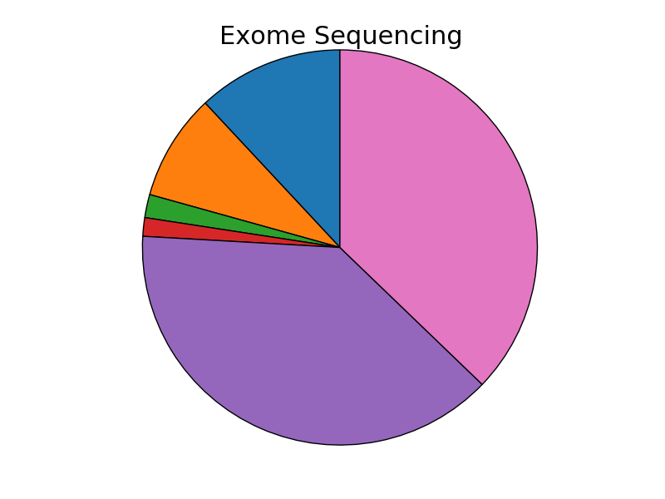
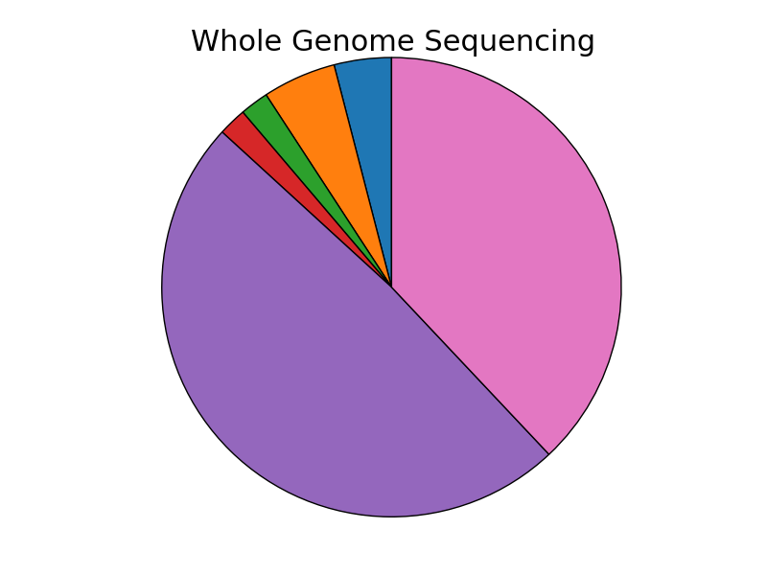
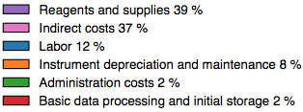
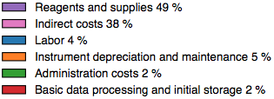
Figure 2

Slide 3
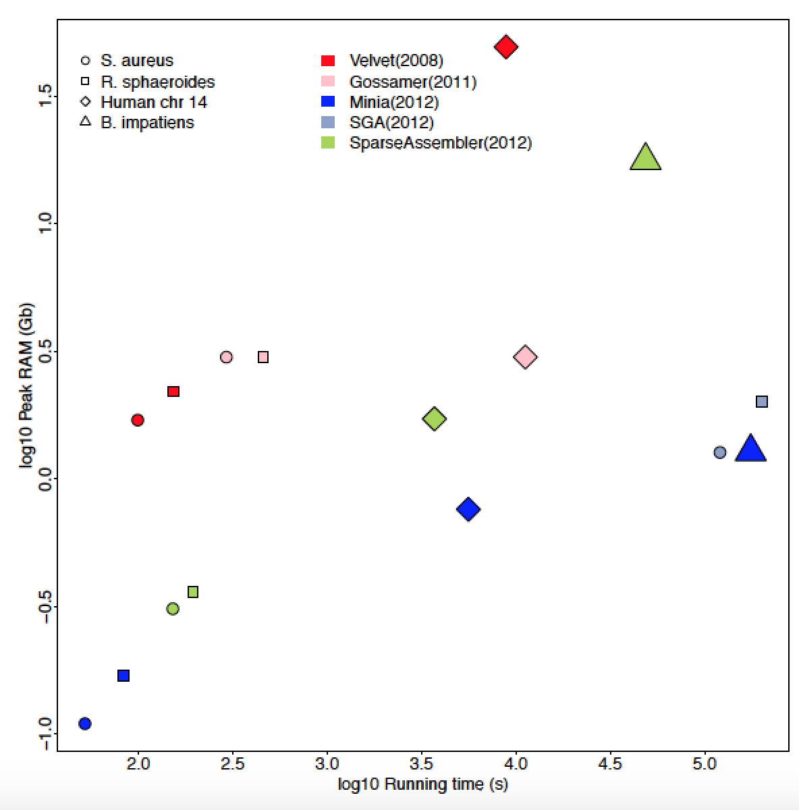
Figure 3
A
B
Notes:
Multiple advances in alignment algorithms have contributed to a exponential decrease in running time over the past forty years. Initial alignment algorithms based on dynamic programming were applicable to the alignment of individual protein sequences. However, they were too slow for efficient alignment at a genome scale. Advances in indexing helped reduce both running time. Additional improvements, in index and scoring structures enabled next generation aligners to further improve alignment time. The negative correlation is also observed between the initial construction of an index and the marginal mapping time per read. Next gen aligners are willing to invest a greater amount of time

Slide 4
Box
A.
B.
C.
Get rid of decimal places
All dashes or none
D.
E.
NIH Reporter

Slide 5
Figure 4
Notes:
The number of faculty position hires at 51 US universities in three year bins. The recent increase in hiring coincides with the explosion in sequencing data. Data was obtained from (http://jeffhuang.com/computer_science_professors.html).

