Slide 1
ENCODE project

Slide 3












The Human
Genome Project
ENCODE
Pilot
ENCODE
Production
Comparative
ENCODE
Epigenome
Roadmap
2000
2005
2010
2015
Worm
Genome
modENCODE
1000 Genomes
Pilot
1000 Genomes
Phase 3
GTEx

Slide 4
ENCODE consortium papers vs. community papers that use ENCODE data but were not funded by ENCODE
Notes:
1 slides from dw encode authors

Slide 5
# of Papers vs. # of Authors from 2004-2014

Slide 6
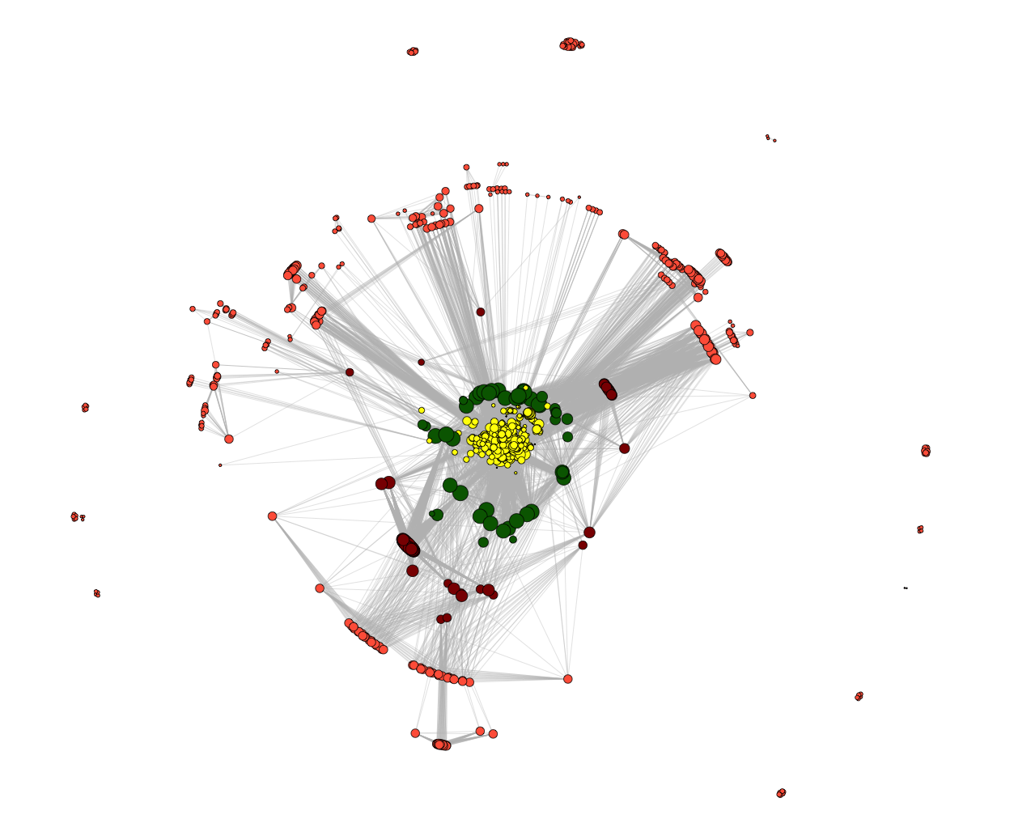
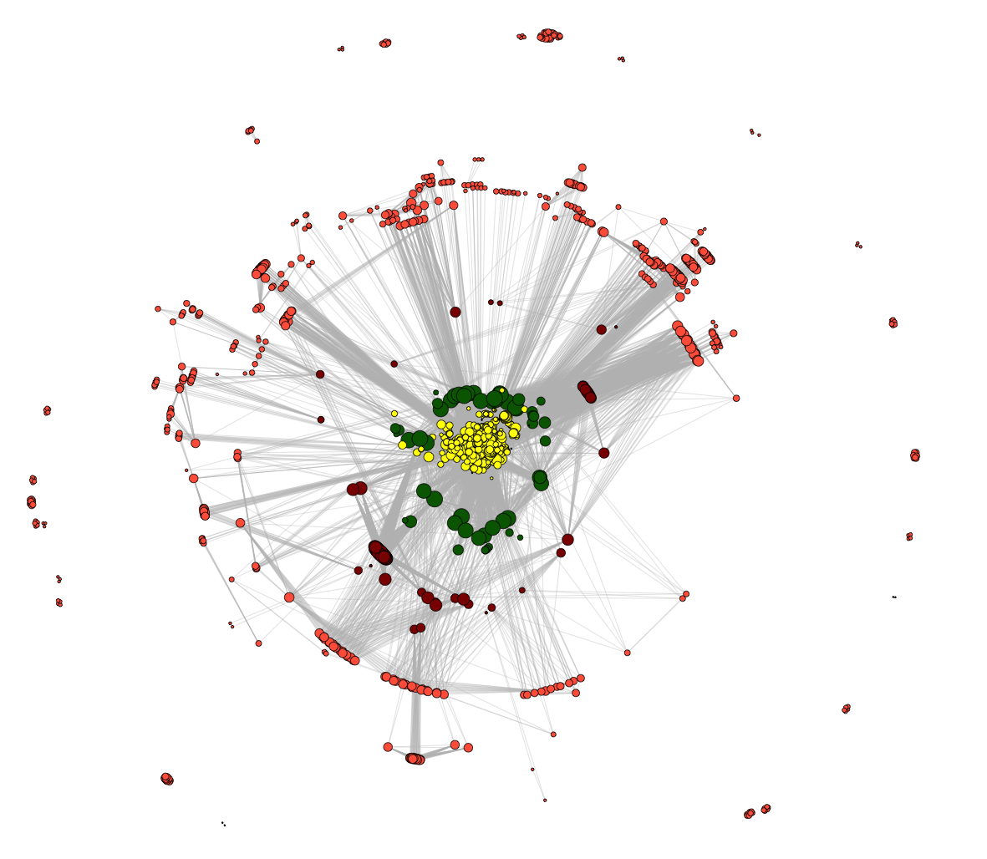
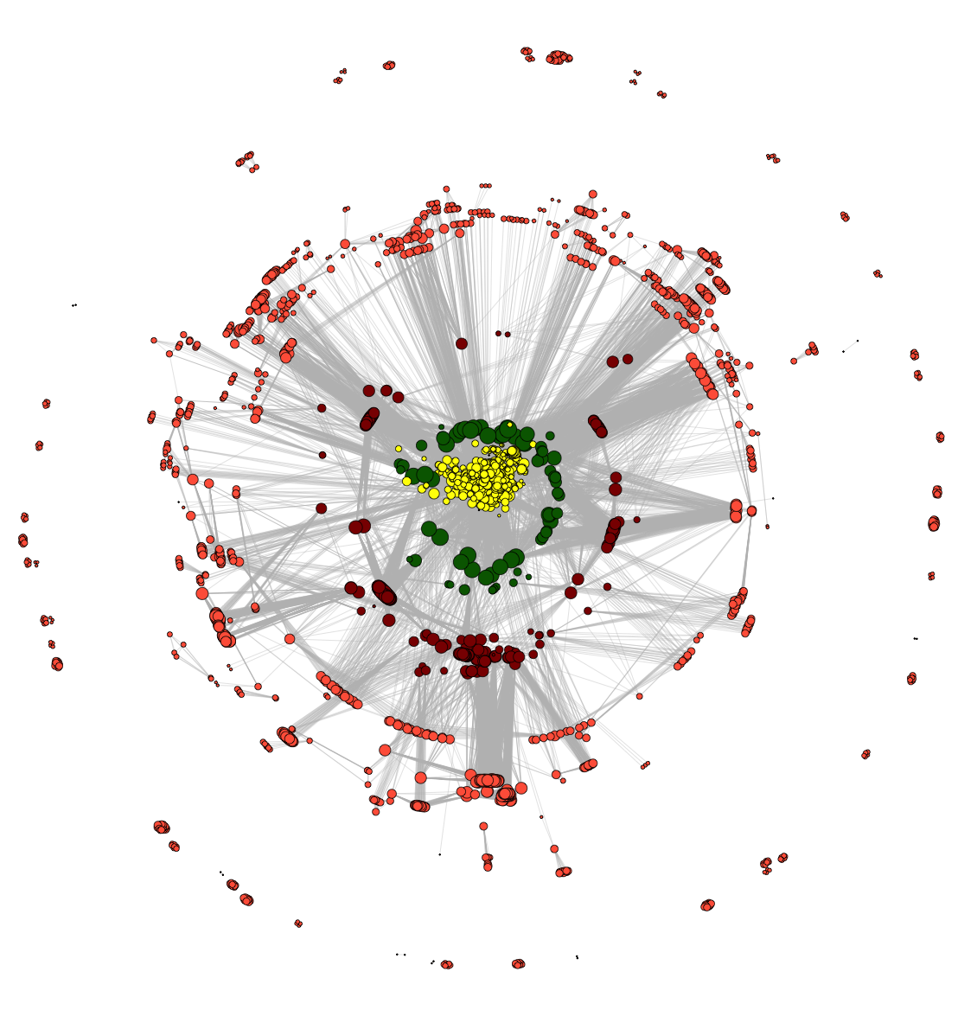
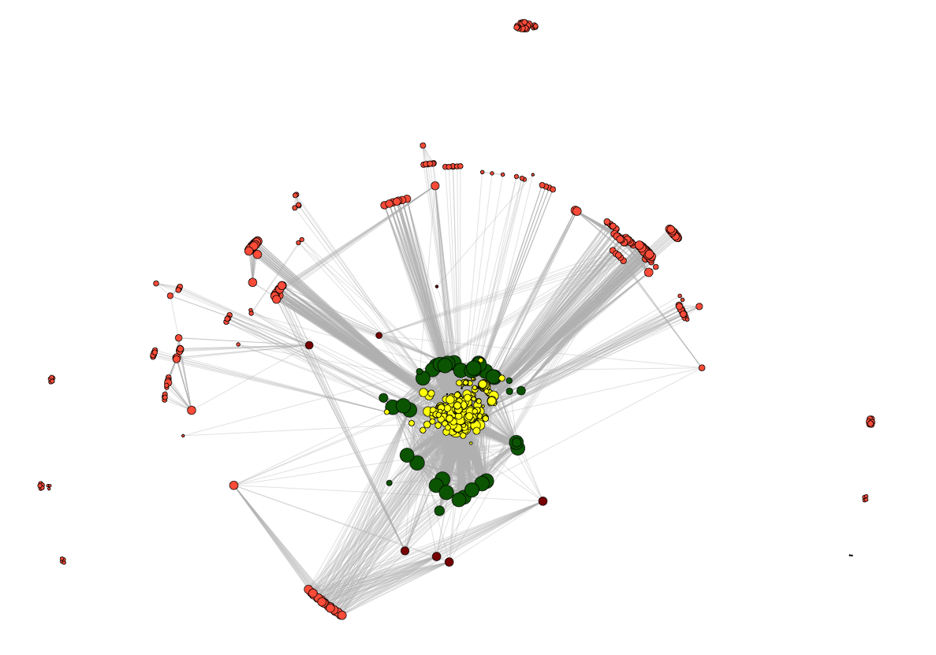
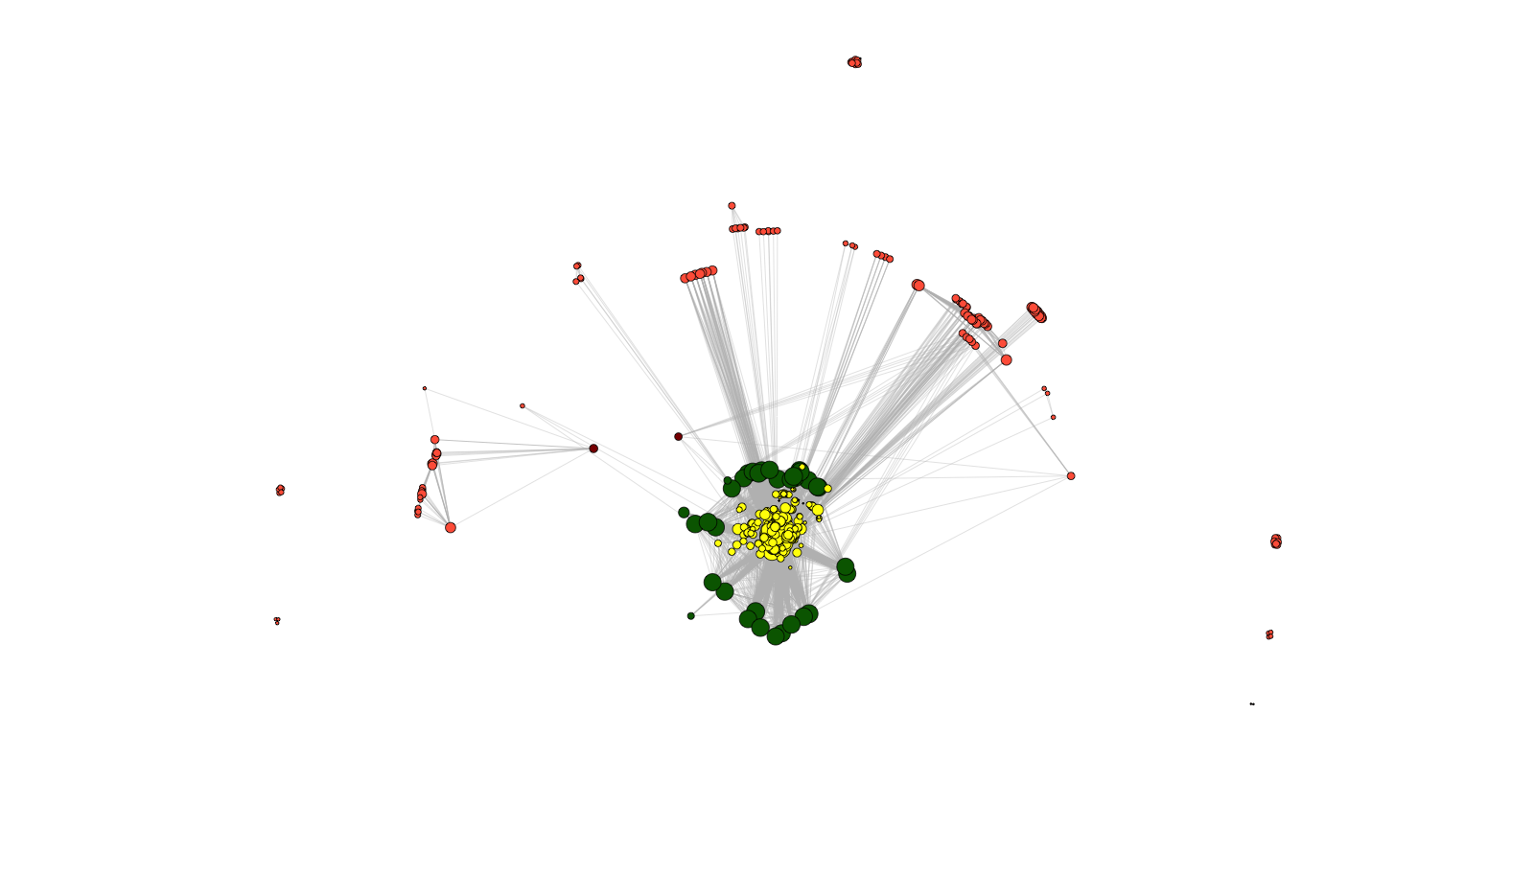
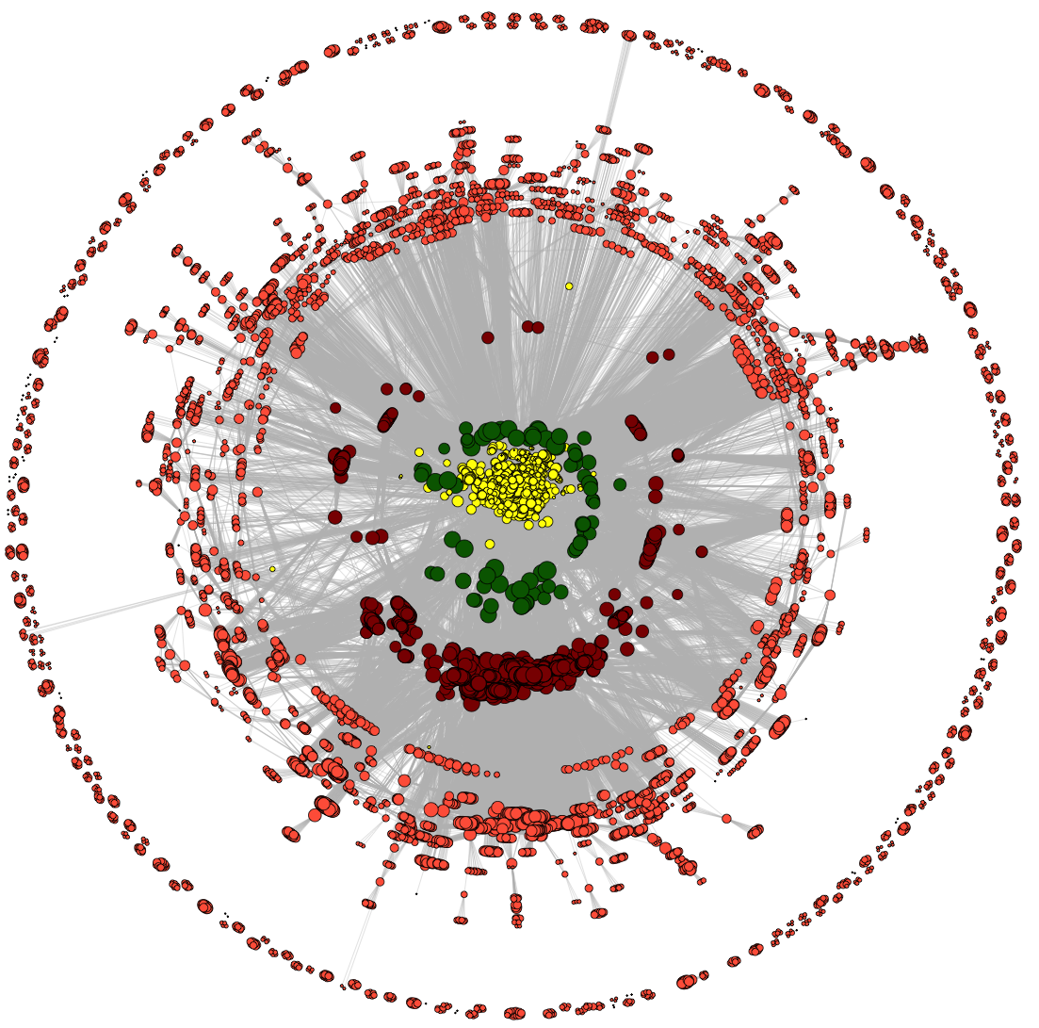
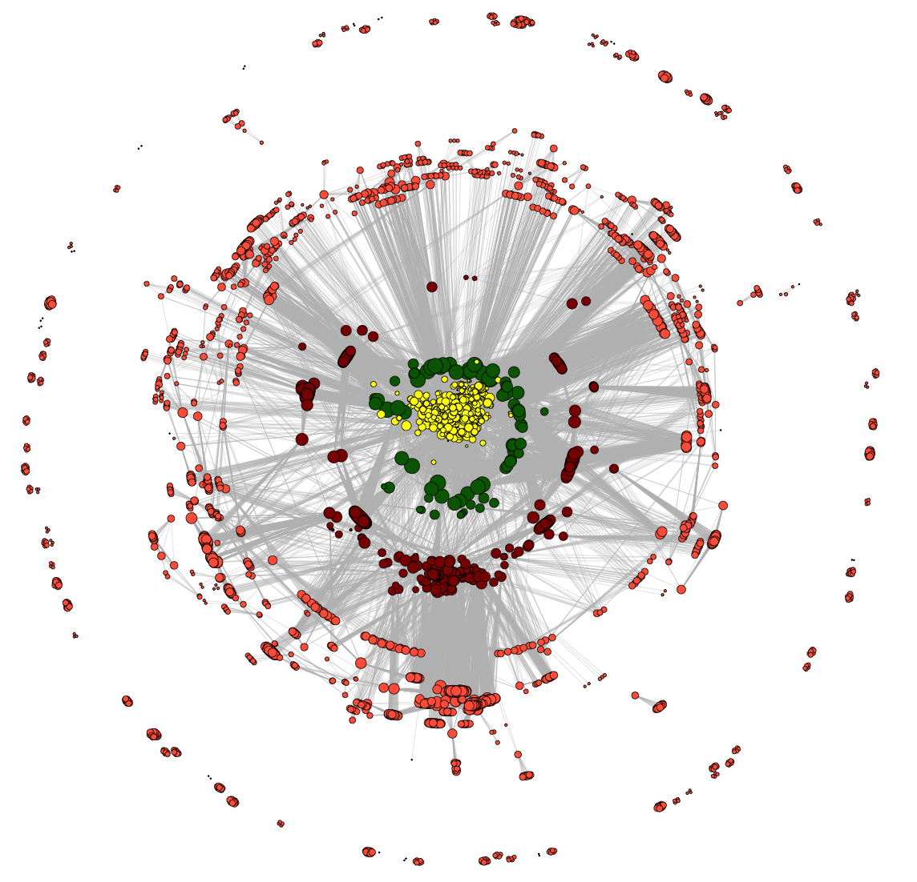
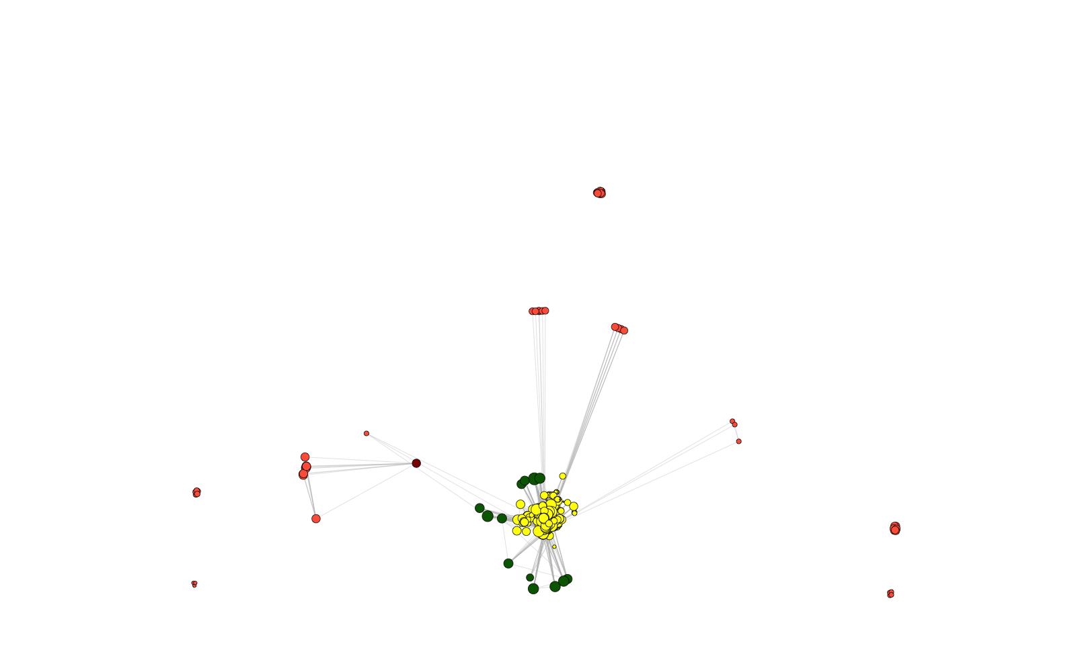
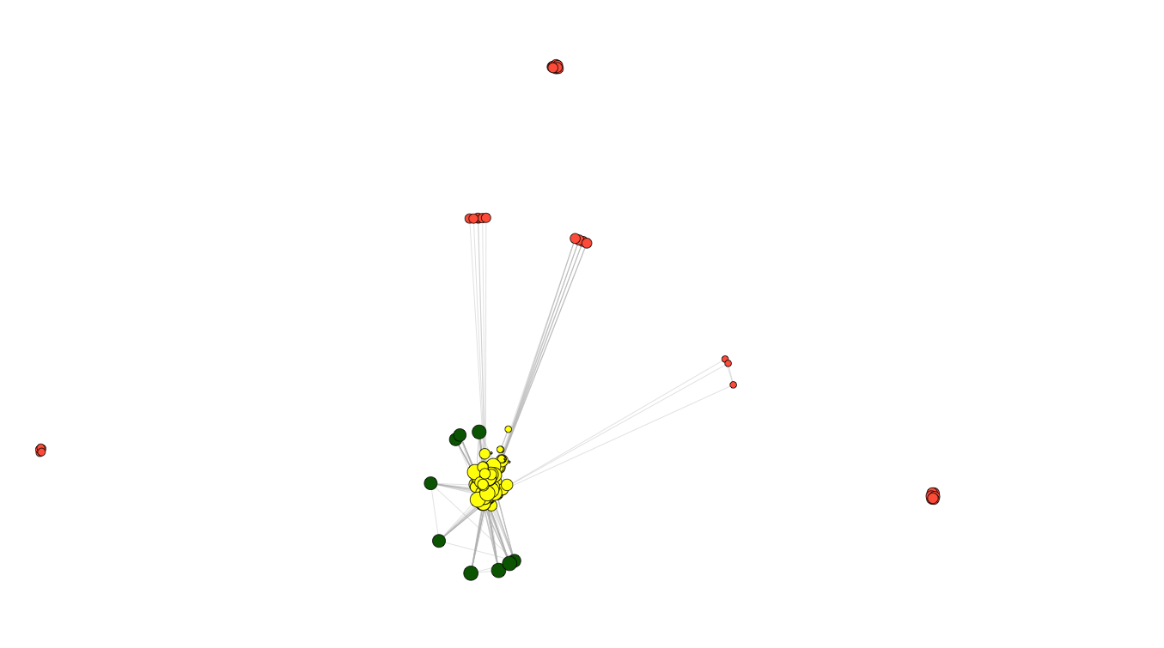
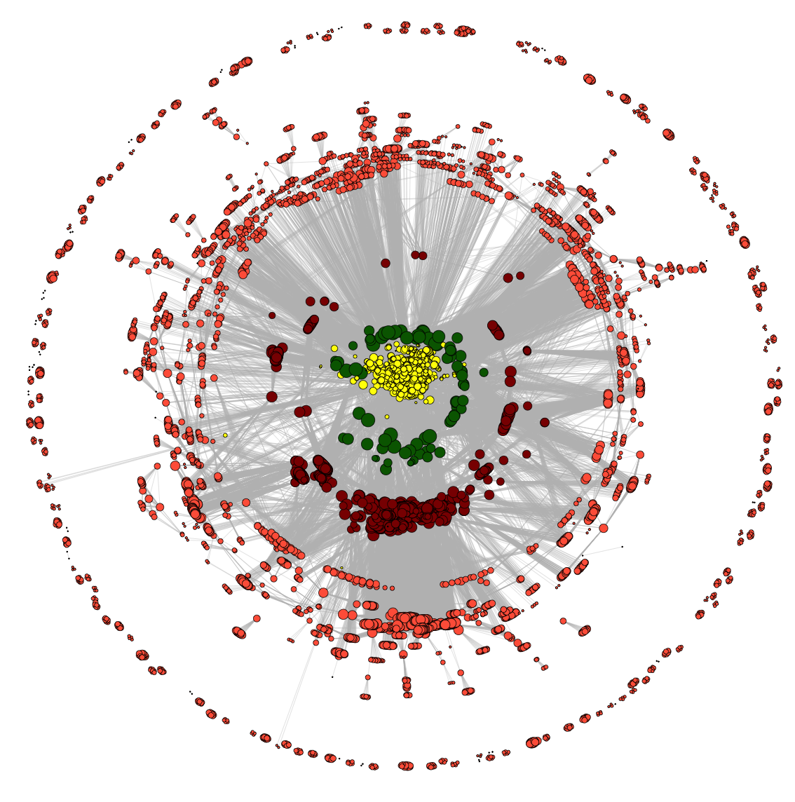

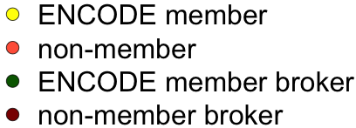
ENCODE co-authorship network
2009
2010
2011
2008
2007
2012
2006
2005
2013
2004
2014
co-authorship

Slide 8
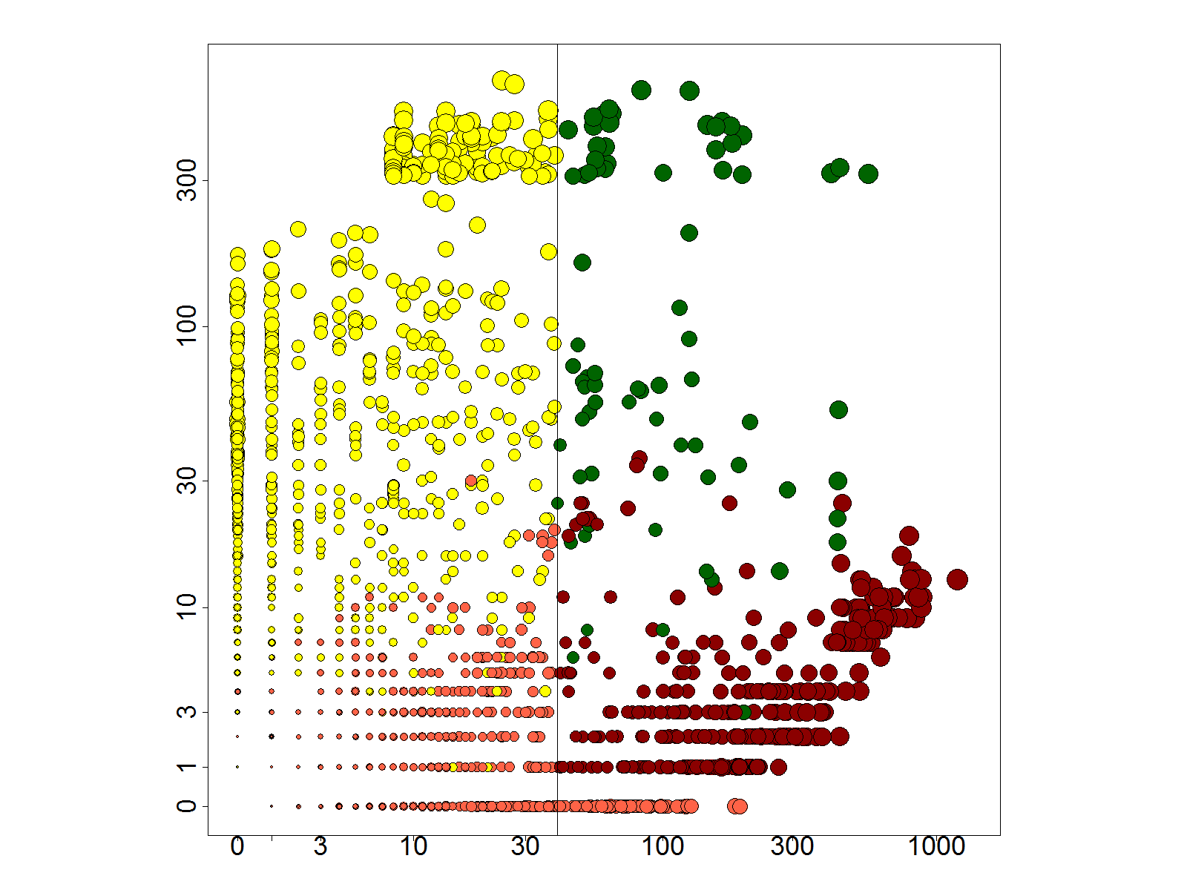
Researchers in a ‘broker’ role
number of ENCODE neighbors
number of non-ENCODE neighbors

