Slide 1
Enhancer evolution across 20 mammals
Villar et al. Cell
Volume 160, Issue 3, Pages 554-566 (January 2015)
DOI: 10.1016/j.cell.2015.01.006
Feb 4th 2016
Journal Club

Slide 2
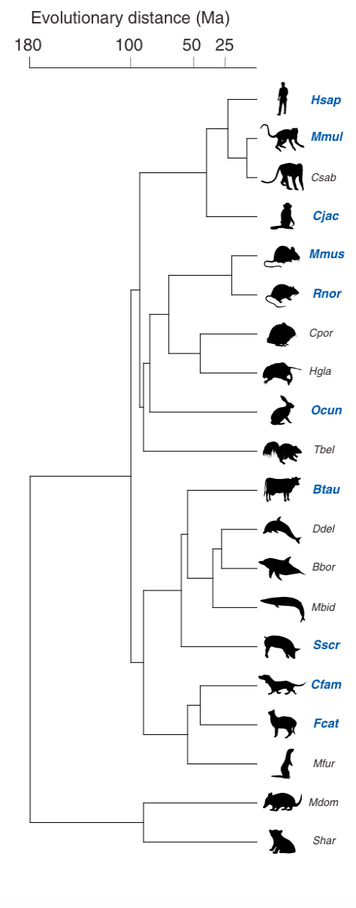
afsdf
Totally 20 mammals
The 10 mammals with high-quality genome sequences are in BLUE
Tissue: liver

Slide 3
Predicting cis-regulatory elements (CRE) using ChIP-seq
H3K27ac peak => enhancer region
H3K4me w/o H3K27ac peak => promoter region
Validation of predicted enhancer sequences
Test: transfer 145bp of an enhancer sequence into liver cancer cells
Results: in the total 400+ tests, 65% show enhancer activity. 97% show either activity or liver specific TF binding

Slide 4
Two types of conservations of the CREs
(1) Sequence conservation
CRE has orthologs in a number (y1) of species out of the 20
y1 indicates sequence conservation level
(2) Activity conservation
CRE has its orthologs also predicted as CRE in y2 out of the y1 species
y2 indicates activity conservation level

Slide 5
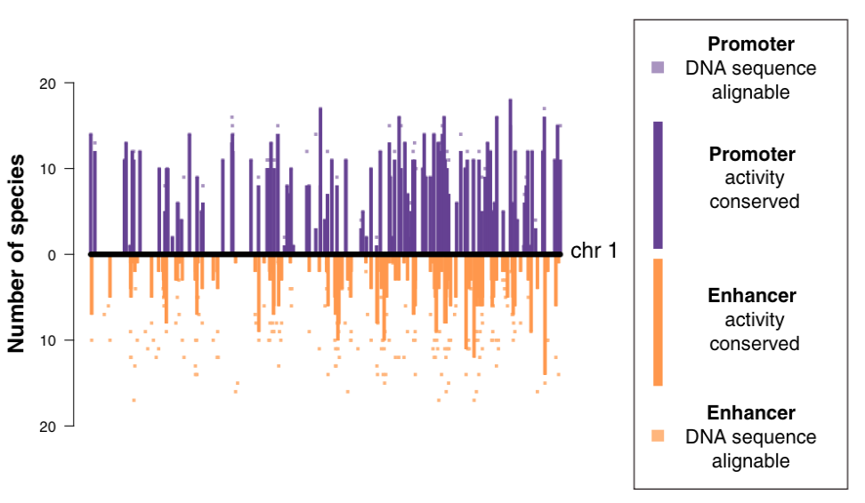
Comparing sequence and activity conservations
Dot (y1) vs Bar (y2)
y1 and y2 are # of species

Slide 6
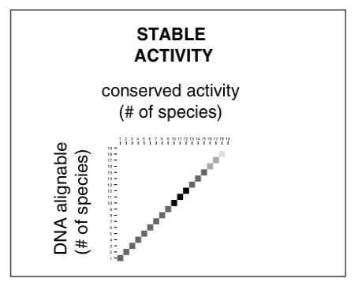
Comparing sequence and activity conservations
If sequence conservation (y1) and activity conservation (y2) are perfectly consistent

Slide 7
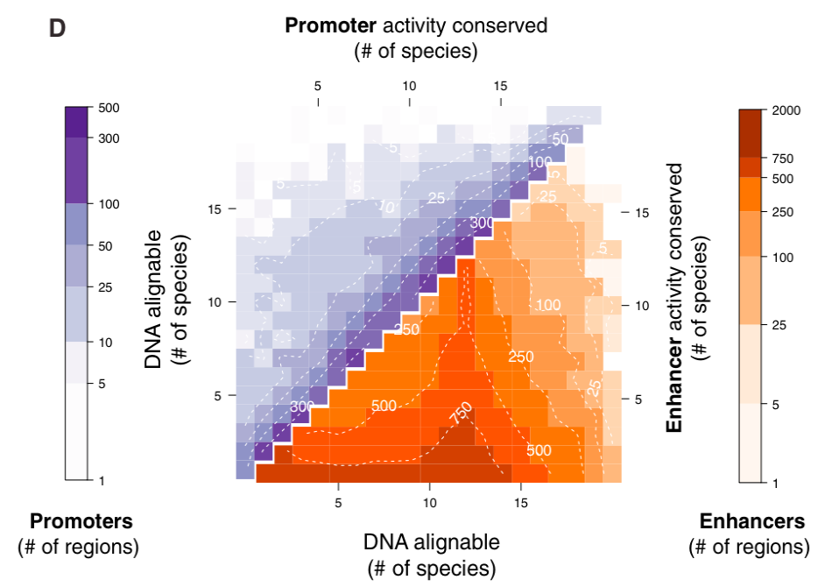
Comparing sequence and activity conservations
Sequence and activity conservations are more consistent in promoter than in enhancer

Slide 8
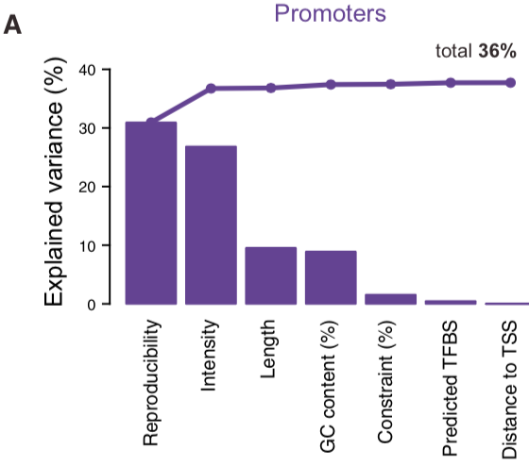
Impact of experimental factors and genome properties on y1 and y2 inconsistency
e.g. y2/y1 ~ Reproducibility, => explain 30% variance

Slide 9
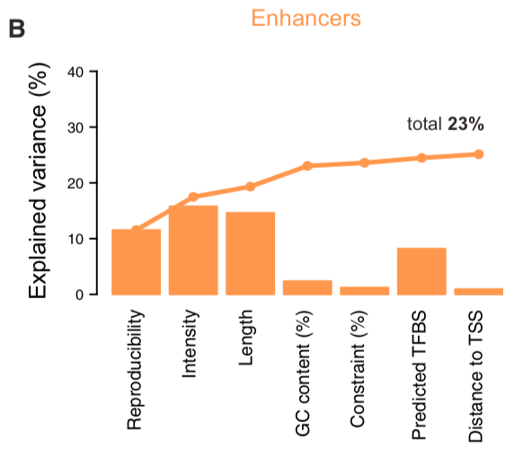
Impact of experimental factors and genome properties on y1 and y2 inconsistency

Slide 10
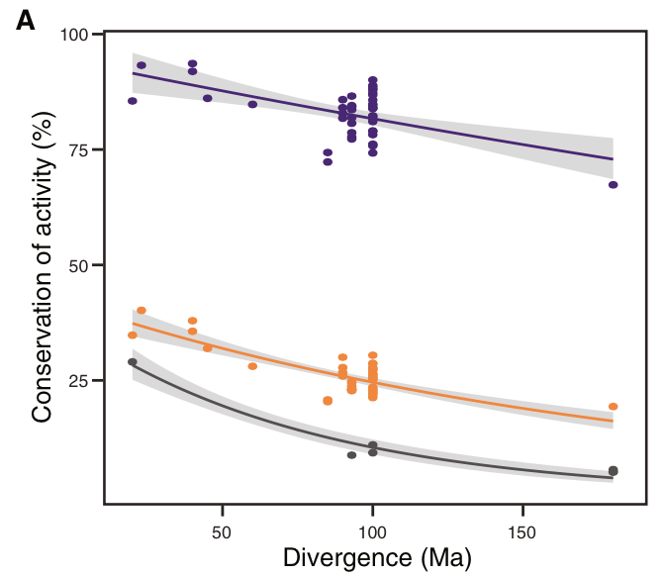
y2/y1 over time: activity divergence rate
Species pairs that diverged 10 to 180 million years ago (ma)
Average y2/y1

Slide 11
y2/y1 over time: activity divergence rate
Species pairs that diverged 10 to 180 million years ago (ma)

Slide 12
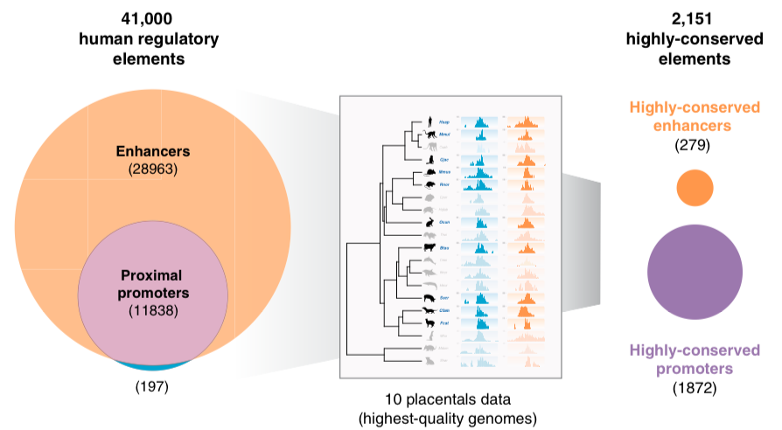
Analyzing regulatory elements conserved in activities
- Identify regulatory elements highly conserved in activities
y2 >= 10

Slide 13
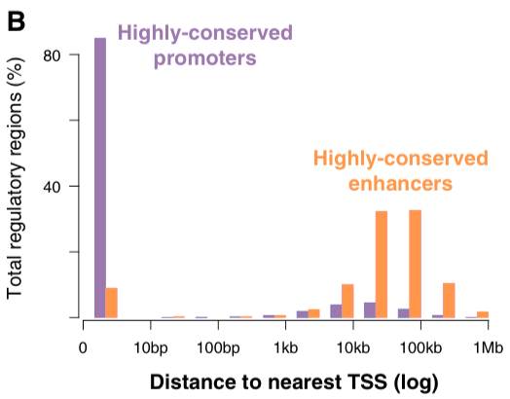
Promoters with conserved activities are closer to TSS than the enhancers

Slide 14
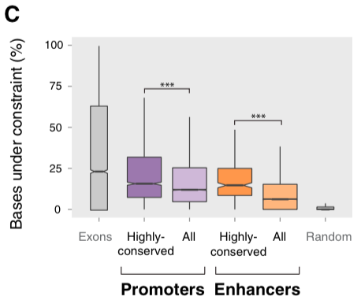
Regulatory elements with conserved activities are also conserved in sequences

Slide 15
Analyzing regulatory elements with activities recently evolved
Identification
The regulatory element in a species has no active orthologs in any of the other 19 mammals
As a result, a mammal has ~1,000 newly evolved promoters and ~10,000 newly evolved enhancers

Slide 16
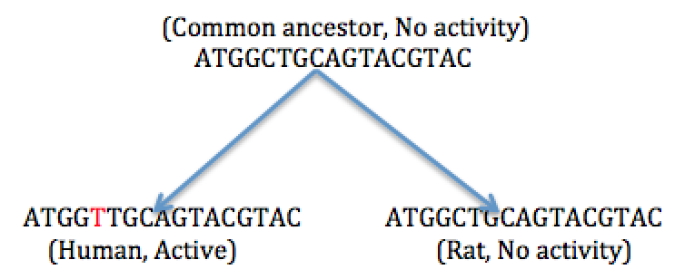
Exaptation: a way of evolving new regulatory elements
Ancestral DNA sequence exists first, then gains TF binding motifs by mutations and becomes a regulatory element

Slide 17
Prediction of the exaptation hypothesis
recently evolved regulatory elements have inactive orthologs in distant species

Slide 18
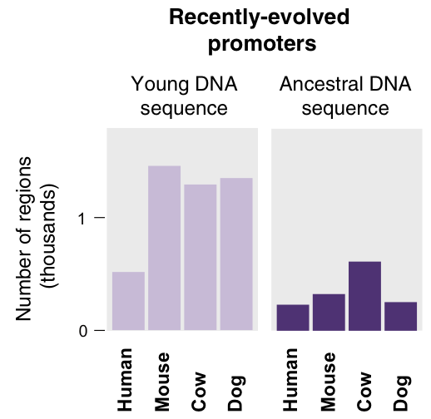
Testing the exaptation hypothesis
Focus on recently regulatory elements in Human, Mouse, Cow and Dog respectively

Slide 19
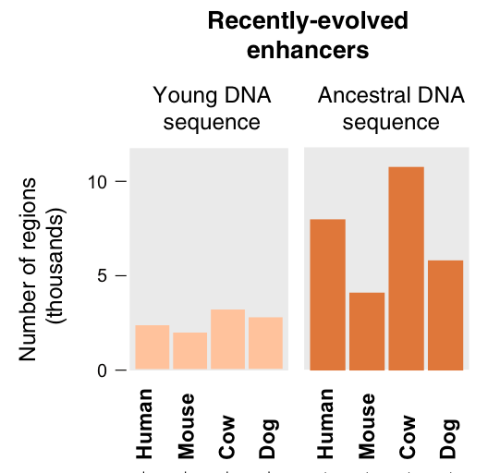
Testing the exaptation hypothesis
Focus on recently regulatory elements in Human, Mouse, Cow and Dog respectively

Slide 20
Summary
Recently evolved enhancers are through exaptation
Orthologs without activity in liver, but in other tissues?

