Slide 1
A. Identify signatures in KIRP

Slide 2
Signatures from Alexandrov
30 signatures from COSMIC (Alexandrov, 12-14’)
  Newer set? 33 signatures? (Alexandrov 15’ Nat. Gen)
Our problem is to recognize signatures in KIRP samples
  We actually transform NMF (harder) to a linear regression problem

Slide 3
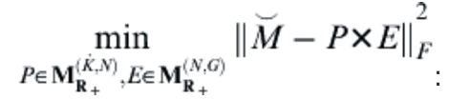
Linear Regression
Now P is known, we want to find E that minimized the Frobenius norm….this becomes a standard linear regression problem
In order to promote sparsity in E, we add an L1 regulizer on E
  But remember E is non-negative!

Slide 5
Signature 4!

Slide 7
Signature 4!

Slide 9
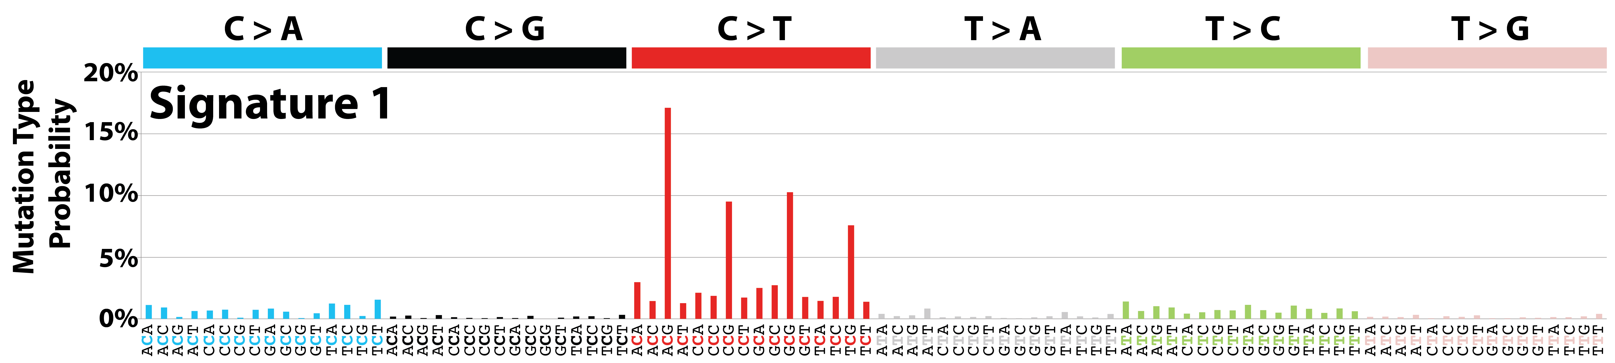
Dominated by Signature 1?
Cancer types: Signature 1 has been found in all cancer types and in most cancer samples.
Proposed aetiology: Signature 1 is the result of an endogenous mutational process initiated by spontaneous deamination of 5-methylcytosine.
Additional mutational features: Signature 1 is associated with small numbers of small insertions and deletions in most tissue types.
Comments: The number of Signature 1 mutations correlates with age of cancer diagnosis.

Slide 10
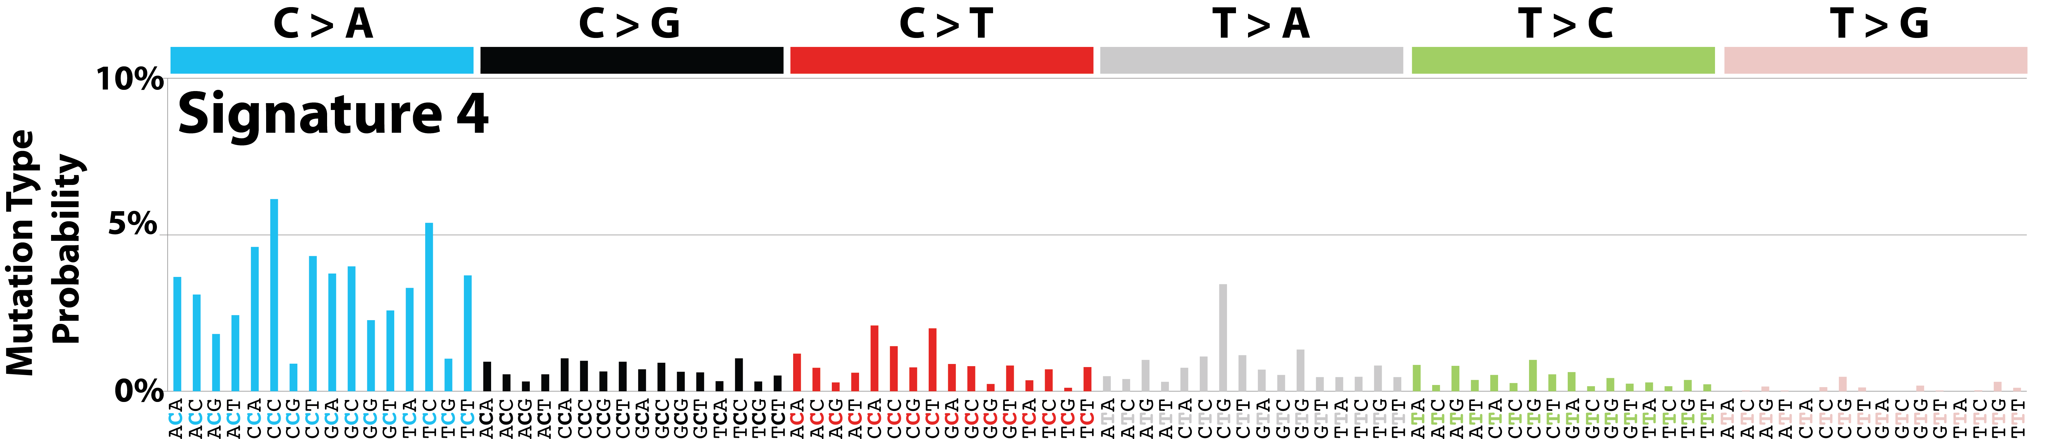
Two cases show Signature 4
Cancer types: Signature 4 has been found in head and neck cancer, liver cancer, lung adenocarcinoma, lung squamous carcinoma, small cell lung carcinoma, and oesophageal cancer.
Proposed aetiology: Signature 4 is associated with smoking and its profile is similar to the mutational pattern observed in experimental systems exposed to tobacco carcinogens (e.g., benzo[a]pyrene). Signature 4 is likely due to tobacco mutagens.
Additional mutational features: Signature 4 exhibits transcriptional strand bias for C>A mutations, compatible with the notion that damage to guanine is repaired by transcription-coupled nucleotide excision repair. Signature 4 is also associated with CC>AA dinucleotide substitutions.
Comments: Signature 29 is found in cancers associated with tobacco chewing and appears different from Signature 4.

Slide 11
B. A web server framework based on AWS

Slide 12
AWS beanstalk
Recommended service for “deploying and scaling web apps and services”
But we find it is not compatible with SQS
  We use Simple Queue Service to coordinate thin front end and computation back end (workers)
  Tasks in SQS will be invisible for certain amount of time after dispatched to workers
    Workers need to explicitly delete the task after successfully returned
  Then we found out although we set the invisible time for several hours, tasks are dispatched to workers every 60s!

Slide 13
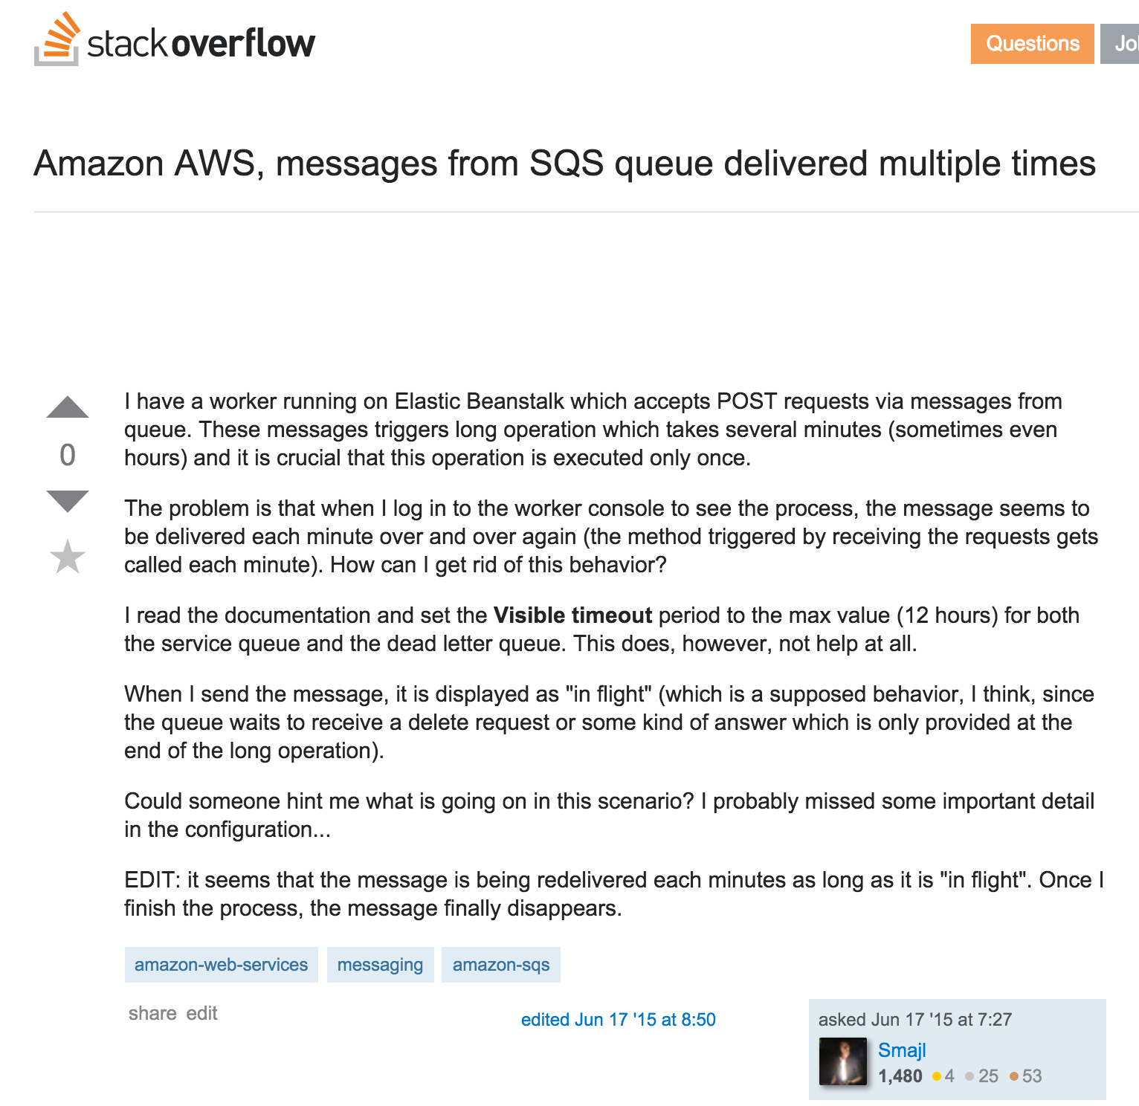
We are not alone…
“…long operation which takes several minutes (sometimes even hours) and it is crucial that this operation is executed only once….the message seems to be delivered each minute over and over again…”

Slide 14
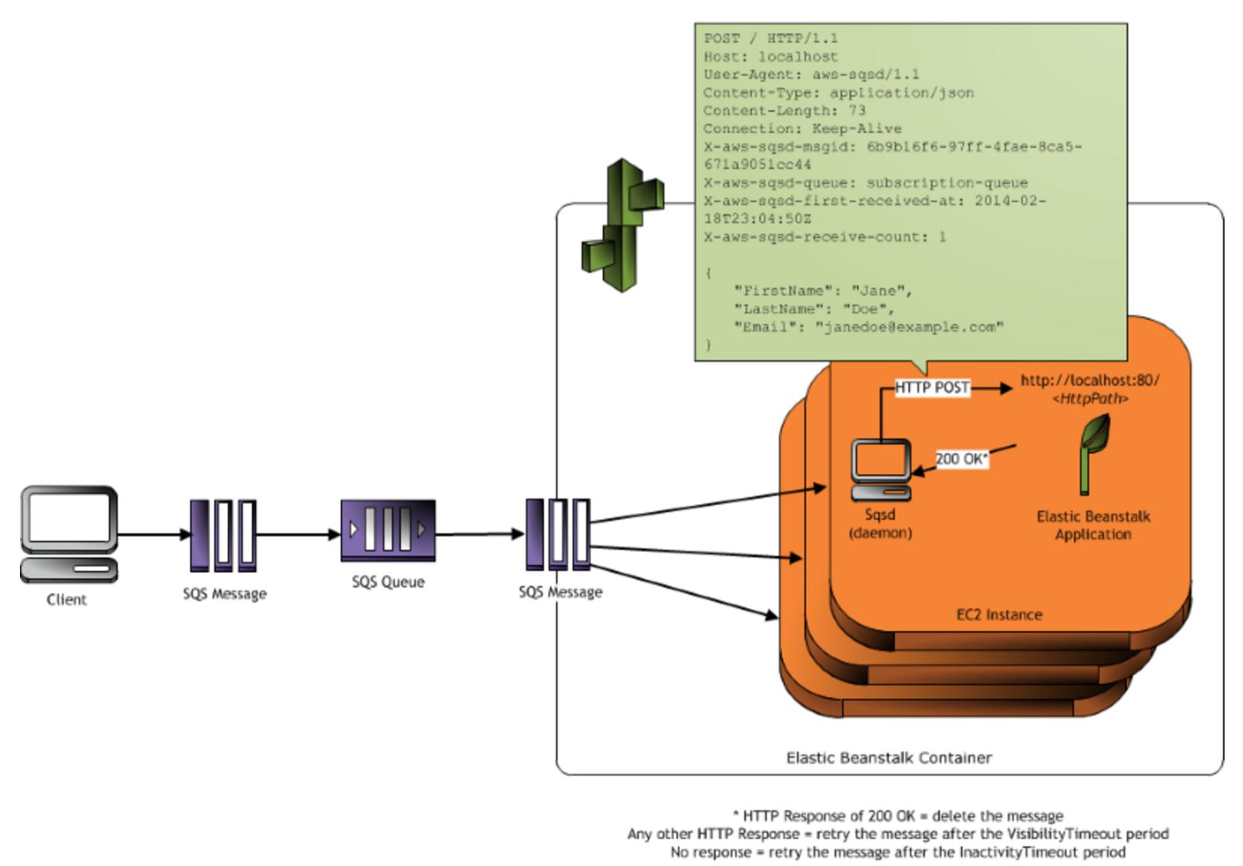
An extra layer…Sqsd?

Slide 15
Sqsd only supports…
On official documentation, the longest invisible time is 1800 second, which is merely 30 minutes.
And after set it to 1800 second, the messages still get re-delivered every 60 second

Slide 16
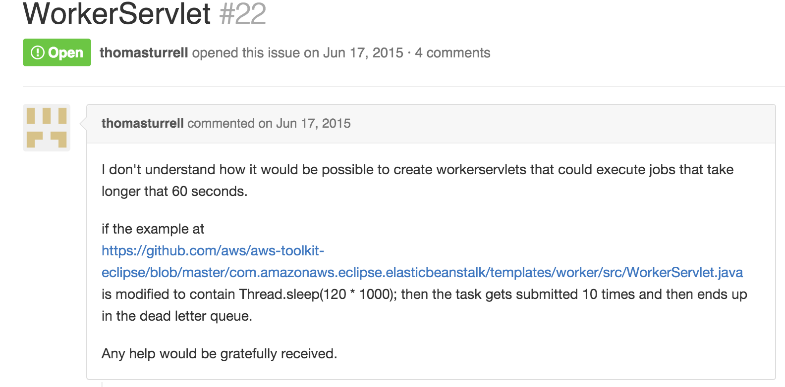
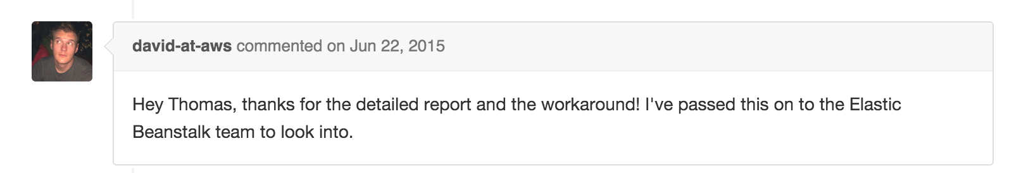
…it is buggy…

Slide 17
What we did
We wrote our own implementation to fetch messages from SQS.
An web server framework based on RoR, fully functional on AWS (STRESS)
Future plan:
  Clean up the code, make simple interface to set up (even for dummies)
  Some queue optimization

