Slide 1
RNA-Seq and ChIP-Seq pipelines

Slide 2
RNA-Seq analysis pipeline

Slide 3
ChIP-Seq analysis pipeline
Quality metrics of read counts
(Strand cross-correlation analysis, number of reads in the peaks, library complexity)
ChIP FastQ file
Quality metrics (FastQC)
Read mapping
(Bowtie)
Signal generation,
file format conversion
(samtools, bedtools, bedGraphToBigWig)
ChIP bigwig file
Control FastQ file
Quality metrics (FastQC)
Read mapping
(Bowtie)
Signal generation,
file format conversion
(samtools, bedtools, bedGraphToBigWig)
Control bigwig file
Check peak calling results
Peak calling
(MACS2, MUSIC)
ChIP-Seq peaks
Downstream analysis
(peak comparison, peak annotation, motif analysis)

Slide 4
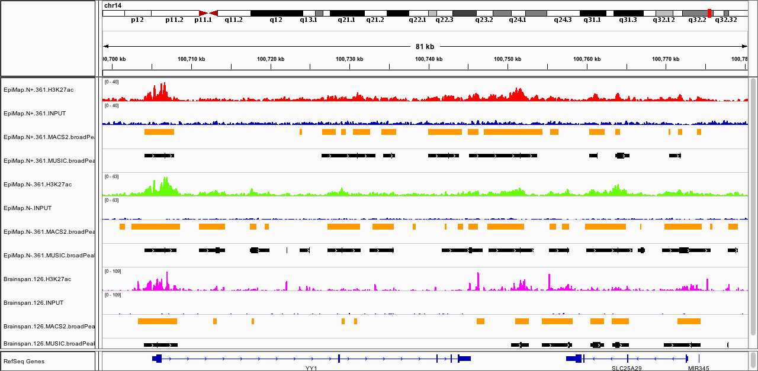
Comparison of ChIP-Seq data across projects
MACS2 DFC H3K27ac peak number overlap fraction
EpiMap NeuN+ DFC | H3K27ac
 | INPUT
 | MACS2 peaks
 | MUSIC peaks
EpiMap NeuN- DFC | H3K27ac
 | INPUT
 | MACS2 peaks
 | MUSIC peaks
Brainspan DFC | H3K27ac
 | INPUT
 | MACS2 peaks
 | MUSIC peaks
MUSIC DFC H3K27ac peak number overlap fraction
Peak overlap

