Slide 1
Significance in biological contexts
Binding sites are often frustrated
Frustration in allostery and local conformational changes
Role of frustration in metastable and multistable proteins
Catalytic Sites
Frustration and the initiation of aggregation
Frustration in nucleic acids and protein complexes
Ferreiro D.U., et al"Frustration in biomolecules." Quarterly reviews of biophysics 47.04 (2014)

Slide 2
Cancer-associated SNV
NON-frustrated region
Frustrated region
Observed: X = # of cancer-associated SNVs that intersect frustrated regions (5 in this case)
Expected: E[X] = [# frustrated residues / total # residues in protein] * [ total # of cancer-associated SNVs]

Slide 3
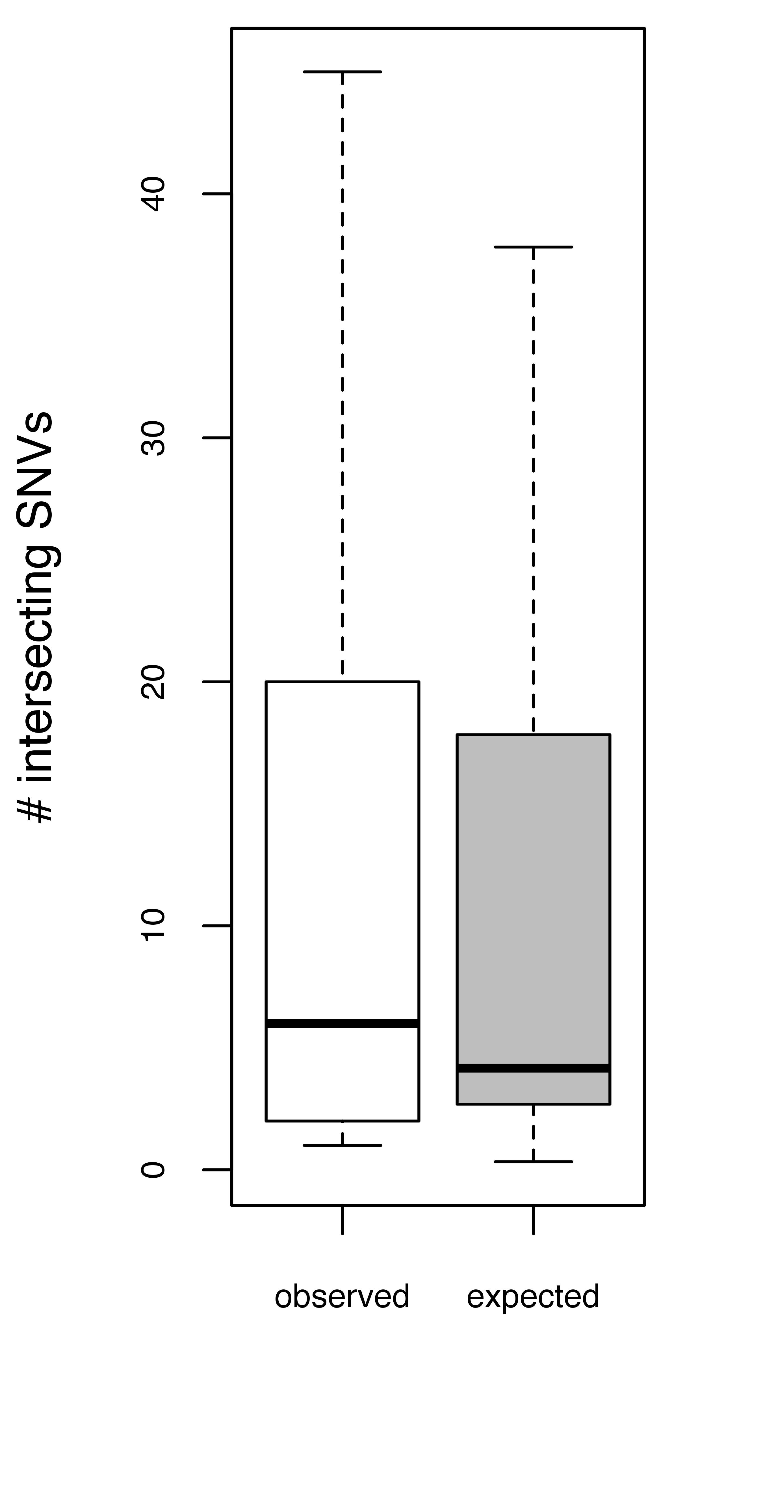
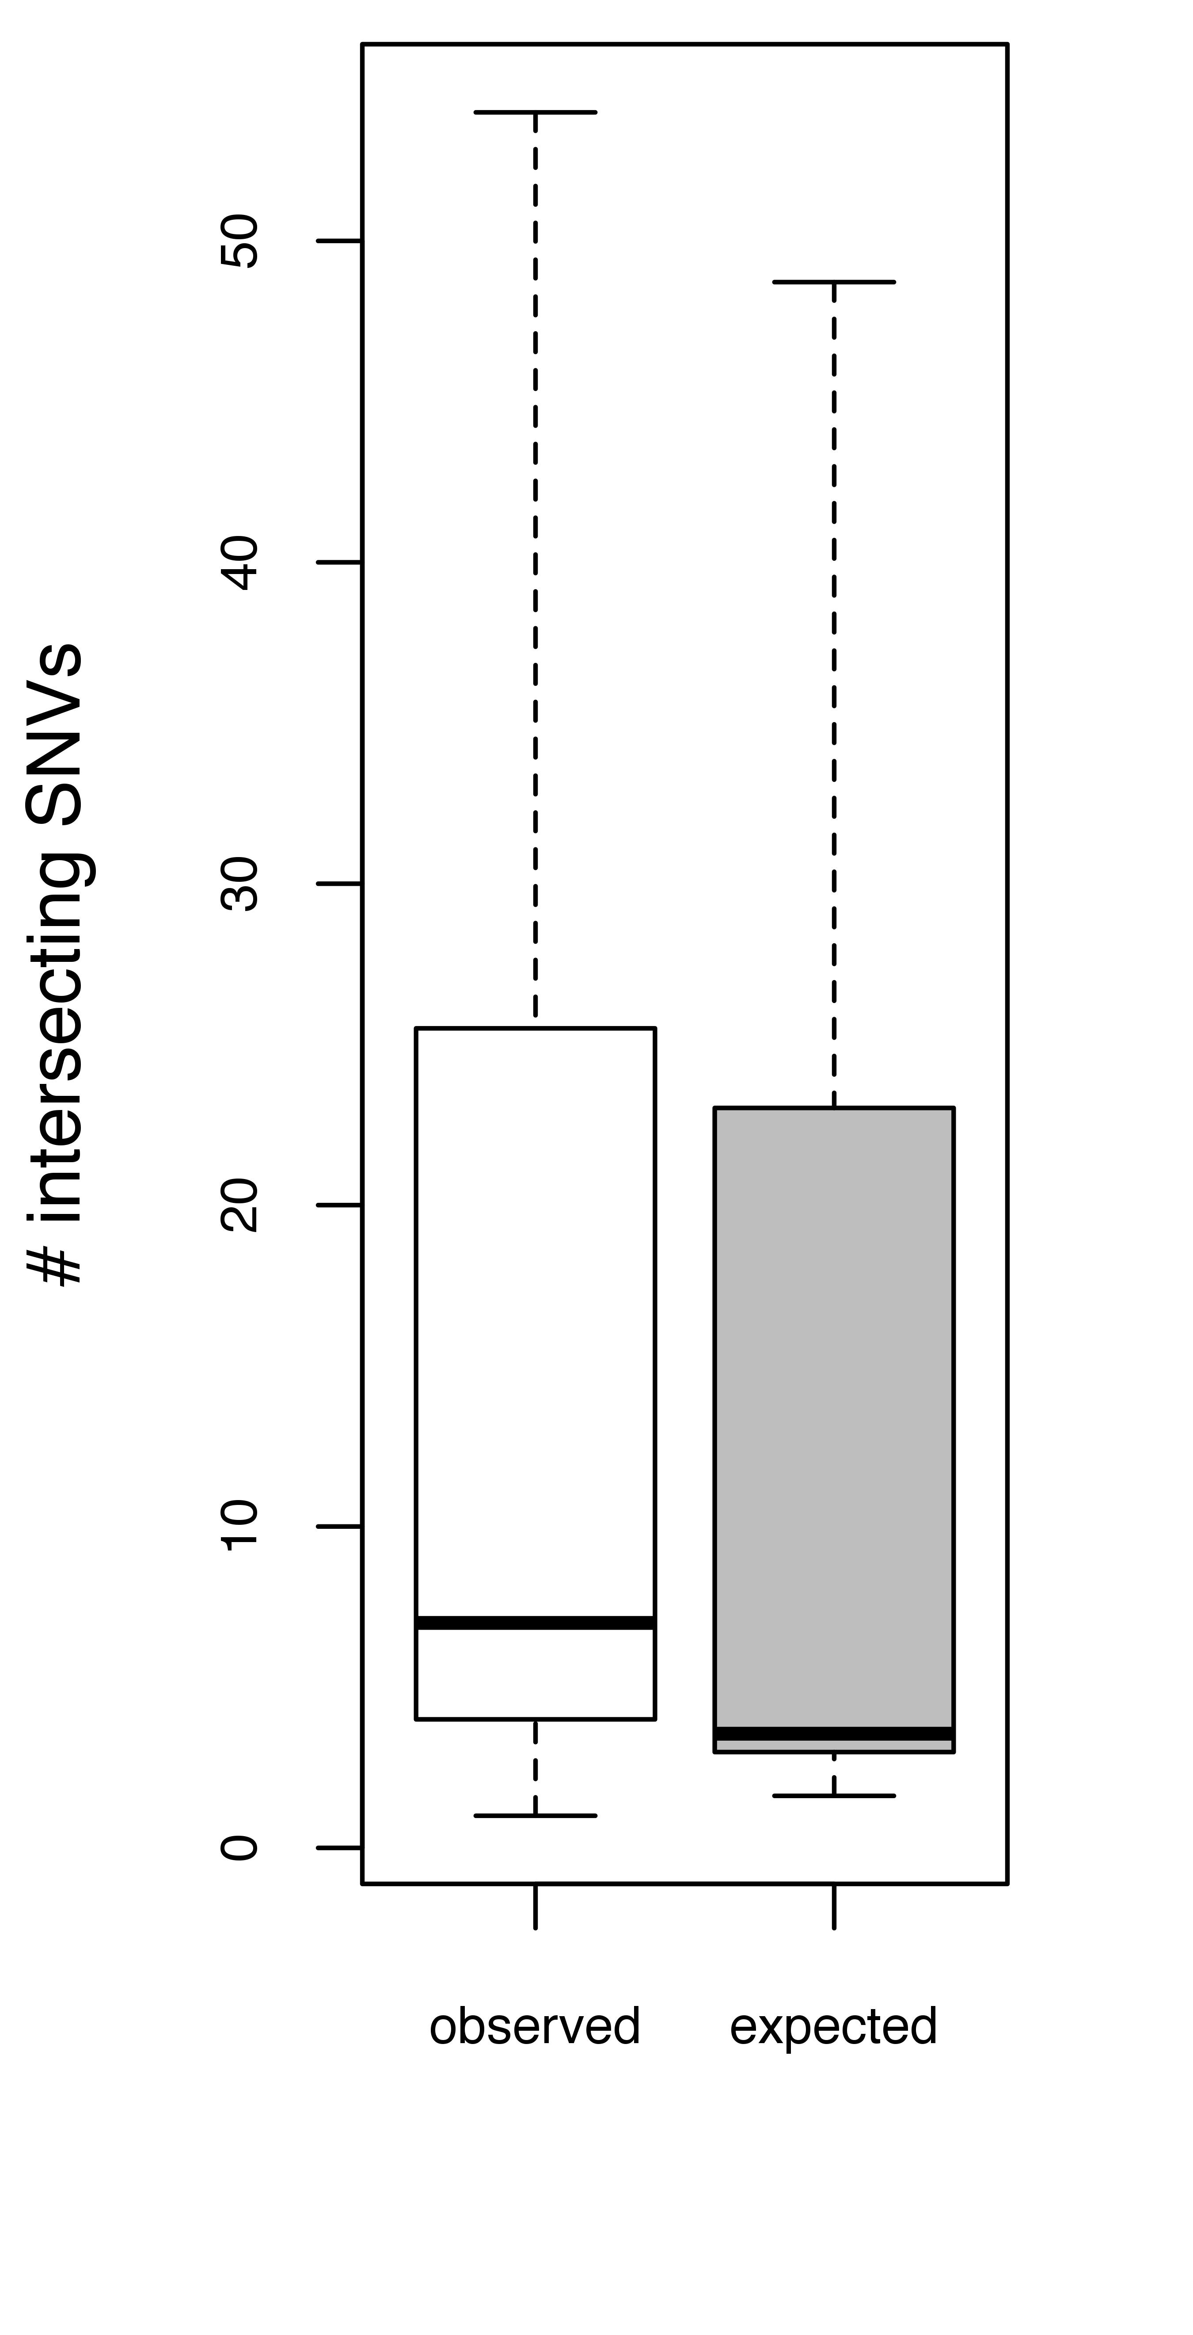
Tumor Suppressor Genes
Minimally Frustr. Residues
Single
Buried
p-value = 0.001912
N = 39
p-value = 3.163e-06
N = 36

Slide 4
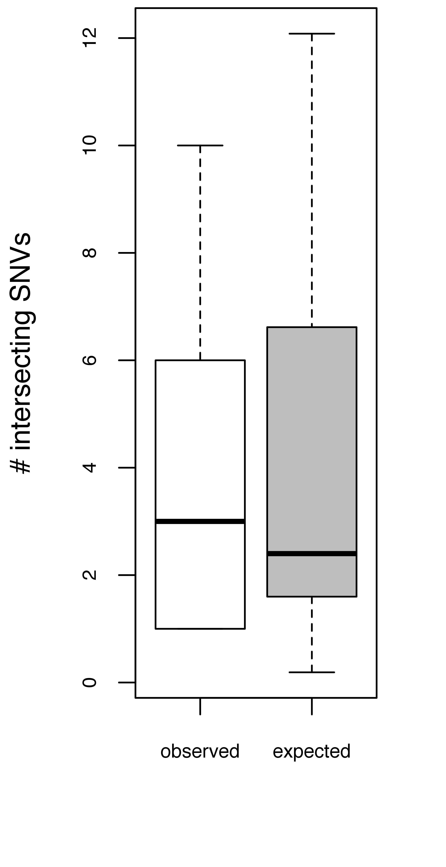
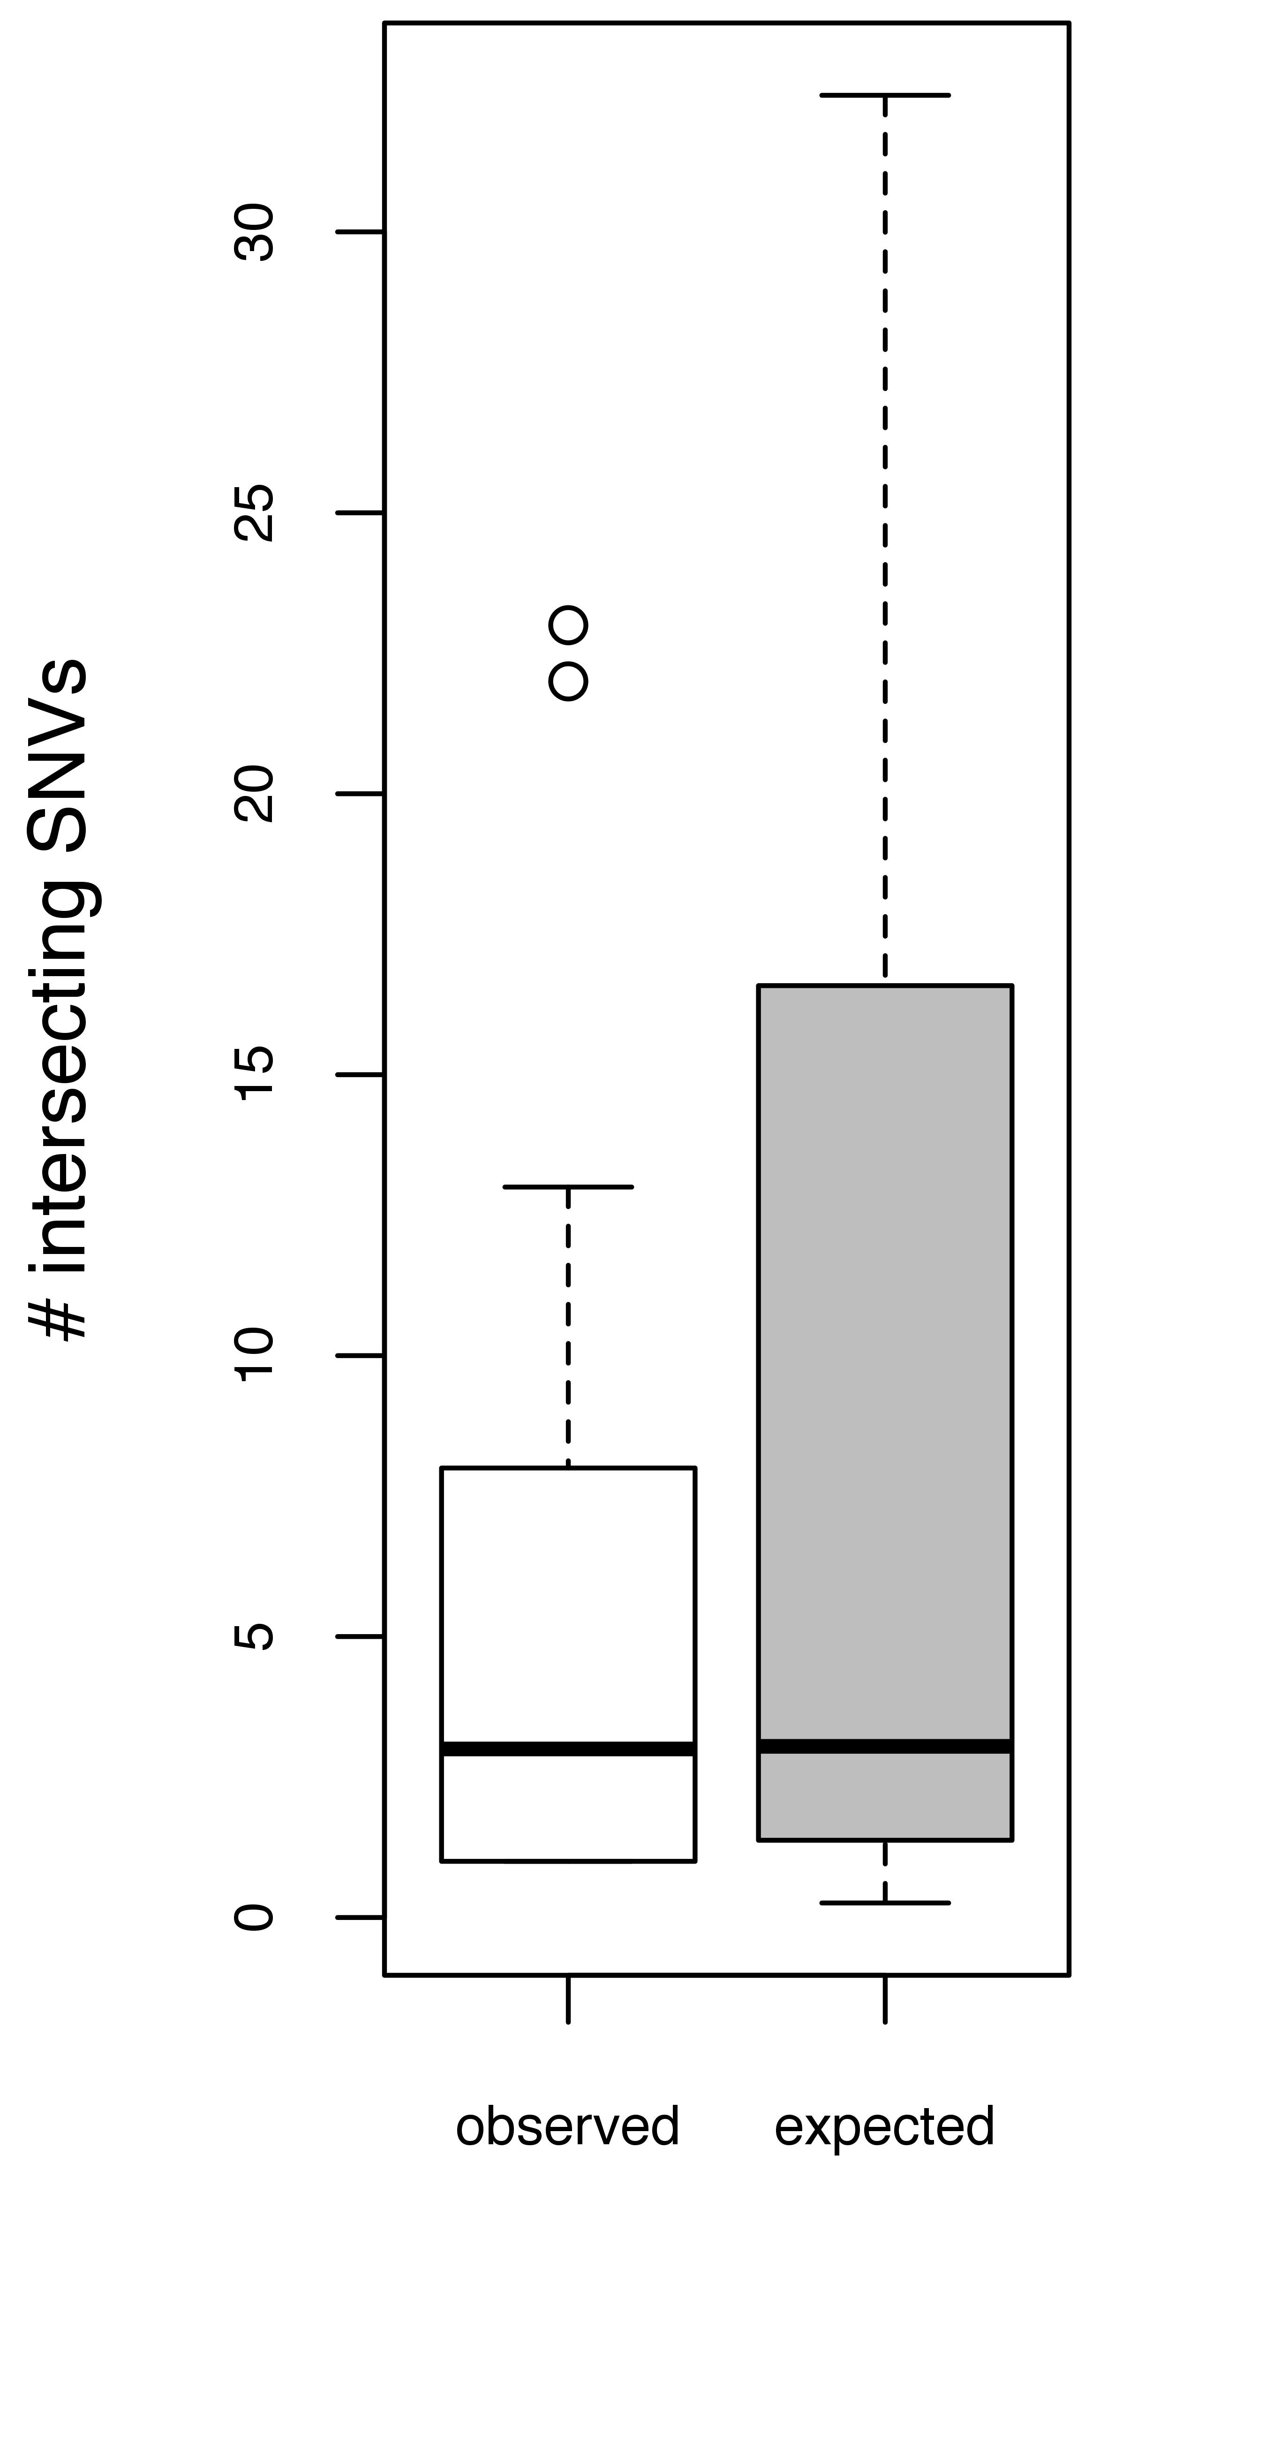
Tumor Suppressor Genes
Maximally Frustr. Residues
Single
Buried
p-value = 0.005519
N = 28
p-value = 0.001818
N = 34

Slide 5
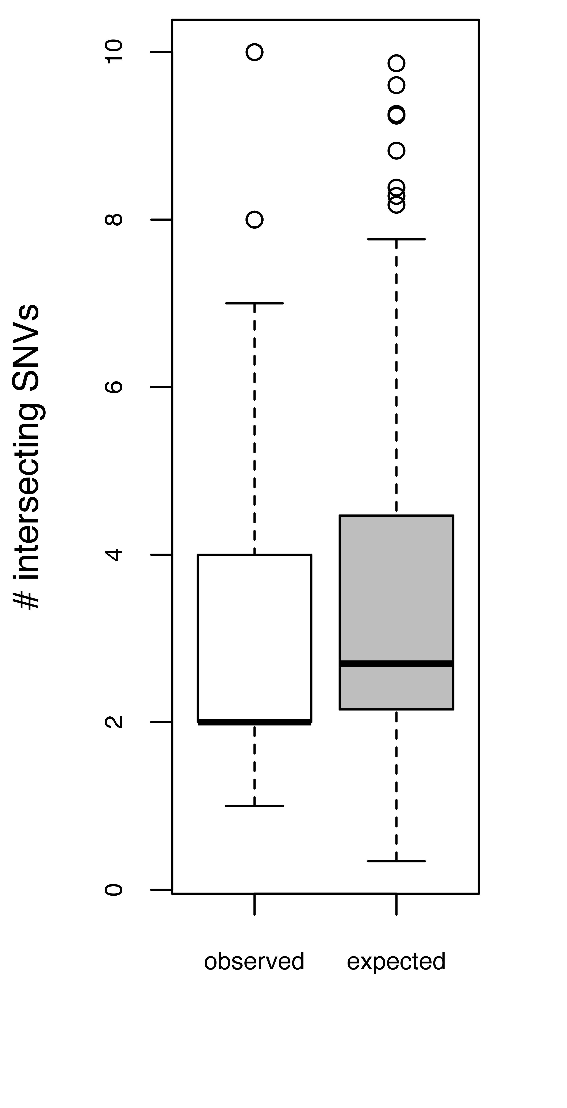
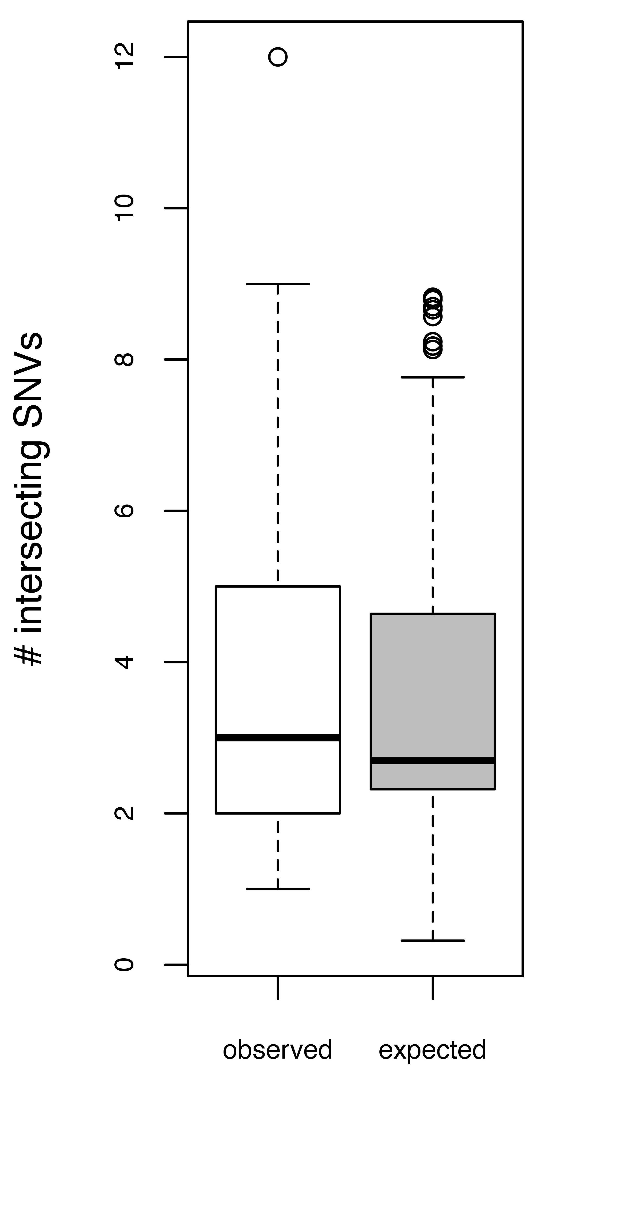
Oncogenes
Minimally Frustr. Residues
Single
Buried
p-value = 0.01498
N = 118
p-value = 0.7594
N = 96

Slide 6
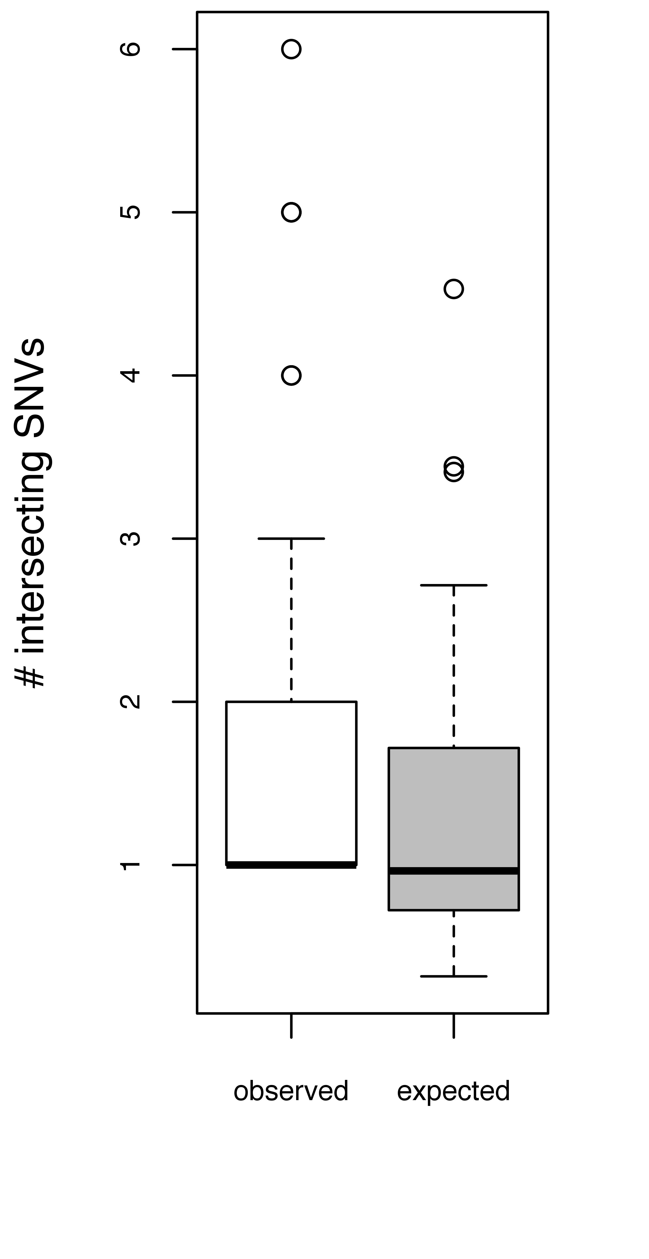
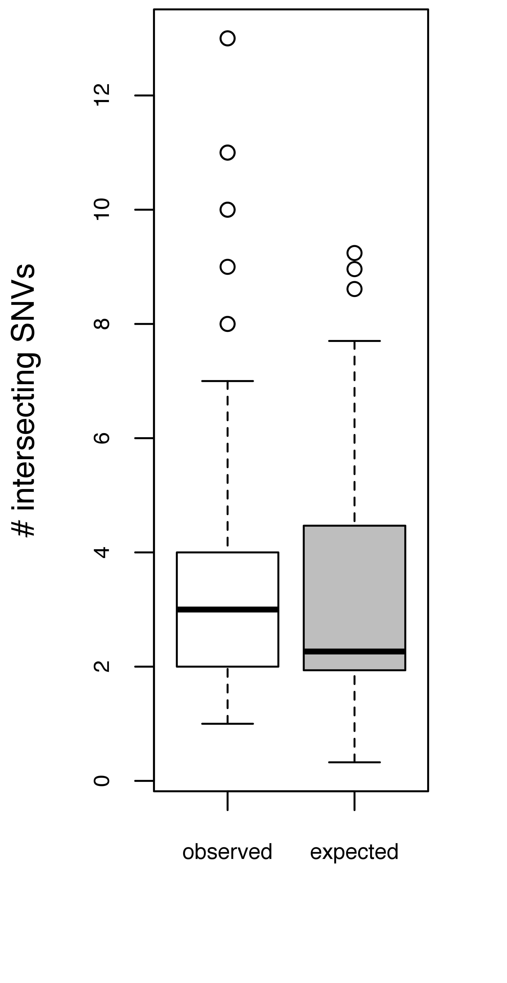
Oncogenes
Maximally Frustr. Residues
Single
Buried
p-value = 2.834e-07
N = 80
p-value = 4.159e-06
N = 112

Slide 7
Distilling this to the Most Interesting Outcomes
Maximally Frustr. Residues Using the Single-Residue Index
TSGs
Oncogenes
p-value = 0.005519
N = 28
p-value = 2.834e-07
N = 80

