Slide 1
PsychENCODE joint data analysis

Slide 2
Aims of PsychENCODE data analysis
Establish uniform data processing pipelines
Discover brain specific spliced transcripts and enhancers
Conduct integrative analysis to discover functional genomic elements and genotypes associated with psychiatric disease
Comparison with GTEx, ENCODE, Roadmap, BrainSpan

Slide 3
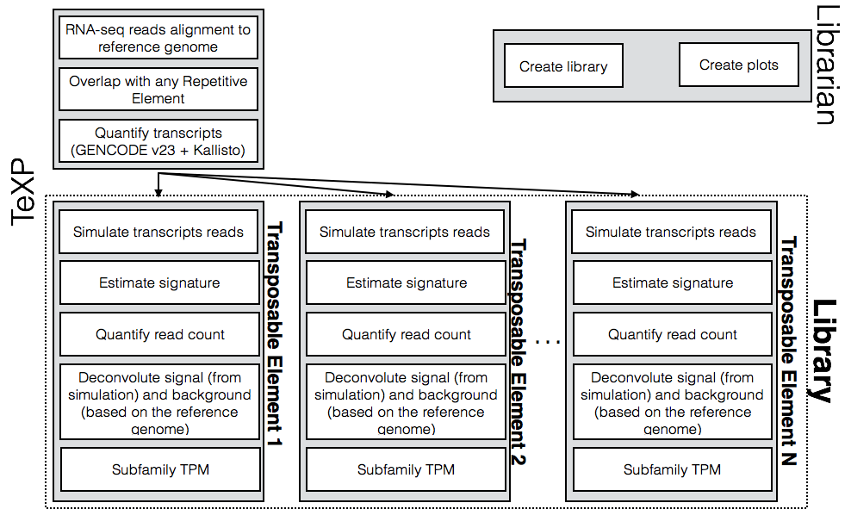
Analysis of Repetitive Element transcription in brain
Use RNA-seq samples from different developmental stages and conditions
Estimate transcription signatures of L1Hs, ALUY, HERVK functional transcripts
Remove the effect of background transcription

Slide 4
Allelic analysis in brain
Notes:
research focus

Slide 5
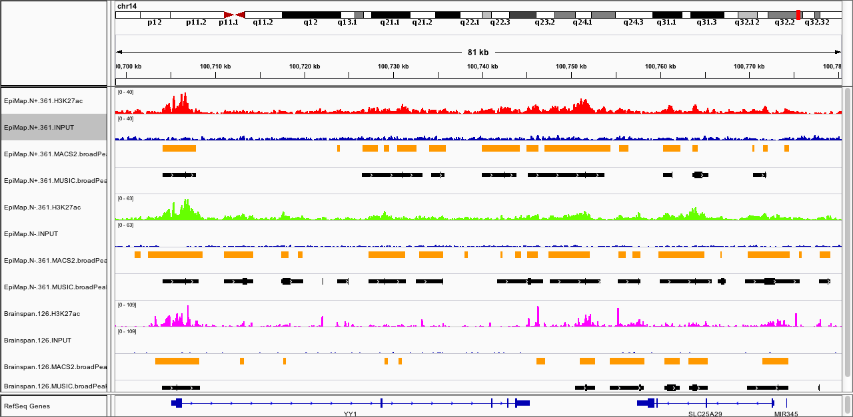
Comparison of ChIP-Seq data across projects
MUSIC H3K27ac Peak number overlap fraction
EpiMap
NeuN+
EpiMap
NeuN-
Brainspan
HSB126
Peak overlap

Slide 6
Future plans
Short term
Long term

