Slide 1
Why and how multiple enhancers are used to regulate a gene in a cell
Jinrui
Jan 27th 2016

Slide 2
Abundance of enhancers in mammalian genome
e.g. ~3-5 enhancers per human gene
Multiple enhancers of a gene are for tissue specific expressions

Slide 3
Multiple enhancers of a gene are active in same cell line
Increase gene expression level?
Reduce expression noise?
Other complicated regulatory roles?

Slide 4
Experimental study
Exp12
Scheme
Jacques P Bothma et al elife 2015

Slide 5
Experimental study
Exp12
Scheme
Exp1
Jacques P Bothma et al elife 2015

Slide 6
Experimental study
Exp12
Scheme
Exp1
Exp2
Jacques P Bothma et al elife 2015

Slide 7
Experimental study
Exp12
Scheme
Exp1
Exp2
On three genes
Knirps: Exp12 >= Exp1 + Exp2
Jacques P Bothma et al elife 2015

Slide 8
Experimental study
Exp12
Scheme
Exp1
Exp2
On three genes
Knirps: Exp12 >= Exp1 + Exp2
Hunchback: Exp12<= Exp1 + Exp2, but > Exp1, Exp2
Jacques P Bothma et al elife 2015

Slide 9
Experimental study
Exp12
Scheme
Exp1
Exp2
On three genes
Knirps: Exp12 >= Exp1 + Exp2
Hunchback: Exp12<= Exp1 + Exp2, but > Exp1, Exp2
Snail: Exp12 < Exp2
Jacques P Bothma et al elife 2015

Slide 10
Main materials and data
Mouse embryonic stem cell (mESC)
Hi-Cap to identify enhancer-promoter linkage
RNA-seq data (for testing expression level)
Single cell RNA-seq data (for testing expression noise)
Enhancer activities (by CAGE) across ~400 tissues and cell lines in mouse

Slide 11
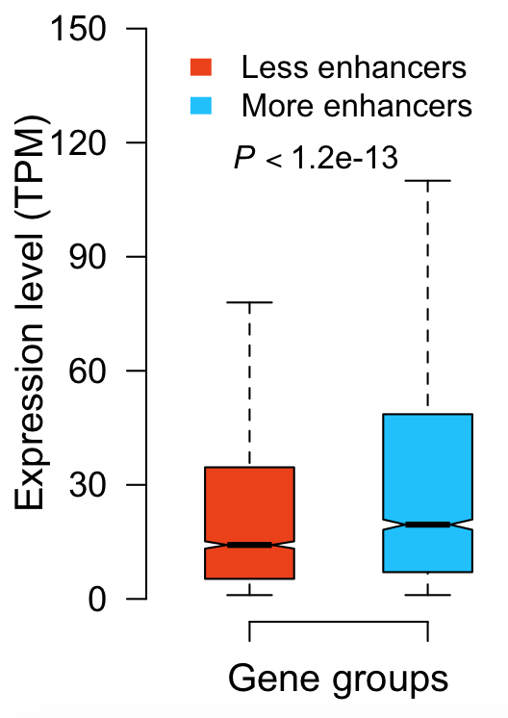
Why multiple enhancers are used to regulate a gene
Gene with more enhancers has higher expression

Slide 12
Is the expression level increase due to promoter?
with stronger promoters?

Slide 13
To test this,
The Hi-Cap data in mESC => enhancer-gene linkages
CAGE data of mouse => an enhancer is active or not in each of the ~400 tissues and cell lines

Slide 14
To test this,
The Hi-Cap data in mESC => enhancer-gene linkages
CAGE data of mouse => an enhancer is active or not in each of the ~400 tissues and cell lines
Results: when a gene has a larger number of active enhancers in, e.g. cell A than in cell B, it has higher expression in cell A.

Slide 15
Is this comparison result because highly expression genes are more likely to interact with random sequences (false positive enhancers)?
with more false discovers as enhancers?

Slide 16
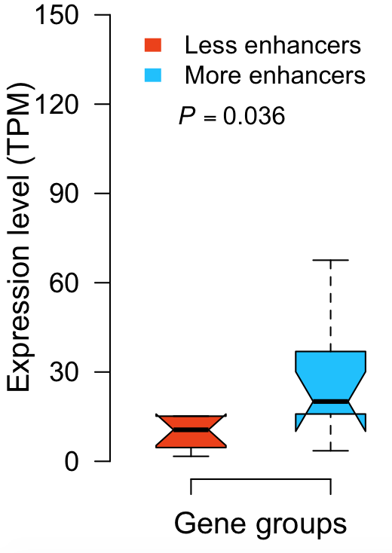
Consider only enhancers validated in VISTA

Slide 17
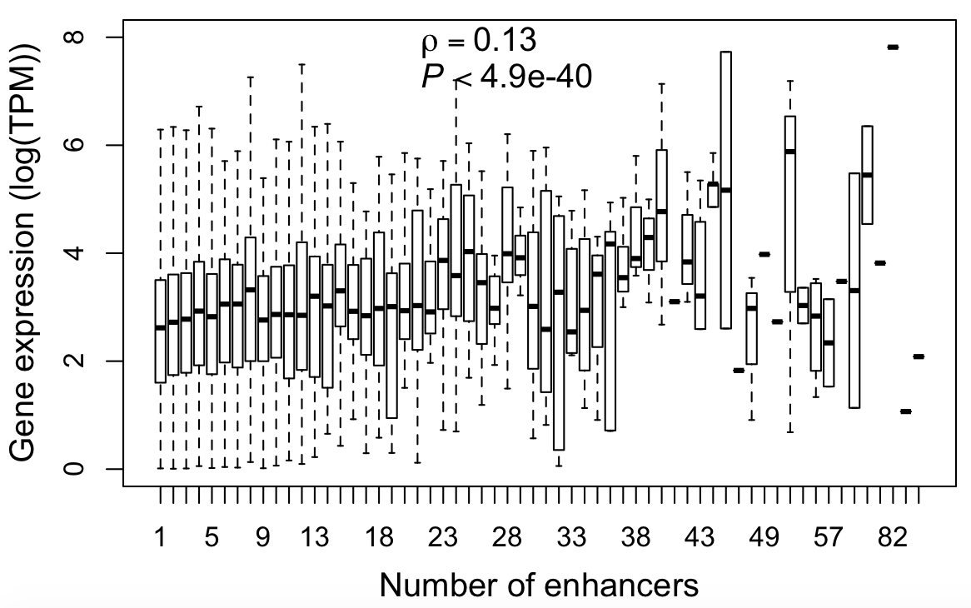
Expression level and # of enhancers are positively correlated (spearman’s rho)

Slide 18
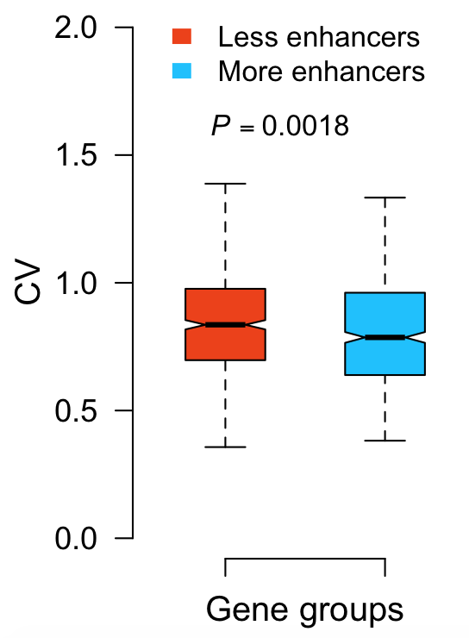
Gene using multiple enhancers has low expression noise
CV: std/mean, calculated using single cell RNA-seq data (Use only genes with average transcripts > 50)
Kim et al. 2013

Slide 19
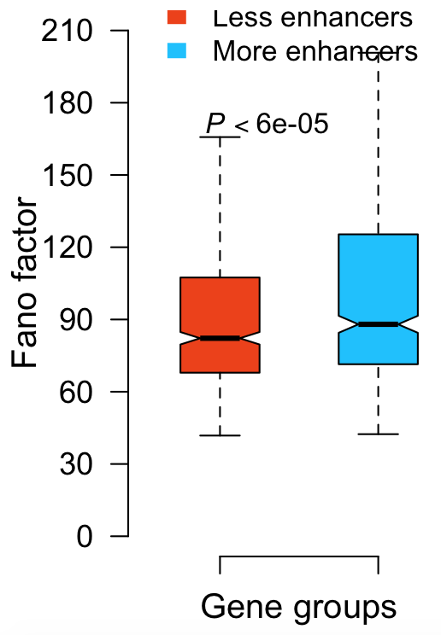
Gene using multiple enhancers has large Fano factor (FF)
FF = Variance/mean. Large FF indicates the expression is highly regulated (deviate from Poisson exp model)

Slide 20
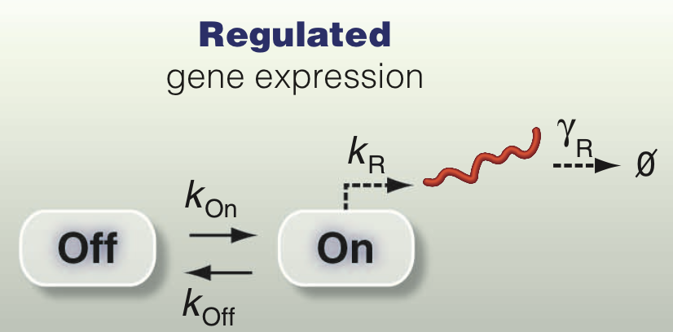
How multiple enhancers regulate gene expression
Modeling gene expression
How enhancers change Kon and/or Koff, and lead to the previously observed expression patterns
Munsky et al. 2012

Slide 21
Single-cell RNA-seq data are used to estimate kon and koff
Use only genes with average transcripts > 50
i.e. 5173 genes
Discard 585 genes with negative kon, koff or kr
Consequently, 4688 genes for further analysis
Kim et al. 2013; Pecoud 2003

Slide 22
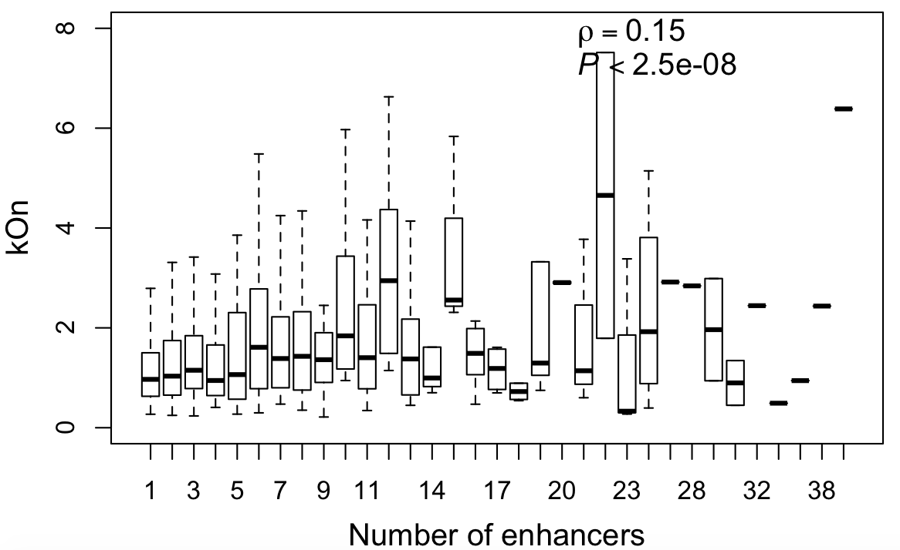
Gene with more enhancers has larger kon

Slide 23
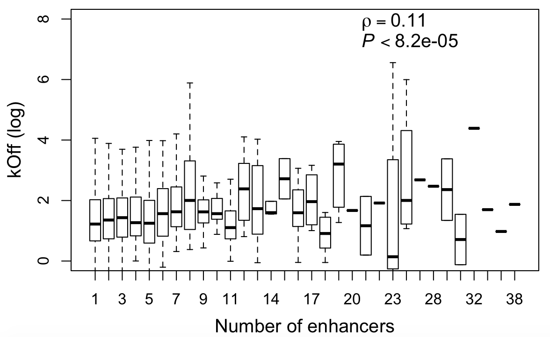
Gene with more enhancers has fast-off promoter (larger koff)

Slide 24
Explanation I
Assumptions
Natural selection requires Kon – Koff >= a
Enhancer increases Kon, usually neutral or beneficial
Mutation at promoter tends to increases Koff, thus is usually purged out by selection

Slide 25
Explanation I
Process
Event1: gain of a new enhancer causes Kon-Koff >> a
Event2: a mutation appears increasing Koff, but due to Event1, still Kon-Koff >=a.
Event3: the mutation is not deleterious, thus is likely to be accepted
Consequently, population Koff increases

Slide 26
Explanation I
Predictions
# of enhancers increases => Kon increases => Koff increases
Conditional on Kon, # of enhancer and Koff have no correlation
Conditional of Koff, # of enhancer and Koff still have a positive correlation, although expected to be weak

Slide 27
Explanation I
Predictions
# of enhancers increases => Kon increases => Koff increases
Conditional on Kon, # of enhancer and Koff have no correlation
Spearman’s rho 0.017, p = 0.55
Conditional of Koff, # of enhancer and Koff still have a positive correlation, although expected to be weak
Spearman’s rho 0.067, p = 0.022

Slide 28
Another possible explanation
Some identified enhancers are chimeras.
Some repressors are identified as enhancers
To test this, identify enactive bindings
Histone modification
eRNA
TF binding (sites)

Slide 29
Future work
Filter out false discovered enhancers
Redo the analyses
Propose popgen model to address
(1) Necessity of adding enhancer
(2) Advantage of adding enhancer over duplicating gene
Enrichment analysis of GO functions

Slide 30
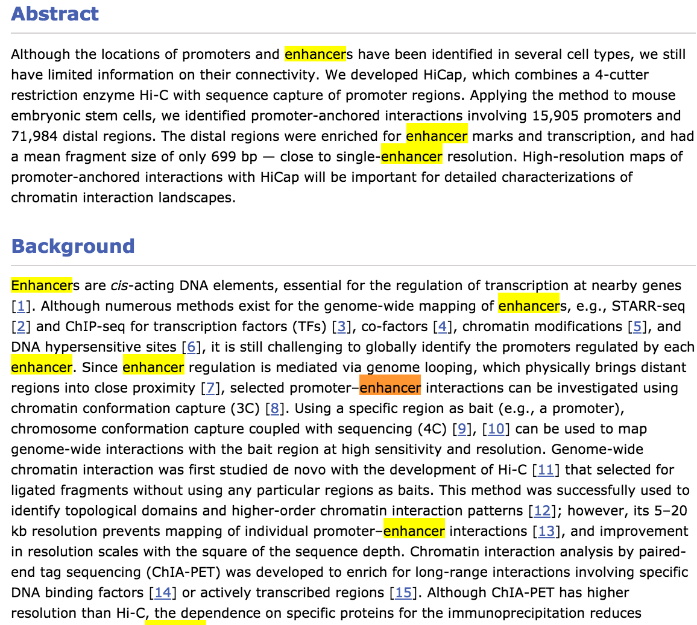
“Enhancers”- are from

