Slide 1
Signature

Slide 2
Signature
C>T in CpG

Slide 3
Signature

Slide 4
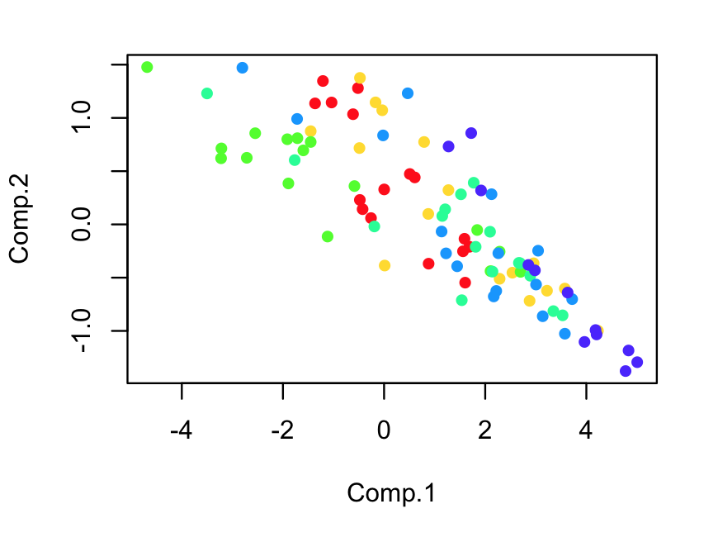
Signature

Slide 5
Signature

Slide 6
Signature

Slide 7
Signature

Slide 8
Smoking Signature?
More TCG > TTG

Slide 9
C>A not significant in smokers

Slide 10
C>T in ACG correlates with age
Cor = 0.44
p = 0.033

Slide 11
Signature
T1 vs. T3: all p < 0.05 except ACG

Slide 12
Signature

Slide 13
More C>T in CpG in Cluster 1 (hypermethylation)
P < 0.0012

Slide 14
Mutations in Chromatin Remodeler

Slide 15
P = 0.023

Slide 16
APOBEC

Slide 17
ApoBEC (inside motif/outside)

Slide 18
Summary
Overall spectrum shows strong C>T in CpG mutation pattern and high between-sample heterogeneity (PCA)
C>T in CpG correlates with Age (ApCpG) and tumor size (T stage, except ApCpG)
Higher C>T in CpG rate among Cluster 1 samples (hypermethylation subgroup)
More mutations in open chromatin (DHS) in chromatin remodeler defect samples
ApoBEC signature in a couple of samples (Fisher exact test needed)

Slide 19
“Yao’s plot”

Slide 20
“Yao’s plot”

