Slide 1
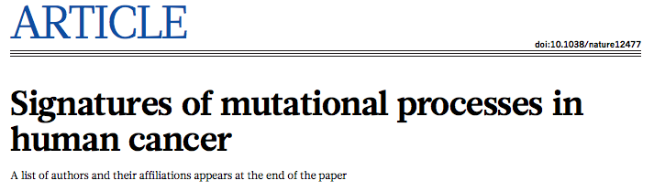
Presented by Jay Krishnan

Slide 2
Overview
Somatic Mutations - Our understanding of biological processes is limited
4,938,362 mutations analyzed from 7,042 cancer samples
  20+ distinct mutational signatures ; 30 cancer classes
Prevalence of signatures in one or many cancer classes
  APOBEC family of cytidine deaminases
Association with age
  Mutagenic exposures or defects in DNA maintenance
Hypermutation
Results highlight the diversity of mutational processes underlying development of cancer
  Cancer aetiology, prevention and therapy
Notes:
Cancer is caused by somatic mutations. Our understanding of the biological processes that generate somatic mutations is limited.
What a some of the causes?
DNA replication machinery, exogenous or endogenous mutagen exposures (UV or tobacco smoking), enzymatic modifications of DNA or defective DNA mismatch repair
Signatures are different combinations of mutation types
Signatures in many cancer types most notably occurs in this paper when a signature attributed to APOBEC family of cytidine deaminases
Before: signatures were explored using a small number of mutated cancer genes that are drivers. To make a mutation signature, a single mutation from each cancer sample is entered into a mutation set aggregated from several cases of a particular cancer type
Now: Sequencing technology has overcome past limitations with new algorithms of identifying signatures
Hypermutation was also found in this study to be localized to small genomic regions or kataegis that are found in many cancer types

Slide 3
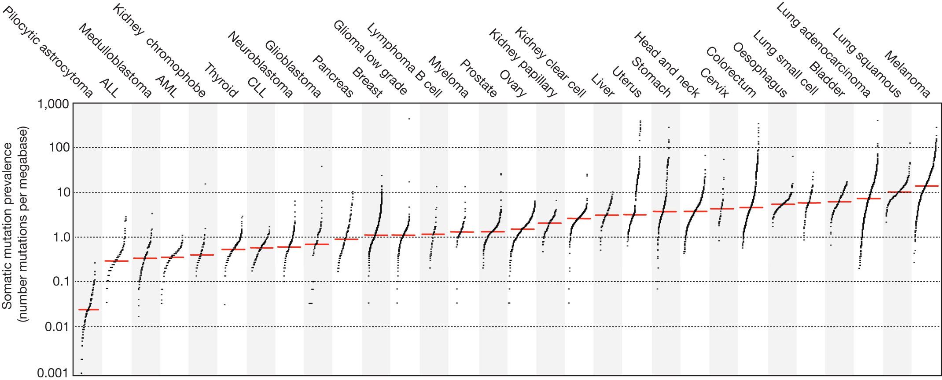

The prevalence of somatic mutations across human cancer types.
LB Alexandrov et al. Nature 000, 1-7 (2013) doi:10.1038/nature12477
Notes:
4,938,362 mutations analyzed from 7,042 cancers samples of 30 different classes
Normal DNA has to also be sequenced.
Red line is the median number of somatic mutations. Ordering of cancer types is based on the median
Vertical axis is log scaled – shows the number of mutations per megabase
Prevalence of somatic mutations is highly variable within a cancer class. Childhood cancers carry the fewest mutations where cancers related to chronic mutagenic exposures exhibited the highest prevalence.

Slide 4
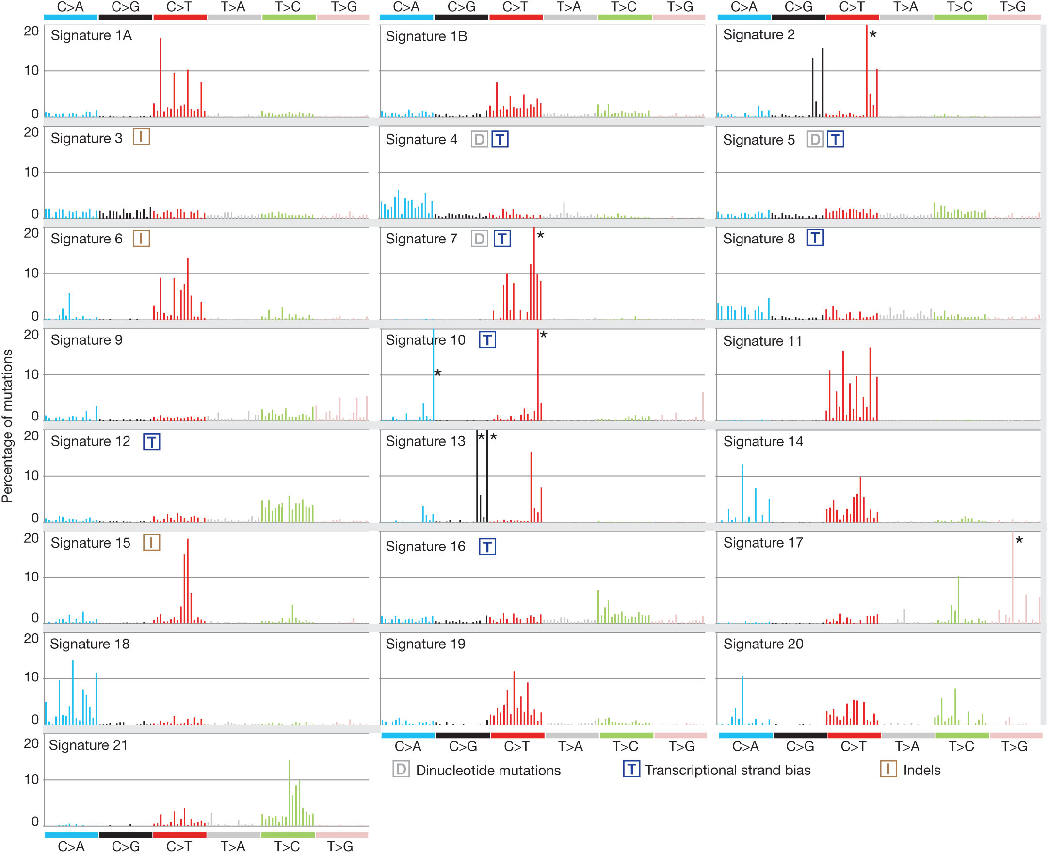
Validated mutational signatures found in human cancer.
LB Alexandrov et al. Nature 000, 1-7 (2013) doi:10.1038/nature12477
Notes:
OVERVIEW:
New Algorithm to extract mutational signatures from catalogues of somatic mutations is applied to cancer whole genome sequences.
Novel and known signatures found.
The contribution to each signature to each cancer sample and the timing of the activity properly estimated.
This approach can be applied to mutational catalogues from sequences of all coding exons. This allows the generation of somatic mutations from 1000s of cancers.
First: mutational signatures were extracted using base substitutions. There are six classes of base substitutions and when you incorporate information around the mutated site you get 96 possible mutations in this classification. This is useful to distinguish signatures that cause same substitutions but in different sequence contexts
Figure shows this approach applied to 30 cancer types revealing 21 distinct but validated mutational signatures
Lots of diversity
Some signatures show 1 or 2 of the 96 combinations (Signature 10) showing high specificity
Others like signature 3 show equal representations of all mutations more or less

Slide 5
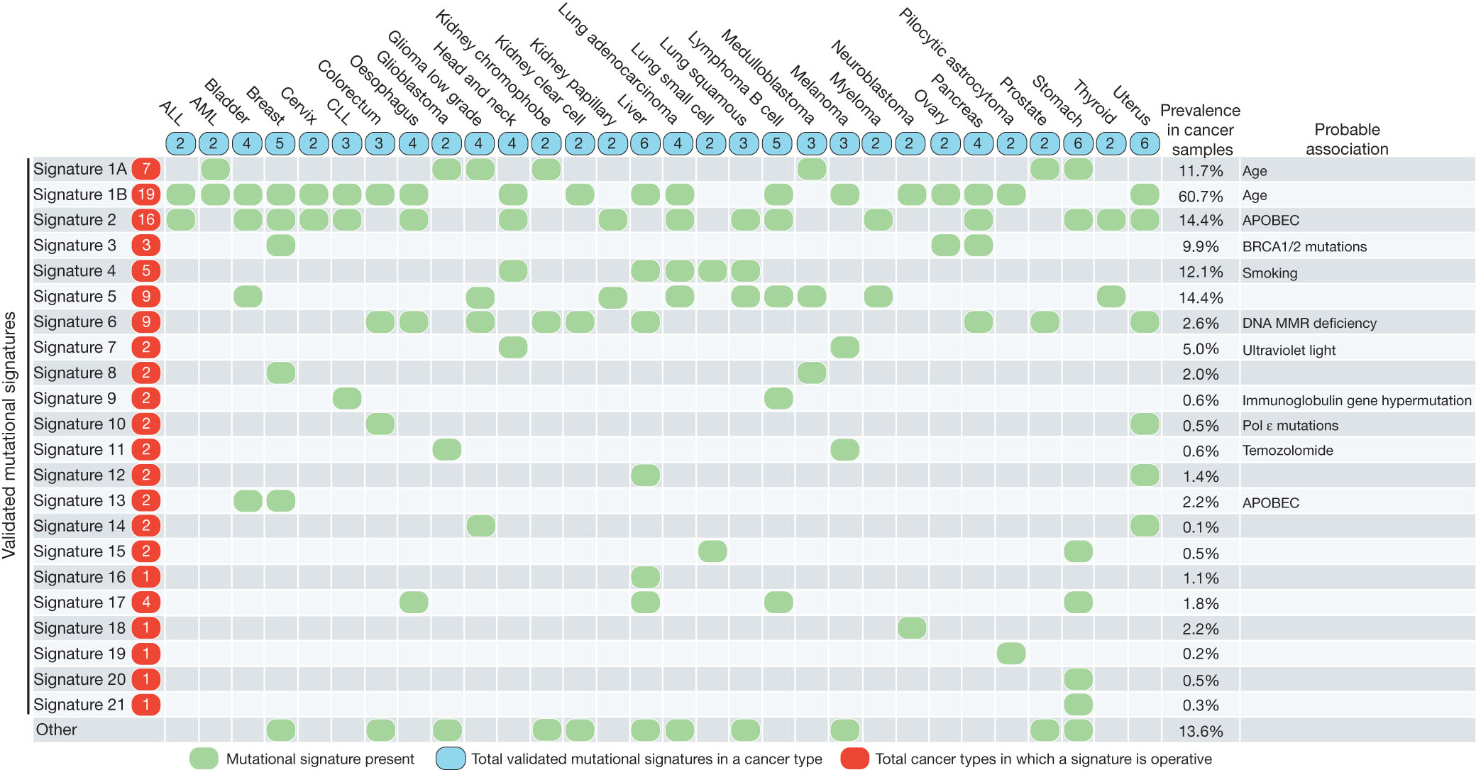
The presence of mutational signatures across human cancer
types.
LB Alexandrov et al. Nature 000, 1-7 (2013) doi:10.1038/nature12477
Notes:
Cancer types ordered A-Z
Mutational signatures are displayed as rows
Prevalence in cancer sample = % of samples (7042 cancers) where signature contributed to a significant number of mutations
Signatures 1A and 1B are observed in 25/30 cancer classes.
We notice the C>T substitutions at NpCpG trinucleotides.
Mutually exclusive in tumour types say that they probably represent the same underlying process.
Paper speculates these signatures are related to elevated rate of spontaneous deamination of 5-methyl-cytosine which results in C>T transitions.
Signature 2 is C>T and C>G and found in 16/30 cancer types
Speculate that this is due to over activity of members of the APOBEC family of cytidine deaminases which covert C to U and due to problems with base excision repair and DNA replication machineries

Slide 6
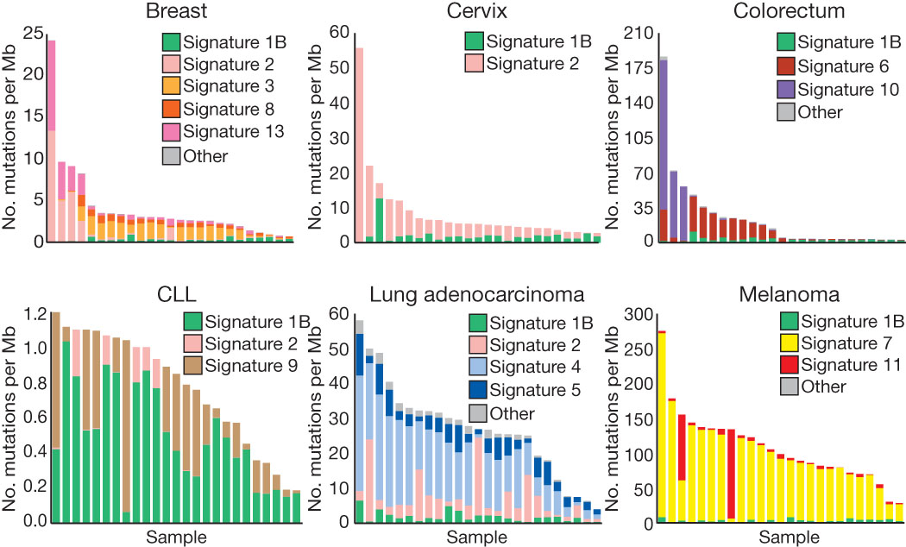
The contributions of mutational signatures to individual cancers
of selected cancer types.
LB Alexandrov et al. Nature 000, 1-7 (2013) doi:10.1038/nature12477
Notes:
Many individual cancer genomes exhibit more than one mutational signature and many different combinations of signatures.
Patterns of contribution to cancer samples is very different between signatures.
Bar represents a typical selected sample for a particular cancer type.
Vertical axis denotes number of mutations per megabase
1A 1B usually has the same amount of contribution while other signatures vary greatly probably due to differing carcinogenic exposures or after neoplastic change.

Slide 7
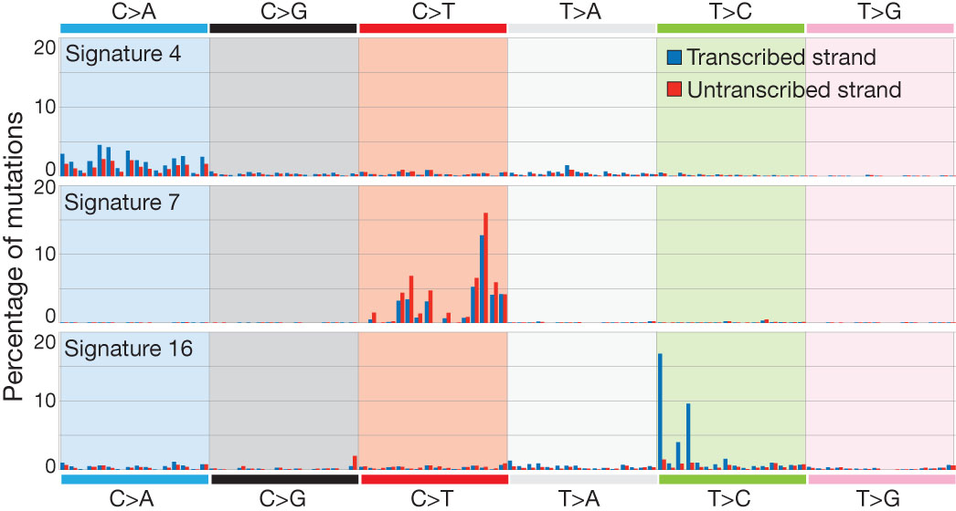
Selected mutational signatures with strong transcriptional strand
bias.
LB Alexandrov et al. Nature 000, 1-7 (2013) doi:10.1038/nature12477
Notes:
Efficiency of DNA damage and DNA maintenance can differ between transcribed and untranscribed strands of genes
Re-extracted substitution mutational signatures incorporating the transcriptional strand on which the mutation had taken place
96*2 = 192 mutation subclasses
Figure 5 shows transcriptional bias for C>A in transcribed strand of signature 4
Going back to Figure 3 we know signature 4 is related to tobacco smoking
So signature 4 is probably an imprint of bulky DNA adducts generated by polycyclic hydrocarbons fond in tobacco smoke
Like this, the authors are able to elucidate the underlying biology of many different signatures

Slide 8
Mutational Signatures with insertions and deletions
Re-extracted mutational signatures adding 2 further classes of mutations
  Indels at short nucleotide repeats
  Indels with overlapping microhomology at breakpoint junctions
3/21 base substitution signatures associated with lots of indels
Patterns of indels, termed as microsatellite instability, are characteristic of cancers with defective DNA mismatch repair
Notes:
We covered base substitutions and transcriptional strand bias previously

Slide 9
Cancer Aetiology and Mutational Signatures
What are the causes?
  1A/1B - deamination of 5-methyl-cytosine
  7 – melanoma and squamous carcinoma due to UV
  4 – Tobacco Smoking
  11 – Some anticancer drugs are mutagens
  6 – DNA mismatch repair
  3 – double strand break repair
Still many signatures to find
Still many unknown underlying reasons

Slide 10
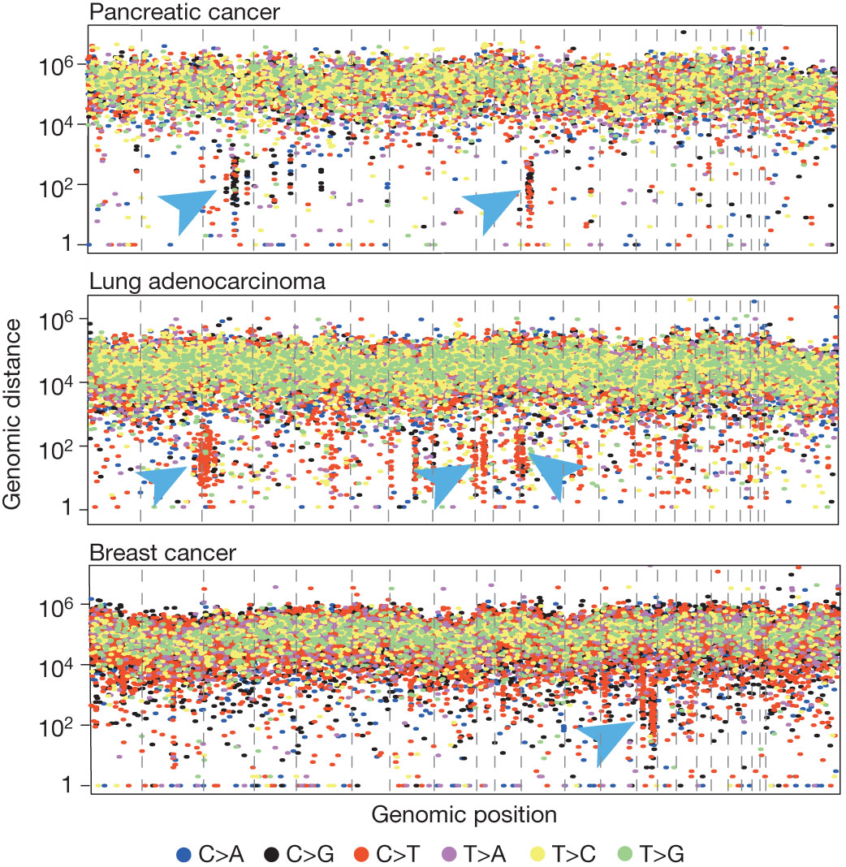
Kataegis in three cancers.
LB Alexandrov et al. Nature 000, 1-7 (2013) doi:10.1038/nature12477
Notes:
Hypermutation was found to be localized to small genomic regions or kataegis that are found in many cancer types
Clusters of C>T and C>g mutations particularly in TpCpN trinucleotides and on the same DNA strand
Foci of kataegis found in vicinity of genomic rearrangements
Problems with APOBEC family enzymes found as a reason
Rainfall plot showing Kataegis in 3 cancers. Each dot is a cancer sample in which a somatic mutation has occurred at that spot. Arrows indicate clusters of mutations or kataegis at the genomic location.

Slide 11
Methodology
Mutational catalogues were stringently filtered
A previously developed computational framework was used to extract the signatures
Framework can be downloaded from http://www.mathworks.com/matlabcentral/fileexchange/38724
Complete set of somatic mutations is available
All mutational signatures are validated

Slide 12
Discussion
Diversity and complexity of somatic mutational processes is being revealed by studying mutational patterns
With WGS more mutational signatures will be extracted
Mechanics of most signatures is still unknown
Biological explanations for Somatic Mutations depend on:
  Compilation of signatures from model systems exposed to known mutagens
  Correlation of contributions of mutational signatures with other biological characteristics in each cancer
    Help from molecular profiling to epidemiology
Future Directions

