Slide 1
--SNV annotation in protein repeat domains
--Using protein intra-domain conservation for SNV annotation
Figure Pack

Slide 2
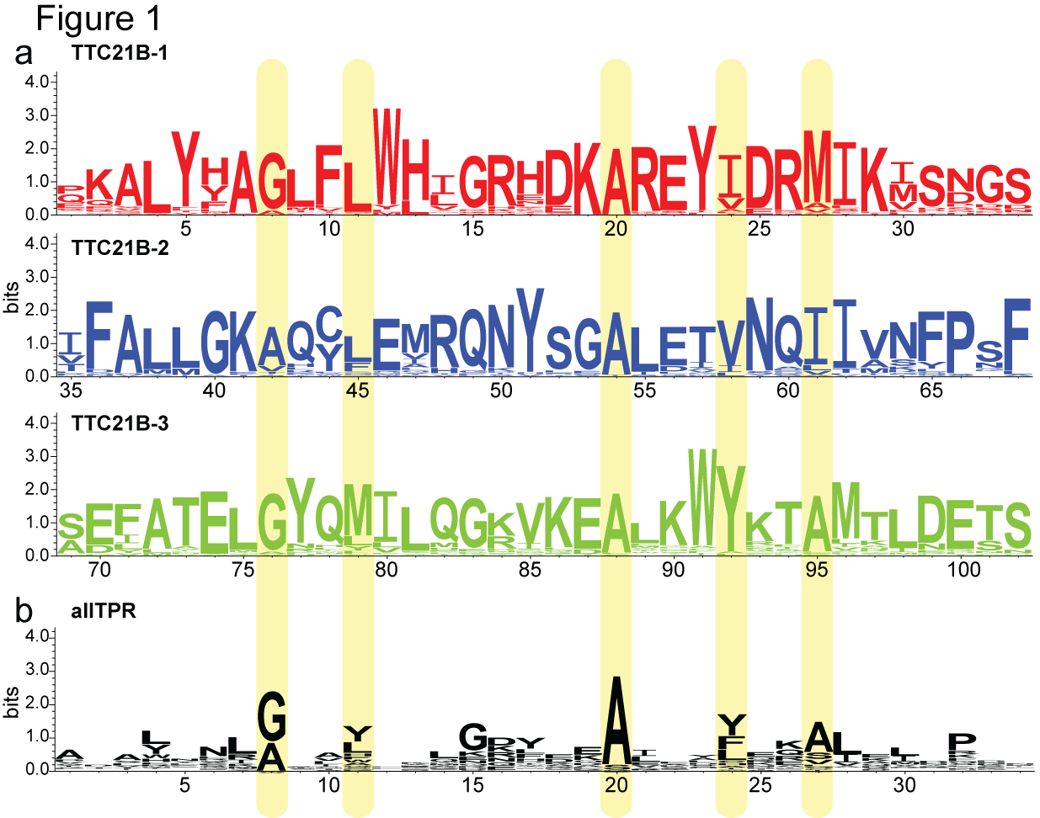
Figure 1. All positions are conserved in conventional multiple sequence alignment by homologous proteins across
multiple species. When we align by domain across species, we can see domain features more clearly (highlighted in yellow).

Slide 3
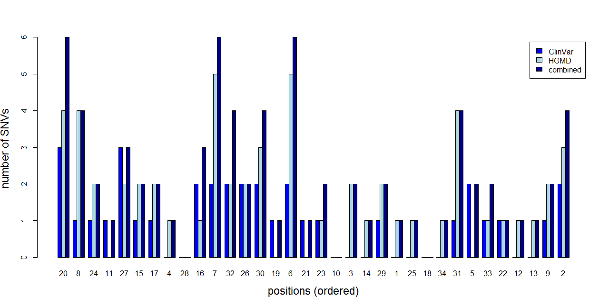
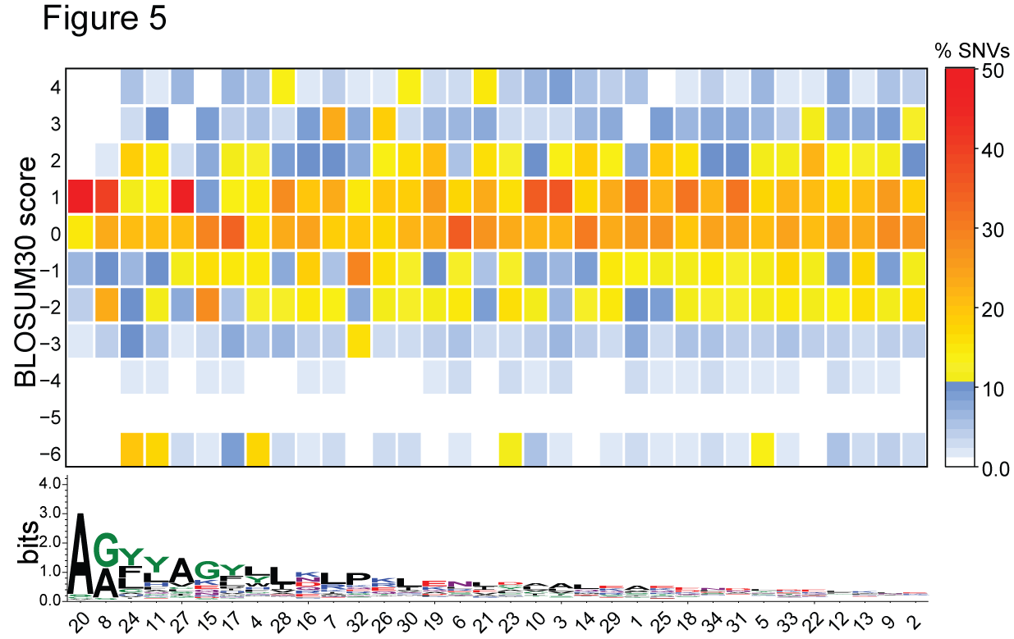
ClinVar/HGMD results

Slide 4
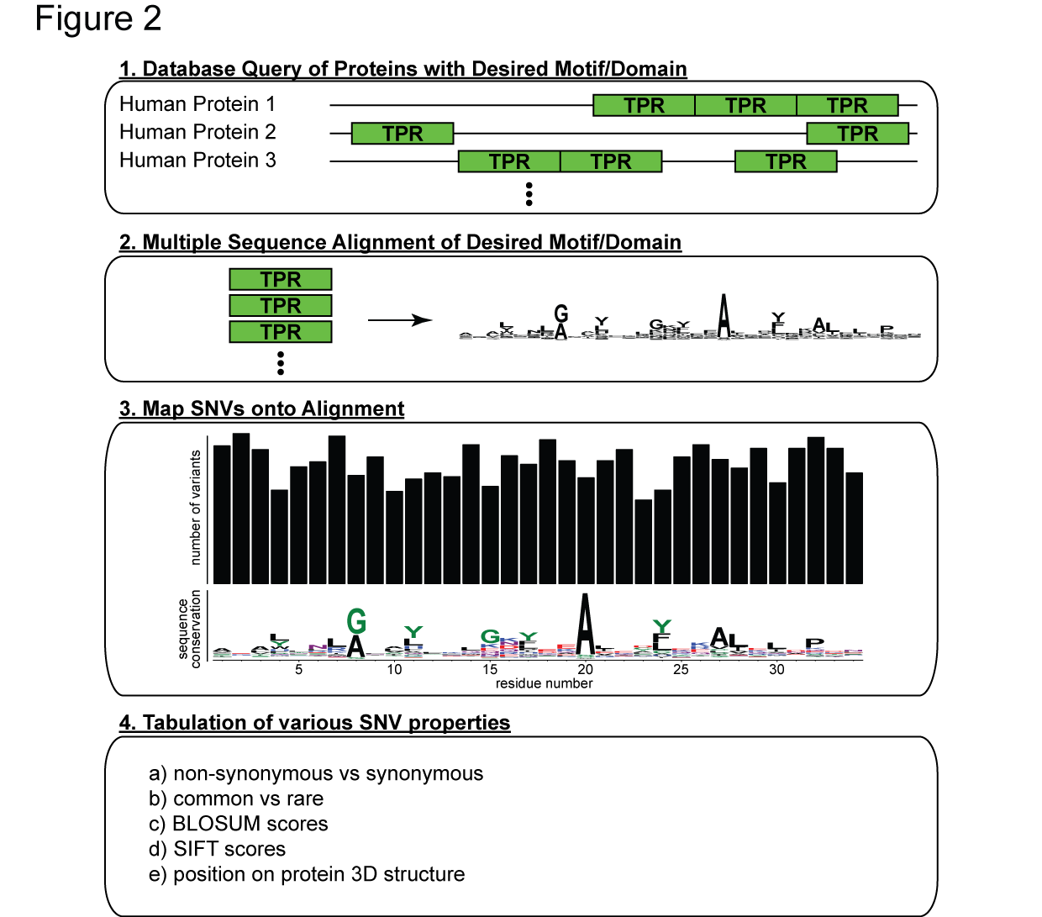
Figure 2. Our approach. (1) We start with querying and obtaining desired domain from a database. In our study, we use TPR motif from the SMART database. (2) We then perform a multiple sequence alignment of the TPR motifs to identify motif- or domain-specific important residues. (3) To further ascertain the importance, we use some proxies for estimating evolutionary constraints. This is done first by mapping SNVs onto the alignment (after excluding singletons), (4) then tabulating SNV properties at each position. Metrics such as the relative proportion of non-synonymous to synonymous SNVs and the proportion of rare with respect to common SNVs are used to estimate selective constraints for each position.

Slide 5
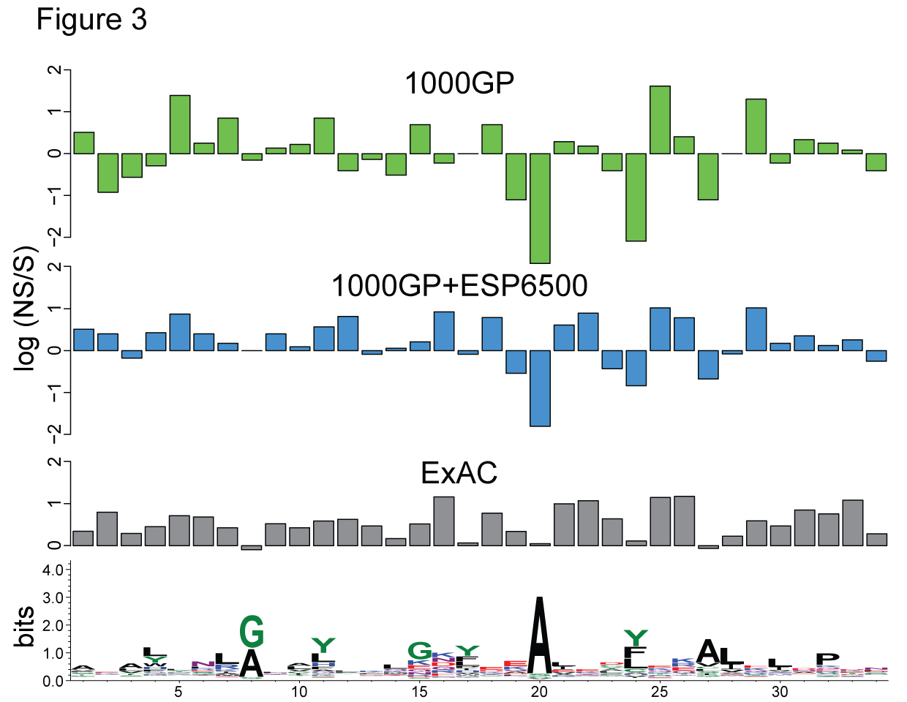
Figure 3. Comparing, amongst 3 datasets, the log ratio of the number of non-synonymous to synonymous SNVs at each TPR motif position.

Slide 6
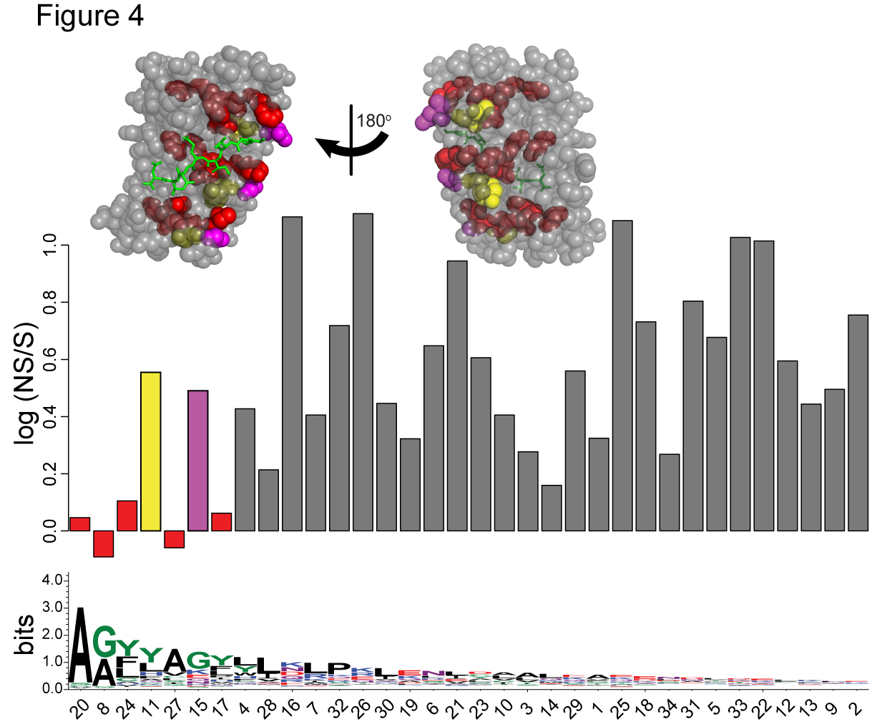
Figure 4. Sequence conservation is related to evolutionary constraints. We rank the positions on the TPR motif according to a descending order of sequence conservation. We observe that the log ratio of NS to S SNVs are consistently low where the sequence conservation is high, except for positions 11 (yellow) and 15 (magenta). This signifies that these positions have indeed high selective constraints. In an X-ray crystal structure of a TPR domain made up of 3 motifs (PDB ID: 1ELW), we can see that the highly conserved positions (red) are mostly at the core of the domain, suggesting their importance in the structural stability of the protein-interacting domain.

Slide 7
ClinVar/HGMD results

Slide 8
Figure 5. BLOSUM30 scores of positions on TPR motif ranked according to sequence conservation. Each box on the heatmap is colored according to the percentage of SNVs at the position on the TPR motif (x-axis) with that BLOSUM30 score (y-axis). We see that at every position, most of the variants are above 0, suggesting that the amino acid changes are mostly tolerable in terms of physiochemical changes. There is also a considerable proportion of changes that are mildly unfavorable (between scores -1 and -2). At some positions such as positions 24,11 and 4, highly unfavorable changes are accommodated at scores of -6.

Slide 9
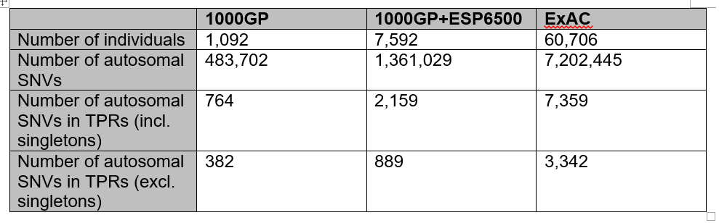
Supplementary Table 1. Number of SNVs in each dataset. The 1000 Genomes Project (1000GP) provides the least number of autosomal SNVs, followed by an approximate 6-fold increase in number of exomes in the combined set of 1000GP and Exome Sequencing Project (ESP6500). Our study uses the dataset from ExAC, with 60,706 individuals, an almost 10-fold increase from the combined set of 1000GP+ESP6500.

Slide 10
For further discussion

Slide 11
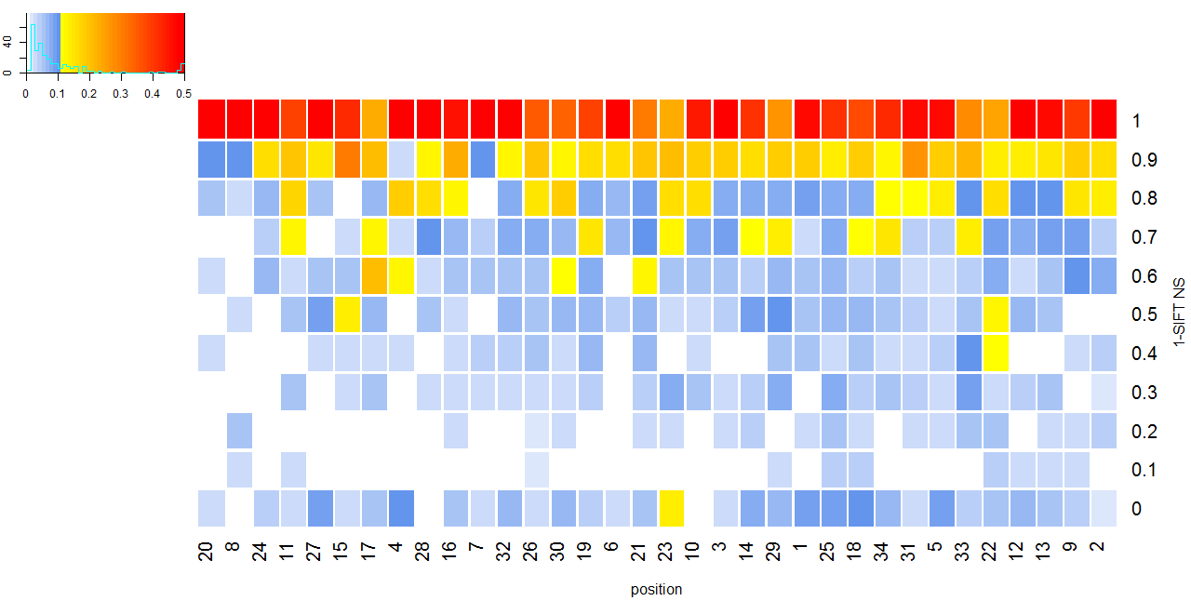
SIFT

Slide 12
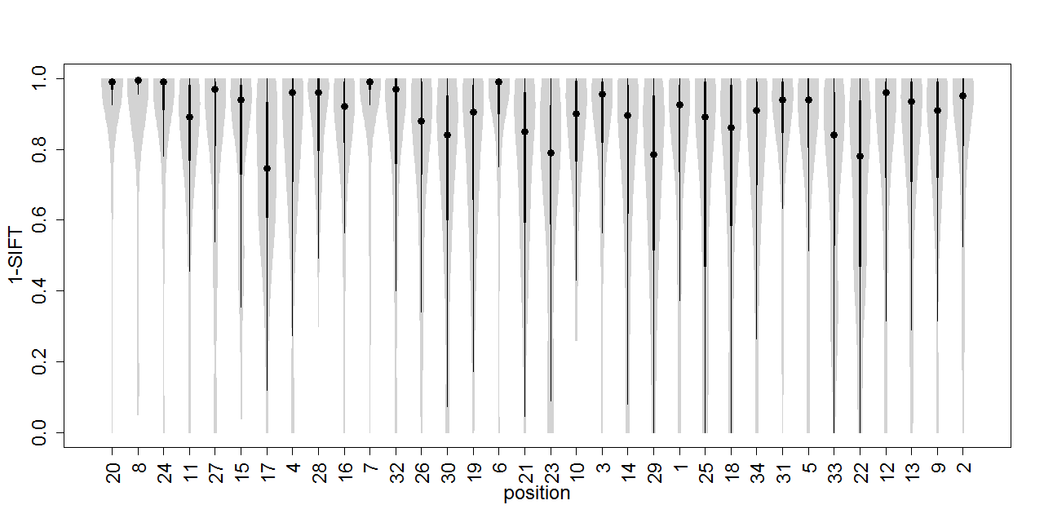
SIFT
*
*
*
*
*

Slide 13
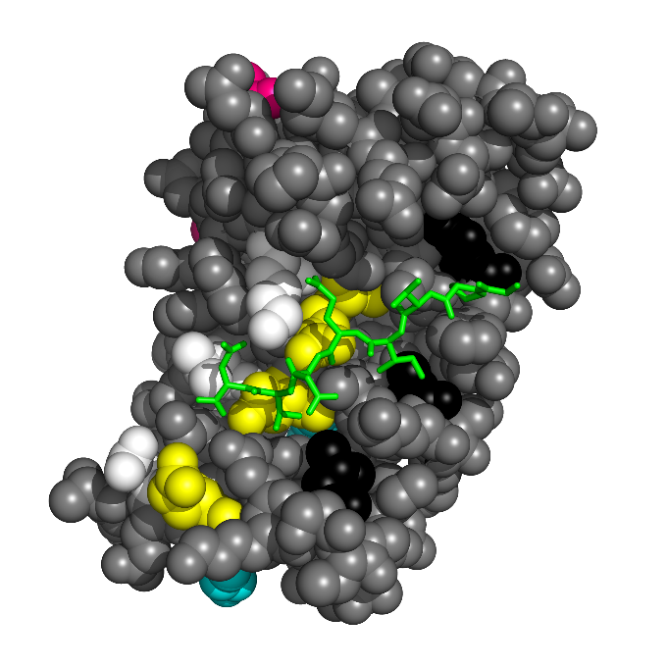
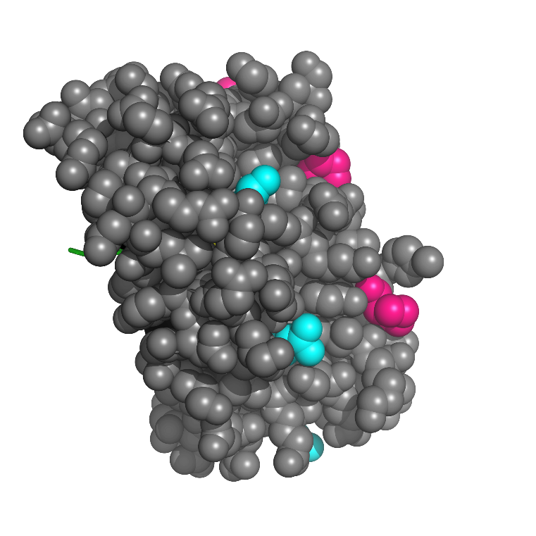
SIFT
*
*
*
*
*

Slide 14
ClinVar/HGMD results

Slide 15
Ankyrins
Magliery paper 1AWC – mouse
3KBU – 1 repeat
3ZKJ – 6 repeats need to read more

Slide 16
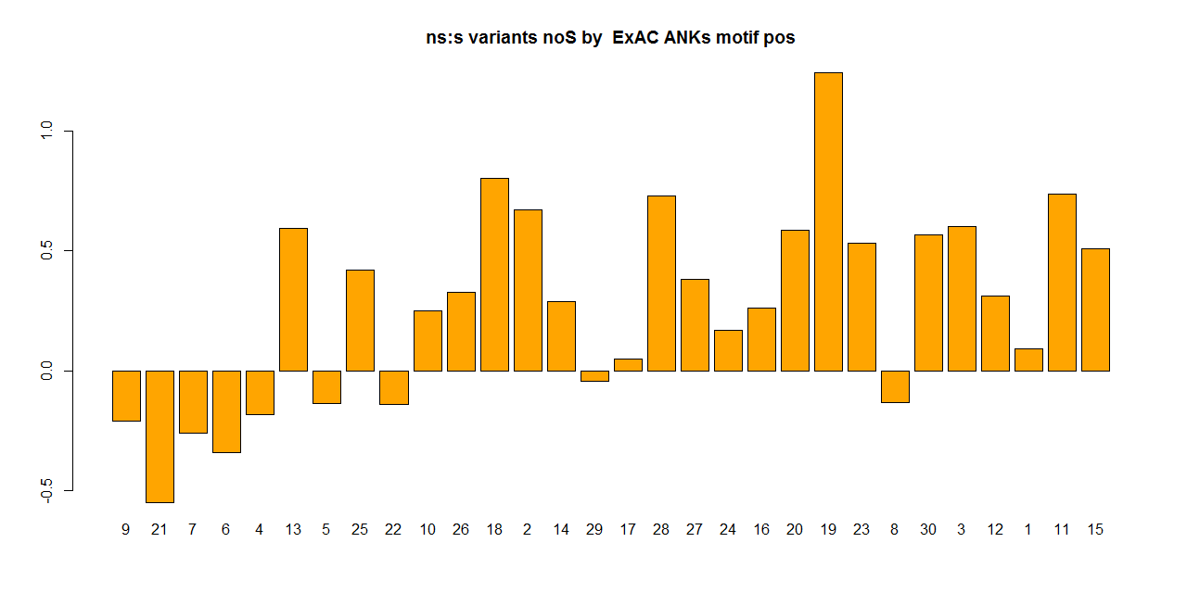
Ordered ns2s
9 21 7 6 4 13 5 25 22 10 26 18 2 14 29 17 28 27 24 16 20 19 23 8 30 3 12 1 11 15

