Slide 1
Enhancer Predictions in Mouse
Jill Moore
Weng Lab
January 2016

Slide 2
Approaches for Predicting Enhancers
Approach #1 –
Center predictions on DNase Peaks.
Optimize peak ranking by incorporating H3K27ac data
Approach #2 –
Center predictions on H3K27ac peaks.
Optimize peak ranking by incorporating DNase data

Slide 3
Controlling For Genome Coverage
Issue #1 - There are more DNase peaks than H3K27ac peaks
Issue #2 – H3K27ac peaks are wider than DNase peaks
 | Hindbrain | Limb | Midbrain | Neural Tube
DNase | 160,907 | 190,647 | 168,090 | 180,835
H3K27ac | 34,130 | 28,049 | 28,960 | 30,431
 | Hindbrain | Limb | Midbrain | Neural Tube
DNase | 150.6 bp | 150.6 bp | 150.4 bp | 150.9 bp
H3K27ac | 815.1 bp | 750.6 bp | 748.6 bp | 742.1 bp

Slide 4
Controlling For Genome Coverage - Solutions
Step #1 – Control for the number of peaks (use the same number of H3K27ac peaks and DNase peaks)
Step #2 –Set all peak widths to 300 bp centered around summit (H3K27ac) or center of peak (DNase)

Slide 5
Methods
We intersected peaks with VISTA elements using Bedtools and required each peak to overlap at least 5% of the VISTA element
For DNase, we used only replicate 1 datasets. For H3K27ac, we used the combined replicate datasets
 | VISTA Positive | VISTA Negative
Overlaps Peak | True Positive | False Positive
Does Not Overlap Peak | False Negative | True Negative

Slide 6
Methods
We generated PR curves by ranking the peaks by different metrics such as p-value, signal, and average ranked signal
We assigned VISTA elements that do NOT overlap a peak signals of 0 and p-values of 1. These regions are the straight lines at the end of each PR curve

Slide 7
Part I Results

Slide 8
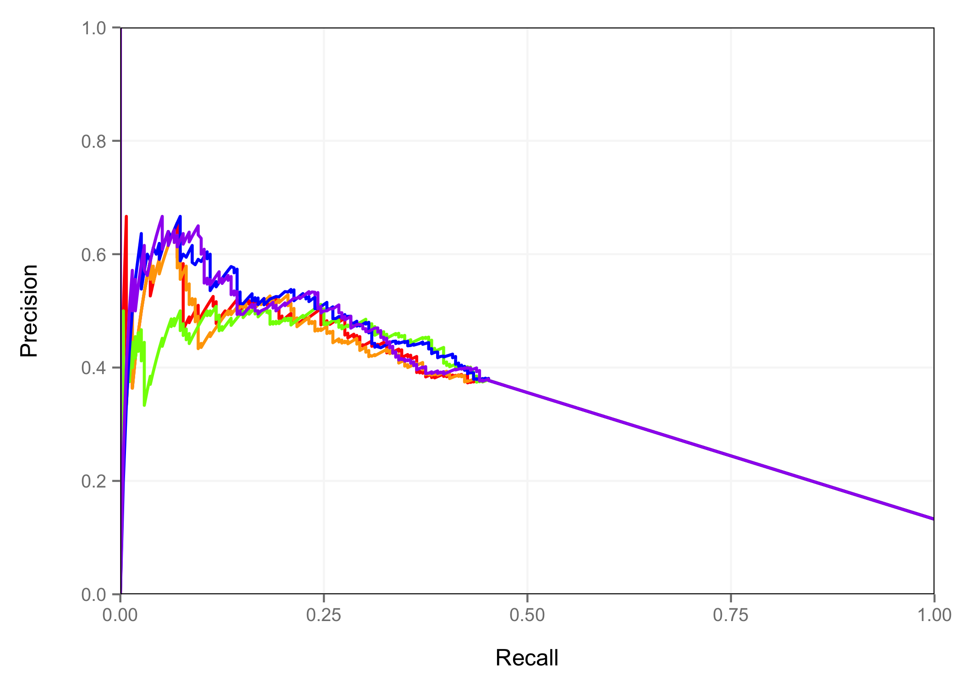
Hindbrain – DNase Peak Space
Peak P-value
DNase Signal
H3K27ac Signal
DNase Signal + H3K27ac Signal
DNase P-value +H3K27ac Signal

Slide 9
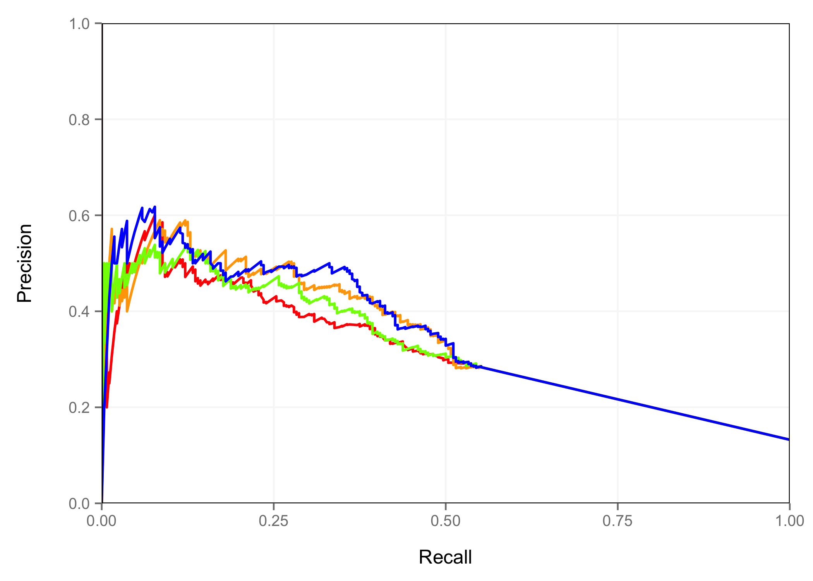
Hindbrain – H3K27ac Peak Space
Peak P-value
DNase Signal
H3K27ac Signal
DNase Signal + H3K27ac Signal

Slide 10
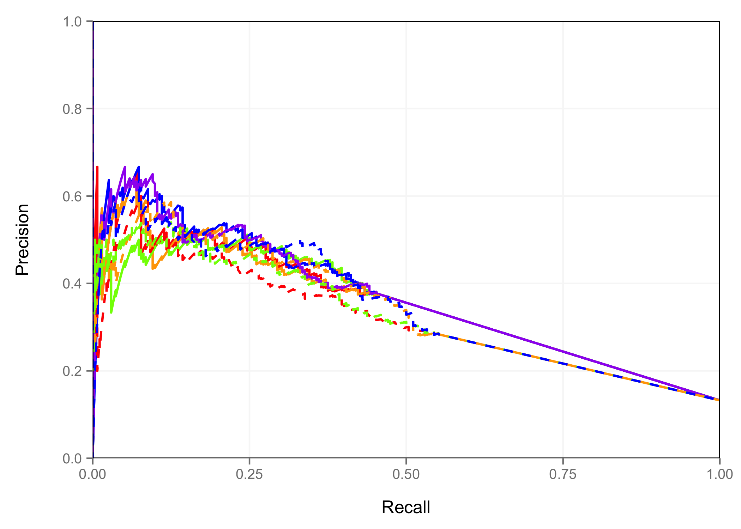
Hindbrain – All Results
Peak P-value
DNase Signal
H3K27ac Signal
DNase Signal + H3K27ac Signal
DNase P-value +H3K27ac Signal
DNase Peaks
Peak P-value
DNase Signal
H3K27ac Signal
DNase Signal + H3K27ac Signal
H3K27ac Peaks

Slide 11
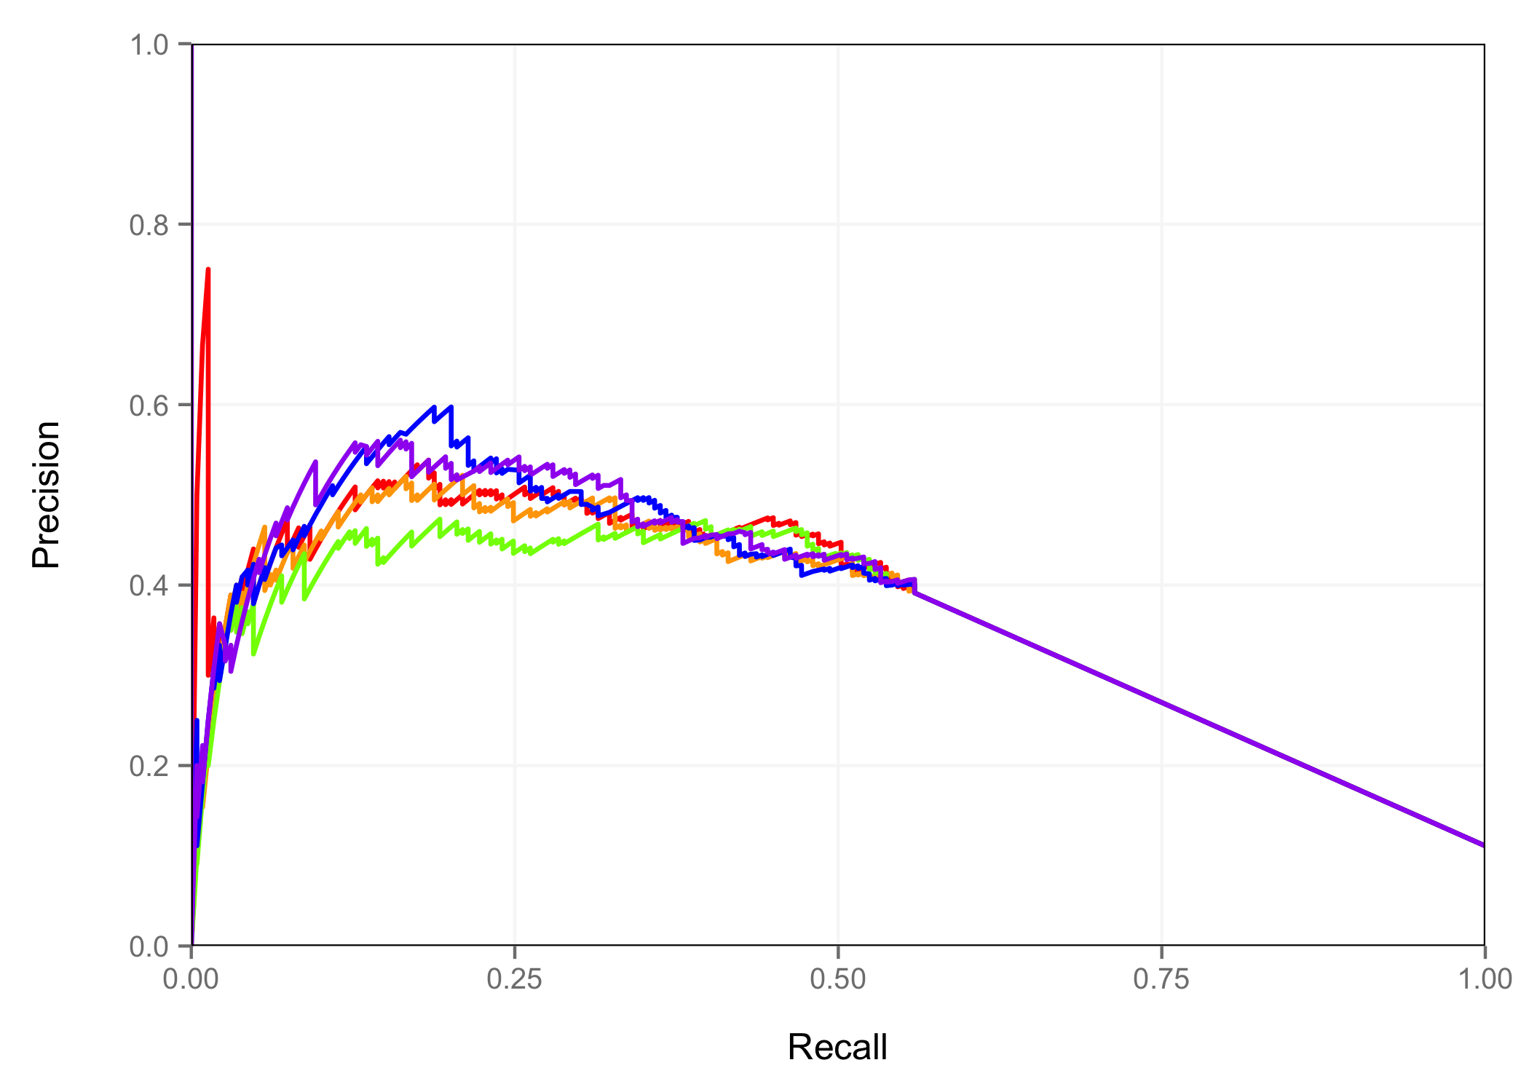
Limb – DNase Peak Space
Peak P-value
DNase Signal
H3K27ac Signal
DNase Signal + H3K27ac Signal
DNase P-value +H3K27ac Signal

Slide 12
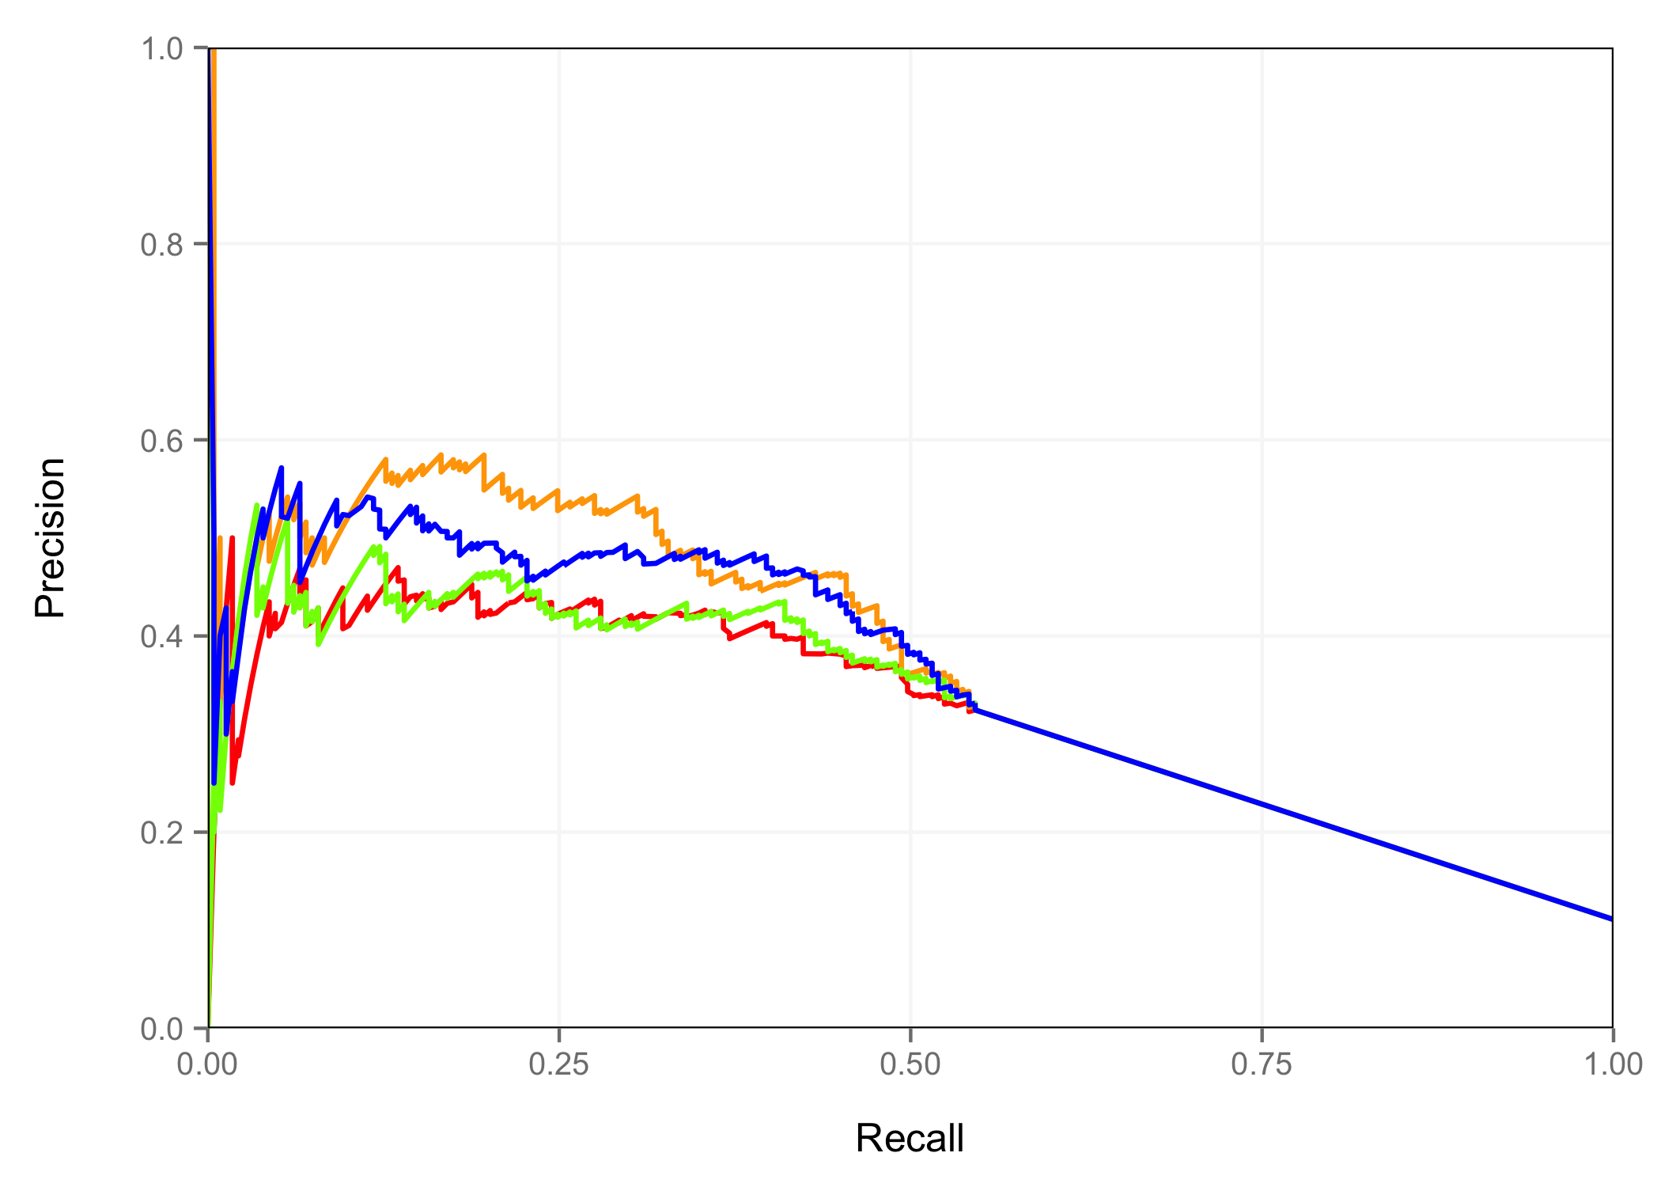
Limb – H3K27ac Peak Space
Peak P-value
DNase Signal
H3K27ac Signal
DNase Signal + H3K27ac Signal

Slide 13
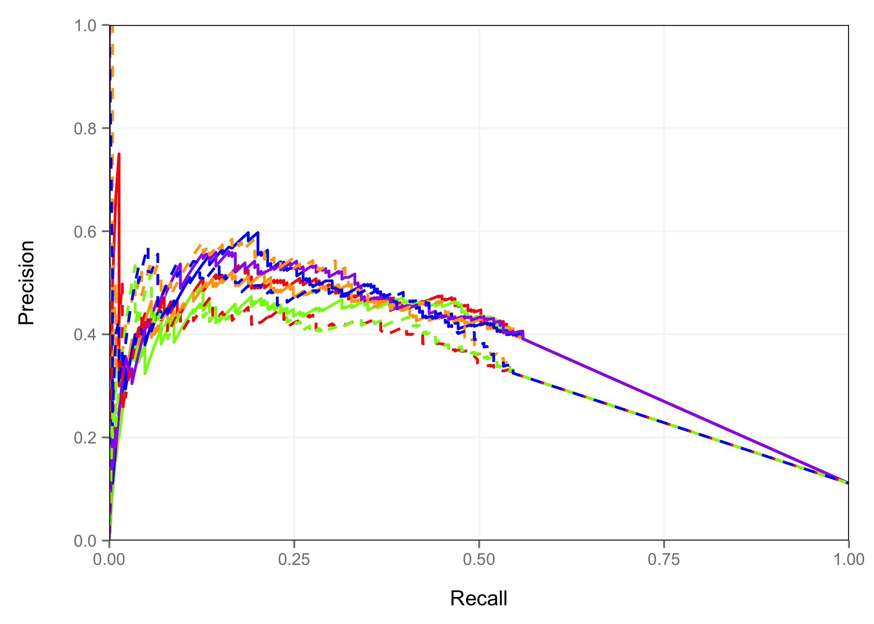
Limb – All Results
Peak P-value
DNase Signal
H3K27ac Signal
DNase Signal + H3K27ac Signal
DNase P-value +H3K27ac Signal
DNase Peaks
Peak P-value
DNase Signal
H3K27ac Signal
DNase Signal + H3K27ac Signal
H3K27ac Peaks

Slide 14
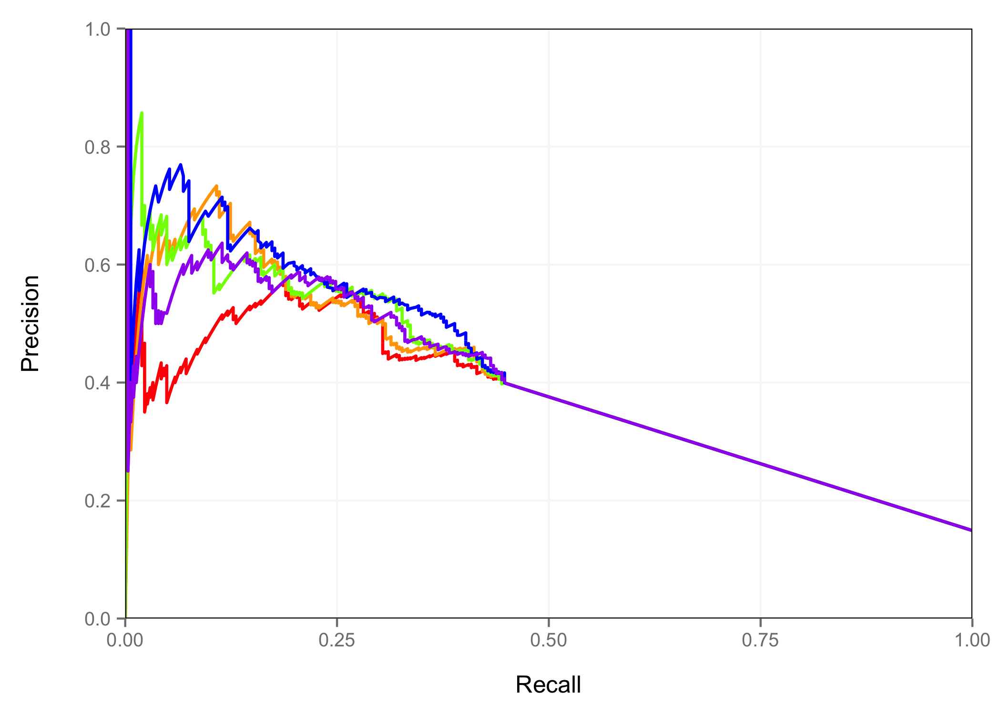
Midbrain – DNase Peak Space
Peak P-value
DNase Signal
H3K27ac Signal
DNase Signal + H3K27ac Signal
DNase P-value +H3K27ac Signal

Slide 15
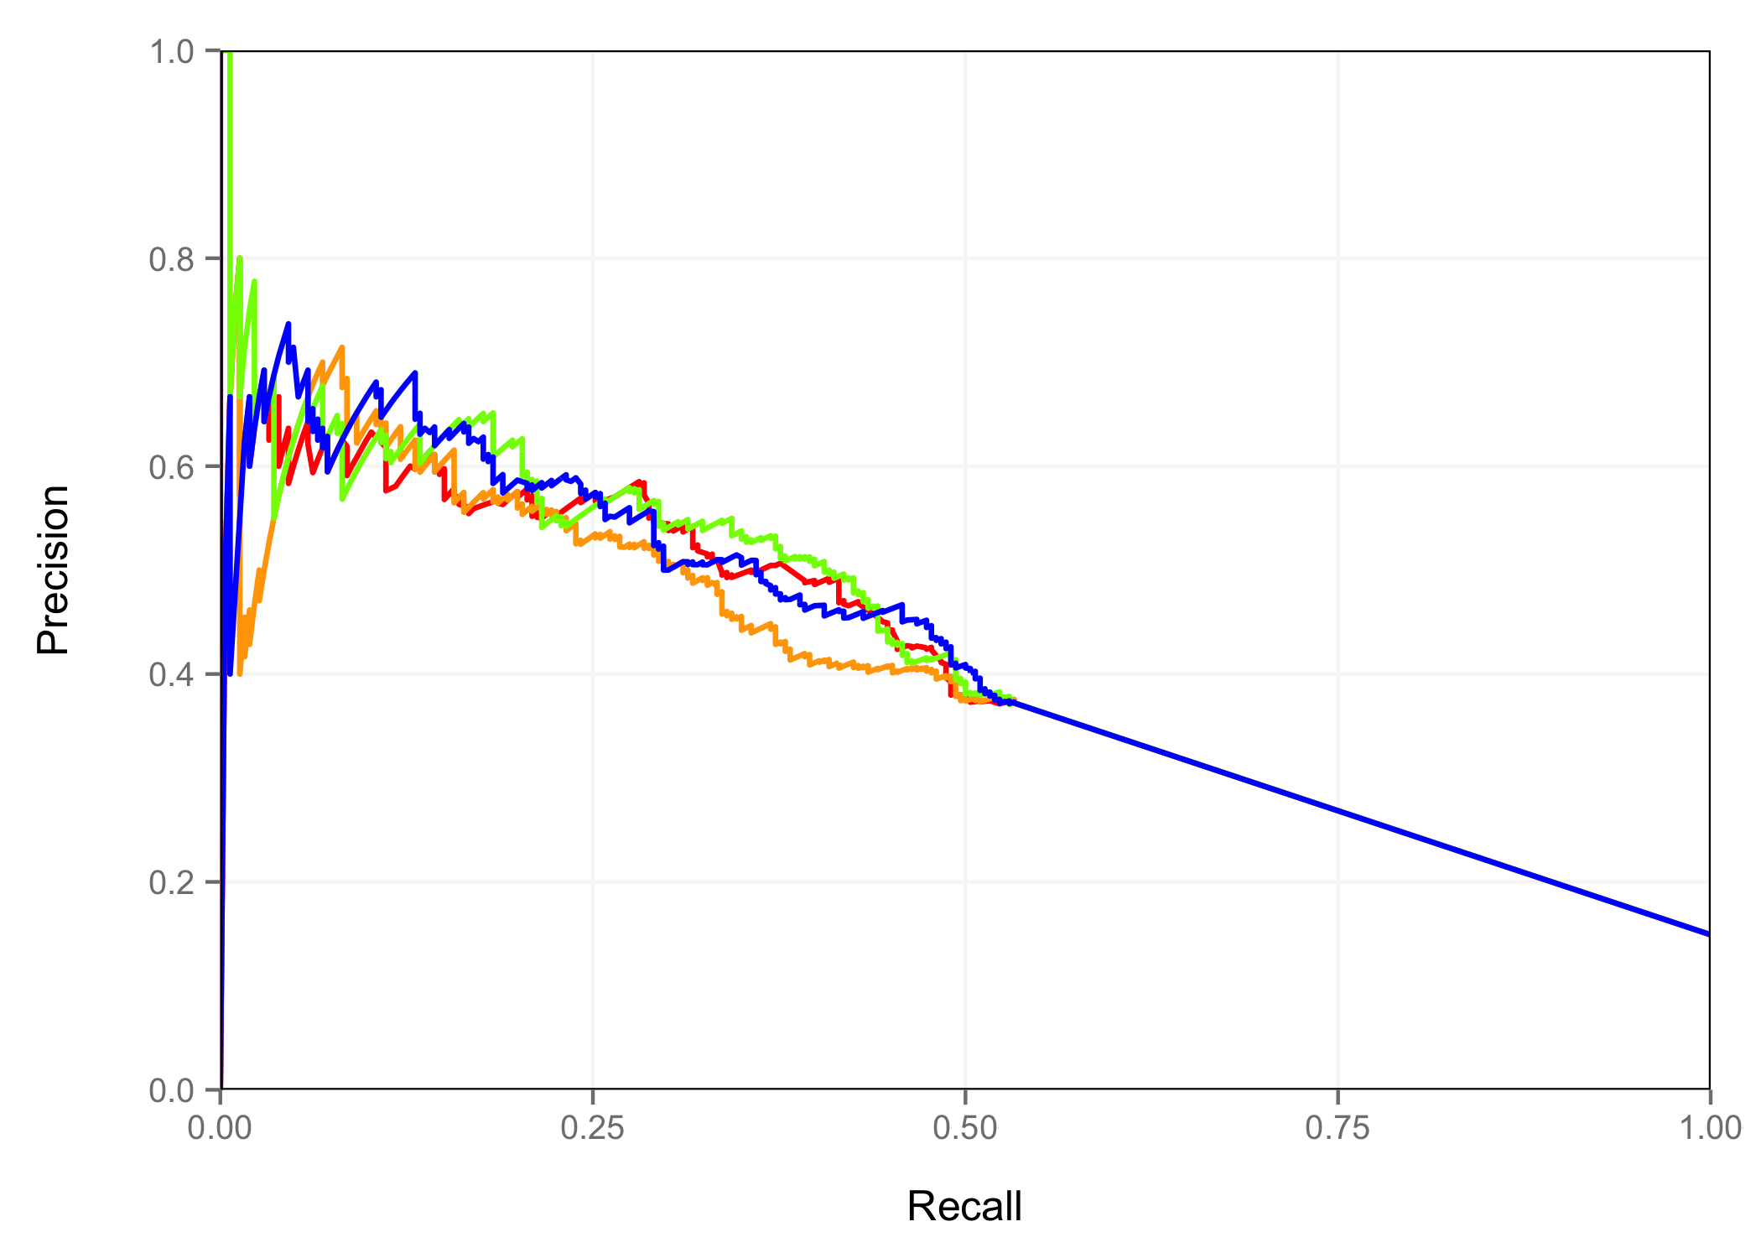
Midbrain – H3K27ac Peak Space
Peak P-value
DNase Signal
H3K27ac Signal
DNase Signal + H3K27ac Signal

Slide 16
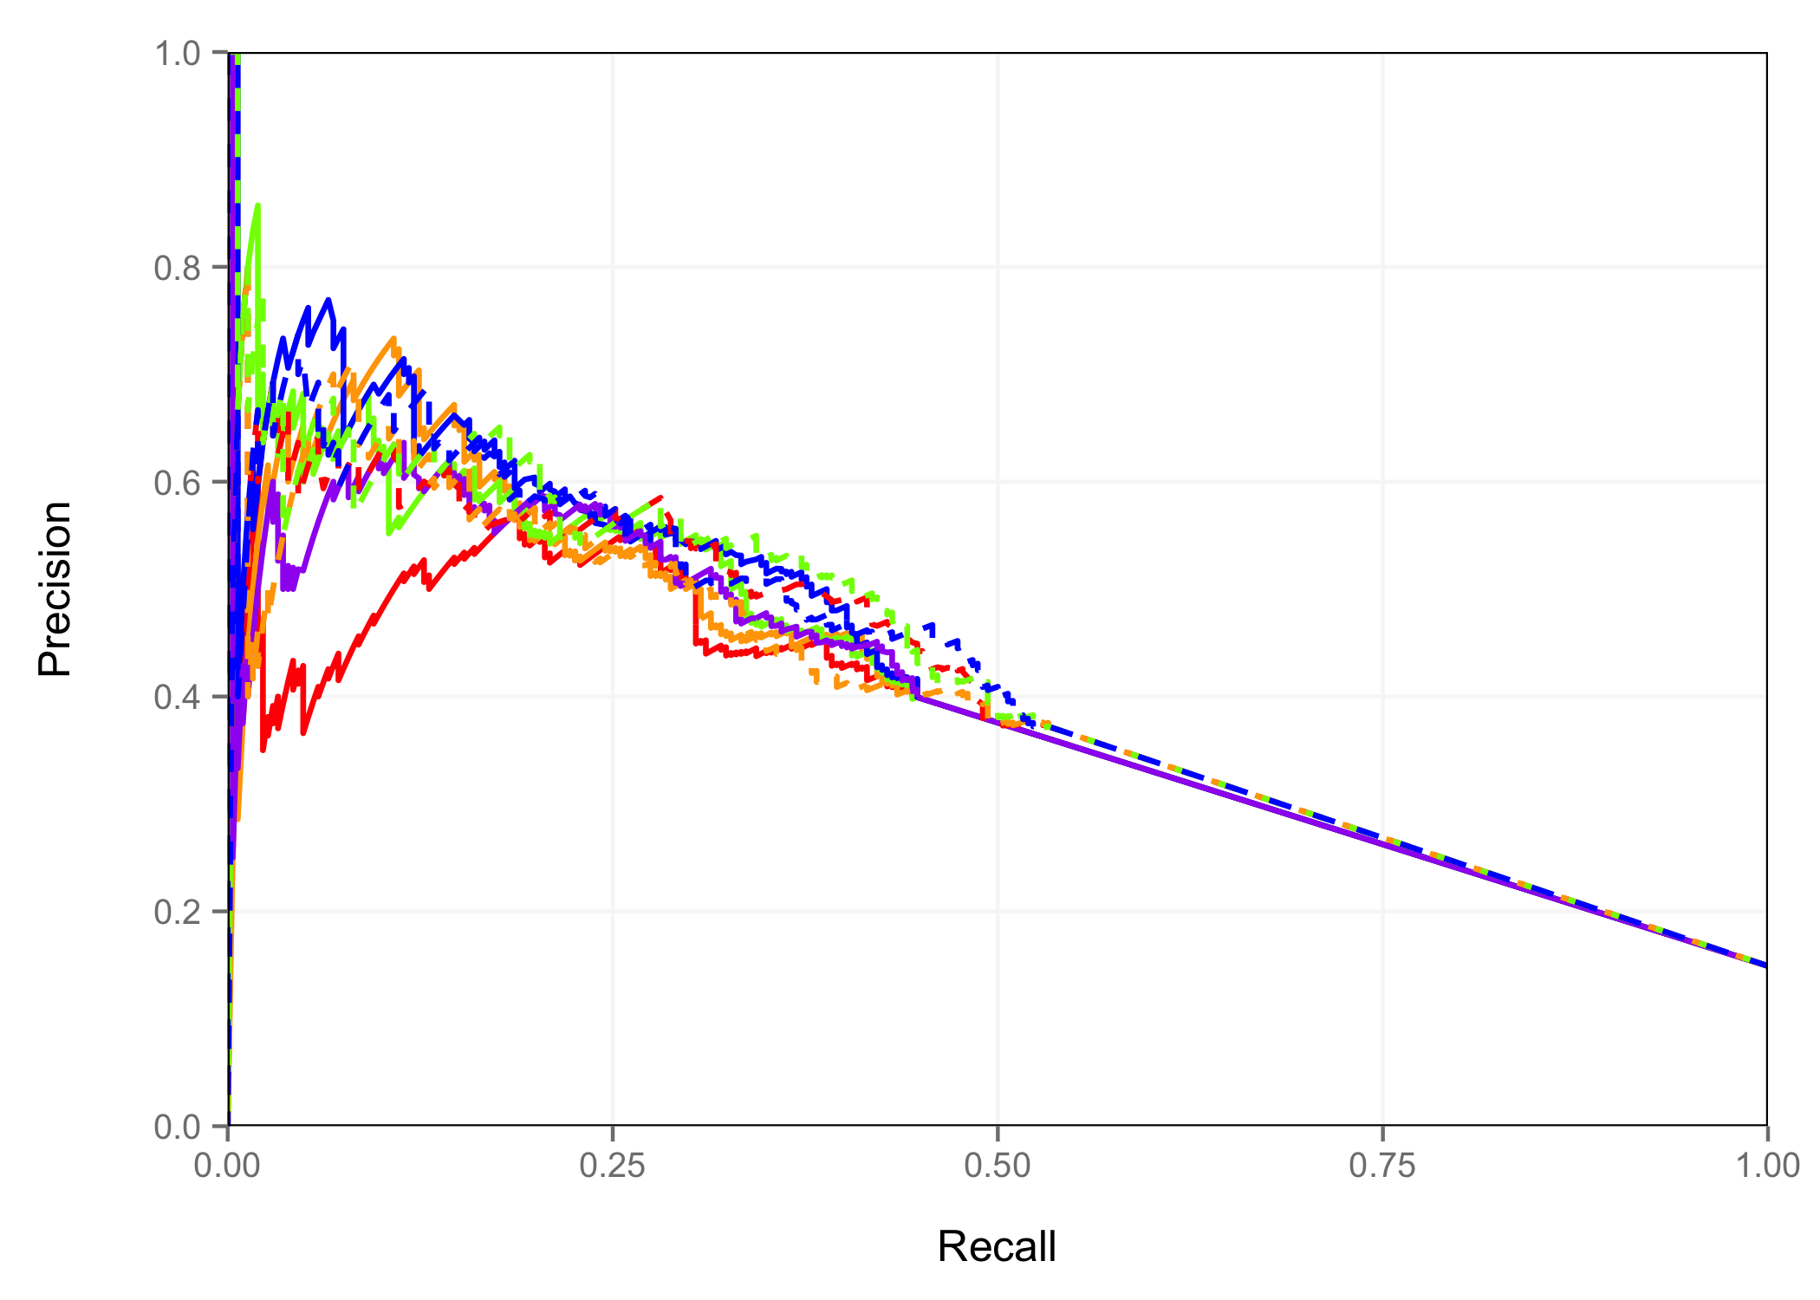
Midbrain – All Results
Peak P-value
DNase Signal
H3K27ac Signal
DNase Signal + H3K27ac Signal
DNase P-value +H3K27ac Signal
DNase Peaks
Peak P-value
DNase Signal
H3K27ac Signal
DNase Signal + H3K27ac Signal
H3K27ac Peaks

Slide 17
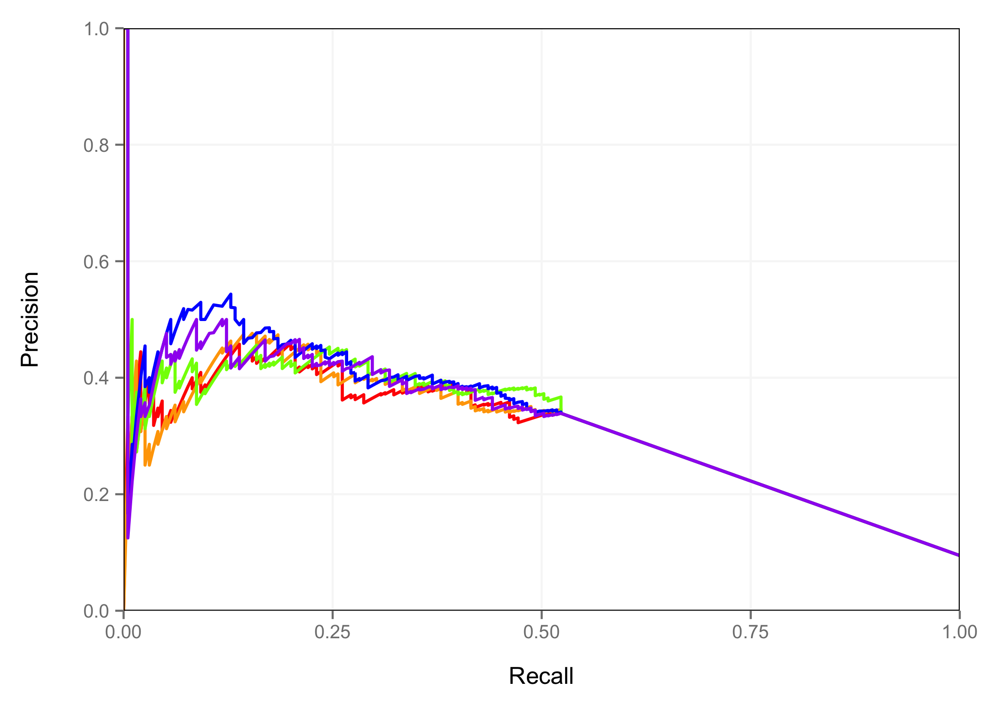
Neural Tube – DNase Peak Space
Peak P-value
DNase Signal
H3K27ac Signal
DNase Signal + H3K27ac Signal
DNase P-value +H3K27ac Signal

Slide 18
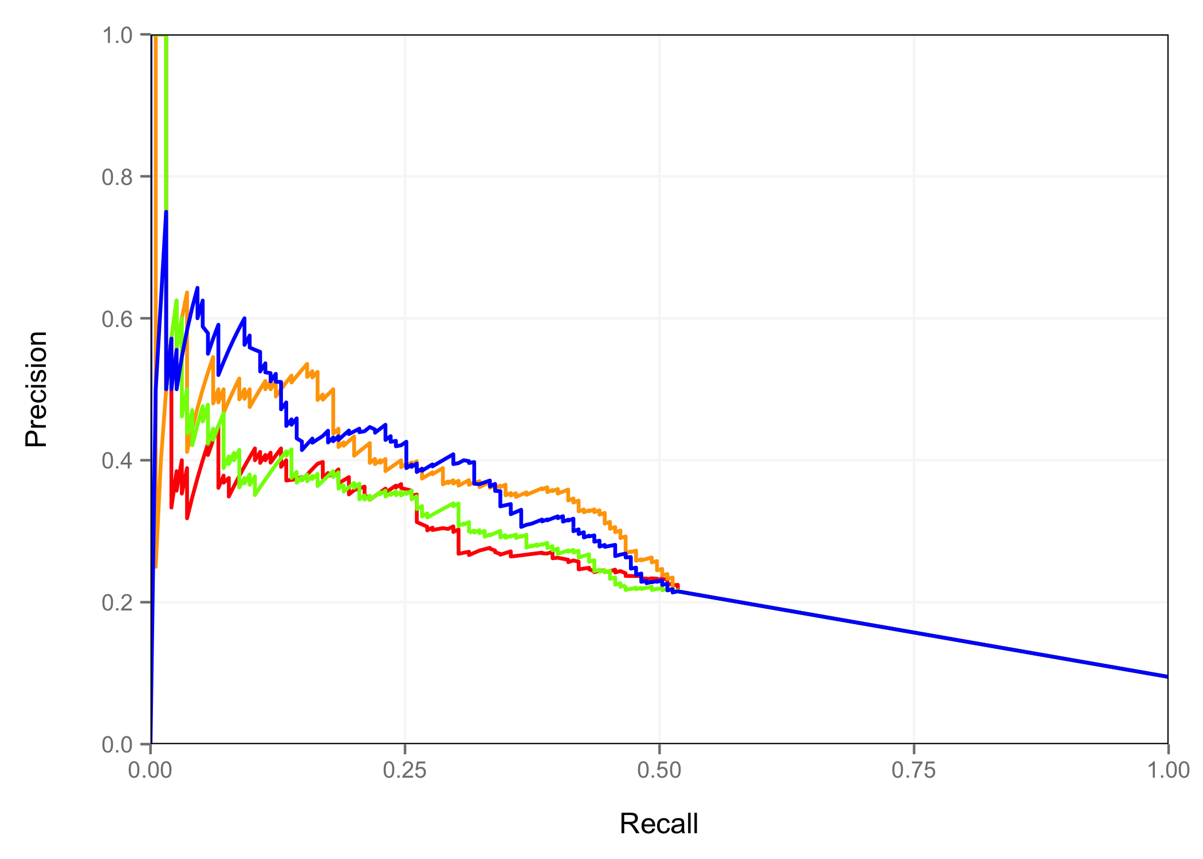
Neural Tube – H3K27ac Peak Space
Peak P-value
DNase Signal
H3K27ac Signal
DNase Signal + H3K27ac Signal

Slide 19
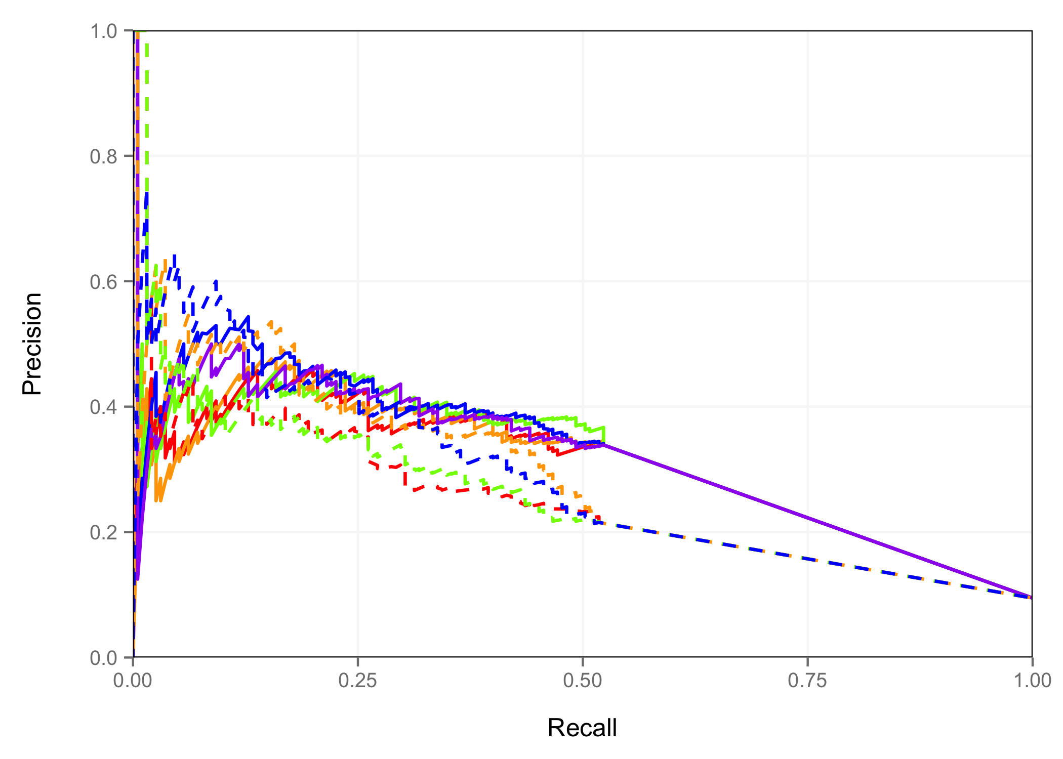
Neural Tube – All Results
Peak P-value
DNase Signal
H3K27ac Signal
DNase Signal + H3K27ac Signal
DNase P-value +H3K27ac Signal
DNase Peaks
Peak P-value
DNase Signal
H3K27ac Signal
DNase Signal + H3K27ac Signal
H3K27ac Peaks

Slide 20
Area Under PR Curves
Peak | Ranking Metric | Midbrain | Hindbrain | Neural Tube | Limb | Average
H3K27ac | H3K27ac Peak P-value | 0.4054 | 0.3141 | 0.2510 | 0.3187 | 32.23%
H3K27ac | H3K27ac Signal | 0.4180 | 0.3236 | 0.2579 | 0.3249 | 33.11%
H3K27ac | DNase Signal | 0.3935 | 0.3390 | 0.2860 | 0.3666 | 34.63%
H3K27ac | DNase & H3K27ac Signal Average Rank | 0.4114 | 0.3448 | 0.2844 | 0.3544 | 34.87%
DNase | DNase Peak P-value | 0.3646 | 0.3520 | 0.3018 | 0.3709 | 34.73%
DNase | DNase Signal | 0.3942 | 0.3480 | 0.3034 | 0.3599 | 35.14%
DNase | H3K27ac Signal | 0.4000 | 0.3457 | 0.3158 | 0.3496 | 35.28%
DNase | DNase & H3K27ac Signal Average Rank | 0.4156 | 0.3650 | 0.3272 | 0.3712 | 36.98%
DNase | DNase P-value & H3K27ac Signal Average Rank | 0.3902 | 0.3628 | 0.3172 | 0.3732 | 36.09%

Slide 21
Conclusion – Part I
1. For time point/tissue combinations with DNase data and H3K27ac data:
  center predictions on DNase peaks
  rank peaks based on an average rank of DNase and H3K27ac signal
2. For time point/tissue combinations with only H3K27ac data:
  center predictions on H3K27ac peaks
  rank peaks based on H3K27ac signal

Slide 22
Next Step - Optimizing Parameters
Width of DNase Signal
Width of H3K27ac Signal
Weights of DNase and H3K27ac ranks
Incorporating H3K4me1/2/3 and H3K9ac histone marks
Incorporating methylation data with normal and Bayesian adjusted ranking

Slide 23
Next Step - Optimizing Parameters
Width of DNase Signal
Width of H3K27ac Signal
Weights of DNase and H3K27ac ranks
Incorporating H3K4me1/2/3 and H3K9ac histone marks
Incorporating methylation data with normal and Bayesian adjusted ranking

Slide 24
Optimal Parameters
Use DNase Signal for 500bp window centered at each DNase peak
Use H3K27ac Signal for 2Kb window centered at each DNase peak (or H3K27ac peak)
Weighing DNase more in the average rank slightly helps in DNase Peak Space
Addition of methylation slightly helps in H3K27ac Peak Space
All other options decrease performance or have inconsistent improvements across tissues

Slide 25
Adjusting Weights of Average Rank –
DNase Peak Space
Note: All DNase Rep1 Peaks were used in this analysis

Slide 26
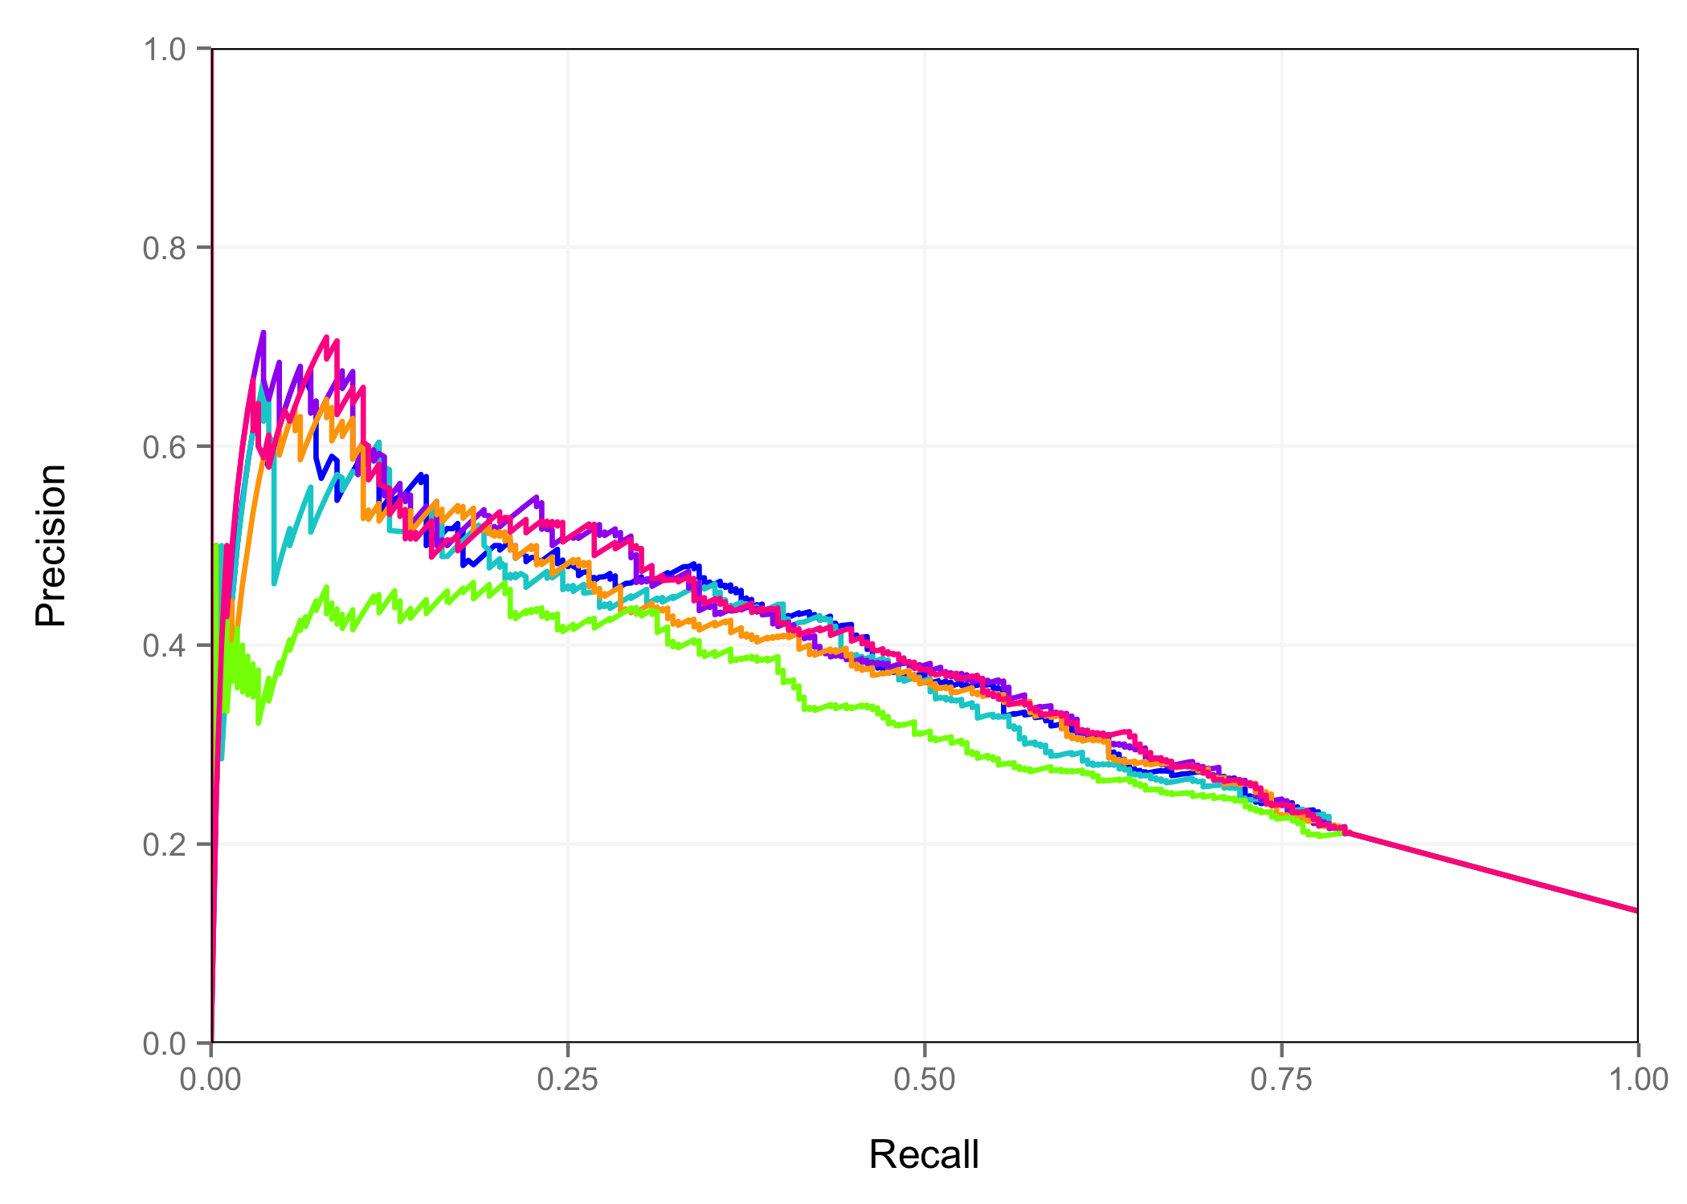
Hindbrain
DNase Signal
H3K27ac Signal
DNase Signal + H3K27ac Signal
4 x DNase Signal + H3K27ac Signal
2 x DNase Signal + H3K27ac Signal
DNase Signal + 2 x H3K27ac Signal

Slide 27
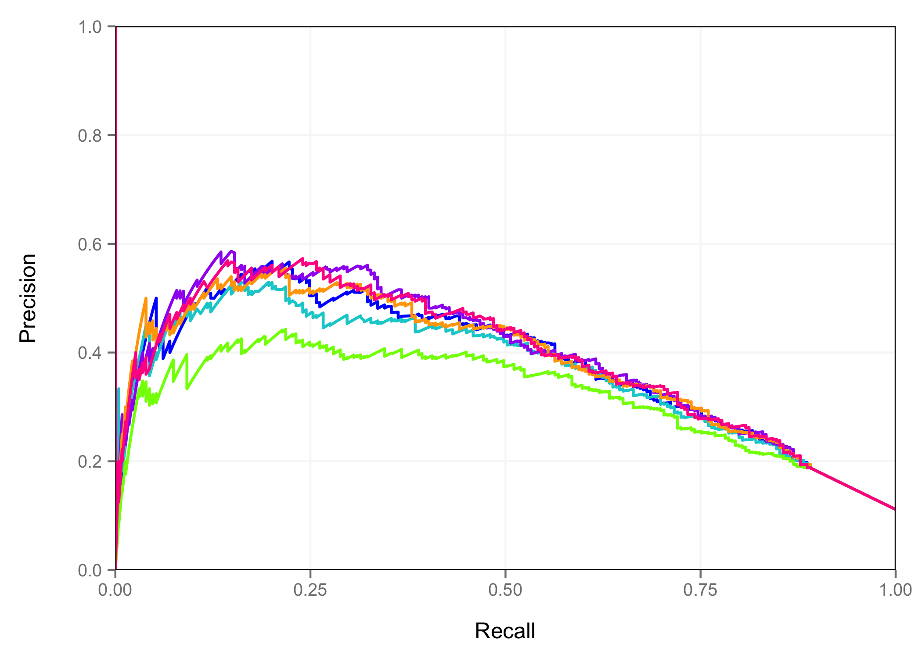
Limb
DNase Signal
H3K27ac Signal
DNase Signal + H3K27ac Signal
4 x DNase Signal + H3K27ac Signal
2 x DNase Signal + H3K27ac Signal
DNase Signal + 2 x H3K27ac Signal

Slide 28
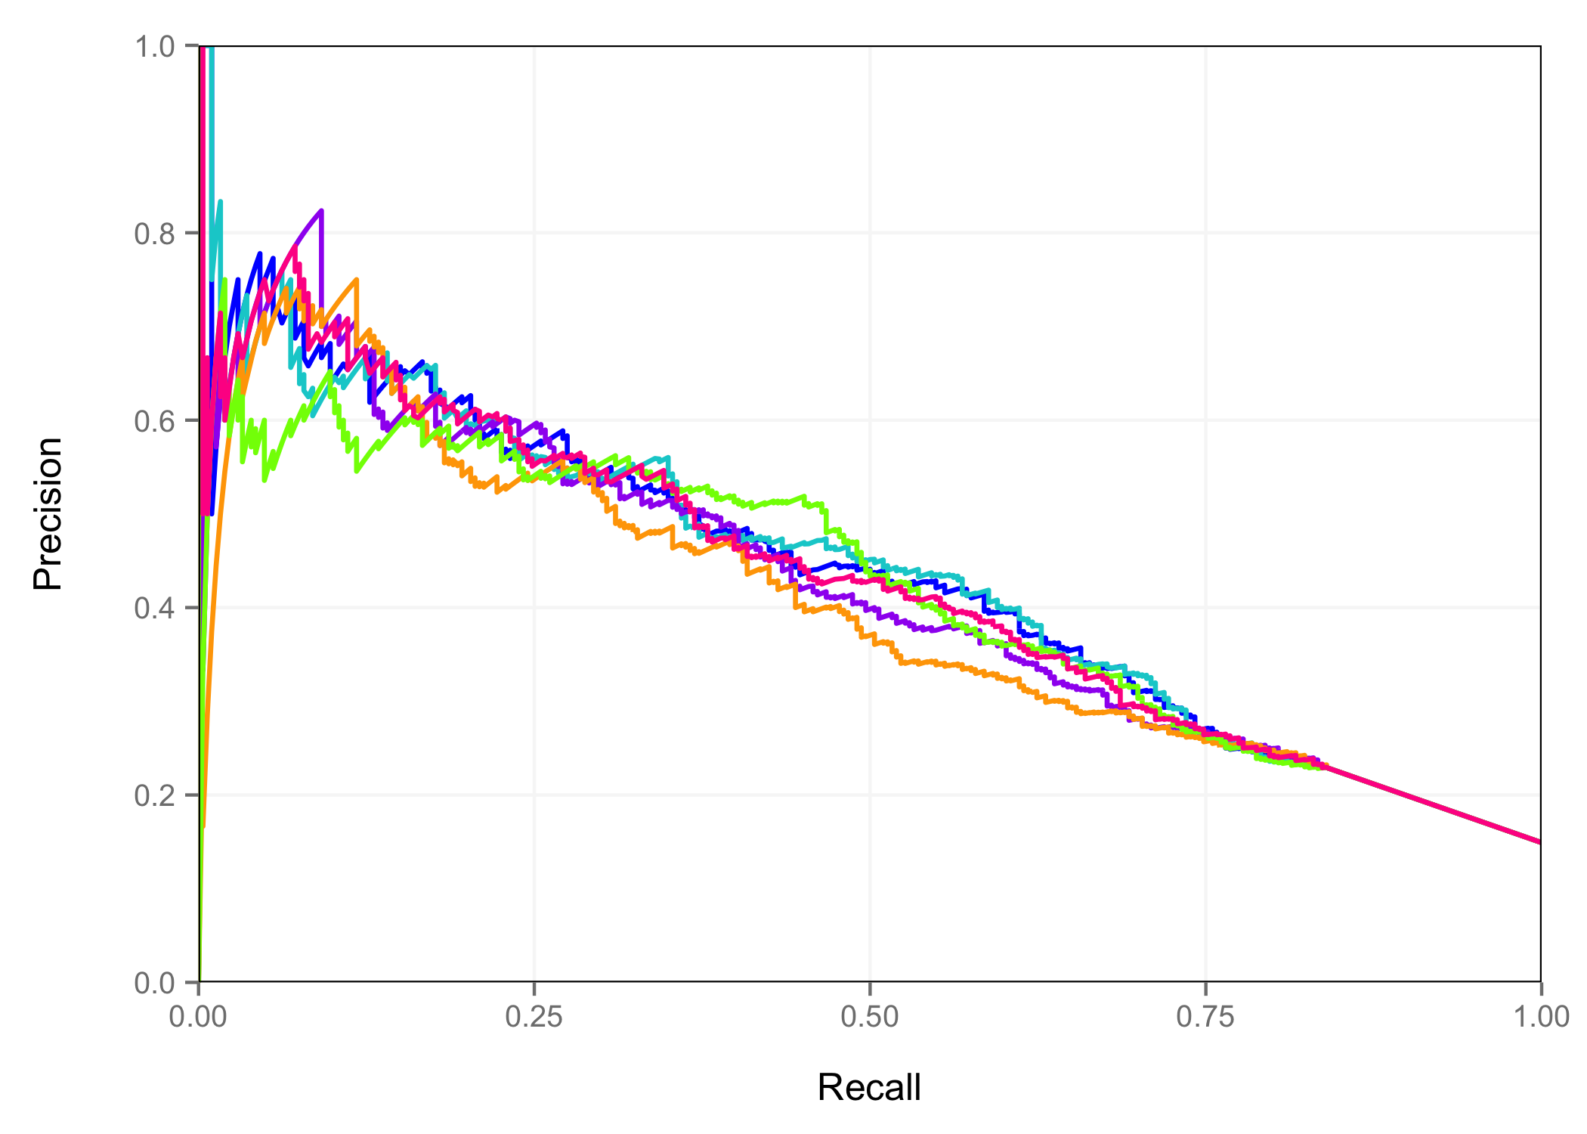
Midbrain
DNase Signal
H3K27ac Signal
DNase Signal + H3K27ac Signal
4 x DNase Signal + H3K27ac Signal
2 x DNase Signal + H3K27ac Signal
DNase Signal + 2 x H3K27ac Signal

Slide 29
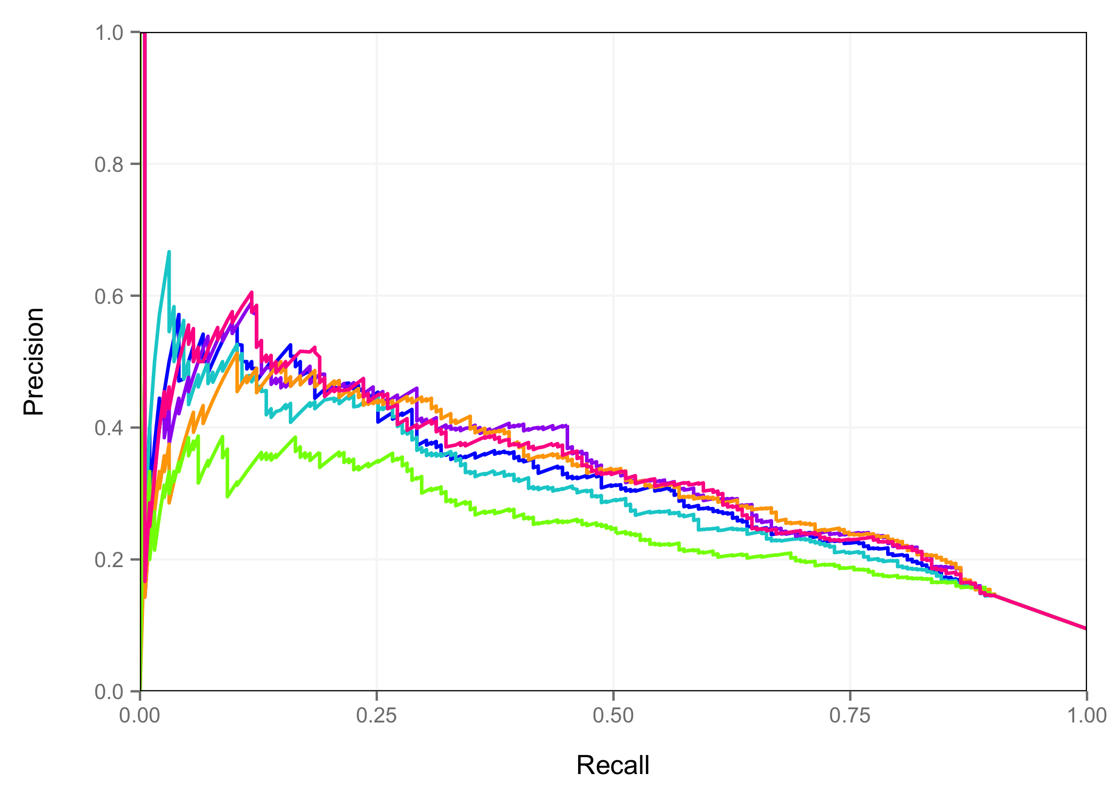
Neural Tube
DNase Signal
H3K27ac Signal
DNase Signal + H3K27ac Signal
4 x DNase Signal + H3K27ac Signal
2 x DNase Signal + H3K27ac Signal
DNase Signal + 2 x H3K27ac Signal

Slide 30
Area Under PR Curves
 | Midbrain | Hindbrain | Neural Tube | Limb | Average
Only DNase | 0.3988 | 0.3572 | 0.3182 | 0.3805 | 36.37%
4 x DNase + H3K27ac | 0.4191 | 0.3733 | 0.3295 | 0.3904 | 37.81%
2 x DNase + H3K27ac | 0.4286 | 0.3726 | 0.3318 | 0.3869 | 38.00%
DNase + H3K27ac | 0.4353 | 0.3647 | 0.3201 | 0.3780 | 37.45%
DNase + 2 x H3K27ac | 0.4363 | 0.3531 | 0.3051 | 0.3634 | 36.45%
Only H3K27ac | 0.4154 | 0.3113 | 0.2461 | 0.3190 | 32.29%

Slide 31
Methylation Results – H3K27ac Peak Space

Slide 32
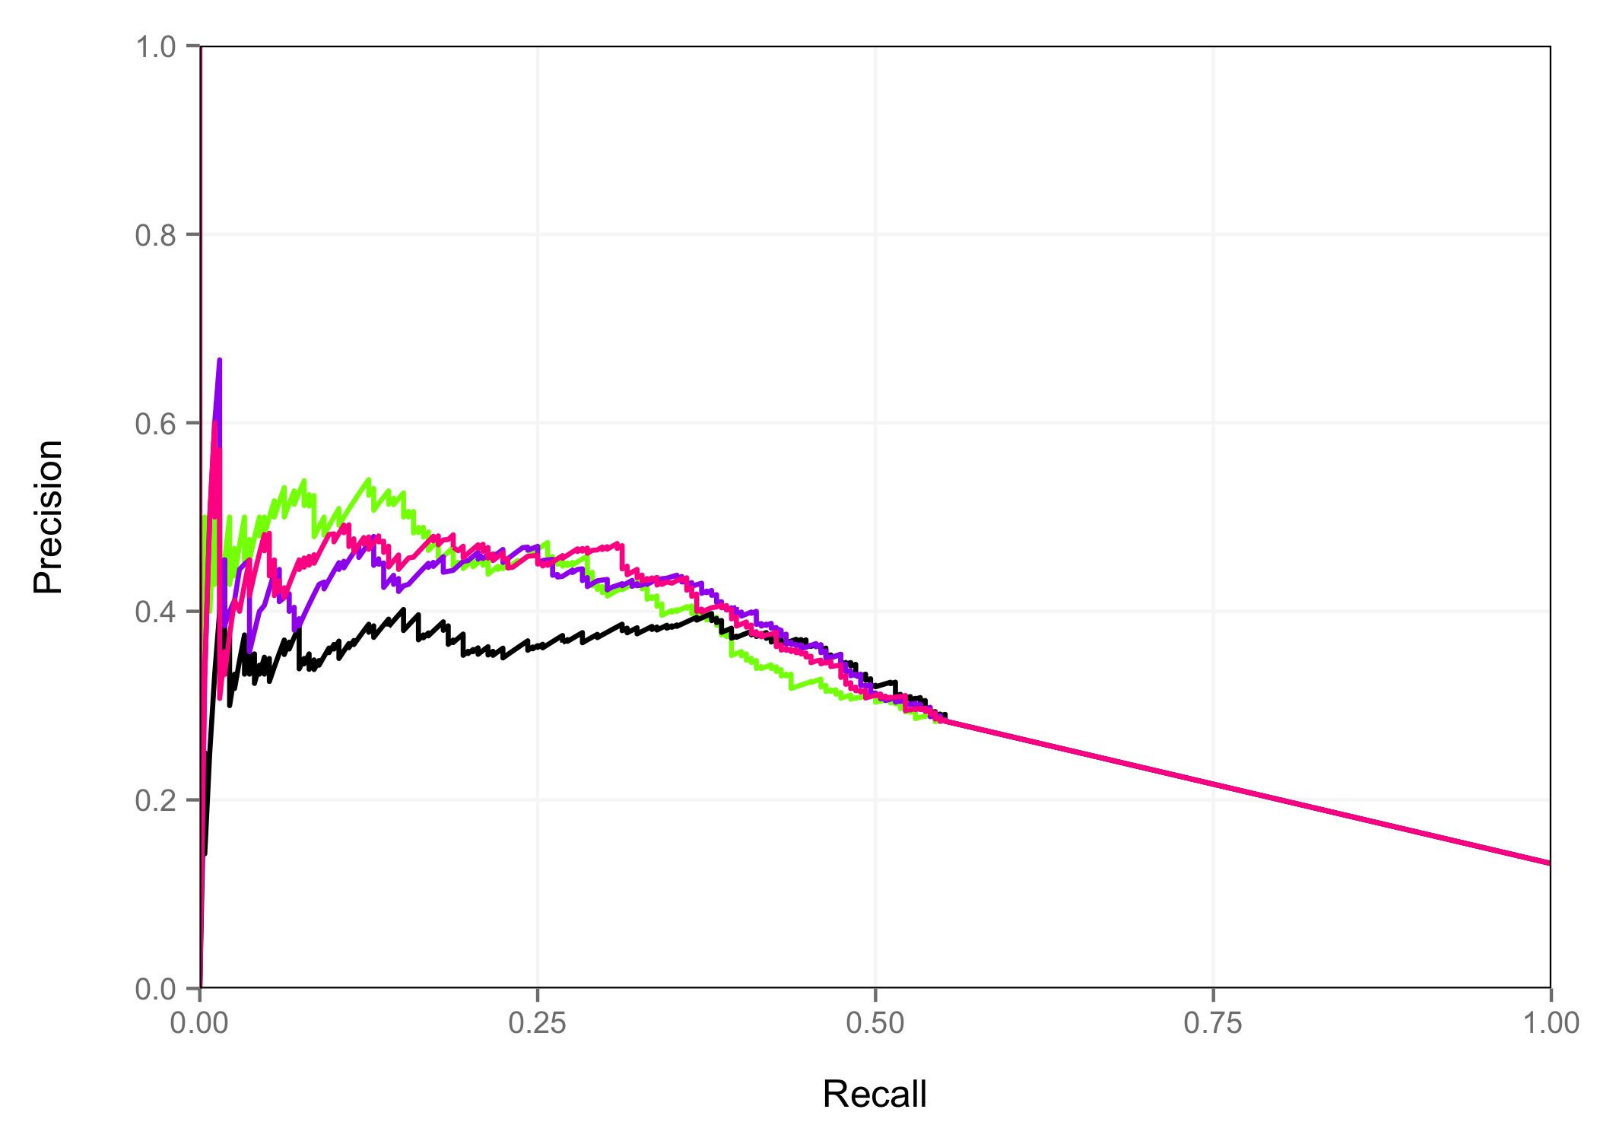
Hindbrain – H3K27ac Peak Space
H3K27ac Signal
% Methylated CpG
H3K27ac Signal + Methylation
H3K27ac Signal x 2 + Methylation

Slide 33
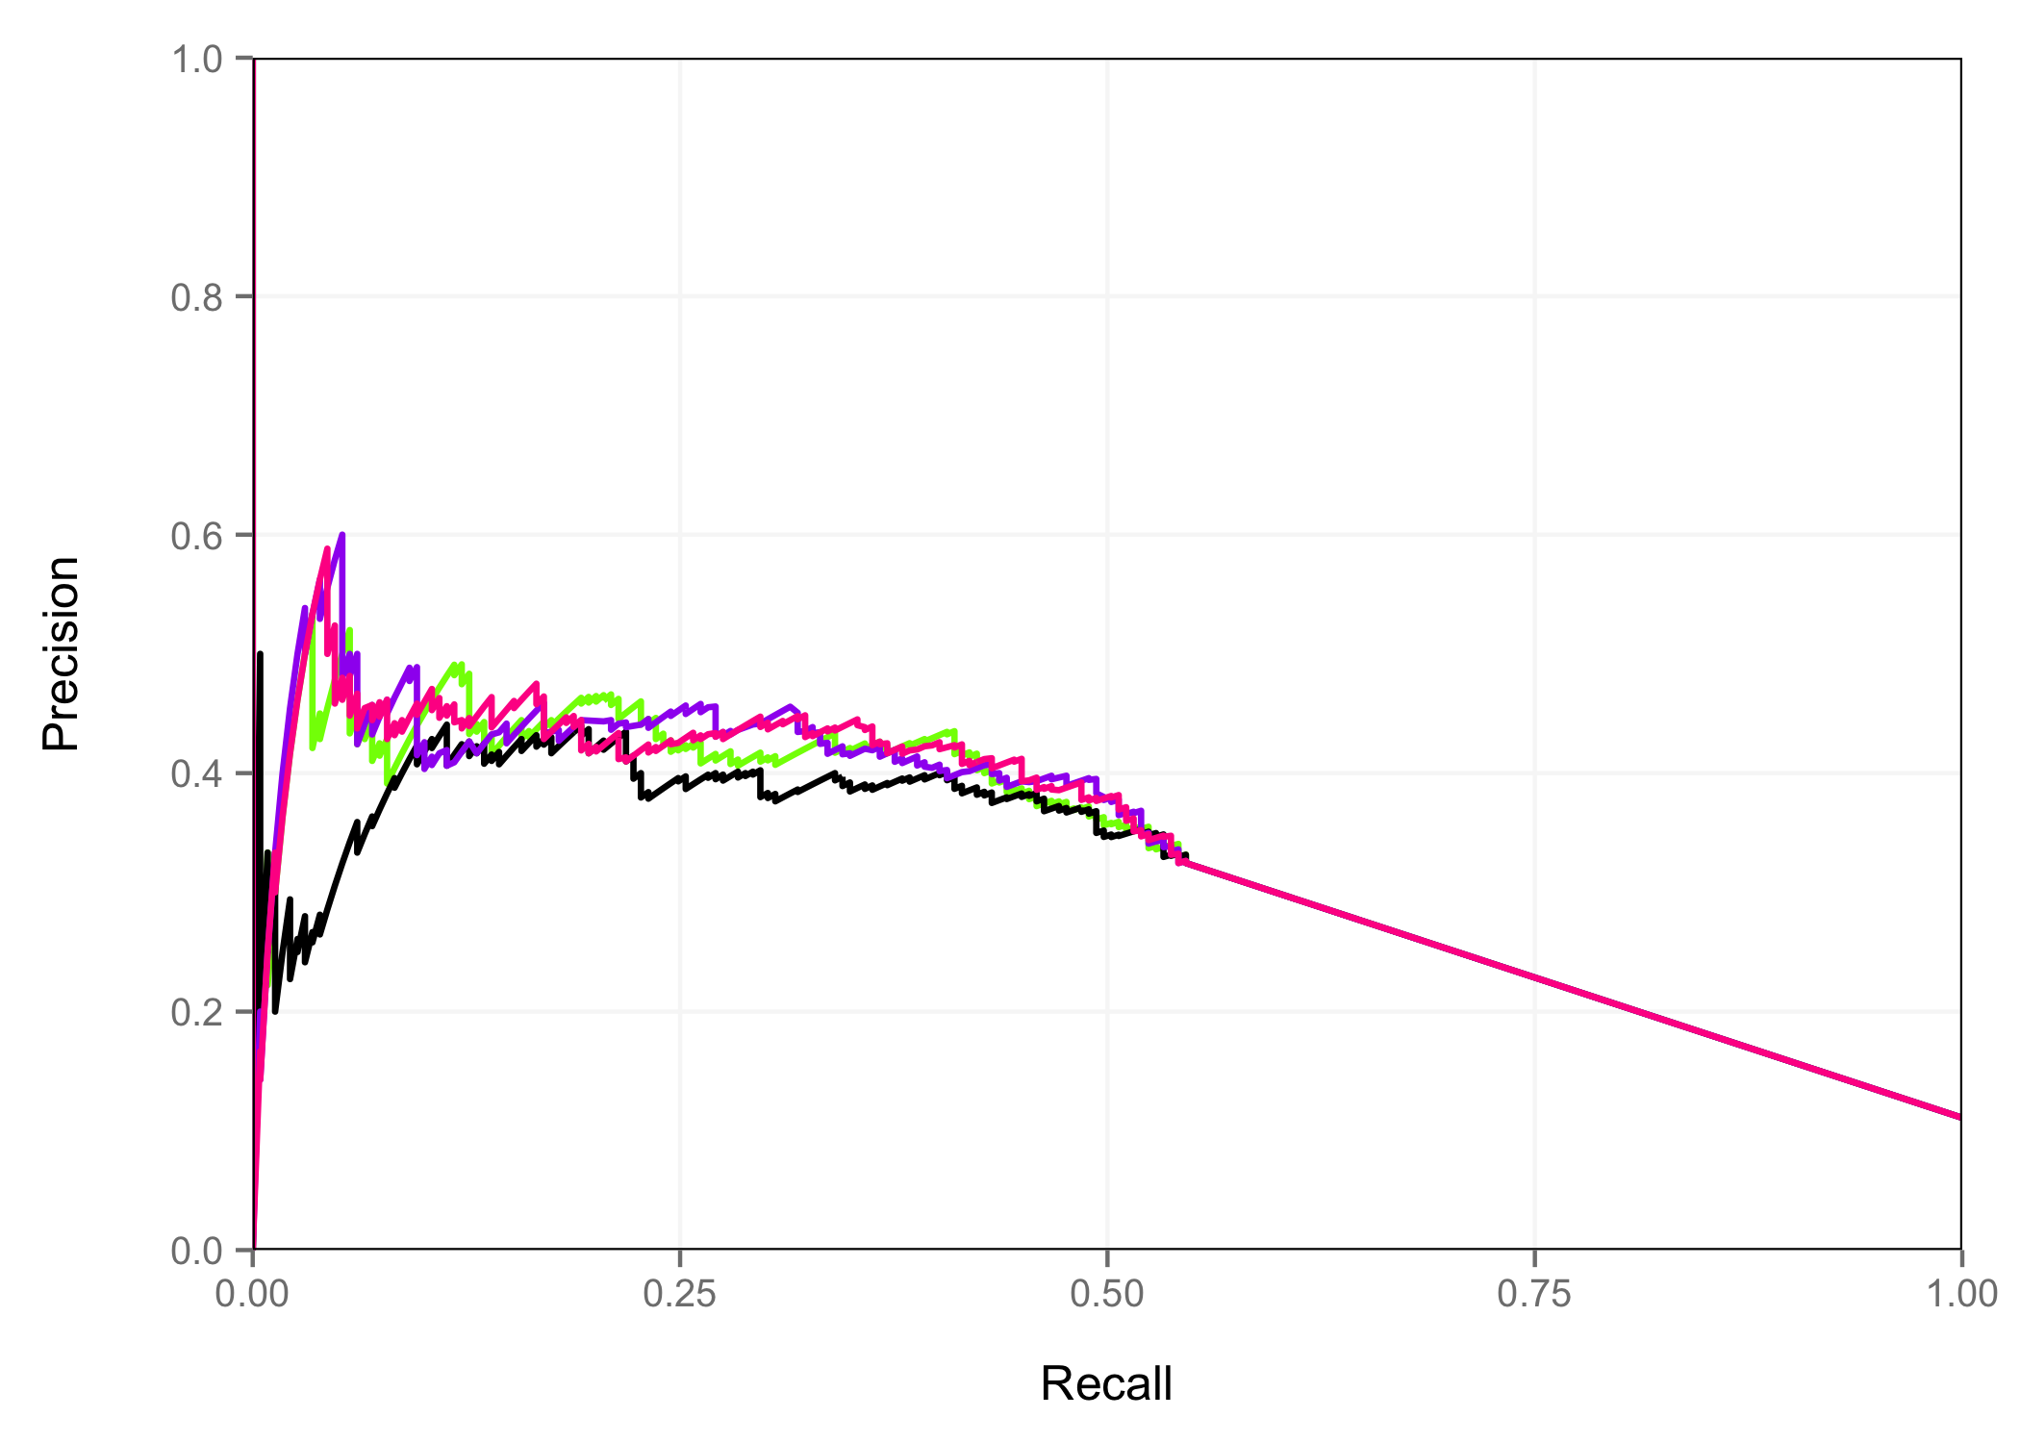
Limb – H3K27ac Peak Space
H3K27ac Signal
% Methylated CpG
H3K27ac Signal + Methylation
H3K27ac Signal x 2 + Methylation

Slide 34
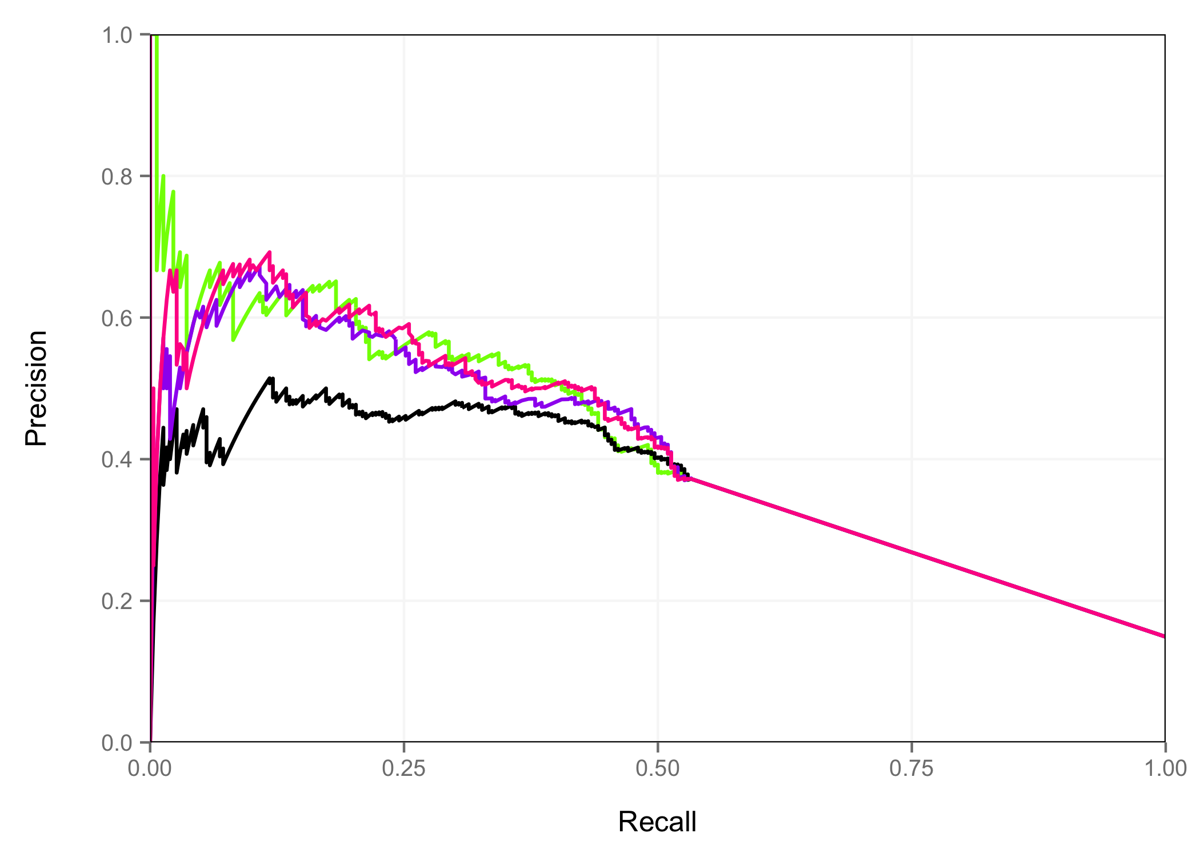
Midbrain – H3K27ac Peak Space
H3K27ac Signal
% Methylated CpG
H3K27ac Signal + Methylation
H3K27ac Signal x 2 + Methylation

Slide 35
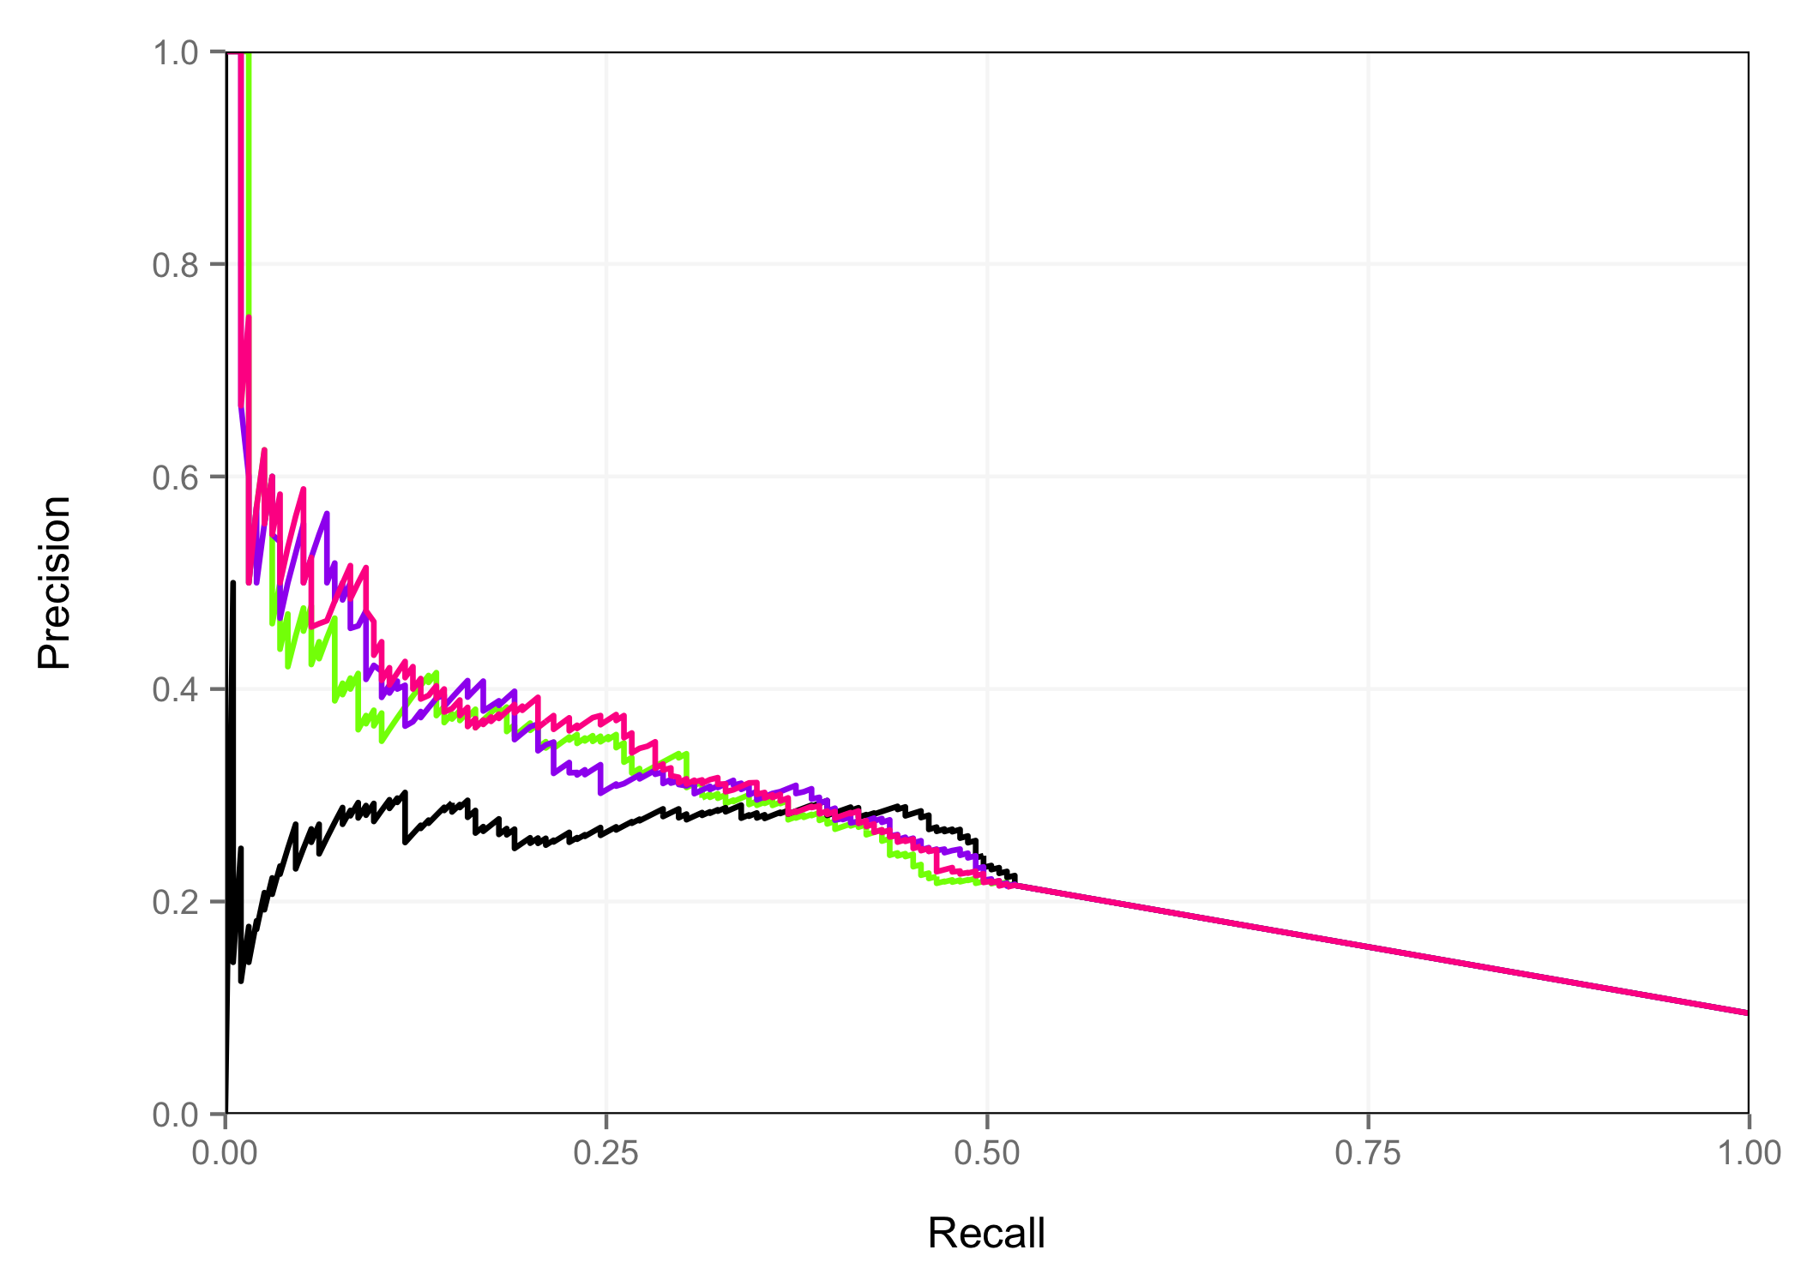
Neural Tube - H3K27ac Peak Space
H3K27ac Signal
% Methylated CpG
H3K27ac Signal + Methylation
H3K27ac Signal x 2 + Methylation

Slide 36
Area Under PR Curves
 | Midbrain | Hindbrain | Neural Tube | Limb | Average
H3K27ac Signal Only | 0.4180 | 0.3236 | 0.2579 | 0.3249 | 33.11%
Methylation Only | 0.3605 | 0.2912 | 0.2135 | 0.3057 | 29.27%
H3K27ac + Methylation | 0.4038 | 0.3191 | 0.2624 | 0.3289 | 32.85%
2 x H3K27ac + Methylation | 0.4114 | 0.3225 | 0.2663 | 0.3285 | 33.22%

Slide 37
Conclusion – Part II
1. For time point/tissue combinations with DNase data and H3K27ac data:
  center predictions on DNase peaks
  rank peaks based on an average rank of DNase x 2 + H3K27ac signal
2. For time point/tissue combinations with only H3K27ac data:
  center predictions on H3K27ac peaks
  rank peaks based on an average rank of H3K27ac signal x 2 + CpG % methylation

