Slide 1
Acyl-CoA-dehydrogenase deficiency
PDB | SNPs | ResPos | origRes | mutRes
2VIG | chr12:121176108:T:G | 217 | MET | ARG | -1.802
2VIG | chr12:121174892:T:A | 105 | ILE | ASN | -2.855
2VIG | chr12:121176421:C:A | 294 | ALA | ASP | -1.728
2VIG | chr12:121177182:C:G | 390 | ILE | MET | -2.909
2VIG | chr12:121177150:C:T | 380 | ARG | TRP | -5.352
2VIG | chr12:121175763:C:T | 199 | ALA | VAL | 0.693
2VIG | chr12:121176633:C:T | 315 | ALA | VAL | 0.297
HGMD SNP disrupting core residues to different extent in a particular disease
8

Slide 2
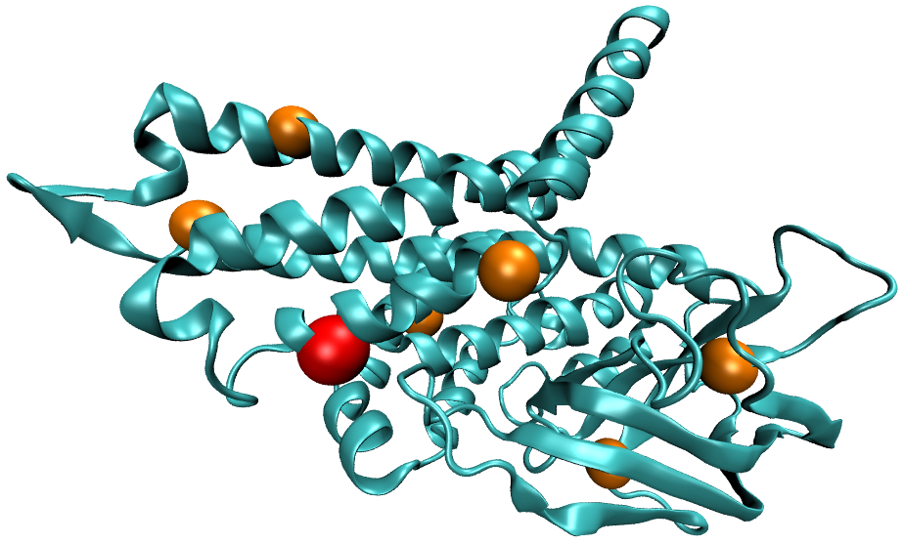
Acyl-CoA-dehydrogenase deficiency
8

Slide 3
Autoimmune Lymphoproliferative Syndrome
PDB | SNPs | ResPos | origRes | mutRes
3EZQ | chr10:90773977:G:A | 260 | ASP | ASN | -0.615
3EZQ | chr10:90773978:A:G | 260 | ASP | GLY | -2.129
3EZQ | chr10:90773977:G:C | 260 | ASP | HIS | -1.355
3EZQ | chr10:90774008:C:T | 270 | THR | ILE | 0.396
3EZQ | chr10:90774008:C:A | 270 | THR | LYS | -0.044
3EZQ | chr10:90774002:A:C | 268 | GLN | PRO | -0.334
3EZQ | chr10:90774050:T:C | 284 | LEU | PRO | 0.015
3EZQ | chr10:90773977:G:T | 260 | ASP | TYR | -4.995
3EZQ | chr10:90773978:A:T | 260 | ASP | VAL | -2.193
HGMD SNPs disrupting surface residues to different extent.
9

Slide 4
Autoimmune Lymphoproliferative Syndrome
9

Slide 5
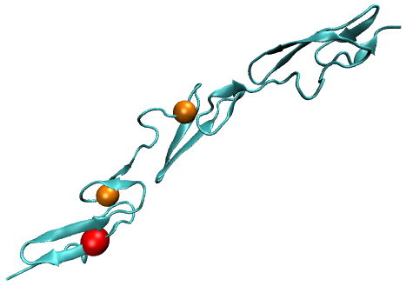
TSG Driver disrupting core residues : NOTCH1 gene
PDB | SNPs | ResPos | origRes | mutRes |  | cancerType
2VJ3 | chr9:139412263:C:T | 461 | CYS | TYR | -2.813 | Head & Neck
2VJ3 | chr9:139412359:C:T | 429 | CYS | TYR | -3.477 | Head & Neck
2VJ3 | chr9:139412360:A:T | 429 | CYS | SER | -1.572 | Lung
2VJ3 | chr9:139412299:C:T | 449 | CYS | SER | -1.085 | Head & Neck
12

Slide 6
Oncogene Driver disrupting surface residues : KRAS gene
PDB | SNPs | ResPos | origRes | mutRes |  | cancerType
4DSO | chr12:25398213:T:A | 36 | ILE | LEU | -0.928 | Esophageal
4DSO | chr12:25380240:C:A | 73 | ARG | MET | -2.495 | Astrocytoma
4DSO | chr12:25398211:T:C | 36 | ILE | MET | -3.631 | AML
4DSO | chr12:25378603:T:C | 132 | ASP | GLY | -1.408 | Stomach
12

