Slide 1
Somatic Mutations Analysis for IBC WGS data
December 22, 2015
Xiaotong Li

Slide 2
Background
Inflammatory Breast Cancer (IBC)^{[1]}
Rare (1%~4%) & Aggressive
Affects young patients population
Standard breast cancer risk factors NOT applicable
NO known risk factors specified to IBC
Recurrence and/or metastases
5-year survival rate: limited to 40%^{[2]}
Whole genome sequencing on 20 IBC samples
Matched tumor-normal pairs
Coverage: tumor sample: 60X; normal sample: 60X(the first two) /40X

Slide 3
Somatic SNV for IBC Samples (average)
Somatic variant | 5941 (4030)* (min: 1109; max: 24815; median: 3865)
Coding variants | 53 (56)
Non-coding variants | 5888 (3974)
Non-coding variants
TFP (transcription factor binding peak) | 693 (544)
TFM (transcription factor bound motifs in peak regions) | 19 (17)
Target gene (TF regulating known cancer gene) | 18 (15)
DHS (DNasel hypersensitive sites) | 795 (616)
ncRNA (non-coding RNA) | 16 (14)
Pseudogene | 15 (17)
Enhancer | 318 (253)
Coding variants
synonymous | 14 (16)
nonsynonymous | 37 (36)
prematureStop | 2 (3)
*:Average number of five ER+HER2- samples
Notes:
Deoxyribonuclease I
IBC-312
base number for each category/annotation

Slide 4
Somatic SNV for IBC Samples (average)
Somatic variant | 5941 (4030)* (min: 1109; max: 24815; median: 3865)
Coding variants | 53 (56)
Non-coding variants | 5888 (3974)
Network hubs
PPI (protein protein interaction network ) | 1833 (1302)
REG (regulatory network) | 1024 (741)
PHOS (phosphorylation network) | 296 (207)
Motif analysis
Motif Gain | 29 (16)
Motif Breaking | 16 (15)
*:Average number of five ER+HER2- samples

Slide 5
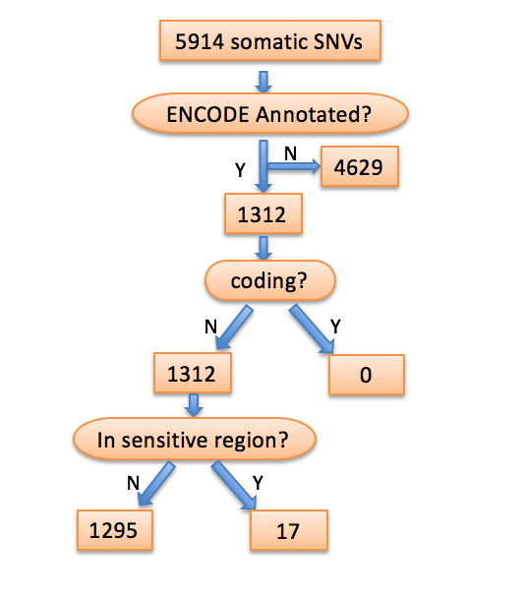
Filtering of somatic variants for identification of candidate drivers
20 IBC samples (average)

Slide 6
In sensitive region?
N
Y
1295
17
Breaks TF motif?
In ultra-sensitive region?
N
Y
N
Y
1282
13
15
2
Target gene known?
Breaks TF motif?
N
Y
N
Y
7
6
2
0
Target gene is a hub?
Target gene known?
N
Y
1
5
Target gene is a hub?
recurrent?

Slide 7
Base substitution mutation spectra

Slide 8
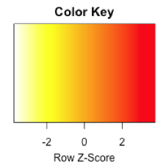
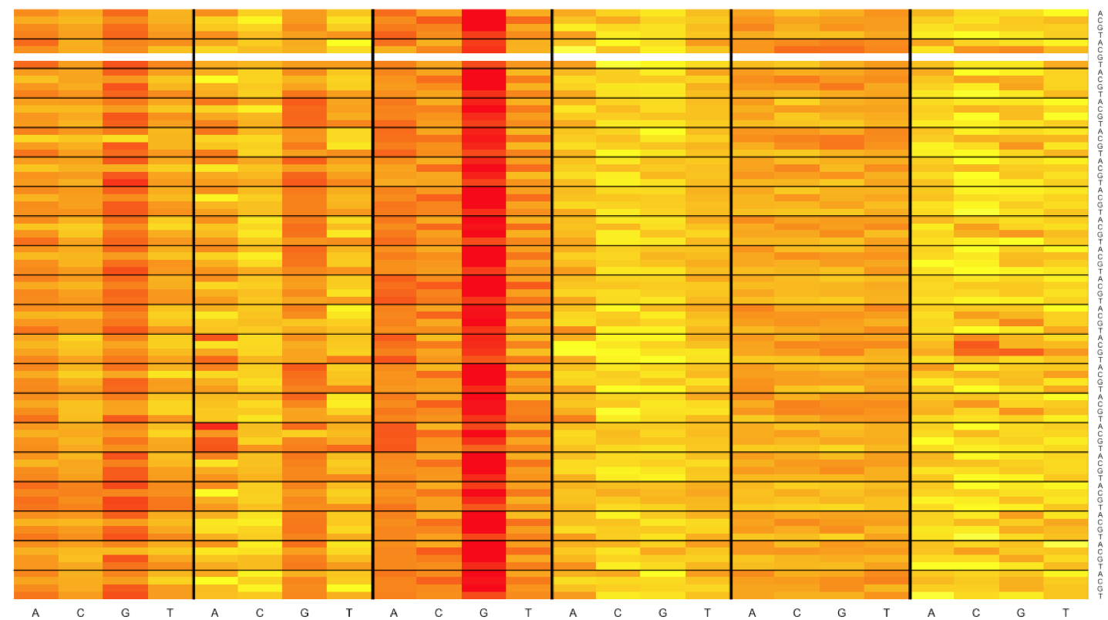
Genomic heatmap for base substitution frequency at tri-nucleotides context
“XpYpZ” triplet
Y: Mutated base
X,Z: Any base
Mutation type
C>A C>G C>T T>A T>C T>G
Five prime base
Three prime base

Slide 9
Inferring Mutational Signatures

Slide 10
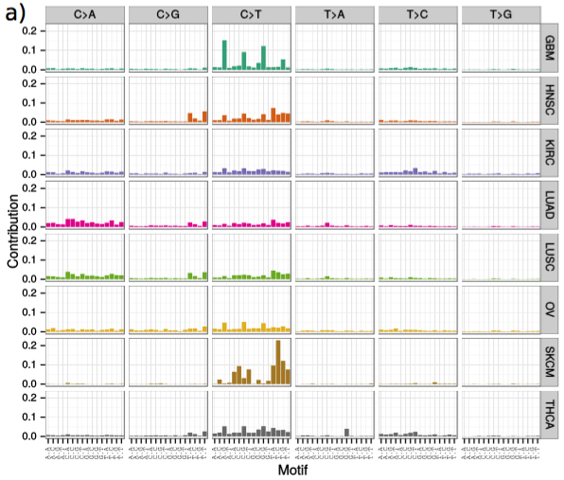
Inferring mutational signatures from SNVs
Example: eight cancer types (whole-exome sequenced samples)
Fig. a Observed mutational spectrum of each study

Slide 11
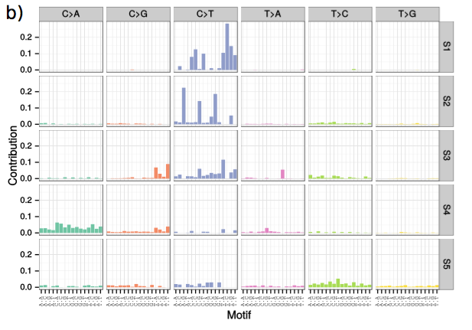
Inferring mutational signatures from SNVs
Decompose the mutational spectra into five mutational signatures

Slide 12
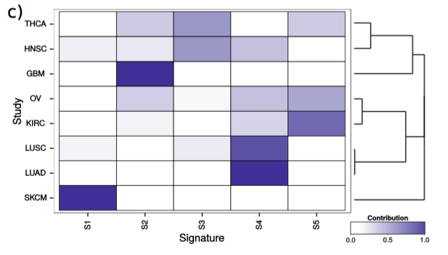
Inferring mutational signatures from SNVs
Hierarchical clustering based on the presence of signatures in each study
Underlines the similarities in mutational processes of biologically related cancer types
Cancer types: - GBM: glioblastoma multiforme - HNSC: head and neck squamous cell carcinoma
- KIRC: kidney chromophobe - LUAD: lung adenocarcinoma - LUSC: lung squamous cell carcinoma - OV: ovarian serous cystadenocarcinoma - SKCM: skin cutaneous melanoma - THCA: thyroid carcinoma

Slide 13
Inferring mutational signatures from SNVs
IBC samples
decipher mutational signatures
hierarchical clustering (ages; ER status; PR status; HER2 status, etc.)
IBC samples vs. Non-IBC samples
decipher mutational signatures
hierarchical clustering

Slide 16
When run Funseq, ensure the input file and output file have the same number of genes, especially when run it with multiple samples

Slide 17
5914 somatic SNVs
ENCODE Annotated?
Y
N
4629
1312
coding?
N
Y
1312
0
In sensitive region?
N
Y
1295
17
Breaks TF motif?
In ultra-sensitive region?
N
Y
N
Y
1282
13
15
2

