Slide 1
P2-TECH
16 Dec 2015
Dan Spakowicz

Slide 2
Chupp Asthma Project -- Samples
168 single cell RNAseq
96 for sample prep 790 (higher quality)
72 for sample prep 791 (lower quality)
20 bulk-cell RNAseq sample
Cell counts and viabilities
88 new Microarray samples

Slide 3
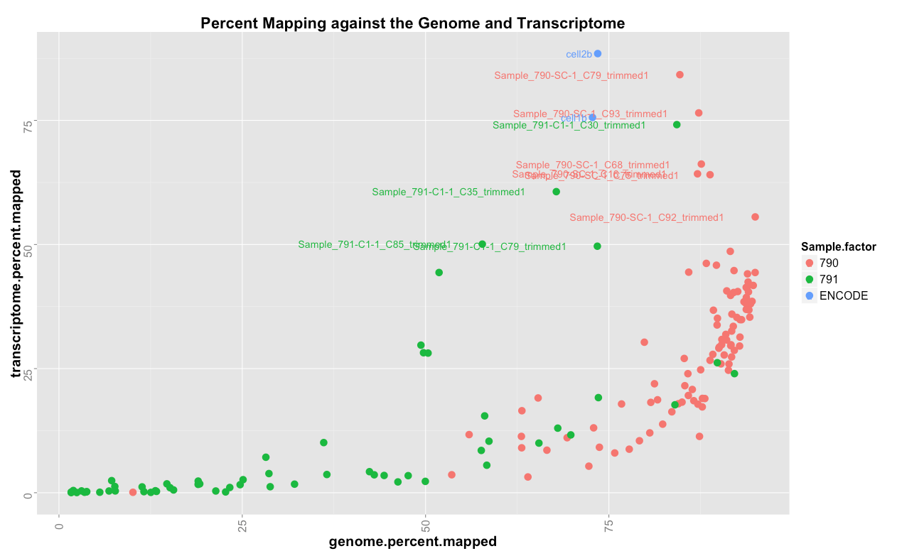
Percent of reads mapping to the genome and transcriptome
Notes:
check the total number of transcriptome reads

Slide 5
What are the unmapped reads?
Randomly sample and BLAST
1)
2)
3)
4)

Slide 7
Notes:
where do the reads that map to the genome go?

Slide 8
40 most abundant matches
Notes:
Punctuated by large amounts of one taxon in one sample, 75th percentile

Slide 9
What are the unmapped reads?
Sample 791-C78
Randomly sample and BLAST
input_to_exogenous_genomes 1264395
exogenous_genomes 735
1)
2)
3)
4)
Notes:
metazoans not in the exceRpt pipeline

Slide 11
Samples with fewer reads are more likely to have a higher fraction that map to exogenous genomes

