Slide 1
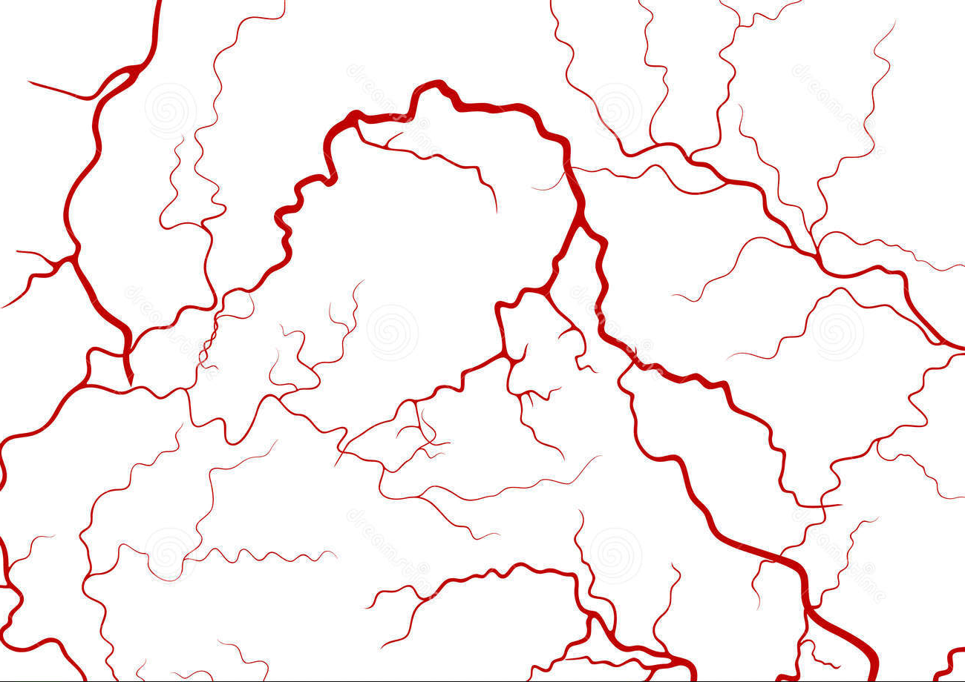
Exploration of miRNA regulation of endothelial cell
MTG GMT Dec 11, 2015

Slide 2
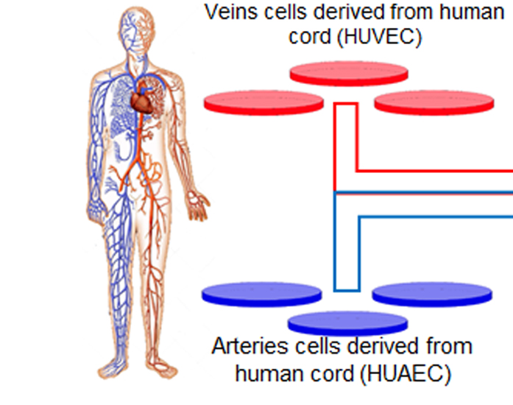
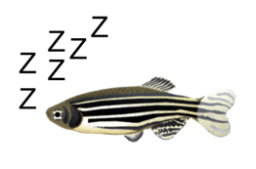
Development of Arteries and Veins
HITS-CLIP for arteries and veins:
Arteries_E1
Arteries_E3
Veins_E2 *
Veins_E3
+
Arteries_L1
Veins_L2
High throughput sequencing data of:
miRNA – seq
4 stages of zebrafish development
And zebrafish organs
mRNA by Giraldez lab
Notes:
Collaborate with a lab at Yale Cardiovascular Research Center, work with zebrafish to characterize small non-coding RNAs as regulators of vascular development. We would like to identify miRNAs-mRNAs interactions that are conserved between human and zebrafish blood vessels.

Slide 3
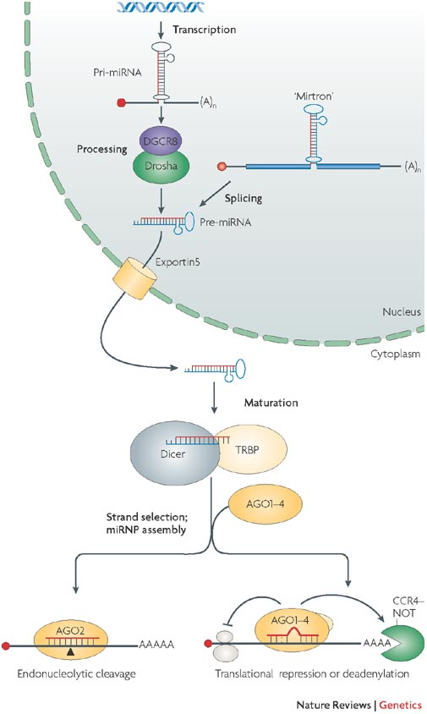
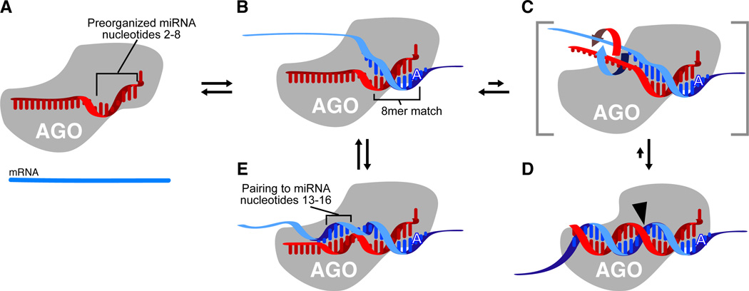
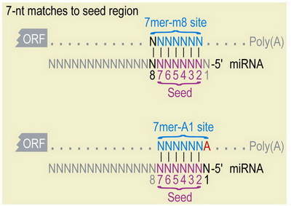
Filipowicz W, et al. Nature Reviews Genetics, 2008
Notes:
MicroRNAs are expressed as autonomous transcripts (pri-miRNA)
The Drosha complex processes pri-miRNAs into hairpin miRNA precursors (pre-miRNAs) in the nucleus
then Dicer cleaves these pre-miRNAs into double stranded 22 nucleotide miRNA in the cytoplasm.
The mature strand from the resulting duplex microRNA is subsequently incorporated into a ribonucleoprotein silencing complex (RISC) and used as a complementary guide sequence that binds to sites in the 3’UTR of a target mRNA.
Upon RISC binding, a target transcript is deadenylated leading to its degradation and translational repression
miRNAs regulate diverse biological functions, including cell proliferation, apoptosis, senescence, differentiation, metabolism, tumorigenesis, and developments in particular has been largly dimostrated their implication in multiple aspects of vascular growth control
MicroRNA (red) bound by Argonaute (AGO) such that nucleotides 2–8 are preorganized to favor efficient pairing. Nucleotide 1 is twisted away from the helix and permanently unavailable for pairing; nucleotides 9–11 are facing away from an incoming mRNA and unavailable for nucleation; the remainder of the miRNA is bound in a configuration that has not been preorganized for efficient pairing.
miRNA are 22nt
Recognition of an 8mer site by the preformed binding pocket. An A at position 1 of the site presumably is recognized directly by the protein of the silencing complex.

Slide 4
Initial Goal
Characterize small non-coding RNAs as regulators of vascular development
Specific miRNA activity and gene expression in artery and vein development, potentially in early stage with cell differentiation
Identify miRNAs-mRNAs interactions that are conserved between human and zebrafish blood vessels

Slide 5
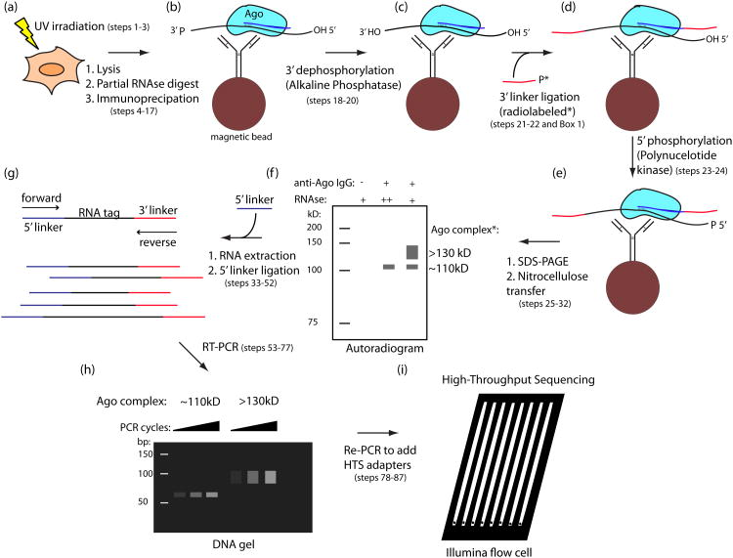
Notes:
Figure 1 | Overview of the HITS-CLIP protocol. A scheme for the experimental portion of the protocol is shown for Ago, with the miRNA drawn in blue and the mRNA in black. Phosphate (P) or hydroxyl (OH) status of RNA ends are indicated where pertinent. (a) UV irradiation of live cells or tissue induces RNA-protein cross-links (Steps 1–3). (b) Material is lysed, RNA is partially digested and the target protein is immunopurified with antibody coupled to magnetic beads (Steps 4–17). (c) Alkaline phosphatase treatment removes 3′ hydroxyl to permit 3′ linker ligation (Steps 18–20). (d) Radiolabeled (*) 3′ linker (red) is ligated to RNA tags (Steps 21 and 22). Note that two options for radiolabeling are presented in the protocol. The figure depicts the use of a radiolabeled 3′ linker, done for Ago and other cases in which direct polynucleotide kinase (PNK) labeling gives high background. (e) Polynucleotide kinase treatment phosphorylates 5′ RNA ends, allowing subsequent 5′ linker ligation (Steps 23 and 24). (f) Complexes are eluted from beads and separated by SDS-PAGE. After transfer to nitrocellulose membrane, complexes are visualized by autoradiography (Steps 25–32). (g) RNA is extracted from the desired membrane region by protease treatment, and the 5′ linker (purple) is ligated to tags (Steps 33–52). (h) Tags are amplified by RT-PCR (Steps 53–77). (i) After the addition of sequencing adapters in a second PCR step, the samples are sequenced on the Illumina platform (Steps 78–87)

Slide 6
Pre-processing & Quality Control
Alignment
Peak Calling
Adapter removal
PCR duplicate removal
RNA-Star Alignment
Novoalign
Piranha
CIMS

Slide 7
Pre-processing & Quality Control
Alignment
Peak Calling
Adapter removal
PCR duplicate removal
RNA-Star Alignment
Novoalign
Piranha
CIMS

Slide 8
Adapter removal
5’ adapter
3’ adapter
Arteries E1: TGGTCA
Arteries E3: TCAAGT
Arteries L1: No barcode
Veins E2: CGTGAT
Veins E3: CGTGAT
Veins L2: No barcode
Ideal barcode:
NNN,CCGG,NN
NNN,CAAT,NN
NNN,GGCG,NN
NNN,GGTT,NN
Our barcode:

Slide 9
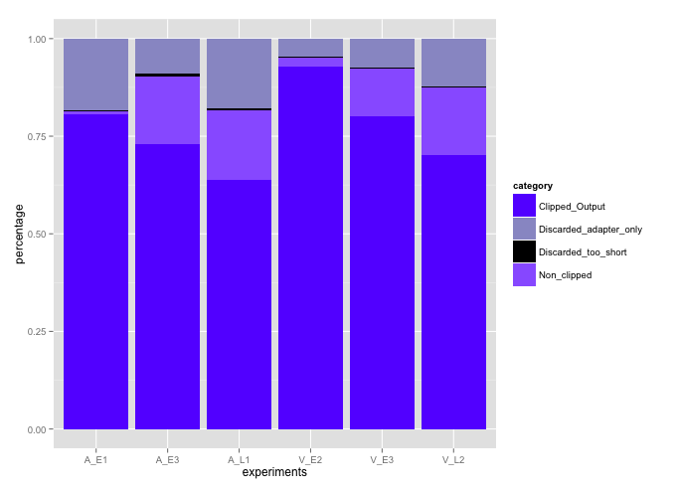

Slide 10
Reads distribution before and after collapsed

Slide 11
Pre-process before mapping
Trim the adapters if any (usually 5’ adapters are removed already)
Remain the reads with no adapters
Remove all reads shorter than 10nt
Remove reads of low qualify
Remove all duplicates reads

Slide 12
Table for statistics about the QC
 | Raw Reads | Adapter Removed | QC’ed | Duplicates Removed | Percentage
Arteries_E1 | 57,862,045 | 46,615,025 | 46,116,068 | 1,150,040 | 1.99%
Arteries_E3 | 42,954,624 | 31,316,678 | 31,024,449 | 568,093 | 1.32%
Arteries_L1 | 26,500,924 | 16,895,579 | 16,526,590 | 493,887 | 1.86%
Veins_E2 | 211,068,374 | 75,376,940 | 75,144,392 | 1,245,258 | 0.59%
Veins_E3 | 45,622,513 | 36,552,747 | 36,203,798 | 605,596 | 1.33%
Veins_L2 | 27,183,463 | 19,102,314 | 18,679,859 | 470,046 | 1.73%
Average | 68,531,991 | 37,643,214 | 37,282,526 | 755,487 | 1.10%

Slide 13
Table for statistics about the QC
 | Raw Reads | Adapter Removed | QC’ed | Duplicates Removed | Percentage
Arteries_E1 | 57,862,045 | 43,992,727 | 43,957,838 | 1,367,885 | 2.36%
Arteries_E3 | 42,954,624 | 35,446,497 | 35,423,394 | 865,658 | 2.02%
Arteries_L1 | 26,500,924 | 19,728,261 | 19,693,619 | 1,391,051 | 5.25%
Veins_E2 | 211,068,374 | 206,139,856 | 206,096,764 | 6,206,472 | 2.94%
Veins_E3 | 45,622,513 | 40,128,883 | 40,103,290 | 948,944 | 2.08%
Veins_L2 | 27,183,463 | 21,424,530 | 21,386,034 | 1,259,930 | 4.63%
Average | 68,531,991 | 61,143,459 | 61,110,157 | 2,006,657 | 2.93%

Slide 14
Pre-processing & Quality Control
Alignment
Peak Calling
Adapter removal
PCR duplicate removal
RNA-Star Alignment
Novoalign
Piranha
CIMS

Slide 15
Pre-processing & Quality Control
Alignment
Peak Calling
Adapter removal
PCR duplicate removal
RNA-Star Alignment
Novoalign
Piranha
CIMS

Slide 16
Mapping: RNA-STAR VS Novoalign
RNAstar:
- Considers junction mapping
Suitable for short reads
Relatively High mapping rate for our data
Novoalign
Compatible with CIMS
Low mapping rate for our data

Slide 17
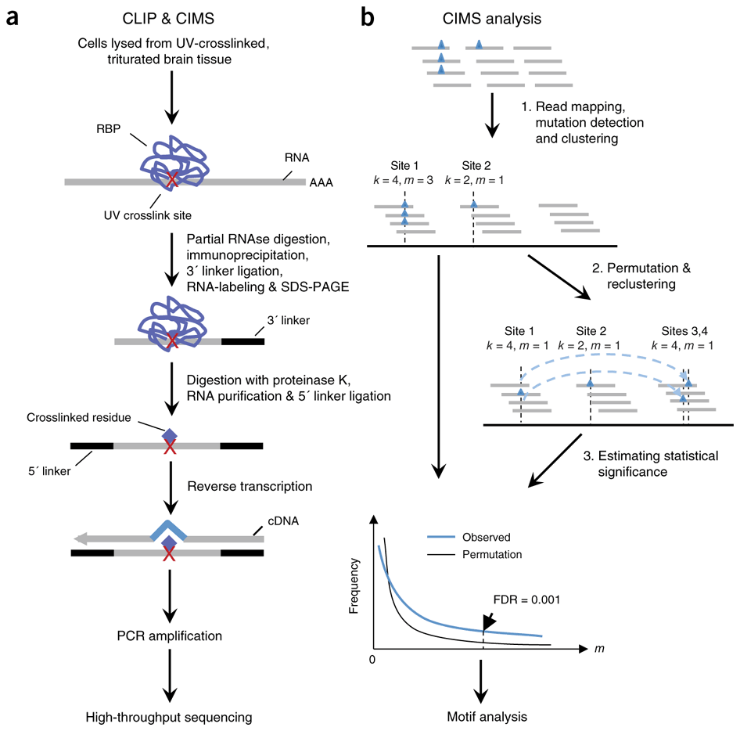
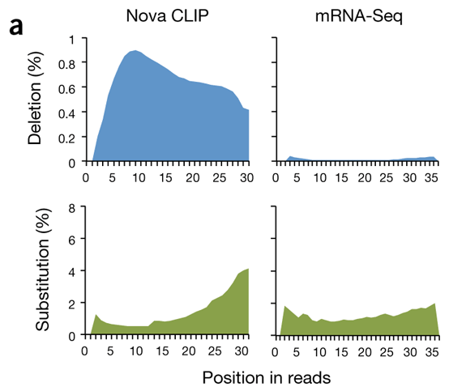
Peak calling: Piranha VS CIMS
CIMS
Crosslinking mostly induces deletions
Crosslinking deletions allow precise mapping of interaction sites.
Zhang C, et al. Nature biotechnology. 2011

Slide 18
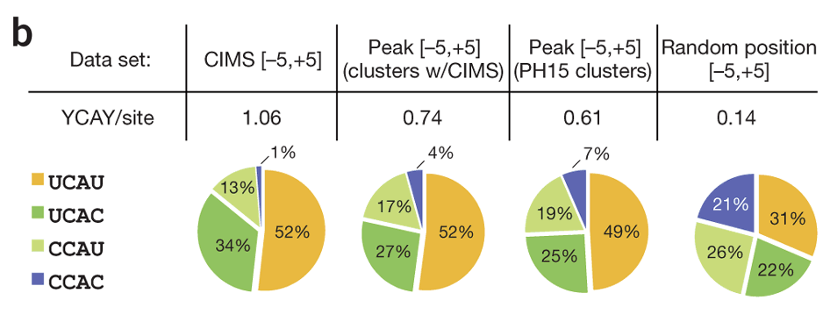
Crosslinking Bias?
Preferential protein binding? Or bias in cross-linking?
Zhang C, et al. Nature biotechnology. 2011

Slide 19
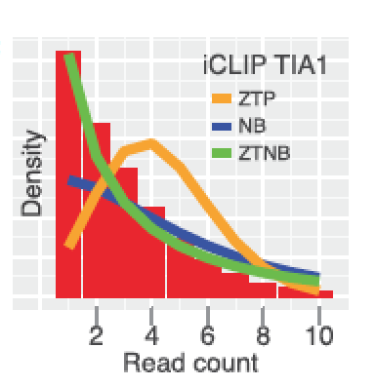
Peak calling: Piranha VS CIMS
Step 1:
3
1
0
2
Step 2:
Select the bins with some reads starts inside
3
1
2
  Problems:
    PCR duplicates can not be controlled in this data set
    Bin size need to be determined
      Larger bin => less sensitive to outliers but difficult to identify the miRNA site
      Smaller bin => more sensitive to PCR duplicates but higher resolution
Notes:
Piranha author suggests at least 30bp
1, 10, 20, 30 bp used

Slide 20
 | Arteries_E1 | Arteries_E3 | Arteries_L1 | Veins_E2 | Veins_E3 | Veins_L2
Raw Reads | 57,862,045 | 42,954,624 | 26,500,924 | 211,068,374 | 45,622,513 | 27,183,463
QC’ed | 1,367,885 | 865,658 | 1,391,051 | 6,206,472 | 948,944 | 1,259,930
Unique map | 693,298 | 251,127 | 529,101 | 4,560,180 | 314,301 | 478,025
collapsed | 44,429 | 28,956 | 127,675 | 260,330 | 33,329 | 82,873
Piranha Peak calling
 | Total peaks | Peaks in 3’UTR |  | Peaks in 1kb down 3’UTR
Arteries | 1,379 | 871 | 63% | 526 | 38%
Veins | 2,545 | 1,497 | 59% | 941 | 37%
*Piranha provides strand specific information for peaks
Notes:
~50M raw, ~2M before mapping, ~1M uniquely mapped, ~100K after collapse
Piranha with bin size 30 was used. Possi

Slide 21
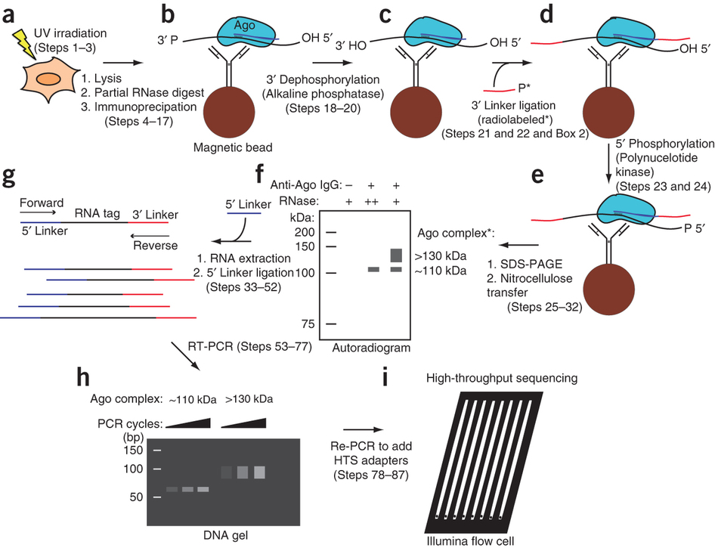
Searching for miRNAs
miRNA length: 16~28nt
The sequenced tag actually bypass the binding site
Piranha count the reads in a bin and use enrichment test. For independence, inside the bin, only count the leftmost side.
The real binding sides will occur following the starting site of the read
Seed searching region should be extended
True binding site
Tested bin with enrichment
Simple math for false positive rate:
If we are searching for 1 miRNA with 7mer seed
  30bp: (30-7+1)/(4^7)=0.001464844, 20bp:(20-7+1)/(4^7)=0.0008544922
200 miRNA with 7mer seed (suppose 200 seeds are difference)
  30bp: 200*(30-7+1)/(4^7)=0.2929688
  20bp:200*(20-7+1)/(4^7)=0.1708984
Adapted from Jing

Slide 22
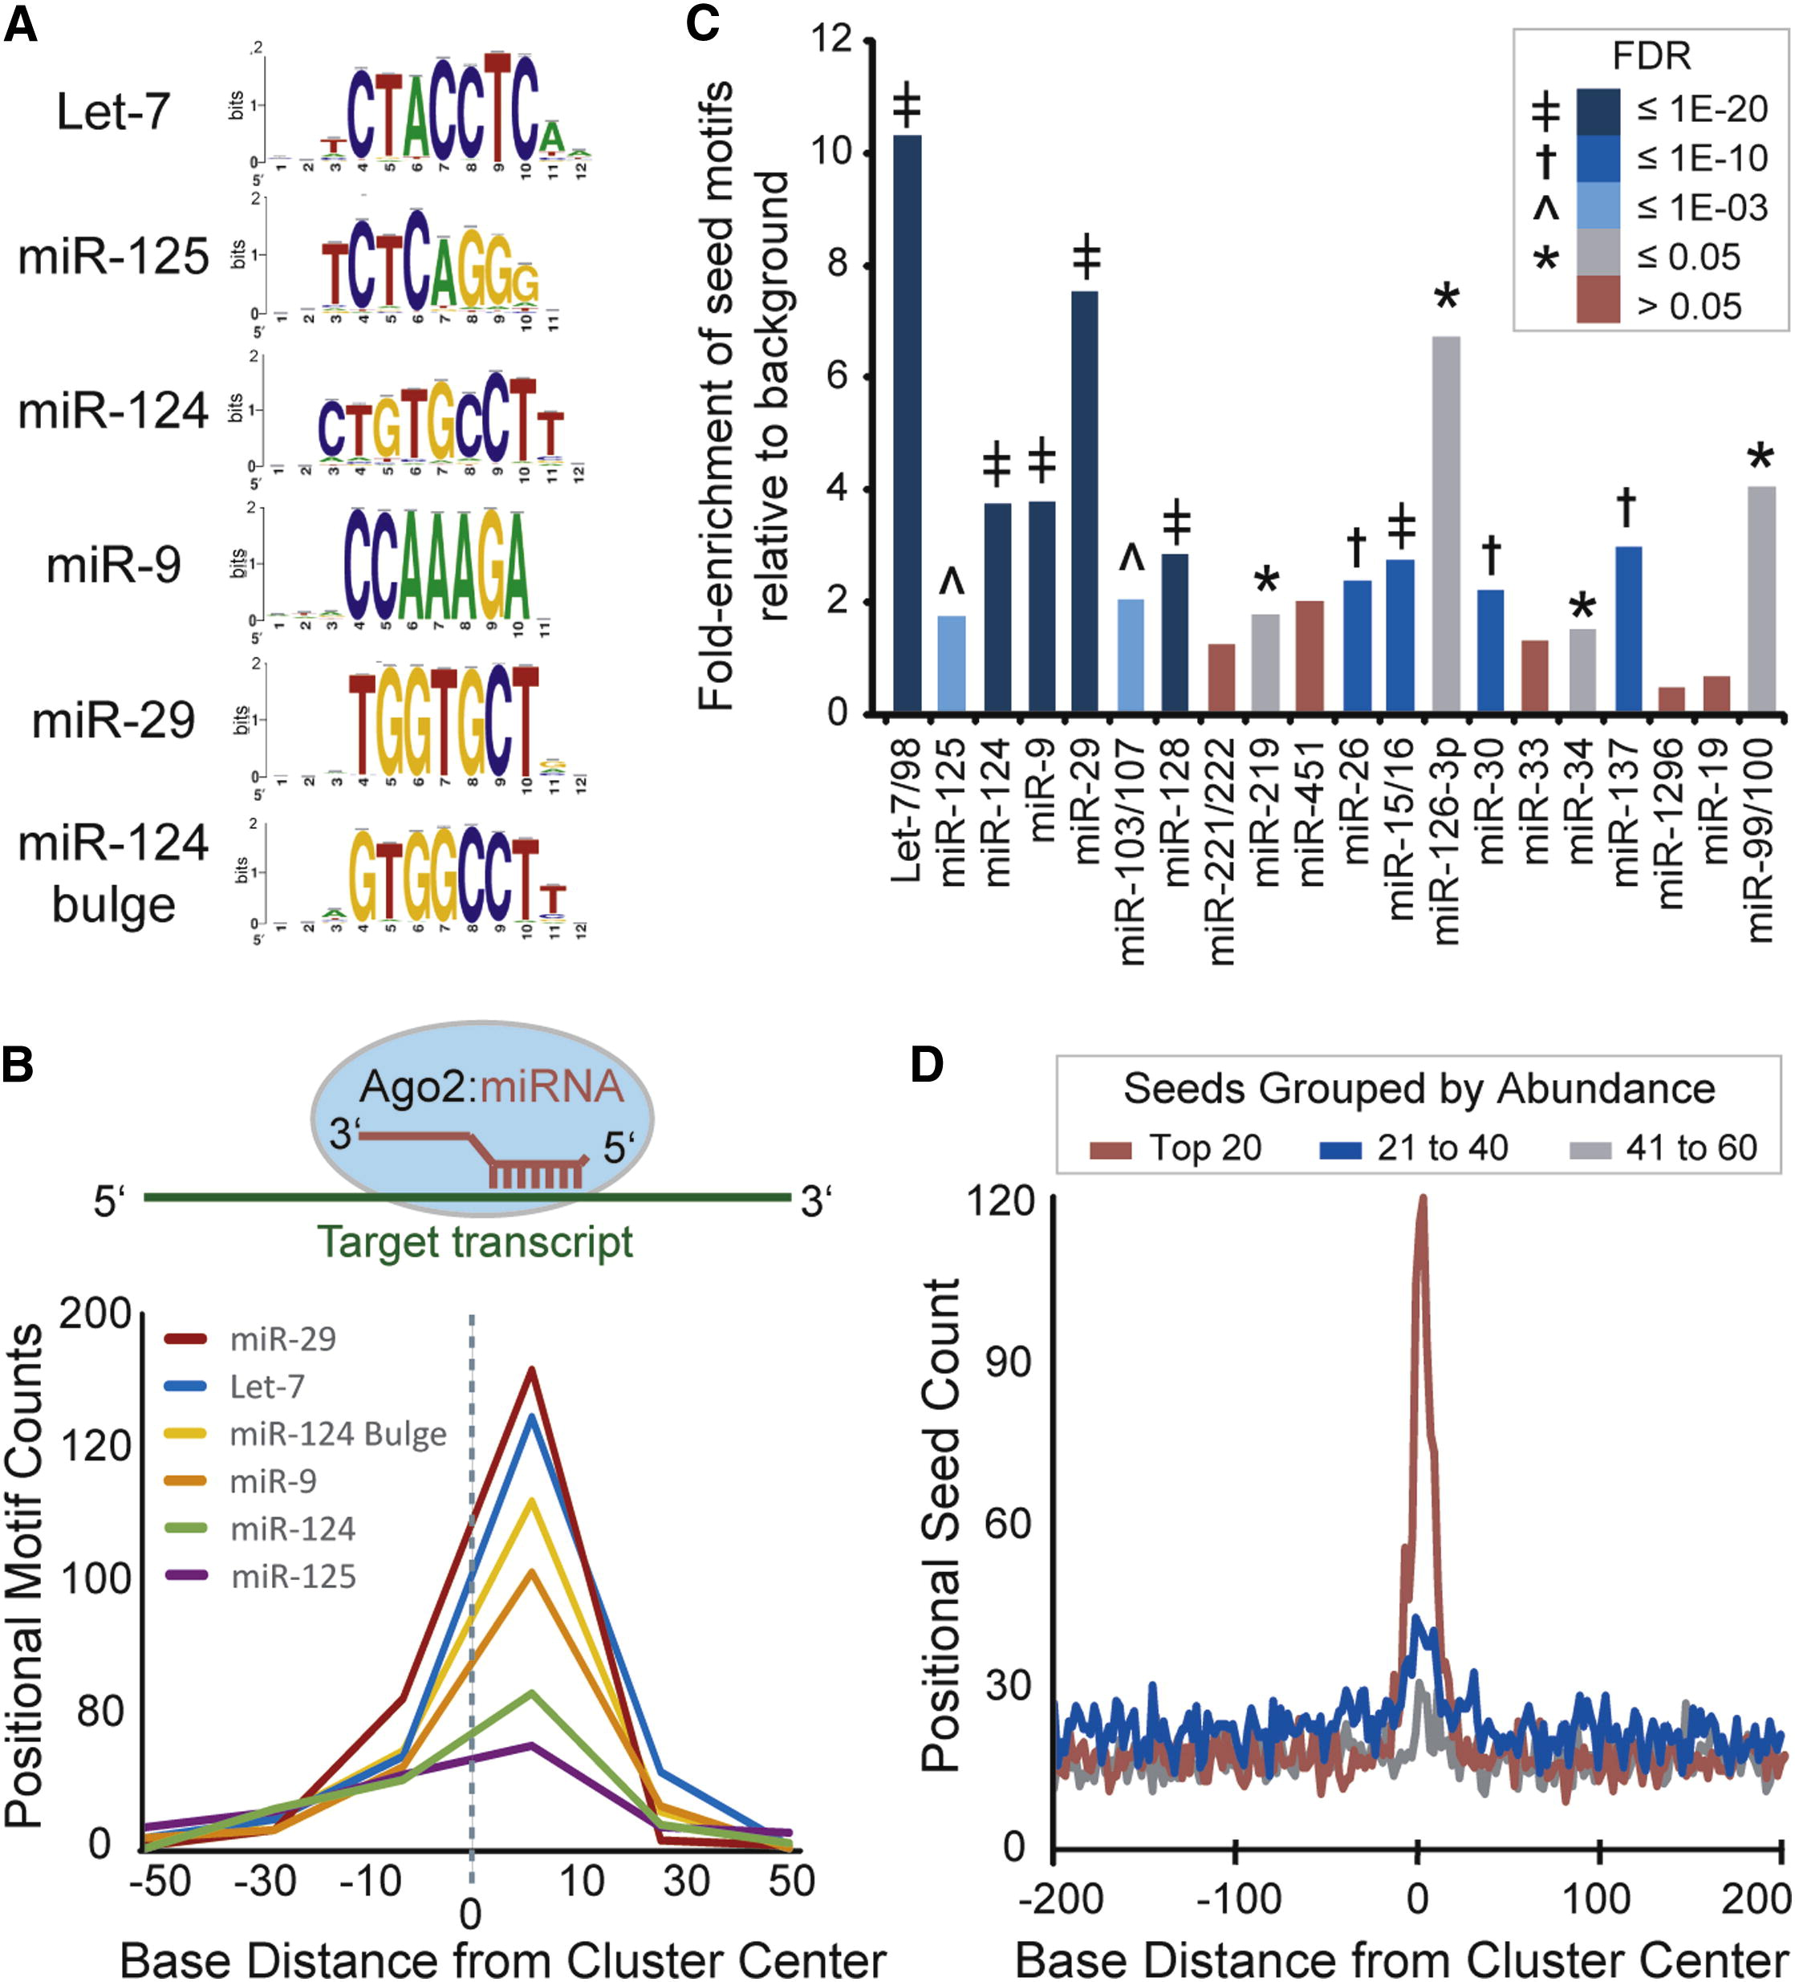
Boudreau R L, et al. Neuron. 2014

Slide 23

Let-7 family Increase EC proliferation (Otsuka et al., 2008)
miR-126 Enhances VEGF signaling in Ecs (Fish et al.,2008; Harris et al 2008; Nicoli et al., 2010)
miR-132 Enhances growth factor signaling (Anand et al., 2010; Jin et al., 2012)
miR-210 Stimulates tube formation and migration (Fasanaro et al., 2008; Pilkkien et al.,2008)
miR-221/222 Inhibits cell proliferation, Anti-angiogenic (Poliseno et al.,2006)
miR-296 Inhibits growth factor receptor recycling and degradation (Wurdinger et al., 2008)
miR-424 Stablizes HIF-1, proangiogenic (Ghosh et al.,2010)
miR-92a Anti-angiogenic. Inhibition enhanced neovascularization inschemic tissues (Bonauer et al.,2009)
miR-143/145 Critical for VSMC differentiation (Cordes et al.,2009)
miR-26a Increases VSMC proliferation (Leeper et al 2011)
Notes:
Single miRNAs important in endothelial cells
MicroRNAs are small, noncoding RNAs (20-23 nucleotides) that negatively regulate gene expression at the post-transcriptional level by binding to mRNAs [base-pairing with complementary sequences in the 3' untranslated regions (UTRs) of protein-coding transcripts]
MicroRNAs are expressed as autonomous transcripts (pri-miRNA), or are found in introns where they are expressed within pre-mRNA
The Drosha complex processes pri-miRNAs into hairpin miRNA precursors (pre-miRNAs) in the nucleus
then Dicer cleaves these pre-miRNAs into double stranded 22 nucleotide miRNA in the cytoplasm.
The mature strand from the resulting duplex microRNA is subsequently incorporated into a ribonucleoprotein silencing complex (RISC) and used as a complementary guide sequence that binds to sites in the 3’UTR of a target mRNA.
Upon RISC binding, a target transcript is deadenylated leading to its degradation and translational repression
miRNAs regulate diverse biological functions, including cell proliferation, apoptosis, senescence, differentiation, metabolism, tumorigenesis, and developments in particular has been largly dimostrated their implication in multiple aspects of vascular growth control

Slide 24
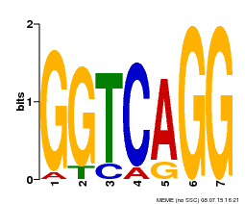
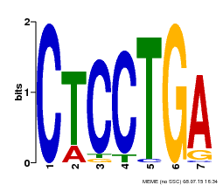
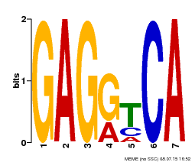
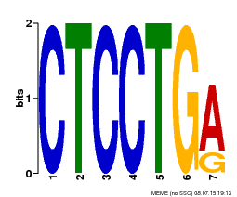
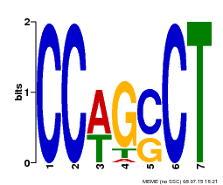
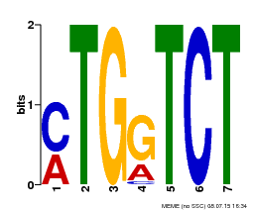
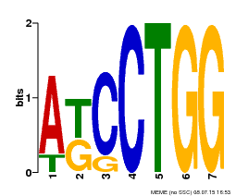
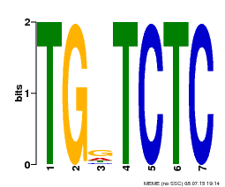
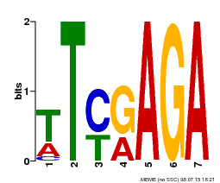
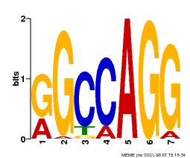
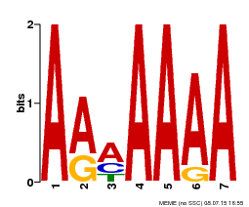
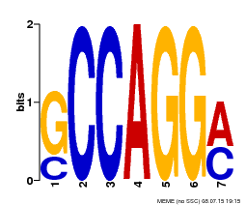
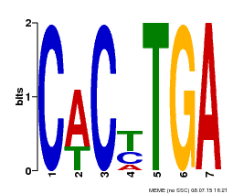
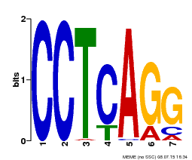
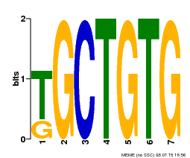
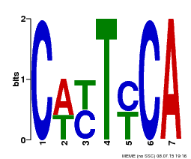
Motif Analysis
Arteries
Positive strand
Arteries
Negative strand
Veins
Positive strand
Veins
Negative strand

Slide 25
miRNA abundance
Mapping the QC’ed reads to the miRNA database
Bar plots show the relative mean levels among the 11 samples for the top 30 most abundant miRNAs (top) and miRNA seeds (bottom). For the latter, miRNAs were grouped into seed families based on shared seed (7m8) sequences.
Boudreau R L, et al. Neuron. 2014

Slide 26
Ateries
miRNA | Count | Fraction
miR-27a-3p | 420,250 | 61.5%
miR-126-3p | 22,920 | 3.4%
miR-21-5p | 21,257 | 3.1%
miR-19b-3p | 17,865 | 2.6%
miR-3960 | 17,765 | 2.6%
Others | 182,970 | 26.8%
Total | 683,027 | 100%
Veins
miRNA | Count | Fraction
miR-27a-3p | 3,000,789 | 70.8%
miR-21-5p | 258,375 | 6.1%
miR-126-3p | 115,973 | 2.7%
miR-30a-5p | 101,679 | 2.4%
miR-19b-3p | 80,829 | 1.9%
Others | 680,535 | 16.1%
Total | 4,238,180 | 100%
Adapted from Donghoon

Slide 27
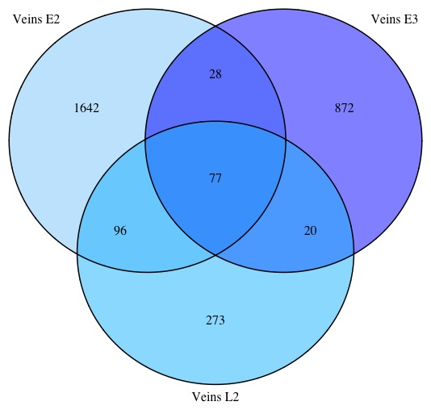
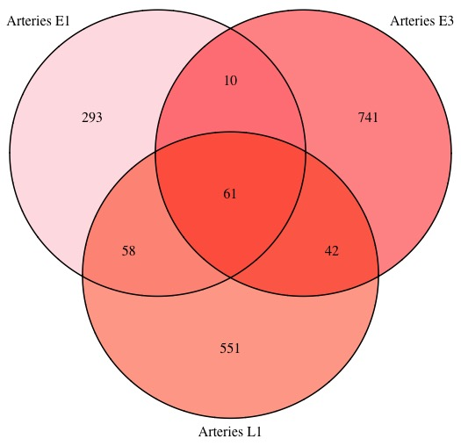
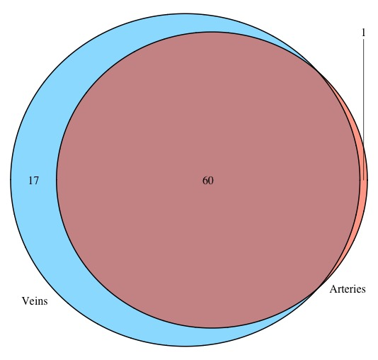
How different are the peaks?

Slide 28
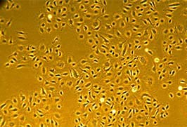
HUVEC
Human Umbilical Vein Endothelial Cells
HUVEC are cells derived from the endothelium of veins from the umbilical cord.
HUVEC is a classic model system to study many aspects of endothelial function and disease, eg, angiogenesis
Published in Balakrishnan, I., et al, Genome‐Wide Analysis of miRNA‐mRNA Interactions in Marrow Stromal Cells. Stem Cells. 2014

Slide 29
Processing HUVEC data
HUVEC | SRA | Raw Reads | Adaptor removed | Duplicates Removed | Uniquely Mapped | Unique Mapping Rate
Replicate 1 | SRR578615 | 14,086,106 | 7,517,141 | 1,333,383 | 757,785 | 56.83%
Replicate 2 | SRR578619 | 18,888,791 | 6,212,445 | 1,414,984 | 680,225 | 48.07%
Average |  | 16,487,449 | 6,864,793 | 1,374,184 | 639,307 | 46.52%
Our data |  | 68,531,991 | 61,143,459 | 2,006,657 | 1,137,672 | 56.69%

Slide 30
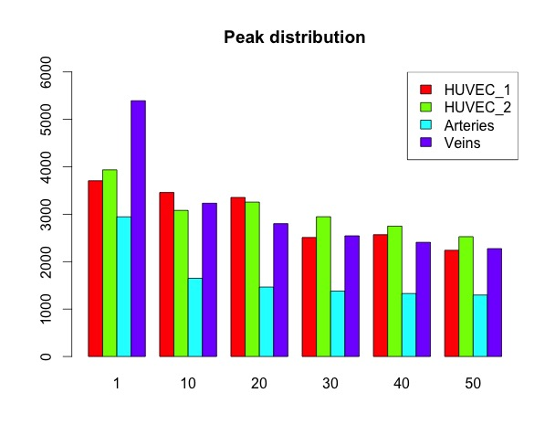
Peak calling

Slide 31
miRNA abundance
Veins & replicate I
miR-27a-3p
miR-21-5p
miR-126-3p
miR-30a-5p
miR-222-3p
miR-4284
miR-3960
miR-93-5p
Veins & replicate II
miR-27a-3p
miR-21-5p
miR-126-3p
miR-30a-5p
miR-222-3p
miR-126-5p
miR-30d-5p
miR-93-5p
miR-30e-5p
Replicate I & replicate II
miR-1273g-3p
miR-31-5p
miR-27a-3p
miR-21-5p
miR-222-3p
miR-30a-5p
miR-324-3p
miR-126-3p
miR-93-5p
Summary:
miR-27a-3p, miR-21-5p, miR-126-3p, miR-30a-5p, miR-222-3p, miR-93-5p

Slide 32
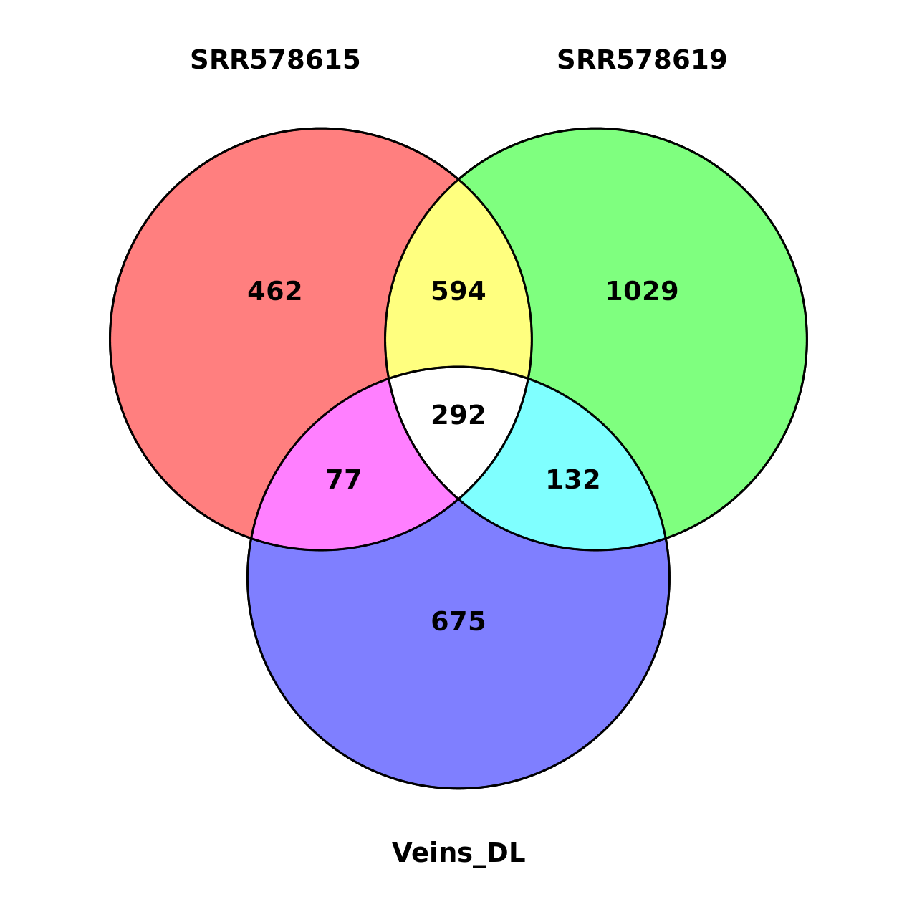
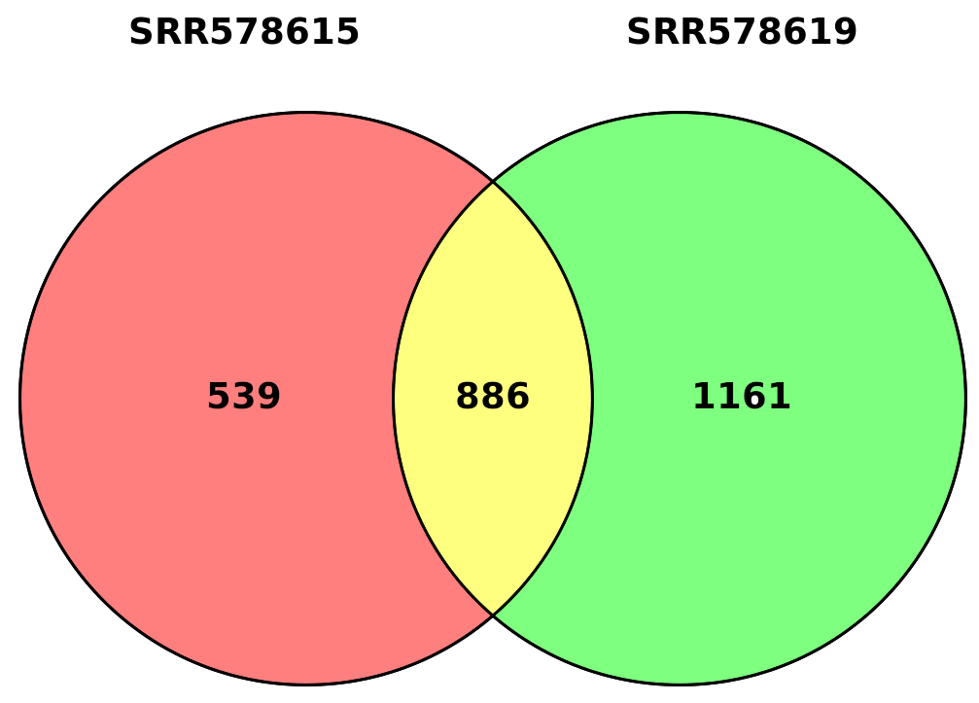
Target genes
Use 3’UTR peaks in Veins and Arteries
Identify miRNA-target interactions
Veins

Slide 33
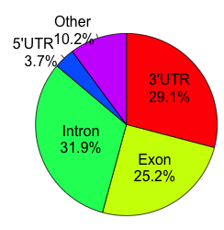
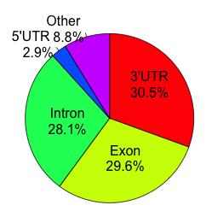
Distribution of Ago-2 peaks within the genome
Arteries
Veins

Slide 34
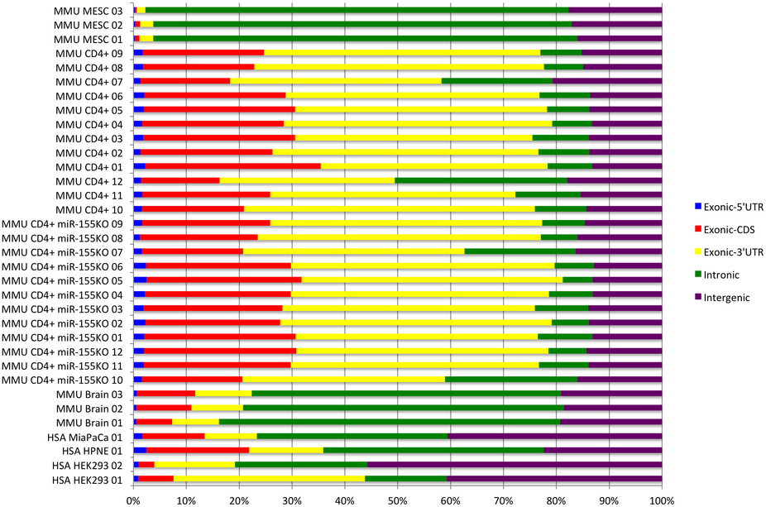
Argonaute CLIP-Seq reveals miRNA targetome diversity across tissue types.
Roles of competing endogenous RNAs in gastric cancer.
Hu Y et al. Brief Funct Genomics. 2015
Functional Conservation of Both CDS- and 30-UTR-Located microRNA Binding Sites between Species
Guojing Liu. Mol. Biol. Evol 2014
Searching the coding region for microRNA targets
Ray M. Marin. RNA 2013
MicroRNAs to Nanog, Oct4 and Sox2 coding regions modulate embryonic stem cell differentiation
Yvonne Tay et al. Nature. 2008
Peter M. Clark et al. Scientific Reports. 2014

Slide 35
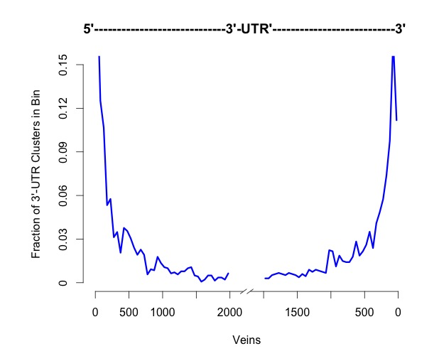
Distribution of Ago-2 peaks within the 3’UTRs

Slide 36
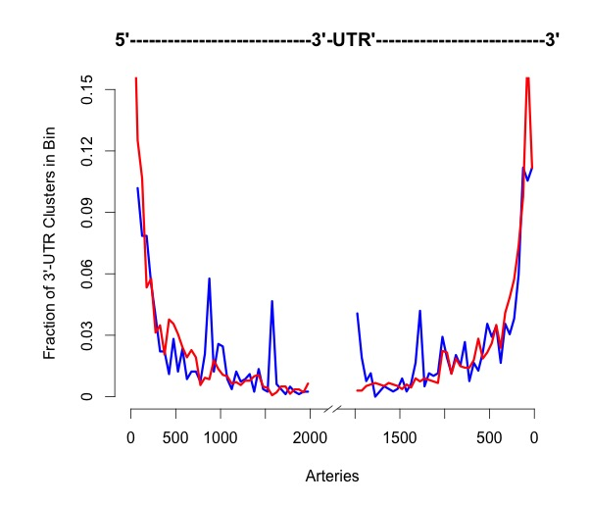
Distribution of Ago-2 peaks within the 3’UTRs
Boudreau R L, et al. Neuron. 2014

Slide 37
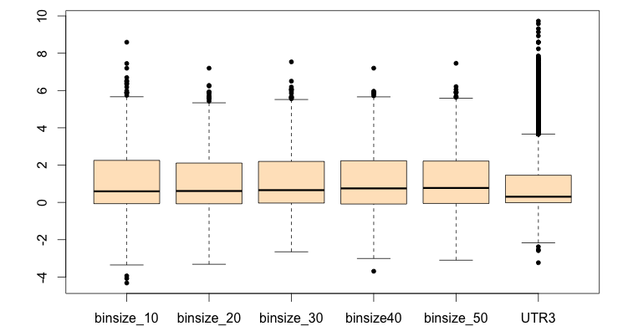
Ago-2 peaks conservation within the 3’UTR
Arteries
0.00454

Slide 38
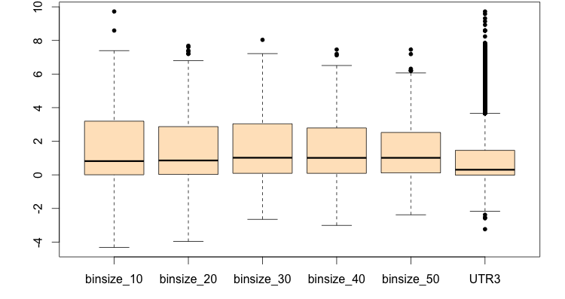
Ago-2 peaks conservation within the 3’UTR
Veins
2.2e - 16

Slide 39
Conclusions on our data
Most peaks fall into the 3’UTR region according to the annotation
Motif analysis does not result in significant motifs for targeting miRNAs
miRNA abundance analysis result agrees with HUVEC data
Peaks show low consistency between biological replicate vein samples and arteries samples
Common peaks are highly overlapped when comparing arteries and veins
Target genes find in two HUVEC biological replicate samples and our veins combined data lacks consistency

Slide 40
Migration
Peak analysis consistent with previous result
Peaks show low consistency between biological replicate vein samples and arteries samples
Common peaks are highly overlapped when comparing arteries and veins
What do we do next?
Analysis of the target genes in arteries and veins
Identify specific signaling pathways in arteries and veins in the RISC complex
Cross reference peaks sequence with GWAS study of cardiometabolic disorders

Slide 41
Comparison of HUAEC and HUVEC genes found in the Ago2-complex
Disease associated with the regulation of HUAEC and HUVEC Ago2-genes
DISEASE pValue
Long QT syndrome type 14 & 15 0.0107
Keutel syndrome 0.0107
CPVT type 4 0.0107
Primary biliary cirrhosis 0.0193
Drug toxicity-related nephropathy 0.0213
Drug-induced hepatotoxicity 0.0319
DISEASE pValue
Inflammatory hepatocellular adenoma 0.0040
Familial FSGS 0.0175
CHTD 4 0.0263
Nephrotic syndrome type 8 0.0263
Nephropathy 0.0263
Multiple types CHD type 4 0.0263
Long QT syndrome type 14 & 15 0.0263
DISEASE pValue
Pulmonary arterial hypertension (PAH) 0.0019
Pericarditis 0.0040
Arrhythmia 0.0041
Atrial fibrillation 0.0059
Familial ventricular tachycardia 0.0063
Primary pulmonary hypertension 1&3 0.0063
Pulmonary veno-occlusive disease 0.0127
Epstein syndrome 0.0127
Fechtner syndrome 0.0127
Coronary artery disease 0.0139
Regeneration of liver 0.0190
Hepatoblastoma 0.0190
Acute myocardial infarction 0.0270
Chronic renal failure 0.0305
GENE ONTOLOGY pValue
structural molecule activity 6.2E-09
cytosol 1.6E-04
cytoskeleton organization 7.6E-04
cytoskeletal protein binding 1.2E-03
actin binding 1.4E-03
ribonucleoprotein complex 2.5E-03
GTPase activity 7.5E-03
structural ribosome 1.0E-02
actin cytoskeleton 1.1E-02
translational elongation 1.1E-02
actin filament-based process 1.3E-02
blood vessel development 1.5E-02
vasculature development 1.9E-02
cytoskeleton 3.0E-02
blood vessel morphogenesis 3.0E-02
Alberto

Slide 42
Aranguren et al, Blood 2013
Hypothesis
miRNAs control vascular cells mechanical homeostasis during increased loading or stiffness
Notes:
Felipe Prosper from University of Navarra
Aernout Lutton from University of Luttun

Slide 43
DEG analysis of fresh Vs cultured HUAEC and HUVEC cells

Slide 44
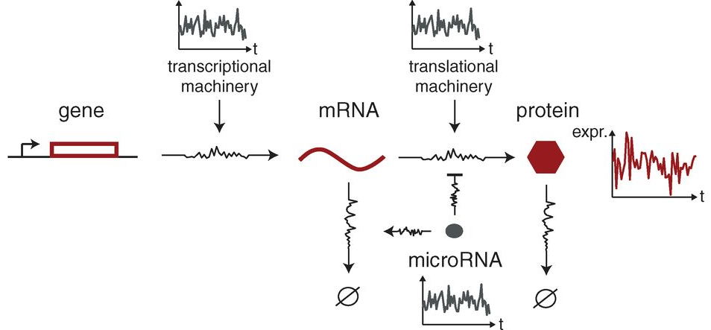
miRNAs control protein expression noises
Protein fluctuation
Degradation
Degradation
J.M. Schmiedel et al., Science, 2015
Poisson fluctuations in mRNA abundance arising from random birth and death of individual mRNA transcripts
Promoter fluctuations arising from stochastic promoter transitions between different transcriptional states
A. Singh et al., Mol Syst Biol, 2013
Notes:
Example, cells which are genetically identical, even within the same tissue, are often observed to have different expression levels of proteins, different sizes and structures. These apparently random differences can have important biological and medical consequences.
Cellular noise was originally, and is still often, examined in the context of gene expression levels – either the concentration or copy number of the products of genes within and between cells. As gene expression levels are responsible for many fundamental properties in cellular biology, including cells' physical appearance, behaviour in response to stimuli, and ability to process information and control internal processes, the presence of noise in gene expression has profound implications for many processes in cellular biology.
Nils Blüthgen, Debora S. Marks, Alexander van Oudenaarden
Most of the highly repressed genes have low expression levels
These genes should have reduced protein expression noise as a consequence of miRNA regulation in vivo
Reduction of intrinsic noise is a generic property of miRNA regulation
miRNAs preferentially target lowly expressed genes
Combinatorial miRNA regulation enhances overall noise reduction by providing strong repression to endogenous genes with only little additional noise from miRNA pools

Slide 45
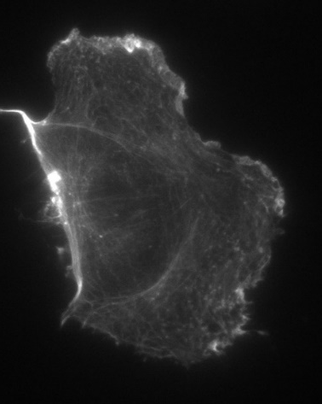
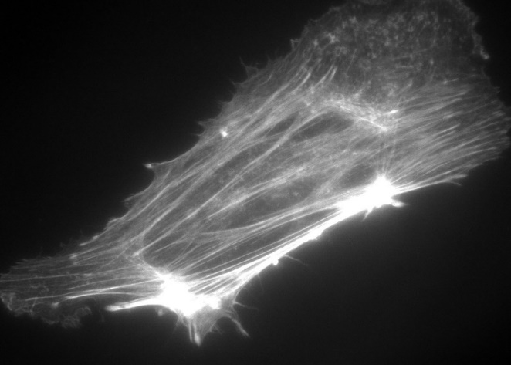
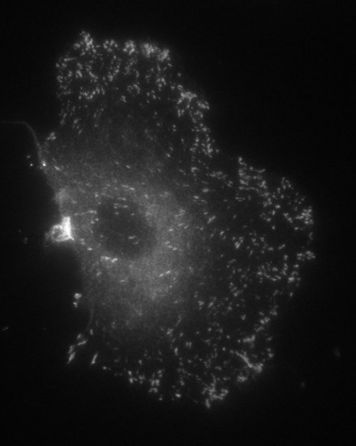
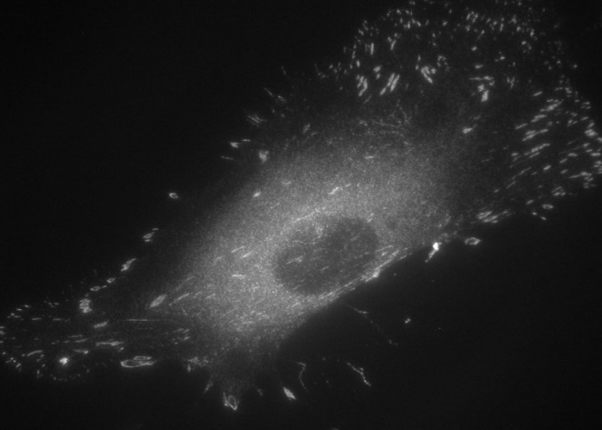
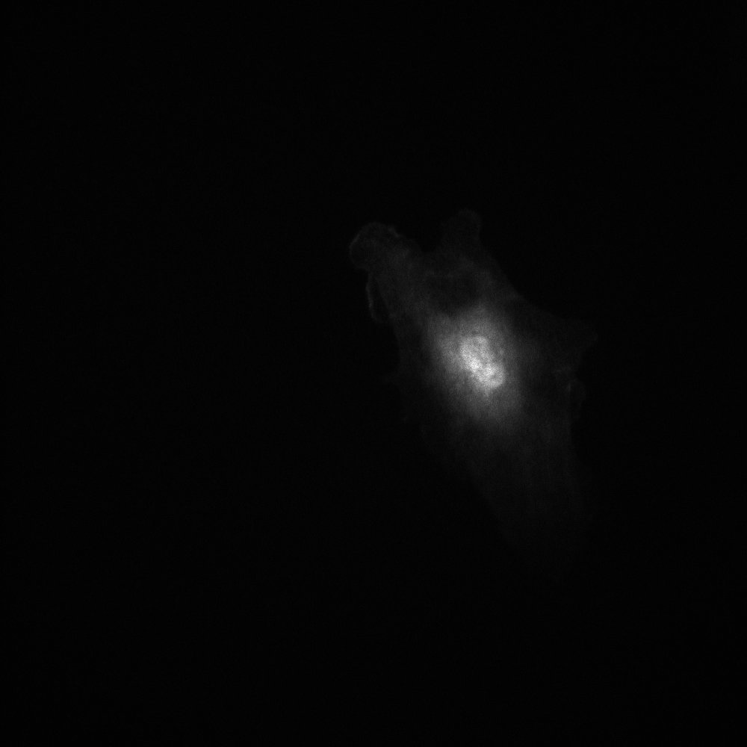

miRNAs control protein expression noises
3 kPa
30 kPa
F-Actin
n= 65-107 Cells (10 10x fields of view)
***p<0.001
Paxillin
n= 1262-3082 Adhesions from 10 Cells/ group
***p<0.001
YAP/TAZ
n= 31-40 Cells / group
*** p<0.001
Notes:
Passage 4 HUVEC on Fibrinogen (10ug/ml) coated PDMS, Cultured in Complete EGM for 1 or 2 days.
Fixed with 4% PFA, permeablized and stained for F-Actin (568 Phalloidin), Paxillin (488 anti-Rabbit), and Hoeschst.
Notes:
The third stiffness I tried (a thin 3kPa gel) looked too stiff (similar to 30kPa). We could potentially go softer than 3kPa if needed.
I took Trizol samples but unfortunately I don’t have them for the softest gels (3kPa gels).
I’m currently doing this again with both Fibrinogen and Fibronectin. I will get better (more cells from larger gels) Trizol samples from those.
My density was a bit too high (some cells were touching), cells were fairly heterogeneous but I tried to pick somewhat representative images.

Slide 46
Working model
miRNA
Force generation
Homeostasis
Extracellular matrix
Fibrosis
Negative feedback
Positive feedback
Stabilized adhesions
Activated RHO-ROCK
Actomyosin contraction
Deformed ECM
Altered ECM gene expression
Survival and proliferation
Notes:
In condition of increasing stiffness, cells can change the expression of particular genes, identified as mechanosensory genes, which are important for extracellular matrix deformation and cell survival and proliferation. This change in gene expression generates a positive feedback loop which leads to a fibrotic status of the cells.
Here, we speculate microRNAs as an important player in the negative feedback loop, which are active to keep the cell in the correct homeostasis status and prevent fibrosis.

Slide 47

Acknowledgement
Gerstein Lab
Mark Gerstein
Jing Zhang
Donghoon Lee
Nicoli Lab
Stefania Nicoli
Albertomaria Moro

