Slide 1
Basic Statistical Analysis and Statistical Power
Leonidas
11/1/2015

Slide 2
1st of December
Romania National Day

Slide 3
https://www.youtube.com/watch?v=-dZGDy45ZeI
https://youtu.be/PM37iJ7ymok?t=1h20m
https://www.youtube.com/watch?v=O7a8zdjPZvA

Slide 4
CONGRATULATIONS
ARIF & AKDES!

Slide 5
Two alleles: A, a
 | A | a
A | AA | Aa
a | Aa | aa
Allelic Model | Phenotype
Multiplicative | 1A : 2Aa : 1a
Additive | 1A : 2Aa : 1a
Dominant | 3A : 1a
Genotypes: 1AA : 2Aa : 1aa

Slide 6
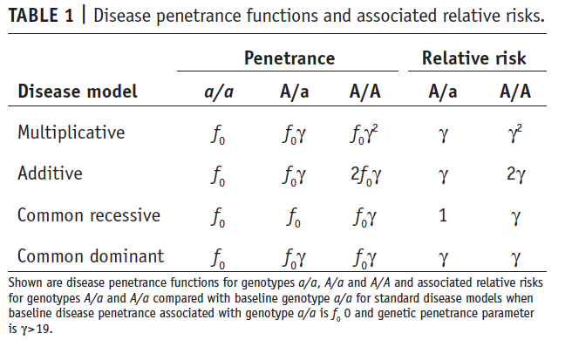
Models and measures of association
A biallelic locus with a and A
The disease penetrance is the risk of disease in individuals carrying that genotype
Standard models for disease penetrance that imply a specific relationship between genotype and phenotype include multiplicative, additive, common recessive and common dominant models.

Slide 7
Models and measures of association
Assuming a genetic penetrance parameter γ (γ>1)
A multiplicative model indicates the risk of disease is increased γ-fold with each additional A allele (see table 1)..
The Relative Risk (RR) compares the disease penetrances between individuals exposed to different genotypes.
In a case-control study in which the ratio of cases to controls is controlled, not possible to estimate
Therefore Odds Ratio (OR) >> OR can be calculated directly from exposure frequencies

Slide 8
Models and measures of association
The allelic OR (HWE):the odds of disease carrying A to the odds of disease carrying allele a.
The genotypic OR (not HWE): the odds of disease in an individual carrying one genotype to the odds of disease in an individual carrying another genotype.
Usually, two genotypic ORs:
A/A vs a/a
A/a vs a/a

Slide 9
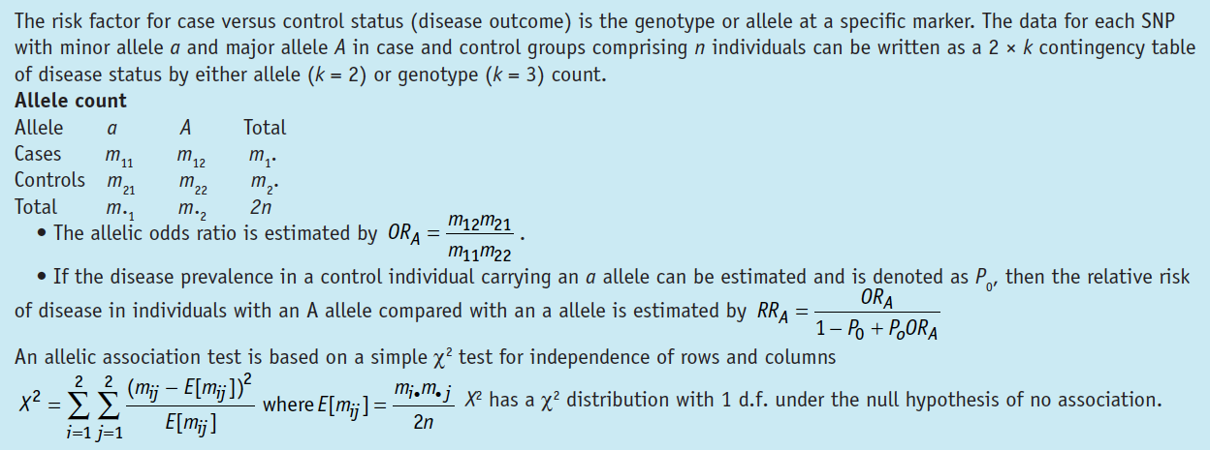
Contingency tables and Associated tests: Allele count
- In a conventional χ2 test for association based on a 2 x 3 contingency table, each genotype is assumed to have an independent association with disease and the resulting genotypic association test has 2 degrees of freedom (d.f.).

Slide 10
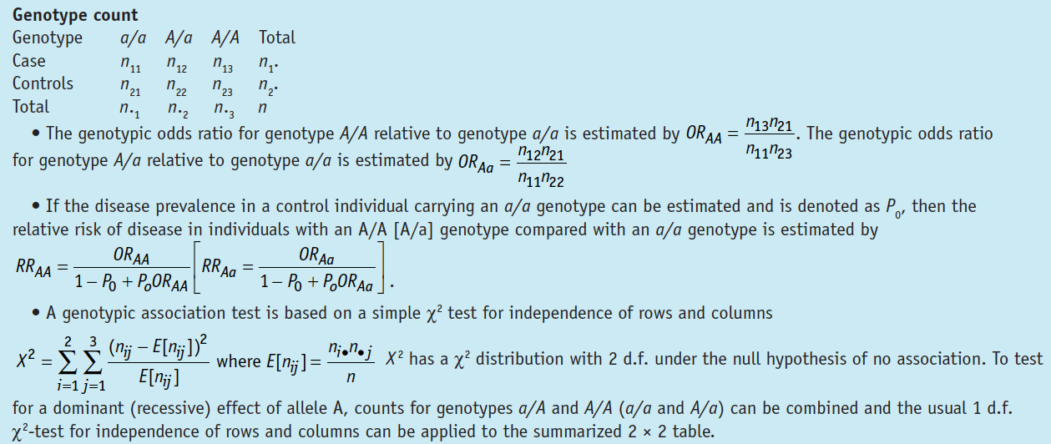
Contingency tables and Associated tests: Genotype Count

Slide 11
Contingency tables and Associated tests: A Cohran-Armitage trend test

Slide 12
Other tests for association
Likelihood ratio (LR) methods
The likelihood of observed data under the proposed model of disease association Vs the likelihood of no association
Logistic regression models to include additional covariates
For example environmental effects (risk factors),
clinical variables (age or onset),
population stratification (e.g., principal components capturing variation due to differential ancestry),
or by the interactive and joint effects of other marker loci

Slide 13
Other tests for association

Slide 14
Controlling for Multiple testing
Family Wise Error Rate (FWER): The probability of making one or more type I erors in a set of tests
Bonferroni (α* = α/n )
Sidak (α* = 1 − (1 − α)1/n)
FDR is problematic for GWA studies
Permutation procedures are computationally intensive but considered the ‘gold standard’
Bayes factors have also been proposed

Slide 15
Interpretation of Results
A SNP rarely directly influencing disease risk (causal)
Allele and disease frequencies are known to vary among populations of different genetic ancestry> Data stratification
Principal component analyses or multidimensional scaling methods are commonly used (Anderson et al 2010)

Slide 16
Replication of results
The first stage : a large number of markers to identify potential signals of association using a nominal P value threshold.
In stage two, the top signals are then followed up by genotyping them on the remaining samples while a joint analysis of data from both stages is conducted
Significant signals are subsequently tested for replication in a second data set

Slide 17
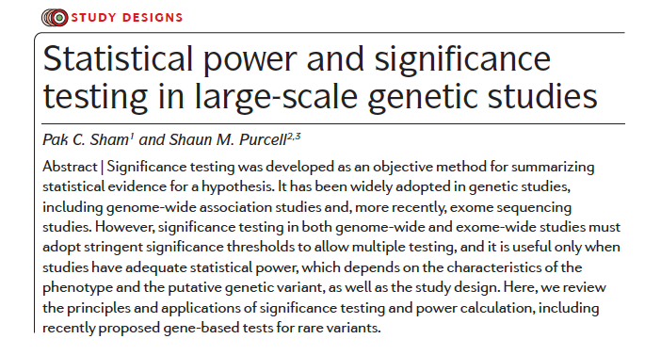

Slide 18
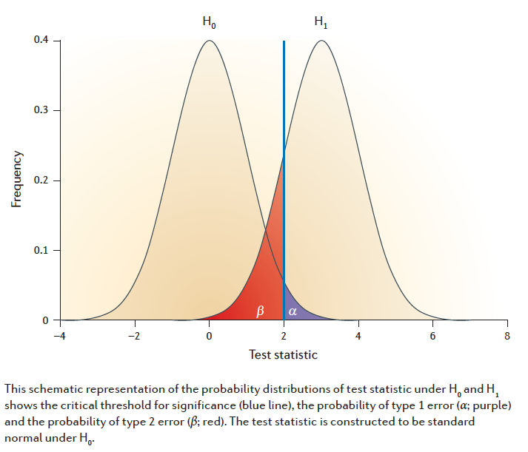
What Is Statistical Power?

Slide 19
Multiple testing burdens in GWAS
Simulation studies using data on ENCODE gave a genome wide significance threshold of 5*10⁻⁸
Another approach for a sample of 5000 cases and controls, with SNP MAF >5% found 3.1x10⁻⁸
10^-8 for African populations

Slide 20
Power Calculation: an example
Allele frequencies: 0.1 for A and 0.9 for B
The risk of disease: 0.01 for BB; 0.02 for AA & AB
100 cases – 100 controls
The two proportions are the total frequencies of the AA and AB genotypes in the cases (p1) and in the controls (p2)
For a sample size of n1 cases and n2 controls, the test statistic is:
Population frequencies for 3 genotypes under HWE:
0.12 = 0.01 (for AA); 2 . 0.1 . 0.9 = 0.18 (for AB); and 0.92 = 0.81 (for BB)
population disease prevalence (K) of (0.02 . 0.01) + (0.02 . 0.18) + (0.01 . 0.81) = 0.0119
The genotype frequencies in the cases are therefore (0.02 . 0.01)/0.0119 = 0.0168 (for AA); 0.02 . 0.18/0.0119 = 0.3025 (for AB); and 0.01 . 0.81/0.0119 = 0.6807 (for BB).

Slide 21
Estimating the probability for α using a bayesian framework
In this formula, P(H0 | P ≤ α) is the false-positive report probability (FPRP)
The above formula can be used to set α ?to control the FPRP as follows:
When the power (1 – β) is low, α has to be set proportionately lower to maintain a fixed FPRP

Slide 22
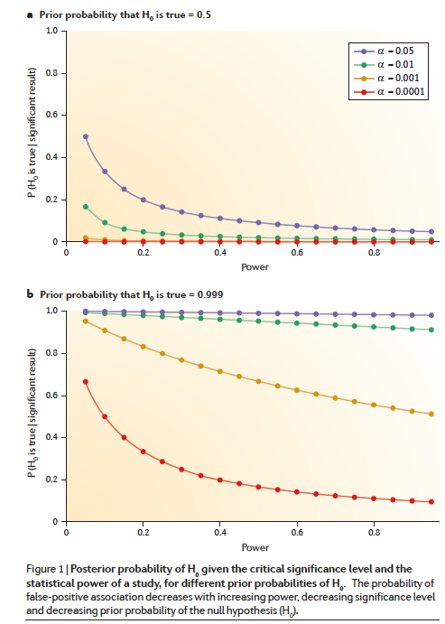

Slide 23
Strategies to Increase Power
Study design considerations
Restrict association testing to variants that are more likely to be causal
By filtering and weighting to prioritize alleles
Very rare alleles assigned a higher priority
Assess conservation across and within multiple species
Identification of controls with high levels of NON-genetic factors
Include SVs

Slide 24
Strategies to Increase Power
Analytical Approaches
Use integrative models that consider multiple cases of genetic variants (combine rare and common)
Test variants across sets of functional related genes

Slide 25
Strategies to Increase Power
Concerns
Parameterize multi locus genetic models with appropriate joint distributions
How to account for technical features of sequencing (bias coverage, incomplete)
Assess appropriate multiple-testing thresholds
Potential impact of population stratification

Slide 26
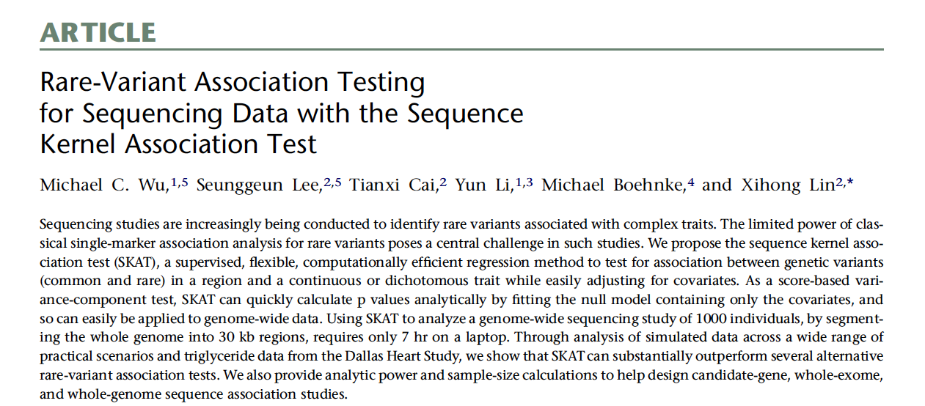
Burden tests - SKAT

Slide 27
Sequence Kernel Association Test (SKAT)
A regression approach that tests for association between variants in a region (both common and rare)
Adjusting for covariates, such as principal components, to account for population stratification
Available in R
Allows the specification of multiple parameters, including:
Size of genomic region
Maximum allele frequency of rare variants
Proportion of rare variants that increases or decreases disease risk
Effect size of individual rare variants
The significance threshold

Slide 28
Sequence Kernel Association Test (SKAT)
SKAT Model and Test for Linear SNP Effects

Slide 29
SKAT Model and Test for Linear SNP Effects
Assume n subjects are sequenced in a region with p variant sites
- Covariates might include age, gender, and top principal components of genetic variation for controlling population stratification
For the i-th subject, yi denotes the phenotype variable, Xi = (Xi1, Xi2, .., Xim) denotes the covariates, and Gi = (Gi1, Gi2,.,Gip) the genotypes for the p variants within the region.
- α0 is an intercept term, α = [α1,., αm]’ is the vector of regression coefficients for the m covariates, β= [β1,.,βp]’ is the vector of regression coefficients for the p observed gene variants
(Typically, we assume an additive genetic model and let Gij, . 0, 1, or 2 represent the number of copies of the minor allele )
null hypothesis H0: b . 0, that is, b1 . b2 . . . bp . 0

Slide 30
Statistical Power vs Sample Size across different models of maximum Odds Ratio (OR)
SKAT – Power analysis
A
B
Max OR | 3 | 4 | 5 | 6
effective sample size | 763 | 326 | 172 | 160
Using the default SKAT.haplotypes dataset, randomly selected subregions of size=5k and ran 100 simulations. In A, we show the statistical power obtained across the different models of maximum Odds Ratio and sample sizes. In B) we show the required sample size for each of these models in order to obtain significant statistical power (α=0.01, β=0.2)
Notes:
Using the default haplotype information in the SKAT.haplotypes dataset, we randomly selected subregions of size=5k and ran 100 simulations. In A, we show the statistical power obtained across the different models of maximum Odds Ratio. In B) we show the required sample size for each of these models in order to obtain significant statistical power (α=0.01, β=0.2)

Slide 31
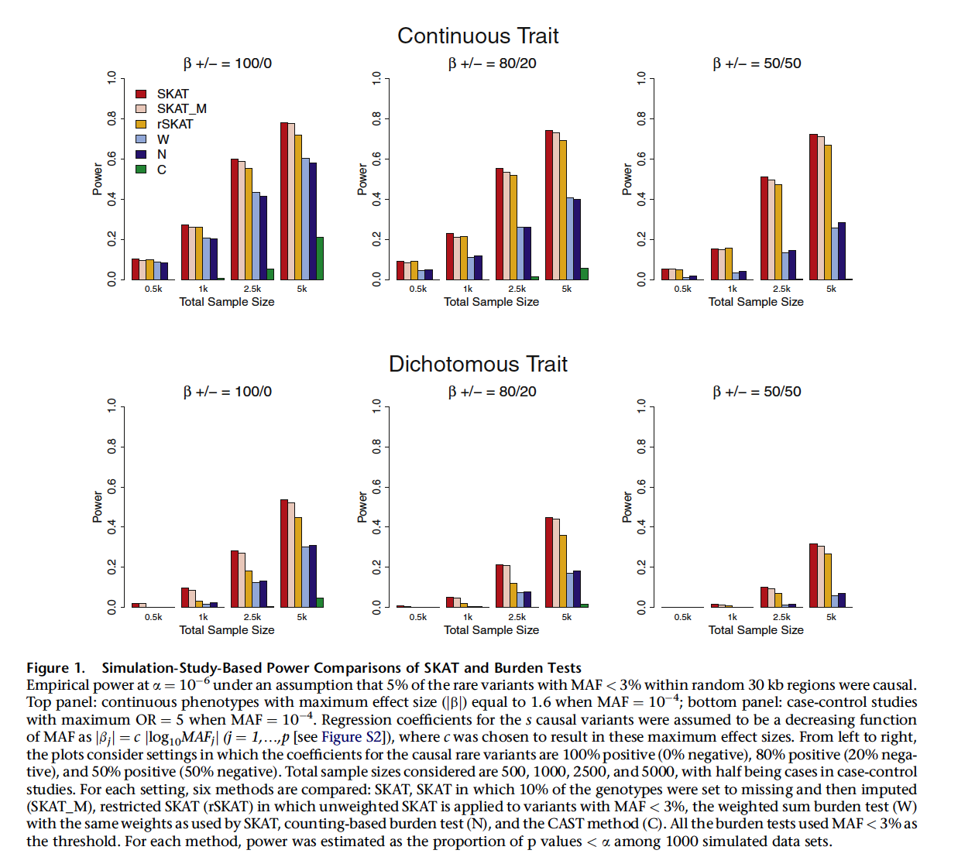

Slide 32
Thank you!

