Slide 1
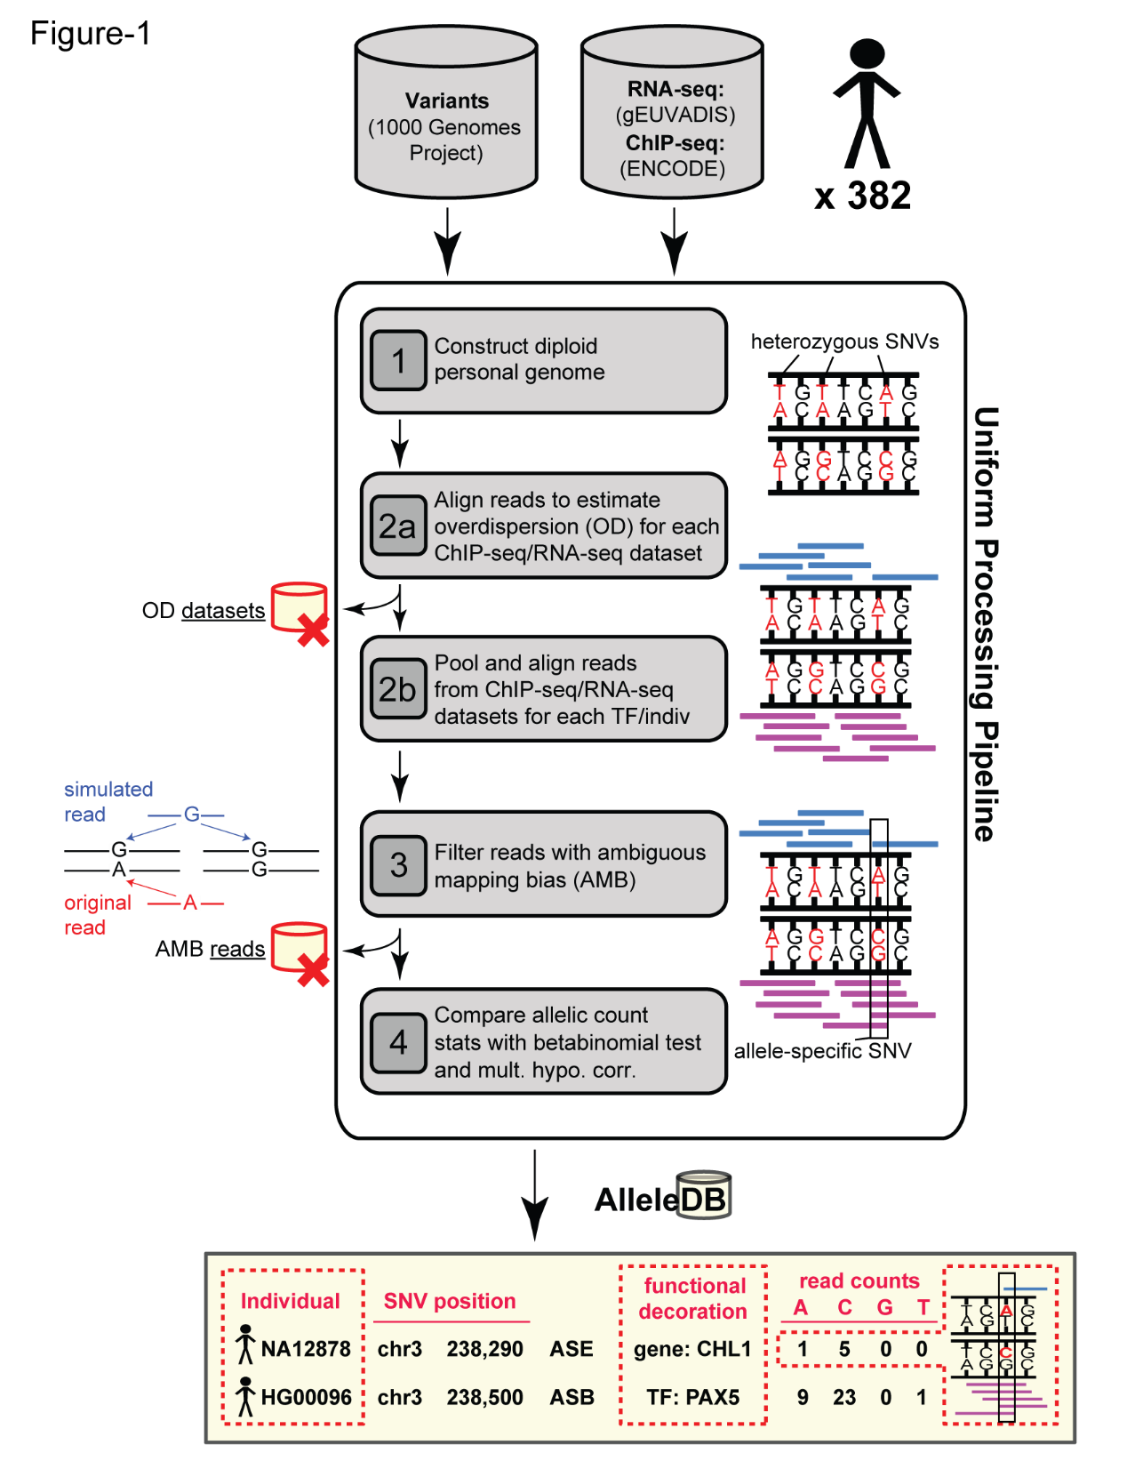

Slide 2
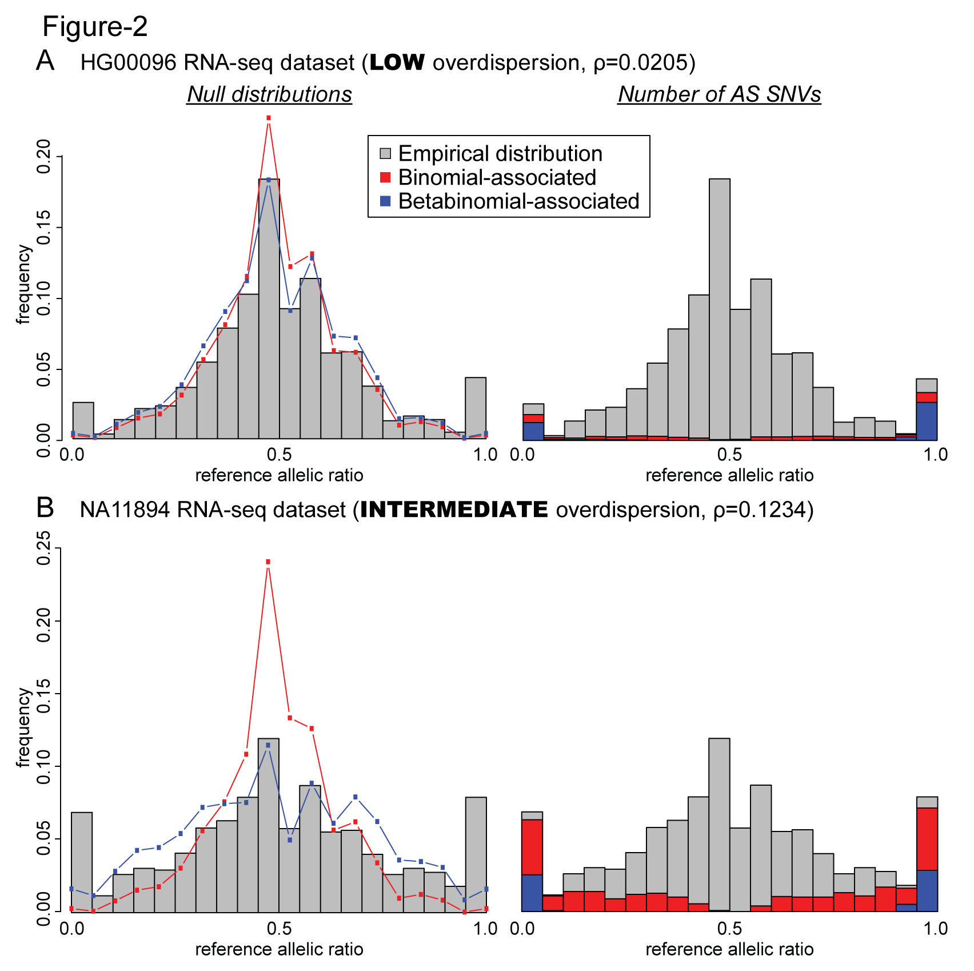

Slide 3
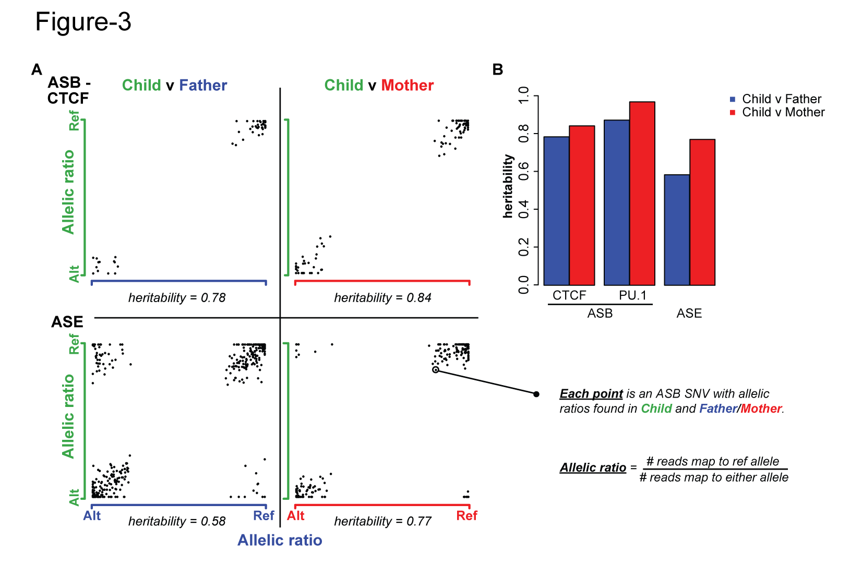

Slide 4
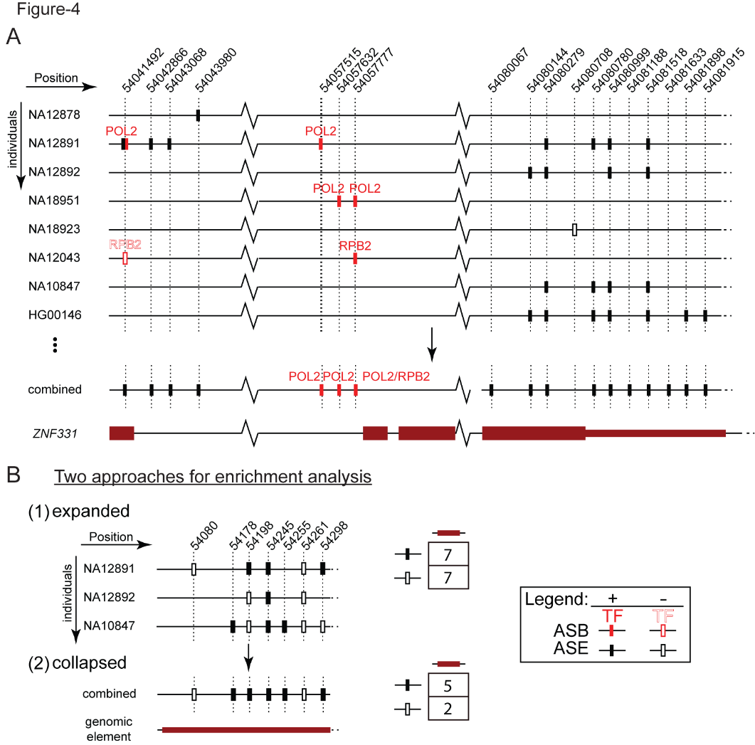

Slide 5
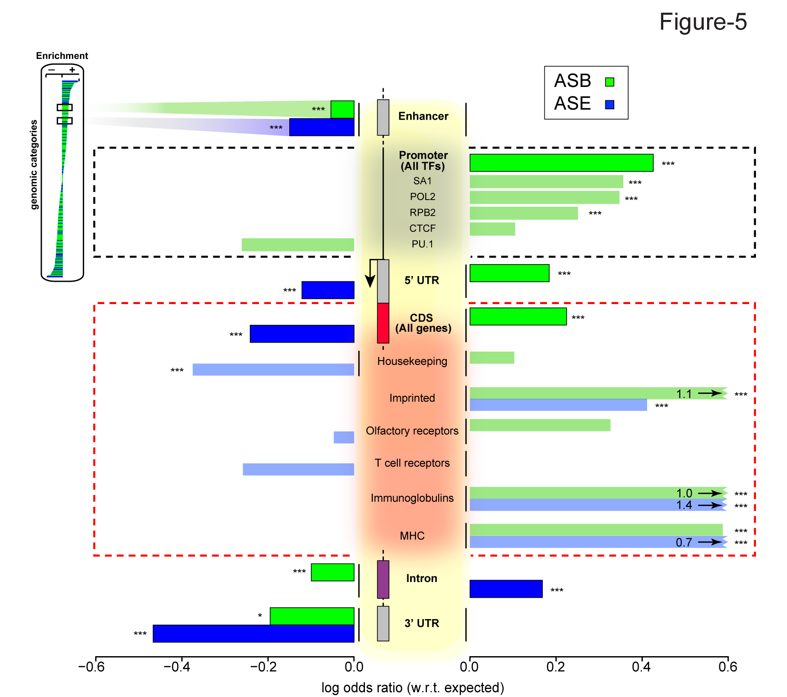

Slide 6
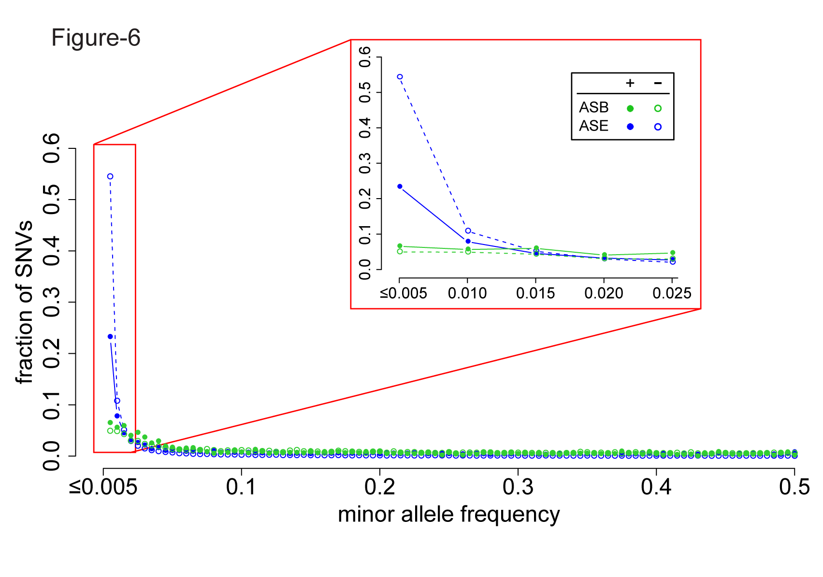

Slide 7
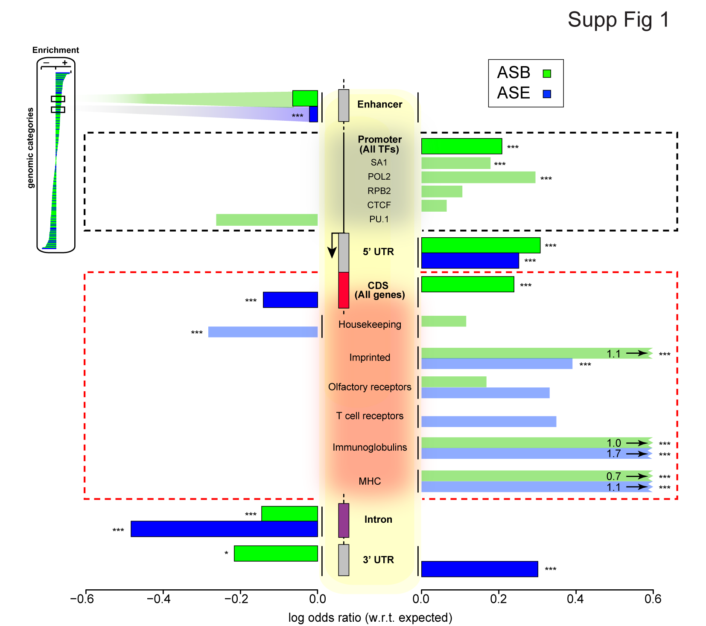

Slide 8
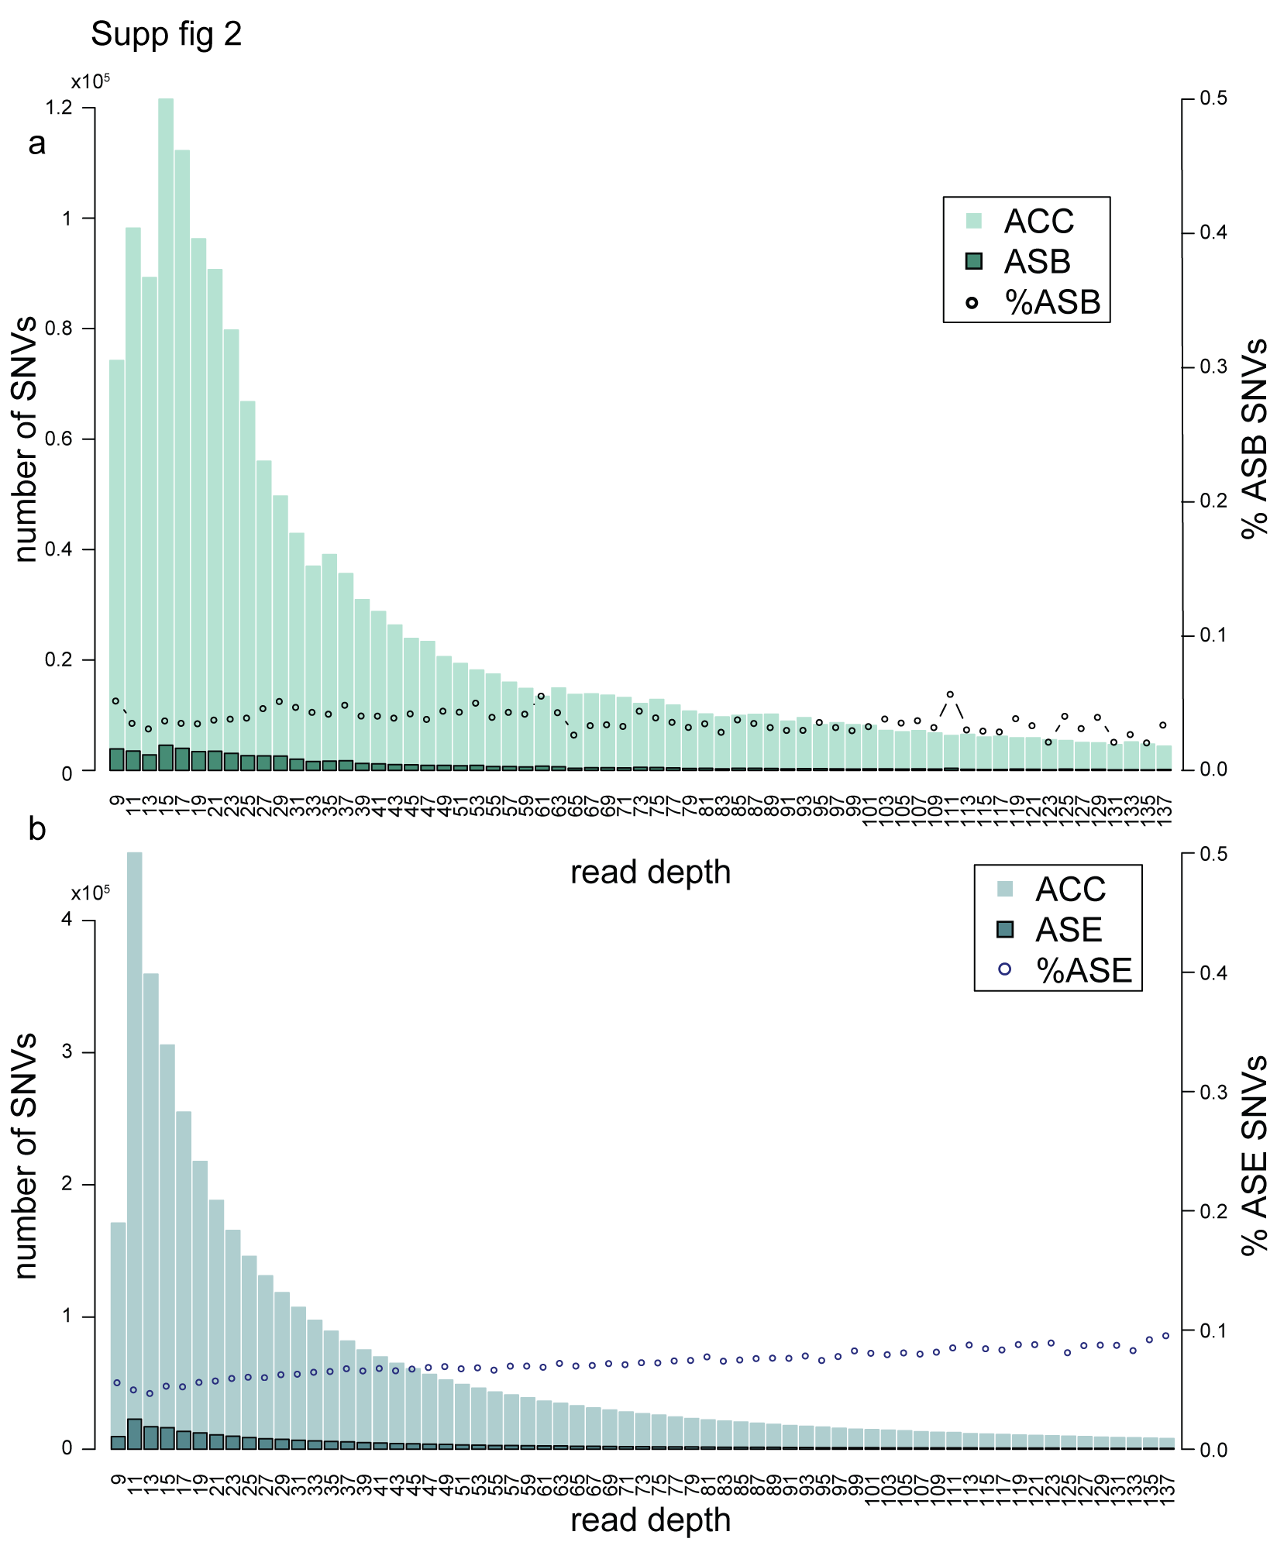

Slide 9
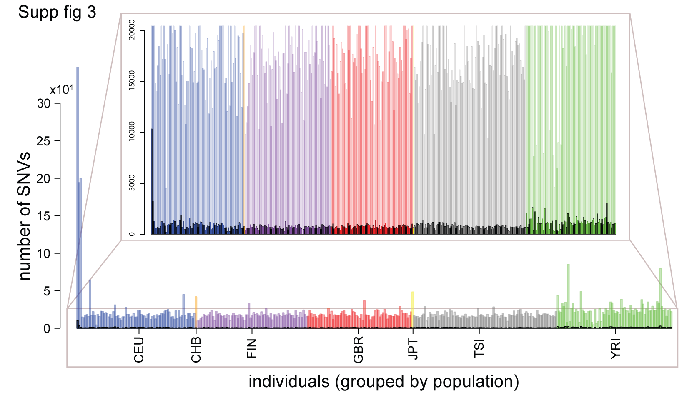

Slide 10
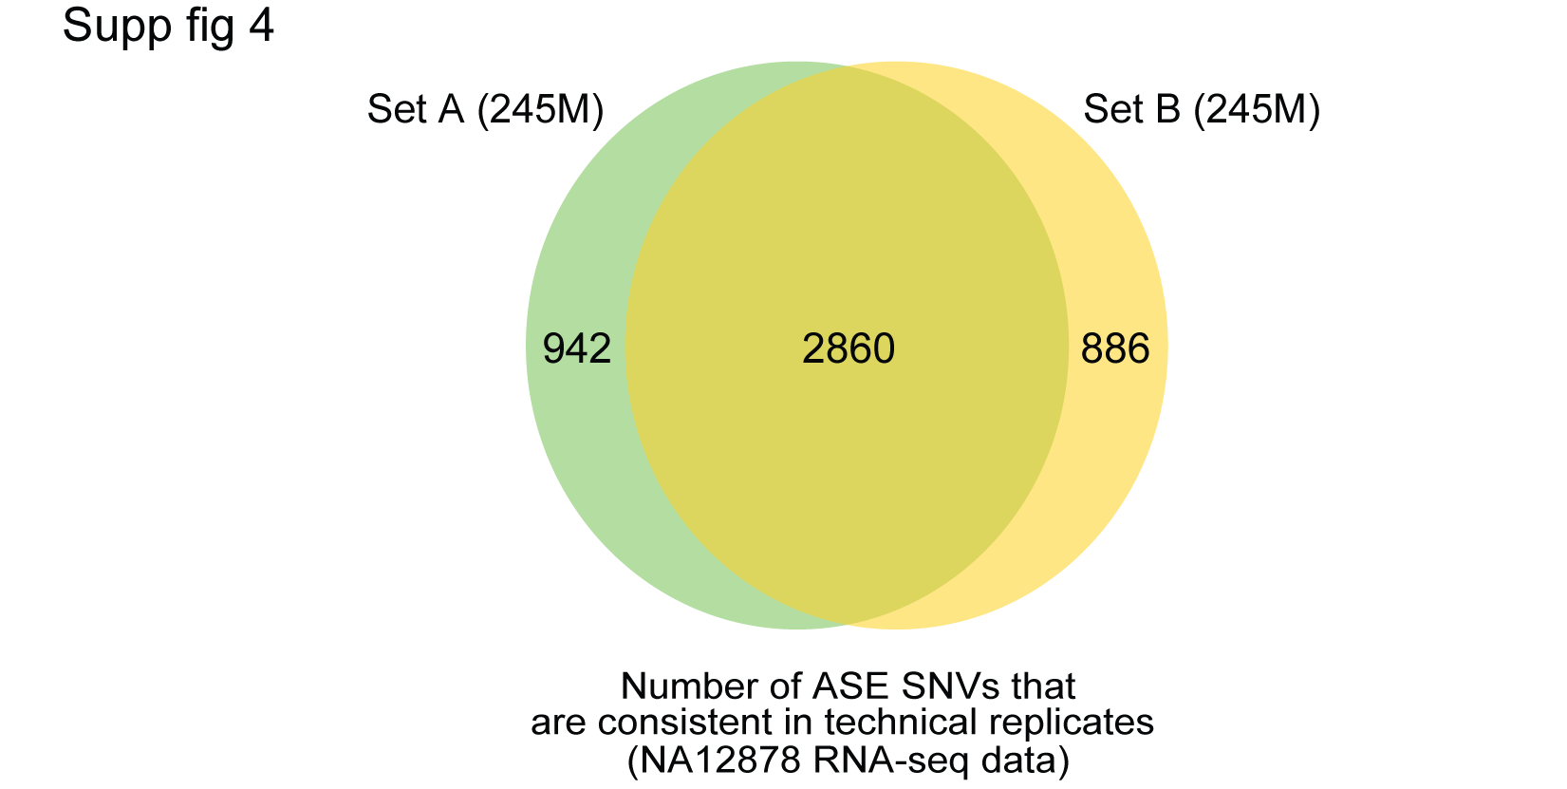

Slide 11
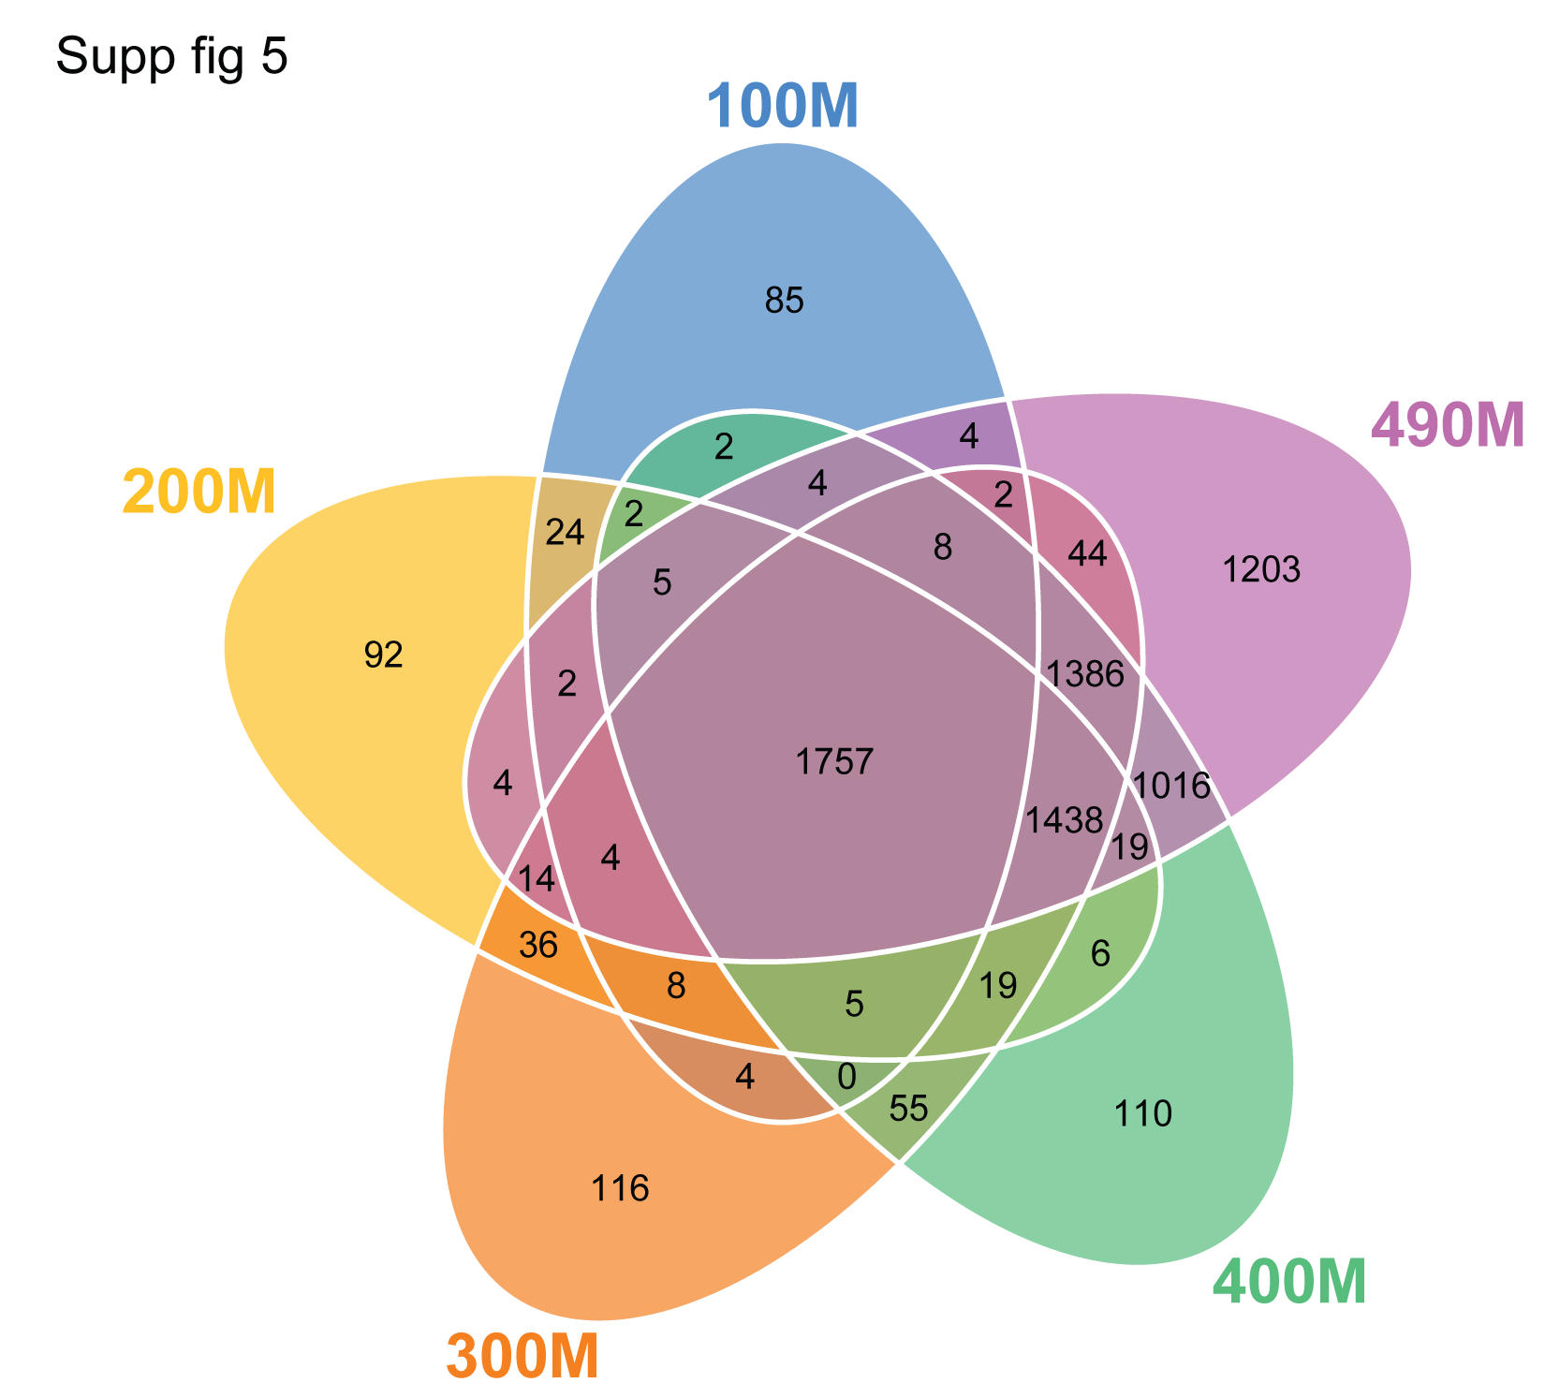

Slide 12


Slide 13


Slide 14
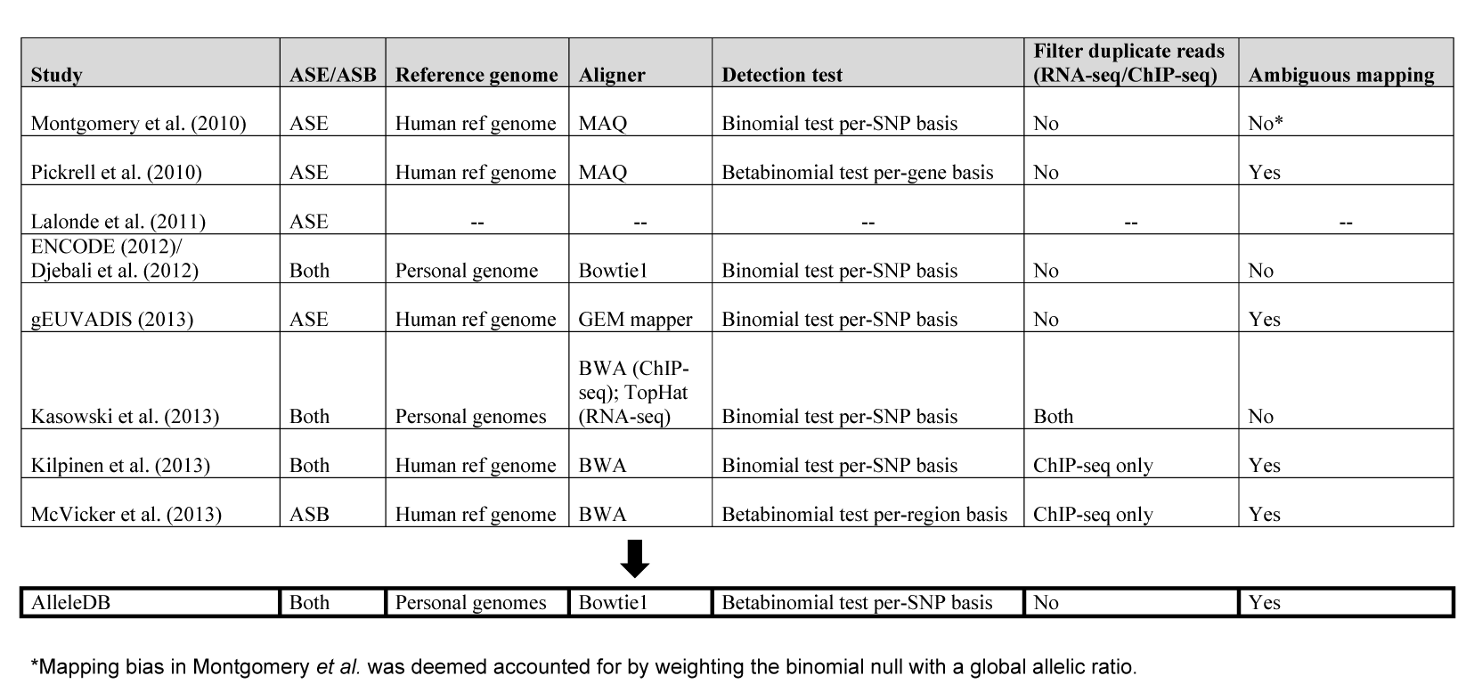
Supp Table 1

Slide 15

Supp Table 2

Slide 16

Supp Table 3

Slide 17

Supp Table 4

Slide 18

Supp Table 5

Slide 19

Supp file 1 – 708 categories

Slide 20

Supp file 2 – 20k genes

Slide 21

Supp file 3 – 40 TFs TFBS in promoters

Slide 22

Supp file 4 – motif disrupting ASB SNVs

Slide 23

Supp file 5 – pseudo code for bisection method

Slide 24

Supp file 6

Slide 25
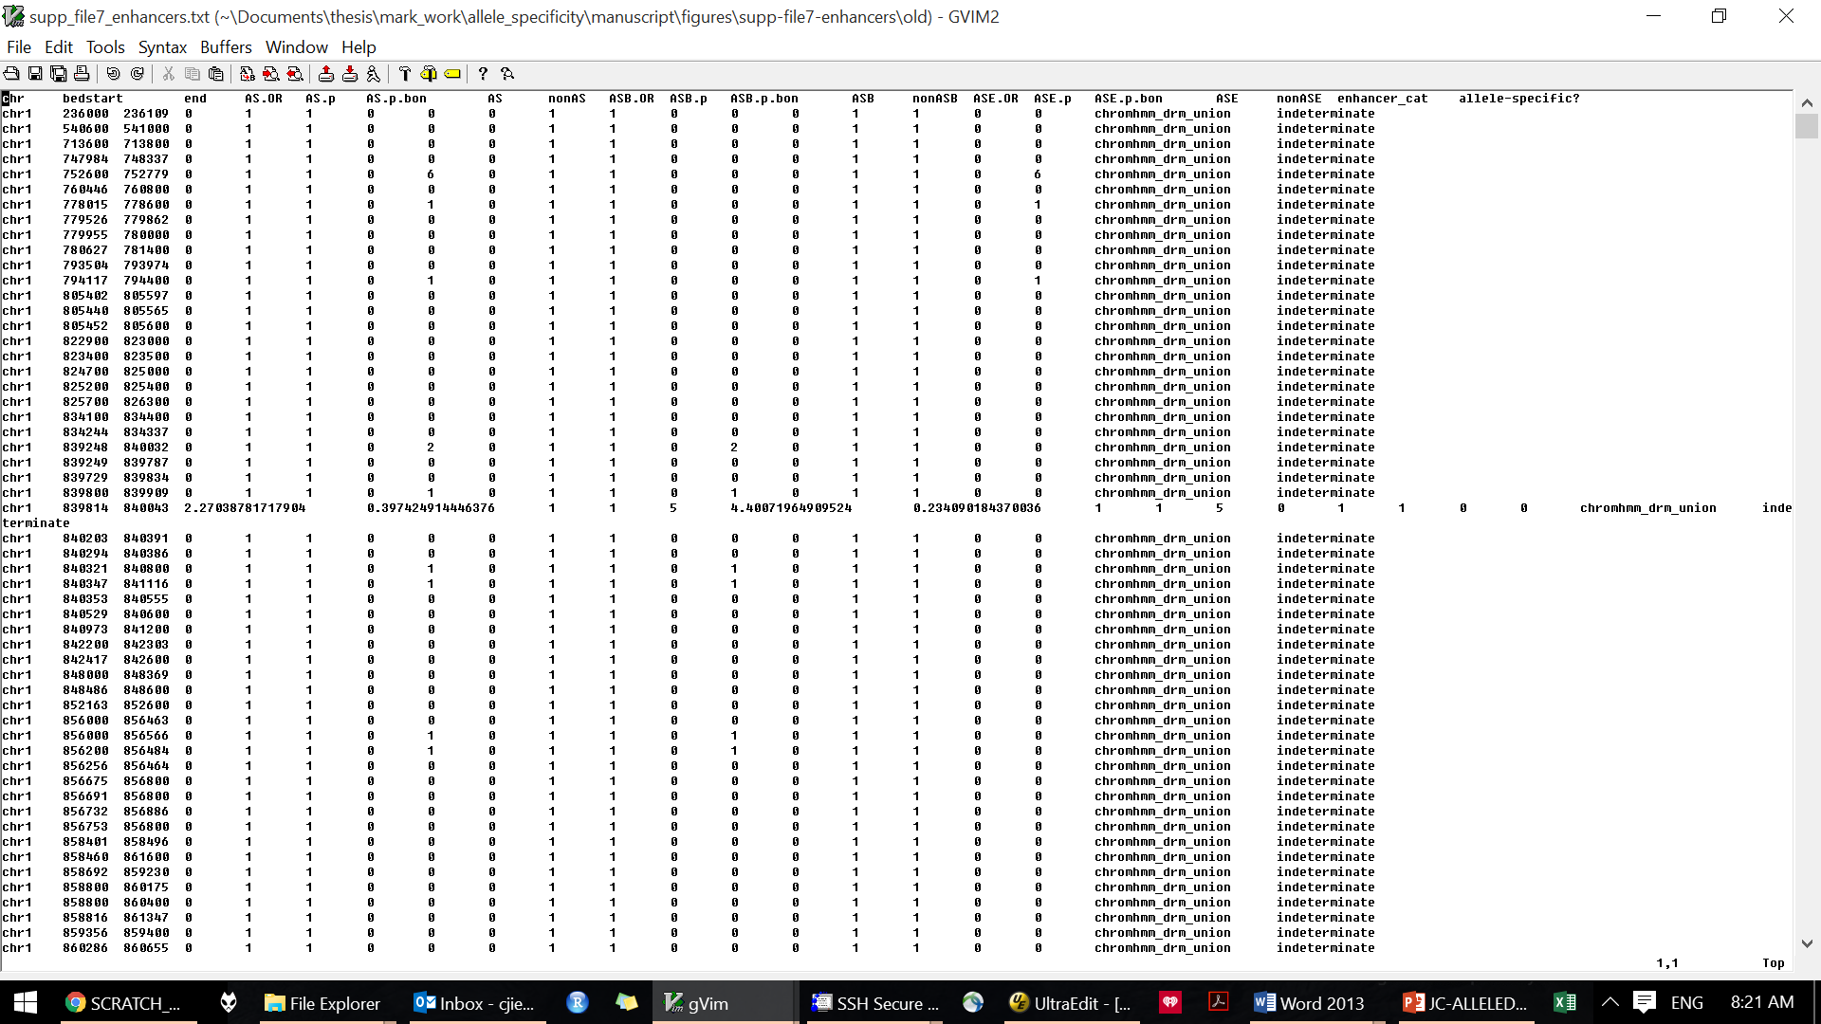
Supp file 7

Slide 26
Alleledb.gersteinlab.org
Online
Downloads
--peaks
--supplementary files

