Slide 1
New AlleleDB submission
Allele
Jieming

Slide 2
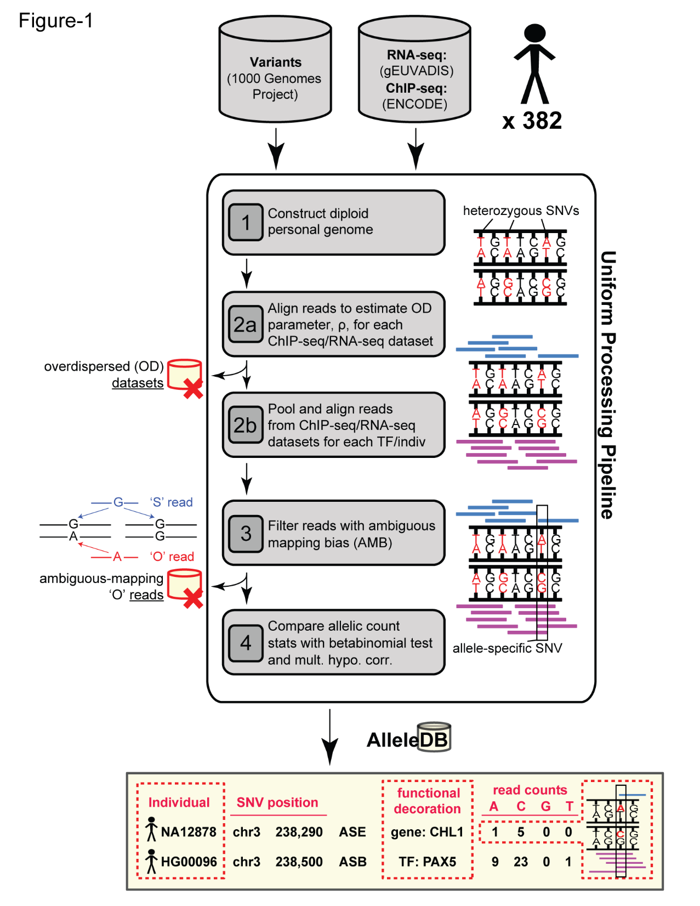
Done

Slide 3
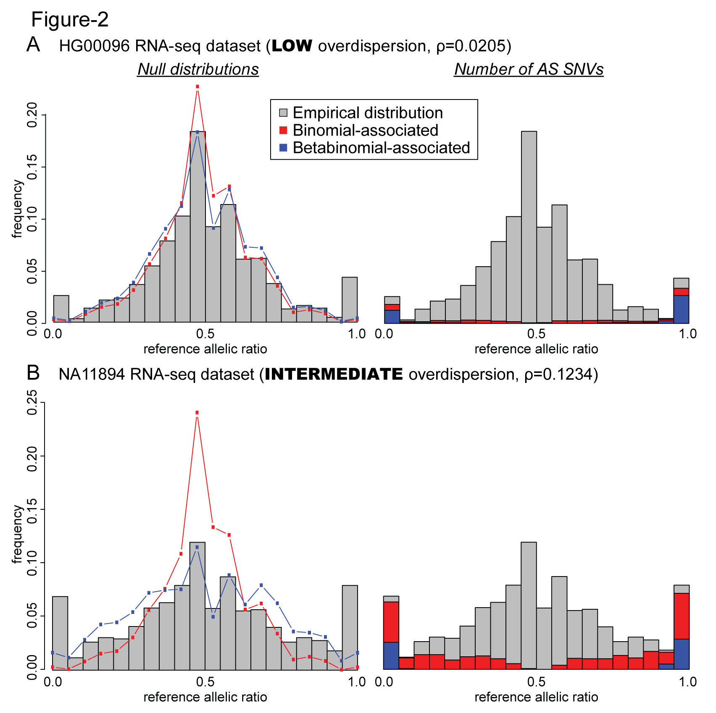
Done

Slide 4
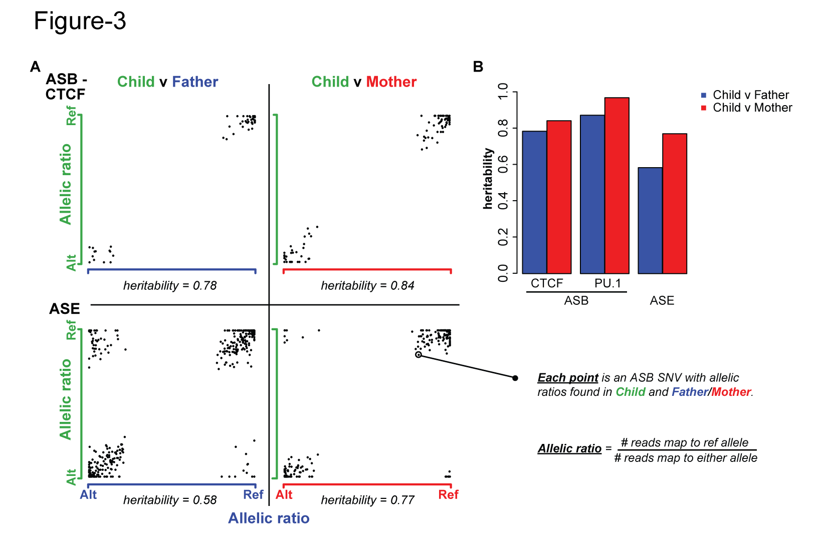
Done

Slide 5
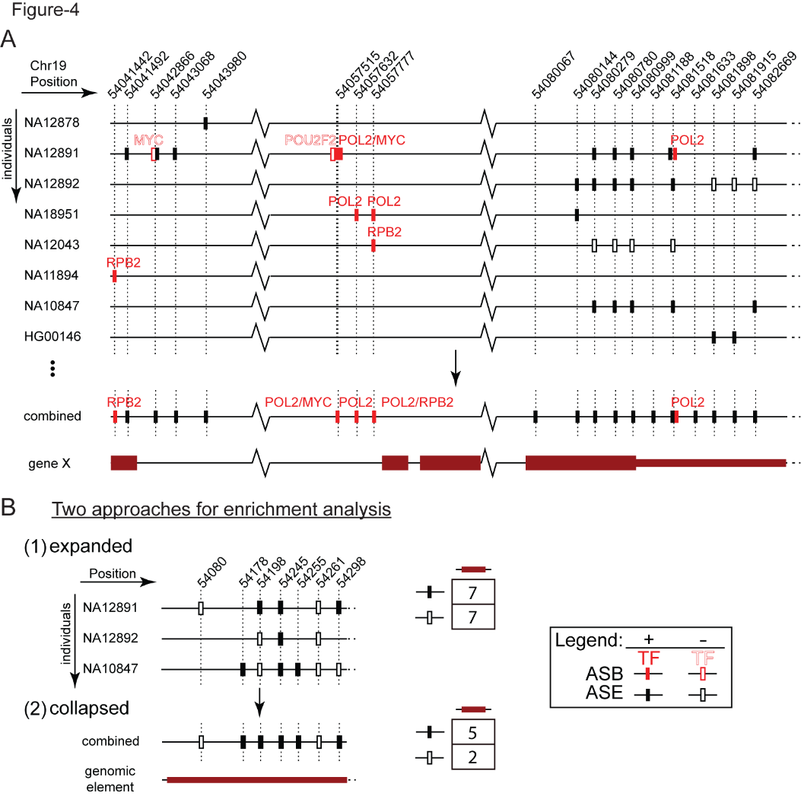
Database visual

Slide 6
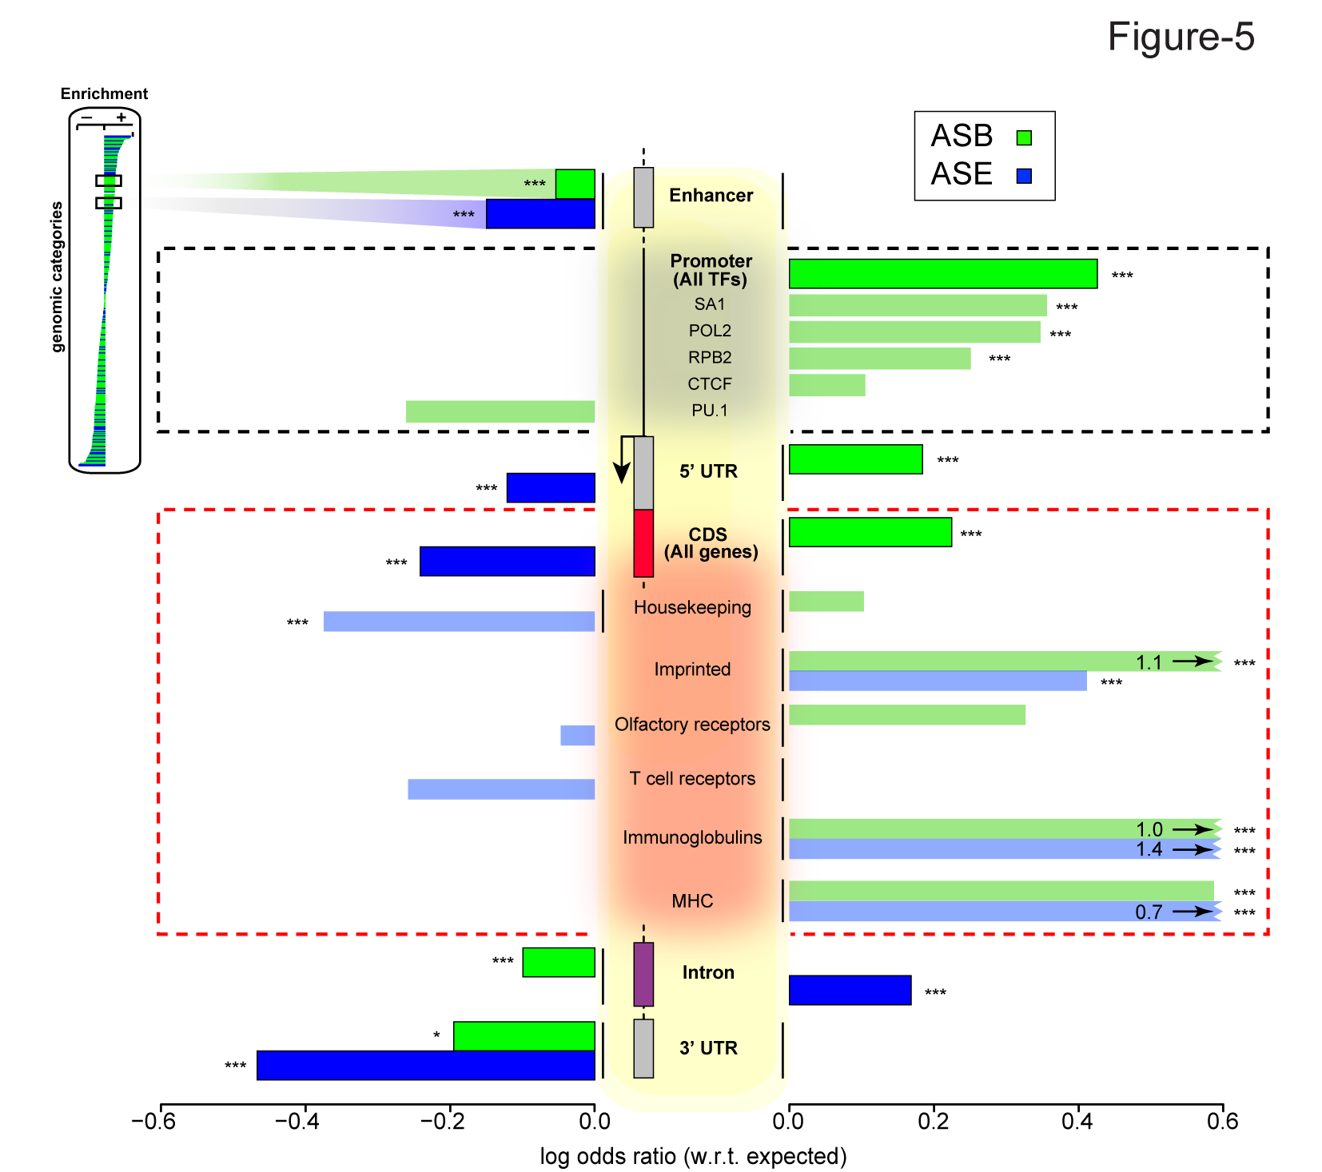
Done

Slide 8
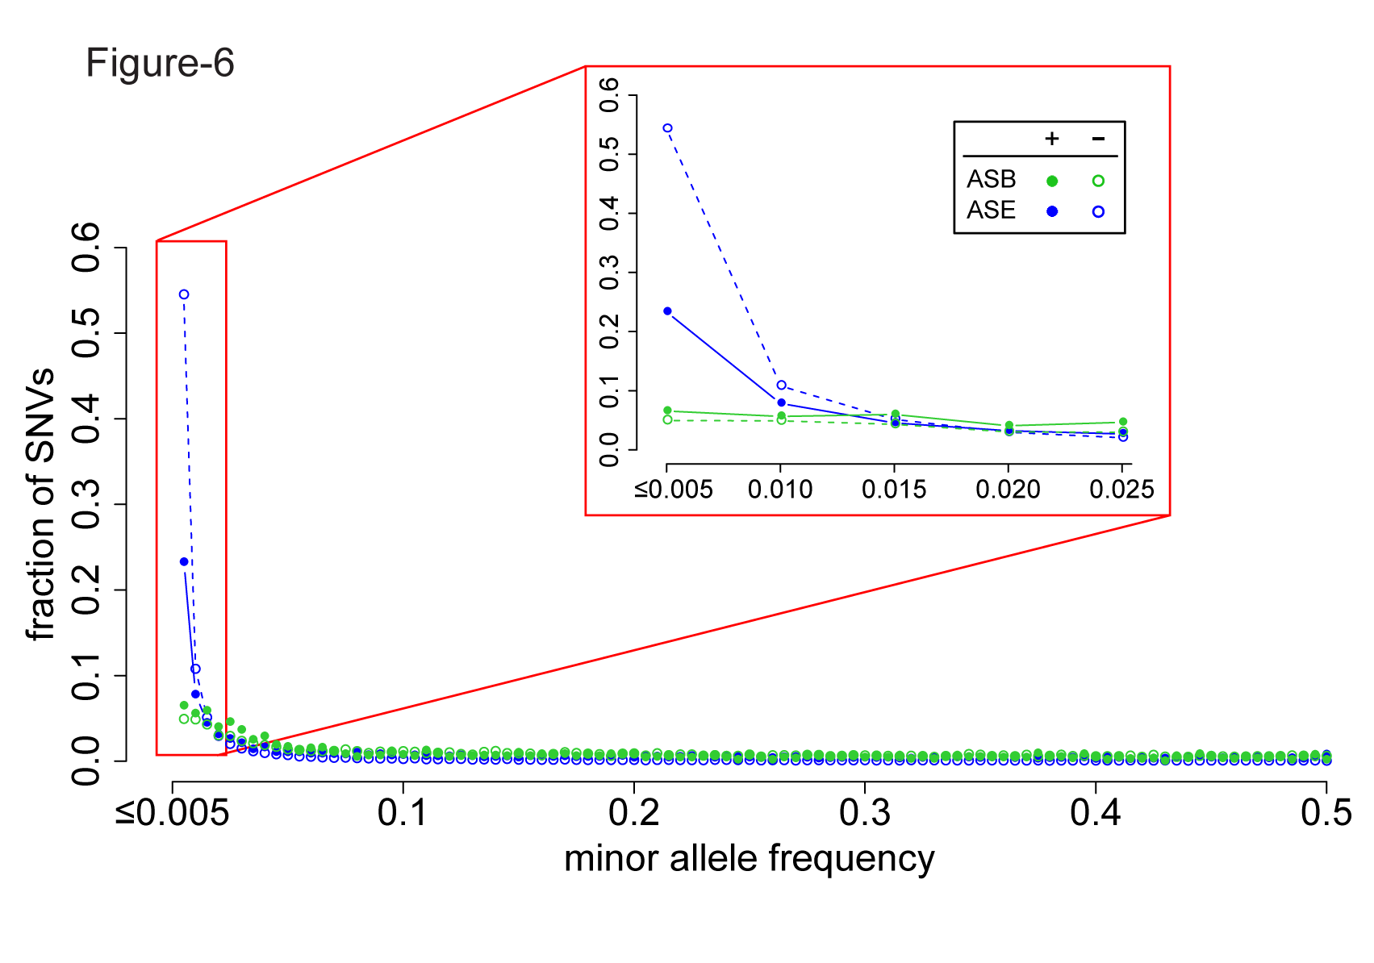
Done

Slide 9
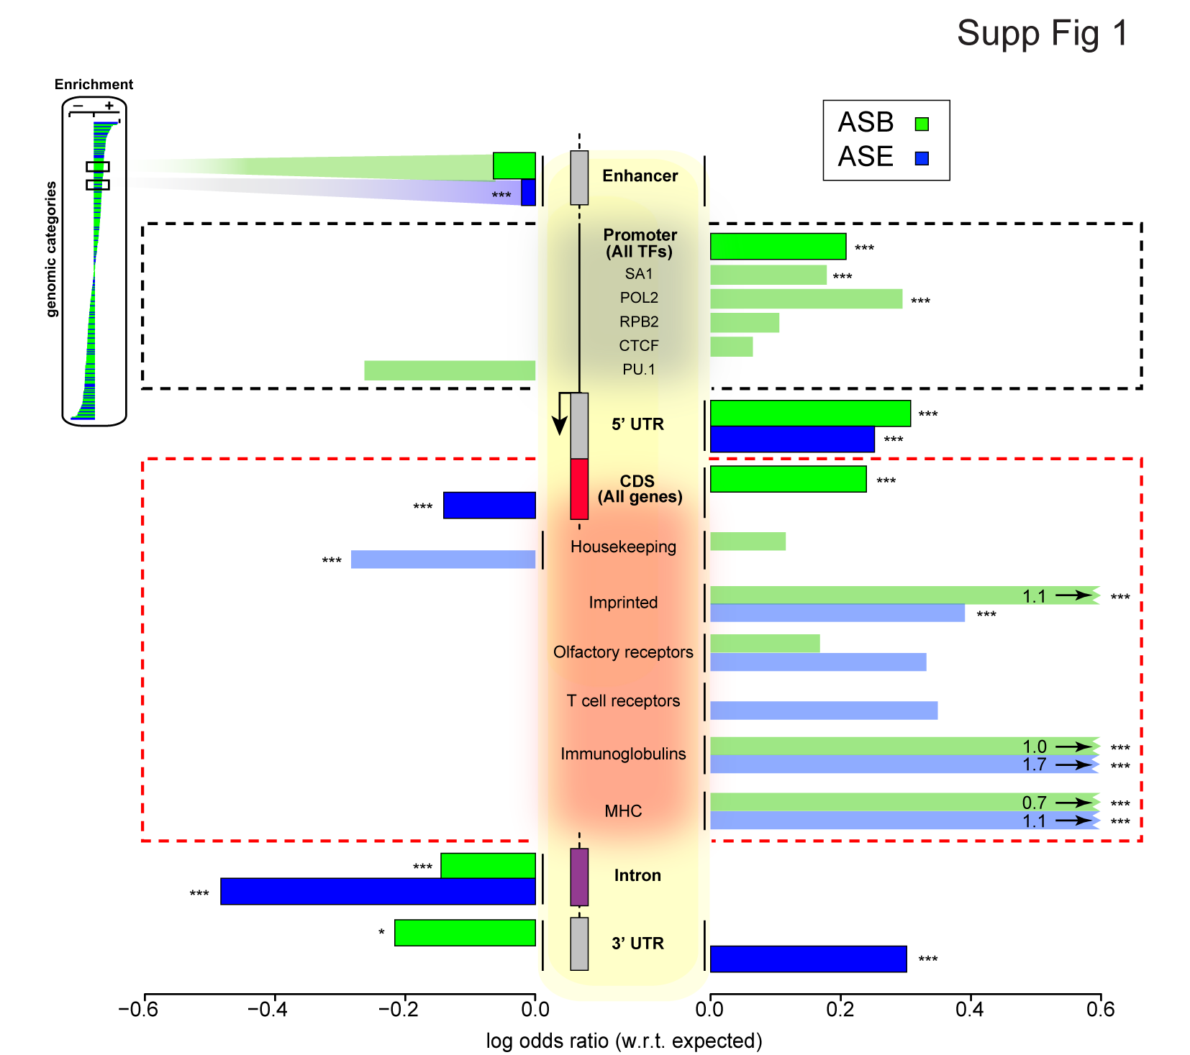
Done

Slide 10
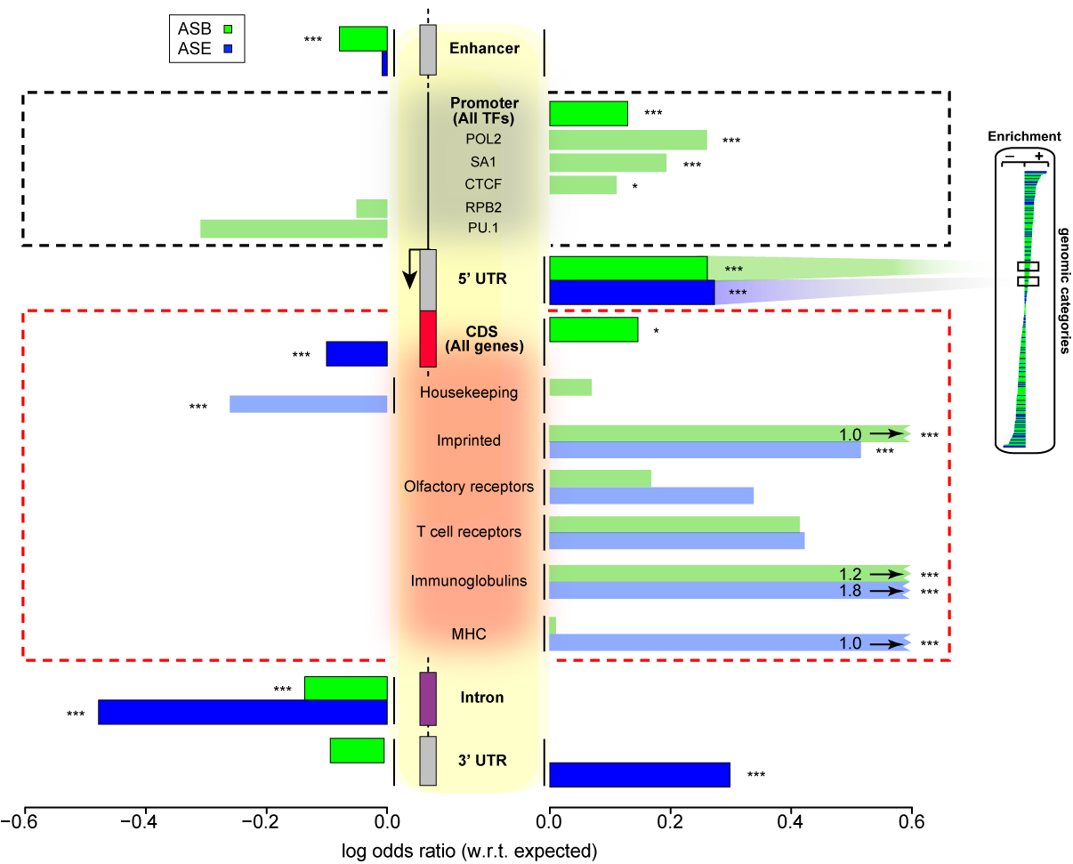

Slide 11
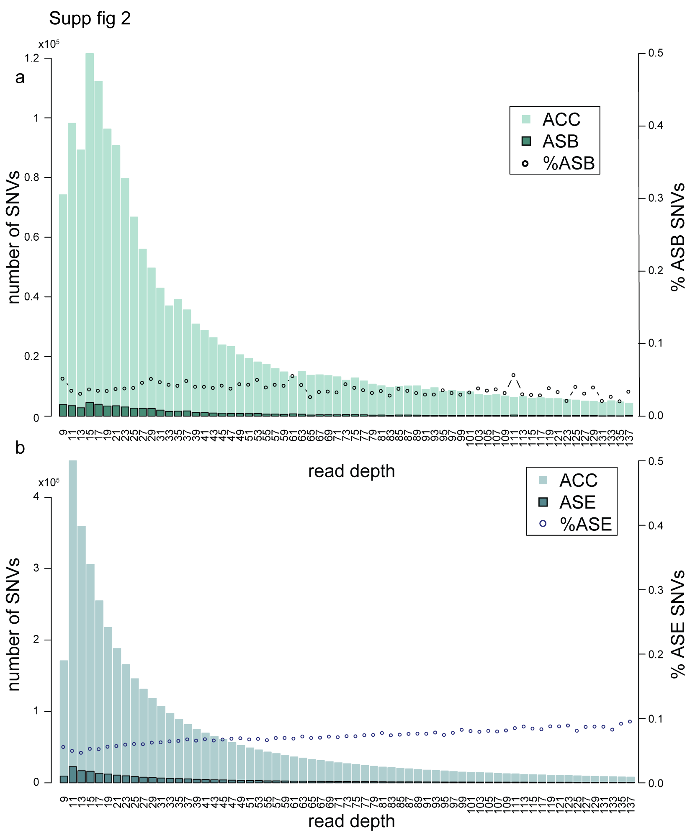
Done

Slide 12
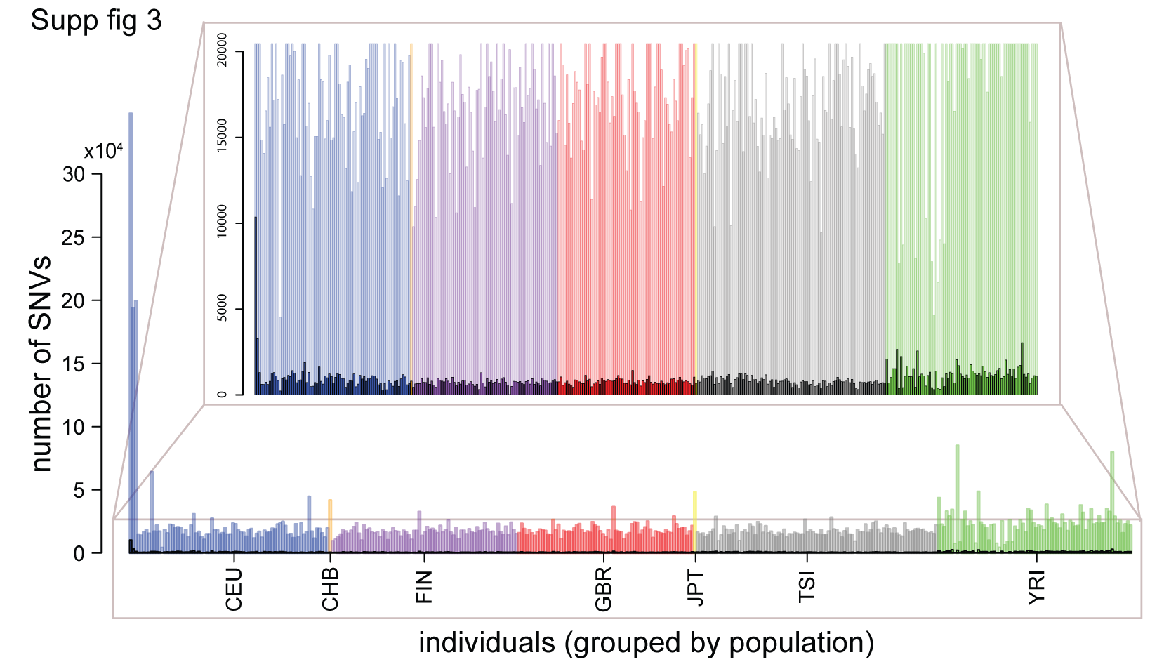
Done

Slide 13
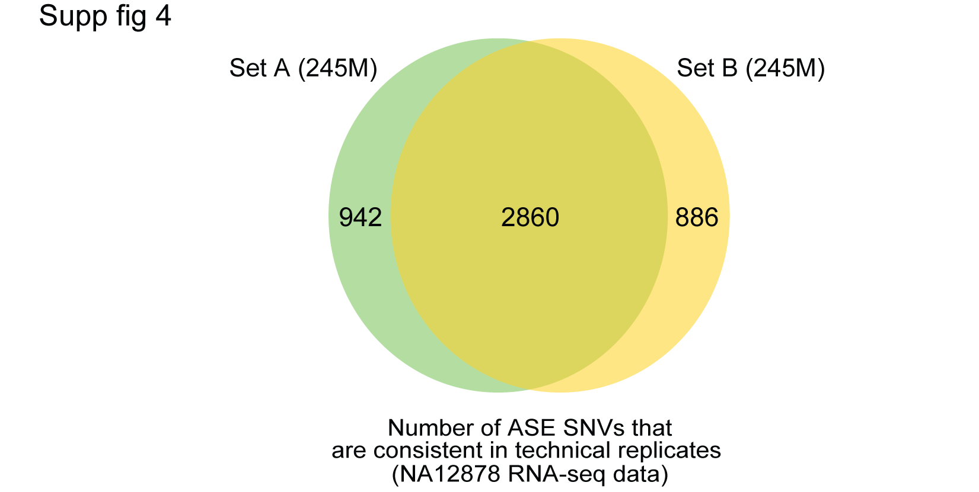
Done

Slide 14
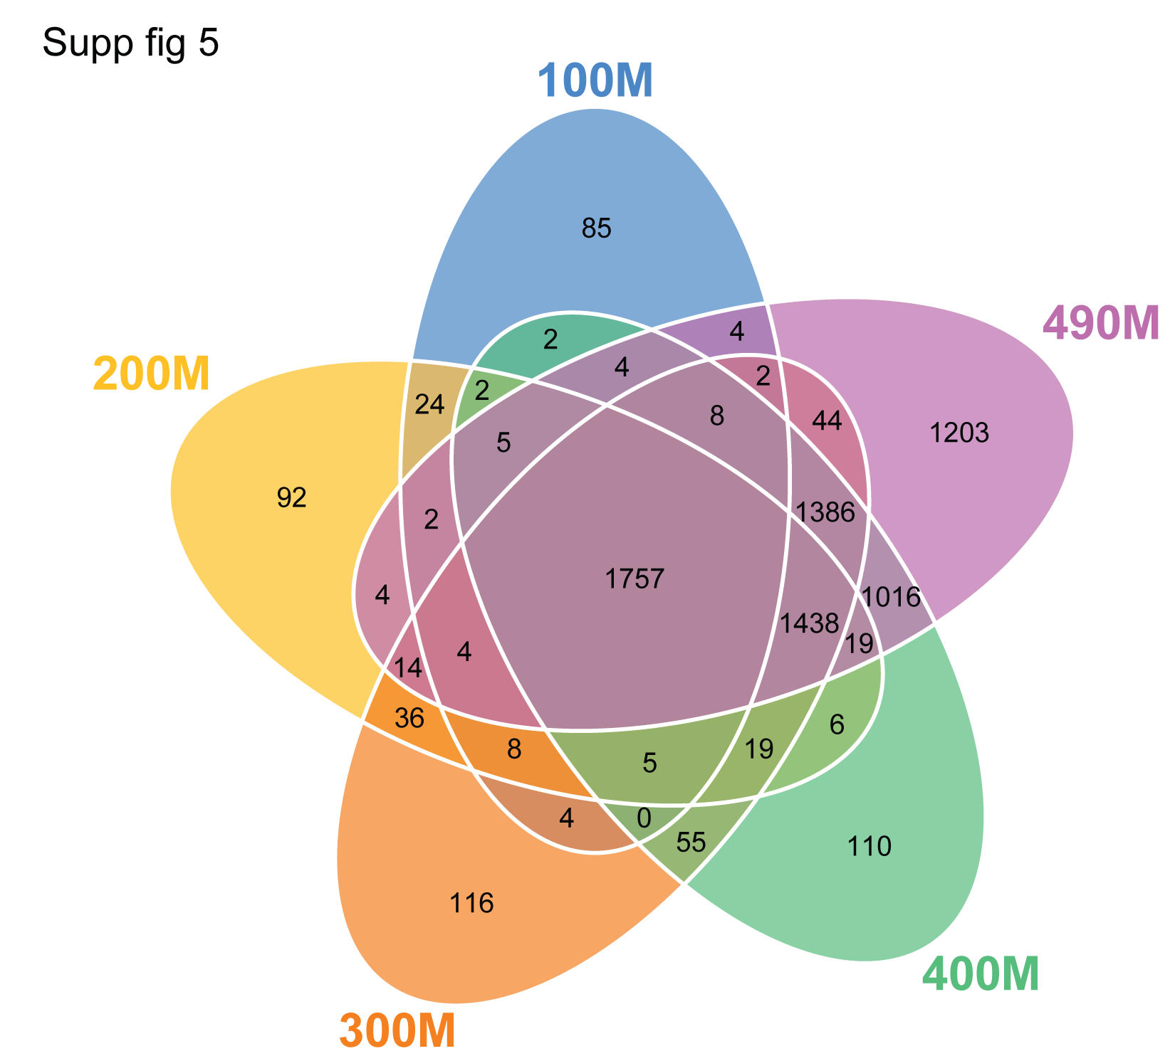
Done

Slide 15


Done

Slide 18
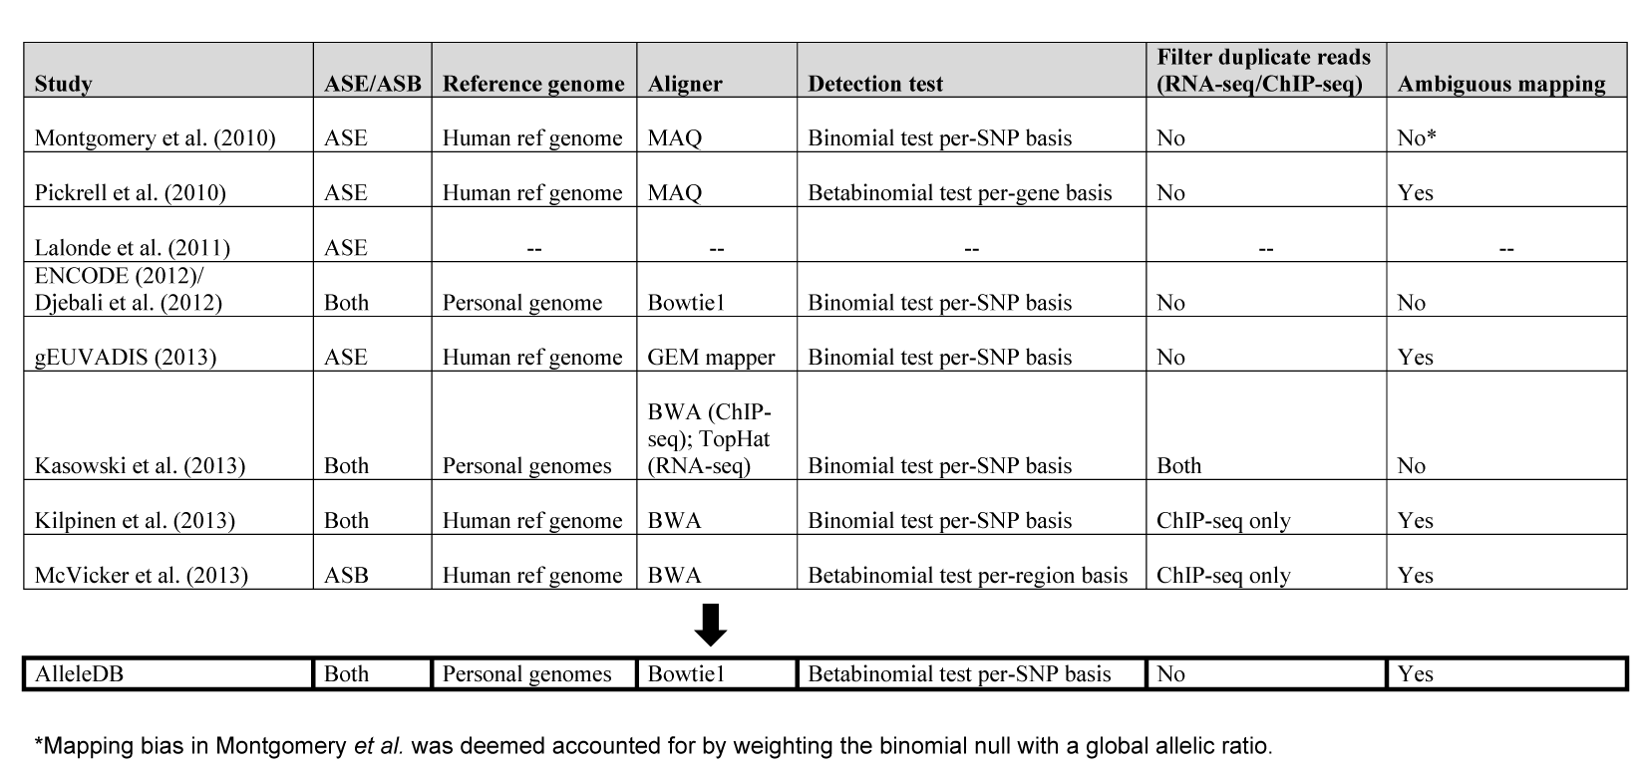
Supp table 1
Done

Slide 19

Supp Table 2
Done

Slide 20

Supp Table 3
Done

Slide 21

Supp Table 4
Done

Slide 22
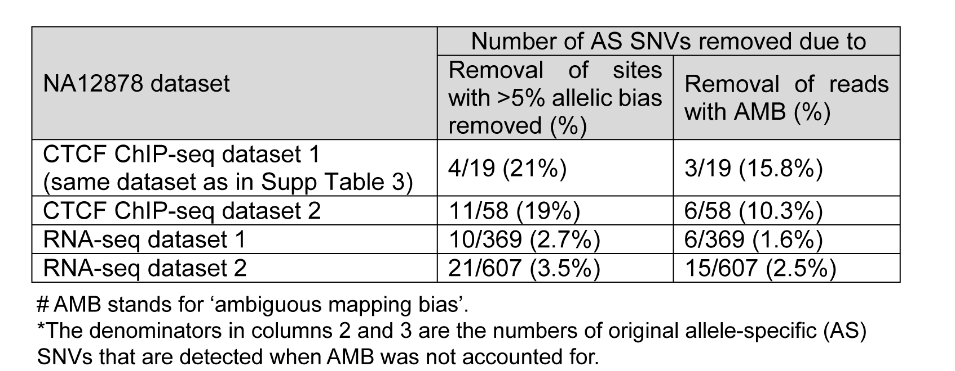
Supp Table 5

Slide 23
Remaining Things to do
Supplementary files 1-7
Set up database

