Slide 1
New AlleleDB submission
Allele
Jieming

Slide 2
Checklist
AlleleDB pipeline
Current pipeline
Arif, Rob and Timur helping me
Response
Manuscript
Figures 1 and 2
Figures 3-6 and main table require results
Supp Figures 1-5 require results
Supp tables 1 and 2
Supp table 3 require results
Supp files 1-4,6,7 require results
Supp file 5 (pseudo code for bisection method)
Website
include AlleleDB tool
Personal genome peaks

Slide 3
AlleleDB ‘ambiguous mapping bias’ module (3) --considerably more efficient now
8 sections
1-alignment-kasowski_SA1_NA10847 --INPUT: *.fastq.gz; OUTPUT: bowtie output
2-map.back.ref-kasowski_SA1_NA10847: --INPUT: (1) OUTPUT, 2ref.chain files; OUTPUT: BED files of reads in reference coordinates
3-intersectBed-kasowski_SA1_NA10847: --INPUT: (2) OUTPUT, het snp file; OUTPUT: which read has SNVs
4-flip-kasowski_SA1_NA10847: --INPUT: (3) OUTPUT; OUTPUT: fastq files of simulated flipped reads that overlap >1 hetSNVs
5-alignment2-kasowski_SA1_NA10847: --INPUT: (4) OUTPUT, ; OUTPUT: aligned, unaligned, multi Bowtie1 output
6-unaligned-kasowski_SA1_NA10847: --INPUT: (5); OUTPUT: BED of unaligned reads
7-multi-kasowski_SA1_NA10847: --INPUT: (5); OUTPUT: BED of multi reads
Remove reads from aligned read pile from (1) --this section filters a) reads overlapping SNVs that are tri/quadallelic, or b) reads that overlap >=5 SNVs c) reads that do not map to same location (+- 10bp) on both parental genomes --Run AlleleSeq with betabinomial calc

Slide 4
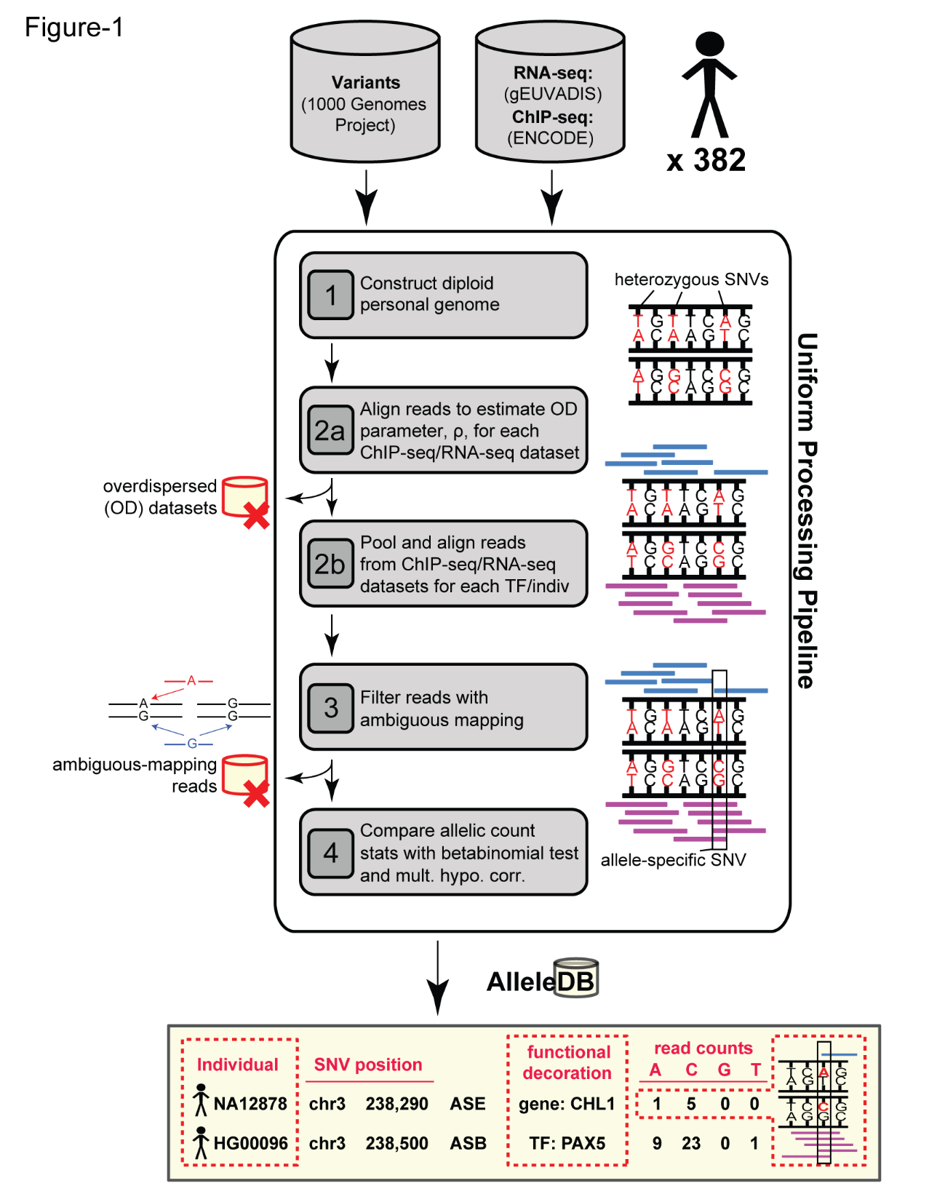

Slide 5
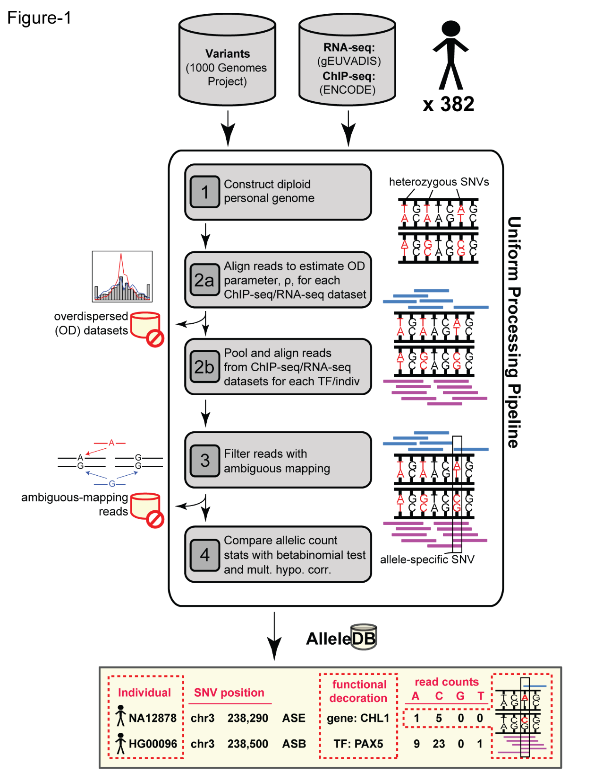

Slide 7
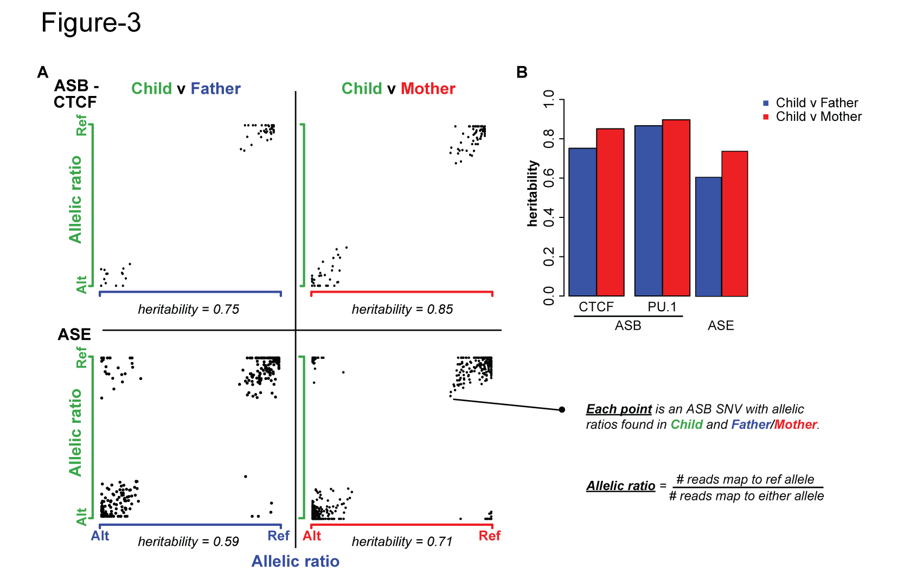

Slide 9
Database visual

Slide 10
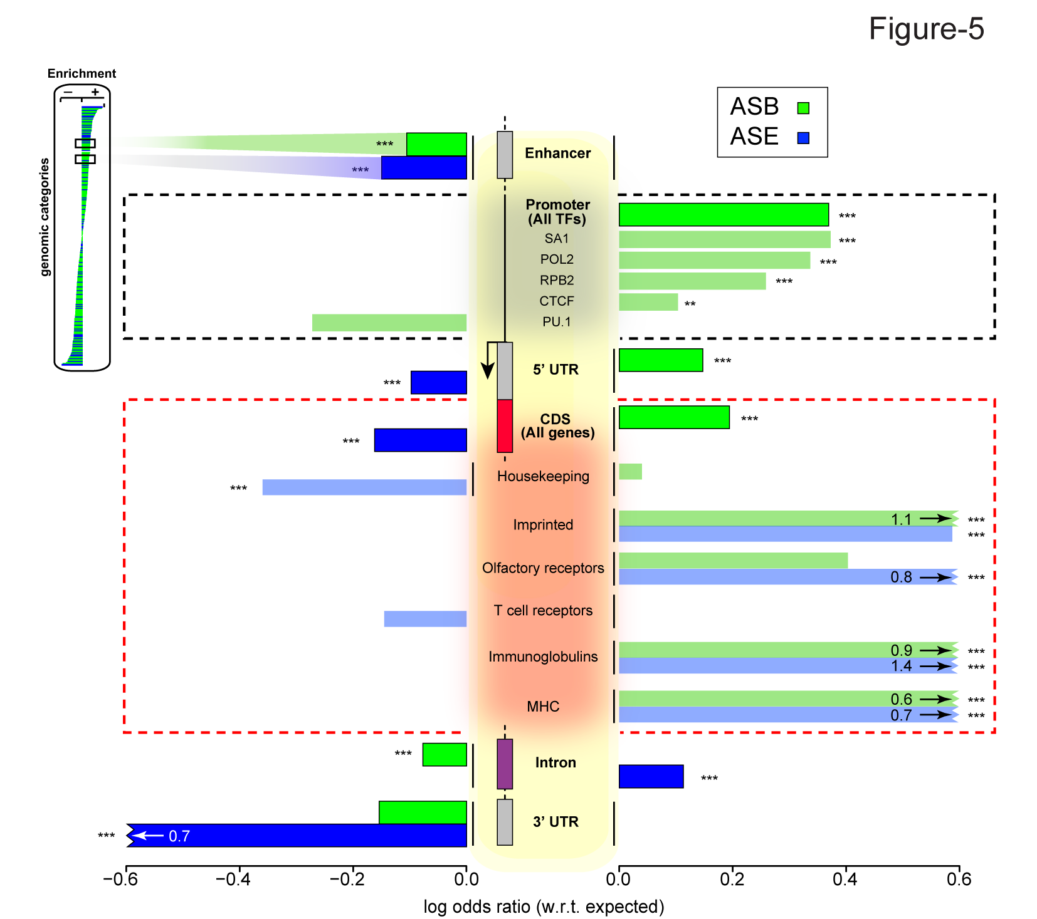

Slide 11
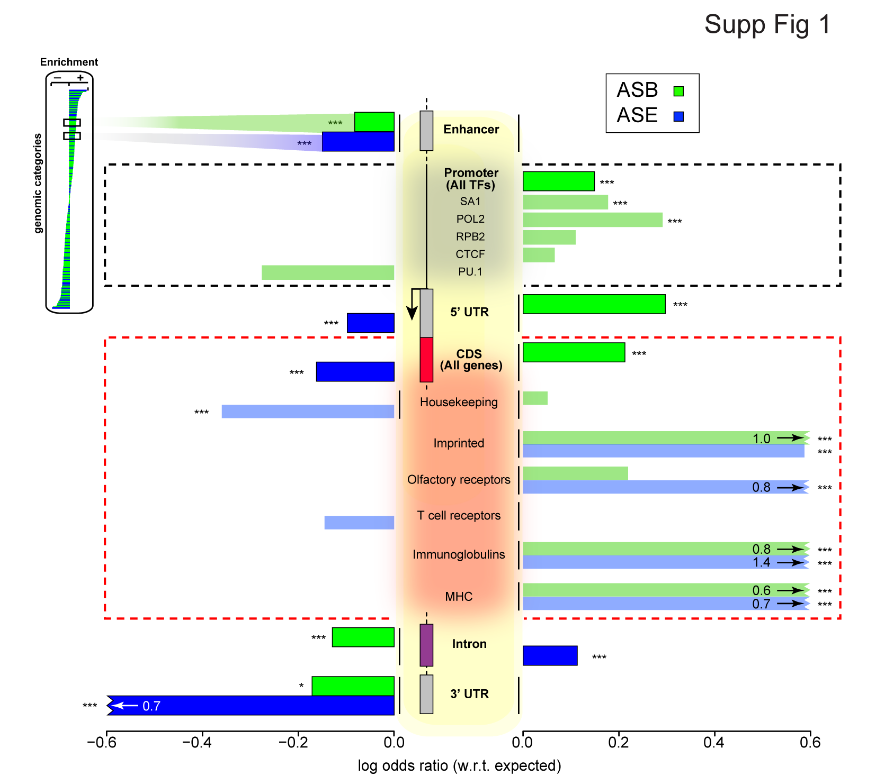

Slide 12
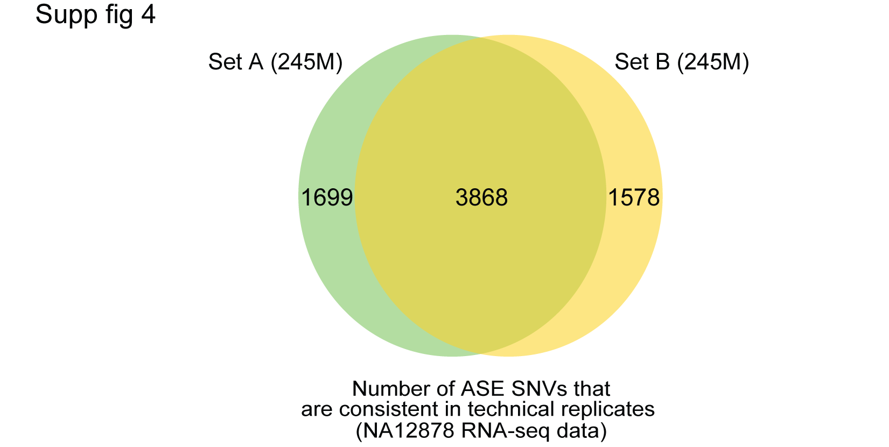

Slide 13
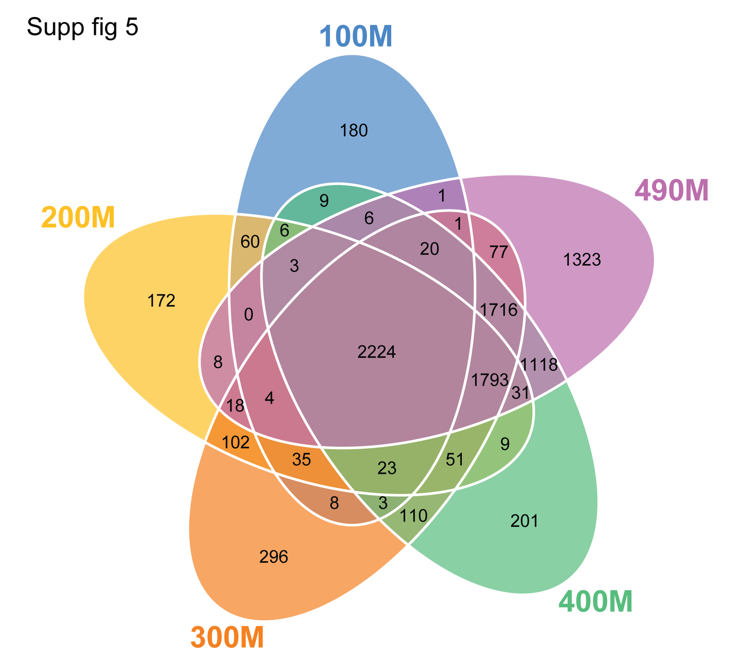

Slide 14
Supp table 1

Slide 15
Supp Table 2

Slide 16
Supp Table 3

Slide 17
Supp Table 4

Slide 18
Supp Table 5

Slide 19
Slides not updated

Slide 20
Freq spectra

Slide 24
AOB
Email to editor for extension of deadline

