Slide 1
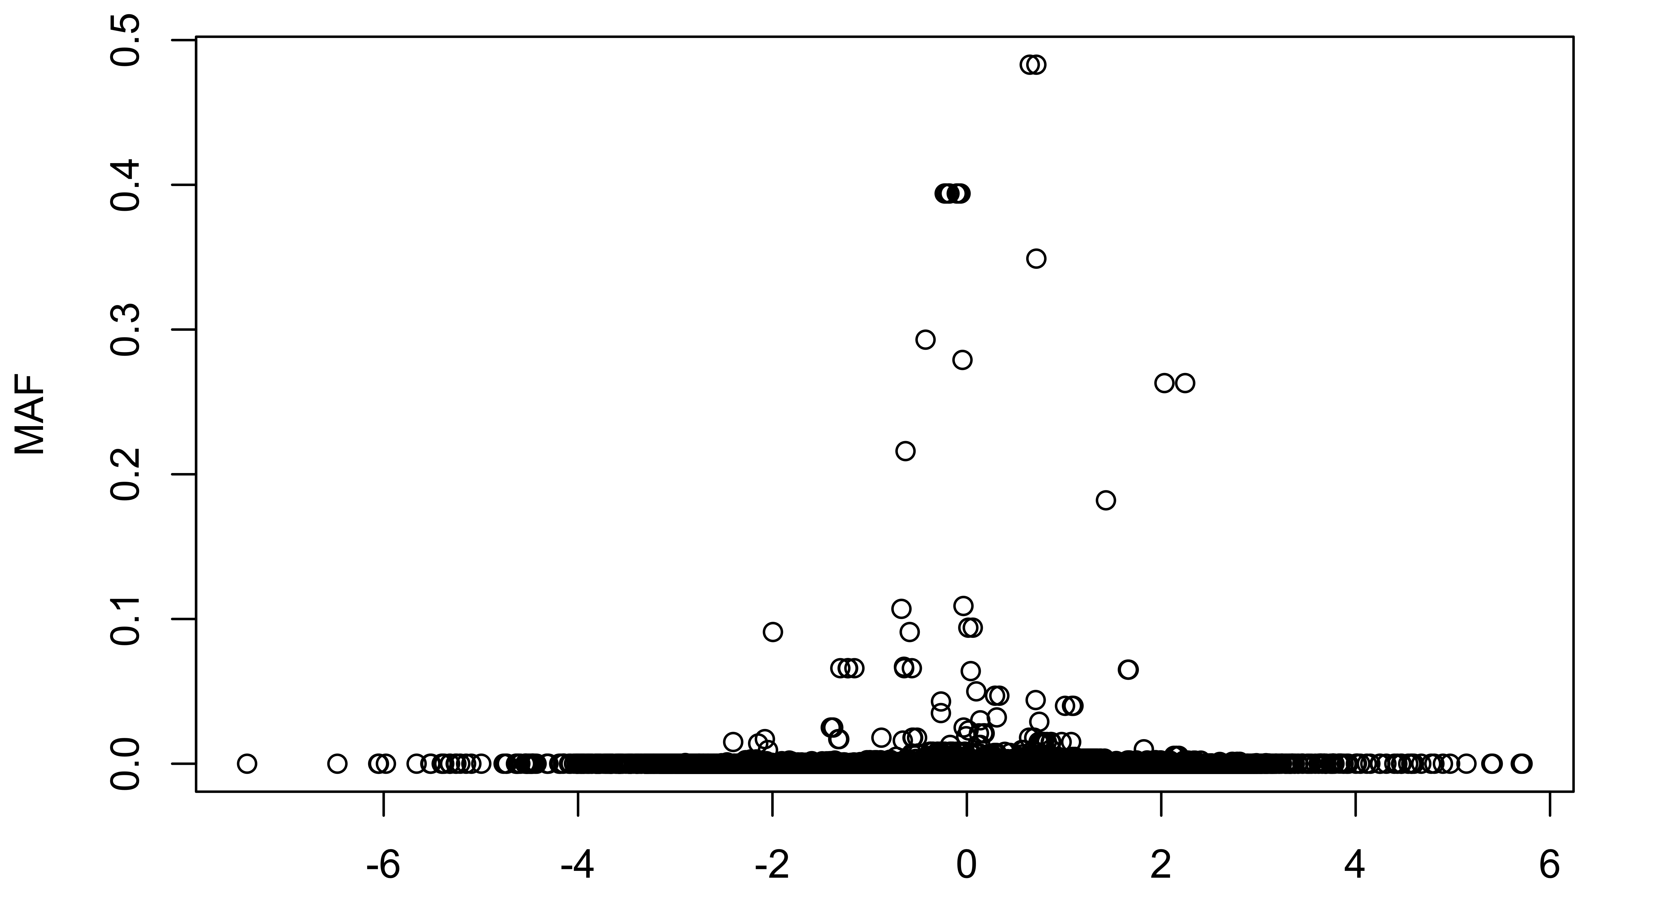
ExAC SNVs within the Core
ΔΔE
Notes:
Exac core

Slide 2
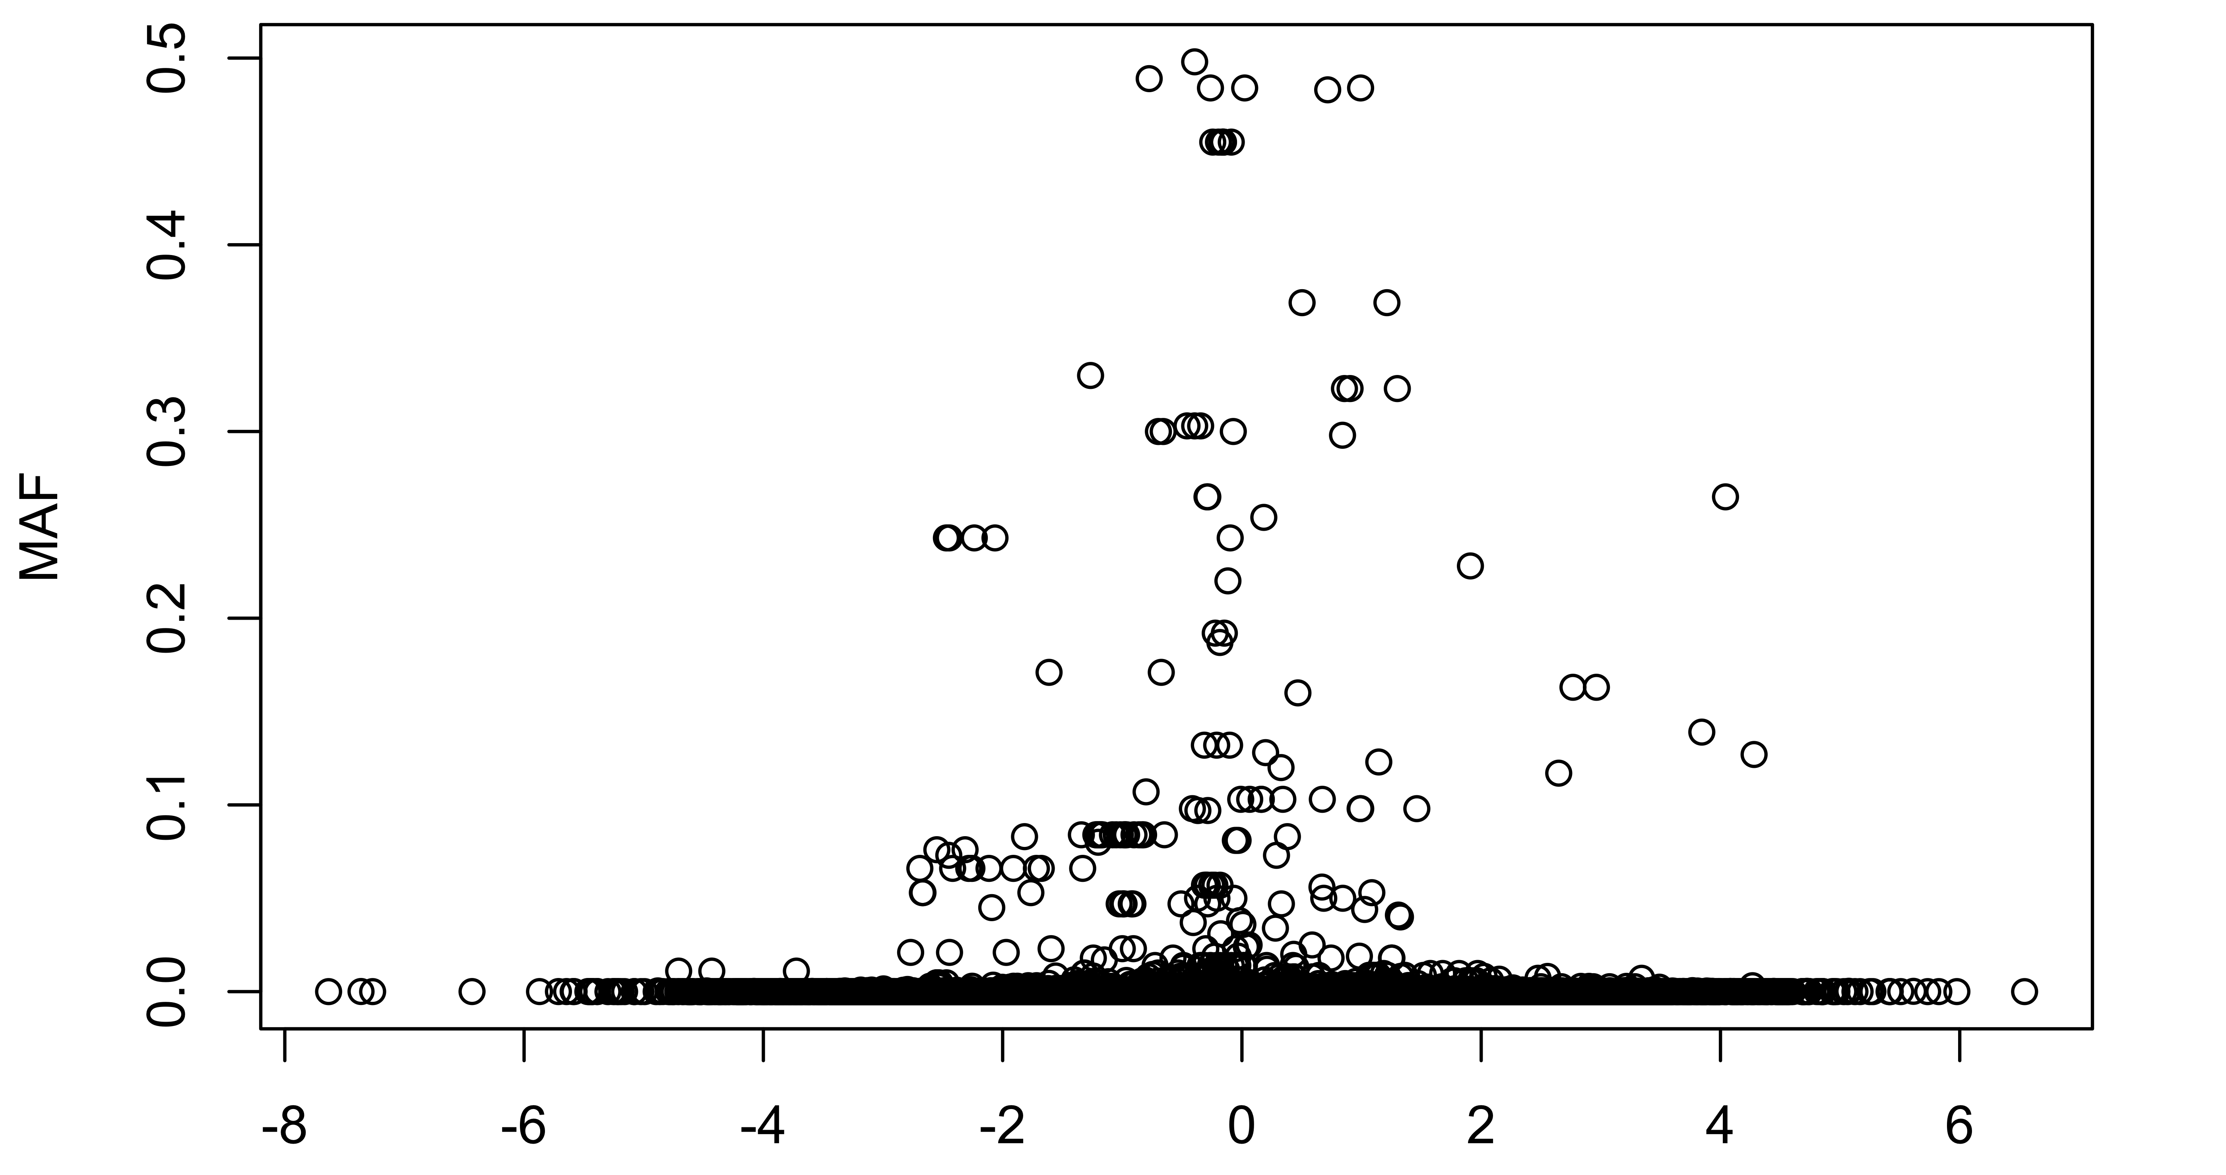
ExAC SNVs at the Surface
ΔΔE
Notes:
Exac surface

Slide 3
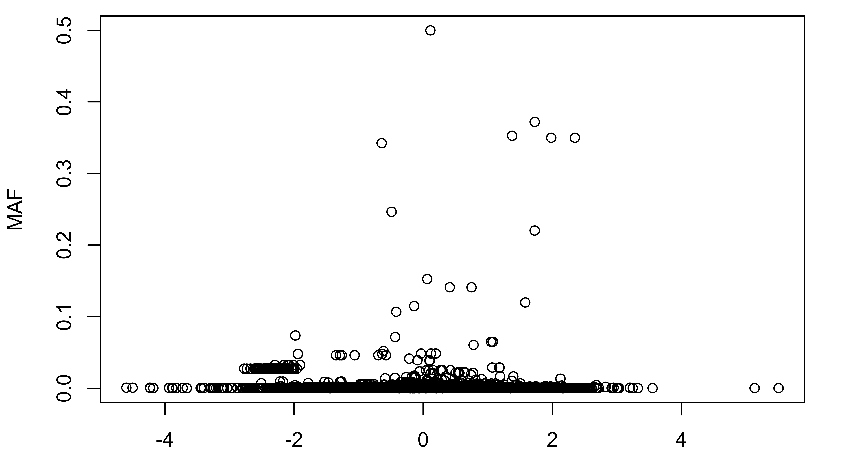
1000G SNVs at the Core
ΔΔE
Notes:
1000G core

Slide 4
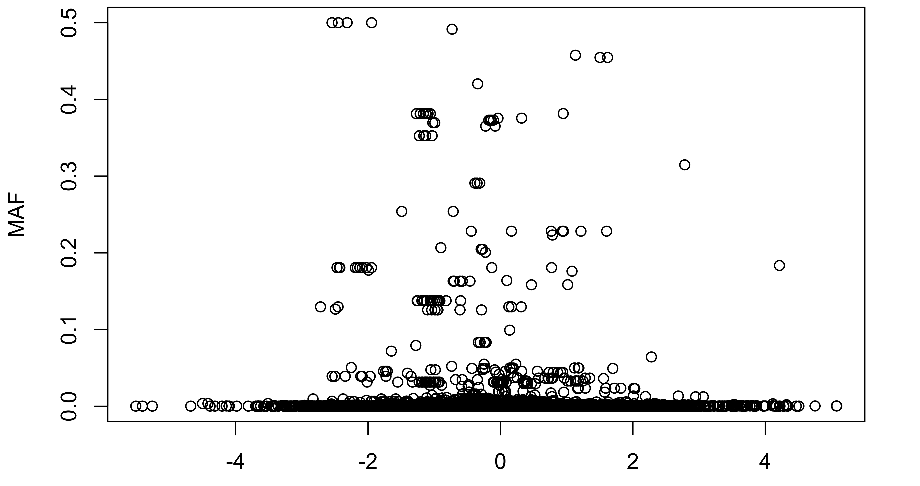
1000G SNVs at the Surface
ΔΔE
Notes:
1000G surface

