Slide 1

scRNA-seq Cleaning and Preliminary QC
Gerstein lab

Slide 2
Outline:
Previous Analyses for U19
Summary statistics
Schematic and example
Current QC strategies
Trimming statistics
Mapping statistics
Preliminary clustering
Discussion of next steps

Slide 3
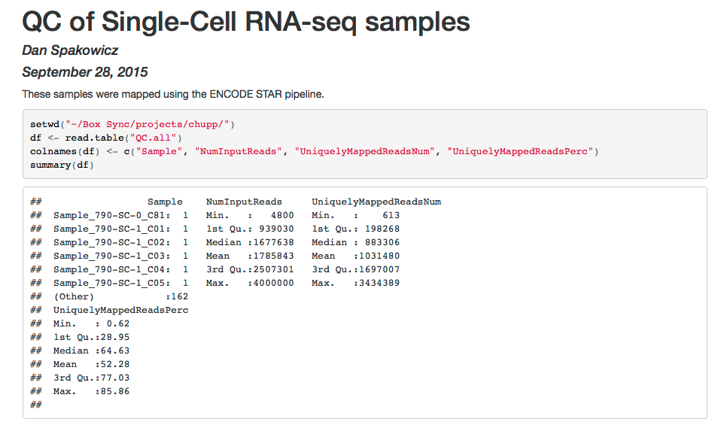
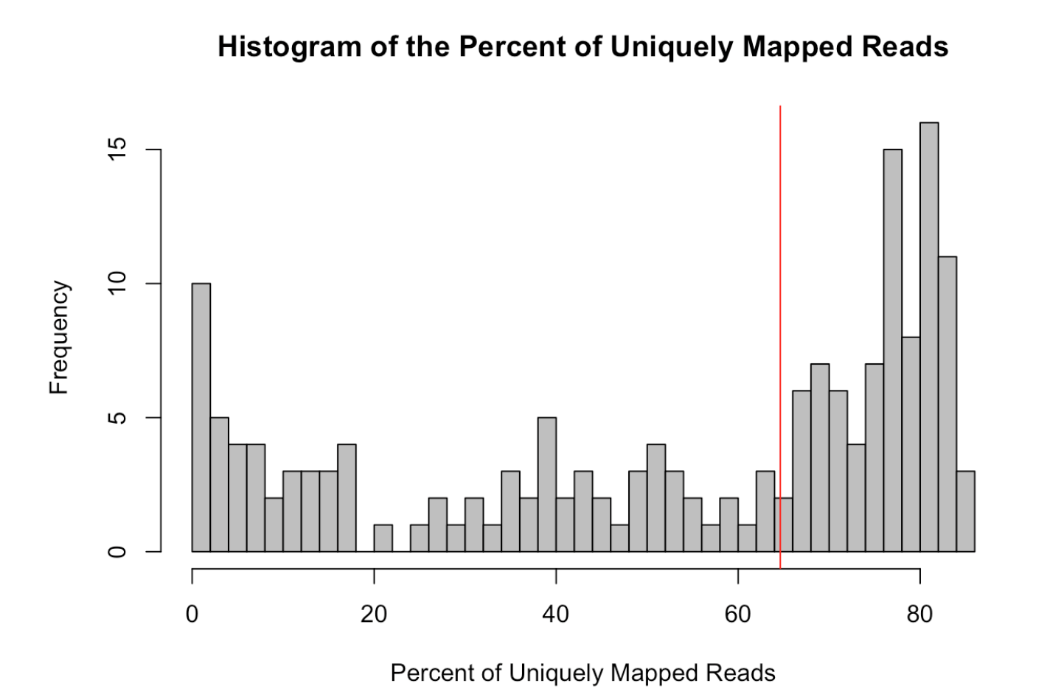
Summary statistics for U19

Slide 4
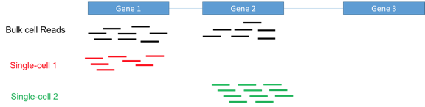
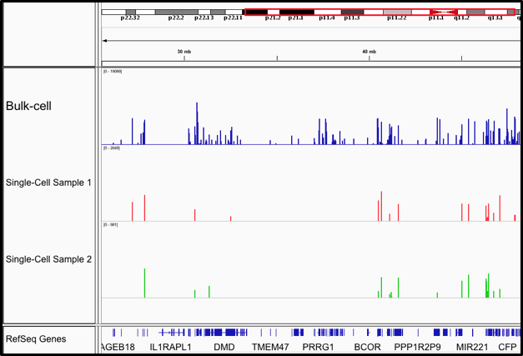
Schematic and example for U19

Slide 5
Analysis Pipeline:
scRNA-seq Data (.fastq)
Trimmed Files (.fastq)
Aligned Files (to transcriptome) (.bam/.sam)
Analyzed Results
Trim_galore
STAR-RSEM
R
3

Slide 6
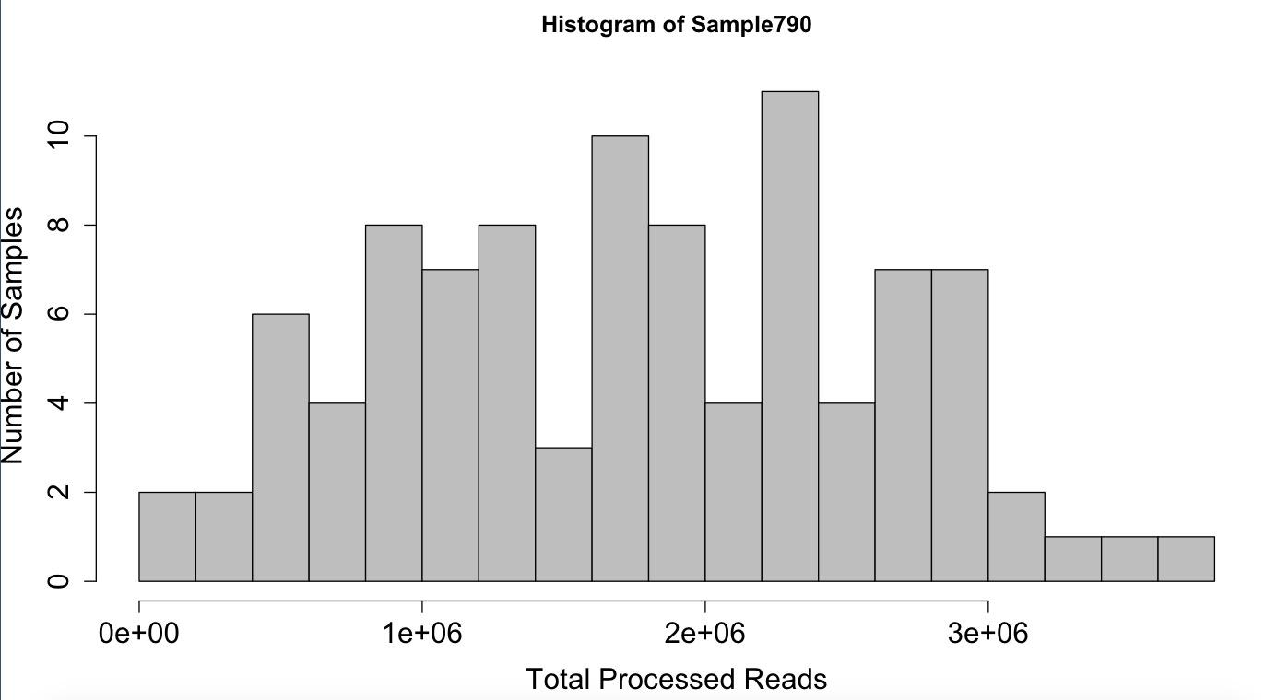
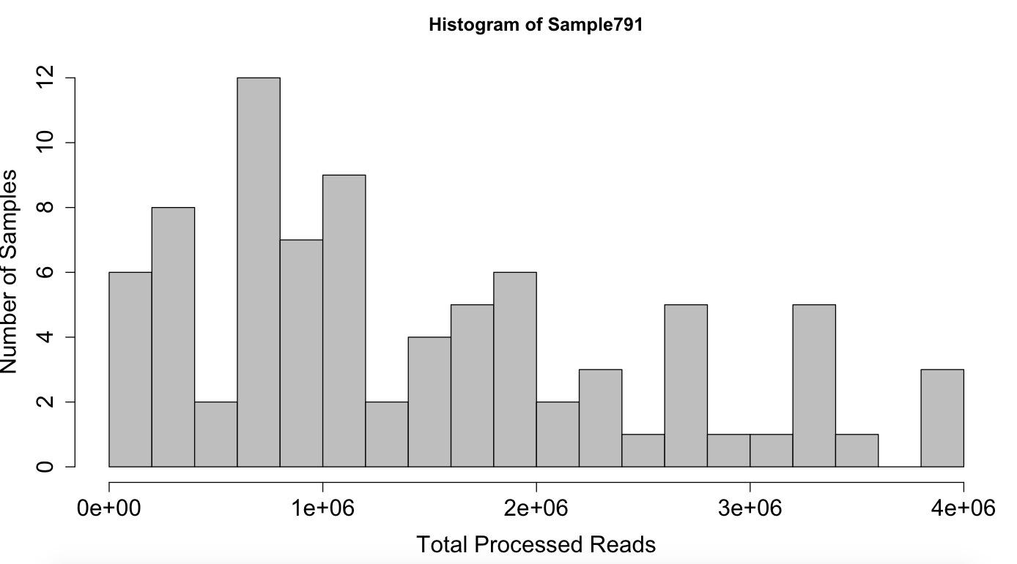
Post-trimming QC
SAMPLES | Read # / cell (mean +/-SD)
790 | 1,759,000 +/- 856,000
791 | 1,458,000 +/- 1,049,000
5

Slide 7
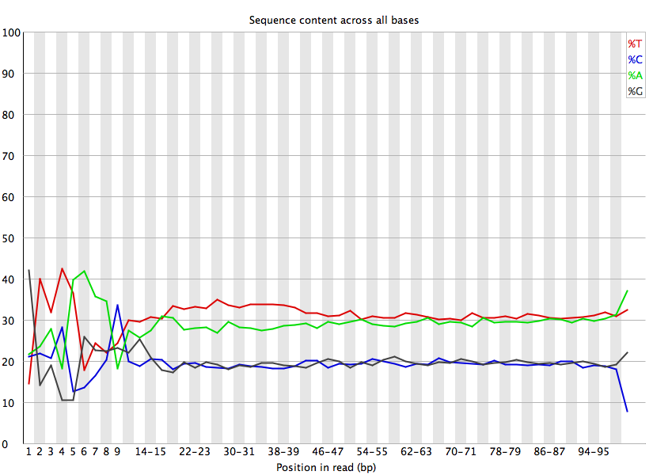
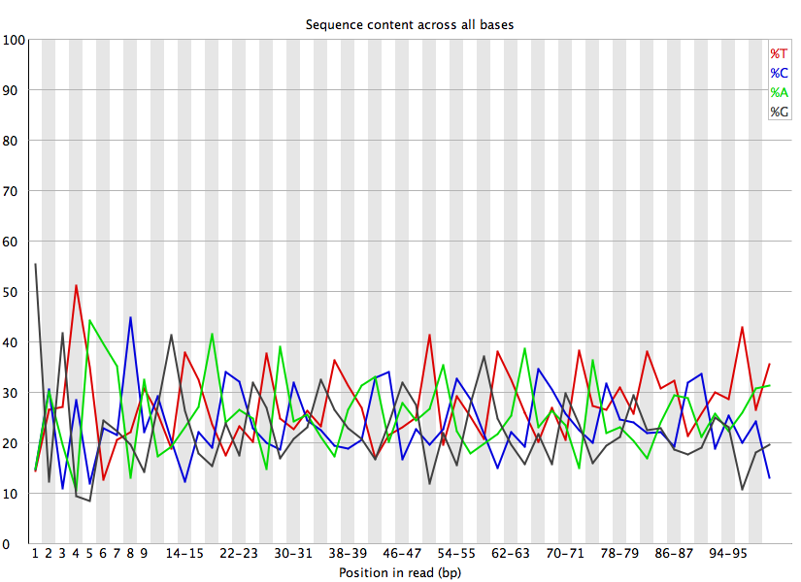
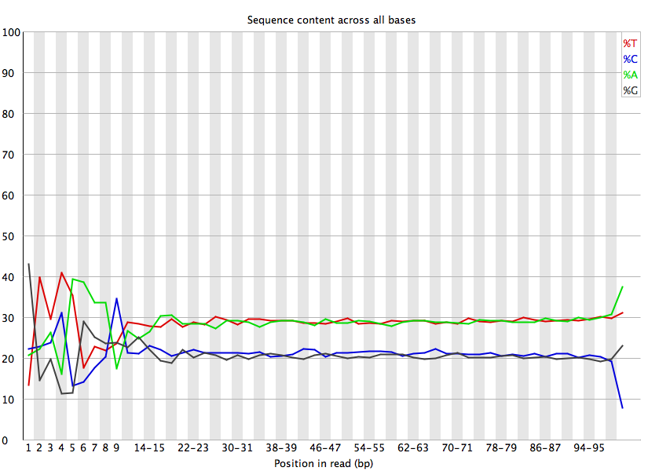

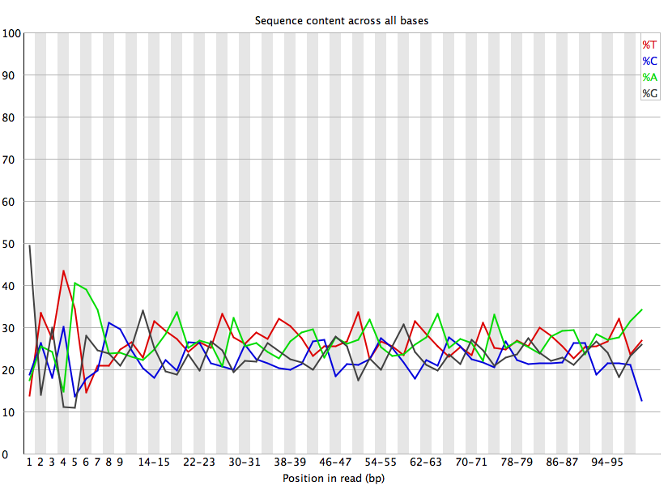
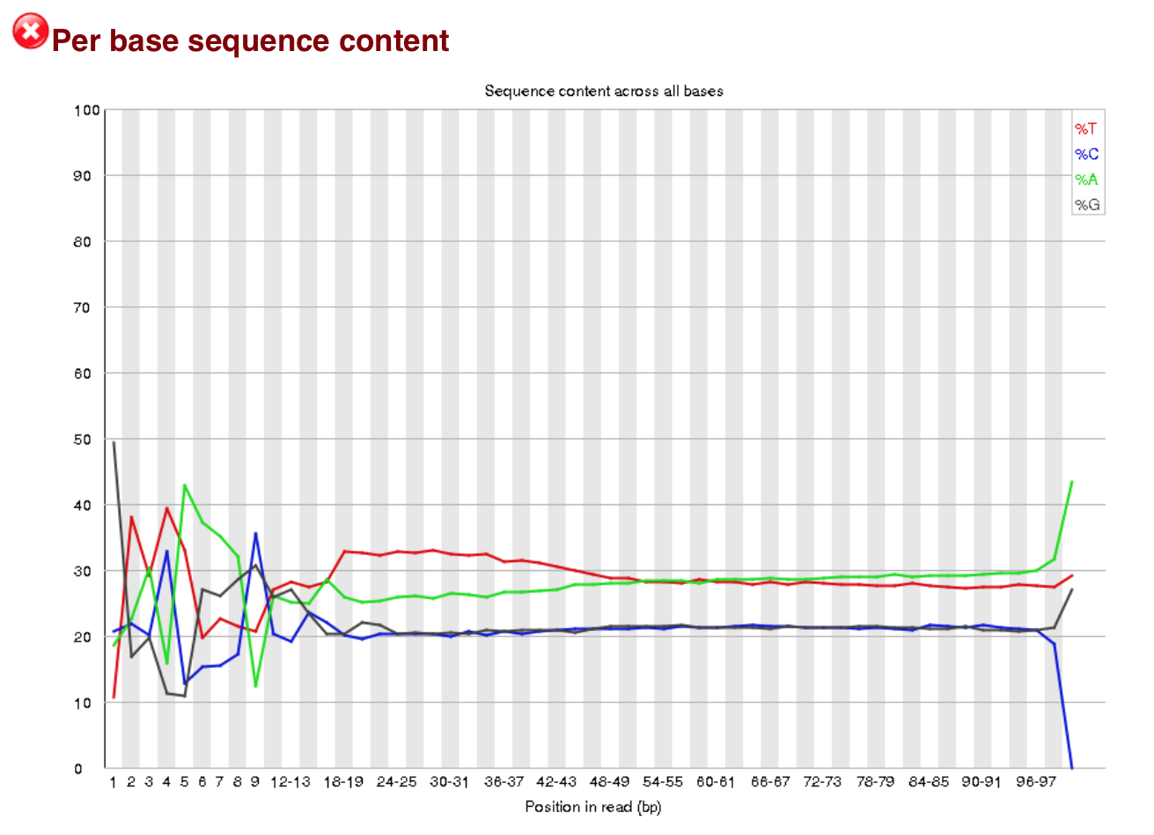
A/T bias in sequence content
790_C12_R1
791_C68_R2
790 Positive Ctrl
ENCODE (control)
790_C43_R2
791_C06_R1
7

Slide 8
Align Files with STAR_RSEM
A wrapper script that utilizes functionality of both STAR and RSEM to analyze RNA-seq data
  The STAR program maps reads to the genome or transcriptome
  The RSEM program produces expression values for the identified loci
11

Slide 9
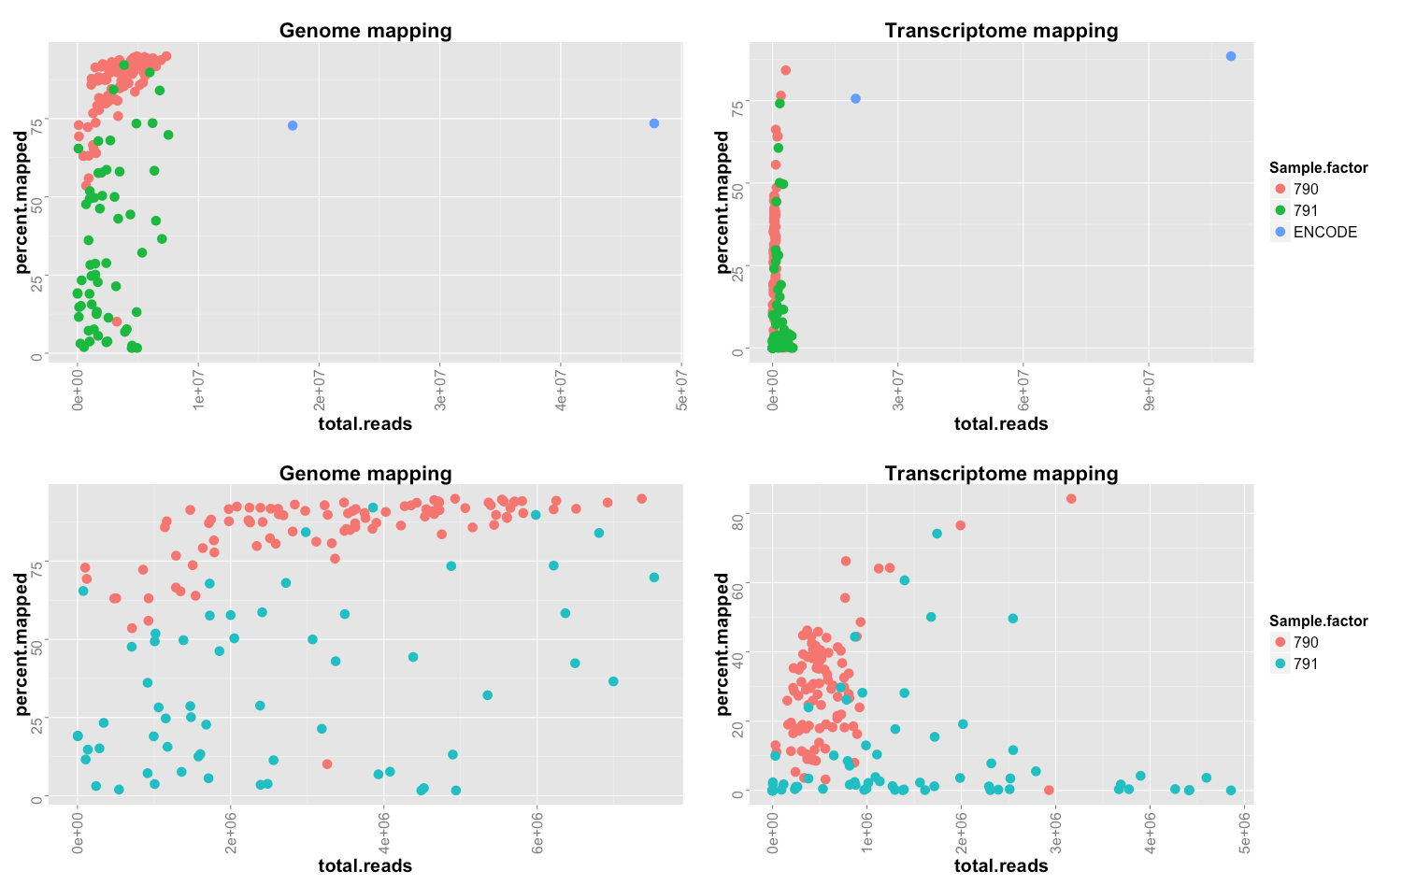
Percent of reads mapping to the genome and transcriptome
Notes:
log scale, remove blue dots

Slide 10
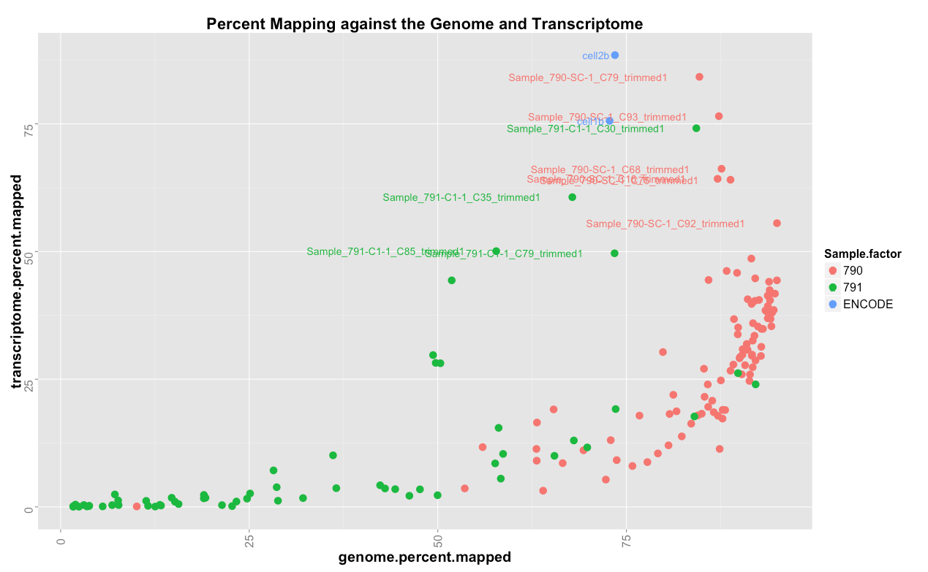
Percent of reads mapping to the genome and transcriptome

Slide 11
Percent of reads mapping to the genome and transcriptome
791-C92

Slide 12
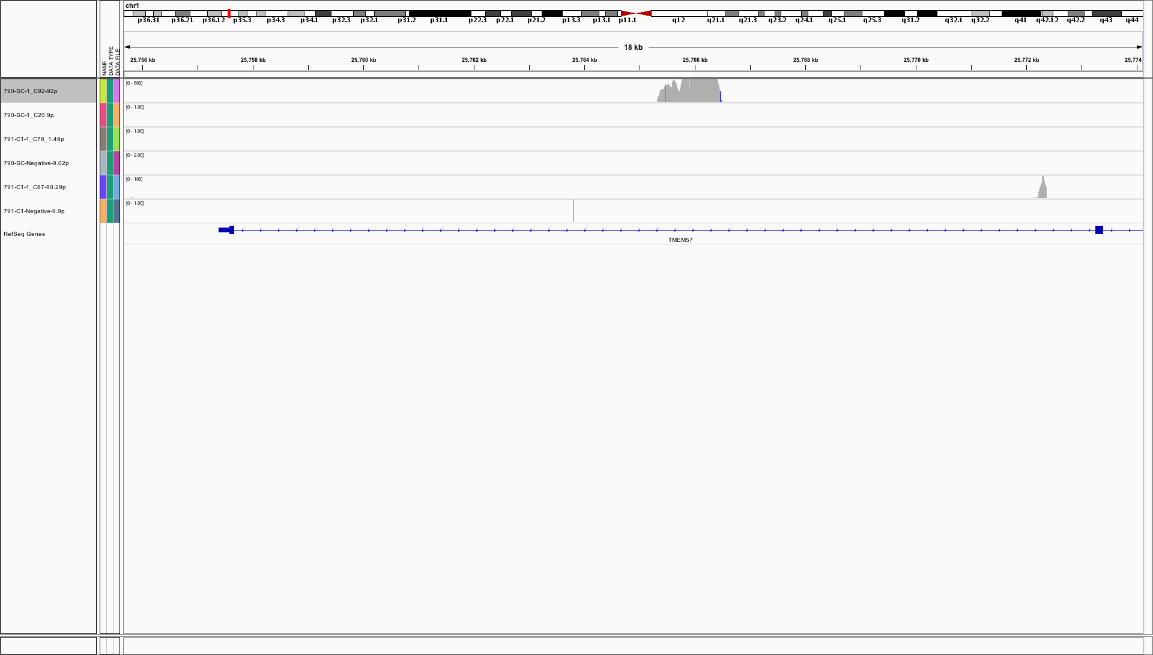
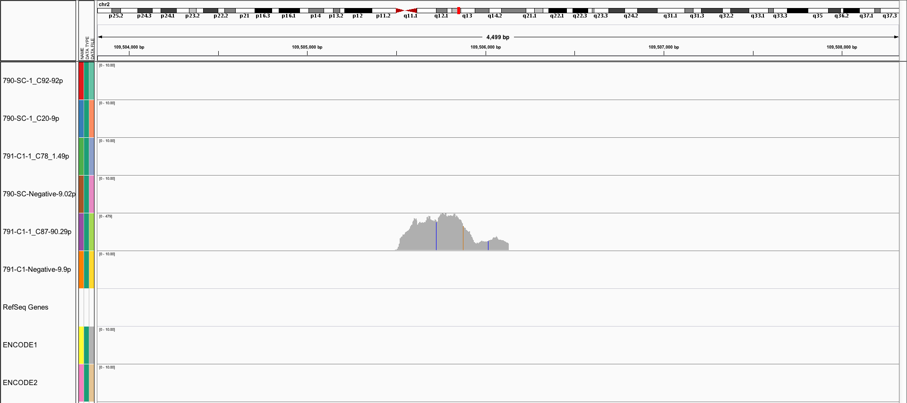
Where are the reads mapping?
Introns
Regions without gene annotation

Slide 13
Percent of reads mapping to the genome and transcriptome
791-C78

Slide 14
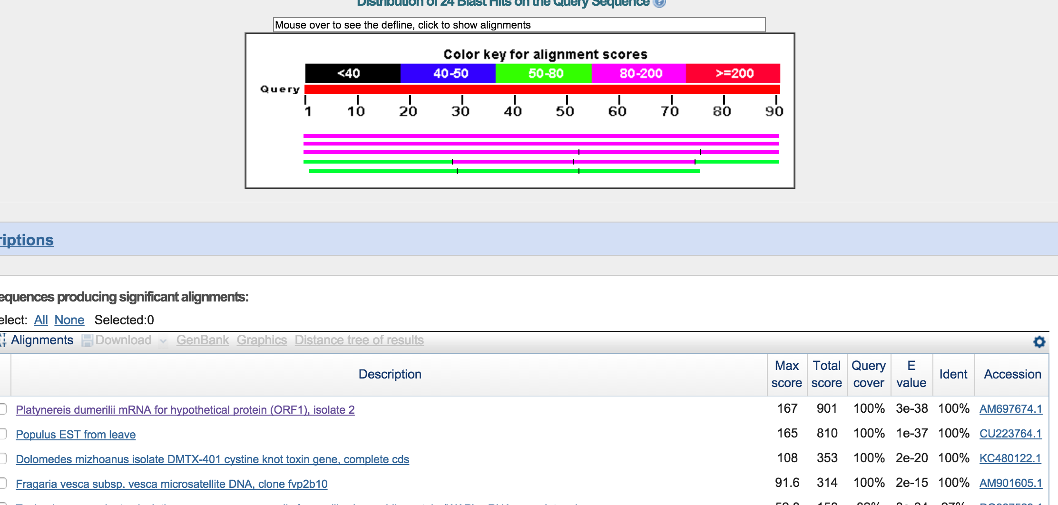
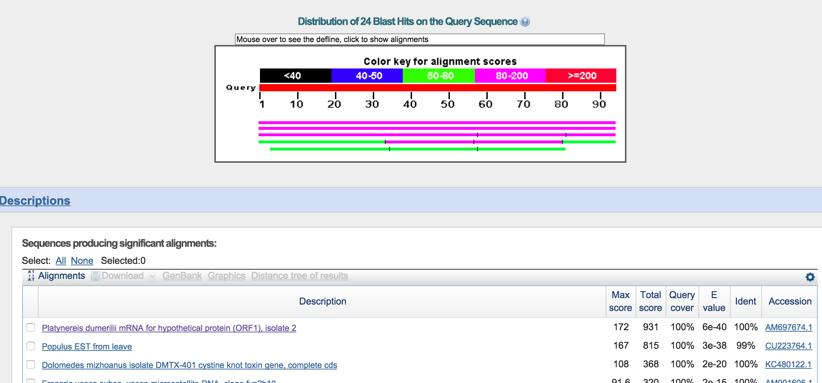
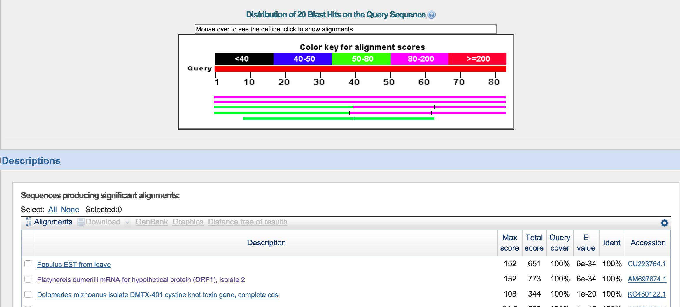
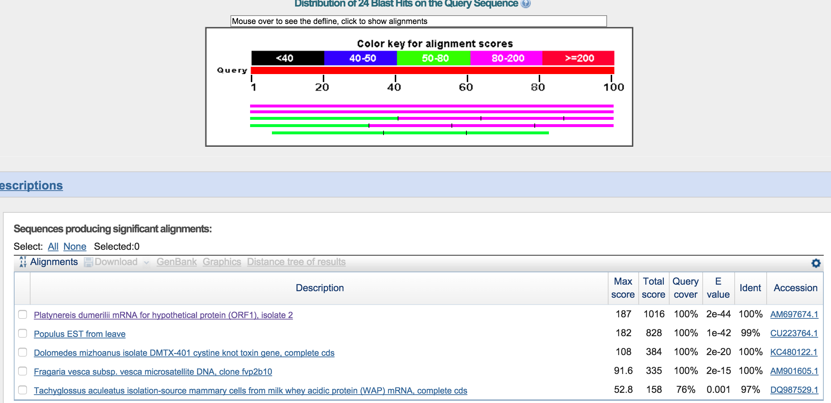
What are the unmapped reads?
Randomly sample and BLAST
1)
2)
3)
4)

Slide 15
Analysis summary
t-Distributed Stochastic Neighbor Embedding (t-SNE) dimensionality reduction
  Are the controls appropriately clustered?
  Can samples of good/poor quality be identified by this method?

Slide 16
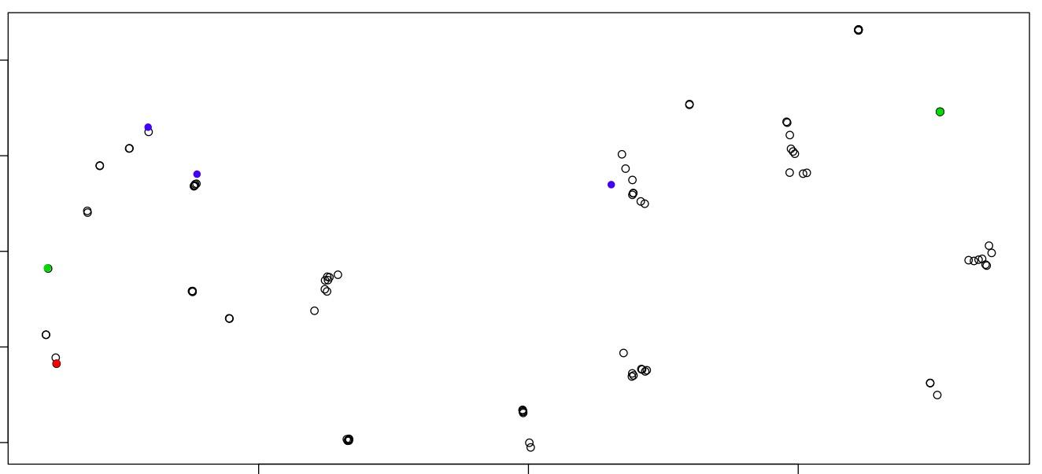
R Analysis
Open Circles = Samples, Green Circles = Debris, Red Circles = Neg Ctrl, Blue Circles = Pos Ctrl
t-SNE (high-dimensional) plot of cells using expression at all loci (log pme_TPM)
13

Slide 17
Summary
Samples 790 and 791 have similar numbers of reads, but 791 has a larger standard deviation
A/T bias plots might indicate problematic 791 samples
Sample 790 has more reads that map to the human genome and transcriptome
For most samples, the percent of reads that align to the transcriptome is lower than ENCODE controls
Possibly consistent contaminating signal in samples with low % mapped to human genome

Slide 19
Future Directions
Technical variability
  Spike-ins?
  UMI’s?
Positive vs negative vs debris controls?

Slide 20
Problems?
When looking back over the alignment log files, we noticed that a substantial amount of reads (50%) were mapping to the genome but not the transcriptome
  Suggests possible DNA contamination of RNA samples
  May explain strange clustering and gene identification
16

Slide 21
Where to Next?
The basic pipeline has been established and tested; however, further analysis is needed along the pipeline to QC data
  Trimming -> % reads trimmed, etc.
  Alignment -> % reads mapping to transcriptome
Methods for identification of relevant gene loci can be improved and automated
17

Slide 22
End!
Thank You!

Slide 23
The Question
Analysis of Chupp scRNA-seq Data
Does the cellular / tissue composition of sputum from patients responsive to asthma treatment differ from that from patients non-responsive to treatment (or on another treatment)?
Address this question using single-cell RNA-seq
1

Slide 24
The Data:
Single cell RNA-seq (scRNA-seq) generated from Illumina HiSeq and Nextera DNA library preparation kit
  2x sputum samples (one from each patient)
  2x sequencing runs (one for each sample) with ~96 cells included (multiplex, barcoded)
We are looking for differences in cell expression and/or distribution of cell types (via biomarkers)
3

Slide 25
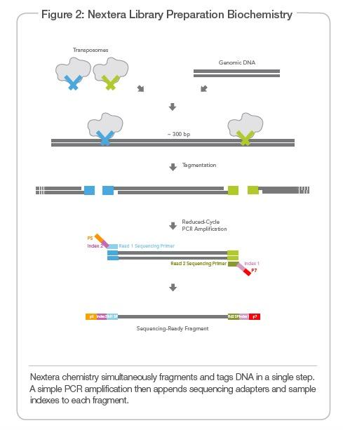
Nextera Sample Preparation
4

Slide 26
Trim Reads with Trim_Galore
A wrapper script that utilizes functionality of Cutadapt and FastQC to trim adapter sequences and apply quality control measures
  Removes low quality base calls at 3’ end of reads
  Removes adapter sequence (Nextera) at 3’ end
    Note: High Stringency can lead to sharp changes in base call % at the 3’ end (decreased C for Nextera)
  Trimming settings used -> paired-end, nextera primer, quality cut-off @ 20, gzipped output files
5

Slide 27
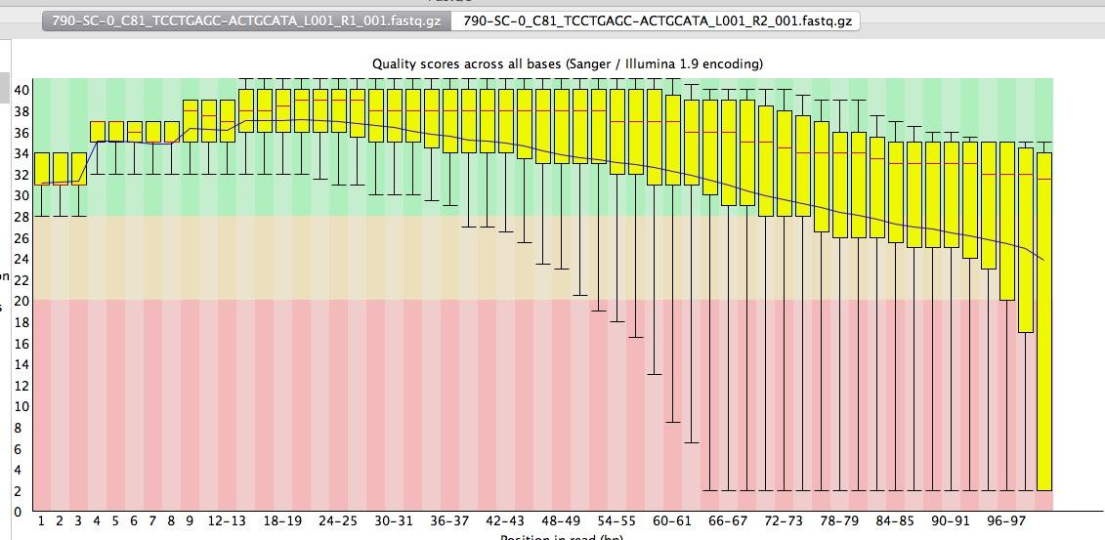
Trimming QC
Original Reads – Noisy base calls and Nextera Primer @ 3’
6

Slide 28
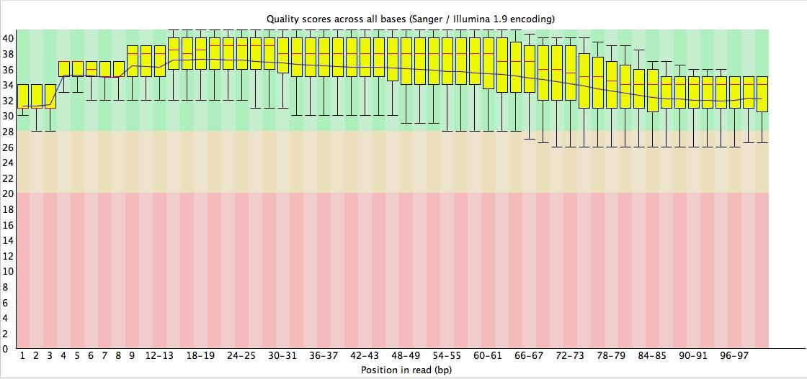
Trimming QC
Trimmed Reads – Base calls >20 and Nextera Primer removed
7

Slide 29
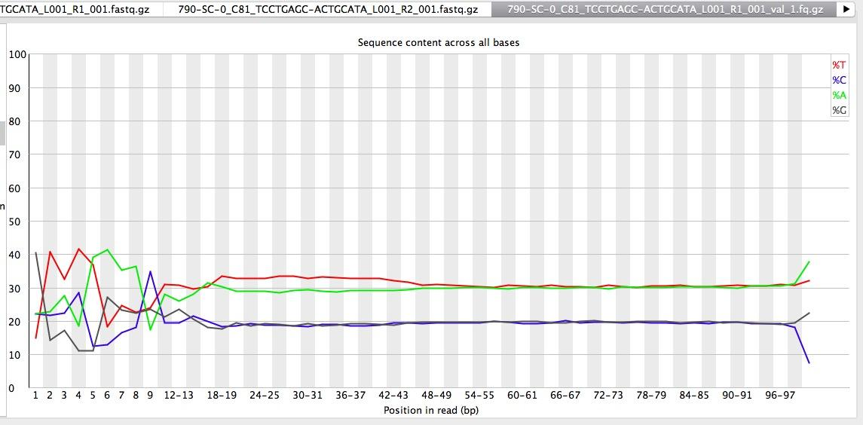
Trimming QC
Strange base pair % at 5’ end of reads -> Why? Barcode? Averaging artifact?
8

Slide 30
The mystery of 791

Slide 31
Where to Next?
The basic pipeline has been established and tested; however, further analysis is needed along the pipeline to QC data
  Trimming -> % reads trimmed, etc.
  Alignment -> % reads mapping to transcriptome
Methods for identification of relevant gene loci can be improved and automated
Learn more! (about sequencing, processing scripts, and R)
15

Slide 33
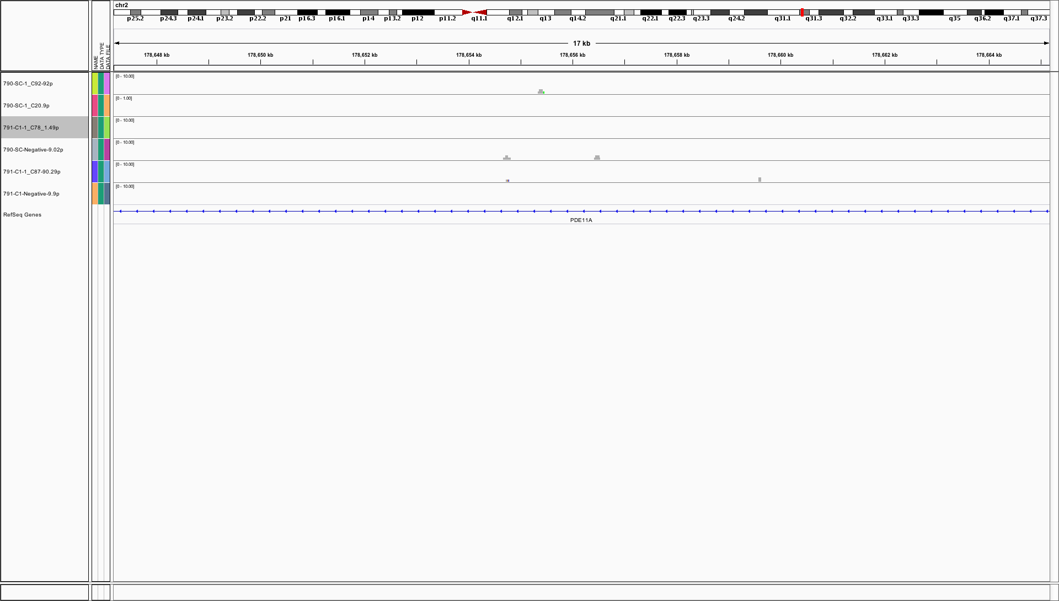

Slide 34
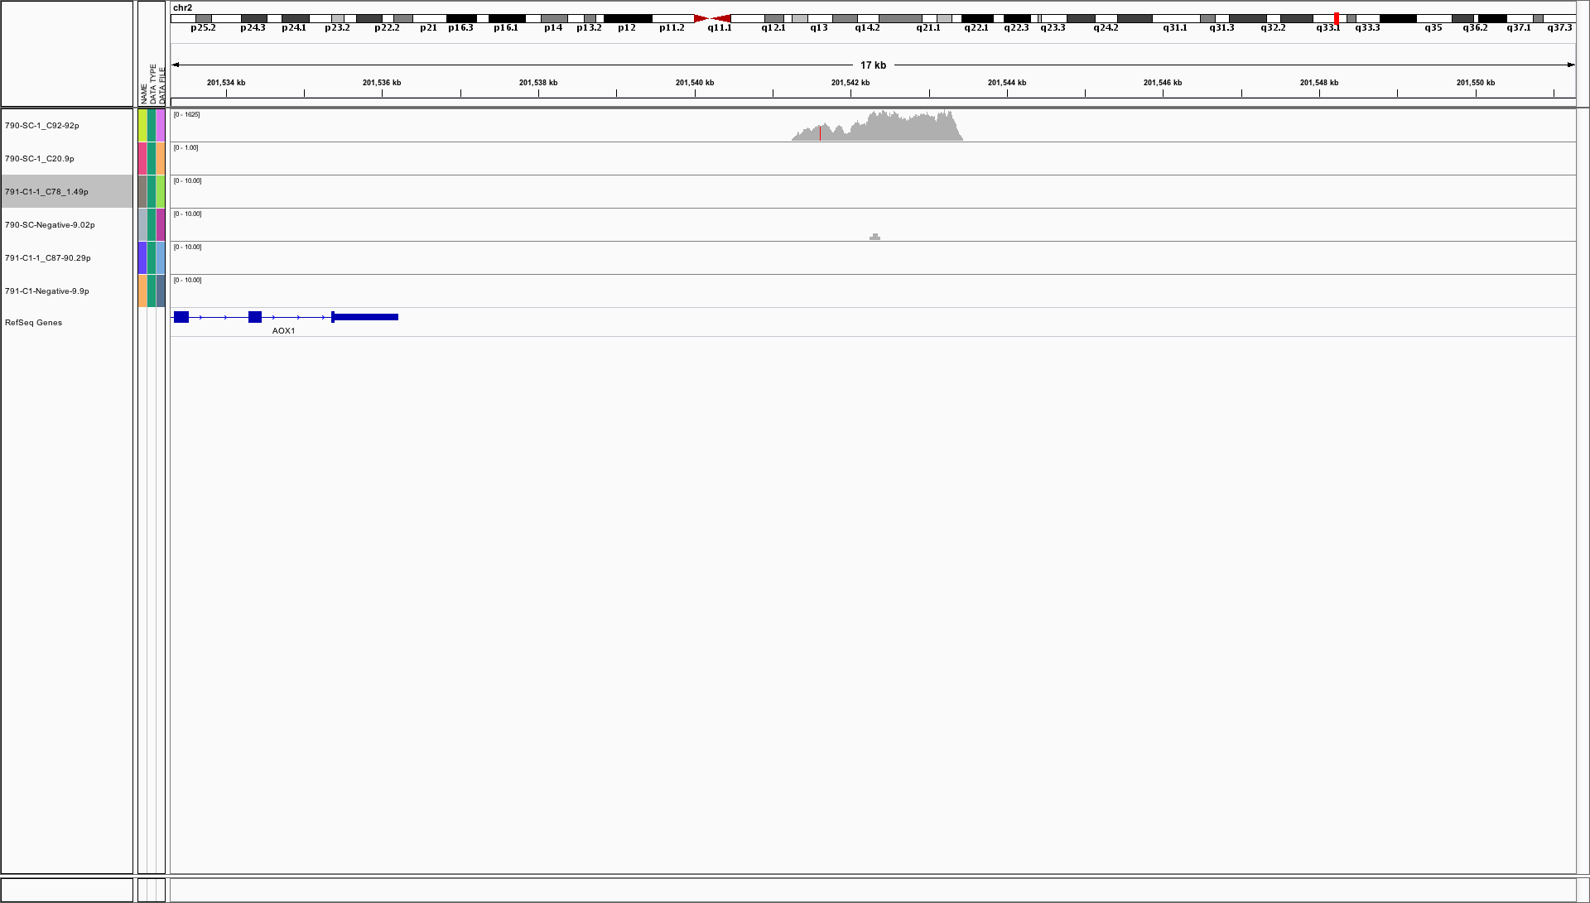

Slide 35
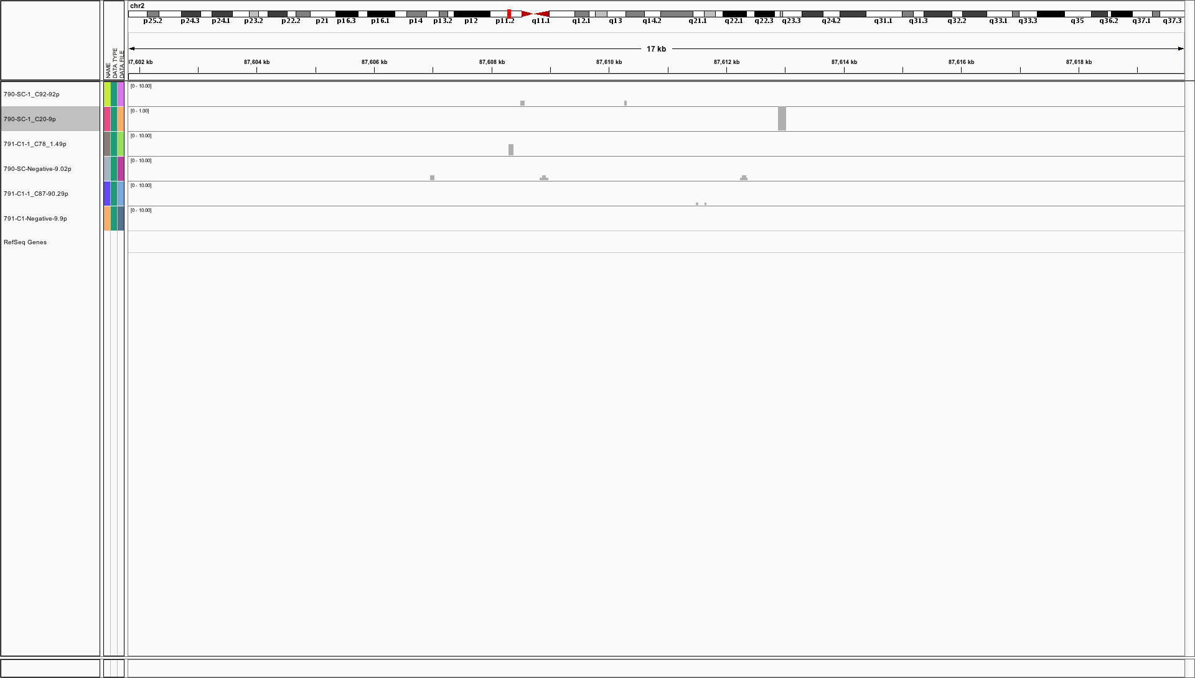

Slide 36
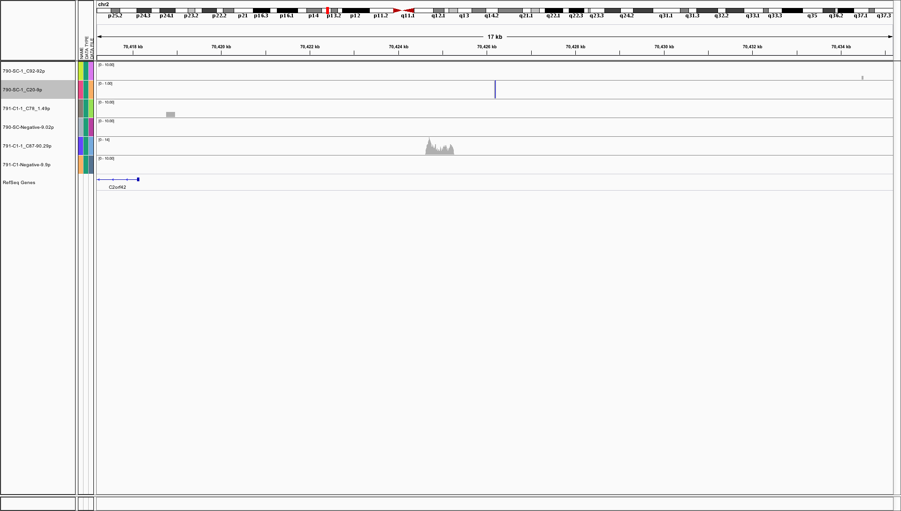

Slide 40
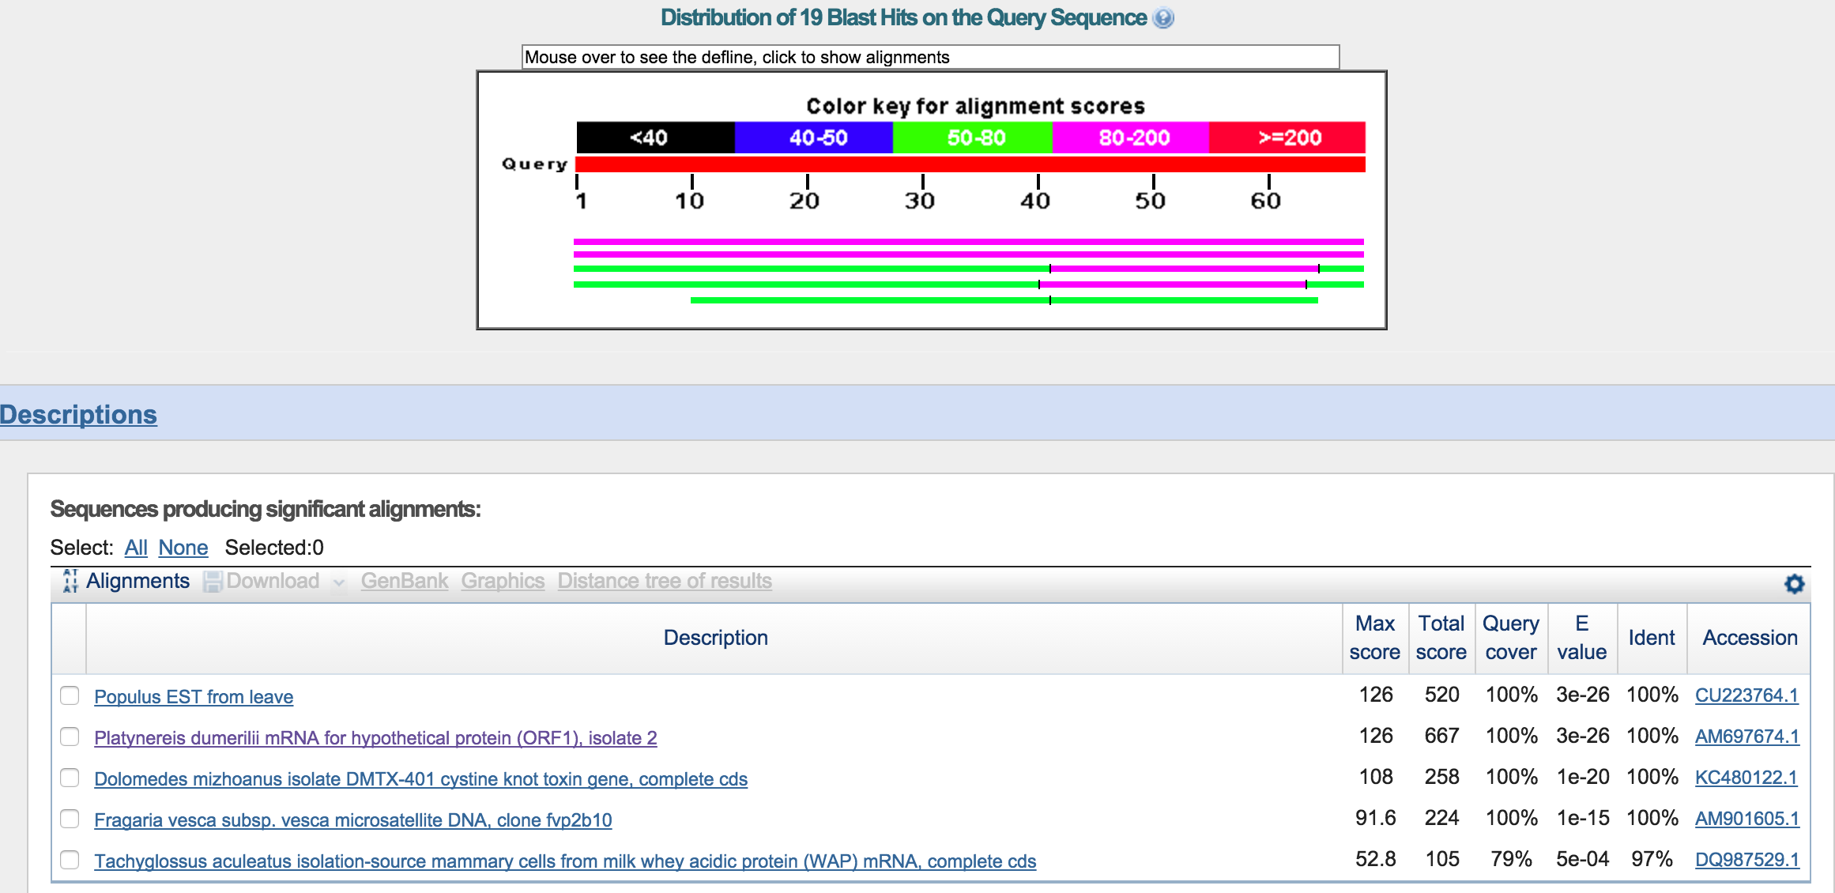

Slide 42
Alignment statistics
% map to genome
% map to transcripts
  Hist of percent maps
Why such a large loss b/n genome and transcript mapping?
  Check for alignments to ribosomes
Ave mapping length
Concerns about standard single cell RNA seq problems
  Pcr biases
    Duplicated reads? (fastqc analysis (kmer something))
    coverage per transcript
    % of transcript’s bases covered by a read
DS to discuss with SKL

Slide 43
Trimming QC
Frequencies of total reads in trimmed samples, for Sample_791
6

Slide 44
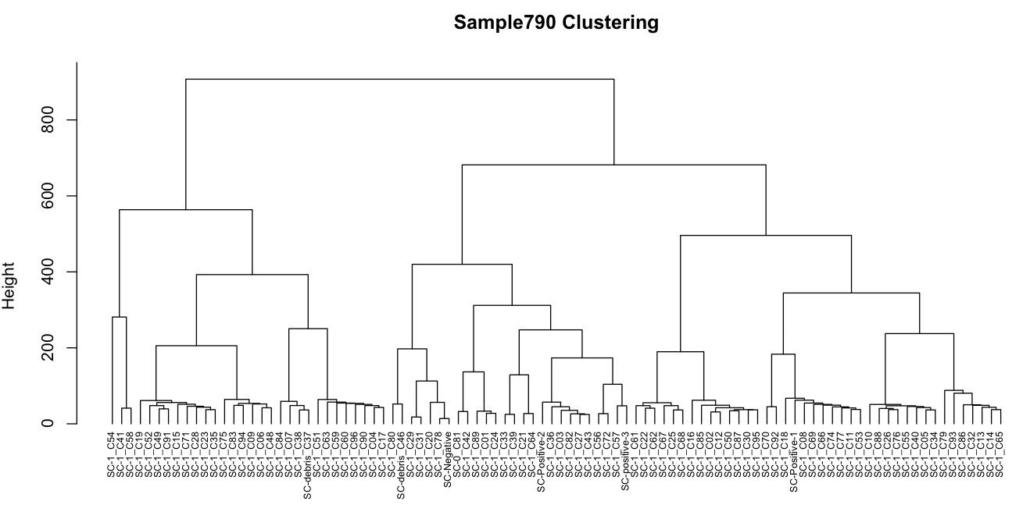
R Analysis
Hierarchical Clustering (Euclidean) of cells using expression at all loci (log pme_TPM)
12

Slide 45
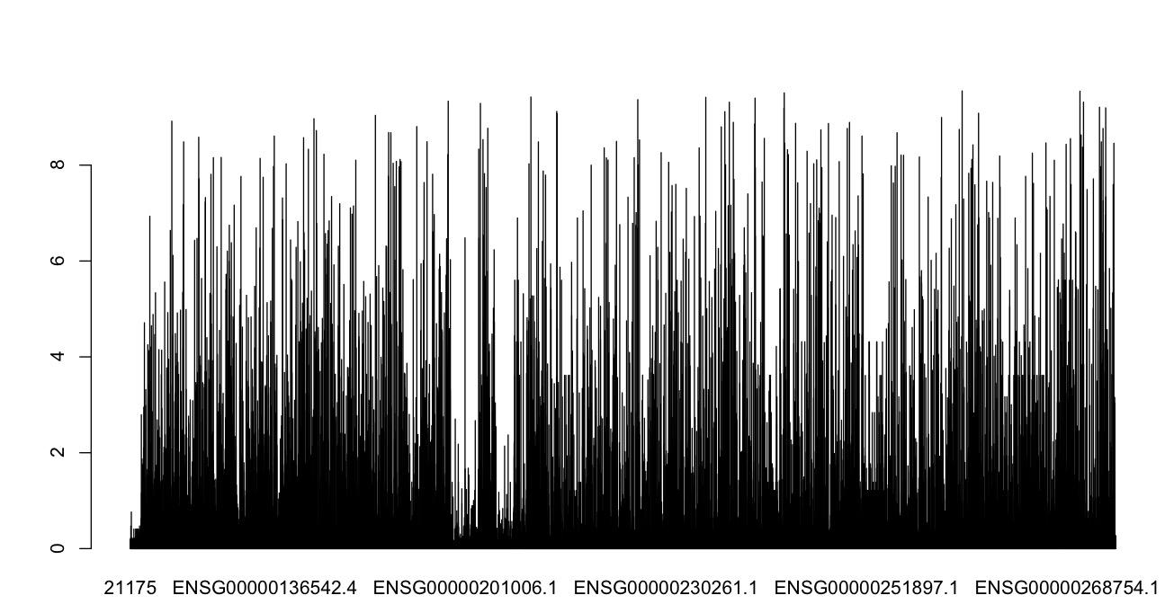
R Analysis
Bar plot of relative variability (SD/mean) of RNA read loci (log pme_TPM)
14

Slide 46
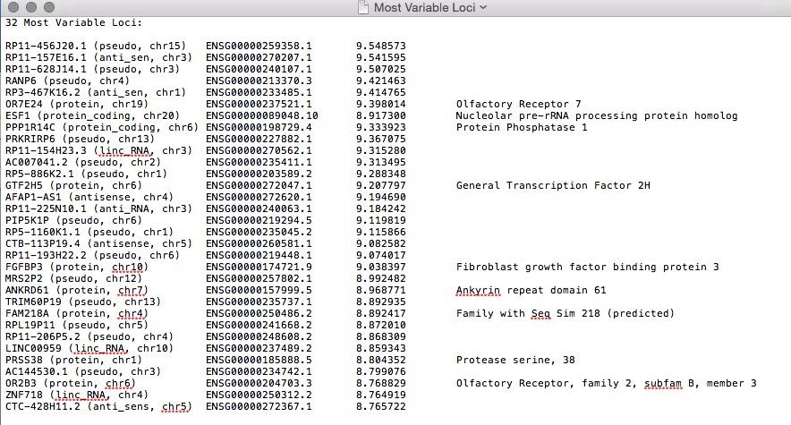
R Analysis
15

Slide 47
The Data:
Single cell RNA-seq (scRNA-seq) generated from Illumina HiSeq and Nextera DNA library preparation kit
  2x sputum samples (one from each patient)
  2x sequencing runs (one for each sample) with ~96 cells included (multiplex, barcoded)
2

Slide 48
Trimming QC
SAMPLES | Read # / cell (mean +/-SD)
790 | 1,758,653 +/- 856,168.9
791 | 1,457,810 +/- 1,049,408
Pre-trimming
Post-trimming
4

Slide 49
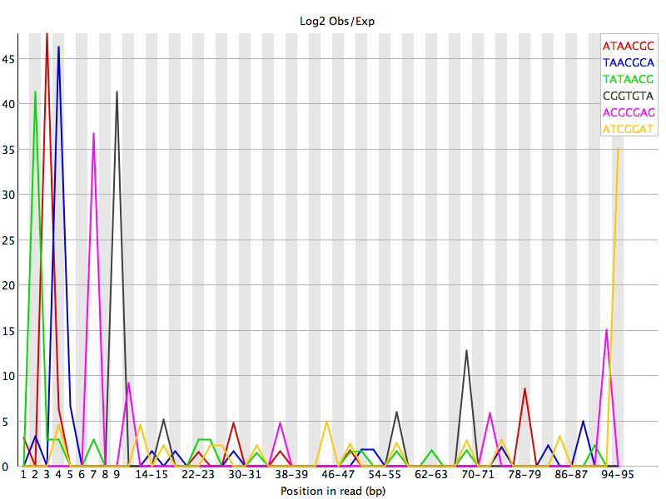
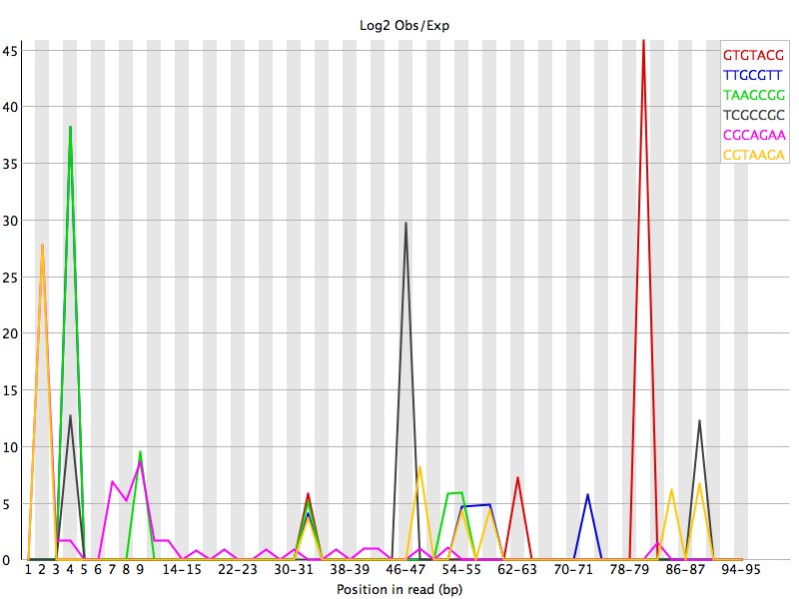
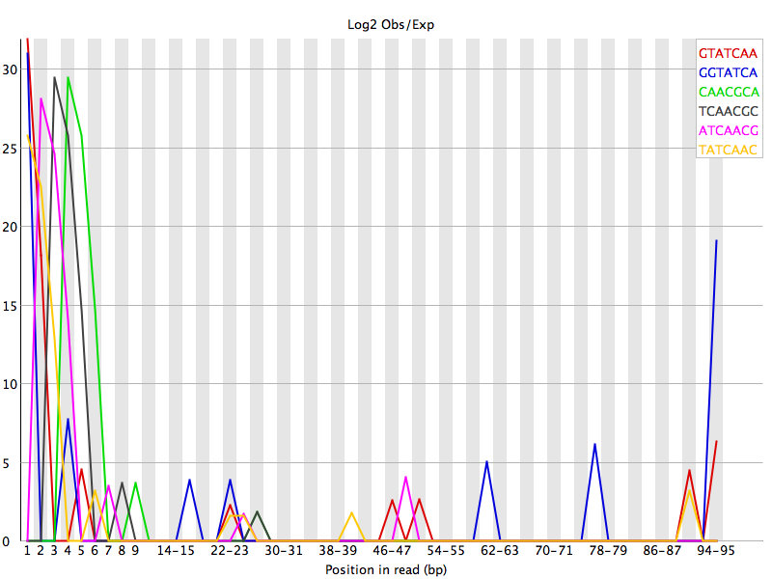
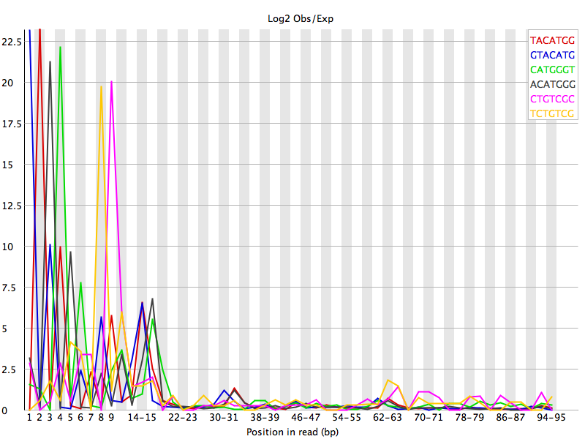
Trimming QC for Sample_790
790_C12_R1
790_C43_R2
Negative Ctrl
Positive Ctrl
8

Slide 50
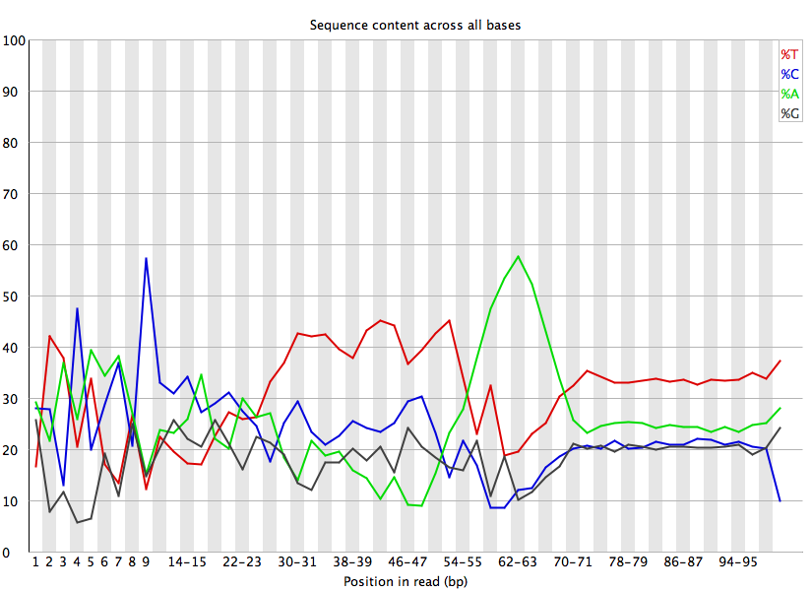
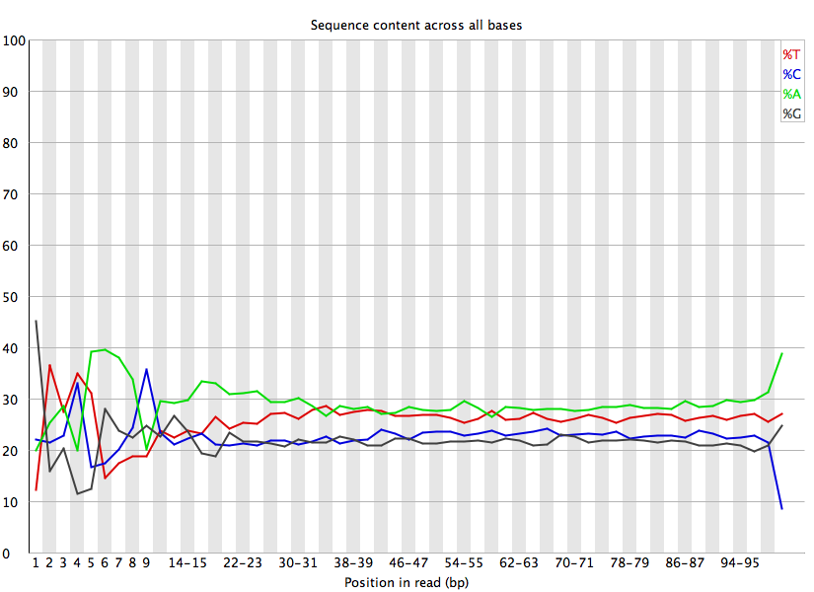
Trimming QC for Sample_791
791_C06_R1
791_C68_R2
Negative Ctrl
Positive Ctrl
9

Slide 52
Align Files with STAR_RSEM
A wrapper script that utilizes functionality of both STAR and RSEM to analyze RNA-seq data
  The STAR program maps reads to the genome or transcriptome
  The RSEM program produces expression values for the identified loci
The “Quant.genes.results” output file was used for downstream analysis (in R)
11

Slide 53
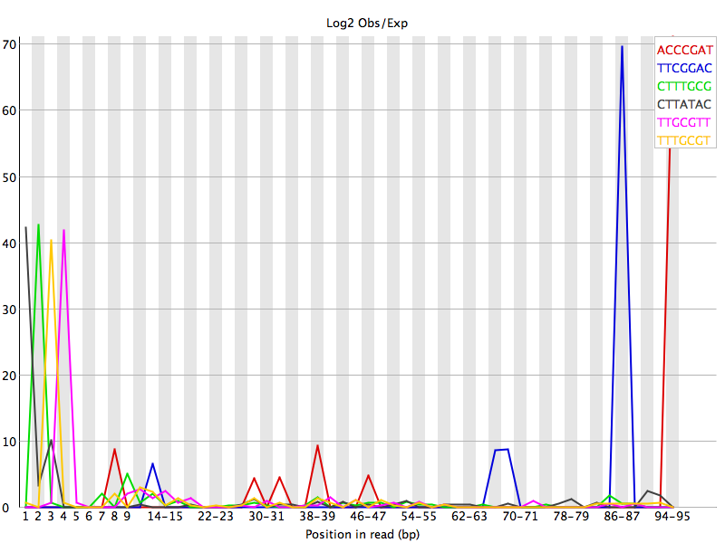
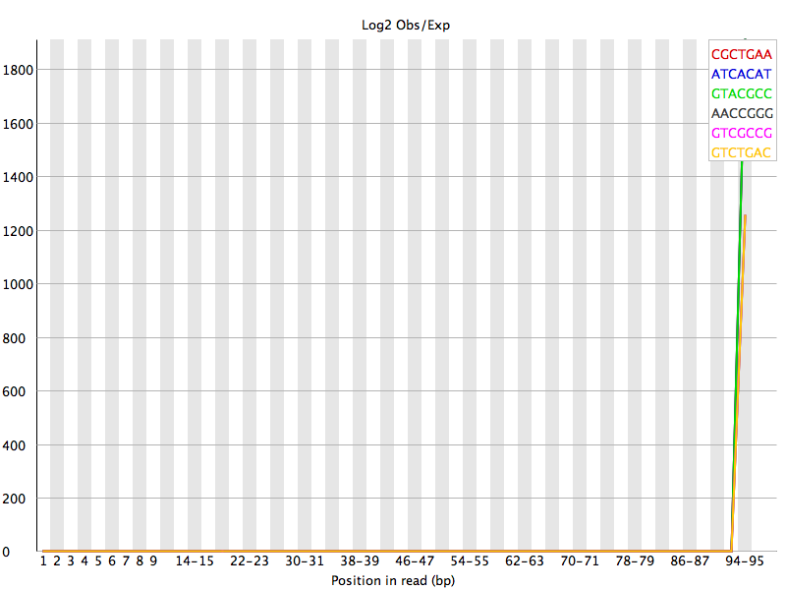
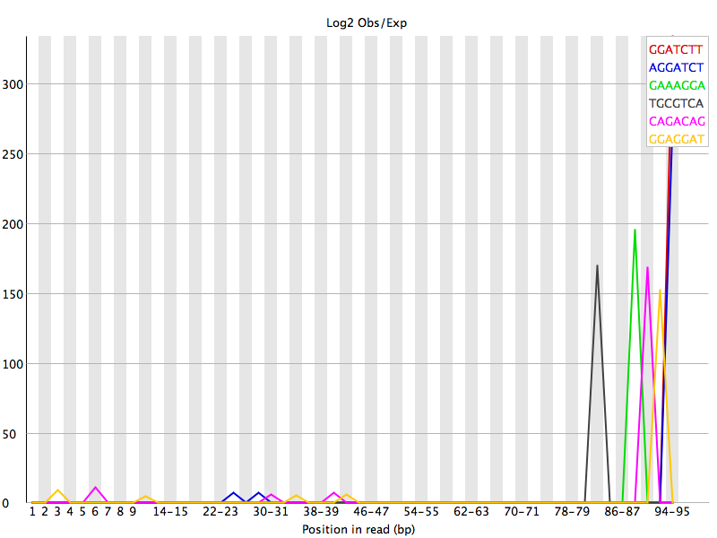
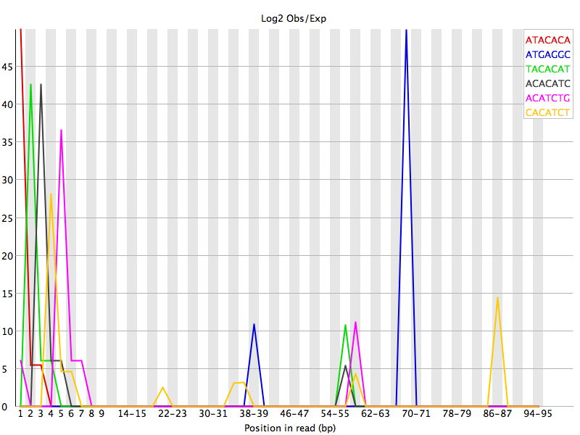
Trimming QC for Sample_791
791_C06_R1
791_C68_R2
Negative Ctrl
Positive Ctrl
10

