Slide 1
New AlleleDB submission
Allele
Jieming

Slide 2
Checklist
AlleleDB pipeline
Current pipeline
Arif, Rob and Timur helping me
Response
Manuscript
Figures 1 and 2
Figures 3-6 and main table require results
Supp Figures 1-5 require results
Supp tables 1 and 2
Supp table 3 require results
Supp files 1-4,6,7 require results
Supp file 5 (pseudo code for bisection method)
Website
include AlleleDB tool
Personal genome peaks

Slide 3
AlleleDB ‘ambiguous mapping bias’ module (3)
--considerably more efficient now
8 sections
1-alignment-kasowski_SA1_NA10847
--INPUT: *.fastq.gz; OUTPUT: bowtie output
2-map.back.ref-kasowski_SA1_NA10847:
--INPUT: (1) OUTPUT, 2ref.chain files; OUTPUT: BED files of reads in reference coordinates
3-intersectBed-kasowski_SA1_NA10847:
--INPUT: (2) OUTPUT, het snp file; OUTPUT: which read has SNVs
4-flip-kasowski_SA1_NA10847:
--INPUT: (3) OUTPUT; OUTPUT: fastq files of simulated flipped reads that overlap >1 hetSNVs
5-alignment2-kasowski_SA1_NA10847:
--INPUT: (4) OUTPUT, ; OUTPUT: aligned, unaligned, multi Bowtie1 output
6-unaligned-kasowski_SA1_NA10847:
--INPUT: (5); OUTPUT: BED of unaligned reads
7-multi-kasowski_SA1_NA10847:
--INPUT: (5); OUTPUT: BED of multi reads
Remove reads from aligned read pile from (1)
--this section filters
a) reads overlapping SNVs that are tri/quadallelic, or
b) reads that overlap >=5 SNVs
c) reads that do not map to same location (+- 10bp) on both parental genomes
--Run AlleleSeq with betabinomial calc

Slide 4
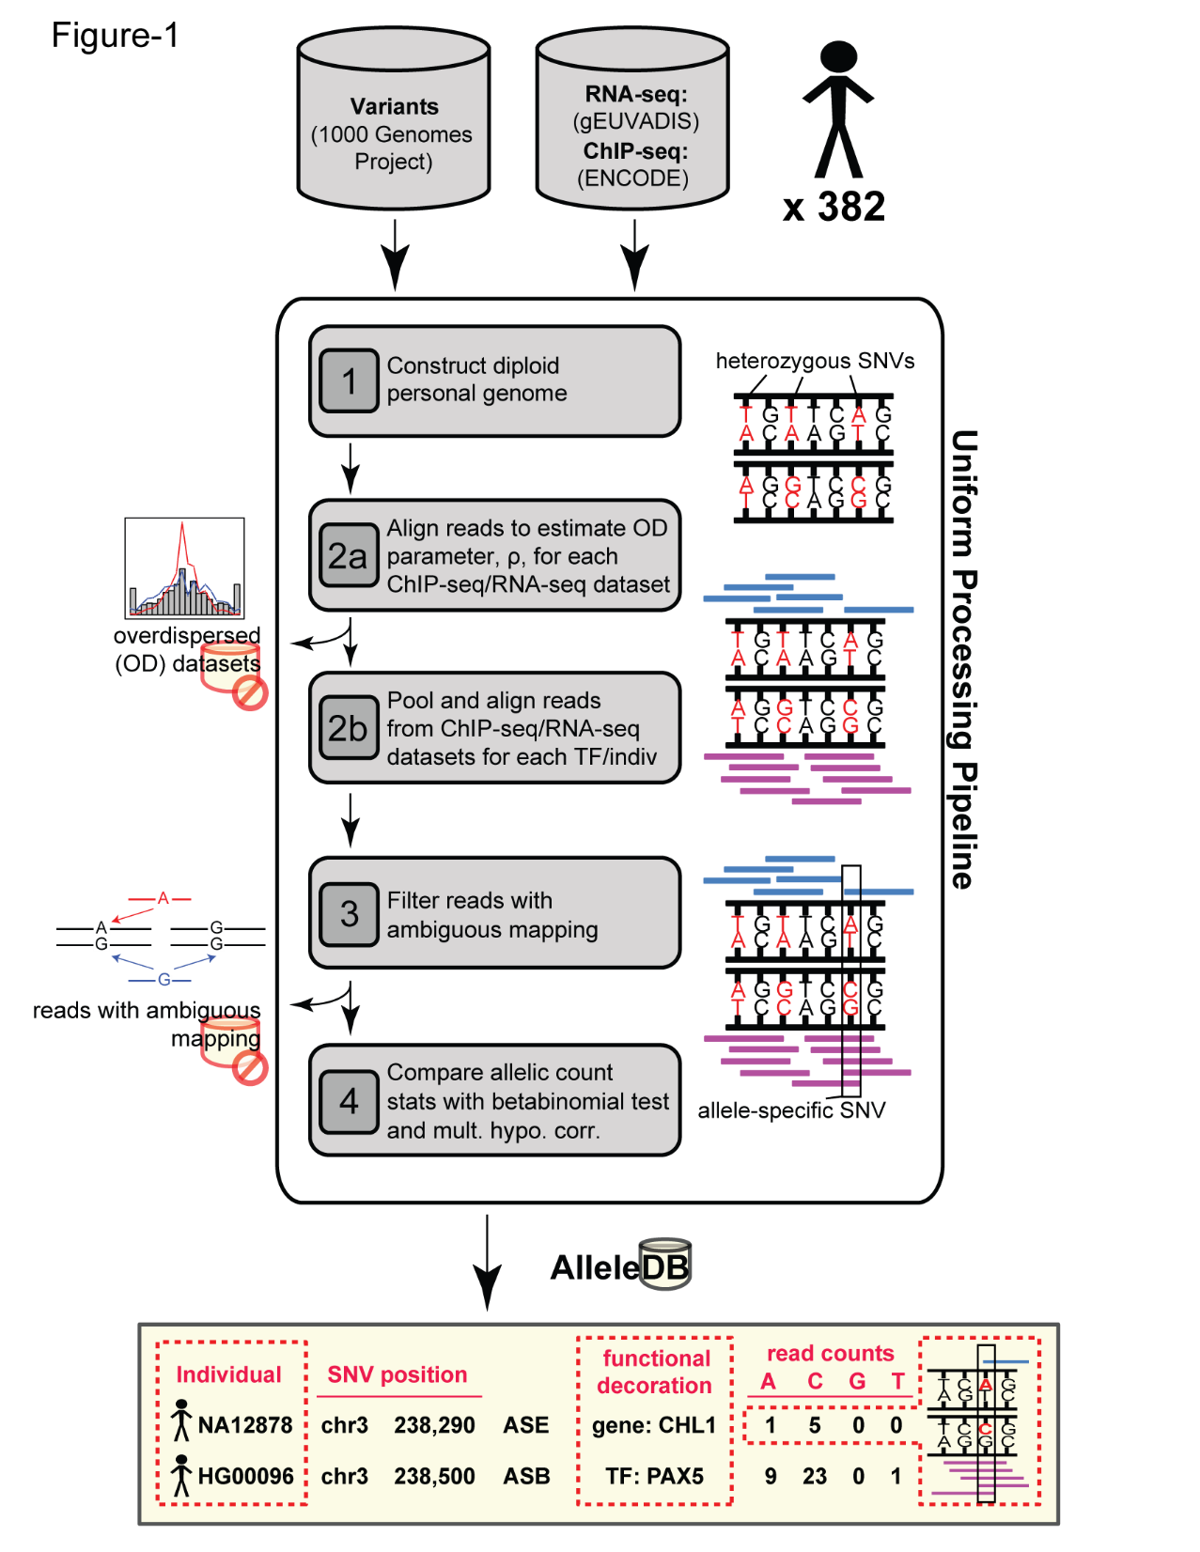

Slide 5
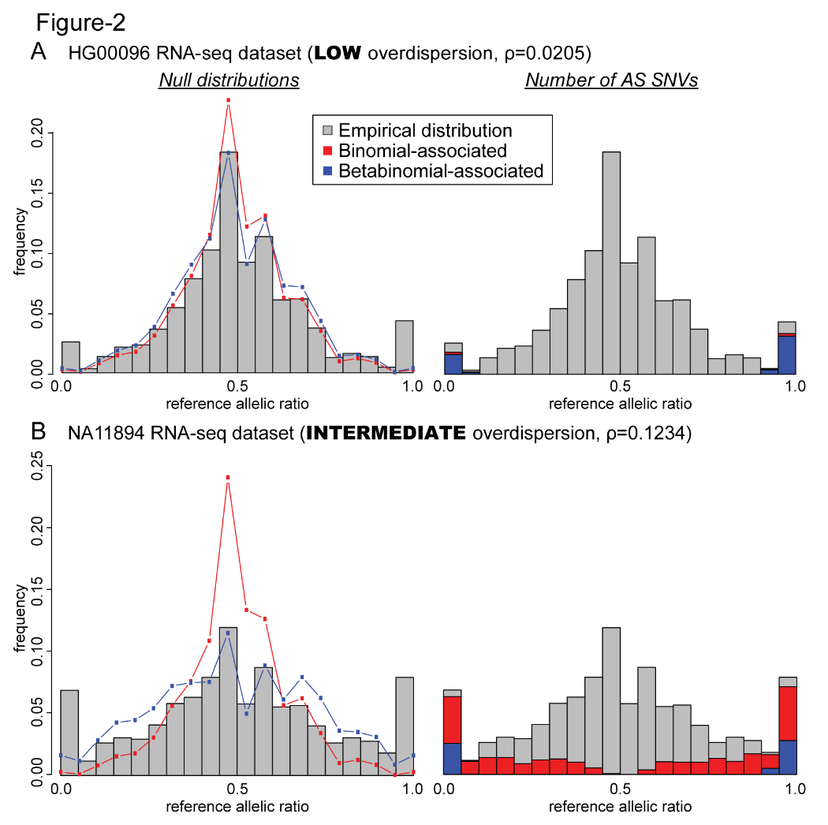

Slide 6
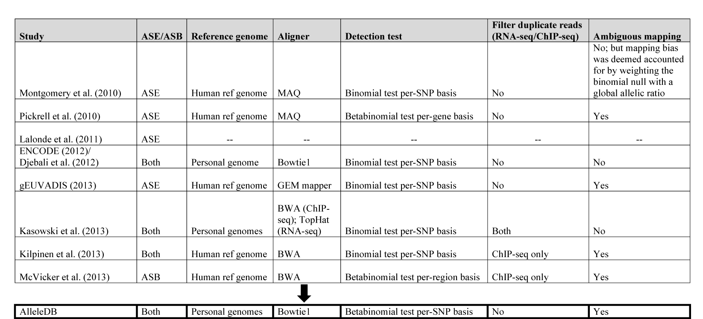
Supp table 1

Slide 7
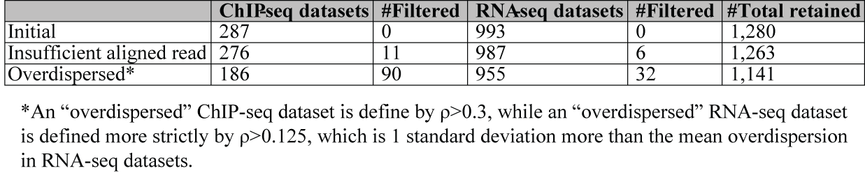
Supp Table 2

Slide 8
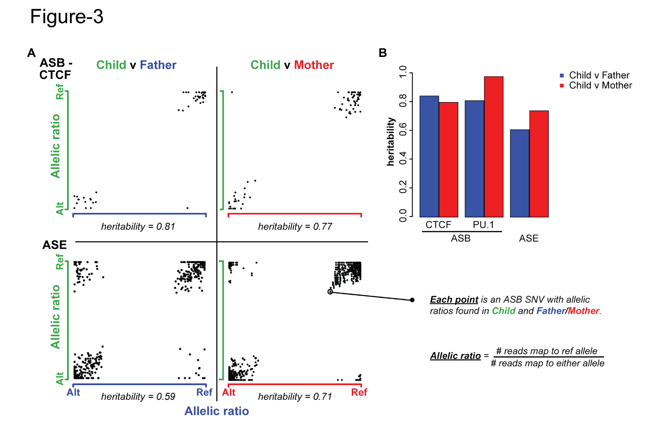
Inheritance

Slide 9
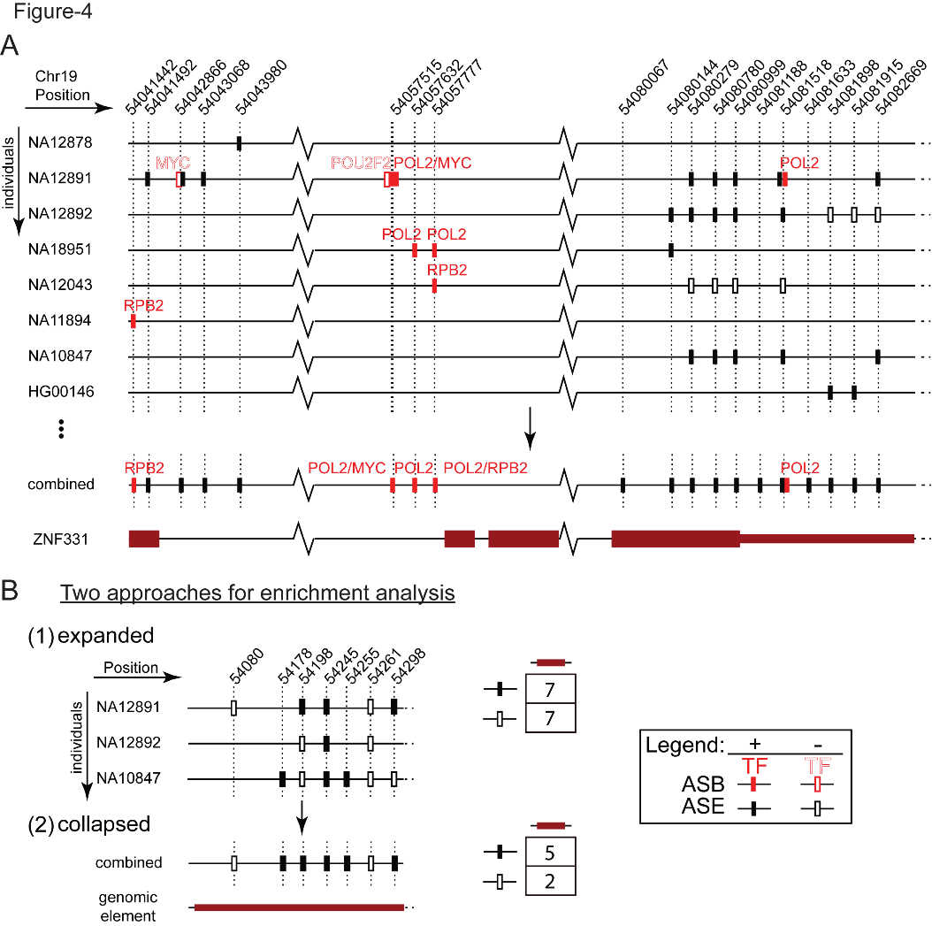
Database visual

Slide 10
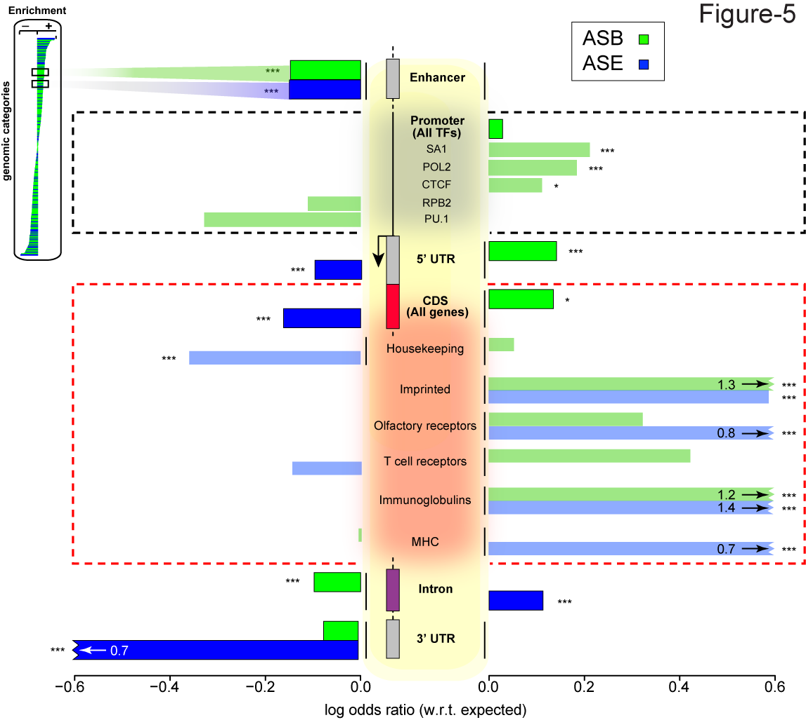
Enrichment expanded (by individual)

Slide 11
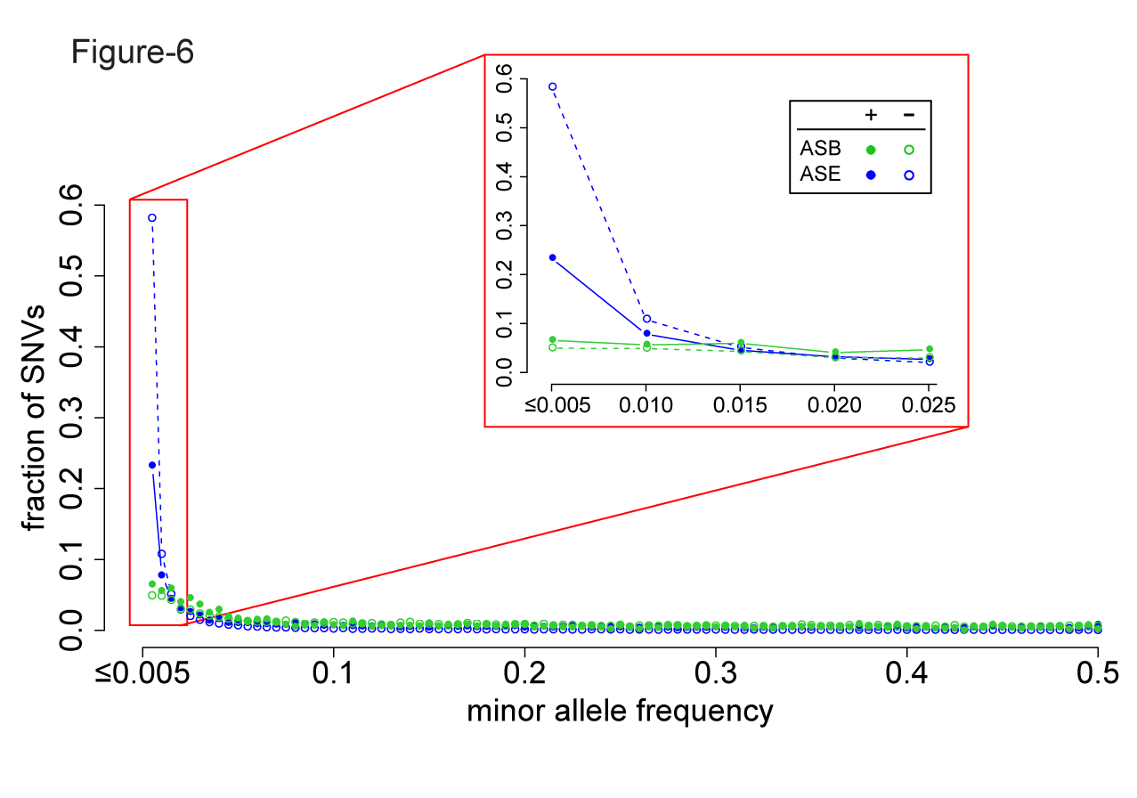
Freq spectra

Slide 12
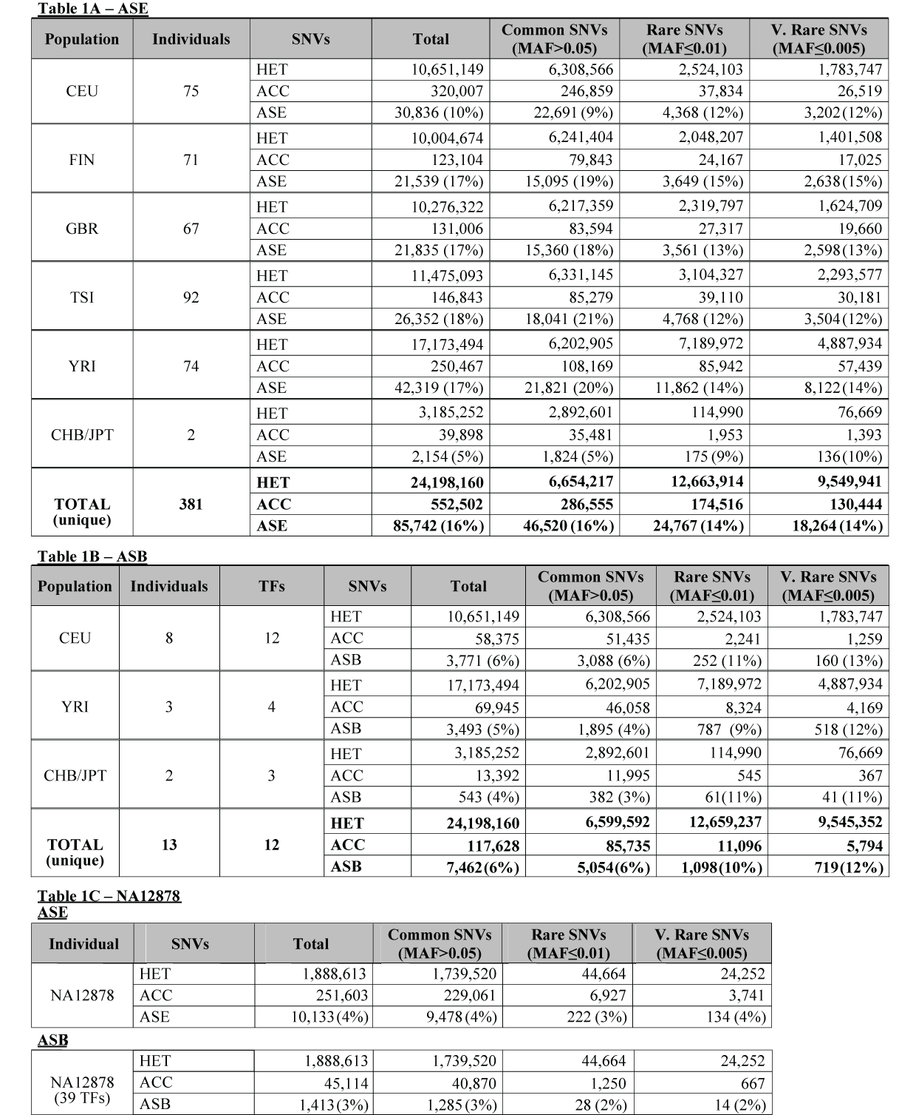

Slide 13
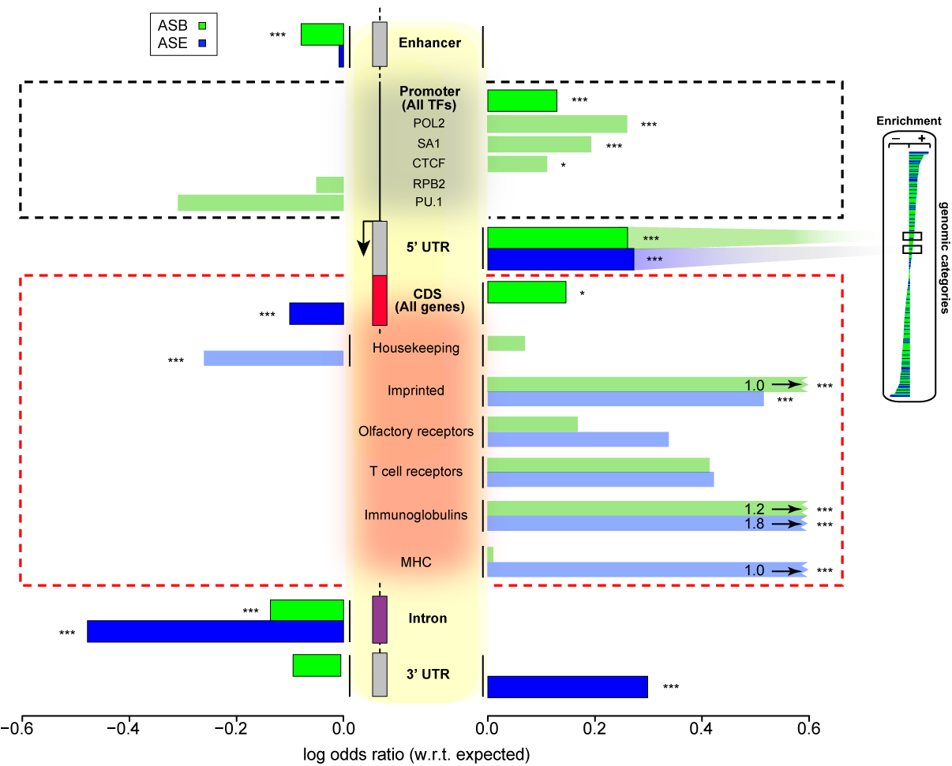
Supp-Enrichment combined (by element)

Slide 14
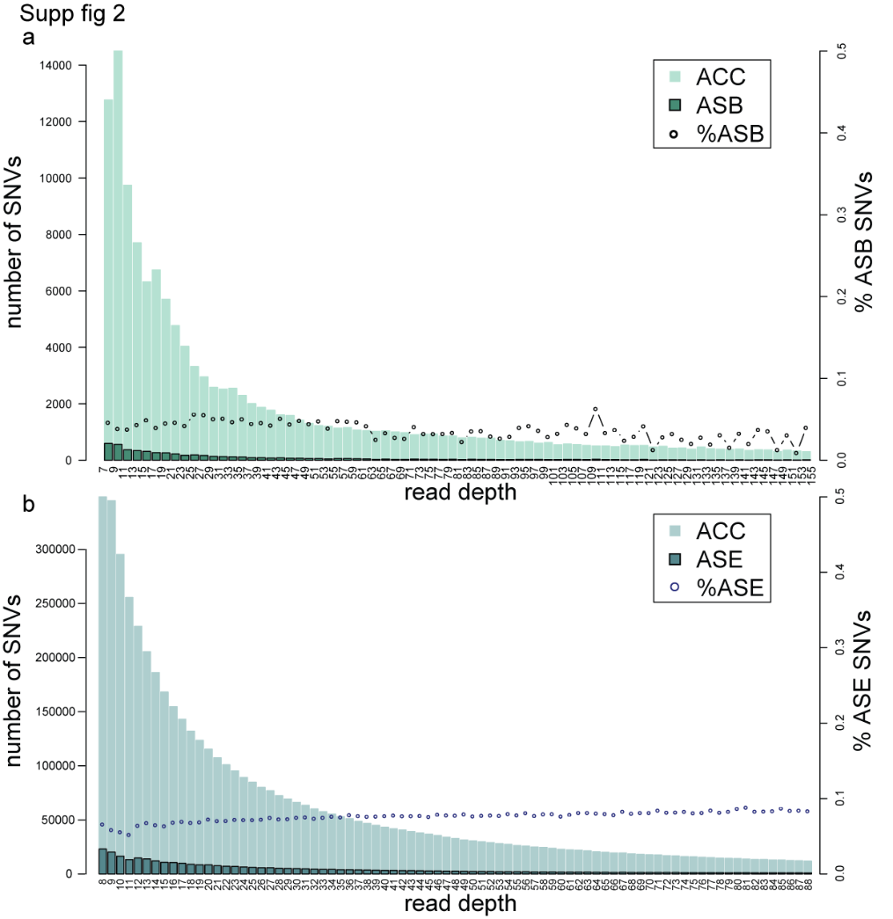

Slide 15
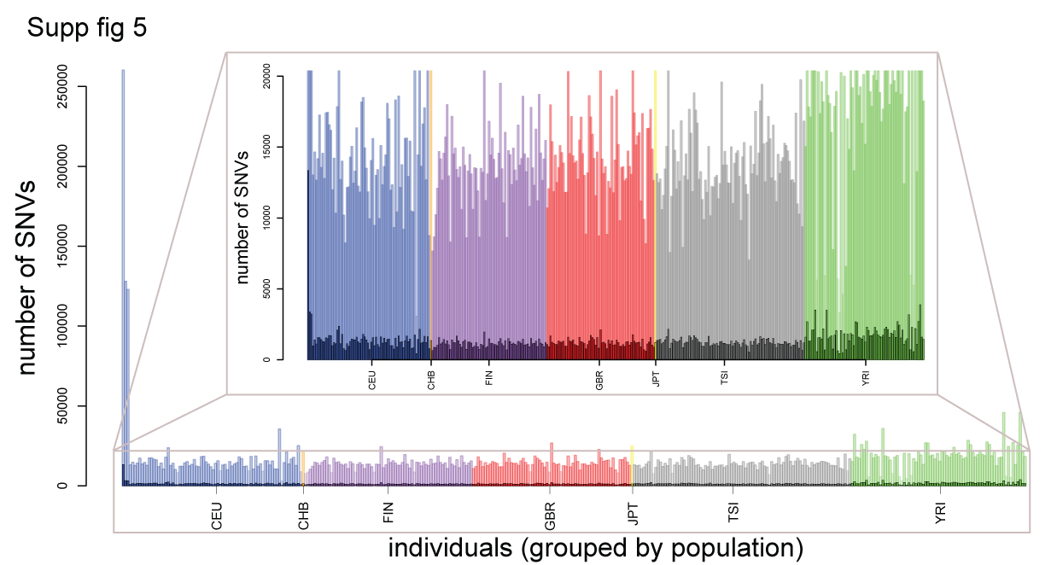

Slide 16
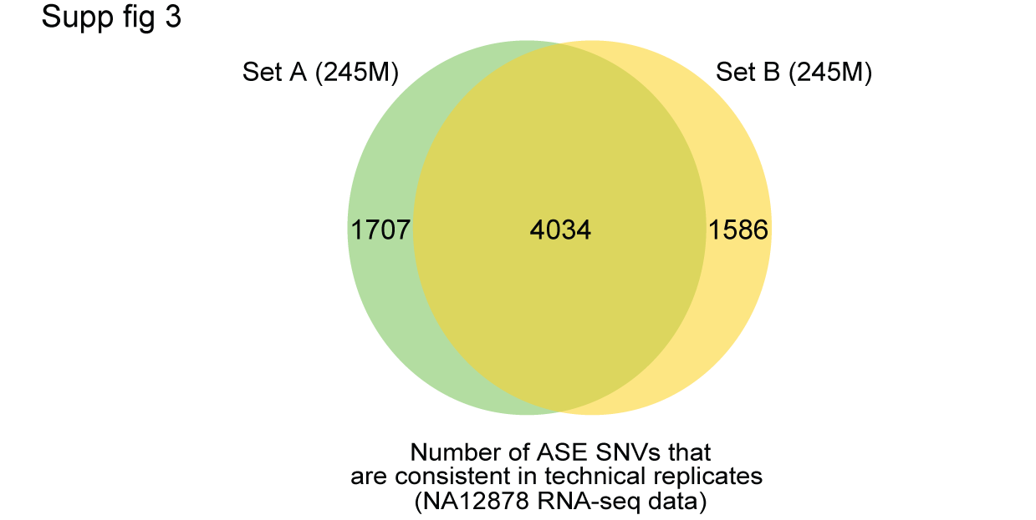

Slide 17
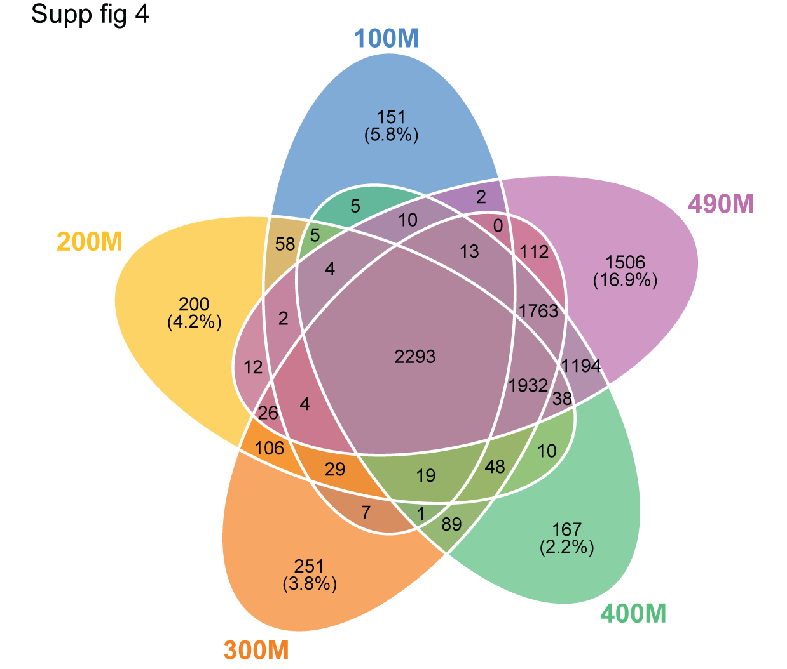

Slide 18
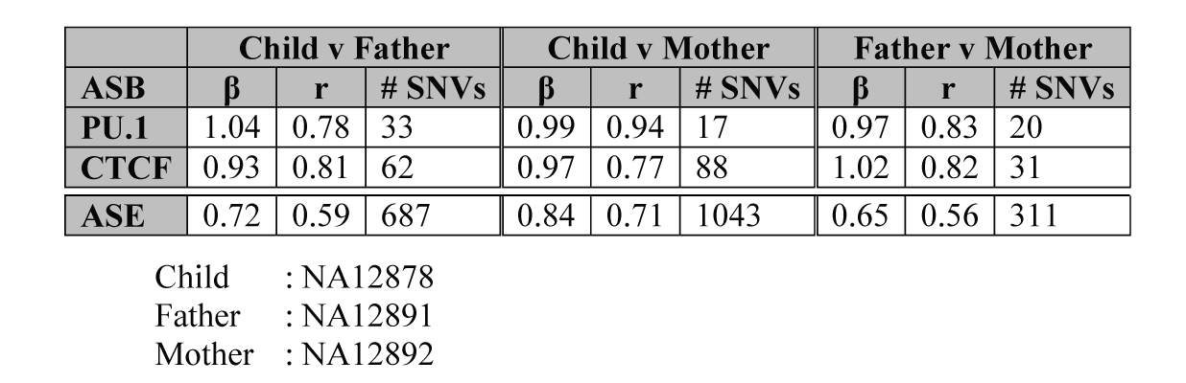

Slide 19
Stuff
Can we extend the deadline?
Looking at how much detection improvement from reference to personal genome then with betabinomial and then with mapping bias correction
+Timur

