Slide 1
Journal Club
11 Nov 2015
DS

Slide 2
2 papers discussed:
Stegle, Oliver, Sarah A. Teichmann, and John C. Marioni. "Computational and analytical challenges in single-cell transcriptomics." Nature Reviews Genetics16, no. 3 (2015): 133-145.
Buettner, Florian, Kedar N. Natarajan, F. Paolo Casale, Valentina Proserpio, Antonio Scialdone, Fabian J. Theis, Sarah A. Teichmann, John C. Marioni, and Oliver Stegle. "Computational analysis of cell-to-cell heterogeneity in single-cell RNA-sequencing data reveals hidden subpopulations of cells." Nature biotechnology 33, no. 2 (2015): 155-160.

Slide 3
Background: U19 asthma grant 3.B.i Processing of Single-Cell RNA-Seq Data
Single-cell RNA-seq has the possibility of offering an unbiased view of the pathways that are transcriptionally activated upon immune-system activation at a single-cell resolution, even when cells seem phenotypically similar. However, single-cell sequencing suffers from more technical noise as compared to bulk RNA-seq, arising largely from three sources: (1) sampling inefficiencies which result in only a small fraction of the total number of transcripts being captured; (2) cell-to-cell variations in sequencing efficiency, potentially due to differences in lysis between cells; and (3) amplification bias owing to the small amount of starting material for the RNA-seq. Attempts have been made to address these concerns [36, 37]. However, there is no standard pipeline in place that addresses all of the concerns in going from raw reads from a sequencer (such as the Illumina Hi-Seq) to robust transcript counts. The main steps of such a pipeline, which have been investigated in the literature, include (1) debarcoding and error correction, (2) Aligning reads from each unique molecular identifier (UMI), and (3) quantifying the biological noise in genes.

Slide 4
Figure 1: Capturing single cells and quantifying mRNA levels using the C₁Single-Cell Auto Prep System. From Pollen, Alex A., et al. "Low-coverage single-cell mRNA sequencing reveals cellular heterogeneity and activated signaling pathways in developing cerebral cortex." Nature biotechnology (2014).
https://www.youtube.com/watch?v=TF4NJRE4Xg4
“…we demonstrate that shallow single-cell mRNA sequencing (~50,000 reads per cell) is sufficient for unbiased cell-type classification and biomarker identification.”
Notes:
(a) Key functional components of the C₁ System are labeled, including the pneumatic components necessary for control of the microfluidic integrated fluidic circuit (IFC) and the thermal components necessary for preparatory chemistry. (b) Left, complete IFC with carrier; reagents and cells are loaded into dedicated carrier wells, and reaction products are exported to other dedicated carrier wells. Middle, diagram of the IFC, with connections between the polydimethylsiloxane microfluidic chip and carrier (pink circles), control lines (red), fluidic lines for preparatory chemistry (blue) and lines connecting the control lines (green) shown. Right, a single cell captured in a 4.5-nl capture site; there are 96 captures sites per IFC. The average single-cell capture rate was 72 ± 5 cells (mean ± s.e.m.) per chip (Supplementary Tables 1 and 2). IFC diagram reprinted with permission from ref. 32. (c) Schematic for a C₁ reaction line, with the reaction line colored light gray and the isolation valves shown in varied colors. All reagents are delivered through a common central bus line (a segment of the bus line is shown on the far left). Each reaction begins in the 4.5-nl capture site. Delivery of the lysis reagent expands the reaction to also include the first 9-nl chamber. The reaction is expanded again after delivery of the reverse transcription (RT) reagent to include the second and third 9-nl chambers. The two 135-nl reaction chambers are included to provide the larger volume required for the PCR reagents. After the addition of RT reagent, the contents of the reaction line are pumped in a loop using a bypass line (bottom) for mixing, and the IFC is then incubated at 42 °C for RT. Mixing is repeated after the addition of the PCR reagents, and thermal cycling is performed. After preparatory chemistry, each single-cell reaction product exits the chip using a dedicated fluidic path to the carrier (path shown to the right). (d) Sequencing of reaction products from 46 K562 cells at low coverage (1.7 × 10⁵ reads per cell) reveals that expression level estimates correlate strongly with known copy numbers of input spikes (Pearson's r = 0.968) from the External RNA Controls Consortium (ERCC) RNA Spike-In Control Mix 1 (2.8 × 10⁴ copies per reaction). (e) The fraction of positive reactions in which ERCC transcripts are detected above 1 TPM in single cells and the coefficient of variation (CV) for ERCC levels are plotted against the spike input amounts. (f–i) Pools of barcoded libraries from 301 cells were sequenced at high coverage by HiSeq and at low coverage by MiSeq. (f) In a representative cell, 4,644 genes were detected above 1 TPM in both data sets. (g) The average number of genes expressed at various levels detected by high-coverage sequencing in each cell type (Online Methods). Data are shown as the mean ± s.d. (h) In a representative cell, the expression levels of genes detected in high- and low-coverage data sets were highly correlated (r = 0.91). (i) Histogram of correlation coefficients for all single cells (n = 301). The mean correlation coefficients increased with expression level: 0.25 (1 < TPM < 10, red), 0.66 (10 ≤ TPM ≤ 100, green), 0.93 (TPM > 100, blue) and 0.91 (all genes with TPM > 1).

Slide 5
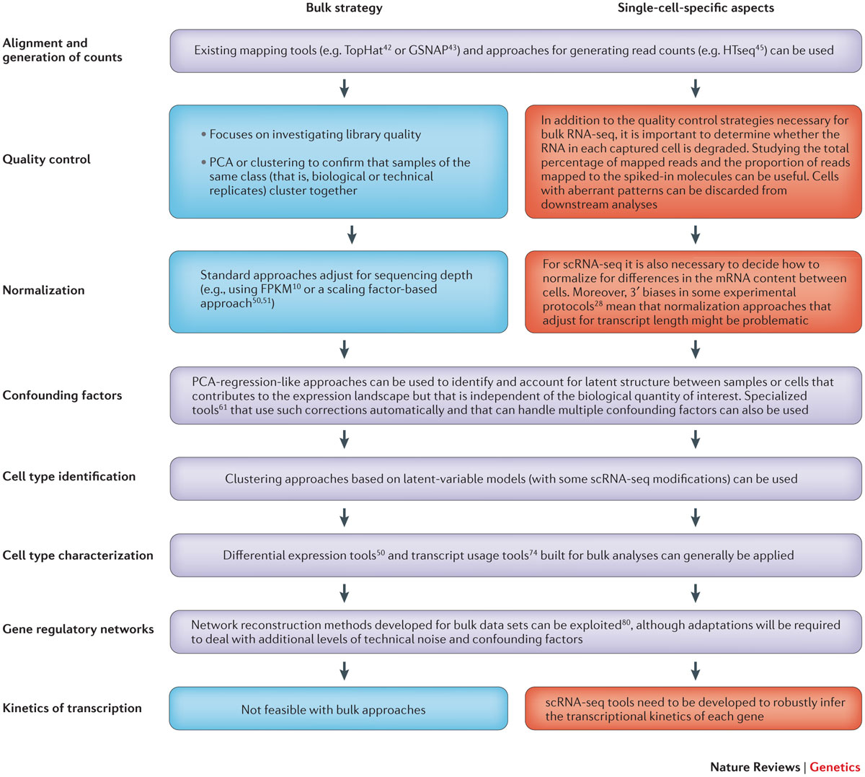
Figure 1: Comparison of bulk and scRNA-seq analytical strategies.
Notes:
A flow chart of the steps in analysis of high-throughput RNA sequencing (RNA-seq) data from bulk cell populations and from single cells is shown. Methods that are common to both approaches are shown in purple, whereas key differences in analysis methods between bulk-based RNA-seq and single-cell RNA-seq (scRNA-seq) are shown in blue and red, respectively. FPKM, fragments per kilobase of exon per million fragments mapped; PCA, principal component analysis.

Slide 6
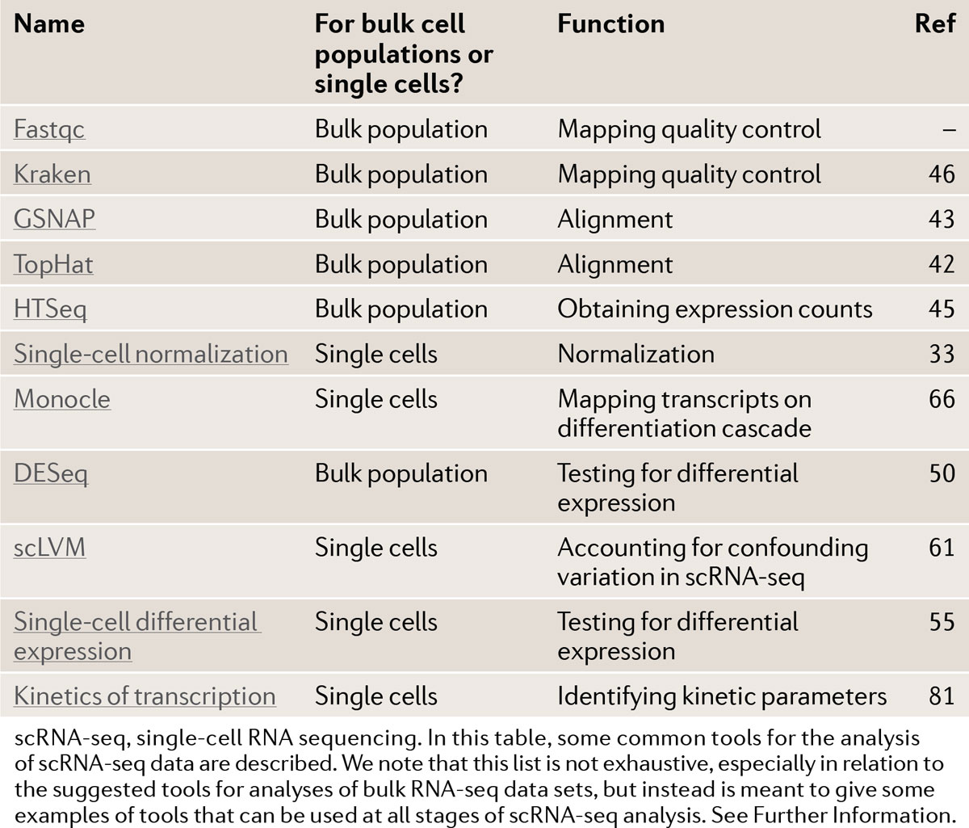
Table 1: Tools for scRNA-seq analysis
Notes:
scRNA-seq, single-cell RNA sequencing. In this table, some common tools for the analysis of scRNA-seq data are described. We note that this list is not exhaustive, especially in relation to the suggested tools for analyses of bulk RNA-seq data sets, but instead is meant to give some examples of tools that can be used at all stages of scRNA-seq analysis. See Further Information.

Slide 7
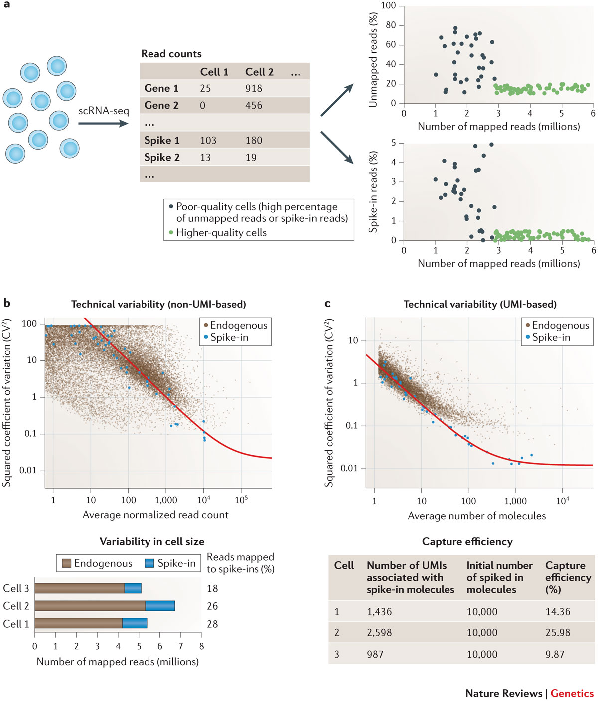
Figure 2: Quality control and normalization.
Other QC methods
How much maps to genome?
Ratio of reads mapped to RNA to those mapped to the spike-in
PCA
Notes:
a | Basic quality control steps are shown. After generating single-cell RNA sequencing (scRNA-seq) data, a key first step is to assess the quality of the data. In addition to quality metrics developed for bulk RNA-seq, it is important to determine whether cells have been captured efficiently and the mRNA fraction amplified faithfully. Two simple but important criteria are to compare the percentage of unmapped reads and the percentage of reads mapped to the external spike-in molecules across cells. Cells in which either of these values is high (grey) are of poor quality and should be discarded, leaving only the higher-quality cells (green) for downstream analyses. b | Spike-ins can be used to model technical variability and examine relative variability in cell size for non-unique molecular identifier (UMI)-based scRNA-seq data. If external spike-in molecules are added at the same volume to the RNA mixture from each cell before processing, they can be used to quantify the degree of technical variability across cells and to examine the relationship between technical variation and gene expression (upper panel). The x axis shows average expression levels across cells, and the y axis shows the squared coefficient of variation; blue points are extrinsic spike-in molecules. The red line indicates the fitted relationship between technical noise and gene expression strength. Additionally, by calculating the ratio between the numbers of reads mapped to the spike-in sequences and to the genes from the organism of interest, the relative amount of mRNA contained in each cell can be estimated (lower panel). c | Spike-ins can also be used to model technical variability and to examine relative variability in cell size for UMI-based scRNA-seq data. Similar to part b, the upper panel illustrates the relationship between technical noise and expression strength — the difference is that the expression level of each gene is now quantified as the number of unique cDNA molecules. Additionally, spike-ins can be used to quantify the capture efficiency and thus infer the number of mRNA molecules contained in the lysate of each cell (lower panel). Upper panels of parts b and c adapted from Ref. 33 and Ref. 40, respectively, Nature Publishing Group.

Slide 8
Figure 1: Molecule counting using UMIs.
FromQuantitative single-cell RNA-seq with unique molecular identifiers
Saiful Islam, Amit Zeisel, Simon Joost, Gioele La Manno, Pawel Zajac, Maria Kasper,Peter Lönnerberg & Sten Linnarsson
Nature Methods 11, 163–166 (2014) doi:10.1038/nmeth.2772

Slide 9
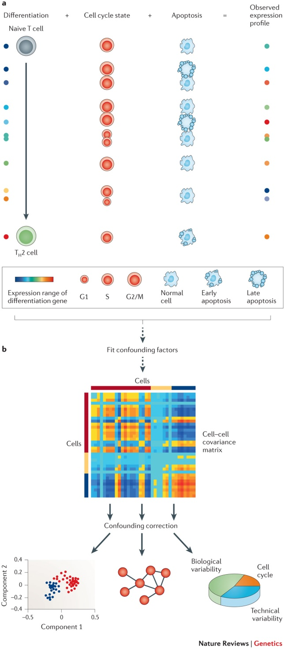
Figure 3: Confounding variables and how to account for them
Notes:
a | For each gene, the observed expression profile generated from single-cell RNA sequencing (scRNA-seq) is caused by a combination of factors. For example, if cells are being sampled randomly from a mixed population containing naive (that is, undifferentiated) cells and cells that are closer to being fully differentiated, then for each cell, the expression profile is a combination of a variety of factors (including position on the differentiation cascade, cell cycle state and apoptotic state). Factors such as the cell cycle or apoptotic state can be considered confounders that prevent the signal of interest (the differentiation state of a cell) from being uncovered. b | Confounding factors need to be identified and corrected for in downstream analyses. Latent-variable models, which are built on approaches applied in bulk RNA-seq studies to infer and correct for hidden factors that cause gene expression heterogeneity^{56, 57, 59}, can be used to deduce the correlation between cells due to factors such as the cell cycle or apoptotic state. Subsequently, the extent of variance in the expression of each gene across cells that is attributable to this factor (and other factors) can be inferred. Additionally, the scRNA-seq data can be corrected by using regression analyses to remove the confounding factor, thus facilitating downstream analyses such as clustering or network analyses. Figure from Ref. 61, Nature Publishing Group.

Slide 10
Figure 1: Overview of the scLVM approach.
Notes:
The observed expression profile of differentiation marker genes (upper panel) is the result of the differentiation process of interest together with the effects of the cell cycle and other confounding sources of variation. After accounting for cell-cycle effects (middle panel), one can uncover gene expression signatures that contribute to the continuous differentiation process more clearly (lower panel). (b) scLVM two-stage procedure. First, in the fitting stage, the cell-to-cell covariance matrix that corresponds to the cell cycle is inferred from the gene expression profiles of genes with cell-cycle annotation (upper panel). The learnt covariance is then used in downstream analyses, including the detection of substructure, the detection of gene-to-gene correlations and the analysis of variance (lower panel). Biol. var., biological variance; Tech. var., technical variance.

Slide 11
Figure 2: Validation of scLVM on cell cycle–staged mESCs.
Agreement b/n scLVM result and “gold standard” cell sorting
With 829 cell-cycle genes
Removing 829 cell cycle genes
Notes:
(a) Comparison of the estimated proportion of variability in the expression of each gene across cells due to the cell cycle as inferred using scLVM (x axis) or with gold standard estimates of the cell-cycle stage derived from the Hoechst staining (y axis). The scatter plot compares the proportion of variance explained by either approach, revealing striking concordance (Pearson's r² = 0.91). (b,c) Nonlinear PCA based on genes not annotated as cell cycle (neither GO nor Cyclebase) (b) and the same nonlinear PCA process carried out using scLVM-corrected gene expression data (c). Cell-cycle annotation of individual cells according to the Hoechst staining is color coded. In the uncorrected expression data, the PCA analysis separates cells according to their cell-cycle stage, even when omitting cell-cycle genes. This clear separation is lost when using scLVM-corrected expression levels, showing that scLVM effectively removes gene expression signatures that are only associated with cell-cycle effects.

Slide 13
Figure 3: Application of scLVM to identify subpopulations in differentiating T-cells.
Notes:
(a) For each gene, scLVM was used to estimate the proportion of variance explained by the cell cycle, technical noise and residual biological variance. Genes were binned by the total variance explained by factors other than technical noise; the bars show average variance contributions for genes in a particular bin. (b) Gene-to-gene variation without cell-cycle correction. (c) Gene-to-gene variation with cell-cycle correction. Shown are −log₁₀ P values from a correlation test between pairs of genes (pv). Without cell-cycle correction, widespread gene-gene correlations were observed. The scLVM correction greatly reduced this background correlation structure (622,769 versus 17,389 correlations, involving 2,053 versus 143 genes; P < 0.05, Bonferroni adjusted). GO analysis revealed that unlike the gene-gene correlations without correction, the significant correlations after scLVLM correction were enriched for plausible functional categories (Supplementary Table 3). (d) Nonlinear PCA applied to the expression data set without cell-cycle correction. The color overlaid on each cell denotes the log₁₀expression of Gata3 in that cell. (e,f) Nonlinear PCA applied to the expression data set with cell-cycle correction. The color overlaid on each cell denotes the cell cycle–corrected log₁₀ expression of Gata3 in that cell. The corrected data set revealed two distinct subclusters of cells, between which Gata3 (e) and, other factors important for proper T_{H}2 differentiation including receptor genes, cytokines and transcription factors (f) were differentially expressed (all P values < 0.001; Supplementary Fig. 13).

Slide 14
Conclusions
Spike-ins and UMIs are desireable to control technical variability
Controlling for cell-cycle variation seems warranted (scLVM)
Other factors?
Complicated by mixture of cell types?
Provide a set of 122 genes that are T-cell differentiation signals
Includes non-specific signals, e.g. glycolysis

Slide 15
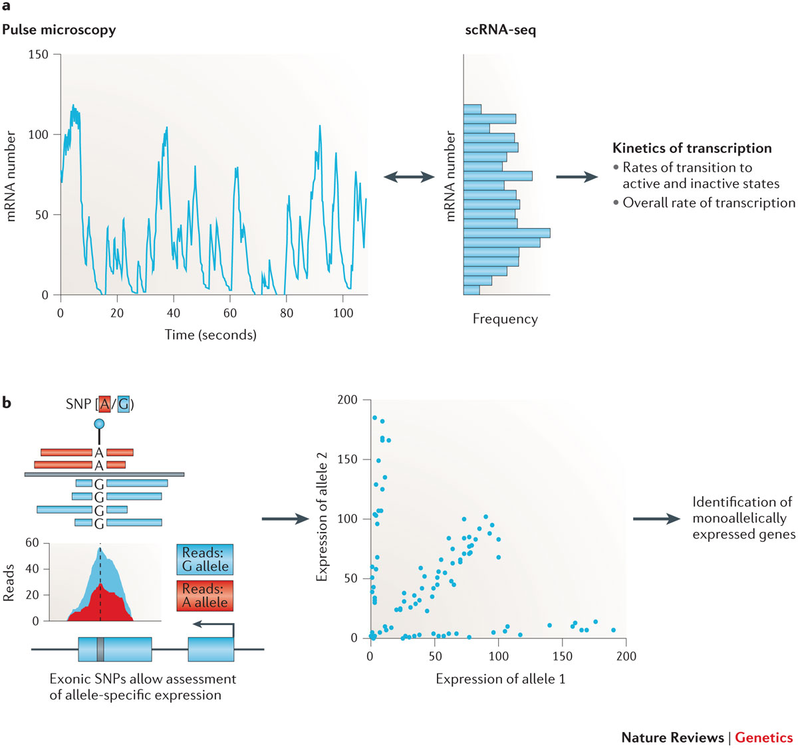
Figure 5: The kinetics of transcription
Notes:
a | Single-cell RNA sequencing (scRNA-seq) can be used to study the kinetics of transcription. RNA labelling followed by pulse microscopy (left panel) can be used to track the expression of a gene over time⁸². scRNA-seq can be used to obtain an instantaneous snapshot of this distribution by measuring the expression of an individual gene across many cells (middle panel)⁸¹. Subsequently, these data can be used to draw inferences about the kinetics of transcription. b | Allele-specific expression can be studied using scRNA-seq. Allele-specific expression can be assayed using single-nucleotide polymorphisms (SNPs) in the sequence of a transcript to allocate reads to alternative alleles. Subsequently, the number of cells in which both alleles are expressed and the numbers of cells in which allele 1 or allele 2 is exclusively expressed can be counted. This allows the identification of genes that display evidence of monoallelic expression4. One important challenge is to address technical issues, especially allelic dropout during sample preparation, which can bias the results.

Slide 16
Figure 4: Application of scLVM to decompose gene expression variability in differentiating T-cells, considering both cell cycle and the T_{H}2 differentiation factor.
Notes:
(a) For each gene, the proportion of variance explained by the cell cycle, T_{H}2 differentiation, a multiplicative interaction between cell cycle and T_{H}2 differentiation, as well as technical noise and residual biological variance was estimated. Genes were binned by the total variance explained by factors other than technical noise; the bars show average variance contributions for genes in a particular bin. (b) Visualization of the identified interaction between factors for cell cycle and T_{H}2 differentiation for the gene Batf. Shown is the expression level of Batf (y axis) as a function of the inferred cell-cycle stage (x axis), where the level of the T_{H}2 factor is encoded in color. The interaction between the cell cycle factor and the T_{H}2 factor can be viewed as the conditional correlation between cell cycle and Batf expression. For fully differentiated cells (high T_{H}2 factor), there is a strong correlation between cell cycle and gene expression (red dashed line, steep slope). In contrast, for partially differentiated cells (negative T_{H}2 factor) this observed correlation is much weaker (dashed blue line, shallow slope). (c) Effect of accounting for different hidden factors on gene-gene correlations. The number of significant edges in the gene-gene correlation network (P< 0.05, Bonferroni adjusted) decreased by over an order of magnitude after correcting for cell cycle; subsequently accounting for T_{H}2 differentiation resulted in a similar reduction of gene-gene correlations. Finally, accounting for the interaction between T_{H}2 and cell cycle yielded an additional reduction of almost 50% of the remaining gene-gene correlations, suggesting that cell cycle and T_{H}2 differentiation are the predominant source of gene-gene correlations in this data set.

Slide 17
Aim 2A. Project Lead: Craft. Determine the role of follicular B helper T (Tfh) cells in promotion of the pathogenic IgE response in endotypes of asthma.
We hypothesize that Tfh cells drive the IgE response in asthma. We will assess the relationship between circulating and tonsillar Tfh cells and disease heterogeneity, including serum IgE, eosinophilia, and disease severity to define relationships with disease endotypes, followed by defining the phenotypic, functional, and genomic characterization of these cells.

Slide 18
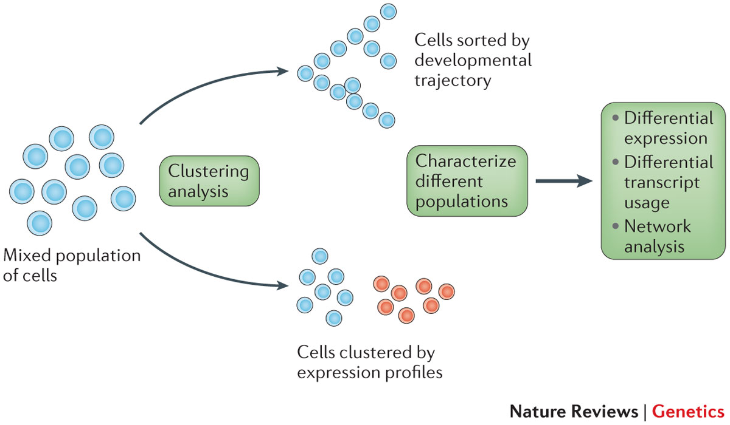
Figure 4: Finding new cell types and allocating cells along a differentiation cascade
Notes:
Unbiased clustering approaches based on principal component analysis (PCA)-like methods^{62, 63, 66}can be used on a mixed population of cells, to either map them along a differentiation cascade or cluster them into new cell types^{55, 58}. Subsequently, the newly identified cascades or populations can be characterized, and new marker genes can be found by identifying genes or transcript isoforms that are differentially expressed between the populations.

Slide 19
Grün, Dominic, Lennart Kester, and Alexander van Oudenaarden. "Validation of noise models for single-cell transcriptomics." nature methods 11.6 (2014): 637-640.

Slide 20
Figure 1: Analysis of gene expression noise with single-cell mRNA sequencing
Notes:
(a) Hand-picked single mESCs were spiked with foreign RNA (left) and sequenced with a modified CEL-Seq³ protocol (Online Methods). To measure technical noise, RNA aliquots from bulk cells were treated likewise (right). (b) CV computed on the basis of transcripts per million (TPM) versus reads per million (RPM). The diagonal (red solid line) and twofold change intervals (red dashed lines) are indicated. (c) CV across control samples as a function of average expression. Blue line indicates CV for a hypothetical Poissonian distribution; dashed line represents CV computed from the s.d. of β, i.e., for global tube-to-tube variability. (d) Count distribution of Pou5f1 transcripts across cells and controls (dashed lines) fitted by negative binomials (solid lines). (e) Different functions were fitted to the count distribution in cells and controls. The goodness of fit was assessed by a χ² test. The bar plot shows the number of genes for which a given distribution was not rejected (χ² test P > 0.01).

Slide 21
Figure 2: Modeling of technical variability and inference of biological noise
Notes:
(a) Schematic of transcript normalization for model I. (b) Linear regression of the transcript counts on the predicted spike-in molecule numbers. Different slopes reflect varying efficiencies between samples. (c,d) CV as a function of average expression in cells and controls with (c) and without (d) count normalization. Predictions are indicated for model I in c and models II and III in d. The moving average and the CV for Poissonian noise are also shown. (e) Schematic of biological noise inference. Cell-to-cell noise (red) was fitted by a negative binomial, and a deconvolution of technical noise (gray) yields biological variability (turquoise). Example distributions are shown for Pou5f1. Noise distributions are similar for models II and III but narrower for model I owing to the elimination of global variability by normalization.

Slide 22
Figure 3: Validation of predicted biological variability by smFISH.
Notes:
(a) Pou5f1 transcripts labeled with Cy5 using smFISH in mESCs (maximal z projections). Single molecules appear as diffraction-limited spots. Nuclei were stained with DAPI. Scale bar, 10 μm. (b) Count distribution for smFISH on Pou5f1 (>100 cells) and a negative binomial fit (black line) with uncertainty interval (dashed lines). The P value for rejecting a negative binomial was computed by a χ² test. (c) CV measured in cells, as inferred after deconvolution of technical noise and measured with smFISH. In the model I comparison, the CV after normalization of transcript counts without deconvolution of sampling noise is also shown. Error bars are derived from estimated standard errors of the numerical fits. (d) z score of deviations between models and smFISH-based CVs averaged across genes. The z score after normalization (Median norm.) of transcript counts without deconvolution of sampling noise is also shown. (e) Distribution of Fano factors as measured in cells and controls and as inferred for biological variability using model III. The distribution after normalization of transcript counts without deconvolution of sampling noise is also shown (Median norm.). The inset shows a histogram of log₂ fold changes between Fano factors before and after deconvolution of technical noise. (f) Scatter plot of Fano factors in the serum versus 2i conditions. Genes that have different Fano factors within their error bars between the two conditions are colored. Error bars are based on standard errors of fitting parameters.

Slide 24
Box 1. scRNA-seq experimental design considerations
The most obvious experimental design questions related to single-cell RNA sequencing (scRNA-seq) experiments are the number of cells that need to be sequenced and the depth to which each individual cell should be sequenced. Both of these questions depend, inevitably, on the biological problem of interest, as well as on technical and financial constraints.As a general rule, it is necessary to generate data from hundreds of cells to identify and characterize subpopulations of cells (especially rare populations) or to study the kinetics of transcription. Of course, if the goal is to answer specific questions relating to a small population of cells (for example, cells from the early developing embryo), such restrictions may not apply.Recent studies using ~102–103 cells30, 36, 62, 65 have discovered previously uncharacterized transcriptional states, corresponding to new cell types or novel positions along differentiation cascades in various experimental systems. However, there are substantial differences in the depth to which the transcriptome of each individual cell was sequenced. Jaitin et al.30 generated an average of 22,000 aligned sequence reads from 1,536 cells. By contrast, Mahata et al.65 generated 12–20 million sequence reads from each of 93 cells. The key factor when determining the required sequencing depth is the number of reads that is necessary to sequence each reverse-transcribed and amplified cDNA molecule (or fragment thereof, if the protocol used does not involve unique molecular identifiers (UMIs)) at least once. When this depth is reached, further sequencing will not yield additional information. This value will depend on capture efficiency, with a higher capture efficiency meaning that deeper sequencing is necessary to fully capture the complexity of the captured transcriptome. However, this increased ability to fully characterize the transcriptome of a cell directly from deep scRNA-seq data is compensated for by the fact that fewer cells are typically able to be analysed by deep scRNA-seq than for shallow scRNA-seq; therefore, it may be that fewer cell types can be confidently identified when using deep scRNA-seq coupled with a small input population of cells.Therefore, a balance between these two experimental parameters must be achieved. However, given the insights already obtained from relatively small numbers of cells, sequencing on the order of hundreds of cells at moderate depth would seem to suffice for many applications.

