Slide 1
Gerstein Lab: Project Update
Analysis of Chupp scRNA-seq Data
Analysis of Chupp scRNA-seq Data
By Brian Barron
Supervised by Koon-Kiu Yan
i

Slide 2
The Question
Analysis of Chupp scRNA-seq Data
Does the cellular / tissue composition of sputum from patients responsive to asthma treatment differ from that from patients non-responsive to treatment (or on another treatment)?
Address this question using single-cell RNA-seq
1

Slide 3
Analysis Pipeline:
scRNA-seq Data (.fastq)
Trimmed Files (.fastq)
Aligned Files (to transcriptome) (.bam/.sam)
Analyzed Results
Trim_galore
STAR-RSEM
R
2

Slide 4
The Data:
Single cell RNA-seq (scRNA-seq) generated from Illumina HiSeq and Nextera DNA library preparation kit
2x sputum samples (one from each patient)
2x sequencing runs (one for each sample) with ~96 cells included (multiplex, barcoded)
We are looking for differences in cell expression and/or distribution of cell types (via biomarkers)
3

Slide 5
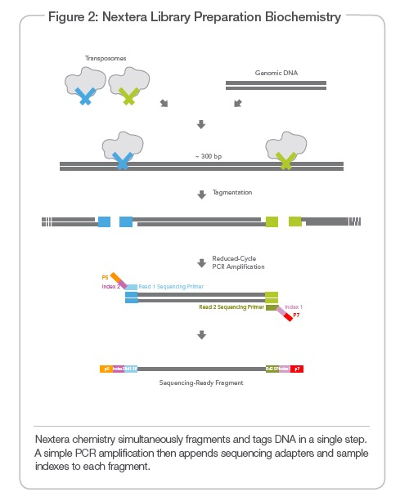
Nextera Sample Preparation
4

Slide 6
Trim Reads with Trim_Galore
A wrapper script that utilizes functionality of Cutadapt and FastQC to trim adapter sequences and apply quality control measures
Removes low quality base calls at 3’ end of reads
Removes adapter sequence (Nextera) at 3’ end
Note: High Stringency can lead to sharp changes in base call % at the 3’ end (decreased C for Nextera)
Trimming settings used -> paired-end, nextera primer, quality cut-off @ 20, gzipped output files
5

Slide 7
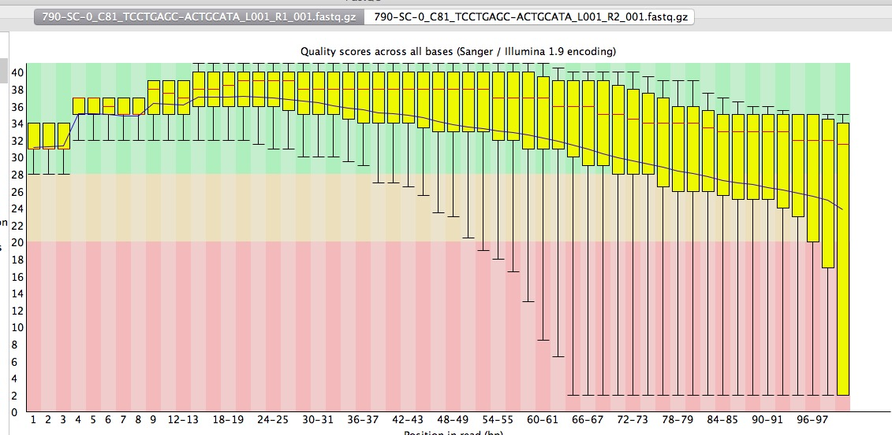
Trimming QC
Original Reads – Noisy base calls and Nextera Primer @ 3’
6

Slide 8
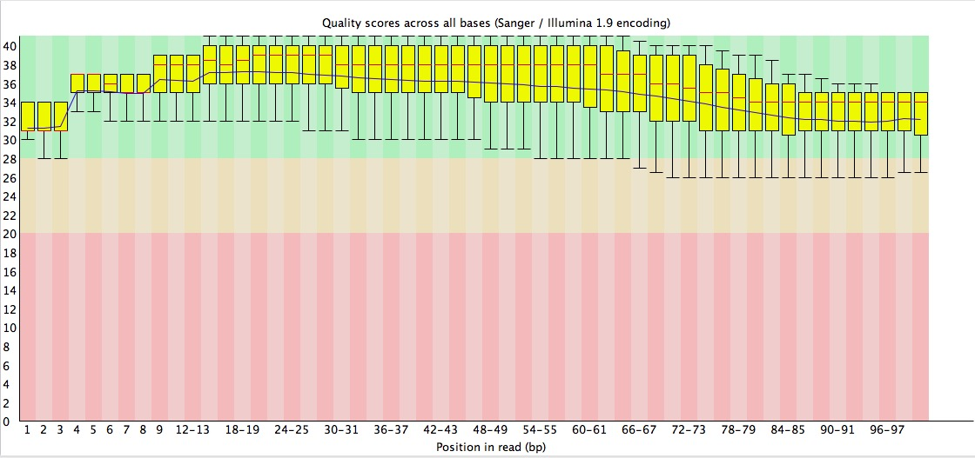
Trimming QC
Trimmed Reads – Base calls >20 and Nextera Primer removed
7

Slide 9
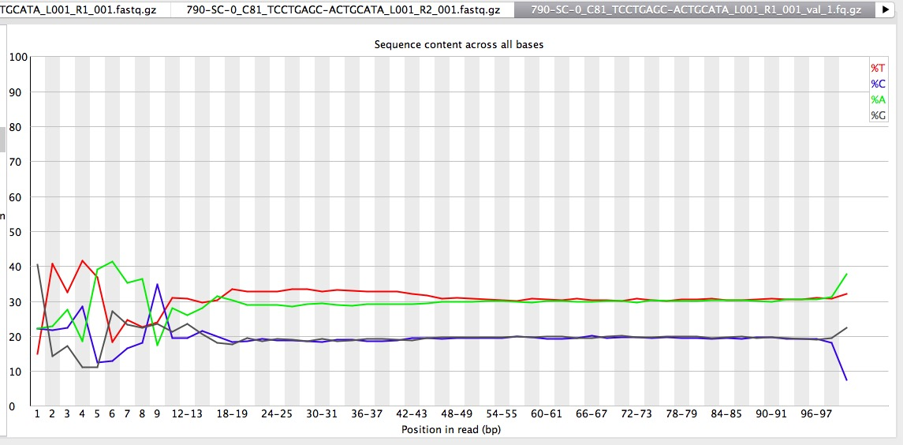
Trimming QC
Strange base pair % at 5’ end of reads -> Why? Barcode? Averaging artifact?
8

Slide 10
Align Files with STAR_RSEM
A wrapper script that utilizes functionality of both STAR and RSEM to analyze RNA-seq data
The STAR program maps reads to the genome or transcriptome
The RSEM program produces expression values for the identified loci
The “Quant.genes.results” output file was used for downstream analysis (in R)
9

Slide 11
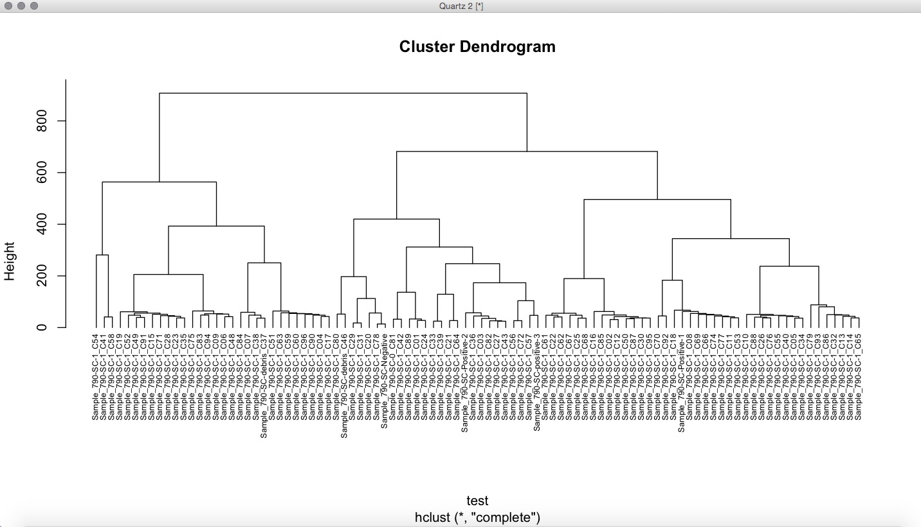
R Analysis
Hierarchical Clustering (Euclidean) of cells using expression at all loci (log pme_TPM)
10

Slide 12
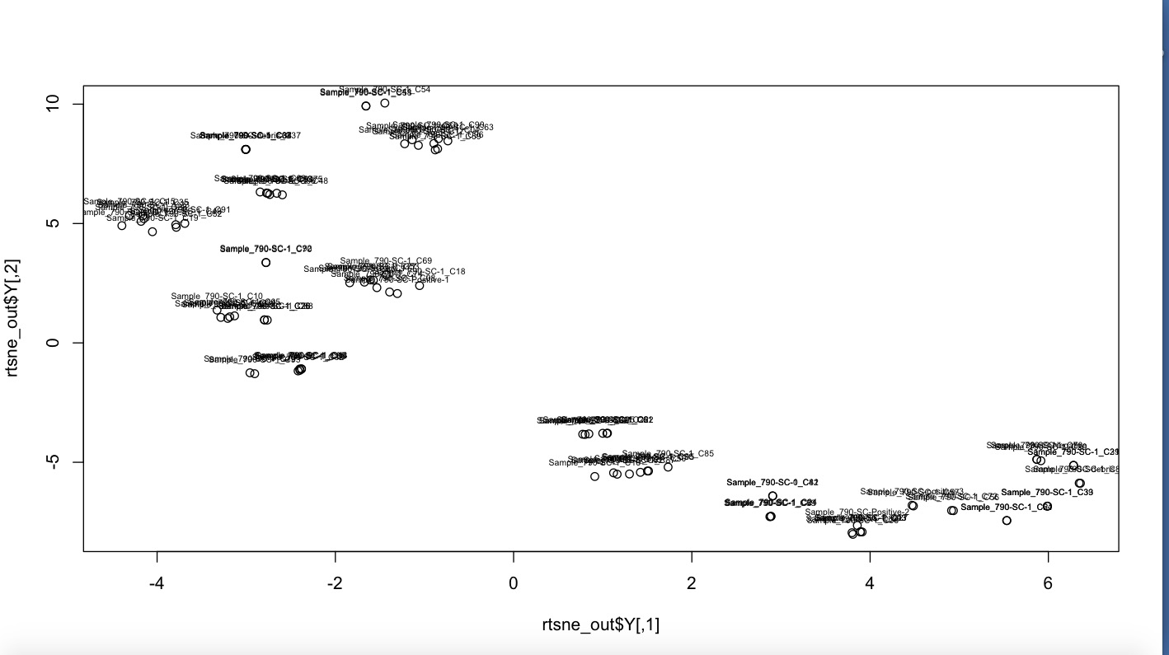
R Analysis
t-SNE (high-dimensional) plot of cells using expression at all loci (log pme_TPM)
11

Slide 13
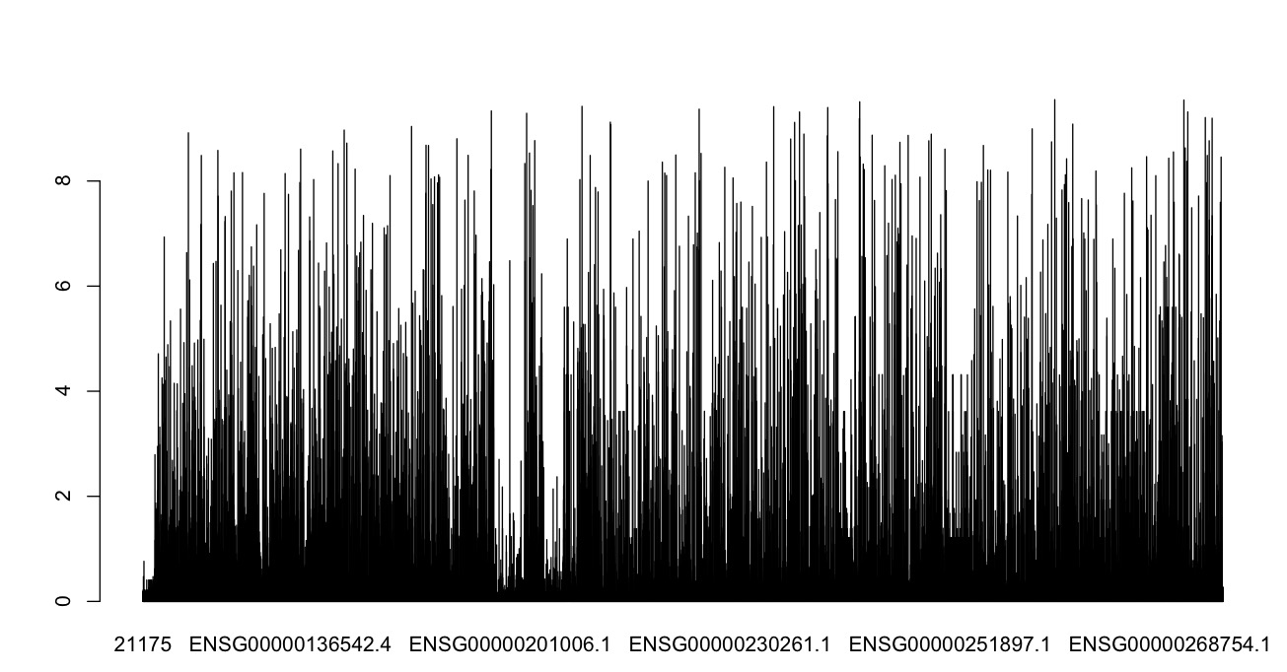
R Analysis
Bar plot of relative variability (SD/mean) of RNA read loci (log pme_TPM)
12

Slide 14
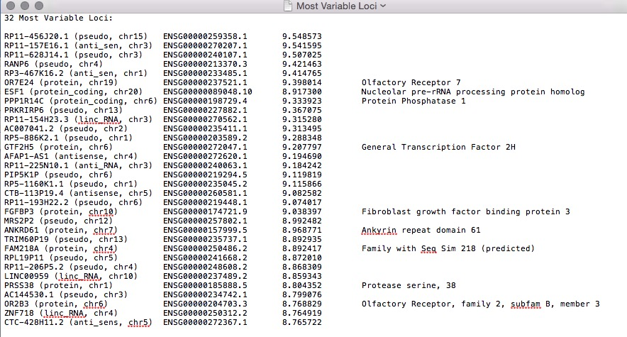
R Analysis
13

Slide 15
Problems?
When looking back over the alignment log files, we noticed that a substantial amount of reads (50%) were mapping to the genome but not the transcriptome
Suggests possible DNA contamination of RNA samples
May explain strange clustering and gene identification
14

Slide 16
Where to Next?
The basic pipeline has been established and tested; however, further analysis is needed along the pipeline to QC data
Trimming -> % reads trimmed, etc.
Alignment -> % reads mapping to transcriptome
Methods for identification of relevant gene loci can be improved and automated
Learn more! (about sequencing, processing scripts, and R)
15

Slide 17
End!
Thank You!

