Slide 1
AlleleDB new submission
Allele
Jieming

Slide 2
Checklist
AlleleDB pipeline
Current pipeline
Arif, Rob and Timur helping me
Response
Manuscript
Figures 1 and 2
Figures 3-6 and main table require results
Supp Figures 1-5 require results
Supp tables 1 and 2
Supp table 3 require results
Supp files 1-4,6,7 require results
Supp file 5 (pseudo code for bisection method)
Website
include AlleleDB tool
Personal genome peaks

Slide 3
AlleleDB current pipeline
8 modules
1-alignment-kasowski_SA1_NA10847 --INPUT: *.fastq.gz; OUTPUT: bowtie output
2-map.back.ref-kasowski_SA1_NA10847: --INPUT: (1) OUTPUT, 2ref.chain files; OUTPUT: BED files of reads in reference coordinates
3-intersectBed-kasowski_SA1_NA10847: --INPUT: (2) OUTPUT, het snp file; OUTPUT: which read has SNVs
4-flip-kasowski_SA1_NA10847: --INPUT: (3) OUTPUT; OUTPUT: fastq files of simulated flipped reads that map to only 1 SNV --reads that overlap indels, tri/quadallelic, or overlap more than 1 SNVs are not considered for the and but are not removed from original read pool
5-alignment2-kasowski_SA1_NA10847: --INPUT: (4) OUTPUT, ; OUTPUT: aligned, unaligned, multi Bowtie1 output
6-unaligned-kasowski_SA1_NA10847: --INPUT: (5); OUTPUT: BED of unaligned reads
7-multi-kasowski_SA1_NA10847: --INPUT: (5); OUTPUT: BED of multi reads
--Remove reads from original read pool --Run AlleleSeq with betabinomial calc

Slide 4
Timur’S modification
A
A
A
A
A
A
A
A
Mat
A
Mat
A
Pat
C
Pat
C
INDEL
C
C
C
C
C
C
C
C
Assume biallelic before simulation,
Generate reads using region ± read length around hetSNV → pooled data has variable read length
Map
Remove reads that multimap → can consider indels/SVs; based on personal genome sequence flanking the SNVs
Assess which site is allele-specific → stringent; 7% in RNA-seq data removed in a test by Timur
Remove by sites.

Slide 6
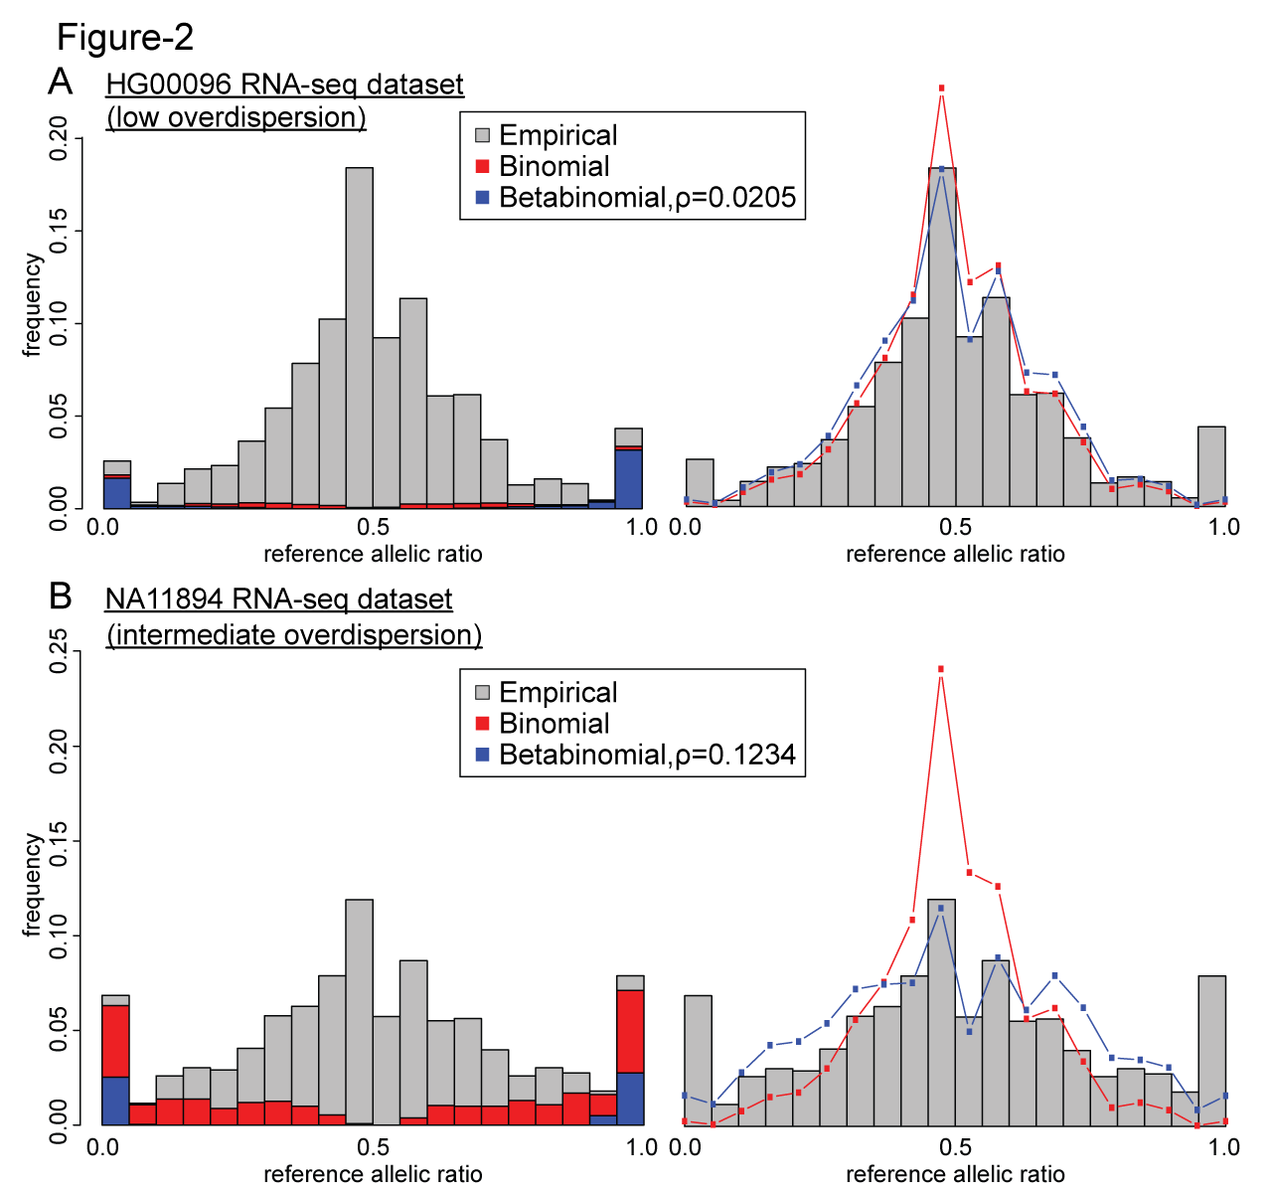

Slide 7
Supp table 1

Slide 8
Supp table 2

