Slide 1



Genomic Privacy
Personalized genomic data generation is booming
Main focus is on protecting variants
“Detection of genome in a mixture”
  Individuals give consent to participate but request anonymity
    HAPMAP, Personal genome project, 1000 Genomes…
Larger and more datasets leads to more realistic risks of linking attacks, that may be much more damaging than detection of genome in a mixture attacks

Slide 2
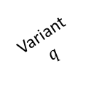
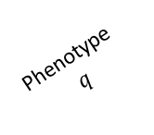

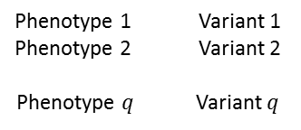

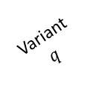
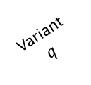
Linking Attack Scenario
Phenotype dataset
(Public)
Genotype dataset
(Stolen/Hacked/Queried)
1
Phenotype-Genotype
correlation dataset
Phenotype
ID
Phenotype 1
Genotype
ID
Variant
$$q$$
HIV Status
Phenotype 2
Phenotype
$$q$$
Variant 1
Variant 2
PID-1
HIV+
-2.7
…
90.3
Phenotype 1 Variant 1
Phenotype 2 Variant 2
Phenotype $q$ Variant $q$
GID-1
0
1
…
1
0.1
…
…
PID-2
HIV-
0.5
8.6
63.5
…
GID-2
2
1
0
…
…
…
…
…
…
…
…
…
…
…
PID-$n$
HIV-
5.4
…
50.3
GID-m
1
2
…
1
-0.2
2
3
Genotype
prediction
Predicted/Matched genotypes
Genotype
ID
Phenotype
ID
HIV
Status
Variant 1
Variant
$$q$$
Predicted variant
genotypes
Variant 2
Phenotype
ID
HIV
Status
GID-1
PID-8
HIV+
0/0
1/1
…
1/1
Variant
$$q$$
4
Variant 2
…
Variant 1
GID-2
PID-3
HIV-
2/2
1/1
0/0
PID-1
HIV+
1
0
…
2
Genotype comparison
and matching
GID-3
PID-1
HIV-
1/0
1/0
…
0/2
PID-2
HIV-
…
…
2
2
1
GID-4
PID-1
HIV+
2/2
0/0
1/1
…
…
…
…
…
…
GID-5
0/1
1/1
…
2/1
PID-$n$
HIV-
0
1
…
1
…
…
…
…
…
…
…

Slide 3

Representative Expression, Genotype, eQTL Datasets
mRNA sequencing for 462 individuals
  Publicly availableQuantification for protein
  coding genes
Approximately 3,000 cis-eQTL (FDR<0.05)
Genotypes are available from the 1000 Genomes Project

Slide 4

Expression and Genotype Distribution
Genotype
2
1
Frequency
$$ρ$$
0
Expression

Slide 5






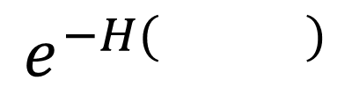

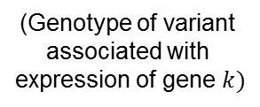

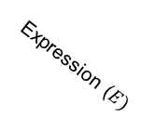
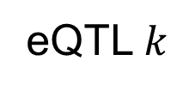








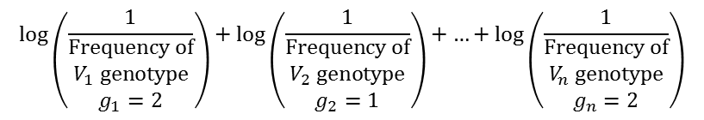



Information Content and Predictability
ICI =
Individual has variant
genotypes $g_{1}$, $g_{2}$, …, $g_{n}$
for variants $V_{1}$, $V_{1}$, …,$V_{n}$
$$\log\left(\frac{1}{\begin{matrix}Frequency of \\ V_{1} genotype \\ g_{1}=2\end{matrix}}\right)+\log\left(\frac{1}{\begin{matrix}Frequency of \\ V_{2} genotype \\ g_{2}=1\end{matrix}}\right)+…+log\left(\frac{1}{\begin{matrix}Frequency of \\ V_{n} genotype \\ g_{n}=2\end{matrix}}\right)$$
Frequency
Frequency
…
Frequency
0
1
2
0
1
2
0
1
2
$V_{1}$ genotype
frequencies
$V_{2}$ genotype
frequencies
$V_{n}$ genotype
frequencies
Joint expression
genotype distribution
Conditional distribution
of $V$ given $E=e$
eQTL $k$
Slice the joint
distribution at $e$
Genotype ($V$)
Frequency
2
$$ρ$$
Frequency
1
$$E$$
$$V$$
$$ρ$$
0
0
1
2
(Expression of
gene $k)$
(Genotype of variant
associated with
expression of gene $k)$
Genotype
$$e$$
Expression ($E)$
Compute
entropy
$π\left( \right)$=
$$e^{−H( )}$$
$$V$$
$$E=e$$
$$V$$
$$E=e$$

Slide 6
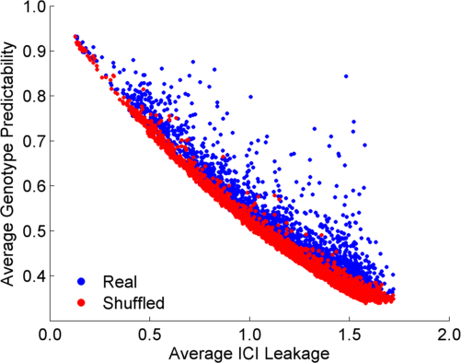
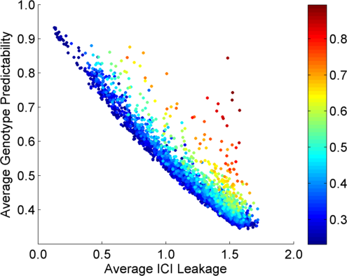
Per eQTL and ICI Cumulative Leakage versus Genotype Predictability
Colors by absolute correlation
Absolute Correlation

Slide 7
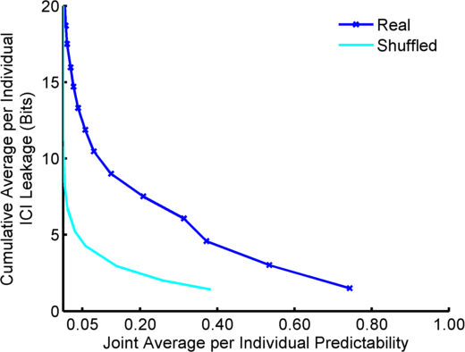
Cumulative Leakage versus Joint Predictability
Best 5 eQTLs
Best 4 eQTLs
Best 3 eQTLs
Best 2 eQTLs
Best eQTL

Slide 8
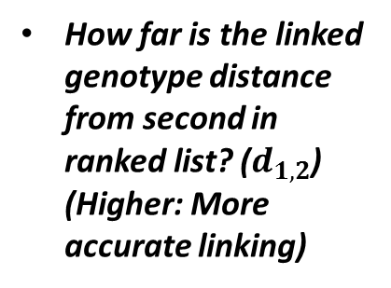
Steps in Instantiation of a (Mock) Linking Attack
Step 1
Step 2
Step 3
Gender, Population, Age
G-P
correlation
dataset
Prediction
methodology
Auxiliary information
Phenotype and genotype selection
Genotype prediction
Linking
Estimate Reliability of Linking
Maximum a Posteriori Genotype
Minimum Distance between Predicted and Individual Genotypes
How far is the linked genotype distance from second in ranked list? ($d_{1,2}$) (Higher: More accurate linking)
Absolute Value of Correlation

Slide 9



















Extremity based
joint distribution
Simplified extremity based
joint distribution
High
$$ρ$$
Positive
extremity
(Genotype: 2)
$$δ$$
Expression
$$δ$$
Negative
extremity.
(Genotype: 0)
Low
0
1
2
0
1
2
0
1
2
Frequency
Probability
Genotype
Genotype
Genotype
0
1
Levels of Expression-Genotype Model Simplifications:
$$E_{k}$$
$p(E_{k},V_{k})$
$$E_{k}$$
$$E_{k}$$
$p(E_{k},V_{k})$
$p(E_{k},V_{k})$
$$E_{k}$$
$p(E_{k},V_{k})$
$$μ_{3}$$
$σ_{3}$
$$μ_{3}$$
$σ$
$$μ_{2}$$
$σ_{2}$
$$μ_{2}$$
$σ$
$$μ_{1}$$
$σ$
$$e_{mid}$$
$$μ_{1}$$
$σ_{1}$
0
1
2
$$V_{k}$$
$$V_{k}$$
$$V_{k}$$
$$V_{k}$$
0
1
2
0
1
2
0
1
2

Slide 10
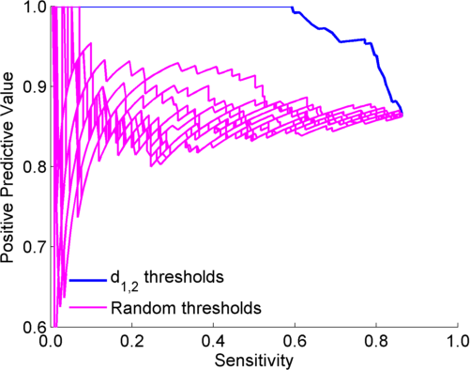
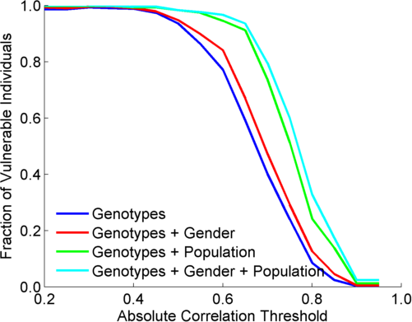
Extremity based linking with
homozygous genotypes
Attacker can estimate the
reliability of linkings
Sensitivity: Fraction of correctly linked
Individuals among all individuals
PPV: Fraction of correctly linked individuals
among selected individuals

Slide 11

Risk Management Framework
ICI
QTL Discovery
$$π$$
QTL identification
Significant
quantitative
trait loci
Leakage vs predictability quantification
Risk assessment
Joint Genotyping
And Phenotyping
Phenotype
dataset
External
QTL databases
Genotype
dataset
Linking
Accuracy
Application of
3-step
linking attacks
Risk assessment
QTL Selection

