Slide 1



Genomic Privacy
Personalized genomic data generation is booming
Main focus is on protecting variants
“Detection of genome in a mixture”
  Individuals give consent to participate but request anonymity
    HAPMAP, Personal genome project, 1000 Genomes…
Larger and more datasets leads to more realistic risks of linking attacks, that may be much more damaging than detection of genomes

Slide 2
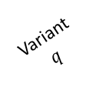
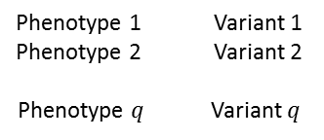

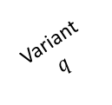
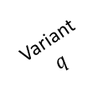
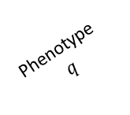
Linking Attack Scenario (3)
Phenotype dataset
(Public)
1
Genotype dataset
(Stolen/Hacked/Queried)
Phenotype
ID
Phenotype 1
Phenotype-Genotype
correlation dataset
Genotype
ID
Variant
$$q$$
HIV Status
Phenotype 2
Phenotype
$$q$$
Variant 1
Variant 2
PID-1
HIV+
0.1
-2.7
…
90.3
Phenotype 1 Variant 1
Phenotype 2 Variant 2
Phenotype $q$ Variant $q$
GID-1
0
1
…
1
PID-2
HIV-
0.5
8.6
…
63.5
…
GID-2
2
1
…
0
…
…
…
…
…
…
…
…
…
…
…
PID-$n$
HIV-
-0.2
5.4
…
50.3
GID-m
1
2
…
1
3
2
Genotype
prediction
Phenotype
ID
HIV
Status
Predicted variant
genotypes
4
Variant 2
Variant
$$q$$
Variant 1
…
PID-1
HIV+
1
0
…
2
Genotype comparison
and matching
PID-2
HIV-
2
2
…
1
…
…
…
…
…
…
PID-$n$
HIV-
0
1
1
Genotype
ID
Phenotype
ID
HIV
Status
Predicted/Matched genotypes
Variant 1
Variant
$$q$$
Variant 2
GID-1
PID-8
HIV+
0/0
1/1
…
1/1
GID-2
PID-3
HIV-
2/2
1/1
…
0/0
GID-3
PID-1
HIV-
1/0
1/0
…
0/2
GID-4
PID-1
HIV+
2/2
0/0
…
1/1
GID-5
0/1
1/1
…
2/1
…
…
…
…
…
…
…
Notes:
Caption: Illustration of Linking attack. (a) Phenotype dataset contains q different phenotype measurements and the HIV Status for n individuals. Genotype dataset contains the variant genotypes for m individuals. Phenotype-Genotype correlation datasets contains q phenotypes, variants, and their correlations. The attacker predicts the variant genotypes and build the predicted genotypes matrix. The attacker then links the phenotype dataset to the genotype dataset by matching the predicted genotypes to the genotype dataset. The linking reveals the HIV status for the subjects in the genotypes dataset. The phenotype, genotype IDs and HIV Status are colored to illustrate how the linking combines the entries in the two datasets. Some of the genotype IDs are not linked to any phenotype. These are indicated with pattern filled rows.

Slide 3
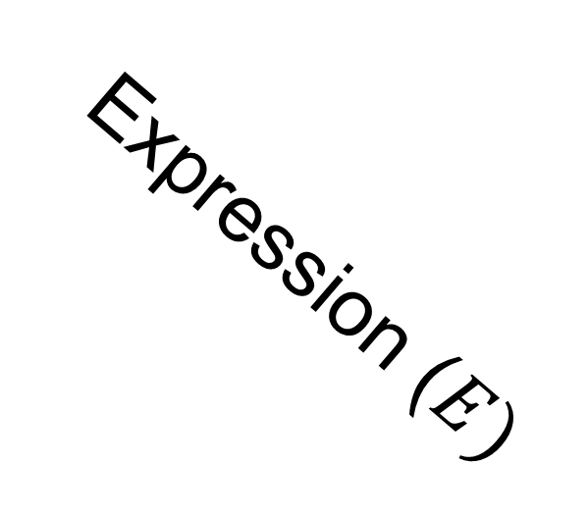
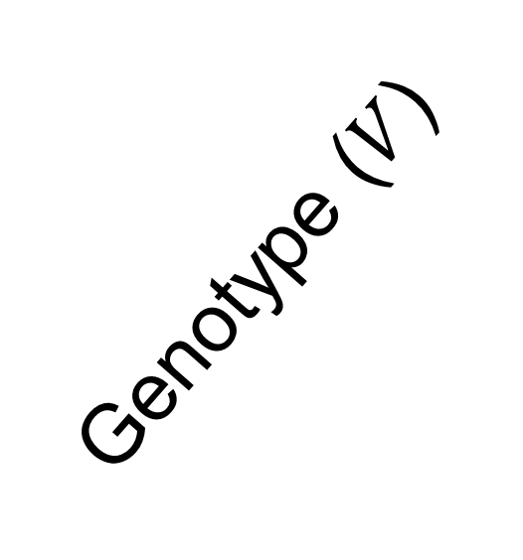
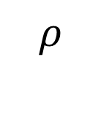
Joint Distribution (4)
2
Genotype ($V$)
Frequency
1
$$ρ$$
0
Expression ($E)$

Slide 4
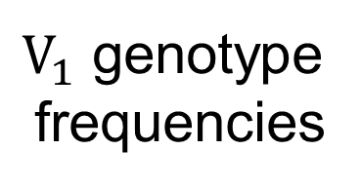

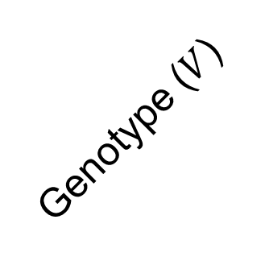
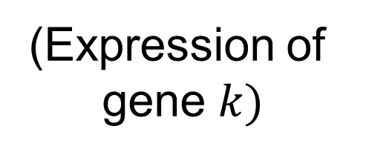










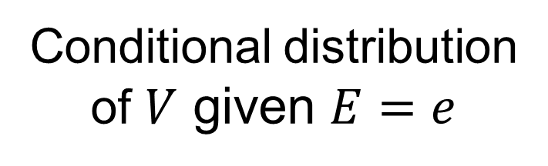


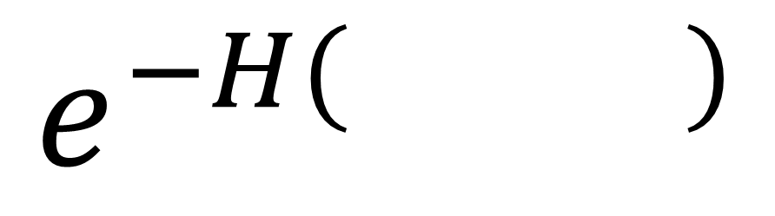
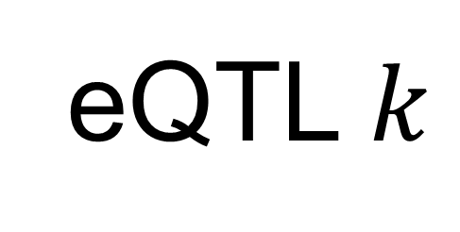
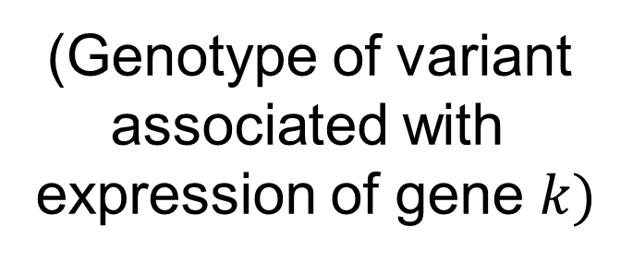
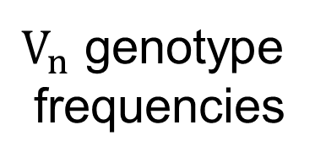

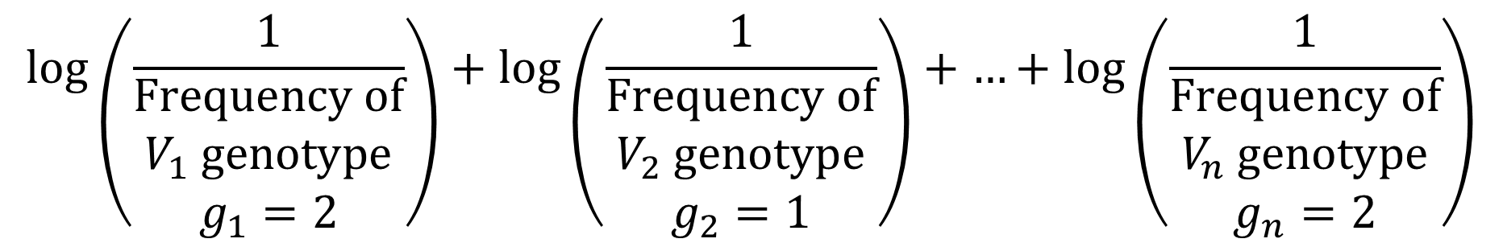
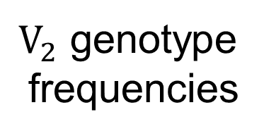



Individual Characterizing Information and Genotype Predictability(5)
ICI =
Individual has variant
genotypes $g_{1}$, $g_{2}$, …, $g_{n}$
for variants $V_{1}$, $V_{1}$, …,$V_{n}$
$$\log\left(\frac{1}{\begin{matrix}Frequency of \\ V_{1} genotype \\ g_{1}=2\end{matrix}}\right)+\log\left(\frac{1}{\begin{matrix}Frequency of \\ V_{2} genotype \\ g_{2}=1\end{matrix}}\right)+…+log\left(\frac{1}{\begin{matrix}Frequency of \\ V_{n} genotype \\ g_{n}=2\end{matrix}}\right)$$
Frequency
Frequency
…
Frequency
0
1
2
0
1
2
0
1
2
=
=
=
$$g_{1}$$
$$g_{2}$$
$$g_{n}$$
$V_{1}$ genotype
frequencies
$V_{2}$ genotype
frequencies
$V_{n}$ genotype
frequencies
Joint expression
genotype distribution
Conditional distribution
of $V$ given $E=e$
eQTL $k$
Slice the joint
distribution at $e$
Genotype ($V$)
$$ρ$$
2
Frequency
$$E$$
$$V$$
1
Frequency
$$ρ$$
0
0
1
2
(Expression of
gene $k)$
(Genotype of variant
associated with
expression of gene $k)$
Genotype
$$e$$
Expression ($E)$
Compute
entropy
$π\left( \right)$=
$$e^{−H( )}$$
$$V$$
$$E=e$$
$$V$$
$$E=e$$

Slide 5
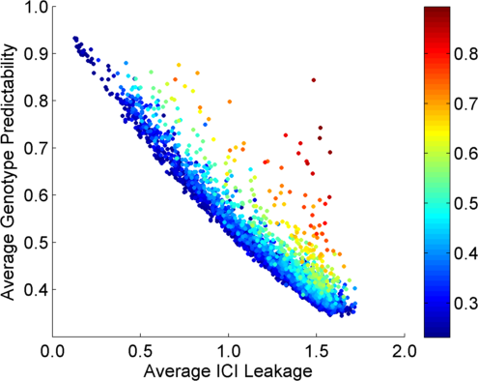
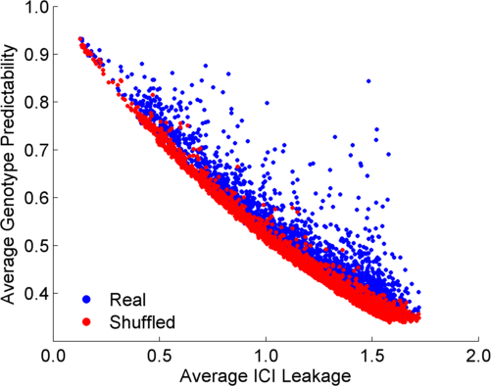
Per eQTL and ICI Cumulative Leakage versus Genotype Predictability
Colors by absolute correlation
Absolute Correlation
Notes:
Caption: (b) Plots show, for each, eQTL the information leakage (x-axis) versus correct genotype predictability (y-axis). For each eQTL, the estimated ICI leakage and genotype predictability are plotted. Each eQTL’s point is colored with respect to the major allele frequency (left) and with respect to absolute correlation of the eQTL (right).

Slide 6
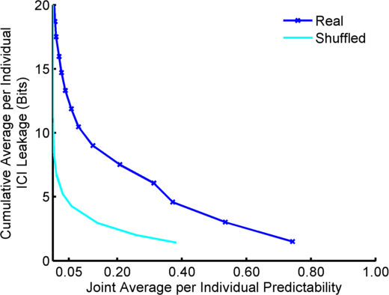
Cumulative Leakage (7)
Best 5 eQTLs
Best 4 eQTLs
Best 3 eQTLs
Best 2 eQTLs
Best eQTL

Slide 7
Linking Attack (8)
Three Steps of a Linking Attack
Step 1
Step 2
Step 3
Gender, Population, Age
G-P
correlation
dataset
Prediction
methodology
Auxiliary information
Phenotype and genotype selection
Genotype prediction
Linking
Absolute Value of Correlation
Maximum a Posteriori Genotype
Minimum Distance between Predicted and Individual Genotypes

Slide 8




Extremity (9)
Extremity based
joint distribution
Simplified extremity based
joint distribution
High
$$ρ$$
Positive
extremity
(Genotype: 2)
Expression
$$δ$$
$$e_{mid}$$
$$δ$$
Negative
extremity.
(Genotype: 0)
Low
0
1
2
0
1
2
0
1
2
Probability
Probability
Genotype
Genotype
Genotype
0
1
Notes:
Caption: Extremity based genotype prediction and extremity based linking attack (a) Figure illustrates the extremity based genotype prediction. The joint distribution of expression levels and genotypes is shown on left. Given the relation between expression and genotypes, the lower expression levels (Labelled with “Negative Extremity” shown in red ellipse on left) are assigned the genotype “TT” and higher expression levels (Labelled with “Positive Extremity” shown in green ellipse on left) are assigned the genotype “CC”. The extremity value 0 is indicated with the dashed grey line which is the midpoint between the highest and lowest expression levels. The heterozygous genotype (TC) is shaded with grey to indicate that it is not used in the genotype prediction.

Slide 9
































Merge with previous
$$E_{k}$$
$p(E_{k},V_{k})$
$$E_{k}$$
$p(E_{k},V_{k})$
(a)
(b)
$$μ_{3}$$
$σ_{3}$
$$μ_{2}$$
$σ_{2}$
$$μ_{1}$$
$σ_{1}$
0
1
2
$$V_{k}$$
0
1
2
$$V_{k}$$
(c)
$$E_{k}$$
$p(E_{k},V_{k})$
(d)
$$E_{k}$$
$p(E_{k},V_{k})$
$$μ_{3}$$
$σ$
$$e_{4}$$
$$μ_{2}$$
$σ$
$$e_{3}$$
$$μ_{1}$$
$σ$
$$e_{2}$$
$$e_{1}$$
0
1
2
$$V_{k}$$
$$V_{k}$$
0
1
2
(e)
$$E_{k}$$
$p(E_{k},V_{k})$
$$e_{mid}$$
0
1
2
$$V_{k}$$
Notes:
Caption: Examples of models of genotype-expression joint distribution with varying numbers of parameters for a positively correlated eQTL. (a) shows the true distribution where grey boxes represent the expression distributions with different genotypes. Red line show the gradient of correlation between genotype and expression. First simplification of the model is shown in (b). The expression distribution can be modeled with Gaussians with different means and variances with total of 6 parameters. The variances can be assumed same for different genotypes (c), where 4 parameters are required. (d) illustrates a representation of the distribution with 4 parameters on expression levels for each genotype. The conditional distribution of expression is uniform (cross shaded rectangles) over the ranges ($e_{1}$, $e_{2}$), ($e_{2}$, $e_{3}$), and ($e_{3}$, $e_{4}$) given genotypes 0, 1, and 2, respectively. The transparent grey rectangles shows the original distributions. (e) is a simplification of (d) where no conditional probability of expression is assigned given genotype is 1. In this model, only 1 parameter ($e_{mid}$) is necessary. The conditional probability of expression given genotypes 0 and 2 are uniform for expression levels below $e_{mid}$ and above $e_{mid}$, respectively (shown with cross shaded rectangles). The original distribution is included with grey rectangles for comparison. Extremity based prediction is an instantiation of the model in (e).

Slide 10
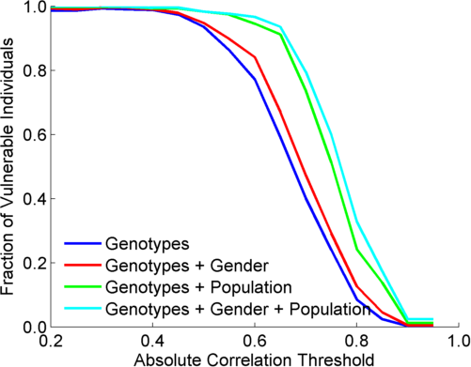
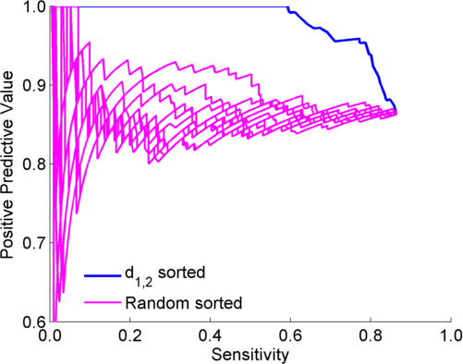
Genotype Prediction and Linking Accuracies (10)
Extremity based linking with
homozygous genotypes
Attacker can esimate the
reliability of linkings
Notes:
Caption: The fraction of vulnerable individuals with MAP genotype prediction. X-axis shows the absolute correlation threshold used to select eQTLs. Y-axis shows the fraction of vulnerable individuals. At correlation threshold of 0.35, the fraction is maximized, as indicated by the dashed yellow line. The red, green, and cyan lines show the fraction of vulnerable individuals when gender, population, and gender and population information, respectively, are available as auxiliary information.

Slide 11

Basic approach for risk management (11)
ICI
QTL Discovery
$$π$$
QTL identification
Significant
quantitative
trait loci
Leakage vs predictability quantification
Risk assessment
Joint Genotyping
And Phenotyping
Phenotype
dataset
External
QTL databases
Genotype
dataset
Application of
3-step
linking attacks
Risk assessment
Linking
Accuracy
QTL Selection
Notes:
Caption: Illustration of risk assessment procedure for joint genotyping/phenotyping data generation. There are two paths of risk assessment to be performed. The first path evaluates the risks associated with release of the QTL datasets. The genotype and phenotype data (on the left) is first used for quantitative trait loci identification (QTL identification box). This generates the significant QTLs. These are then utilized, in addition to the list of external QTL databases, in quantification of leakage versus predictability (ICI versus $π$ plots), as presented in Section 2.2. These results are then relayed to the risk assessment procedures. The second risk assessment procedure evaluates the release of genotype and phenotype datasets. For this, the datasets are input to application of the 3-step linking attacks with different QTL and linking methodologies (Presented in Sections 2.3, and 2.4, and other linking attacks in the literature) for evaluation of characterization risks. The results are then relayed to risk assessment procedures.

Slide 12
Comparison to Detection of a genome attacks
(a)
Linking attacks
(Schadt et al, Extremity attack)
(b)
“Detection of a genome in a mixture”
Attacks (Homer et al, Im et al)
“Predicting”
Phenotypes
Sensitive Phenotypes
Genotype
Dataset
QTL Study
Statistics
---------------------
Population Genotyping
Study
Statistics
Genotype
Prediction
Predicted
Genotypes
Sensitive Phenotypes
IDs
Genotypes
Statistical
Testing
Reference
Population
Allele
Frequencies
Genotype
Linking
Study
Membership
Status (0/1)
Genotype
Dataset
IDs
Predicted
Genotypes
Genotypes
Sensitive Phenotypes
Notes:
Caption: Schematic comparison of Linking attacks (Left) and detection of a genome in a mixture attacks (Right). Each box in the figure represents a dataset in the form of a matrix. Multiple boxes next to each other correspond to concatenation of matrices. Linking attacks aim at linking genotype and phenotype datasets. The phenotype datasets contain both “predicting” phenotypes and other phenotypes, some of which can be sensitive. The attacker first predict genotypes for each of the predicting phenotype. The predicted genotypes are then compared with the genotypes in the genotype dataset. After the linking, all the datasets are concatenated where the identifiers can be matched to the sensitive phenotypes. Different colors indicate how the linking merges different information. The detection of a genome in a mixture attacks start with a genotype dataset. The attacker gets access to the statistics of a GWAS or genotyping dataset (for example, correlation coefficients or allele frequencies). Then the attacker generates a statistic and tests it against that of a reference population. The testing result can be converted into the study membership indicator (attended/not attended) which shows whether the tested individual was in the study cohort or not.

