Slide 1
Genomic Privacy: Intertwined Social & Technical Issues
Setting the Stage: the Advent of Personal Genomics
The Dilemma of Genomic Privacy
  Fundamental, inherited info that’s very private vs the need for large-scale data-sharing to enable med. research
Current Social & Tech Approaches
  GINA, Consents &
  "Secure" use of dbGAP
  Issues: burdensome security, inconsistencies + ways the solutions have been partially "hacked”
  Strawman Hybrid Soc-Tech Proposal (Licensure, Cloud Enclaves. Quantifying Leaks, & Closely Coupled priv.-public data)
RNA-seq – practical problem of publicly sharing some of the info
  Removing SNVs in reads using MRF
  Quantifying & removing variant info from expression levels + eQTLs
  Further complications: SVs in pervasive transcription?

Slide 2
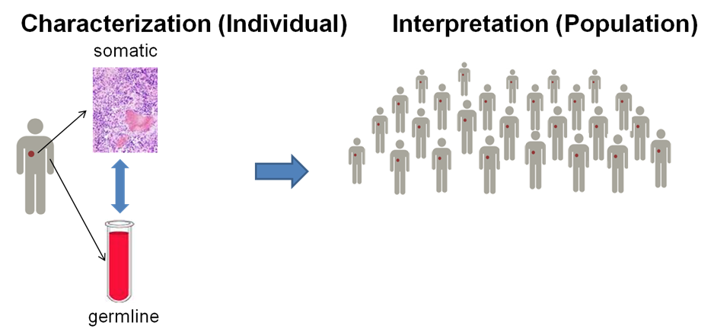
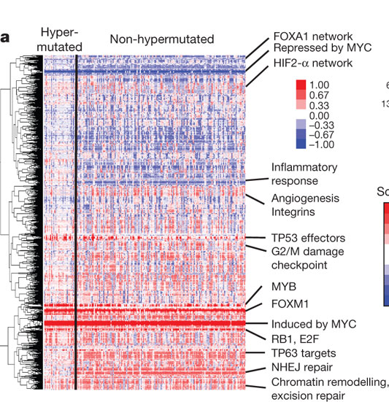
RNA-Seq for cancer
https://www.broadinstitute.org/cancer/cga/
Phenotype variations across individuals (e.g., gene expression from RNA-seq)
Individual
Gene
Biological mechanisms to drive phenotype differences across individuals
Blue – under expressed
Red – over expressed
The Cancer Genome Atlas Network Nature 487, 330-337 (2012) doi:10.1038/nature11252

Slide 3
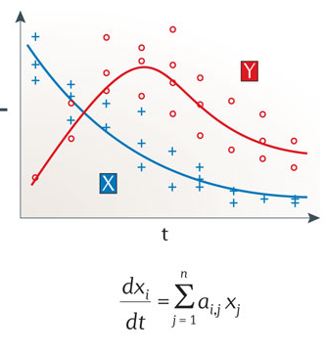
Computational models to identify biological mechanisms for gene expression: gene regulation
Boolean logical model
Continuous model
Istrail & Davidson, PNAS, ‘04
Nicolas Le Novère, Nature Reviews Genetics, ‘15

Slide 4
From larva/funseq to loregic
Genomic variants across individuals
  larva/funseq
Variants affect gene regulation
gene expression variations across individuals
  gene regulatory mechanisms that drive expression differences
  “logic” is a good model to capture regulatory mechanism
  “logic operation” exists in gene regulation widely

Slide 5
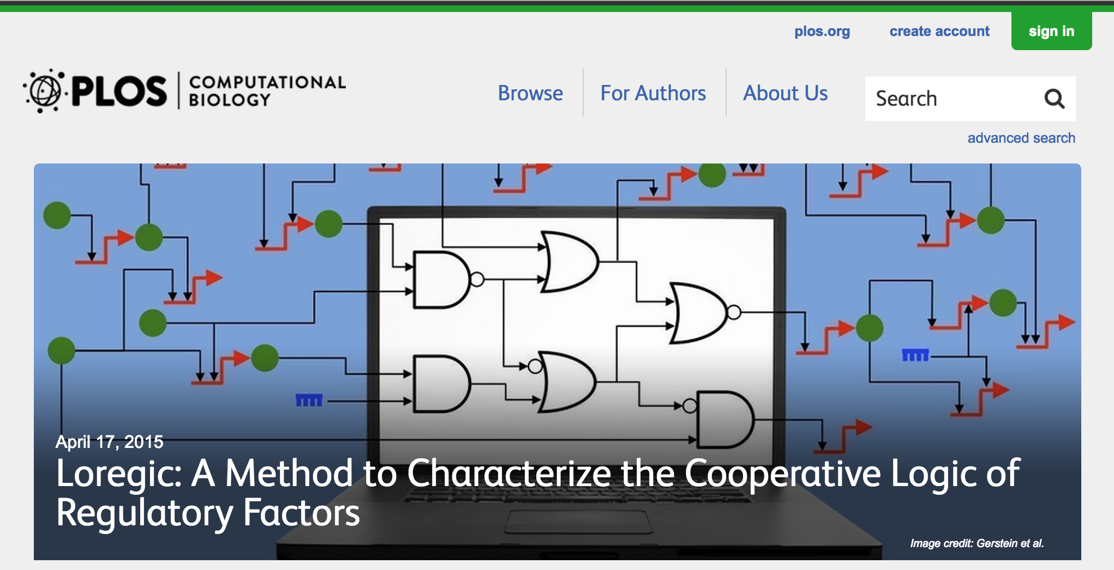
Loregic: A method to characterize the cooperative logic of regulatory factors
Wang D, Yan K-K, Sisu C, Cheng C, Rozowsky J, Meyerson W, Gerstein M (2015), PLoS Comput Biol 11(4): e1004132. doi: 10.1371/journal.pcbi.1004132
General-purpose tool, R package: github.com/gersteinlab/loregic
Notes:
we called our method Loregic, which uses logic gate models to characterize the cooperative logic of gene regulatory factors. we published Loregic in Plos comp. bio.

Slide 6
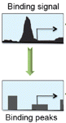
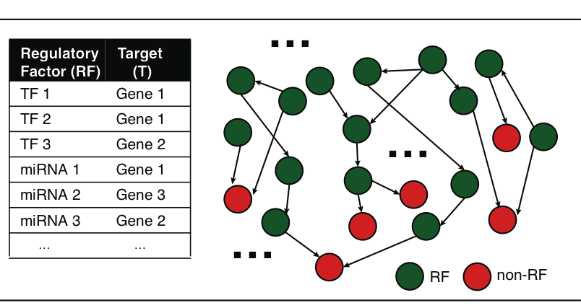
A gene can be regulated by multiple gene regulatory factors
Next generation sequencing techniques (e.g., ChIP-seq, CLIP-seq) predict gene regulatory factors (RFs) and their target genes
transcription factors (TFs)
micro-RNAs
…
Gene regulatory network
Peak calling
Many genes are regulated by multiple RFs.
How RFs coordinate to regulate target gene expression?
cooperative?
competitive?
independent?
…
Notes:
besides gene expression data, next generation sequencing technologies such as ChIP-seq and CLIP-seq can identify the target genes of gene regulatory factors. the regulatory factors include TF, mirnas and so on like TF1 and TF2 regulate Gene 1. Then, we can create a gene regulatory network. it is very likely that a target gene can be regulated by two or more RFs. e.g., we can get a lot of regulatory triplets where RF1 and RF2 regulate a common target gene T. Then, we would ask how two RFs coordinate to regulate T? are they really cooperative, or competitive, or independent? Is there a way to describe their cooperativity?

Slide 7
Modeling cooperativity between RFs to target gene using logic gates
A regulatory triplet
2-input-1-output logic gate
10110101…
10110101…
RF1
RF1
?
T
00110101…
T
00110101…
10110101…
01110111…
RF2
RF2
0 – gene off
1 – gene on
after binarizing gene expression data*
Input type (RF1, RF2) | RF1 | 0 | 0 | 1 | 1
 | RF2 | 0 | 1 | 0 | 1
Output | T | X | X | X | X
Binarized expression
X can be 0 or 1, so there are 2⁴=16 possible output combinations, each of which corresponds to a unique 2-input-1-output logic gate
…
*BoolNet, R package
Notes:
let’s look at a particular triplet, TF1 and TF2 regulate Gene 1. At logical level, gene expression has two states, gene is on or off, i.e., 1 represents gene is expressed or 0 represents gene is not expressed. So, then we can look at the triplet as 2-input-1-output system. TF1 and TF2 are inputs, and Gene 1 are output, and then use a 2-input-1-output logic gate to model this triplet. As shown in a truth table, there are 4 different types of input of TF1 and TF2, 00, 01, 10, 11, and for each input type, there are 2 possible output types, 1 or 0. so in total, we have 2^4 = 16 possible logic gates that can be used to describe the triplet.

Slide 8
An example: selection of the best-matched logic gate
Laplace’s rule of succession
s=(# of selected output state for the input type + 1)
/(# of input type + 2)
Consistency score:
6/7*5/7*6/7*5/7=0.37
Wang, et al., PLoS Computational Biology, 2015
Notes:
*********************************************
This toy example demonstrates that how we choose the best matched logic gates. first, for each input type of TF1, TF2 like 01, green, we count numbers of 0 and 1 output from Gene 1 data. and select the most state as output of this input type. e.g., we have 4 zeros and 1 one, then 0 is considered as output of input type 01. we also calculate the output’s succession prob using laplace’s rule of succession derived from Bayes' theorem, like 5/7. after we go thru all four input types, we get a truth table. Here, it’s the table for the AND gate. Also, we define production of four output succession probs as consistency score to the matched logic gate. e.g. the consistency score is 0.37 for AND gate.

Slide 9
Application 1 – transcription factor cooperativity in Yeast cell cycle
Target gene | 2464
TF | 176
Triplet | 39,011
Time point | 59
AND-like gates
Wang, et al., PLoS Computational Biology, 2015
Notes:
First, we apply Loregic to characterize TF cooperativity during yeast cell cycle, and found AND gate matches the most triplets, which implies that yeast TFs need to cooperate during cell cycle. we were able to distinguish three categories for this triplet group: 1) “homogenous” gate-consistent triplets – matching the same logic gate across all targets (e.g., top table); 2) “inhomogeneous” gate-consistent triplets – matching different logic gates across all targets (e.g., middle table); and 3) non-gate-consistent triplets, i.e. triplets inconsistent with all logic gates across all targets (e.g., bottom table).

Slide 10


Application 2 – transcription factor cooperativity in Acute Myeloid Leukemia (AML)
Target gene | 1824 | ENCODE Data (K562, ChIP-seq) http://encodenets.gersteinlab.org/
TF | 70
Regulatory triplet | 50,865 | TCGA Data (AML, level 3, RNA-seq) https://tcga-data.nci.nih.gov/tcga/tcgaDownload.jsp
Patient sample | 197
Wang, et al., PLoS Computational Biology, 2015
Notes:
Then, we apply Loregic to the human cancer data. e.g., we characterized the TF cooperativity in leukemia cancer using 70 TF chip-seq data in ENCODE and gene expression data across 200 patients in TCGA. it is interesting to find that OR gate matches the most triplets, which implies that TF may not cooperate with each other in human cancer.

Slide 11
Application 2 – transcription factor cooperativity in Acute Myeloid Leukemia (AML)
OR-like gates
number of logic-gate consistent triplets
Wang, et al., PLoS Computational Biology, 2015
Notes:
Then, we apply Loregic to the human cancer data. e.g., we characterized the TF cooperativity in leukemia cancer using 70 TF chip-seq data in ENCODE and gene expression data across 200 patients in TCGA. it is interesting to find that OR gate matches the most triplets, which implies that TF may not cooperate with each other in human cancer.

Slide 12

Cancer-related TF, MYC universally amplifies target expression
2,153 (RF1=MYC, RF2=other TFs, T=all common targets) triplets
RF1
OR(RF1, RF2)
OR(RF1, NOT RF2)
number of logic-gate consistent triplets
High expression of MYC is sufficient for high target gene expression
Wang, et al., PLoS Computational Biology, 2015
Notes:
So, we then look at triplets with cancer-related TFs, e.g., MYC. biologists found that MYC universally amplifies target gene expressions in lymphocytes. we checked 2000 MYC associated triplets where MYC is 1st RF, and found the most MYC associated triplets are consistent with three logic gates, RF1, RF1+RF2 and RF1+~RF2 with significant enrichments. all three logic gates mean that high expression of MYC is sufficient for high target gene expression, which supports that MYC is a universal amplifier.
then use MYC to slince targe gene expresison in cancer

Slide 13
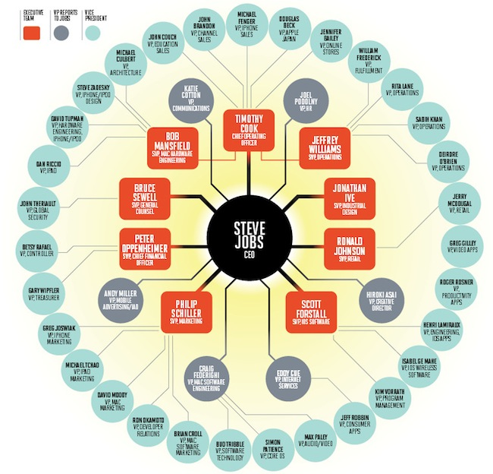
Global Hierarchical Structure
In-degree = 1
TF out-degree = 3
TF target
non-TF target
Algorithms for Defining Hierarchical Structure
Breadth-first Search
Globally minimize upward edges
Globally maximize hierarchy “score”
Hierarchy Height Statistic =
(normalized TF Out deg. – In deg.)

Slide 14
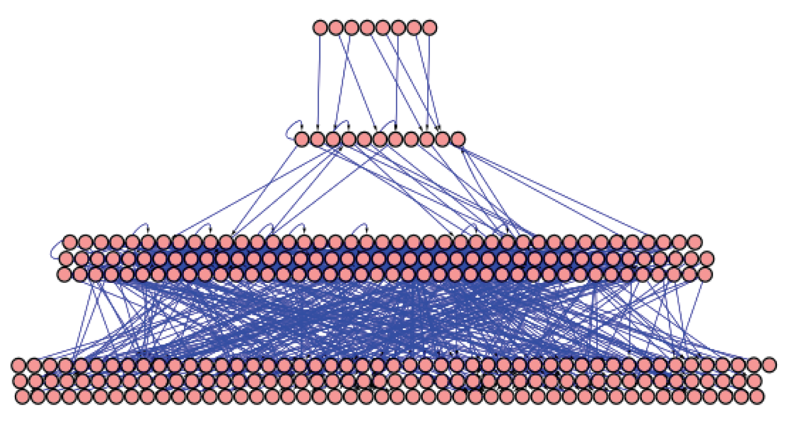
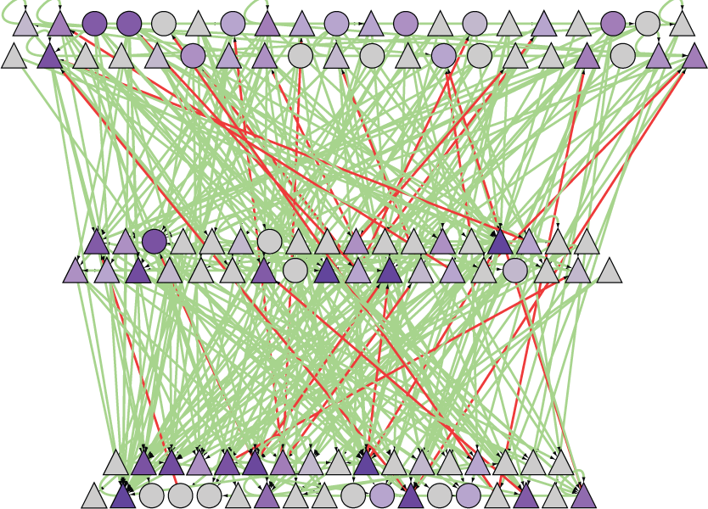
Hierarchy algorithm: from Hairball to Hierarchy
[ Cheng et al. GenomeBiol., ’15) ]
Yeast transcriptional regulatory network
Human transcriptional regulatory network
[Yu et al., PNAS (‘06)]
[ Gerstein et al. Nature (in press, '12) ]

Slide 15
Logical cooperativity across hierarchical layers in gene regulatory network
Hierarchical gene regulatory network in yeast
Consistency score
The regulations of middle and top TFs more likely follow logical operations than the bottom TFs.
Wang, et al., PLoS Computational Biology, 2015
Notes:
We also constructed the regulatory hierarchical networks with top, middle and bottom layers using yeast TFs [5], and found that the scores for the gate-consistent triplets targeting the bottom TFs are lower than the ones targeting middle and top TFs (Fig. S3), which implies that the regulations of middle and top TFs more likely follow logical operations than the bottom TFs. Also, this tells us that we may need more detailed models such as continuous models than boolean logics to study gene regulation.

Slide 16
Genomic Privacy: Intertwined Social & Technical Issues
Setting the Stage: the Advent of Personal Genomics
The Dilemma of Genomic Privacy
  Fundamental, inherited info that’s very private vs the need for large-scale data-sharing to enable med. research
Current Social & Tech Approaches
  GINA, Consents &
  "Secure" use of dbGAP
  Issues: burdensome security, inconsistencies + ways the solutions have been partially "hacked”
  Strawman Hybrid Soc-Tech Proposal (Licensure, Cloud Enclaves. Quantifying Leaks, & Closely Coupled priv.-public data)
RNA-seq – practical problem of publicly sharing some of the info
  Removing SNVs in reads using MRF
  Quantifying & removing variant info from expression levels + eQTLs
  Further complications: SVs in pervasive transcription?

Slide 17
From loregic to DREISS
Many regulatory triplets do not follow logical cooperativity such as in yeast bottom TFs during cell cycle
  Advanced models needed to capture regulatory mechanisms
Internal/external regulatory networks
  e.g., internal & external factors affect a pathway
Continuous models
  State-space models

Slide 18
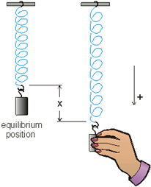
Internal and external gene regulatory networks
Internal Group
External Group
How to identify gene expression dynamics driven by internal/external regulation?
Internal regulation
External regulation
Interested system | Internal regulatory network | External regulatory network
Cross-species conserved genes | Conserved transcriptional factors (TFs) | Non-conserved TFs
Protein-coding genes | TFs | micro-RNAs
Individual’s protein coding genes | Wild-type TFs | Somatic mutated TFs
Protein-coding genes in brain | Commonly expressed TFs | Brain-specific expressed TFs
Protein-coding genes in development | House-keeping TFs | Developmental TFs
External force
[Wang et al. PLOS CB (in revision, ‘15)]
Notes:
connect loregic to here too! to see regulatory mechanisms similar too

Slide 19
State-space model for internal and external gene regulatory networks
Internal Group
External Group
How to identify gene expression dynamics driven by internal/external regulation?
Internal regulation
External regulation
Control: Gene expression vector of external factors at time t
State space model
X_{t+1}
A
X_{t}
B
U_{t}
B_{kl} captures temporal casual influence from external factor k to Gene l in internal group
State: Gene expression vector of Group X at time t+1
A_{ij} captures temporal casual influence from Gene i to Gene j in internal group
State: Gene expression vector of internal group at time t
[Wang et al. PLOS CB (in revision, ‘15)]
Notes:
connect loregic to here too! to see regulatory mechanisms similar too

Slide 20
Effective state space model for meta-genes
Not enough data to estimate state space model for genes
(e.g., 25 time points per gene to estimate 4 millions elements of A or B for 2000 genes)
Dimensionality reduction from genes to meta-genes (e.g., singular value decomposition)
Effective state space model for meta-genes
(e.g., 250 time points to estimate 50 matrix elements if 5 meta-genes)

Slide 21
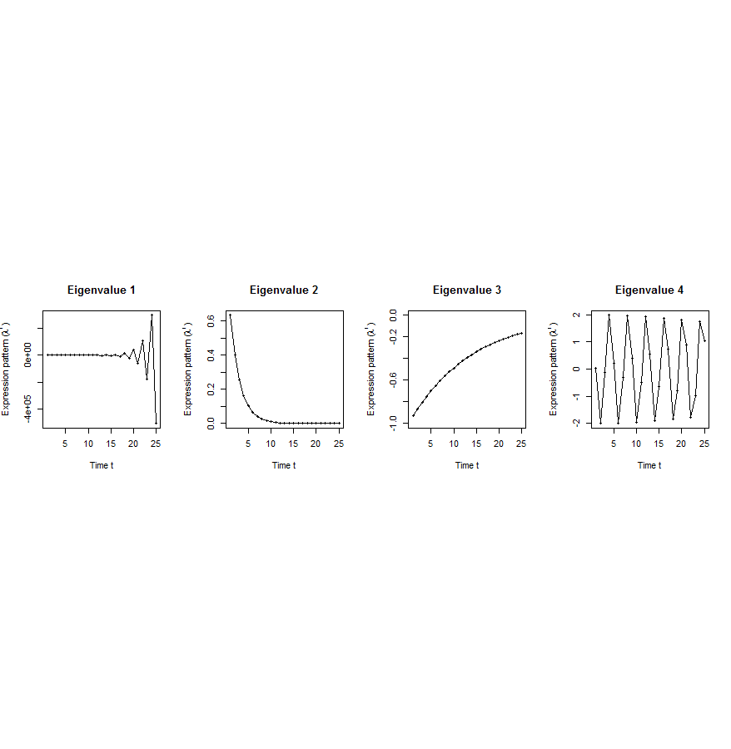
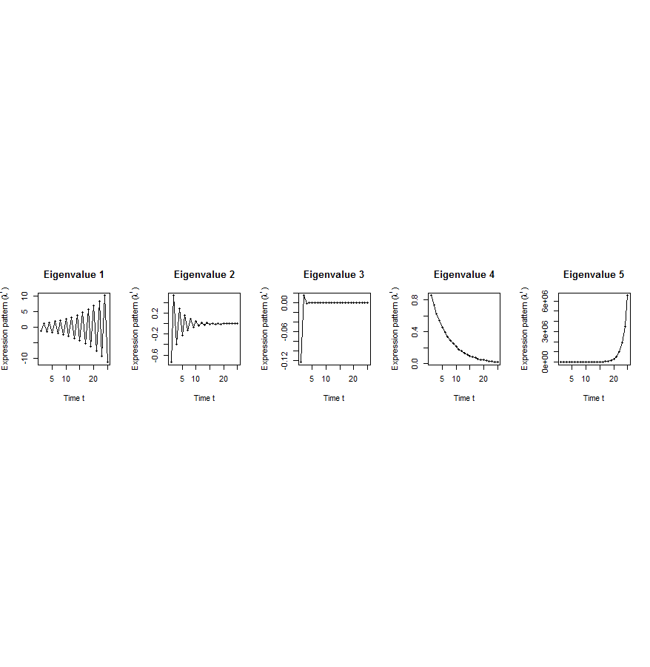
Canonical temporal expression trajectories from effective state space model
Internal driven dynamics
Externally driven dynamics
p^{th} internal principal dynamic pattern (iPDP): [λ_{p}¹, λ_{p}², …, λ_{p}^{T}],
where λ_{p} is p^{th} eigenvalue of Ã.
q^{th} external principal dynamic pattern (ePDP): [σ_{q}¹, σ_{q}², …, σ_{q}^{T}],
where σ_{q} is q^{th} eigenvalue of .
Canonical temporal expression trajectories
(e.g., degradation, growth, damped oscillation, etc.)
iPDP expression
ePDP expression
time
time
[Wang et al. PLOS CB (in revision, ‘15)]
Notes:
if we look at A tilde, it controls the dynamic trajectory of expression part internally driven by meta-genes of X. according to the analytic solution, the internally driven expression part Xtilde I can be linear combinations of A tilde’s eigenvalue’s exponentials across time, which are defined by us as internal principal dynamic pattern (iPDP). B tilde controls the dynamic trajectory of X’s metagene expression part externally driven by U. similarly, we can find external principal dynamic pattern (ePDP) based on B tilde’s eigenvalue exponentials across time. Actually, those patterns are canonical temporal expression trajectories, which are as simple as degradation, growth, damped oscillation temporal processes). In short, from metagene effective model, we are able to identify internal and external driven canonical temporal expression trajectories.

Slide 22
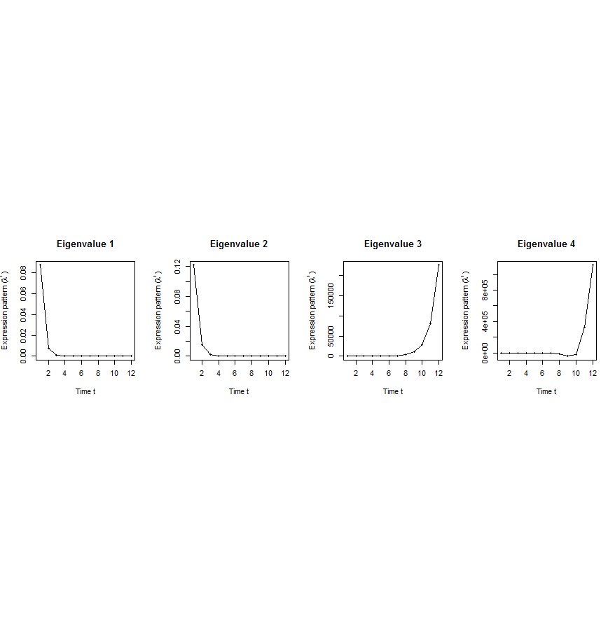
Flowchart
[Wang et al. PLOS CB (in revision, ‘15)]
A. Gene state-space model
C. Meta-gene state-space model
B. Dimensionality Reduction
X_{t+1}=AX_{t}+BU_{t}
Genes of X
Meta-genes of X
time
E. Gene’s internal (INT) and external (EXT) driven expression dynamics composed of PDPs
D. Internal/External Principal Dynamic Patterns (PDPs)
time
[λ_{p}¹, λ_{p}², …, λ_{p}^{T}] [σ_{q}¹, σ_{q}², …, σ_{q}^{T}]
x^{INT}=c₁ +c₂
+c₃ +c₄
Genes of U
Meta-genes of U
time
time
…
x^{EXT}=d₁ +d₂
+d₃ +d₄
/
Internal regulation among genes/meta-genes Group X by A/Ã
/
External regulation from genes/meta-genes in Group U
to genes/meta-genes in Group X by B/
/
Genes/Meta-genes in Group X
/
Genes/Meta-genes in Group U

Slide 23
Breast cancer cell cycle under hormonal stimulation
Dataset | Group X (internal) | Group U (external) | Time samples of a full cell cycle
Human breast cancer cell cycle under hormonal stimulation | 1132 metazoan conserved genes incl. 150 orthologous TFs | 1870 non-conserved metazoan transcription factors | T=12 time points: 0, 4, 6, 8, 12, …, 28, 32 hours
Oscillated iPDP by conserved TFs
a full cell cycle
Oscillated ePDP by non-conserved TFs
faster cycle due to hormone
[Wang et al. PLOS CB (in revision, ‘15)]

Slide 24
Transcriptome Analysis:
Expression Clustering across Distant Organisms
Intro to Comparative ENCODE
  Lots of Matched Data for Comparative Analysis
Expression Clustering, Cross-species
  Potts-model optimization gives 16 conserved co-expression modules (which can potentially annotate ncRNAs/TARs)
Relating Clusters to Hourglass Genes
  Developmental 'hourglass' genes in 12 of the clusters. They also exhibit intra-organism hourglass behavior.
  Stage alignment of worm & fly development, strongest with hourglass genes
Decoupling expression changes into those driven by worm-fly conserved genes vs species-specific ones
  Using dimensionality reduction to help determine internal & external drivers
  Conserved genes have similar canonical patterns (iPDPs) in contrast to species specific ones (Ex of ribosomal v signaling genes)

