Slide 1

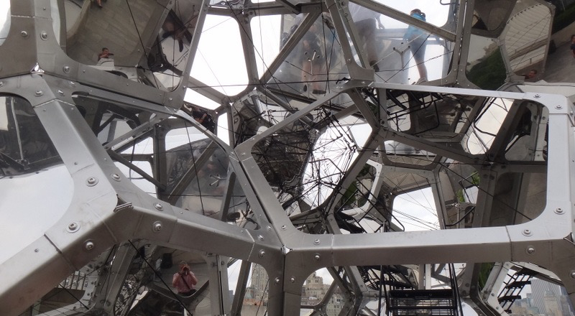
Genomic Privacy:
Intertwined Social & Technical Aspects
1 (c) Mark Gerstein, 2002, Yale, bioinfo.mbb.yale.edu
Mark Gerstein, Yale
Slides freely downloadable from Lectures.GersteinLab.org
& “tweetable” (via @markgerstein). See last slide for more info.
Notes:
1

Slide 2
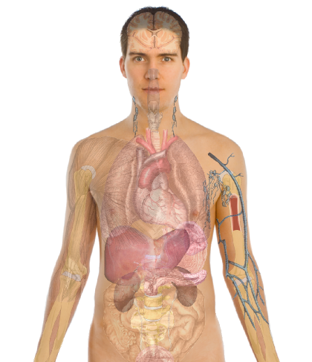
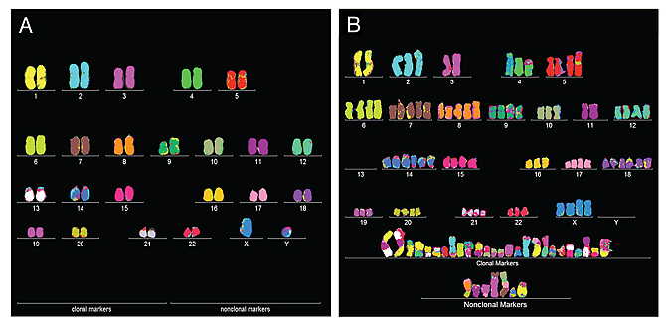
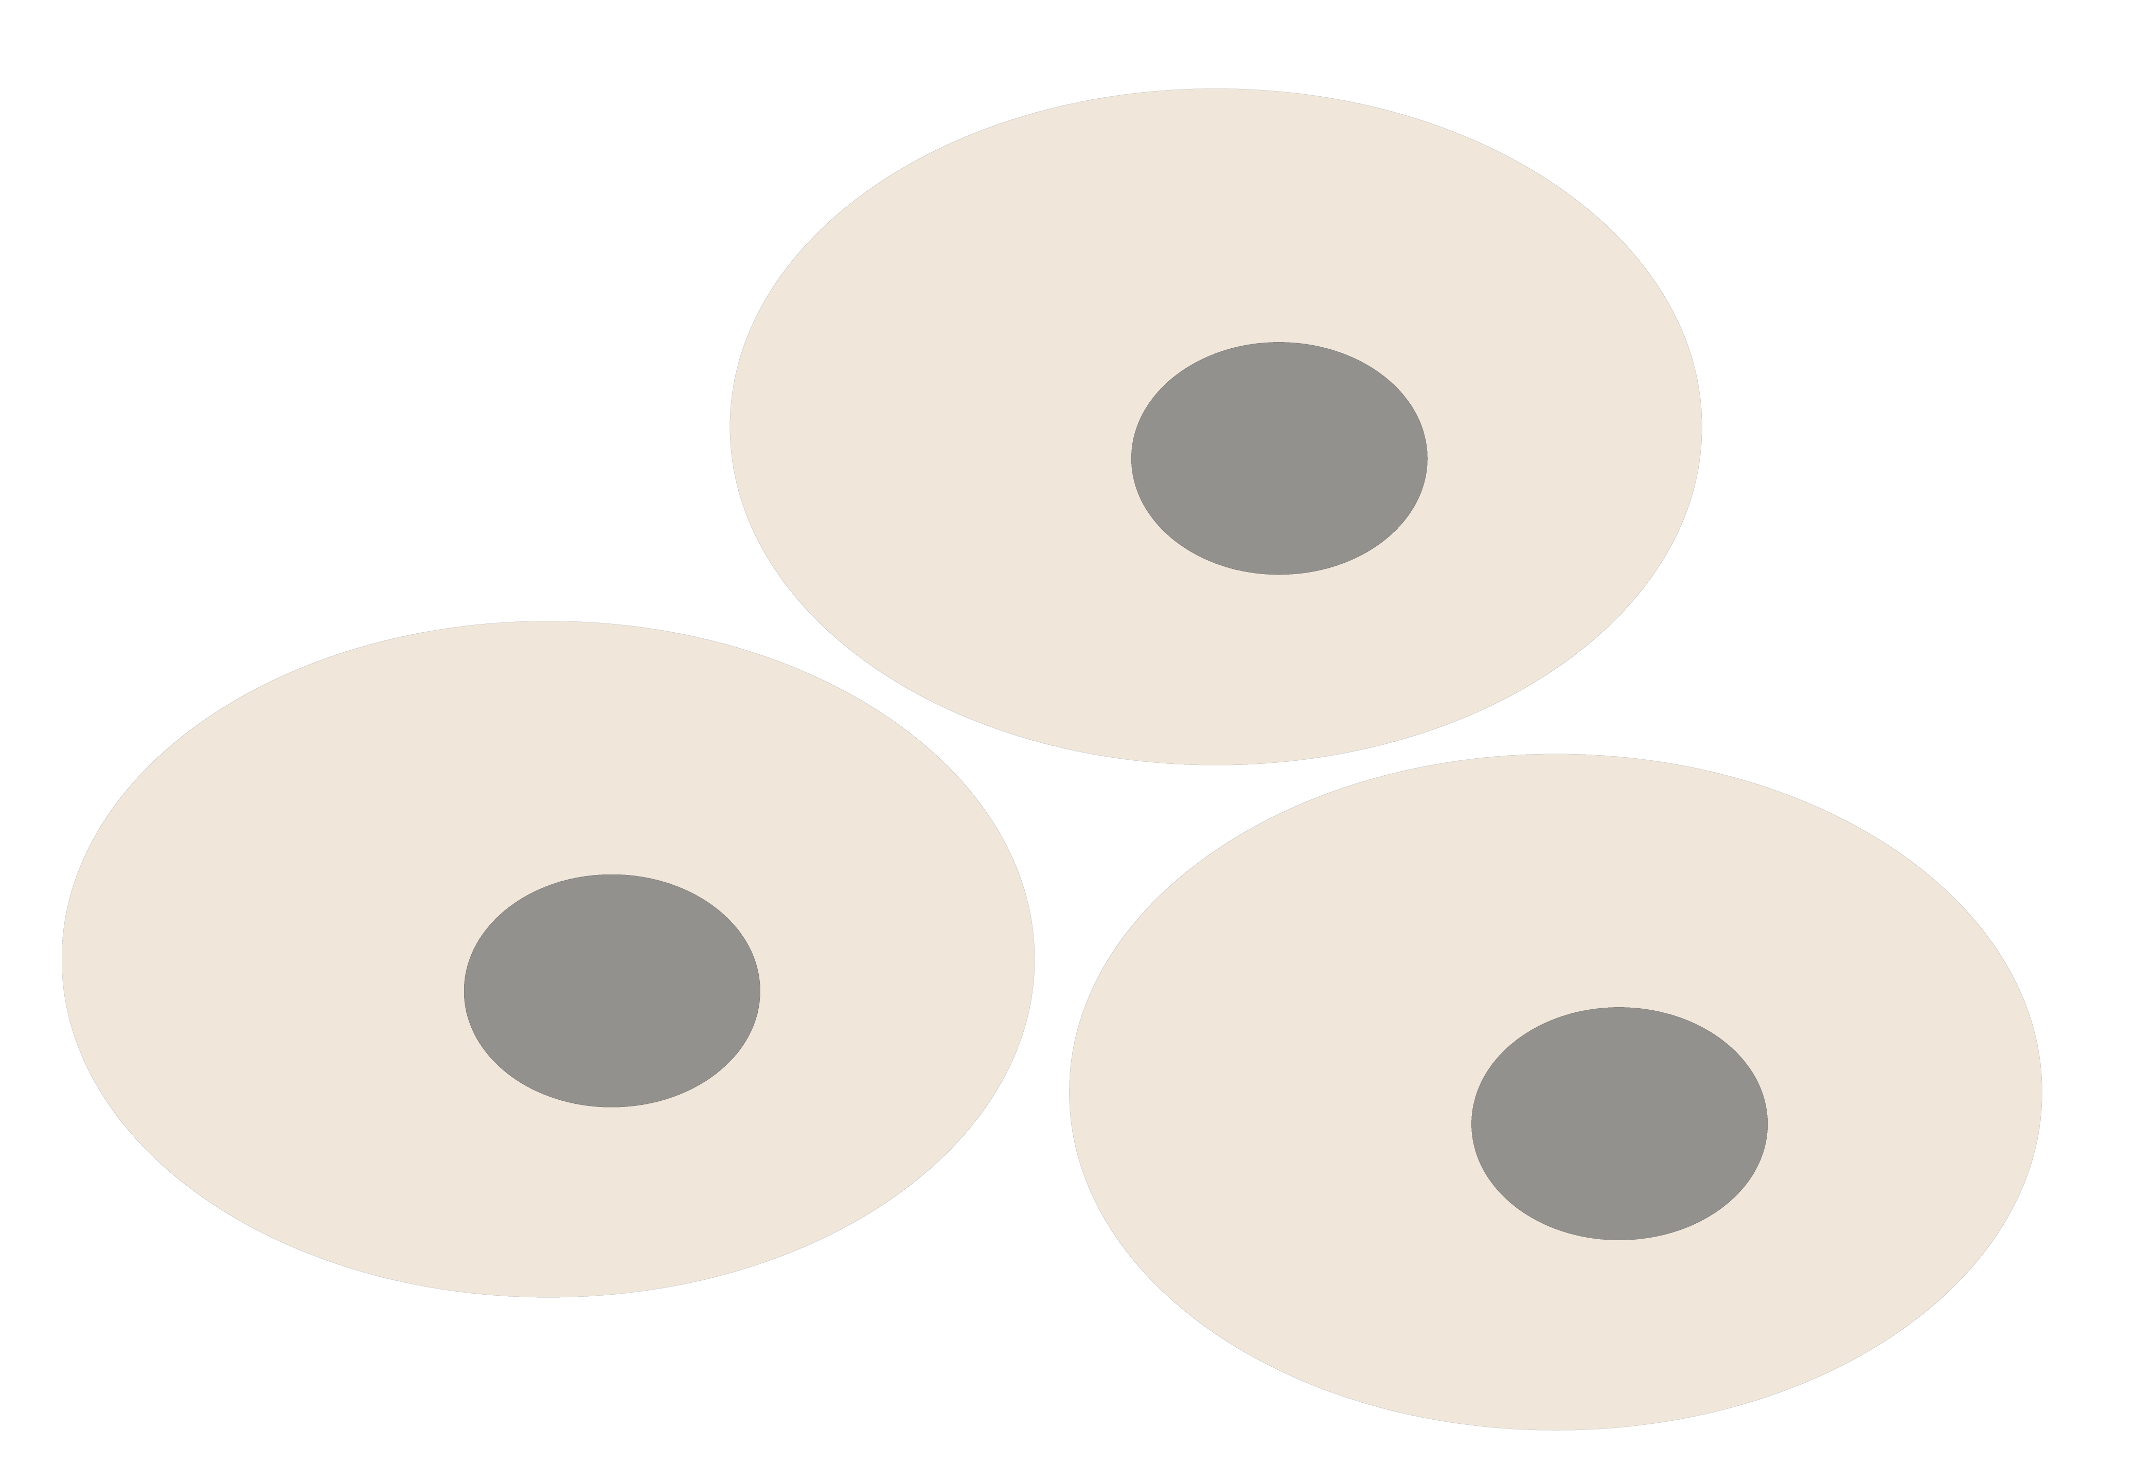
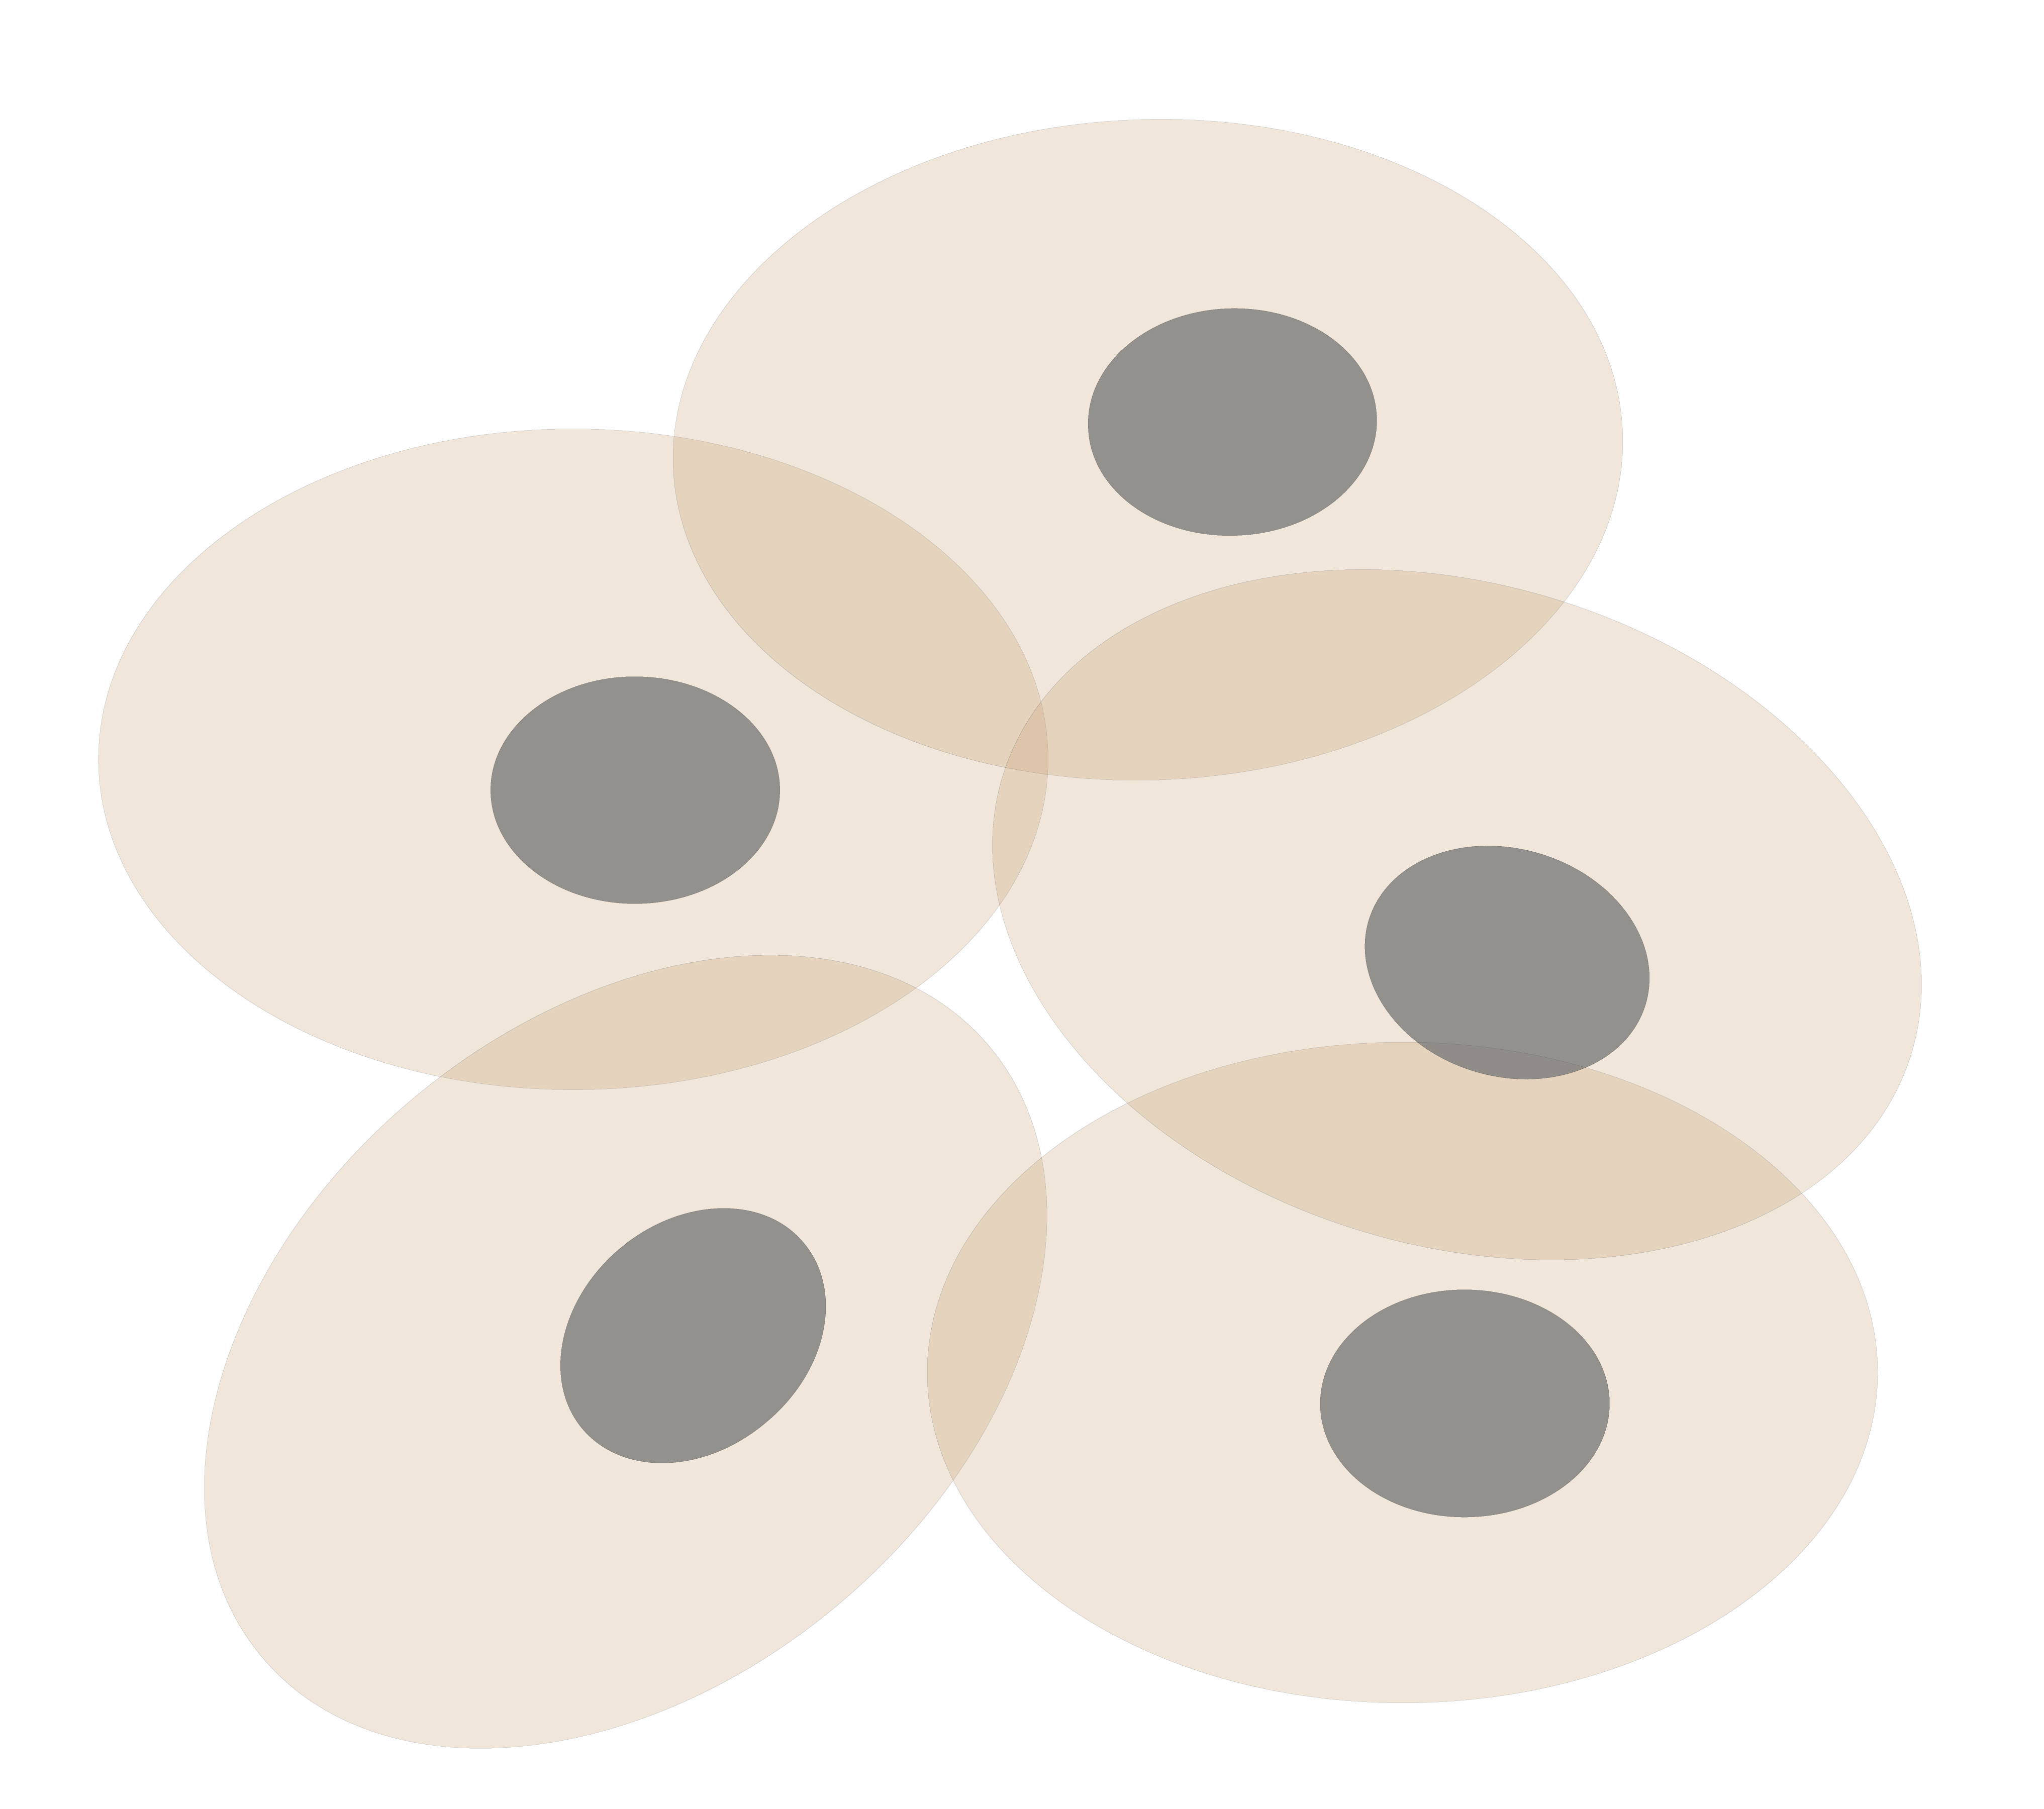
Personal Genomics
as a Gateway into Biology
Personal genomes soon will become a commonplace part of medical research & eventually treatment (esp. for cancer). They will provide a primary connection for biological science to the general public.
normal
tumor

Slide 3
Personal Genomics
as a Gateway into Biology
Personal genomes soon will become a commonplace part of medical research & eventually treatment (esp. for cancer). They will provide a primary connection for biological science to the general public.

Slide 4


Slide 5
RNA-seq
Genome-wide transcription
  Gene transcription and non-canonical transcription
  Fusion transcripts
  Alternative splicing
  Allele specific expression
Large magnitude of RNA-seq data generated
  ENCODE, modENCODE, TCGA, GTEx, Roadmap, psychENCODE, etc.
  Mostly the data is about the phenotype (e.g., cancer gene expression), but the individual information often comes along as collateral
  Maybe we can separate private info but couple it with the public presentation?

Slide 6
Genomic Privacy: Intertwined Social & Technical Issues
Setting the Stage: the Advent of Personal Genomics
The Dilemma of Genomic Privacy
  Fundamental, inherited info that’s very private vs the need for large-scale data-sharing to enable med. research
Current Social & Tech Approaches
  GINA, Consents &
  "Secure" use of dbGAP
  Issues: burdensome security, inconsistencies + ways the solutions have been partially "hacked”
  Strawman Hybrid Soc-Tech Proposal (Licensure, Cloud Enclaves. Quantifying Leaks, & Closely Coupled priv.-public data)
RNA-seq – practical problem of publicly sharing some of the info
  Removing SNVs in reads using MRF
  Quantifying & removing variant info from expression levels + eQTLs
  Further complications: SVs in pervasive transcription?

Slide 7
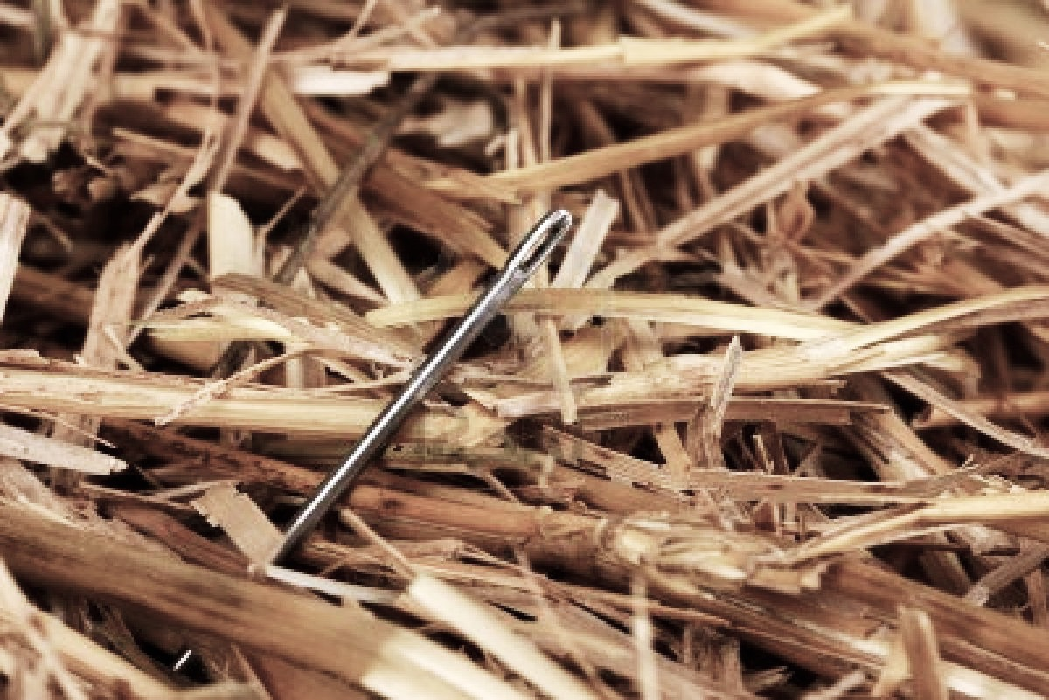
Finding Key Variants in Cancer Genomes: the Needle in the Haystack
[Image credit: www.yourgrantauthority.com ‘15]
Increasing number of whole genome sequenced for tumor/normal pairs
  Eg >2500 for PCAWG
Lots of somatic mutations in an average tumor (~5K/sample), particularly in non-coding regions
A focus is distinguishing drivers & passengers
  Canonical Drivers are mutations driving cancer progression
    Thought to be under positive selection
    Recur in the same position, gene or functional element across tumors in different individuals
  Passengers are thought not be significant to driving cancer progression
    Collateral damage
    Could result from impaired DNA repair processes
Most driver work has focused on genes
  eg Youn & Simon (‘11). Bioinformatics; Lawrence et al. (‘13). Nature

Slide 8
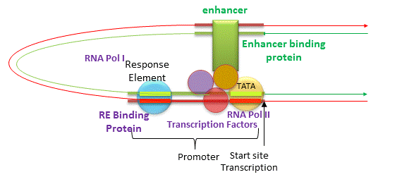
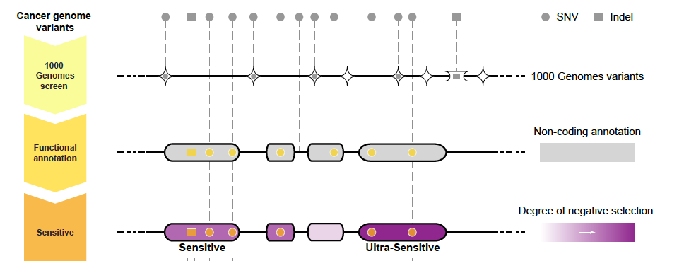
Noncoding Annotations
Promoters
TF binding sites
Transcription start sites
DHS sites
Enhancers
[Jakubowski, csbsju.edu ‘14]
Ultra-sensitive & Ultra-conserved elements Non-coding regions more conserved than expectation across the human population & between species [Bejerano et al. (‘04). Science; Khurana et al., Science (‘13)]

Slide 9


Mutation recurrence
Cancer Type 1
Cancer Type 2
Cancer Type 3

Slide 10
Mutation recurrence
Cancer Type 1
Cancer Type 2
Cancer Type 3
Early replicated regions
Late replicated regions

Slide 11
Noncoding annotations
Cancer Type 1
Cancer Type 2
Cancer Type 3
Early replicated regions
Late replicated regions

Slide 12
Noncoding annotations
Cancer Type 1
Cancer Type 2
Cancer Type 3
Early replicated regions
Late replicated regions

Slide 13
Cancer Somatic Mutational Heterogeneity, across cancer types, samples & regions
[Lochovsky et al. NAR (’15)]

Slide 14




Cancer Somatic Mutation Modeling
3 models to evaluate the significance of mutation burden
Suppose there are k genome elements. For element i, define:
  n_{i}: total number of nucleotides
  x_{i}: the number of mutations within the element
  p: the mutation rate
  R: the replication timing bin of the element
Model 1: Constant Background Mutation Rate (Model from Previous Work)
Model 2: Varying Mutation Rate
Model 3: Varying Mutation Rate with Replication Timing Correction
[Lochovsky et al. NAR (’15)]

Slide 15
LARVA Model Comparison
Comparison of mutation count frequency implied by the binomial model (model 1) and the beta-binomial model (model 2) relative to the empirical distribution
The beta-binomial distribution is significantly better, especially for accurately modeling the over-dispersion of the empirical distribution
[Lochovsky et al. NAR (’15)]

Slide 16
Adding DNA replication timing correction further improves the beta-binomial model
Bottom 10% of rep. timing bins requires large correction
Top 10% of rep. timing bins
requires little correction
[Lochovsky et al. NAR (’15)]

Slide 17
LARVA Results
TSS LARVA results
These have
literature-verified
cancer associations
β-binomial
noncoding annotation
p-values in sorted order
binomial
[Lochovsky et al. NAR (’15)]

Slide 18
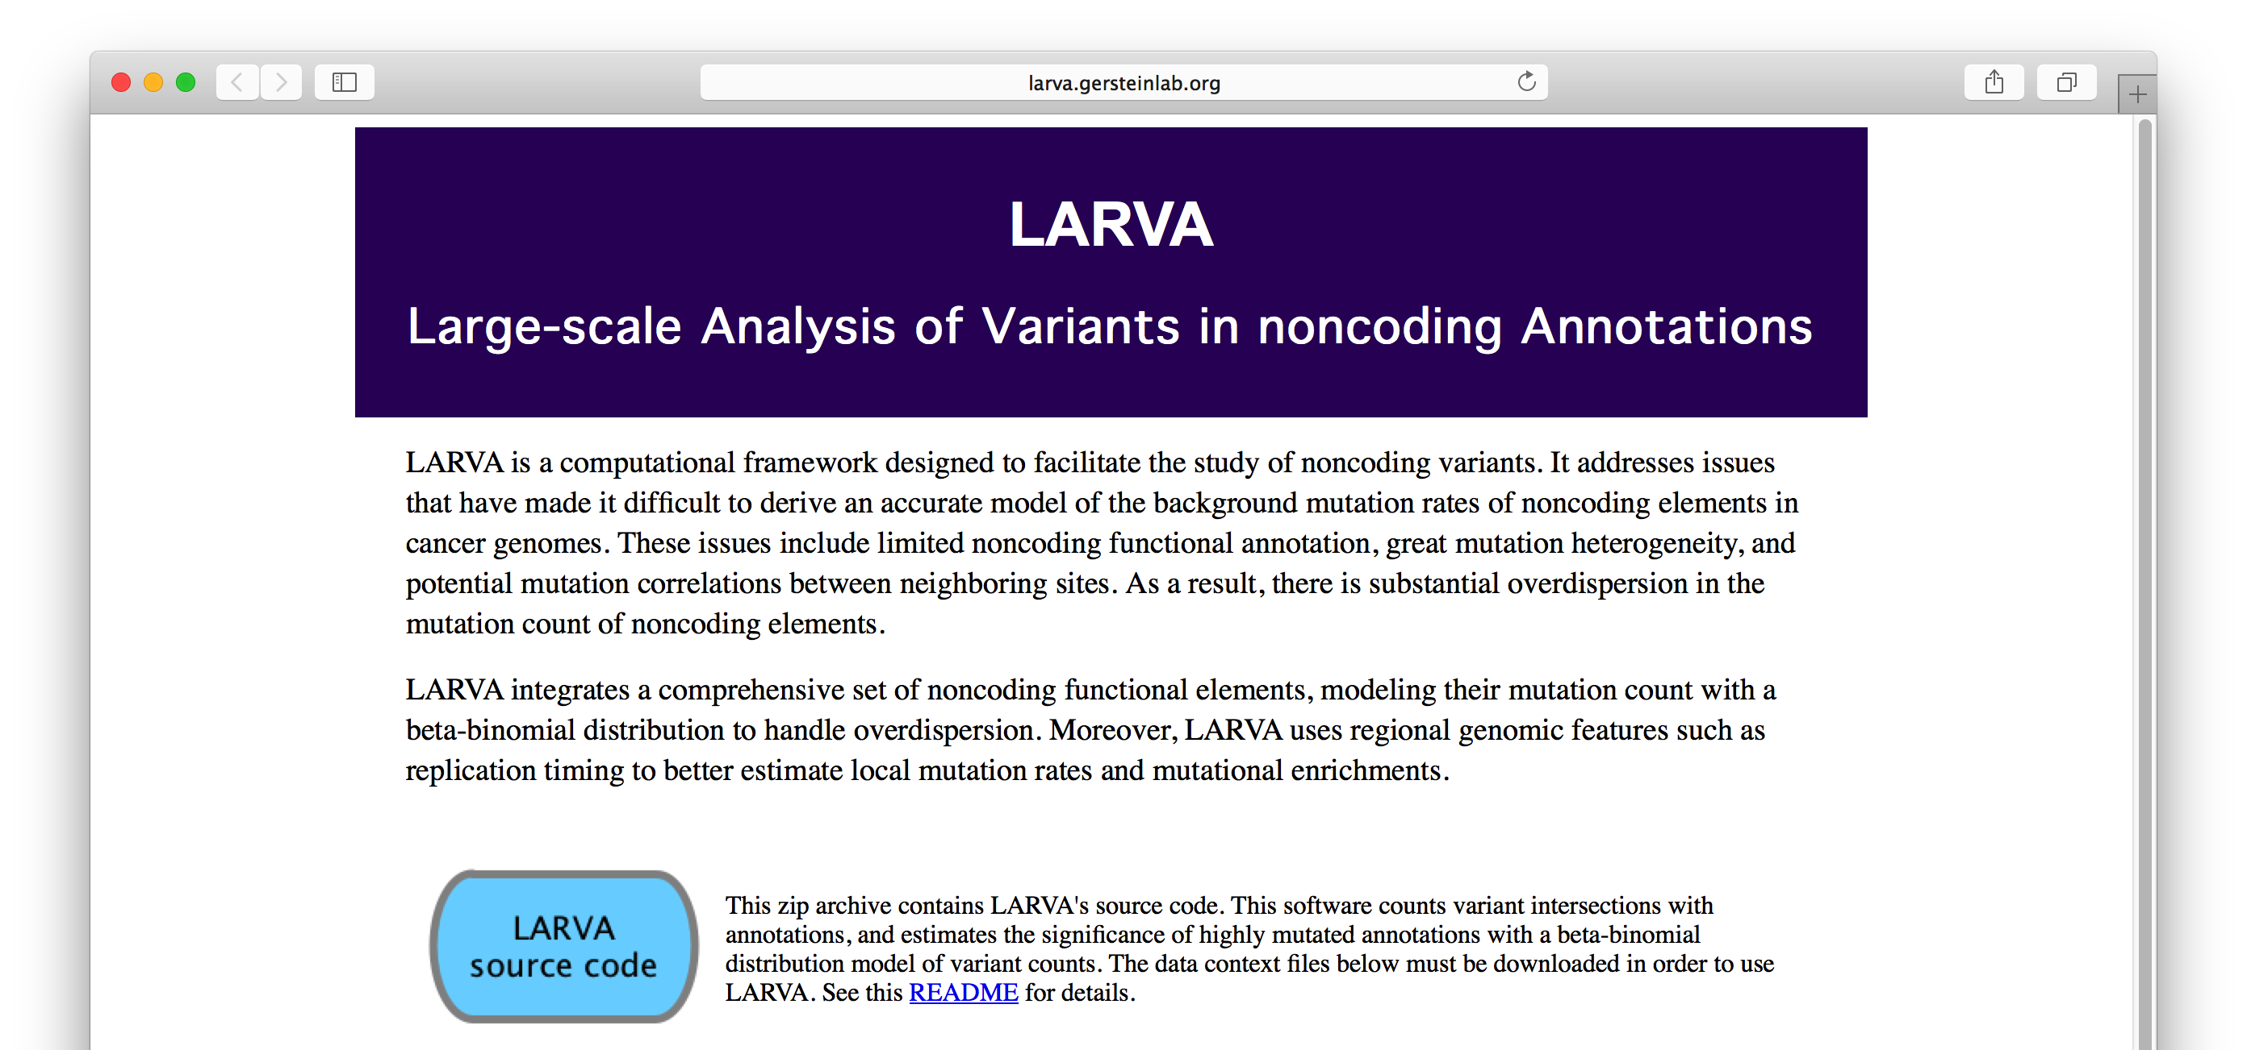
LARVA Implementation
http://larva.gersteinlab.org/
Freely downloadable C++ program
  Verified compilation and correct execution on Linux
A Docker image is also available to download
  Runs on any operating system supported by Docker
Running time on transcription factor binding sites (a worst case input size) is ~80 min
  Running time scales linearly with the number of annotations in the input

Slide 19

Acknowledgements
LARVA.gersteinlab.org
  L Lochovsky*, J Zhang*, Y Fu, E Khurana
FunSeq2.gersteinlab.org
  Y Fu, Z Liu, S Lou, J Bedford, X Mu, K Yip, E Khurana

Slide 20
Info about content in this slide pack
General PERMISSIONS
  This Presentation is copyright Mark Gerstein,
  Yale University, 2015.
  Please read permissions statement at
  www.gersteinlab.org/misc/permissions.html .
  Feel free to use slides & images in the talk with PROPER acknowledgement
  (via citation to relevant papers or link to gersteinlab.org).
  Paper references in the talk were mostly from Papers.GersteinLab.org.
PHOTOS & IMAGES. For thoughts on the source and permissions of many of the photos and clipped images in this presentation see http://streams.gerstein.info .
  In particular, many of the images have particular EXIF tags, such as kwpotppt , that can be easily queried from flickr, viz: http://www.flickr.com/photos/mbgmbg/tags/kwpotppt

Slide 21
Genomic Privacy: Intertwined Social & Technical Issues
Setting the Stage: the Advent of Personal Genomics
The Dilemma of Genomic Privacy
  Fundamental, inherited info that’s very private vs the need for large-scale data-sharing to enable med. research
Current Social & Tech Approaches
  GINA, Consents &
  "Secure" use of dbGAP
  Issues: burdensome security, inconsistencies + ways the solutions have been partially "hacked”
  Strawman Hybrid Soc-Tech Proposal (Licensure, Cloud Enclaves. Quantifying Leaks, & Closely Coupled priv.-public data)
RNA-seq – practical problem of publicly sharing some of the info
  Removing SNVs in reads using MRF
  Quantifying & removing variant info from expression levels + eQTLs
  Further complications: SVs in pervasive transcription?

Slide 22
From larva/funseq to loregic
Genomic variants across individuals
  larva/funseq
Variants affect gene regulation
gene expression variations across individuals
  gene regulatory mechanisms that drive expression differences
  “logic” is a good model to capture regulatory mechanism
  “logic operation” exists in gene regulation widely

Slide 23
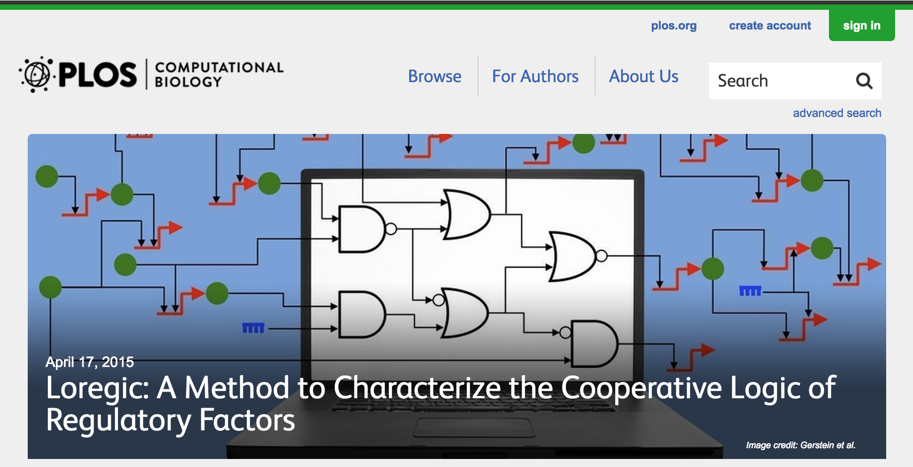
Loregic: A method to characterize the cooperative logic of regulatory factors
Wang D, Yan K-K, Sisu C, Cheng C, Rozowsky J, Meyerson W, Gerstein M (2015), PLoS Comput Biol 11(4): e1004132. doi: 10.1371/journal.pcbi.1004132
General-purpose tool, R package: github.com/gersteinlab/loregic
Notes:
we called our method Loregic, which uses logic gate models to characterize the cooperative logic of gene regulatory factors. we published Loregic in Plos comp. bio.

Slide 24
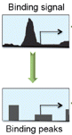
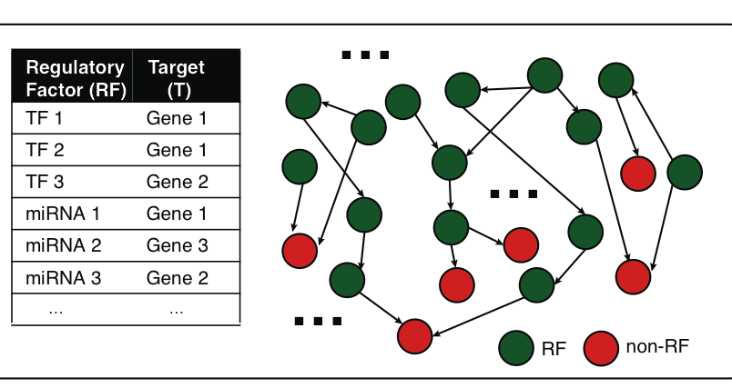
A gene can be regulated by multiple gene regulatory factors
Next generation sequencing techniques (e.g., ChIP-seq, CLIP-seq) predict gene regulatory factors (RFs) and their target genes
transcription factors (TFs)
micro-RNAs
…
Gene regulatory network
Peak calling
Many genes are regulated by multiple RFs.
How RFs coordinate to regulate target gene expression?
cooperative?
competitive?
independent?
…
Notes:
besides gene expression data, next generation sequencing technologies such as ChIP-seq and CLIP-seq can identify the target genes of gene regulatory factors. the regulatory factors include TF, mirnas and so on like TF1 and TF2 regulate Gene 1. Then, we can create a gene regulatory network. it is very likely that a target gene can be regulated by two or more RFs. e.g., we can get a lot of regulatory triplets where RF1 and RF2 regulate a common target gene T. Then, we would ask how two RFs coordinate to regulate T? are they really cooperative, or competitive, or independent? Is there a way to describe their cooperativity?

Slide 25
Modeling cooperativity between RFs to target gene using logic gates
A regulatory triplet
2-input-1-output logic gate
10110101…
10110101…
RF1
RF1
?
T
00110101…
T
00110101…
10110101…
01110111…
RF2
RF2
0 – gene off
1 – gene on
after binarizing gene expression data*
Input type (RF1, RF2) | RF1 | 0 | 0 | 1 | 1
 | RF2 | 0 | 1 | 0 | 1
Output | T | X | X | X | X
Binarized expression
X can be 0 or 1, so there are 2⁴=16 possible output combinations, each of which corresponds to a unique 2-input-1-output logic gate
…
*BoolNet, R package
Notes:
let’s look at a particular triplet, TF1 and TF2 regulate Gene 1. At logical level, gene expression has two states, gene is on or off, i.e., 1 represents gene is expressed or 0 represents gene is not expressed. So, then we can look at the triplet as 2-input-1-output system. TF1 and TF2 are inputs, and Gene 1 are output, and then use a 2-input-1-output logic gate to model this triplet. As shown in a truth table, there are 4 different types of input of TF1 and TF2, 00, 01, 10, 11, and for each input type, there are 2 possible output types, 1 or 0. so in total, we have 2^4 = 16 possible logic gates that can be used to describe the triplet.

Slide 26
An example: selection of the best-matched logic gate
Laplace’s rule of succession
s=(# of selected output state for the input type + 1)
/(# of input type + 2)
Consistency score:
6/7*5/7*6/7*5/7=0.37
Wang, et al., PLoS Computational Biology, 2015
Notes:
*********************************************
This toy example demonstrates that how we choose the best matched logic gates. first, for each input type of TF1, TF2 like 01, green, we count numbers of 0 and 1 output from Gene 1 data. and select the most state as output of this input type. e.g., we have 4 zeros and 1 one, then 0 is considered as output of input type 01. we also calculate the output’s succession prob using laplace’s rule of succession derived from Bayes' theorem, like 5/7. after we go thru all four input types, we get a truth table. Here, it’s the table for the AND gate. Also, we define production of four output succession probs as consistency score to the matched logic gate. e.g. the consistency score is 0.37 for AND gate.

Slide 27
Application 1 – transcription factor cooperativity in Yeast cell cycle
Target gene | 2464
TF | 176
Triplet | 39,011
Time point | 59
AND-like gates
Wang, et al., PLoS Computational Biology, 2015
Notes:
First, we apply Loregic to characterize TF cooperativity during yeast cell cycle, and found AND gate matches the most triplets, which implies that yeast TFs need to cooperate during cell cycle. we were able to distinguish three categories for this triplet group: 1) “homogenous” gate-consistent triplets – matching the same logic gate across all targets (e.g., top table); 2) “inhomogeneous” gate-consistent triplets – matching different logic gates across all targets (e.g., middle table); and 3) non-gate-consistent triplets, i.e. triplets inconsistent with all logic gates across all targets (e.g., bottom table).

Slide 28


Application 2 – transcription factor cooperativity in Acute Myeloid Leukemia (AML)
Target gene | 1824 | ENCODE Data (K562, ChIP-seq) http://encodenets.gersteinlab.org/
TF | 70
Regulatory triplet | 50,865 | TCGA Data (AML, level 3, RNA-seq) https://tcga-data.nci.nih.gov/tcga/tcgaDownload.jsp
Patient sample | 197
Wang, et al., PLoS Computational Biology, 2015
Notes:
Then, we apply Loregic to the human cancer data. e.g., we characterized the TF cooperativity in leukemia cancer using 70 TF chip-seq data in ENCODE and gene expression data across 200 patients in TCGA. it is interesting to find that OR gate matches the most triplets, which implies that TF may not cooperate with each other in human cancer.

Slide 29
Application 2 – transcription factor cooperativity in Acute Myeloid Leukemia (AML)
OR-like gates
number of logic-gate consistent triplets
Wang, et al., PLoS Computational Biology, 2015
Notes:
Then, we apply Loregic to the human cancer data. e.g., we characterized the TF cooperativity in leukemia cancer using 70 TF chip-seq data in ENCODE and gene expression data across 200 patients in TCGA. it is interesting to find that OR gate matches the most triplets, which implies that TF may not cooperate with each other in human cancer.

Slide 30

Cancer-related TF, MYC universally amplifies target expression
2,153 (RF1=MYC, RF2=other TFs, T=all common targets) triplets
RF1
OR(RF1, RF2)
OR(RF1, NOT RF2)
number of logic-gate consistent triplets
High expression of MYC is sufficient for high target gene expression
Wang, et al., PLoS Computational Biology, 2015
Notes:
So, we then look at triplets with cancer-related TFs, e.g., MYC. biologists found that MYC universally amplifies target gene expressions in lymphocytes. we checked 2000 MYC associated triplets where MYC is 1st RF, and found the most MYC associated triplets are consistent with three logic gates, RF1, RF1+RF2 and RF1+~RF2 with significant enrichments. all three logic gates mean that high expression of MYC is sufficient for high target gene expression, which supports that MYC is a universal amplifier.
then use MYC to slince targe gene expresison in cancer

Slide 31
Genomic Privacy: Intertwined Social & Technical Issues
Setting the Stage: the Advent of Personal Genomics
The Dilemma of Genomic Privacy
  Fundamental, inherited info that’s very private vs the need for large-scale data-sharing to enable med. research
Current Social & Tech Approaches
  GINA, Consents &
  "Secure" use of dbGAP
  Issues: burdensome security, inconsistencies + ways the solutions have been partially "hacked”
  Strawman Hybrid Soc-Tech Proposal (Licensure, Cloud Enclaves. Quantifying Leaks, & Closely Coupled priv.-public data)
RNA-seq – practical problem of publicly sharing some of the info
  Removing SNVs in reads using MRF
  Quantifying & removing variant info from expression levels + eQTLs
  Further complications: SVs in pervasive transcription?

Slide 32
From loregic to DREISS
Many regulatory triplets do not follow logical cooperativity such as in yeast cell cycle
  Advanced models needed to capture regulatory mechanisms
Internal/external regulatory networks
  e.g., internal & external factors affect a pathway
Continuous models
  State-space models

Slide 33
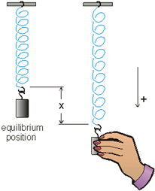
Internal and external gene regulatory networks
Internal Group
External Group
Internal regulation
How to identify gene expression dynamics driven by internal/external regulation?
External regulation
Interested system | Internal regulatory network | External regulatory network
Cross-species conserved genes | Conserved transcriptional factors (TFs) | Non-conserved TFs
Protein-coding genes | TFs | micro-RNAs
Individual’s protein coding genes | Wild-type TFs | Somatic mutated TFs
Protein-coding genes in brain | Commonly expressed TFs | Brain-specific expressed TFs
Protein-coding genes in development | House-keeping TFs | Developmental TFs
External force
[Wang et al. PLOS CB (in revision, ‘15)]
Notes:
connect loregic to here too! to see regulatory mechanisms similar too

Slide 34
State-space model for internal and external gene regulatory networks
External Group
Internal Group
Internal regulation
How to identify gene expression dynamics driven by internal/external regulation?
External regulation
Control: Gene expression vector of external factors at time t
State space model
X_{t+1}
A
X_{t}
B
U_{t}
B_{kl} captures temporal casual influence from external factor k to Gene l in internal group
State: Gene expression vector of Group X at time t+1
A_{ij} captures temporal casual influence from Gene i to Gene j in internal group
State: Gene expression vector of internal group at time t
[Wang et al. PLOS CB (in revision, ‘15)]
Notes:
connect loregic to here too! to see regulatory mechanisms similar too

Slide 35
Effective state space model for meta-genes
Not enough data to estimate state space model for genes
(e.g., 25 time points per gene to estimate 4 millions elements of A or B for 2000 genes)
Dimensionality reduction from genes to meta-genes (e.g., singular value decomposition)
Effective state space model for meta-genes
(e.g., 250 time points to estimate 50 matrix elements if 5 meta-genes)

Slide 36
Effective state space model for meta-genes
Not enough data to estimate state space model for genes
Dimensionality reduction from genes to meta-genes (e.g., SVD)
Effective state space model for meta-genes
For example, after projecting 3147 worm-fly orthologous genes to 5 meta-genes, Ã is 5x5 matrix (A is 3147x3147 matrix)
[Wang et al. PLOS CB (in revision, ‘15)]

Slide 37
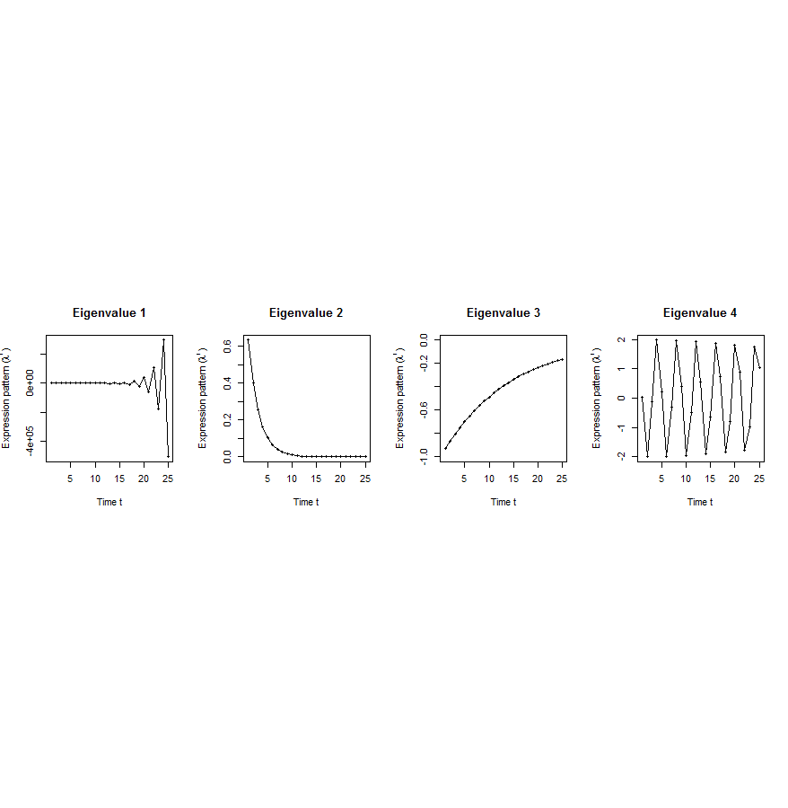
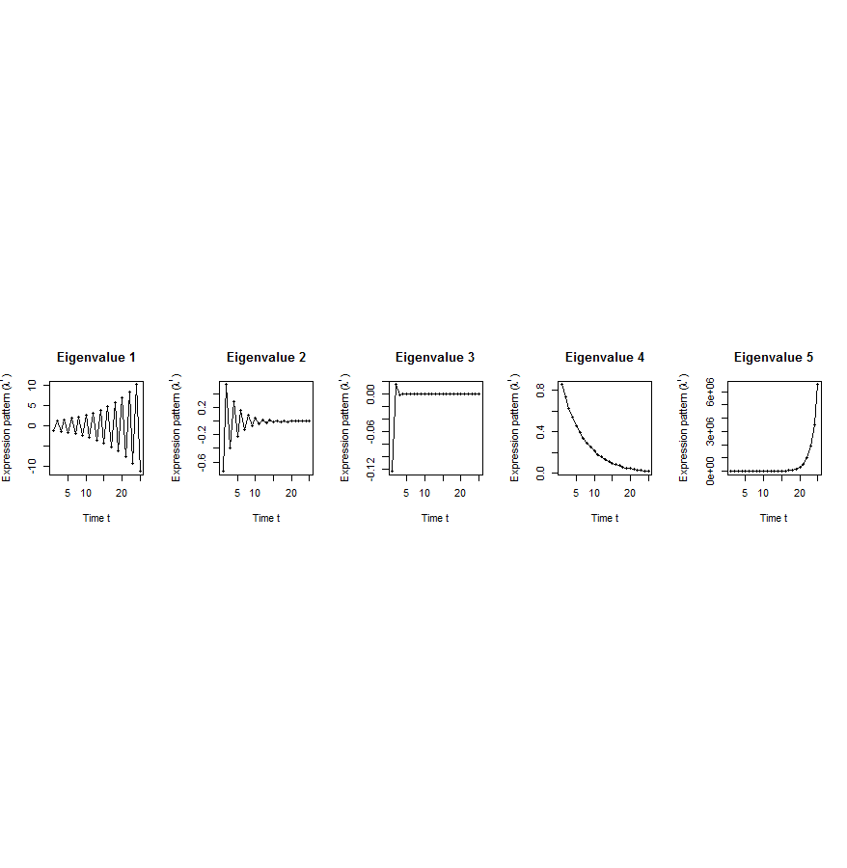
Canonical temporal expression trajectories from effective state space model
Internal driven dynamics
Externally driven dynamics
p^{th} internal principal dynamic pattern (iPDP): [λ_{p}¹, λ_{p}², …, λ_{p}^{T}],
where λ_{p} is p^{th} eigenvalue of Ã.
q^{th} external principal dynamic pattern (ePDP): [σ_{q}¹, σ_{q}², …, σ_{q}^{T}],
where σ_{q} is q^{th} eigenvalue of .
Canonical temporal expression trajectories
(e.g., degradation, growth, damped oscillation, etc.)
iPDP expression
ePDP expression
time
time
[Wang et al. PLOS CB (in revision, ‘15)]
Notes:
if we look at A tilde, it controls the dynamic trajectory of expression part internally driven by meta-genes of X. according to the analytic solution, the internally driven expression part Xtilde I can be linear combinations of A tilde’s eigenvalue’s exponentials across time, which are defined by us as internal principal dynamic pattern (iPDP). B tilde controls the dynamic trajectory of X’s metagene expression part externally driven by U. similarly, we can find external principal dynamic pattern (ePDP) based on B tilde’s eigenvalue exponentials across time. Actually, those patterns are canonical temporal expression trajectories, which are as simple as degradation, growth, damped oscillation temporal processes). In short, from metagene effective model, we are able to identify internal and external driven canonical temporal expression trajectories.

Slide 38
Breast cancer cell cycle under hormonal stimulation
Dataset | Group X (internal) | Group U (external) | Time samples of a full cell cycle
Human breast cancer cell cycle under hormonal stimulation | 1132 metazoan conserved genes incl. 150 orthologous TFs | 1870 non-conserved metazoan transcription factors | T=12 time points: 0, 4, 6, 8, 12, …, 28, 32 hours
Oscillated iPDP by conserved TFs
a full cell cycle
Oscillated ePDP by non-conserved TFs
faster cycle due to hormone
[Wang et al. PLOS CB (in revision, ‘15)]

Slide 39
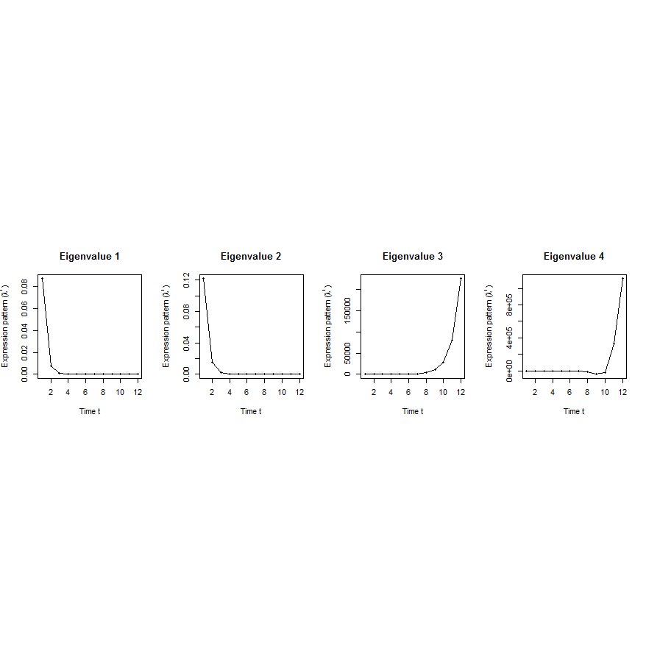
[Wang et al. PLOS CB (in revision, ‘15)]
A. Gene state-space model
C. Meta-gene state-space model
B. Dimensionality Reduction
X_{t+1}=AX_{t}+BU_{t}
Genes of X
Meta-genes of X
time
E. Gene’s internal (INT) and external (EXT) driven expression dynamics composed of PDPs
D. Internal/External Principal Dynamic Patterns (PDPs)
time
[λ_{p}¹, λ_{p}², …, λ_{p}^{T}] [σ_{q}¹, σ_{q}², …, σ_{q}^{T}]
x^{INT}=c₁ +c₂
+c₃ +c₄
Genes of U
Meta-genes of U
time
time
…
x^{EXT}=d₁ +d₂
+d₃ +d₄
/
Internal regulation among genes/meta-genes Group X by A/Ã
/
External regulation from genes/meta-genes in Group U
to genes/meta-genes in Group X by B/
/
Genes/Meta-genes in Group X
/
Genes/Meta-genes in Group U

Slide 40
Transcriptome Analysis:
Expression Clustering across Distant Organisms
Intro to Comparative ENCODE
  Lots of Matched Data for Comparative Analysis
Expression Clustering, Cross-species
  Potts-model optimization gives 16 conserved co-expression modules (which can potentially annotate ncRNAs/TARs)
Relating Clusters to Hourglass Genes
  Developmental 'hourglass' genes in 12 of the clusters. They also exhibit intra-organism hourglass behavior.
  Stage alignment of worm & fly development, strongest with hourglass genes
Decoupling expression changes into those driven by worm-fly conserved genes vs species-specific ones
  Using dimensionality reduction to help determine internal & external drivers
  Conserved genes have similar canonical patterns (iPDPs) in contrast to species specific ones (Ex of ribosomal v signaling genes)

Slide 41


The Conundrum of Genomic Privacy: Is it a Problem?
Yes
Genetic Exceptionalism :
genome is potentially very revealing about one’s identity & characteristics
Most discussion of Identification Risk but what about Characterization Risk?
  Finding you were in study X vs identifying that you have trait Y from studying your identified genome
No
Shifting societal foci
No one really cares
about your genes
You might not care
[Klitzman & Sweeney ('11), J Genet Couns 20:98l; Greenbaum & Gerstein ('09), New Sci. (Sep 23) ]

Slide 42

Tricky Privacy Considerations in Personal Genomics
Personal Genomic info. essentially meaningless currently but will it be in 20 yrs? 50 yrs?
  Genomic sequence very revealing about one’s children. Is true consent possible?
  Once put on the web it can’t be taken back
Culture Clash: Genomics historically has been a proponent of “open data” but not clear personal genomics fits this
Ethically challenged history of genetics
Ownership of the data & what consent means (Hela)
  Could your genetic data give rise to a product line?
[D Greenbaum & M Gerstein (’08). Am J. Bioethics; D Greenbaum & M Gerstein, Hartford Courant, 10 Jul. '08 ; SF Chronicle, 2 Nov. '08;
Greenbaum et al. PLOS CB (‘11) ; Greenbaum & Gerstein ('13), The Scientist; Photo from NY Times]

Slide 43

The Other Side of the Coin:
Why we should share
Sharing helps speed research
  Large-scale mining of this information is important for medical research
  Privacy is cumbersome, particularly for big data
  Sharing is important for reproducible research
Sharing is useful for education
[Yale Law Roundtable (‘10). Comp. in Sci. & Eng. 12:8; D Greenbaum & M Gerstein (‘09). Am. J. Bioethics; D Greenbaum & M Gerstein (‘10). SF Chronicle, May 2, Page E-4;
Greenbaum et al. PLOS CB (‘11)]

Slide 44

The Dilemma
[Economist, 15 Aug ‘15]
What is acceptable risk? What is acceptable data leakage? Can we quantify leakage?
Cost Benefit Analysis: how helpful is identifiable data in genomic research v. potential harm from a breach?
The individual (harmed?) v the collective (benefits)
  But do sick patients care about their privacy?
Maybe a we need a few "test pilots” (ala PGP)?
  Sports stars & celebrities?

Slide 45












Genomics has similar "Big Data" Dilemma in the Rest of Society
Sharing & "peer-production" is central to success of many new ventures, with the same risks as in genomics
We confront privacy risks every day we access the internet
(...or is the genome more exceptional & fundamental?)
[Seringhaus & Gerstein ('09), Hart. Courant (Jun 5); Greenbaum & Gerstein ('11), NY Times (6 Oct)]

Slide 46
Genomic Privacy: Intertwined Social & Technical Issues
Setting the Stage: the Advent of Personal Genomics
The Dilemma of Genomic Privacy
  Fundamental, inherited info that’s very private vs the need for large-scale data-sharing to enable med. research
Current Social & Tech Approaches
  GINA, Consents &
  "Secure" use of dbGAP
  Issues: burdensome security, inconsistencies + ways the solutions have been partially "hacked”
  Strawman Hybrid Soc-Tech Proposal (Licensure, Cloud Enclaves. Quantifying Leaks, & Closely Coupled priv.-public data)
RNA-seq – practical problem of publicly sharing some of the info
  Removing SNVs in reads using MRF
  Quantifying & removing variant info from expression levels + eQTLs
  Further complications: SVs in pervasive transcription?

Slide 47
Current Social & Technical Solutions
Consents
“Protected” distribution of data (dbGAP)
Local computes on secure computer
Issues
  Non-uniformity of consents & paperwork
    Different international norms, leading to confusion
  Encryption & computer security creates burdensome requirements on data sharing & large scale analysis
  Many schemes get “hacked”
[Greenbuam et al ('04), Nat. Biotech; Greenbaum & Gerstein ('13), The Scientist]

Slide 48
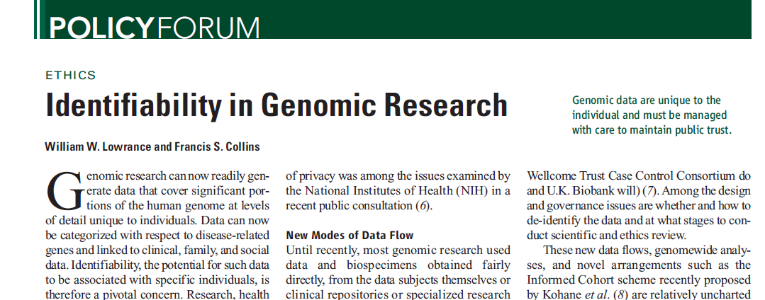
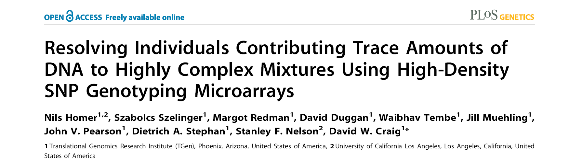
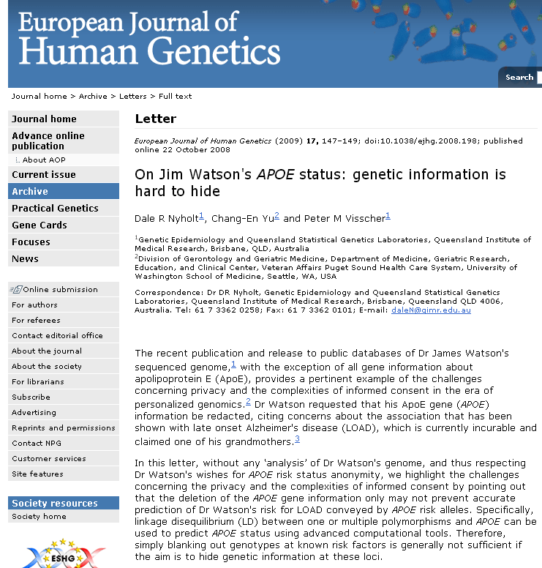
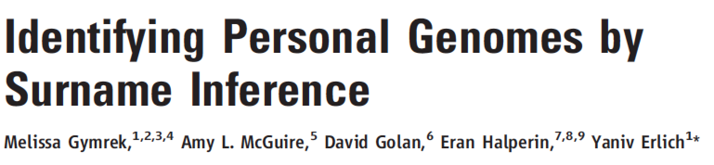
Matching against reference genotype. The number of DNA markers such as single-nucleotide polymorphisms (SNPs) that are needed to uniquely identify a single person is small; Lin et al. estimate that only 30 to 80 SNPs could be sufficient
Linking to nongenetic databases. A second route to identifying genotyped subjects is deduction by linking and then matching geno-type- plus-associated data (such as gender, age, or disease being studied) with data in health-care, administrative, criminal, disaster response, or other databases … If the nongenetic data are overtly identified, the task is straightforward
A framework for accurately and robustly resolving whether individuals are in a complex genomic DNA mixture using high-density single nucleotide polymorphism (SNP) genotyping microarrays.
We demonstrate an approach for rapidly and sensitively determining whether a trace amount (<1%) of genomic DNA from an individual is present within a complex DNA mixture
Identifying anonymized 1000G individuals through DB xref

Slide 49


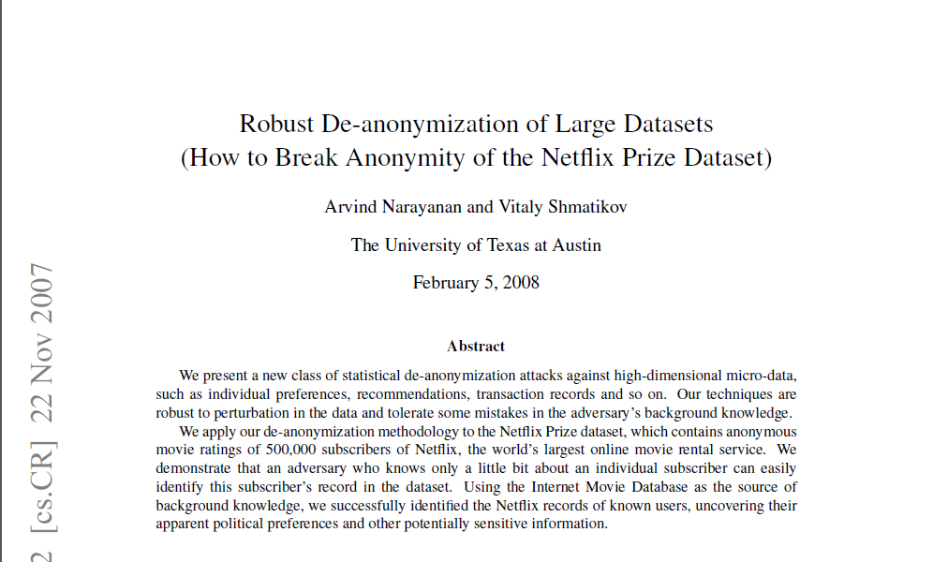
Cross correlated small set of identifiable IMDB movie database rating
records with large set of “anonymized” Netflix customer ratings

Slide 50
Strawman Hybrid Social & Tech Proposed Solution?
Fundamentally, researchers have to keep genetic secrets
  Genetic Licensure & training for individuals
  (similar to medical license, drivers license)
Technology to make things easier
  Cloud computing & enclaves (eg solution of Genomics England)
Technological barriers shouldn't create a social incentive for “hacking”
Quantifying Leakage & allowing a small amounts of it (eg photos of eye color)
Careful separation & coupling of private & public data
  Lightweight, freely accessible secondary datasets coupled to underlying variants
  Selection of stub & "test pilot" datasets for benchmarking
  Develop programs on public stubs on your laptop, then move the program to the cloud for private production run
[D Greenbaum, M Gerstein (‘11). Am J Bioeth 11:39. Greenbaum & Gerstein, The Scientist ('13)]

Slide 51
Genomic Privacy: Intertwined Social & Technical Issues
Setting the Stage: the Advent of Personal Genomics
The Dilemma of Genomic Privacy
  Fundamental, inherited info that’s very private vs the need for large-scale data-sharing to enable med. research
Current Social & Tech Approaches
  GINA, Consents &
  "Secure" use of dbGAP
  Issues: burdensome security, inconsistencies + ways the solutions have been partially "hacked”
  Strawman Hybrid Soc-Tech Proposal (Licensure, Cloud Enclaves. Quantifying Leaks, & Closely Coupled priv.-public data)
RNA-seq – practical problem of publicly sharing some of the info
  Removing SNVs in reads using MRF
  Quantifying & removing variant info from expression levels + eQTLs
  Further complications: SVs in pervasive transcription?

Slide 52

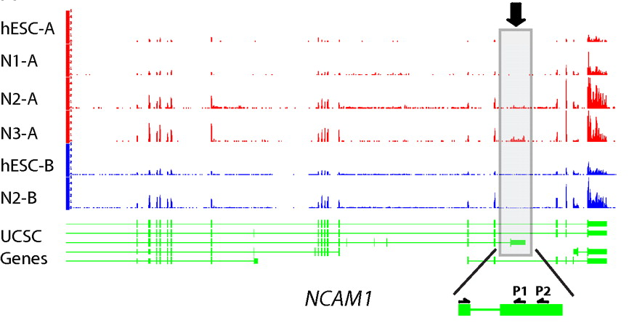
RNA-seq
RNA-seq uses next-generation sequencing technologies to reveal RNA presence and quantity within a biological sample.
ATACAAGCAAGTATAAGTTCGTATGCCGTCTT
GGAGGCTGGAGTTGGGGACGTATGCGGCATAG
TACCGATCGAGTCGACTGTAAACGTAGGCATA
ATTCTGACTGGTGTCATGCTGATGTACTTAAA
Reads (fasta)
－ Quality scores (fastq)
－ Mapping (BAM)
－ Contain variant information in transcribed regions
Quantitative information from RNA-seq signal: average signals at exon level (RPKMs)
Reads => Signal
[PLOS CB 4:e1000158; PNAS 4:107: 5254 ; IJC 123:569 ]

Slide 53
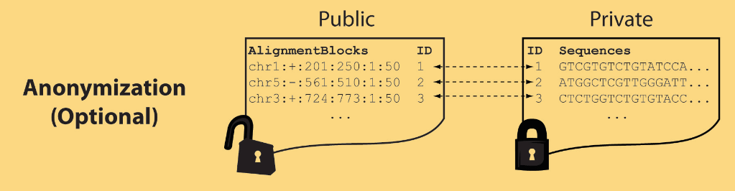
Light-weight formats
Some lightweight format clearly separate public & private info., aiding exchange
Files become much smaller
Distinction between formats to compute on and those to archive with – become sharper with big data
Reads
(linked via ID,
10X larger than
mapping coord.)
Mapping coordinates without variants (MRF)
[Bioinformatics 27: 281]

Slide 54
MRF Examples
chr2:+:601:630:1:30,chr2:+:921:940:31:50
TS
TE
TS
TE
Reference
AlignmentBlock 1
AlignmentBlock 2
10X Compression Ex.
Raw ELAND export file has uncompressed file size: ∼4 GB; total number of reads: ∼20 million; number of mapped reads: ∼12 million .
MRF file is significantly smaller (∼400 MB uncompressed, ∼130 MB compressed with gzip).
BAM file
has a size of ∼1.2 GB.
Splice junction Read
QS
QE/QS
QE
Legend: TS = TargetStart, TE = TargetEnd, QS = QueryStart, QE = QueryEnd
chr9:+:431:480:1:50|chr9:+:945:994:1:50
TS
TE
TS
TE
Reference
AlignmentBlock 1
AlignmentBlock 2
Reference based compression (ie CRAM) is similar but it stores actual variant beyond just position of alignment block
Paired-end Read
QS
QE
QS
QE
Legend: TS = TargetStart, TE = TargetEnd, QS = QueryStart, QE = QueryEnd
[Habegger et al., Bioinformatics (‘11)]

Slide 55
Genomic Privacy: Intertwined Social & Technical Issues
Setting the Stage: the Advent of Personal Genomics
The Dilemma of Genomic Privacy
  Fundamental, inherited info that’s very private vs the need for large-scale data-sharing to enable med. research
Current Social & Tech Approaches
  GINA, Consents &
  "Secure" use of dbGAP
  Issues: burdensome security, inconsistencies + ways the solutions have been partially "hacked”
  Strawman Hybrid Soc-Tech Proposal (Licensure, Cloud Enclaves. Quantifying Leaks, & Closely Coupled priv.-public data)
RNA-seq – practical problem of publicly sharing some of the info
  Removing SNVs in reads using MRF
  Quantifying & removing variant info from expression levels + eQTLs
  Further complications: SVs in pervasive transcription?

Slide 56

eQTL Mapping Using RNA-Seq Data
eQTLs are genomic loci that contribute to variation in mRNA expression levels
eQTLs provide insights on transcription regulation, and the molecular basis of phenotypic outcomes
eQTL mapping can be done with RNA-Seq data
[Biometrics 68(1) 1–11]
Notes:
A diagram to illustrate the RNA‐seq count variation of one gene due to an cis‐eQTL. (a) RNA‐seq measurements of a hypothetic gene with two exons in three diploid individuals. The target SNP which we test for association has the genotype CT, CC, and TT for the three individuals. There is an SNP on the first exon, which has genotype AT, AT, and AA for the three individuals. ASE can be measured by those sequence reads that overlap with a heterozygous exonic SNP. Therefore we can measure ASE for individuals (i) and (ii). However, association testing by ASE is only possible if the target SNP is heterozygous, thus only individual (i) can be used to test for eQTL by ASE (b) ASE measurements for individual (i). (c) TReC measured for the three individuals across the two exons of this gene.
© IF THIS IMAGE HAS BEEN PROVIDED BY OR IS OWNED BY A THIRD PARTY, AS INDICATED IN THE CAPTION LINE, THEN FURTHER PERMISSION MAY BE NEEDED BEFORE ANY FURTHER USE. PLEASE CONTACT WILEY'S PERMISSIONS DEPARTMENT ON PERMISSIONS@WILEY.COM OR USE THE RIGHTSLINK SERVICE BY CLICKING ON THE 'REQUEST PERMISSION' LINK ACCOMPANYING THIS ARTICLE. WILEY OR AUTHOR OWNED IMAGES MAY BE USED FOR NON-COMMERCIAL PURPOSES, SUBJECT TO PROPER CITATION OF THE ARTICLE, AUTHOR, AND PUBLISHER.

Slide 57
2 slides of introduction
Large scale molecular phenotyping are becoming more and more available
An important aspect that will be practical in near future is genomic privacy
Protection of variants (MRF), then protection of implicit genotypic information that can lead to linking attacks (PrivaSeq)

Slide 58
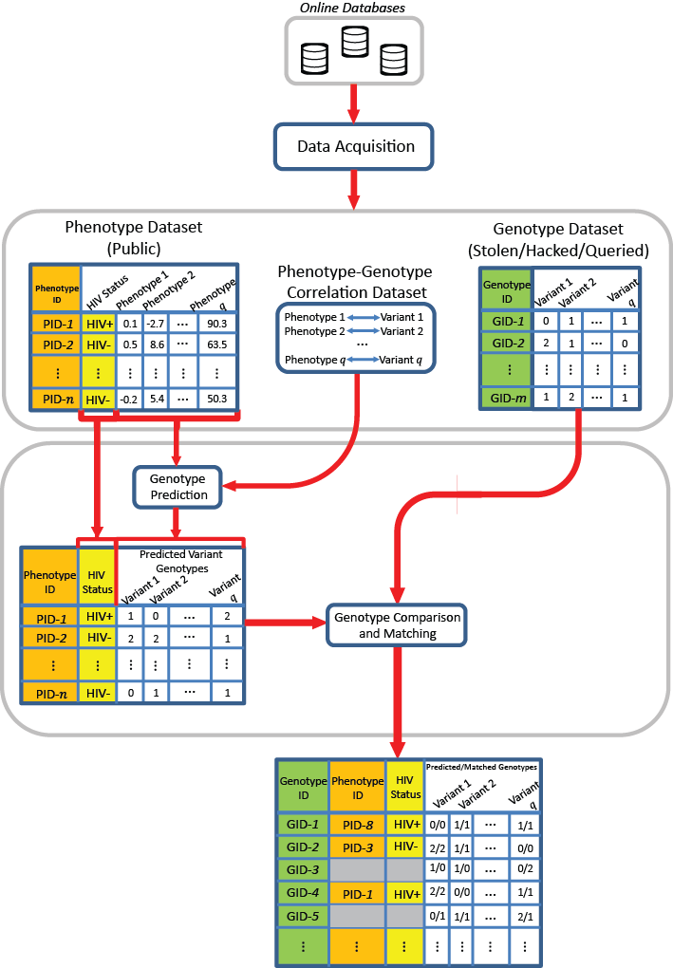
Linking Attack Scenario
[Harmanciet al. Nat. Meth. (in revision)]

Slide 59
Linking Attack Scenario
[Harmanciet al. Nat. Meth. (in revision)]

Slide 60
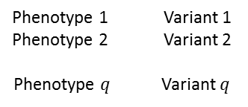
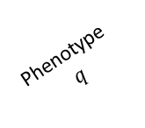
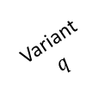
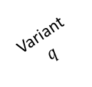

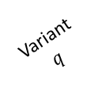
Linking Attack Scenario (3)
Phenotype dataset
(Public)
1
Genotype dataset
(Stolen/Hacked/Queried)
Phenotype
ID
Phenotype 1
Phenotype
Phenotype-Genotype
correlation dataset
Genotype
ID
Variant
HIV Status
Phenotype 2
Variant 1
Variant 2
PID-1
HIV+
0.1
-2.7
…
90.3
Phenotype 1 Variant 1
Phenotype 2 Variant 2
Phenotype Variant
GID-1
0
1
…
1
PID-2
HIV-
0.5
8.6
…
63.5
…
GID-2
2
1
…
0
…
…
…
…
…
…
…
…
…
…
…
PID-
HIV-
-0.2
5.4
…
50.3
GID-m
1
2
…
1
3
2
Genotype
prediction
Phenotype
ID
HIV
Status
Predicted variant
genotypes
4
Variant 2
Variant
HIV+
Variant 1
…
Genotype comparison
and matching
PID-1
HIV-
1
0
…
2
PID-2
2
2
1
…
…
…
…
…
…
PID-
HIV-
0
1
…
1
Genotype
ID
Phenotype
ID
HIV
Status
Predicted/Matched genotypes
Variant 1
Variant
Variant 2
GID-1
PID-8
HIV+
0/0
1/1
…
1/1
GID-2
PID-3
HIV-
2/2
1/1
…
0/0
GID-3
PID-1
HIV-
1/0
1/0
…
0/2
GID-4
PID-1
HIV+
2/2
0/0
…
1/1
GID-5
0/1
1/1
…
2/1
…
…
…
…
…
…
…
Notes:
Caption: Illustration of Linking attack. (a) Phenotype dataset contains q different phenotype measurements and the HIV Status for n individuals. Genotype dataset contains the variant genotypes for m individuals. Phenotype-Genotype correlation datasets contains q phenotypes, variants, and their correlations. The attacker predicts the variant genotypes and build the predicted genotypes matrix. The attacker then links the phenotype dataset to the genotype dataset by matching the predicted genotypes to the genotype dataset. The linking reveals the HIV status for the subjects in the genotypes dataset. The phenotype, genotype IDs and HIV Status are colored to illustrate how the linking combines the entries in the two datasets. Some of the genotype IDs are not linked to any phenotype. These are indicated with pattern filled rows.

Slide 61
Quantifying ICI Leaked and Predictability
Amount of individual characterizing Information (ICI) in a set of n variants:
  How many rare genotypes there are in the set?
Predictability of genotypes given expression levels (π): Given that the k_{th} gene’s expression level is e_{k,j} , how much randomness is left in the genotype?
[Harmanciet al. Nat. Meth. (in revision)]

Slide 62
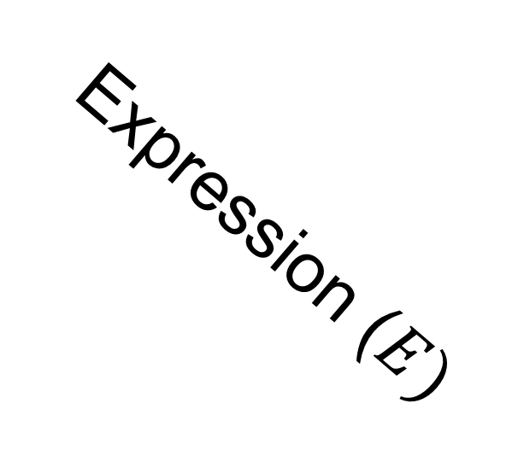
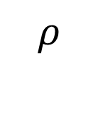
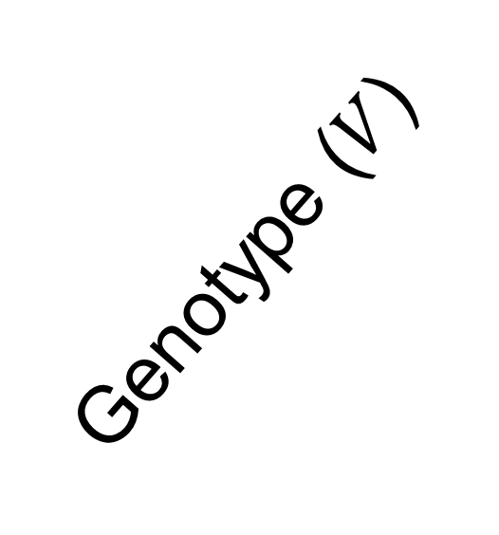
Joint Distribution (4)
2
Genotype ()
Frequency
1
0
Expression (

Slide 63
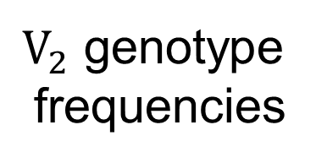


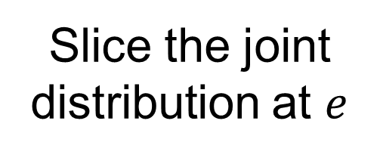
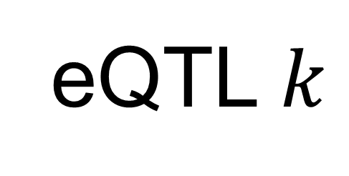


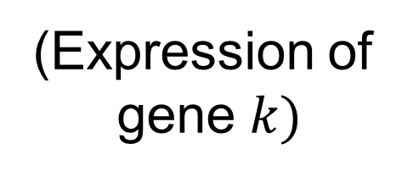
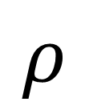
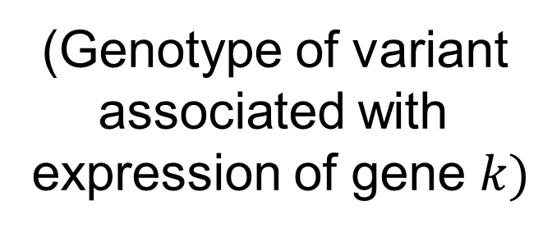
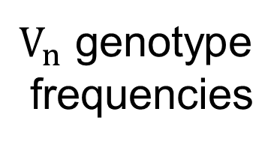
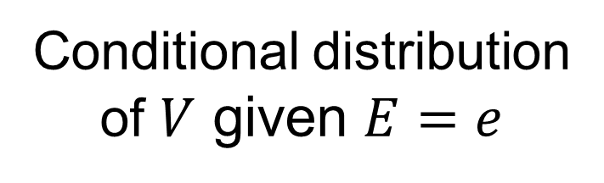
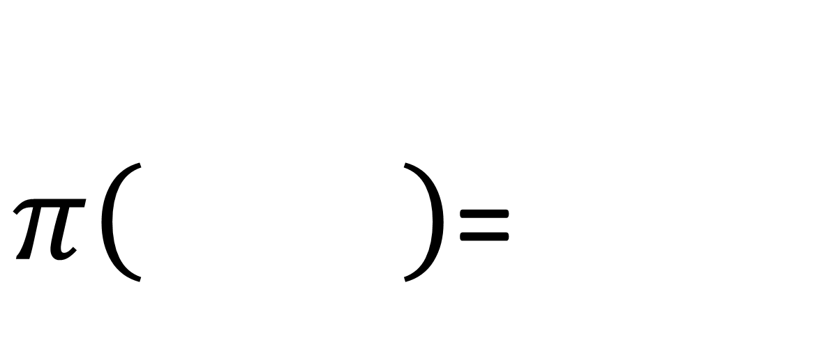
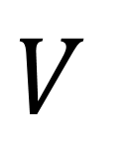
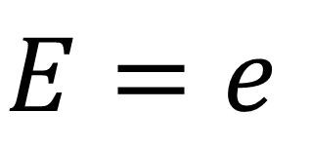
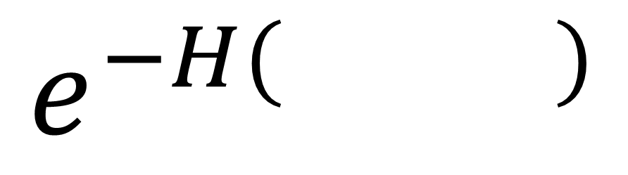

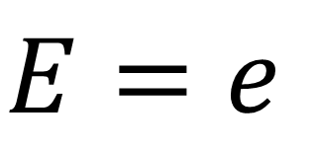
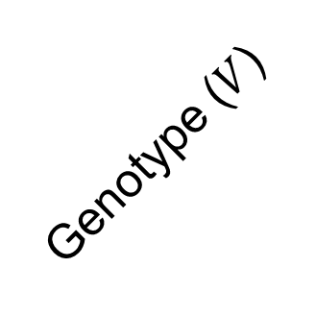
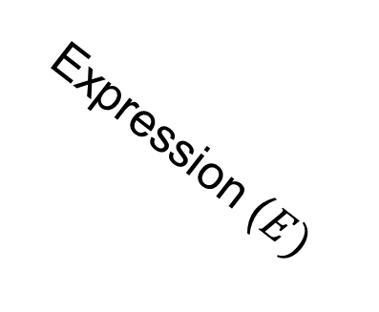
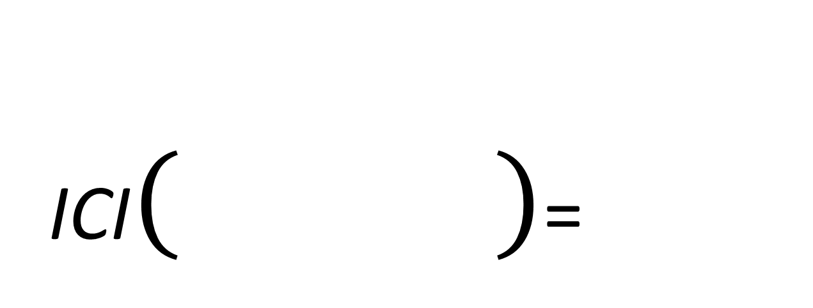
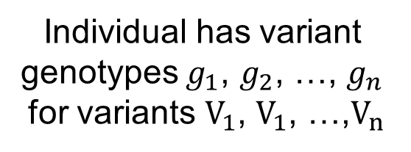
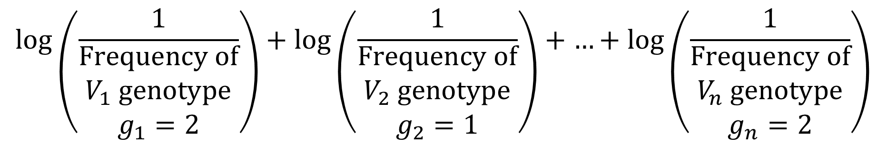




Individual Characterizing Information and Genotype Predictability(5)
ICI=
Individual has variant
genotypes , , …,
for variants , , …,
Frequency
Frequency
…
Frequency
0
1
2
0
1
2
0
1
2
=
=
=
genotype
frequencies
genotype
frequencies
genotype
frequencies
Joint expression
genotype distribution
Conditional distribution
of given
eQTL
Slice the joint
distribution at
Genotype ()
2
Frequency
1
Frequency
0
1
2
0
(Expression of
gene
(Genotype of variant
associated with
expression of gene
Genotype
Expression (
Compute
entropy
=

Slide 64

Relating Predictability to ICI Leakage – A few key SNPs with good predictability & Great Leakage.
Perhaps these could removed?
[Harmanciet al. Nat. Meth. (in revision)]

Slide 65


Per eQTL and ICI Cumulative Leakage versus Genotype Predictability
Colors by absolute correlation
Absolute Correlation
Notes:
Caption: (b) Plots show, for each, eQTL the information leakage (x-axis) versus correct genotype predictability (y-axis). For each eQTL, the estimated ICI leakage and genotype predictability are plotted. Each eQTL’s point is colored with respect to the major allele frequency (left) and with respect to absolute correlation of the eQTL (right).

Slide 66

Cumulative Leakage (7)
Best 5 eQTLs
Best 4 eQTLs
Best 3 eQTLs
Best 2 eQTLs
Best eQTL

Slide 67
Linking Attack (8)
Three Steps of a Linking Attack
Step 1
Step 2
Step 3
Gender, Population, Age
G-P
correlation
dataset
Prediction
methodology
Auxiliary information
Phenotype and genotype selection
Genotype prediction
Linking
Absolute Value of Correlation
Maximum a Posteriori Genotype
Minimum Distance between Predicted and Individual Genotypes

Slide 68
































Fig S5
(a)
(b)
0
1
2
0
1
2
(c)
(d)
0
1
2
0
1
2
(e)
0
1
2
Notes:
Caption: Examples of models of genotype-expression joint distribution with varying numbers of parameters for a positively correlated eQTL. (a) shows the true distribution where grey boxes represent the expression distributions with different genotypes. Red line show the gradient of correlation between genotype and expression. First simplification of the model is shown in (b). The expression distribution can be modeled with Gaussians with different means and variances with total of 6 parameters. The variances can be assumed same for different genotypes (c), where 4 parameters are required. (d) illustrates a representation of the distribution with 4 parameters on expression levels for each genotype. The conditional distribution of expression is uniform (cross shaded rectangles) over the ranges (, ), (, ), and (, ) given genotypes 0, 1, and 2, respectively. The transparent grey rectangles shows the original distributions. (e) is a simplification of (d) where no conditional probability of expression is assigned given genotype is 1. In this model, only 1 parameter () is necessary. The conditional probability of expression given genotypes 0 and 2 are uniform for expression levels below and above , respectively (shown with cross shaded rectangles). The original distribution is included with grey rectangles for comparison. Extremity based prediction is an instantiation of the model in (e).

Slide 69




Extremity (9)
Extremity based
joint distribution
Simplified extremity based
joint distribution
High
Positive
extremity
(Genotype: 2)
Expression
Negative
extremity.
(Genotype: 0)
Low
0
1
2
0
1
2
0
1
2
Probability
Probability
Genotype
Genotype
Genotype
0
1
Notes:
Caption: Extremity based genotype prediction and extremity based linking attack (a) Figure illustrates the extremity based genotype prediction. The joint distribution of expression levels and genotypes is shown on left. Given the relation between expression and genotypes, the lower expression levels (Labelled with “Negative Extremity” shown in red ellipse on left) are assigned the genotype “TT” and higher expression levels (Labelled with “Positive Extremity” shown in green ellipse on left) are assigned the genotype “CC”. The extremity value 0 is indicated with the dashed grey line which is the midpoint between the highest and lowest expression levels. The heterozygous genotype (TC) is shaded with grey to indicate that it is not used in the genotype prediction.

Slide 70


Genotype Prediction and Linking Accuracies (10)
Extremity based linking with
homozygous genotypes
Attacker can esimate the
reliability of linkings
Notes:
Caption: The fraction of vulnerable individuals with MAP genotype prediction. X-axis shows the absolute correlation threshold used to select eQTLs. Y-axis shows the fraction of vulnerable individuals. At correlation threshold of 0.35, the fraction is maximized, as indicated by the dashed yellow line. The red, green, and cyan lines show the fraction of vulnerable individuals when gender, population, and gender and population information, respectively, are available as auxiliary information.

Slide 71
Genomic Privacy: Intertwined Social & Technical Issues
Setting the Stage: the Advent of Personal Genomics
The Dilemma of Genomic Privacy
  Fundamental, inherited info that’s very private vs the need for large-scale data-sharing to enable med. research
Current Social & Tech Approaches
  GINA, Consents &
  "Secure" use of dbGAP
  Issues: burdensome security, inconsistencies + ways the solutions have been partially "hacked”
  Strawman Hybrid Soc-Tech Proposal (Licensure, Cloud Enclaves. Quantifying Leaks, & Closely Coupled priv.-public data)
RNA-seq – practical problem of publicly sharing some of the info
  Removing SNVs in reads using MRF
  Quantifying & removing variant info from expression levels + eQTLs
  Further complications: SVs in pervasive transcription?

Slide 72

Acknowledgements
CNVnator
A Abyzov
Cost of sequencing
A Sboner, XJ Mu
Data privacy
A Harmanci, D Greenbaum
ENCODE pseudogenes & transcriptome
B Pei, L Habegger, J Rozowsky, A Harmanci, KK Yan
RSEQtools
L Habegger, A Sboner, TA Gianoulis, J Rozowsky, A Agarwal, M Snyder
Hiring Postdocs. See gersteinlab.org/jobs !
[papers.gersteinlab.org/subject/privacy]

Slide 73

Models
Acknowledgements
ORTHOCLUST.gersteinlab.org :
KK Yan, D Wang,
J Rozowsky, H Zheng, C Cheng
DREISS.gersteinlab.org
D Wang, F He, S Maslov
Hiring Postdocs. See gersteinlab.org/jobs !

Slide 74



Acknowledgements
modENCODE/ENCODE Transcriptome group [EncodeProject.org/comparative]
Joel Rozowsky, Koon-Kiu Yan, Daifeng Wang,
Chao Cheng, James B. Brown, Carrie A. Davis, LaDeana Hillier, Cristina Sisu, Jingyi Jessica Li, Baikang Pei, Arif O. Harmanci, Michael O. Duff, Sarah Djebali, Roger P. Alexander, Burak H. Alver, Raymond K. Auerbach, Kimberly Bell, Peter J. Bickel, Max E. Boeck, Nathan P. Boley, Benjamin W. Booth, Lucy Cherbas, Peter Cherbas, Chao Di, Alex Dobin, Jorg Drenkow, Brent Ewing, Gang Fang, Megan Fastuca, Elise A. Feingold, Adam Frankish, Guanjun Gao, Peter J. Good, Phil Green, Roderic Guigó, Ann Hammonds, Jen Harrow, Roger A. Hoskins, Cédric Howald, Long Hu, Haiyan Huang, Tim J. P. Hubbard, Chau Huynh, Sonali Jha, Dionna Kasper, Masaomi Kato, Thomas C. Kaufman, Rob Kitchen, Erik Ladewig, Julien Lagarde, Eric Lai, Jing Leng, Zhi Lu, Michael MacCoss, Gemma May, Rebecca McWhirter, Gennifer Merrihew, David M. Miller, Ali Mortazavi, Rabi Murad, Brian Oliver, Sara Olson, Peter Park, Michael J. Pazin, Norbert Perrimon, Dmitri Pervouchine, Valerie Reinke, Alexandre Reymond, Garrett Robinson, Anastasia Samsonova, Gary I. Saunders, Felix Schlesinger, Anurag Sethi, Frank J. Slack, William C. Spencer, Marcus H. Stoiber, Pnina Strasbourger, Andrea Tanzer, Owen A. Thompson, Kenneth H. Wan, Guilin Wang, Huaien Wang, Kathie L. Watkins, Jiayu Wen, Kejia Wen, Chenghai Xue, Li Yang, Kevin Yip, Chris Zaleski, Yan Zhang, Henry Zheng, Steven E. Brenner, Brenton R. Graveley, Susan E. Celniker,
Thomas R Gingeras, Robert Waterston
Hiring Postdocs. See gersteinlab.org/jobs !

Slide 75
Comparison to Detection of a genome attacks
(a)
Linking attacks
(Schadt et al, Extremity attack)
(b)
“Detection of a genome in a mixture”
Attacks (Homer et al, Im et al)
“Predicting”
Phenotypes
Sensitive Phenotypes
Genotype
Dataset
QTL Study
Statistics
---------------------
Population Genotyping
Study
Statistics
Genotype
Prediction
Predicted
Genotypes
Sensitive Phenotypes
IDs
Genotypes
Statistical
Testing
Reference
Population
Allele
Frequencies
Genotype
Linking
Study
Membership
Status (0/1)
Genotype
Dataset
IDs
Predicted
Genotypes
Genotypes
Sensitive Phenotypes
Notes:
Caption: Schematic comparison of Linking attacks (Left) and detection of a genome in a mixture attacks (Right). Each box in the figure represents a dataset in the form of a matrix. Multiple boxes next to each other correspond to concatenation of matrices. Linking attacks aim at linking genotype and phenotype datasets. The phenotype datasets contain both “predicting” phenotypes and other phenotypes, some of which can be sensitive. The attacker first predict genotypes for each of the predicting phenotype. The predicted genotypes are then compared with the genotypes in the genotype dataset. After the linking, all the datasets are concatenated where the identifiers can be matched to the sensitive phenotypes. Different colors indicate how the linking merges different information. The detection of a genome in a mixture attacks start with a genotype dataset. The attacker gets access to the statistics of a GWAS or genotyping dataset (for example, correlation coefficients or allele frequencies). Then the attacker generates a statistic and tests it against that of a reference population. The testing result can be converted into the study membership indicator (attended/not attended) which shows whether the tested individual was in the study cohort or not.

Slide 76
More Information on this Talk
SUBJECT: Networks
DESCRIPTION:
NOTES:
This PPT should work on mac & PC. Paper references in the talk were mostly from Papers.GersteinLab.org.
PERMISSIONS: This Presentation is copyright Mark Gerstein, Yale University, 2010. Please read permissions statement at http://www.gersteinlab.org/misc/permissions.html . Feel free to use images in the talk with PROPER acknowledgement (via citation to relevant papers or link to gersteinlab.org).
PHOTOS & IMAGES. For thoughts on the source and permissions of many of the photos and clipped images in this presentation see http://streams.gerstein.info . In particular, many of the images have particular EXIF tags, such as kwpotppt , that can be easily queried from flickr, viz: http://www.flickr.com/photos/mbgmbg/tags/kwpotppt .
Notes:
76

Slide 77
Default Theme
Default Outline Level 1
  Level 2

Slide 78
Genomic Privacy: Intertwined Social & Technical Issues
Setting the Stage: the Advent of Personal Genomics
The Dilemma of Genomic Privacy
  Fundamental, inherited info that’s very private vs the need for large-scale data-sharing to enable med. research
Current Social & Tech Approaches
  GINA, Consents &
  "Secure" use of dbGAP
  Issues: burdensome security, inconsistencies + ways the solutions have been partially "hacked”
  Strawman Hybrid Soc-Tech Proposal (Licensure, Cloud Enclaves. Quantifying Leaks, & Closely Coupled priv.-public data)
RNA-seq – practical problem of publicly sharing some of the info
  Removing SNVs in reads using MRF
  Quantifying & removing variant info from expression levels + eQTLs
  Further complications: SVs in pervasive transcription?

Slide 79

Discovering Transcriptionally Active Regions
(novel RNA contigs)
Cluster reads setting minimum-run and maximum gap parameters for newly identified transcribed regions (TARs)
Assess exon discovery rates for known genes and noncoding RNAs
Known exon
Known exon
TAR
TAR
TAR
novel TAR
correct identification
ENCODE RNA-Seq Data
[Nature 512:445 ('14)]

Slide 80

Non-Canonical Transcription
 |  | Human
 |  | Elements | Genome Coverage
 |  |  | Kb | %
mRNAs (exons) |  | 20,007 | 86,560 | 3.0
Pseudogenes |  | 11,216 | 27,089 | 0.95
Total ncRNAs |  | 22,154 | 17,770 | 0.62
Regions Excluding mRNAs, Pseudogenes or Annotated ncRNAs |  | 283,816 | 2,731,811 | 95.5
 | Transcription Detected (TARs) | 708,253 | 916,401 | 32.0
4.5% of human genome are transcribed and associated with standard annotations;
32% of human genome give rise to TARs or non-canonical transcription, i.e., transcription from genomic regions not associated with standard annotations;
Non-canonical transcripts show lower transcription level compared to protein coding transcripts
[Nature 512(7515):445-8]

Slide 81

Example of Application of CNVnator to RD data
[Abyzov et al. Gen. Res. (’11)]
NA12878, Solexa 36 bp paired reads, ~30x coverage

Slide 82
Many non-canonical transcripts are real but some
potentially reflecting mis-mapping from genes
Pseudogene: ENSG00000225648.1
Parent: ENSG00000126524.4
Pseudogene: ENSG00000232553.2
Parent: ENSG00000176444.13
Non-coding transcription may correlate with coding transcription
Potential mapping artifacts: reads from coding regions mapped to non-coding elements or vice versa due to sequence similarity
[Genome Biol. 13: R51]

Slide 83

Basic approach for risk management (11)
ICI
QTL Discovery
QTL identification
Significant
quantitative
trait loci
Leakage vs predictability quantification
Risk assessment
Joint Genotyping
And Phenotyping
Phenotype
dataset
External
QTL databases
Genotype
dataset
Application of
3-step
linking attacks
Risk assessment
Linking
Accuracy
QTL Selection
Notes:
Caption: Illustration of risk assessment procedure for joint genotyping/phenotyping data generation. There are two paths of risk assessment to be performed. The first path evaluates the risks associated with release of the QTL datasets. The genotype and phenotype data (on the left) is first used for quantitative trait loci identification (QTL identification box). This generates the significant QTLs. These are then utilized, in addition to the list of external QTL databases, in quantification of leakage versus predictability (ICI versus $π$ plots), as presented in Section 2.2. These results are then relayed to the risk assessment procedures. The second risk assessment procedure evaluates the release of genotype and phenotype datasets. For this, the datasets are input to application of the 3-step linking attacks with different QTL and linking methodologies (Presented in Sections 2.3, and 2.4, and other linking attacks in the literature) for evaluation of characterization risks. The results are then relayed to risk assessment procedures.

Slide 84

Difficulty in Securing Computers & Data
[Smith et al ('05), Genome Bio]

Slide 85

Genetic Information Nondisclosure Act of 2008
Title I relating to Health Insurance
Title II relating to Employment Discrimination
GINA Prohibits:
  group and individual health insurers from using genetic data for determining eligibility or premiums
  insurers from requesting that the insured undergo genetic testing
  employers from using genetic data to may employment decisions
  Employers from requesting genetic data about an employee or their family
85

Slide 86
Transcriptome Analysis:
Expression Clustering across Distant Organisms
Intro to Comparative ENCODE
  Lots of Matched Data for Comparative Analysis
Expression Clustering, Cross-species
  Potts-model optimization gives 16 conserved co-expression modules (which can potentially annotate ncRNAs/TARs)
Relating Clusters to Hourglass Genes
  Developmental 'hourglass' genes in 12 of the clusters. They also exhibit intra-organism hourglass behavior.
  Stage alignment of worm & fly development, strongest with hourglass genes
Decoupling expression changes into those driven by worm-fly conserved genes vs species-specific ones
  Using dimensionality reduction to help determine internal & external drivers
  Conserved genes have similar canonical patterns (iPDPs) in contrast to species specific ones (Ex of ribosomal v signaling genes)

