Slide 1
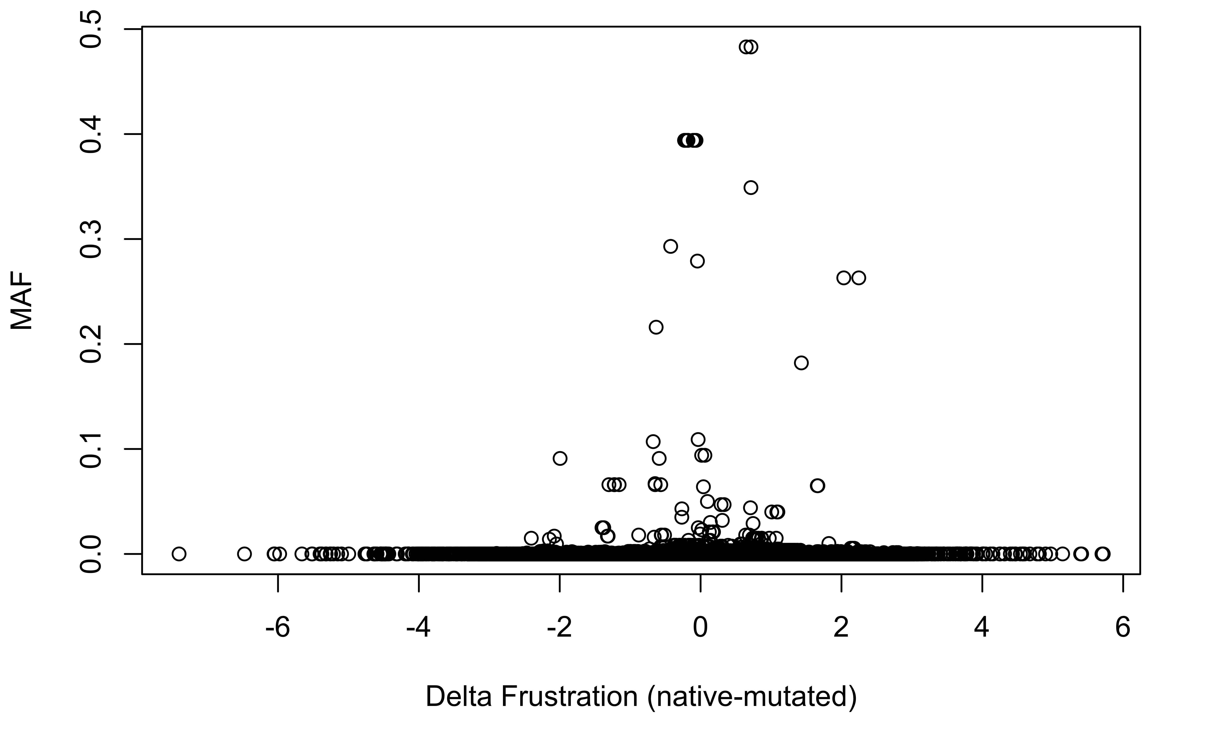
ExAC SNVs within the Core
Notes:
Exac core

Slide 2
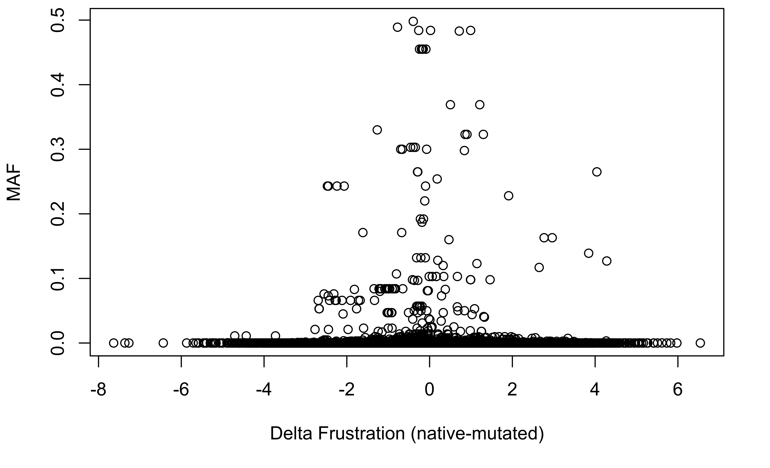
ExAC SNVs at the Surface
Notes:
Exac surface

