Slide 1
Classification of Housekeeping and Developmental Enhancer Based on Regulatory Region Sequence
Yunsi Yang
Anurag Sethi

Slide 2
Methods
Naïve Bayes Classifier
Random Forest
Support Vector Machine
  Basic k-mer sequence
  Gapped k-mer features
Binomial Logistic Regression
  Significantly difference k-mer
  High weighted k-mer scored by SVM

Slide 3


Naïve Bayes Classifier & Random Forest
 | Naïve Bayes Classifier | Random Forest
Prediction table
AUC | 0.765 | 0.706
Use significantly different k-mer count as predictor
3-mer | ATG AGA TTA
4-mer | ATGA TTAC TTAA TTTA GGGG AATG AGAT CAGG TACC TCGA
5-mer | AGATA CACTG TCGAT ATCGA TATCG TTTAA AATGA GGCGC TTACC AGCTG CATTC TGACC TGGGG TTTAC
6-mer | TATCGA ATCGAT CAGCTG ACAGCT CTATCG TCGATA GTGACC AGATAA CGATAG TTTAAA ATTTAA GGTCAC
7-mer | TATCGAT GGTCACA ATCGATA ACAGCTG ACTATCG TGTGACC CTATCGA GTGTGAC TCGATAG TTATCGA ATATCGA ATCGATT GTTATCG GTCACAC TCACACT

Slide 4
Support Vector Machine
A nonlinear classifier by applying the kernel function
Kernel: Spectrum, Mismatch and Gaussian
Spectrum kernel gives best results
As cost =5, (Cost hyperparameter affects the trade off between complexity and frequency of error. If it is too high, we may have overfitting.)
As cost =1 and k=5, AUC: 0.758
Model | AUC
Support Vector Machine
k=3 | 0.683
k=4 | 0.727
k=5 | 0.741
k=6 | 0.716
k=7 | 0.643

Slide 5
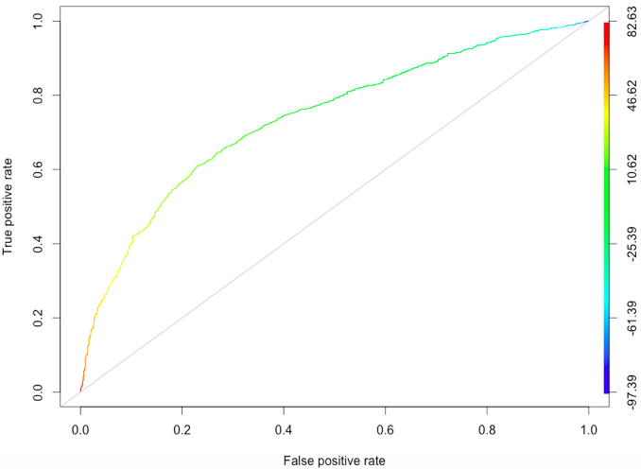
SVM using Gapped k-mer Features
Ghandi, Mahmoud, et al. “Enhanced regulatory sequence prediction using gapped k-mer features.” (2014): e1003711.
Address limitation of using combination of k-mers: most long k-mers do not appear in training set sequence and receive zero count.
Three parameters:
  l: the whole word length including gaps
  k: the number of informative, or non-gapped,
  positions
  m_{max}: maximum number of mismatches
  L=10, K=5, maxnmm=3
AUC: 0.738

Slide 6
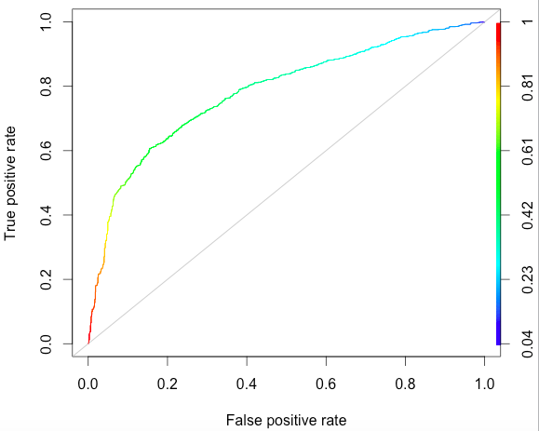


Binomial Logistic Regression
Step 1: Use all significant kmer as prediction (n=55)
Step 2: Backwards stepwise regression to
narrow down variables (n=32)
AGA TTAA TTTA GGGG AATG CAGG TACC TCGA
CACTG TATCG TTTAA AATGA TTACC ATCGAT CAGCTG
CTATCG TCGATA GTGACC AGATAA …
AUC: 0.782

Slide 7
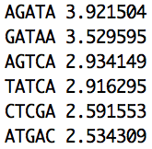
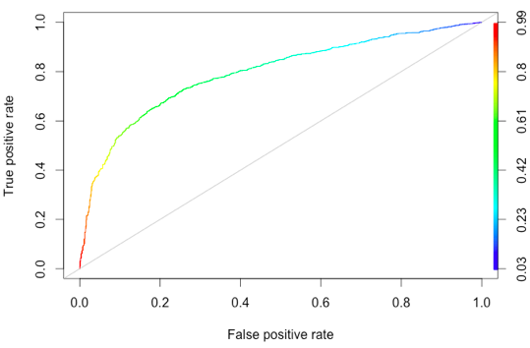

  Binomial Logistic Regression using high weighted k-mer scored by SVM
Step 1: Select high weighted k-mer scored by SVM ( k= 3… 6 and absolute weight>2.5) (n=119)
Step 2: Backwards stepwise regression to
narrow down variables (n=72)
AUC: 0.794

Slide 8
Method summary
Using significantly different kmers:
Naïve Bayes Classifier : 0.765
Random Forest: 0.706
Binomial Logistic Regression : 0.782
Using all kmers:
Support Vector Machine : 0.758

Slide 9
Improve Logistic Regression
Overlapping between hkCP and dCP enhancers
  Proportion of overlapping in hkCp enhancer:
  1800/5956=0.302
  Proportion of wrong prediction in hkCP enhancer:
  392/1202=0.326
  Next step: Consider a third group, hkCP and dCP
  shared enhancer peaks
 | hkCP | RpS12 | eEF1delta | NipB | X16 | dCP | DSCP | eve | evelong | pnr | hsp70
hkCP | 5956 | 269 | 279 | 271 | 222 | 1800 | 143 | 105 | 100 | 118 | 99
RpS12 | 269 | 289 | 266 | 250 | 217 | 89 | 123 | 92 | 90 | 106 | 85
eEF1delta | 279 | 266 | 352 | 306 | 232 | 113 | 148 | 112 | 100 | 110 | 98
NipB | 271 | 250 | 306 | 504 | 241 | 199 | 253 | 182 | 169 | 177 | 176
X16 | 222 | 217 | 232 | 241 | 261 | 99 | 136 | 103 | 102 | 116 | 97
dCP | 1800 | 89 | 113 | 199 | 99 | 5407 | 190 | 145 | 143 | 153 | 165
DSCP | 143 | 123 | 148 | 253 | 136 | 190 | 431 | 239 | 217 | 181 | 202
eve | 105 | 92 | 112 | 182 | 103 | 145 | 239 | 338 | 212 | 141 | 168
evelong | 100 | 90 | 100 | 169 | 102 | 143 | 217 | 212 | 301 | 142 | 168
pnr | 118 | 106 | 110 | 177 | 116 | 153 | 181 | 41 | 142 | 209 | 152
hsp70 | 99 | 85 | 98 | 176 | 97 | 165 | 202 | 168 | 168 | 152 | 235

Slide 10
 | hkCP | RpS12 | eEF1delta | NipB | X16 | dCP | DSCP | eve | evelong | pnr | hsp70
hkCP | 5956 | 269 | 279 | 271 | 222 | 1800 | 143 | 105 | 100 | 118 | 99
RpS12 | 269 | 289 | 266 | 250 | 217 | 89 | 123 | 92 | 90 | 106 | 85
eEF1delta | 279 | 266 | 352 | 306 | 232 | 113 | 148 | 112 | 100 | 110 | 98
NipB | 271 | 250 | 306 | 504 | 241 | 199 | 253 | 182 | 169 | 177 | 176
X16 | 222 | 217 | 232 | 241 | 261 | 99 | 136 | 103 | 102 | 116 | 97
dCP | 1800 | 89 | 113 | 199 | 99 | 5407 | 190 | 145 | 143 | 153 | 165
DSCP | 143 | 123 | 148 | 253 | 136 | 190 | 431 | 239 | 217 | 181 | 202
eve | 105 | 92 | 112 | 182 | 103 | 145 | 239 | 338 | 212 | 141 | 168
evelong | 100 | 90 | 100 | 169 | 102 | 143 | 217 | 212 | 301 | 142 | 168
pnr | 118 | 106 | 110 | 177 | 116 | 153 | 181 | 41 | 142 | 209 | 152
hsp70 | 99 | 85 | 98 | 176 | 97 | 165 | 202 | 168 | 168 | 152 | 235
  Using selected genomic regions
  (~5MB; BAC screens) to find significantly different kmer
  *Supplementary table 6 from Ref. 3
  Next step: Using peaks from genome-wide screen
    Test on OSC cell
 | Experiment 2
Core promoter, Experiment 1 | GW replicate | BAC replicate
RpS12 (hkCP) | 0.98 | 0.86
DSCP (dCP) | 0.85 | 0.75
hsp70 | 0.82 | 0.79
eEF1delta | 0.99 | 0.87
x16 | 0.99 | 0.86
NipB | 1 | 0.83
pnr | ND | 0.89

Slide 11
Reference
1. Lee, Dongwon, Rachel Karchin, and Michael A. Beer. “Discriminative prediction of mammalian enhancers from DNA sequence.” Genome research 21.12 (2011): 2167-2180.
2. Ghandi, Mahmoud, et al. “Enhanced regulatory sequence prediction using gapped k-mer features.” (2014): e1003711.
3. Zabidi, Muhammad A., et al. “Enhancer--core-promoter specificity separates developmental and housekeeping gene regulation.” Nature (2014).

