Slide 1
Summary of brain related project datasets
PsychENCODE
PsychENCODE external data
Brainspan
CommonMind Consortium
AMP AD Knowledge
Psychiatric Genomics Consortium
GTEx
Roadmap
GWAS

Slide 2
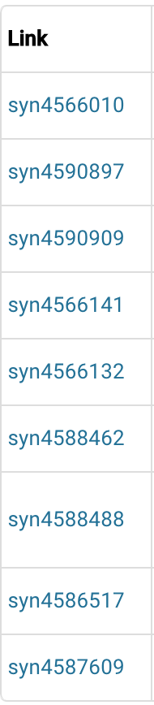
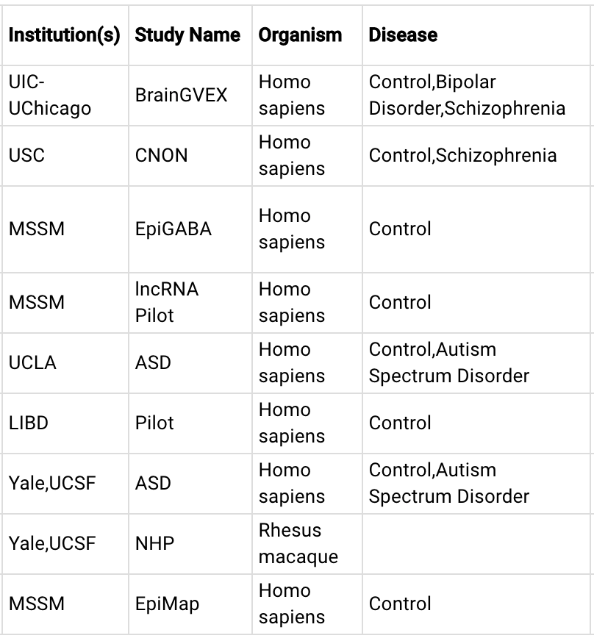
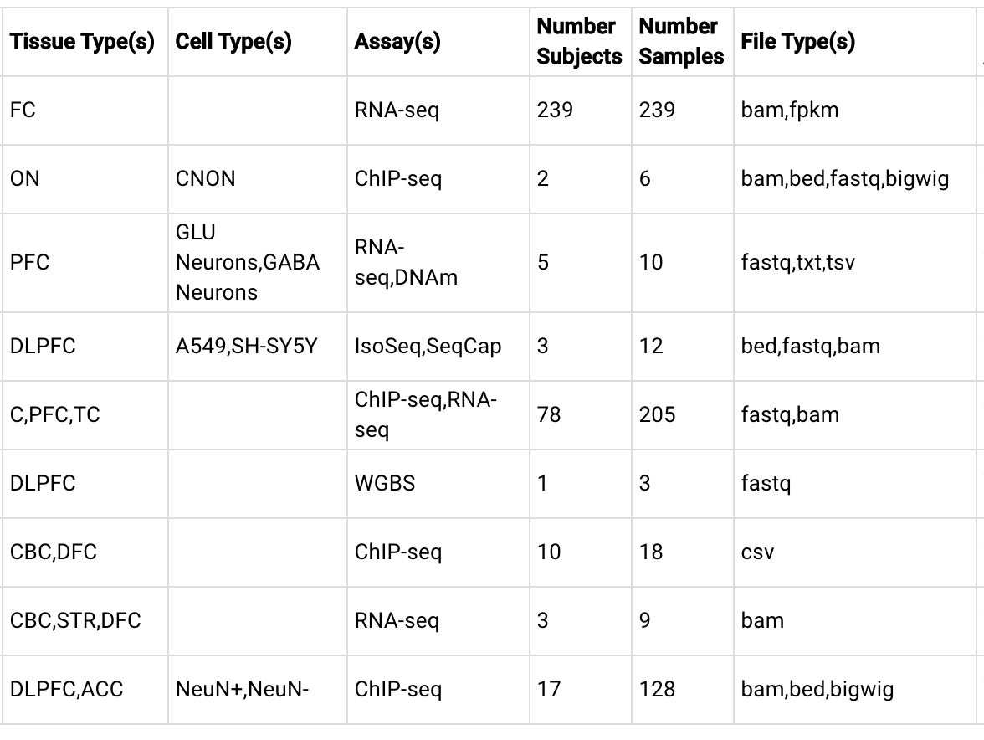
PsychENCODE data

Slide 3
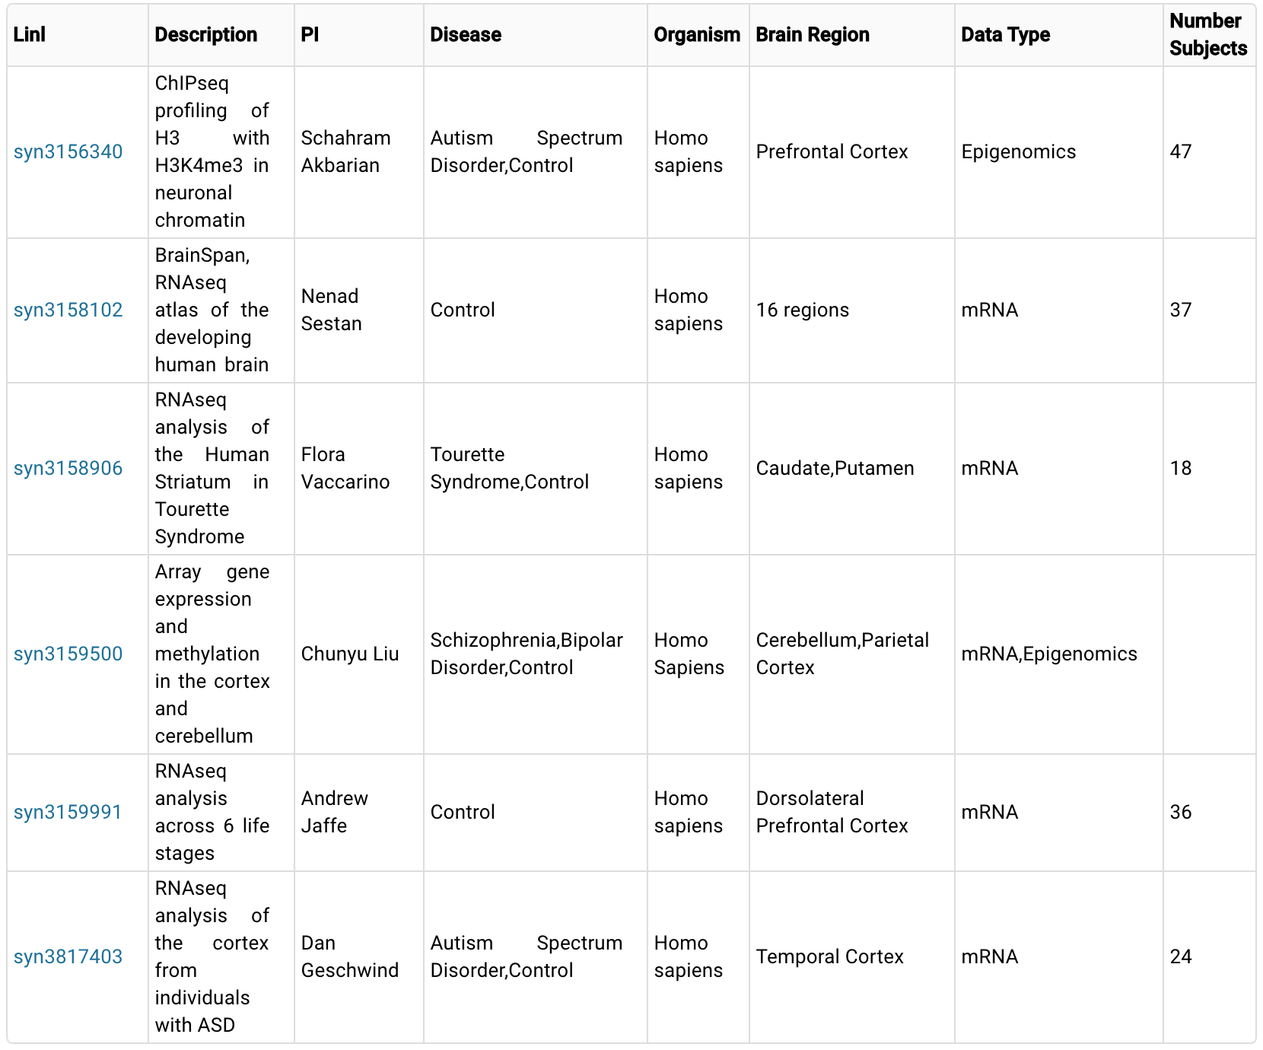
PsychENCODE external data

Slide 4
BrainSpan
Atlas of the Developing Human Brain
http://www.brainspan.org/static/download.html
Developmental Transcriptome Dataset
  Downloadable archive files containing normalized expression values and meta-data (as displayed in heatmap) for analysis:
  RNA-Seq Gencode v10 summarized to exons
  RNA-Seq Gencode v10 summarized to genes
  Exon microarray summarized to probe sets
  Exon microarray summarized to genes
  Archived data files containing normalized RPKM expression values employing a historical normalization method (available prior to October 2013):
  RNA-Seq Gencode v3c summarized to exons
  RNA-Seq Gencode v3c summarized to genes
Prenatal LMD Microarray Dataset
  Downloadable archive files containing normalized expression values for each brain and meta-data for analysis:
  H376.IIIA.02, male, 15 pcw
  H376.IIIB.02. female, 16 pcw
  H376.IV.02, female, 21 pcw
  H376.IV.03, female, 21pcw
  Imaging dataset for
Supplemental Data
  MRI/DTI data for prenatal specimens
  Methylation
  MicroRNA
  MRF bigWig Gencode v10
  MRF Gencode v3c

Slide 5
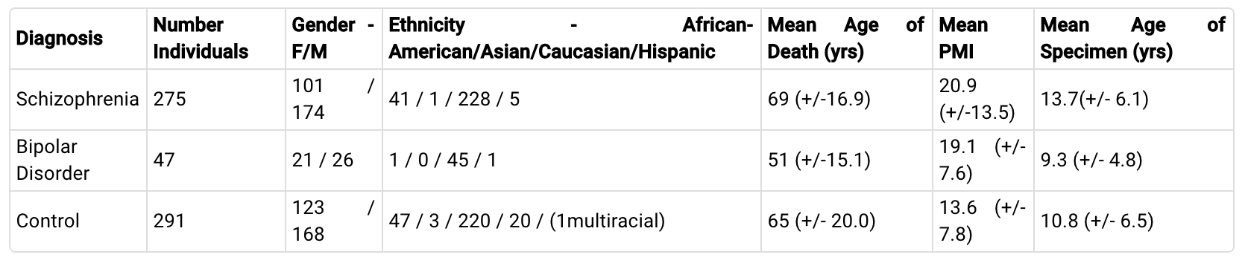
CommonMind Consortium
Overview:The consortium has as a goal to generate and analyze large-scale genomic data from human subjects with neuropsychiatric disease and to make these data and the associated analytical results broadly available to qualified investigators.

Slide 6
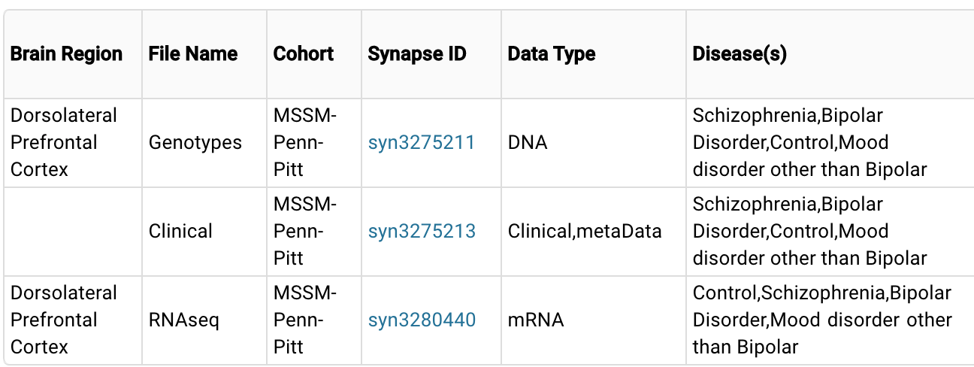
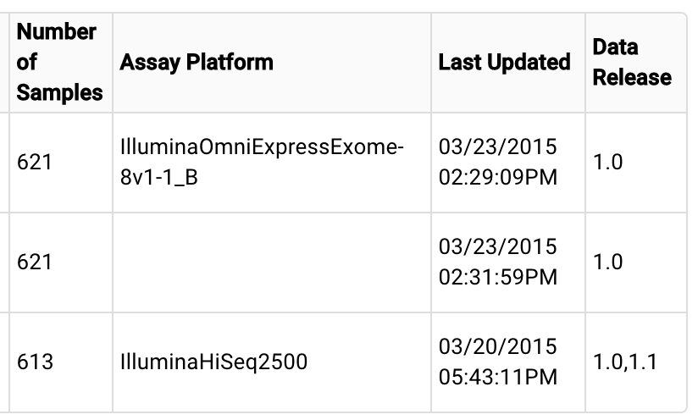
CommonMind Consortium

Slide 7
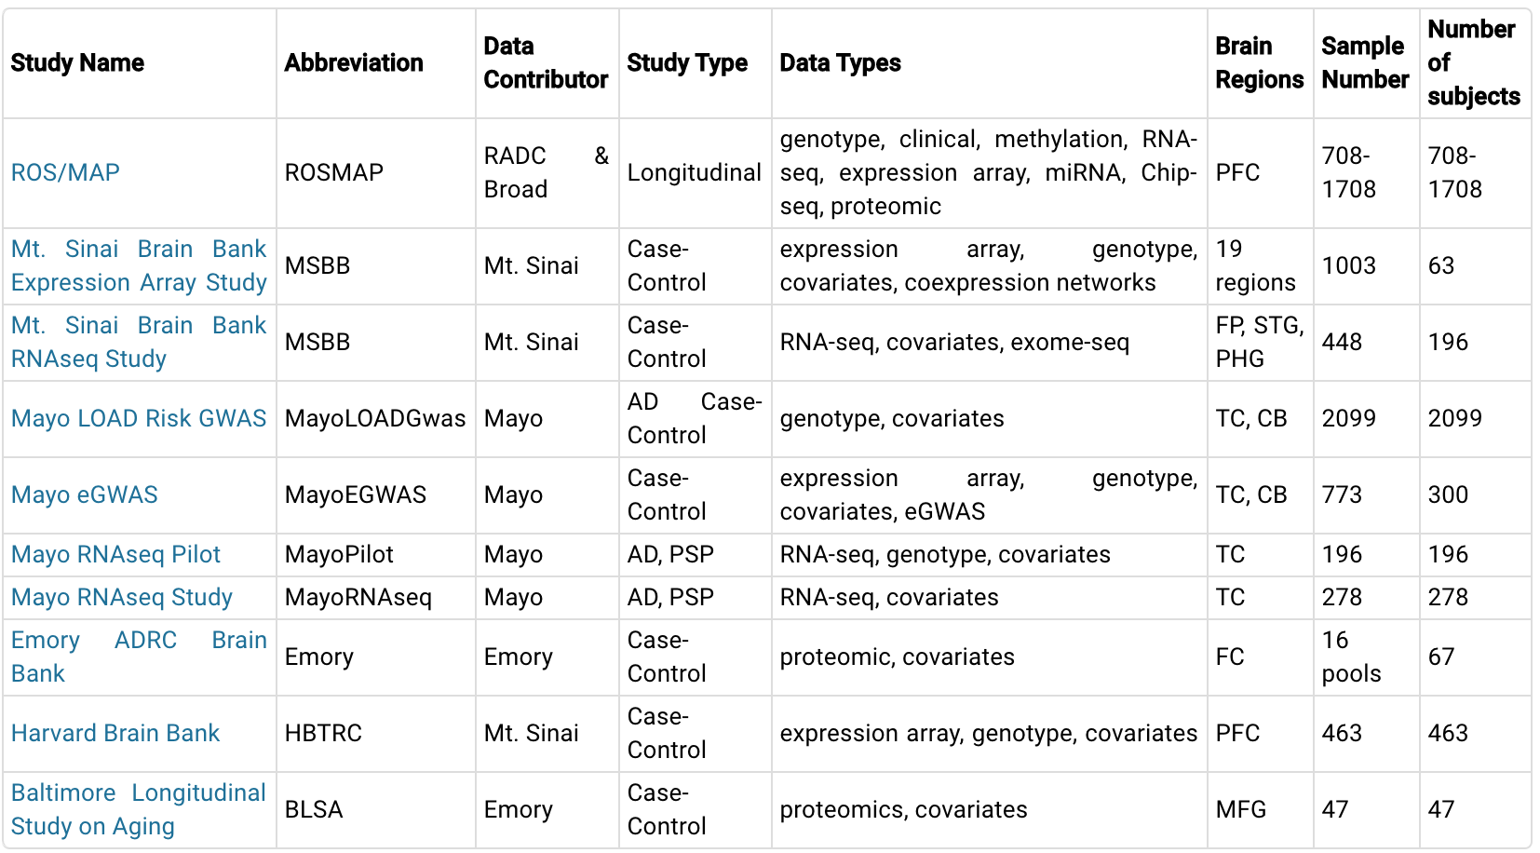
AMP AD Knowledge
Neurodegenerative disease data from the Accelerating Medicine Partnership for Alzheimer's Disease Target Discovery and Preclinical Validation Project.
Notes:
Human, animal (mice/7fly) and cell

Slide 8
Broad-Rush | ROSMAP | RNA-Seq | May 2015 | syn3388564 | 724 | false | syn3219045 | Dorsolateral Prefrontal Cortex | Alzheimer's Disease, Control |  | Homo sapiens
Broad-Rush | ROSMAP | Array Genotype | February 2015 | syn3157325 | 1709 | true | syn3219045 |  | Alzheimer's Disease, Control | http://www.ncbi.nlm.nih.gov/pubmed/22054870 | Homo sapiens
Broad-Rush | ROSMAP | Imputed Genotype | February 2015 | syn3157329 | 1709 | true | syn3219045 |  | Alzheimer's Disease, Control | http://www.ncbi.nlm.nih.gov/pubmed/22054870 | Homo sapiens
Broad-Rush | ROSMAP | Clinical | February 2015 | syn3191087 | 1059 | true | syn3219045 |  | Alzheimer's Disease, Control | http://www.ncbi.nlm.nih.gov/pubmed/22471860 | Homo sapiens
Broad-Rush | ROSMAP | miRNA nanostring | May 2015 | syn3387325 | 734 | true | syn3219045 | Dorsolateral Prefrontal Cortex | Alzheimers Disease, Control |  | Homo sapiens
Broad-Rush | ROSMAP | H3K9Ac ChIP-Seq | November 2015 |  |  | false | syn3219045 | Dorsolateral Prefrontal Cortex |  |  | Homo sapiens
Broad-Rush | ROSMAP | DNA Methylation | February 2015 | syn3157275 | 740 | true | syn3219045 | Dorsolateral Prefrontal Cortex | Alzheimer's Disease, Control | http://www.ncbi.nlm.nih.gov/pubmed/25129075 | Homo sapiens
Broad-Rush | BroadiPSC | RNA-seq | May 2015 | syn3607401 | 15 | true | syn3607401 |  | iPSC model |  | iPSC
Broad-Rush | BroadMDMi | RNA-seq | May 2015 | syn3607404 | 14 | true | syn3607404 |  |  |  | Cell Line

Slide 9
Emory | Emory | Mass Spectrometry | February 2015 | syn3218563 | 80 | true | syn3218563 | Medial Frontal Gyrus | Autosomal Dominant Parkinson's Disease, Alzheimer's Disease, Amyotrophic Lateral Sclerosis, Corticobasal Degeneration, Control, Frontotemporal Dementia, Mild Cognitive Impairment, Parkinson's Disease, | http://www.ncbi.nlm.nih.gov/pubmed/24023061 | Homo sapiens
Emory | ACT | Mass Spectrometry | November 2015 |  |  | false |  |  |  |  | Homo sapiens
Emory | BLSA | Mass Spectrometry | May 2015 | syn3606086 | 47 | true | syn3606086 | Medial Frontal Gyrus | Alzheimers Disease, Control, Asymptomatic Alzheimers Disease |  | Homo sapiens

Slide 10
Mount Sinai | HBTRC | Gene Expression | February 2015 | syn3159435 | 529 | true | syn3159435 | Dorsolateral Prefrontal Cortex | Alzheimer's Disease, Control | http://www.ncbi.nlm.nih.gov/pmc/articles/PMC3677161/#SD1 | Homo sapiens
Mount Sinai | HBTRC | Array Genotype | February 2015 | syn3159435 | 529 | true | syn3159435 |  | Alzheimer's Disease, Control | http://www.ncbi.nlm.nih.gov/pmc/articles/PMC3677161/#SD1 | Homo sapiens
Mount Sinai | HBTRC | Clinical | February 2015 | syn3159435 | 529 | true | syn3159435 |  | Alzheimer's Disease, Control | http://www.ncbi.nlm.nih.gov/pmc/articles/PMC3677161/#SD1 | Homo sapiens
Mount Sinai | MSBB | Array Expression | February 2015 | syn3219494 | 63 | true | syn3157699 | Frontal Pole, Occiptial Visual Cortex, Inferior Temporal Gyrus, Middle Temporal Gyrus, Superior Temporal Gyrus, Posterior Cingulate Cortex, Anterior Cingulate, Parahippocampal Gyrus,Temporal Pole, Precentral Gyrus, Inferior Frontal Gyrus, Dorsolateral Prefrontal Cortex, Superior Parietal Lobule, Prefrontal Cortex, Amygdala, Caudate Nucleus, Hippocampus, Nucleus Accumbens, Putamen | Alzheimer's Disease, Control |  | Homo sapiens
Mount Sinai | MSBB | RNA-Seq | February 2015 | syn3157743 | 448 | true | syn3159438 | Frontal Pole, Superior Temporal Gyrus, Parahipocampal Gyrus | Alzheimer's Disease, Control |  | Homo sapiens | Phase I
Mount Sinai | MSBB | RNA-seq | August 2015 | syn3157743 | 60 | true | syn3157743 | Frontal Pole, Superior Temporal Gyrus, Parahipocampal Gyrus | Alzheimers Disease, Controls |  | Homo sapiens | Phase II

Slide 11
Mount Sinai | MSBB | Exome sequencing | August 2015 | syn4645334 | 278 | true | syn3157743 |  | Alzheimers Disease, Controls |  | Homo sapiens
Mount Sinai | MSBB | Coexpression Networks | February 2015 | syn3157700 |  | true | syn3157699 | Frontal Pole, Occiptial Visual Cortex, Inferior Temporal Gyrus, Middle Temporal Gyrus, Superior Temporal Gyrus, Posterior Cingulate Cortex, Anterior Cingulate, Parahippocampal Gyrus,Temporal Pole, Precentral Gyrus, Inferior Frontal Gyrus, Dorsolateral Prefrontal Cortex, Superior Parietal Lobule, Prefrontal Cortex, Amygdala, Caudate Nucleus, Hippocampus, Nucleus Accumbens, Putamen | Alzheimer's Disease, Control |  | Homo sapiens
Mount Sinai | HBTRC | Imputed Genotypes | May 2015 | syn3981980 | 529 | true | syn3981980 |  | Alzheimers Disease, Control |  | Homo sapiens
Mount Sinai | MSMM | RNA-seq | November 2015 |  |  | false |  |  |  |  | Mus musculus
Mount Sinai | MSDM | RNA-seq | August 2015 | syn4587607 |  | true | syn4587607 |  |  |  | Drosophila melanogaster
Mount Sinai | ROSMAP | RNA-seq | August 2015 | syn3537580 | 10 | true | syn3219045 | Dorsolateral Prefrontal Cortex | Alzheimers Disease, Control |  | Homo sapiens | Sample Swap data
Myers-NIAGADS | ROSMAP | Array Expression | May 2015 | syn3800853 | 490 | true | syn3219045 | Dorsolateral Prefrontal Cortex | Alzheimer's Disease, Control |  | Homo sapiens

Slide 12
UFL-Mayo-ISB | TAUAPPms | RNA-Seq | February 2015 | syn3157183 | 60 | true | syn3157182 |  | Tau mouse model |  | Mus musculus
UFL-Mayo-ISB | MayoEGWAS | Array Expression | February 2015 | syn3157225 | 359 | true | syn3157225 | Temporal Cortex, Cerebellum | Alzheimer's Disease, Control | http://www.ncbi.nlm.nih.gov/pubmed/22685416 | Homo sapiens
UFL-Mayo-ISB | MayoLOADGWAS | Genotype | February 2015 | syn2910256 | 2099 | true | syn2910256 |  | Alzheimer's Disease, Control | http://www.ncbi.nlm.nih.gov/pubmed/19136949 | Homo sapiens
UFL-Mayo-ISB | MayoEGWAS | eSNP Results | February 2015 | syn3157249 |  | true | syn3157249 | Temporal Cortex, Cerebellum | Alzheimer's Disease, Control | http://www.ncbi.nlm.nih.gov/pubmed/22685416 | Homo sapiens
UFL-Mayo-ISB | MayoPilot | RNA-Seq | February 2015 | syn3157268 | 192 | true | syn3157268 | Temporal Cortex | Alzheimer's Disease, Progressive Supranuclear Palsy |  | Homo sapiens
UFL-Mayo-ISB | IL10 | Nanostring Expression | February 2015 | syn3157175 | 27 | true | syn3157175 |  | APP mouse model | http://www.ncbi.nlm.nih.gov/pubmed/25619653 | Mus musculus
UFL-Mayo-ISB | MayoRNAseq | RNA-seq | May 2015 | syn3163039 | 278 | true | syn3163039 | Temporal Cortex | Alzheimers Disease |  | Homo sapiens | Phase I
UFL-Mayo-ISB | MayoBB | RNA-seq | February 2016 |  |  | false |  |  |  |  | Homo sapiens | Phase II
UFL-Mayo-ISB | TAUAPPms | RNA-seq | May 2015 | syn3435792 | 128 | true | syn3435792 | Forebrain |  |  | Mus Musculus | PS1, App, and CRND8 Mouse Model
UFL-Mayo-ISB | ROSMAP | RNA-seq | August 2015 | syn3537579 | 10 | true | syn3219045 | Dorsolateral Prefrontal Cortex | Alzheimers Disease, Control |  | Homo sapiens | Sample Swap data
UFL-Mayo-ISB | MayoLOADGWAS | TLR Genotype | August 2015 | syn3157242 | 7015 | true | syn2910256 |  | Alzheimer's Disease, Control

Slide 13
Psychiatric Genomics Consortium (PGC)
http://www.med.unc.edu/pgc/
The PGC has completed mega-analyses for five psychiatric disorders: ADHD, autism, bipolar disorder, major depressive disorder, and schizophrenia.
Initial “cross-disorder” analysis to look for genetic variants that predispose to multiple disorders.
Disorder | About this disorder | Manuscript status
ADHD (Attention Deficit Hyperactivity Disorder) | Link | Published
Autism | Link | Incorporating more samples and see cross-disorder paper
Bipolar disorder | Link | Published
Cross-disorder | Link | Published
Cross-disorder coheritability |  | Published
MDD (Major depression disorder) | Link | Published
Schizophrenia | Link | Published

Slide 14
PGC
Disorder | File | MD5 Checksum
ADHD | pgc.adhd.2012-10.zip | e12fdd6d5722071edcfa6f30f8395292
AUT | PGC.ASD.euro.all.25Mar2015.txt.gz | 06b2187e80da32c11300aedb185406cb
BIP | pgc.bip.2012-04.zip | a675a65c7ff3eb824f90910e8ffc0fdd
Cross-disorder Full ADHD subset AUT subset BIP subset MDD subset SCZ subset Genetic profile scoring | pgc.cross.full.2013-03.zip pgc.cross.add.zip pgc.cross.aut.zip pgc.cross.bip.zip pgc.cross.mdd.zip pgc.cross.scz.zip pgc.cross.scoring.5files.zip | a3c30e83b96d7f035bfa7a20c715a53b 527061d9a71e51ed6487946178298031 88f10ed65b002663ee474d11db15c9ef bdd66812f9c0512f6e2f1e0571f42102 221f3fb404e41a5ccd4e0df0559cb88f 77faff697e9dd822bf55fb096321befe 7b93be642044eaf22f1bab81a1fe24a0
MDD | pgc.mdd.2012-04.zip | 895b82d43e11c5e915c34cab5a5e3335
SCZ1 Sweden+SCZ1 | pgc.scz.2012-04.zip scz.swe.pgc1.2013-11b.zip | a12136ad6c54d450793c63e30640b1a4 c1816b9dffdbaca0d7fdbde8580c1f77
PsychChip content GWAS/exome backbone PGC custom content | PsychChip_15048346_B.csv.zip PsychChip_FINAL.score.csv.zip | 62953a0e80f2702fb9de25e6cf75e283 6ed7bf499f8e06249c21b332836e22f6
SCZ2 readme Significant regions Risk score training set Full SNP results Credible causal SNPs | scz2.readme.pdf scz2.regions.zip scz2.prs.txt.gz scz2.snp.results.txt.gz pgc.scz2.credible.SNPs.zip | 81bb9c1187f622356bd15c7ff73dd01d e5f4c6e98dd574354c72bef9c2c4455f b67d19b738d61c216667f7ce372182e8 af7b9b521a196ce711d99060426fe01e 3ec34848def0fc6fd211fa6c1e8c6f88
BIP1 vs SCZ1 | bip1.scz1.ruderfer2014.zip | 4e4a5fe8526a2d0a4c9eb42a93f7cb0f

Slide 15
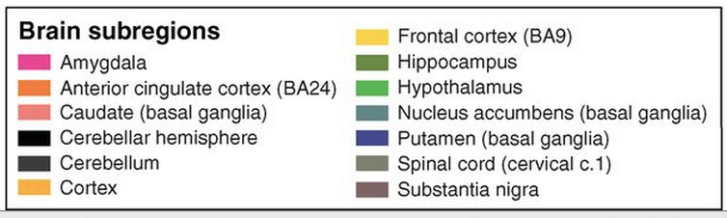
The aim of the Genotype - Tissue Expression (GTEx) Project
RNA-seq and eQTL
http://www.gtexportal.org/home/
http://www.gtexportal.org/home/tissueSummaryPage
http://www.gtexportal.org/home/datasets2

Slide 16
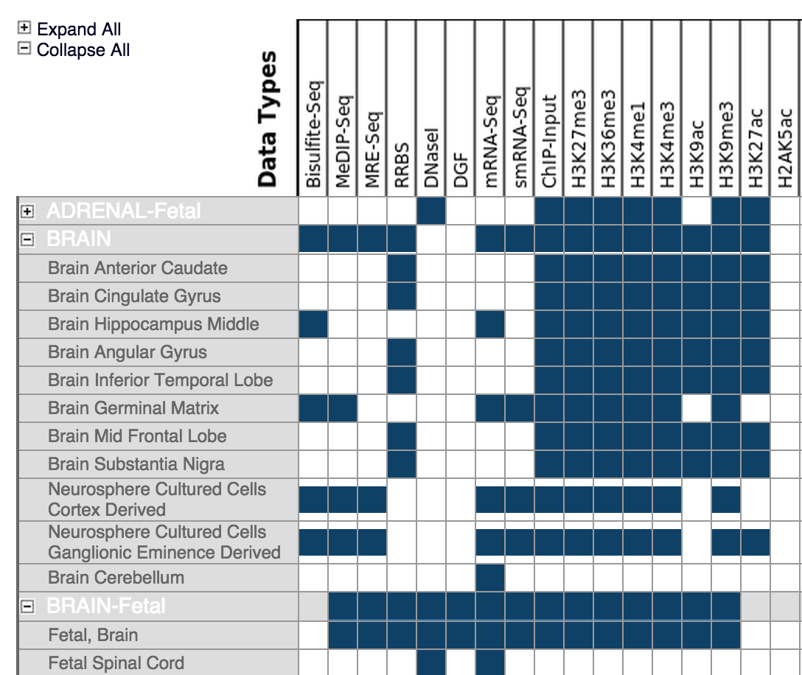
Roadmap Epigenomics Mapping Consortium
Download: http://www.ncbi.nlm.nih.gov/epigenomics
Notes:
Methylation measurement in brain middle

Slide 17
GWAS
SNPs related to brain diseases
GRASP: Genome-Wide Repository of Associations Between SNPs and Phenotypes
  A deeply extracted and annotated database of genome-wide association studies (GWAS) results. GRASP v2.0 contains ∼8.87 million SNP associations reported in 2082 studies.
GRASP includes all available genetic association results from papers, their supplements and web-based content meeting the following guidelines:
  All associations with P<0.05 from GWAS defined as >= 25,000 markers tested for 1 or more traits.
  Study exclusion criteria: CNV-only studies, replication/follow-up studies testing <25K markers, non-human only studies, article not in English, gene-environment or gene-gene GWAS where single SNP main effects are not given, linkage only studies, aCGH/LOH only studies, heterozygosity/homozygosity (genome-wide or long run) studies, studies only presenting gene-based or pathway-based results, simulation-only studies, studies which we judge as redundant with prior studies since they do not provide significant inclusion of new samples or exposure of new results (e.g., many methodological papers on the WTCCC and FHS GWAS).
http://grasp.nhlbi.nih.gov/Search.aspx

