Slide 1
Looking at allelic bias in personal genomes
Jieming
14th Oct 2015
Allele

Slide 2
Procedure briefly
ChIP Data: pooled POL2 NA12878
Pgenome:
Reference
NA12878 1000GP P3 SNVs
NA12878 1000GP P3 SNVs+Indels
NA12878 1000GP P3 SNVs+Indels+SVs
Align reads to paternal and maternal genomes
Obtain each set of aligned reads that overlap het SNVs
Flip reads, for only those overlapping 1 SNV
Align flipped reads to mat, pat and ref genomes (all 3 are from hs37d5ss from 1000GP)

Slide 3
NA12878 POL2 combined (compare read mappings)
 | Ref genome | Pgenome: snvs only | Pgenome: snvs + indels only | Pgenome: snvs + indels + SVs
Reads processed | 208,051,087 | 208,051,087 | 208,051,087 | 208,051,087
# reads uniquely aligned | 171,944,588 (82.65%) | 172,591,380 (82.96%) M: 171,965,218 (82.66%) P: 171,969,566 (82.66%) | 172,738,321 (83.03%) M: 171,982,014 (82.66%) P: 171,982,614 (82.66%) | 172,743,175 (83.03%) M: 171,977,765 (82.66%) P: 171,978,147 (82.66%)
# reads that failed to align | 18,279,824 (8.79%) | M: 18,290,611 (8.79%) P: 18,276,409 (8.78%) | M: 18,286,906 (8.79%) P: 18,270,944 (8.78%) | M: 18,293,522 (8.79%) P: 18,277,990 (8.79%)
# reads that multimap | 17,826,675 (8.57%) | M: 17,795,258 (8.55%) P: 17,805,112 (8.56%) | M: 17,782,167 (8.55%) P: 17,797,529 (8.55%) | M: 17,779,800 (8.55%) P: 17,794,950 (8.55%)

Slide 4
Procedure briefly (with SVs)
ChIP Data: Kilpinen et al 2013
Pgenome: NA12878 1000GP P3 SNVs+Indels (with SVs)
Align reads to paternal and maternal genomes
Obtain each set of aligned reads that overlap het SNVs
Flip reads, for only those overlapping 1 SNV
Align flipped reads to mat, pat and ref genomes (all 3 are from hs37d5ss from 1000GP)

Slide 5
Alignment for NA12878 RNA-seq (Kilpinen et al. 2013)
 | Ref genome | Pgenome: snvs only | Pgenome: snvs + indels only | Pgenome: snvs + indels + SVs
Reads processed | 37,558,398 | 37558398 | 37558398 | 37,558,398
# reads uniquely aligned | 25,303,498 (67.37%) | 25,486,837 (67.86%) M: 25,345,119 (67.48%) P: 25,352,964 (67.50%) | 25538449 (68.00%) M: 25,371,892 (67.55%) P: 25,383,016 (67.58%) | 25,568,042 (68.08%) M: 25,394,098 (67.61%) P: 25,412,184 (67.66%)
# reads that failed to align | 8,213,405 (21.87%) | M: 8,195,227 (21.82%) P: 8,195,017 (21.82%) | M: 8,174,209 (21.76%) P: 8,172,957 (21.76%) | M: 8,181,317 (21.78%) P: 8,173,224 (21.76%)
# reads that multimap | 4,041,495 (10.76%) | M: 4,018,052 (10.70%) P: 4,010,417 (10.68%) | M: 4,012,297 (10.68%) P: 4,002,425 (10.66%) | M: 3,982,983 (10.60%) P: 3,972,990 (10.58%)

Slide 6
For maternally mapped reads overlapping hetSNVs
Number of SNVs | Number of reads with this number of SNVs | Proportion of reads with this number of SNVs
1 | 606319 | 0.912484
2 | 47549 | 0.071559
3 | 5045 | 0.007593
4 | 2666 | 0.004012
5 | 1861 | 0.002801
6 | 584 | 0.000879
7 | 196 | 0.000295
8 | 34 | 5.12E-05
9 | 152 | 0.000229
10 | 36 | 5.42E-05
11 | 7 | 1.05E-05
12 | 22 | 3.31E-05

Slide 7
For paternally mapped reads overlapping hetSNVs
Number of SNVs | Number of reads with this number of SNVs | Proportion of reads with this number of SNVs
1 | 600085 | 0.909293
2 | 46038 | 0.06976
3 | 6777 | 0.010269
4 | 3156 | 0.004782
5 | 2461 | 0.003729
6 | 885 | 0.001341
7 | 165 | 0.00025
8 | 31 | 4.70E-05
9 | 162 | 0.000245
10 | 17 | 2.58E-05
11 | 33 | 5.00E-05
12 | 137 | 2.08E-04

Slide 8
A
read 1
Mat
A
C
Pat
C
C
C
read 2
::::::::::::::
bsub-newSV-kilpinen-pooled-rnaseq-na12878-matflip2mat.err
::::::::::::::
# reads processed: 603115
# reads with at least one reported alignment: 561035 (93.02%)
# reads that failed to align: 18772 (3.11%)
# reads with alignments suppressed due to -m: 23308 (3.86%)
Reported 561035 alignments to 1 output stream(s)
::::::::::::::
bsub-newSV-kilpinen-pooled-rnaseq-na12878-matflip2pat.err
::::::::::::::
# reads processed: 603115
# reads with at least one reported alignment: 582903 (96.65%)
# reads that failed to align: 687 (0.11%)
# reads with alignments suppressed due to -m: 19525 (3.24%)
Reported 582903 alignments to 1 output stream(s)
::::::::::::::
bsub-newSV-kilpinen-pooled-rnaseq-na12878-matflip2ref.err
::::::::::::::
# reads processed: 603115
# reads with at least one reported alignment: 566053 (93.85%)
# reads that failed to align: 13394 (2.22%)
# reads with alignments suppressed due to -m: 23668 (3.92%)
Reported 566053 alignments to 1 output stream(s)

Slide 9
Unaligned & multis
Unaligned
685/687 overlap NA12878 1000GP P3 indels
2/2 overlap with NA12878 1000GP P3 defined SVs
Multi
0/19525 overlap NA12878 1000GP P3 SVs/CNVs
::::::::::::::
bsub-newSV-kilpinen-pooled-rnaseq-na12878-matflip2pat.err
::::::::::::::
# reads processed: 603115
# reads with at least one reported alignment: 582903 (96.65%)
# reads that failed to align: 687 (0.11%)
# reads with alignments suppressed due to -m: 19525 (3.24%)
Reported 582903 alignments to 1 output stream(s)

Slide 10
How much do multi reads affect results (SNVs are from combined RNAseq)
Multi: Matflip2pat (19525) | Counts.bed | Binomial.intHets | Betabinom.intHets
Total number of SNVs | 354306 | 45984 | 10357
How many SNVs multireads overlap | 1788 | 588 | 130
-- Need to further check the percentage in bias?
-- Check using alleleDB genome

Slide 11
A
read 1
Pat
A
C
Mat
C
C
C
read 2
::::::::::::::
bsub-newSV-kilpinen-pooled-rnaseq-na12878-patflip2mat.err
::::::::::::::
# reads processed: 596693
# reads with at least one reported alignment: 574405 (96.26%)
# reads that failed to align: 1003 (0.17%)
# reads with alignments suppressed due to -m: 21285 (3.57%)
Reported 574405 alignments to 1 output stream(s)
::::::::::::::
bsub-newSV-kilpinen-pooled-rnaseq-na12878-patflip2pat.err
::::::::::::::
# reads processed: 596693
# reads with at least one reported alignment: 563586 (94.45%)
# reads that failed to align: 17742 (2.97%)
# reads with alignments suppressed due to -m: 15365 (2.58%)
Reported 563586 alignments to 1 output stream(s)
::::::::::::::
bsub-newSV-kilpinen-pooled-rnaseq-na12878-patflip2ref.err
::::::::::::::
# reads processed: 596693
# reads with at least one reported alignment: 563805 (94.49%)
# reads that failed to align: 11780 (1.97%)
# reads with alignments suppressed due to -m: 21108 (3.54%)
Reported 563805 alignments to 1 output stream(s)

Slide 12
Unaligned and multis
Unaligned
697/1,003 overlap NA12878 P3 indels
306/306 overlap NA12878 P3 defined SVs
Multi
1/21285 overlap NA12878 1000GP P3 SVs/CNVs
::::::::::::::
bsub-newSV-kilpinen-pooled-rnaseq-na12878-patflip2mat.err
::::::::::::::
# reads processed: 596693
# reads with at least one reported alignment: 574405 (96.26%)
# reads that failed to align: 1003 (0.17%)
# reads with alignments suppressed due to -m: 21285 (3.57%)
Reported 574405 alignments to 1 output stream(s)

Slide 13
Procedure briefly (without SVs)
ChIP Data: pooled POL2 NA12878
Pgenome: NA12878 alleleDB Broad high coverage GATK BP v3
 | Pgenome: snvs + indels only
Reads processed | 208,051,087
# reads uniquely aligned | 177,100,441 (85.12%) M: 176,552,187 (84.86%) P: 176,550,828 (84.86%)
# reads that failed to align | M: 13,892,634 (6.68%) P: 13,892,364 (6.68%)
# reads that multimap | M: 17,606,266 (8.46%) P: 17,607,895 (8.46%)

Slide 14
A
read 1
Mat
A
C
Pat
C
C
C
read 2
::::::::::::::
bsub-alleleDB_genome-combined-POL2-NA12878-matflip2mat.err
::::::::::::::
# reads processed: 3145498
# reads with at least one reported alignment: 3009856 (95.69%)
# reads that failed to align: 68050 (2.16%)
# reads with alignments suppressed due to -m: 67592 (2.15%)
Reported 3009856 alignments to 1 output stream(s)
::::::::::::::
bsub-alleleDB_genome-combined-POL2-NA12878-matflip2pat.err
::::::::::::::
# reads processed: 3145498
# reads with at least one reported alignment: 3089439 (98.22%)
# reads that failed to align: 1726 (0.05%)
# reads with alignments suppressed due to -m: 54333 (1.73%)
Reported 3089439 alignments to 1 output stream(s)
::::::::::::::
bsub-alleleDB_genome-combined-POL2-NA12878-matflip2ref.err
::::::::::::::
# reads processed: 3145498
# reads with at least one reported alignment: 3031305 (96.37%)
# reads that failed to align: 54457 (1.73%)
# reads with alignments suppressed due to -m: 59736 (1.90%)
Reported 3031305 alignments to 1 output stream(s)

Slide 15
Unaligned and multis
Unaligned
1,726/1,726 overlap NA12878 Broad indels (36bp)
1,724/1,726 (10bp)
Multi
942/54333 overlap NA12878 Broad indels? (36bp)
346/54333 (10bp)
::::::::::::::
bsub-alleleDB_genome-combined-POL2-NA12878-matflip2pat.err
::::::::::::::
# reads processed: 3145498
# reads with at least one reported alignment: 3089439 (98.22%)
# reads that failed to align: 1726 (0.05%)
# reads with alignments suppressed due to -m: 54333 (1.73%)
Reported 3089439 alignments to 1 output stream(s)

Slide 16
A
read 1
Pat
A
C
Mat
C
C
C
read 2
::::::::::::::
bsub-alleleDB_genome-combined-POL2-NA12878-patflip2mat.err
::::::::::::::
# reads processed: 3145302
# reads with at least one reported alignment: 3089732 (98.23%)
# reads that failed to align: 1689 (0.05%)
# reads with alignments suppressed due to -m: 53881 (1.71%)
Reported 3089732 alignments to 1 output stream(s)
::::::::::::::
bsub-alleleDB_genome-combined-POL2-NA12878-patflip2pat.err
::::::::::::::
# reads processed: 3145302
# reads with at least one reported alignment: 3007460 (95.62%)
# reads that failed to align: 69244 (2.20%)
# reads with alignments suppressed due to -m: 68598 (2.18%)
Reported 3007460 alignments to 1 output stream(s)
::::::::::::::
bsub-alleleDB_genome-combined-POL2-NA12878-patflip2ref.err
::::::::::::::
# reads processed: 3145302
# reads with at least one reported alignment: 3029489 (96.32%)
# reads that failed to align: 56658 (1.80%)
# reads with alignments suppressed due to -m: 59155 (1.88%)
Reported 3029489 alignments to 1 output stream(s)

Slide 17
Unaligned and multis
Unaligned
1,689/1,689 overlap NA12878 Broad indels (36bp)
1,689 (10bp)
Multi
1035/53881 overlap NA12878 Broad indels (36bp)
394/53881 (10bp)
::::::::::::::
bsub-alleleDB_genome-combined-POL2-NA12878-patflip2mat.err
::::::::::::::
# reads processed: 3145302
# reads with at least one reported alignment: 3089732 (98.23%)
# reads that failed to align: 1689 (0.05%)
# reads with alignments suppressed due to -m: 53881 (1.71%)
Reported 3089732 alignments to 1 output stream(s)

Slide 18
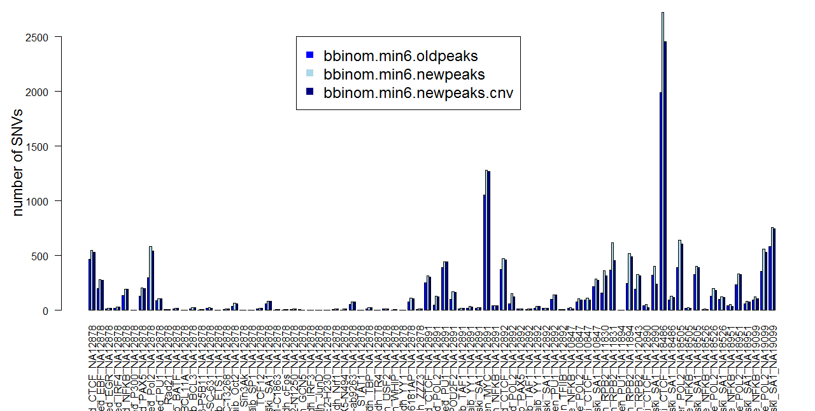
Newpeaks and cnv filter

Slide 19
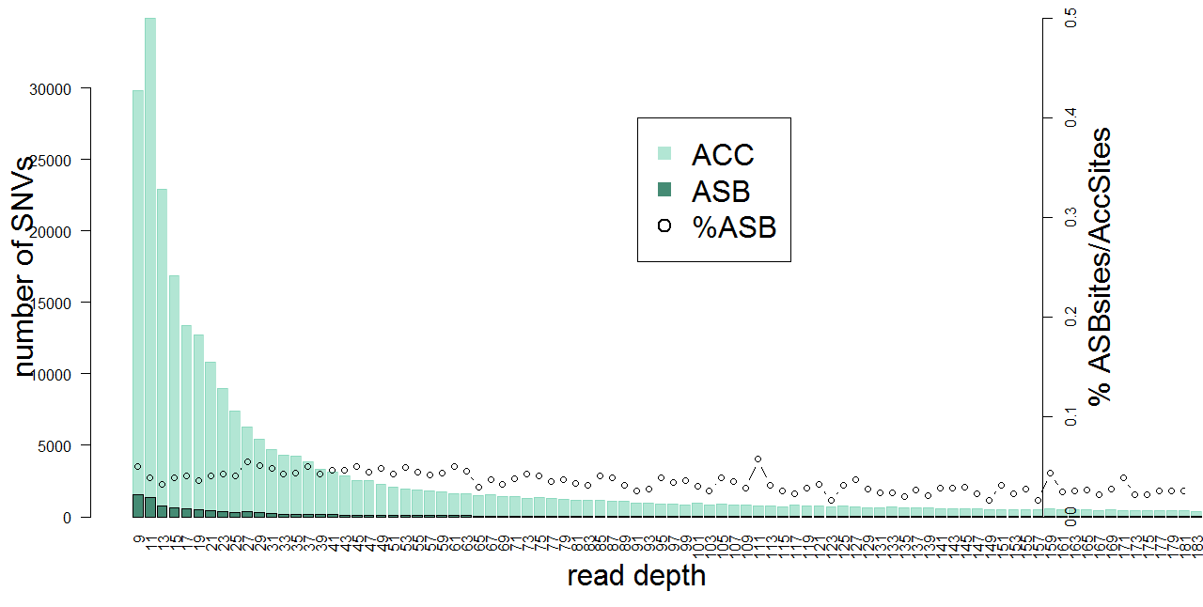
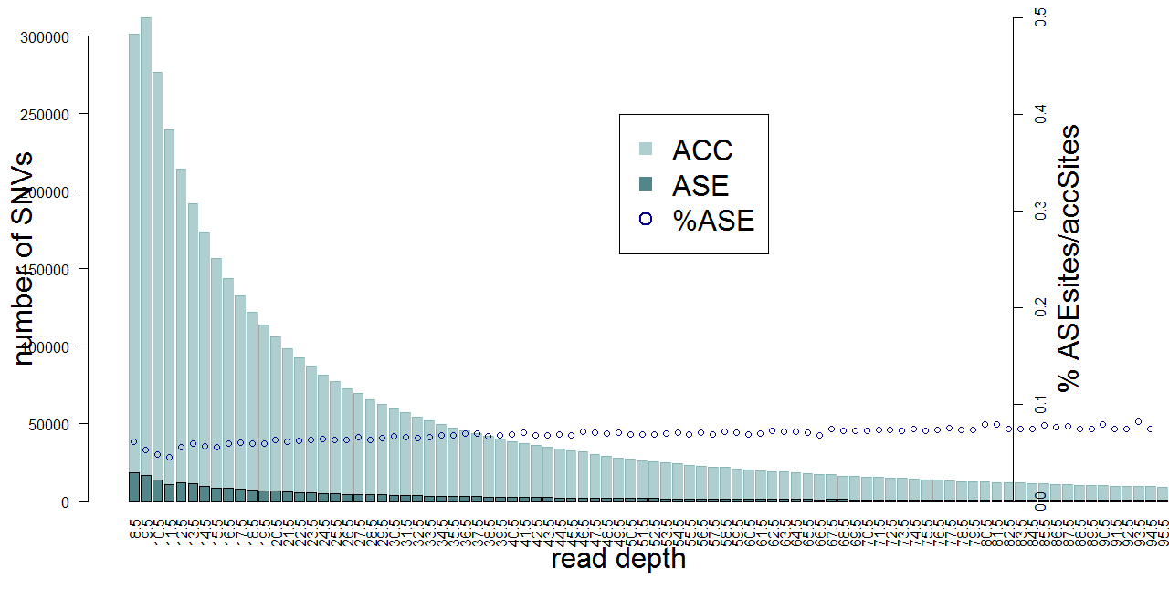
Old
New

Slide 20
SNVs with 5% Allelic Bias --combined Pol2
By sites
216 intHets in either mat or pat bias (216/557=39%)
By reads (estimated using minimum read of N=11)
95/216 intHets removed (95/557=17%)
121 still intHets

Slide 21
SNVs with 5% Allelic Bias --encode rnaseq
By sites
307 intHets in either mat or pat bias (307/10486=3%)
By reads
169/307 intHets SNVs were removed (169/10486=1.6%)
138 still intHets

