Slide 1

Variants in Cancer Genomes
Increasing number of whole genome sequenced
Lots of random mutations due to broken DNA repair mechanisms
A major focus of cancer research : distinguish drivers and passengers
  Drivers are mutations that drive cancer progression
  Passengers are due to impaired DNA repair processes
Goal: Finding the key mutations in ~3M Germline variants & ~5K Somatic Variants in one Sample
The proverbial needle
in a haystack
[Image credit: www.yourgrantauthority.com ‘15]

Slide 2
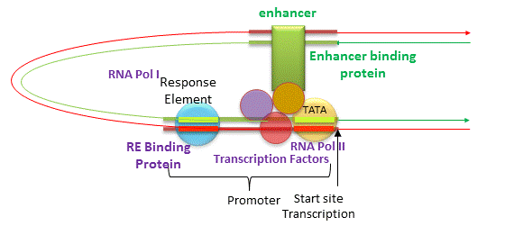
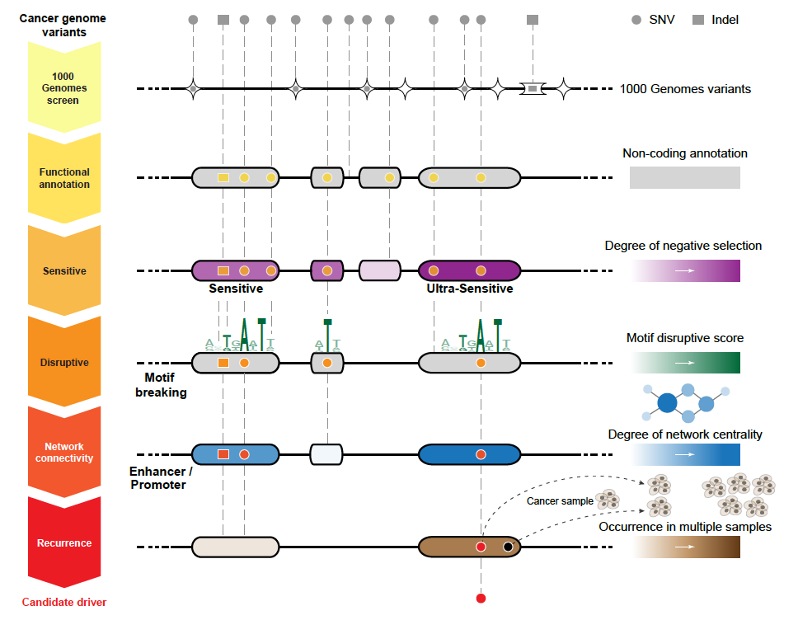
Noncoding Annotations
Promoters
TF binding sites
Transcription start sites
DHS sites
Enhancers
[Jakubowski, csbsju.edu ‘14]
Ultra-sensitive sites
Ultra-conserved sites
[Khurana et al., Science (‘13)]

Slide 3
Identification of non-coding candidate drivers amongst somatic variants: Scheme
[Khurana et al., Science (‘13)]

Slide 4
Identification of non-coding candidate drivers amongst somatic variants: Scheme
Funseq 1.0
Function
Prioritization
Funseq 2.0
Better
Functional
Annotation
LARVA
[Khurana et al., Science (‘13)]

Slide 5
From Funseq 1.0 to Funseq 2.0
Newly added features
  Motif disruption score: changes in PWMs
  Network centrality analysis: PPI, regulatory, and phosphorylation networks
New scoring system
  Entropy based scoring system
HOT region
Sensitive region
Polymorphisms
Genome
Feature weight:
p = probability of the feature overlapping natural polymorphisms
For a variant:
5
[Fu et al., GenomeBiology ('14)]
Notes:
Better schematic ….

Slide 6


Mutation recurrence
Cancer Type 1
Cancer Type 2
Cancer Type 3

Slide 7
Mutation recurrence
Cancer Type 1
Cancer Type 2
Cancer Type 3
Early replicated regions
Late replicated regions

Slide 8
Noncoding annotations
Cancer Type 1
Cancer Type 2
Cancer Type 3
Early replicated regions
Late replicated regions

Slide 9
Noncoding annotations
Cancer Type 1
Cancer Type 2
Cancer Type 3
Early replicated regions
Late replicated regions

Slide 10
Cancer Somatic Mutational Heterogeneity
Challenge: Huge cancer type, sample, and regional mutation rate heterogeneity
Goal: identify potential noncoding cancer drivers
LARVA: Large-scale Analysis of Recurrent Variants in noncoding Annotations
[Lochovsky et al. NAR (’15)]

Slide 11




Cancer Somatic Mutation Modeling
3 models to evaluate the significance of mutation burden
Suppose there are k genome elements. For element i, define:
  n_{i}: total number of nucleotides in i
  x_{i}: the number of mutations within element i
  p: the mutation rate
  R: the replication timing bin of i
Model 1: Constant Background Mutation Rate (Model from Previous Work)
Model 2: Varying Mutation Rate
Model 3: Varying Mutation Rate with Replication Timing Correction
[Lochovsky et al. NAR (’15)]

Slide 12
LARVA Model Comparison
Comparison of mutation count frequency implied by the binomial model (model 1) and the beta-binomial model (model 2) relative to the empirical distribution
The beta-binomial distribution is significantly better, especially for accurately modeling the over-dispersion of the empirical distribution
[Lochovsky et al. NAR (’15)]

Slide 13
LARVA Model Comparison
Demonstrate that adding the DNA replication timing correction (model 3) further improves the beta-binomial model (model 2)
Top 10% of replication timing bins requires little correction
Bottom 10% of replication timing bins requires massive correction
[Lochovsky et al. NAR (’15)]

Slide 14
LARVA Results
TSS LARVA results
These have
literature-verified
cancer associations
noncoding annotation
p-values in sorted order
[Lochovsky et al. NAR (’15)]

Slide 15
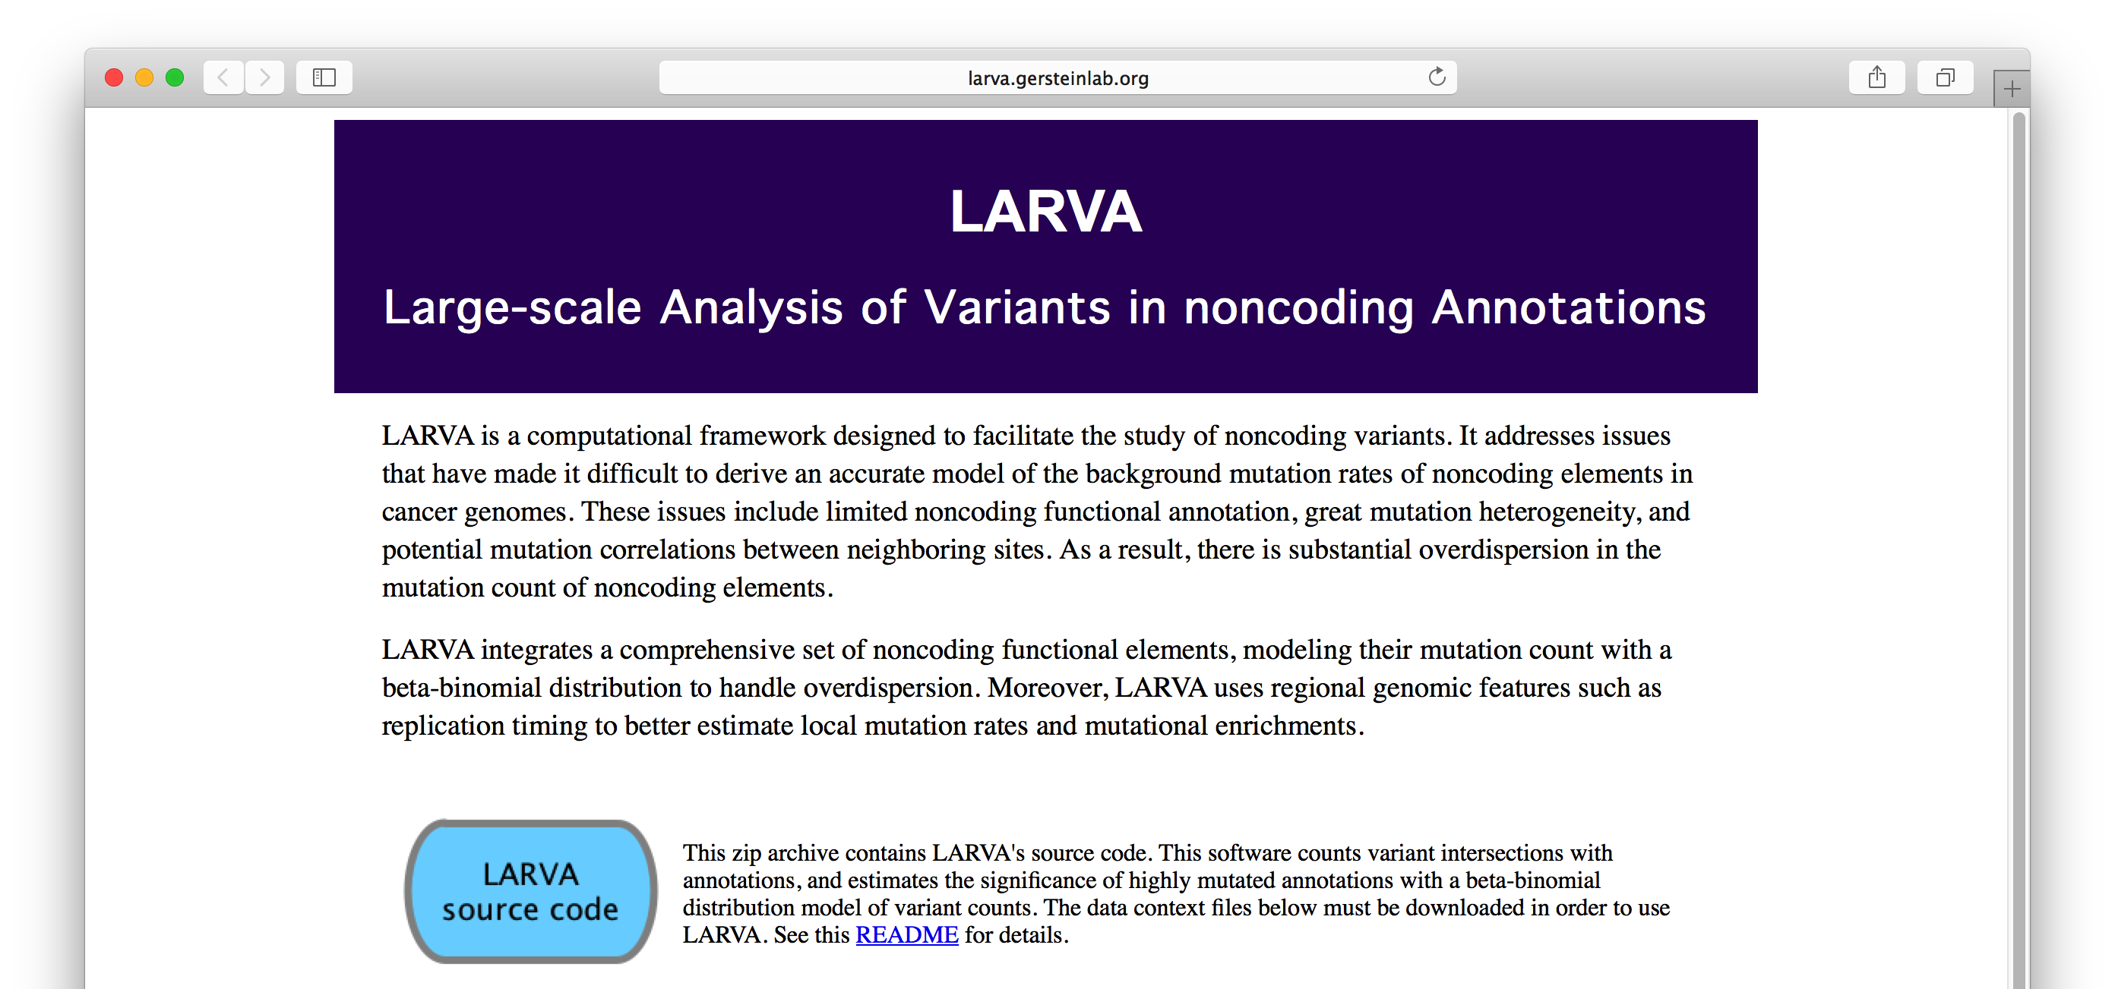
LARVA Implementation
http://larva.gersteinlab.org/
Freely downloadable C++ program
  Verified compilation and correct execution on Linux
A Docker image is also available to download
  Runs on any operating system supported by Docker
Running time on transcription factor binding sites (a worst case input size) is ~80 min
  Running time scales linearly with the number of annotations in the input

Slide 16
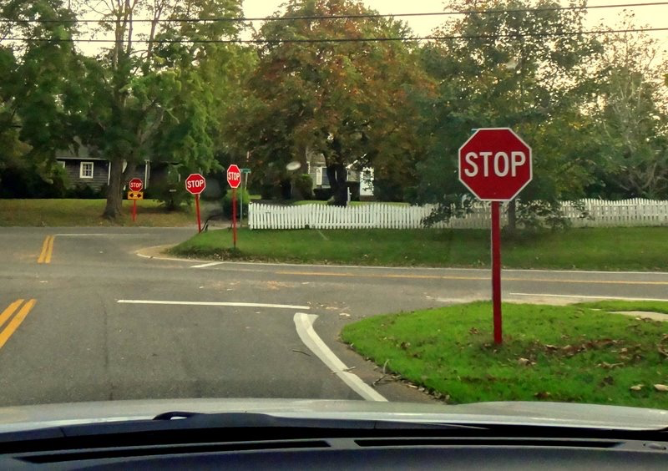
Acknowledgements
LARVA.gersteinlab.org
  L Lochovsky*, J Zhang*, Y Fu, E Khurana
FunSeq2.gersteinlab.org
  Y Fu, Z Liu, S Lou, J Bedford, X Mu, K Yip, E Khurana

