Slide 1
Choosing a Cell Line for nuclear body grant
HiC data
IMR90, HMEC, NHEK, K562, HUVEC, KBM7, and HeLa
These from Rao et al Cell 2014, maybe a couple of others as well
Imaging evidence of nuclear bodies
K562 looks good (next slide/asking Karla)
ChIP/CLIP-Seq data
CLIP mainly in K562 and HepG2 for ENCODE3
Cell cycle RNA-Seq/other seq assays
Very hard to find RNA-Seq data
U2OS, HeLa, and ZR-75.1 cells have microarray data

Slide 2
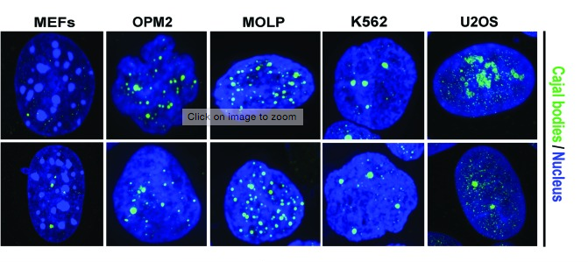
Imaging – Fluorescence imaging of Coilin
Also asked Karla
Bartova et al Nucleus 2014

