Slide 1
Looking at allelic bias in personal genomes
Jieming
30th Sept 2015
Allele

Slide 2
Procedure briefly (without SVs)
ChIP Data: pooled CTCF NA12878
Pgenome:
Reference
NA12878 1000GP P3 SNVs
NA12878 1000GP P3 SNVs+Indels
NA12878 1000GP P3 SNVs+Indels+SVs
Align reads to paternal and maternal genomes
Obtain each set of aligned reads that overlap het SNVs
Flip reads, for only those overlapping 1 SNV
Align flipped reads to mat, pat and ref genomes
(all 3 are from hs37d5ss from 1000GP)

Slide 3
NA12878 POL2 combined
(compare read mappings)
 | Ref genome | Pgenome: snvs only | Pgenome: snvs + indels only | Pgenome: snvs + indels + SVs
Reads processed | 208,051,087 | 208,051,087 | 208,051,087 | 208,051,087
# reads uniquely aligned | 171,944,588 (82.65%) | 172,591,380 (82.96%) M: 171,965,218 (82.66%) P: 171,969,566 (82.66%) | 172,738,321 (83.03%) M: 171,982,014 (82.66%) P: 171,982,614 (82.66%) | 172,743,175 (83.03%) M: 171,977,765 (82.66%) P: 171,978,147 (82.66%)
# reads that failed to align | 18,279,824 (8.79%) | M: 18,290,611 (8.79%) P: 18,276,409 (8.78%) | M: 18,286,906 (8.79%) P: 18,270,944 (8.78%) | M: 18,293,522 (8.79%) P: 18,277,990 (8.79%)
# reads that multimap | 17,826,675 (8.57%) | M: 17,795,258 (8.55%) P: 17,805,112 (8.56%) | M: 17,782,167 (8.55%) P: 17,797,529 (8.55%) | M: 17,779,800 (8.55%) P: 17,794,950 (8.55%)

Slide 4
Alignment for NA12878 RNA-seq
(Kilpinen et al. 2013)
 | Ref genome | Pgenome: snvs only | Pgenome: snvs + indels only | Pgenome: snvs + indels + SVs
Reads processed | 37,558,398 | 37558398 | 37558398 | 37,558,398
# reads uniquely aligned | 25,303,498 (67.37%) | 25,486,837 (67.86%) M: 25,345,119 (67.48%) P: 25,352,964 (67.50%) | 25538449 (68.00%) M: 25,371,892 (67.55%) P: 25,383,016 (67.58%) | 25,568,042 (68.08%) M: 25,394,098 (67.61%) P: 25,412,184 (67.66%)
# reads that failed to align | 8,213,405 (21.87%) | M: 8,195,227 (21.82%) P: 8,195,017 (21.82%) | M: 8,174,209 (21.76%) P: 8,172,957 (21.76%) | M: 8,181,317 (21.78%) P: 8,173,224 (21.76%)
# reads that multimap | 4,041,495 (10.76%) | M: 4,018,052 (10.70%) P: 4,010,417 (10.68%) | M: 4,012,297 (10.68%) P: 4,002,425 (10.66%) | M: 3,982,983 (10.60%) P: 3,972,990 (10.58%)

Slide 5
Procedure briefly (with SVs)
ChIP Data: Kilpinen et al 2013
Pgenome: NA12878 1000GP P3 SNVs+Indels (with SVs)
Align reads to paternal and maternal genomes
Obtain each set of aligned reads that overlap het SNVs
Flip reads, for only those overlapping 1 SNV
Align flipped reads to mat, pat and ref genomes
(all 3 are from hs37d5ss from 1000GP)

Slide 6
For maternally mapped reads overlapping hetSNVs
Number of SNVs | Number of reads with this number of SNVs | Proportion of reads with this number of SNVs
1 | 831870 | 0.914559
2 | 65258 | 0.071745
3 | 8589 | 0.009443
4 | 2482 | 0.002729
5 | 1111 | 0.001221
6 | 232 | 0.000255
7 | 30 | 3.30E-05
8 | 13 | 1.43E-05
9 | 1 | 1.10E-06

Slide 7
For paternally mapped reads overlapping hetSNVs
Number of SNVs | Number of reads with this number of SNVs | Proportion of reads with this number of SNVs
1 | 897424 | 0.932774
2 | 51379 | 0.053403
3 | 10139 | 0.010538
4 | 2119 | 0.002202
5 | 810 | 0.000842
6 | 156 | 0.000162
7 | 69 | 7.17E-05
8 | 4 | 4.16E-06
9 | 2 | 2.08E-06

Slide 8
A
read 1
Mat
A
C
Pat
C
C
C
read 2
::::::::::::::
bsub-newSV-kilpinen-pooled-rnaseq-na12878-matflip2mat.err
::::::::::::::
# reads processed: 434831
# reads with at least one reported alignment: 404476 (93.02%)
# reads that failed to align: 27267 (6.27%)
# reads with alignments suppressed due to -m: 3088 (0.71%)
Reported 404476 alignments to 1 output stream(s)
::::::::::::::
bsub-newSV-kilpinen-pooled-rnaseq-na12878-matflip2pat.err
::::::::::::::
# reads processed: 434831
# reads with at least one reported alignment: 398482 (91.64%)
# reads that failed to align: 26430 (6.08%)
# reads with alignments suppressed due to -m: 9919 (2.28%)
Reported 398482 alignments to 1 output stream(s)
::::::::::::::
bsub-newSV-kilpinen-pooled-rnaseq-na12878-matflip2ref.err
::::::::::::::
# reads processed: 434831
# reads with at least one reported alignment: 395285 (90.91%)
# reads that failed to align: 28024 (6.44%)
# reads with alignments suppressed due to -m: 11522 (2.65%)
Reported 395285 alignments to 1 output stream(s)

Slide 9
Unaligned & multis
Unaligned
874/26,430 overlap NA12878 1000GP P3 indels
1/25,556 overlap with NA12878 1000GP P3 defined SVs
Multi
0/9919 overlap NA12878 1000GP P3 SVs/CNVs
::::::::::::::
bsub-newSV-kilpinen-pooled-rnaseq-na12878-matflip2pat.err
::::::::::::::
# reads processed: 434831
# reads with at least one reported alignment: 398482 (91.64%)
# reads that failed to align: 26430 (6.08%)
# reads with alignments suppressed due to -m: 9919 (2.28%)
Reported 398482 alignments to 1 output stream(s)

Slide 10
How much do multi reads affect results
Multi: Matflip2pat (41876) | Counts.bed | Binomial.intHets | Betabinom.intHets
Total number of SNVs | 26745 (3%) | 2065 (7%) | 600 (8%)
How many SNVs multireads overlap | 732 | 146 | 49
How many SNVs multireads overlap that are rd>=1.5 || rd<=0.5 (CNV) | 8 | 0 | 2 ?
-- Need to further check the percentage in bias?
-- Check if they overlaps with SV/CNV calls detected in P3 1KG.
AlleleDB 2 additional changes:
1) peaks remapping
2) betabinomial read depth filtering

Slide 11
How much do multi reads affect results
Multi: Matflip2pat (41876) | Counts.bed | Binomial.intHets | Betabinom.intHets
Total number of SNVs | 26745 (3%) | 2065 (7%) | 600 (8%)
How many SNVs multireads overlap | 732 | 146 | 49
How many SNVs multireads overlap that are rd>=1.5 || rd<=0.5 (CNV) | 8 | 0 | 2 ?
# SNVs with rd>=1.5 || rd<=0.5 (CNV) | 645 | 0 | 16 …
-- Need to further check the percentage in bias?
-- Check if they overlaps with SV/CNV calls detected in P3 1KG.
AlleleDB 2 additional changes:
1) peaks remapping
2) betabinomial read depth filtering

Slide 12
A
read 1
Pat
A
C
Mat
C
C
C
read 2
::::::::::::::
bsub-newSV-kilpinen-pooled-rnaseq-na12878-patflip2mat.err
::::::::::::::
# reads processed: 448259
# reads with at least one reported alignment: 416386 (92.89%)
# reads that failed to align: 29420 (6.56%)
# reads with alignments suppressed due to -m: 2453 (0.55%)
Reported 416386 alignments to 1 output stream(s)
::::::::::::::
bsub-newSV-kilpinen-pooled-rnaseq-na12878-patflip2pat.err
::::::::::::::
# reads processed: 448259
# reads with at least one reported alignment: 423908 (94.57%)
# reads that failed to align: 22706 (5.07%)
# reads with alignments suppressed due to -m: 1645 (0.37%)
Reported 423908 alignments to 1 output stream(s)
::::::::::::::
bsub-newSV-kilpinen-pooled-rnaseq-na12878-patflip2ref.err
::::::::::::::
# reads processed: 448259
# reads with at least one reported alignment: 419968 (93.69%)
# reads that failed to align: 24371 (5.44%)
# reads with alignments suppressed due to -m: 3920 (0.87%)
Reported 419968 alignments to 1 output stream(s)

Slide 13
Unaligned and multis
Unaligned
1,080/29,429 overlap NA12878 P3 indels
10/28,349 overlap NA12878 P3 defined SVs
Multi
0/9919 overlap NA12878 1000GP P3 SVs/CNVs
::::::::::::::
bsub-newSV-kilpinen-pooled-rnaseq-na12878-patflip2mat.err
::::::::::::::
# reads processed: 448259
# reads with at least one reported alignment: 416386 (92.89%)
# reads that failed to align: 29420 (6.56%)
# reads with alignments suppressed due to -m: 2453 (0.55%)
Reported 416386 alignments to 1 output stream(s)

Slide 14
2 issues
Peak mapping to reference coordinates
→ will affect ASB variants
No betabinomial CNV filter
→ will affect all results… hopefully not too much

Slide 15
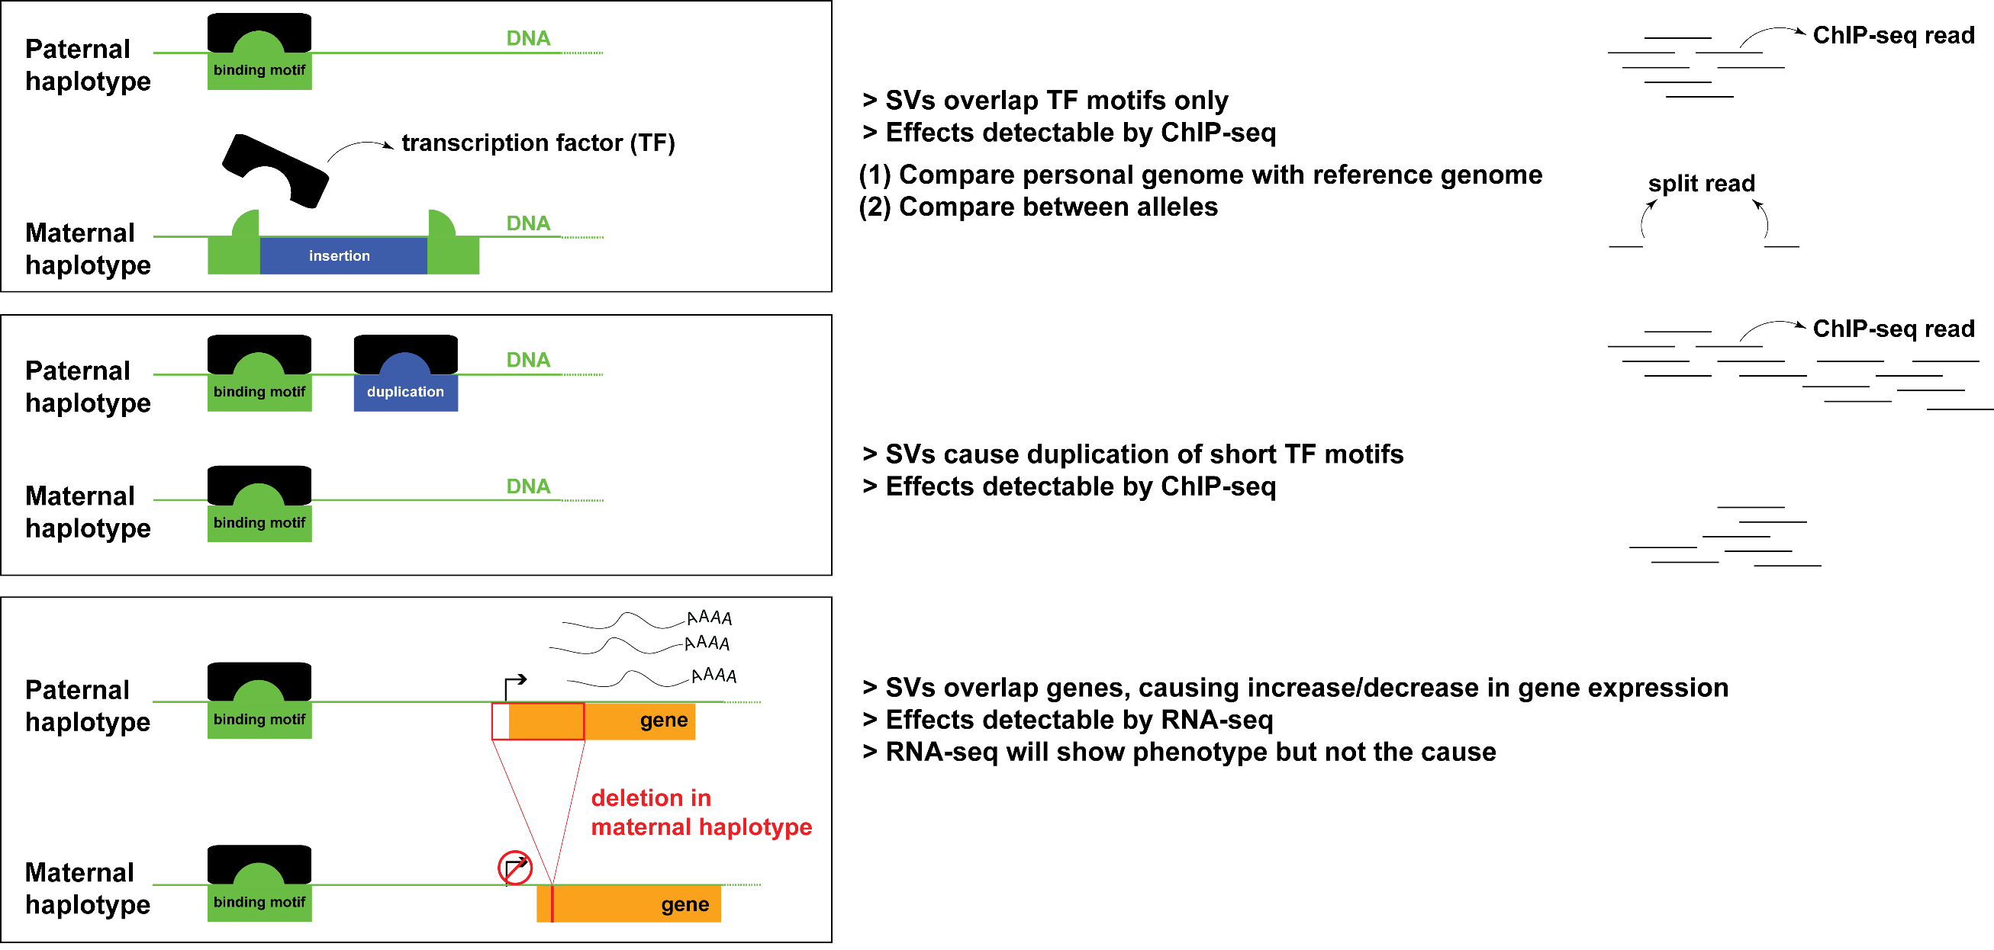
Personal genome can better explain heterozygous effects of SVs

Slide 16
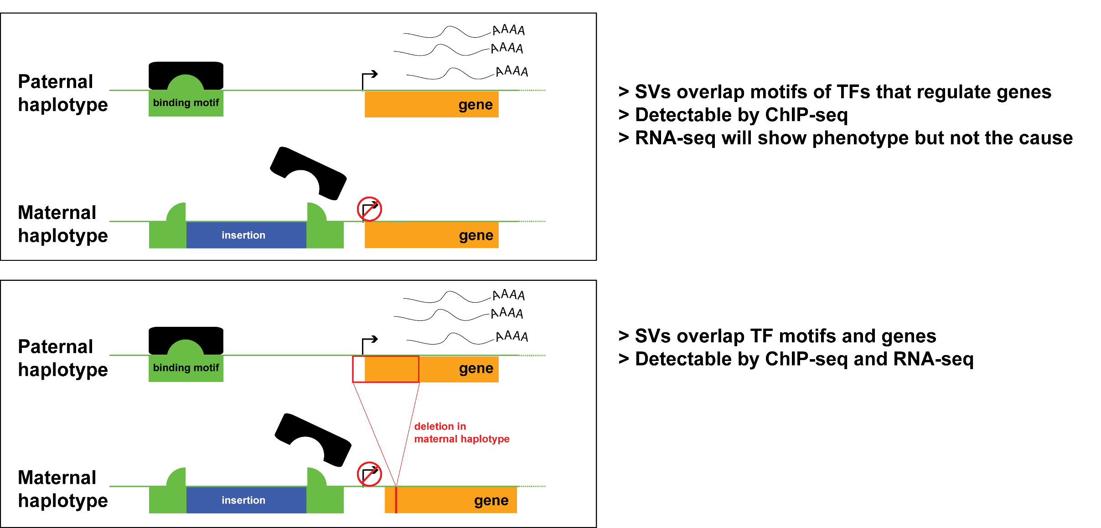
Personal genome can better explain heterozygous effects of SVs

Slide 17
Towards a better genome representation:
Alignment for NA12878 Pol2 ChIP-seq
 | Ref genome | Pgenome: snvs only | Pgenome: snvs + indels only | Pgenome: snvs + indels + SVs
Reads processed | 208,051,087 | 208,051,087 | 208,051,087 | 208,051,087
# reads uniquely aligned | 171,944,588 (82.65%) | 172,591,380 (82.96%) M: 171,965,218 (82.66%) P: 171,969,566 (82.66%) | 172,738,321 (83.03%) M: 171,982,014 (82.66%) P: 171,982,614 (82.66%) | 172,743,175 (83.03%) M: 171,977,765 (82.66%) P: 171,978,147 (82.66%)
# reads that failed to align | 18,279,824 (8.79%) | M: 18,290,611 (8.79%) P: 18,276,409 (8.78%) | M: 18,286,906 (8.79%) P: 18,270,944 (8.78%) | M: 18,293,522 (8.79%) P: 18,277,990 (8.79%)
# reads that multimap | 17,826,675 (8.57%) | M: 17,795,258 (8.55%) P: 17,805,112 (8.56%) | M: 17,782,167 (8.55%) P: 17,797,529 (8.55%) | M: 17,779,800 (8.55%) P: 17,794,950 (8.55%)
Almost 1M increase in reads !

Slide 18
Towards a better genome representation:
Alignment for NA12878 RNA-seq (Kilpinen et al. 2013)
 | Ref genome | Pgenome: snvs only | Pgenome: snvs + indels only | Pgenome: snvs + indels + SVs
Reads processed | 37,558,398 | 37558398 | 37558398 | 37,558,398
# reads uniquely aligned | 25,303,498 (67.37%) | 25,486,837 (67.86%) M: 25,345,119 (67.48%) P: 25,352,964 (67.50%) | 25538449 (68.00%) M: 25,371,892 (67.55%) P: 25,383,016 (67.58%) | 25,568,042 (68.08%) M: 25,394,098 (67.61%) P: 25,412,184 (67.66%)
# reads that failed to align | 8,213,405 (21.87%) | M: 8,195,227 (21.82%) P: 8,195,017 (21.82%) | M: 8,174,209 (21.76%) P: 8,172,957 (21.76%) | M: 8,181,317 (21.78%) P: 8,173,224 (21.76%)
# reads that multimap | 4,041,495 (10.76%) | M: 4,018,052 (10.70%) P: 4,010,417 (10.68%) | M: 4,012,297 (10.68%) P: 4,002,425 (10.66%) | M: 3,982,983 (10.60%) P: 3,972,990 (10.58%)

Slide 19
Transcriptome mapping
Number of exons
Reference
genome
Pgenome: snvs+indels+svs
Pgenome: snvs+indels
280,123 consensus exons
Oliver Stegle and Jieming Chen

Slide 20
NA12878 RNA-seq (Kilpinen et al.)
 | Ref genome (GRCh37) | Pgenome: snvs + indels only | Pgenome: snvs + indels + SVs
# reads aligned | 37,435,162 | 37,702,108 | 37,707,787
Oliver Stegle and Jieming Chen

Slide 21
Utility of SVs:
Exons with direct SV overlap
Comparing between Pgenome-SVs compared to the Pgenome-snpsIndels
18 exons with a direct SV overlap
→ 6/18 exons were expressed (>10 reads)
→ 4/6 showed substantial changes in expression (≥ 1 fold change) when using the

