Slide 1
Personal genome construction with SVs

Slide 2
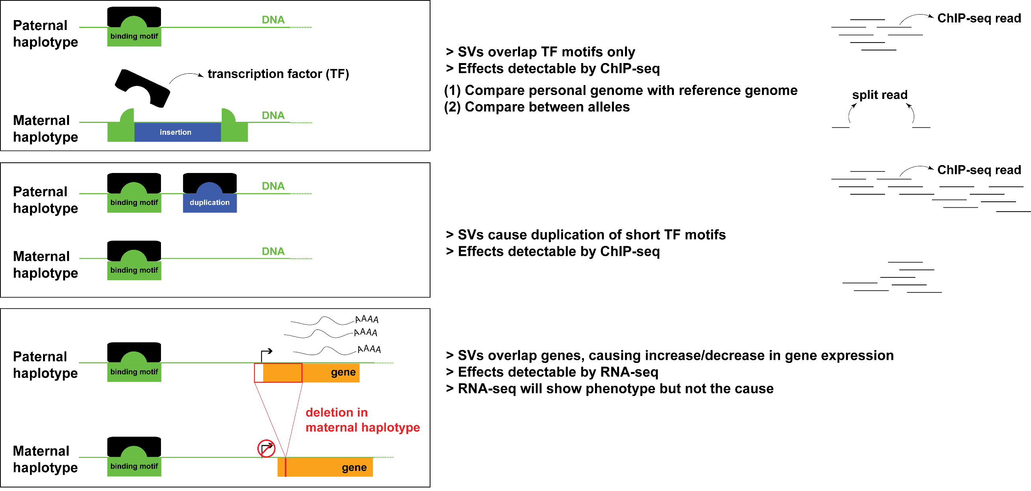
Personal genome can better explain heterozygous effects of SVs

Slide 3
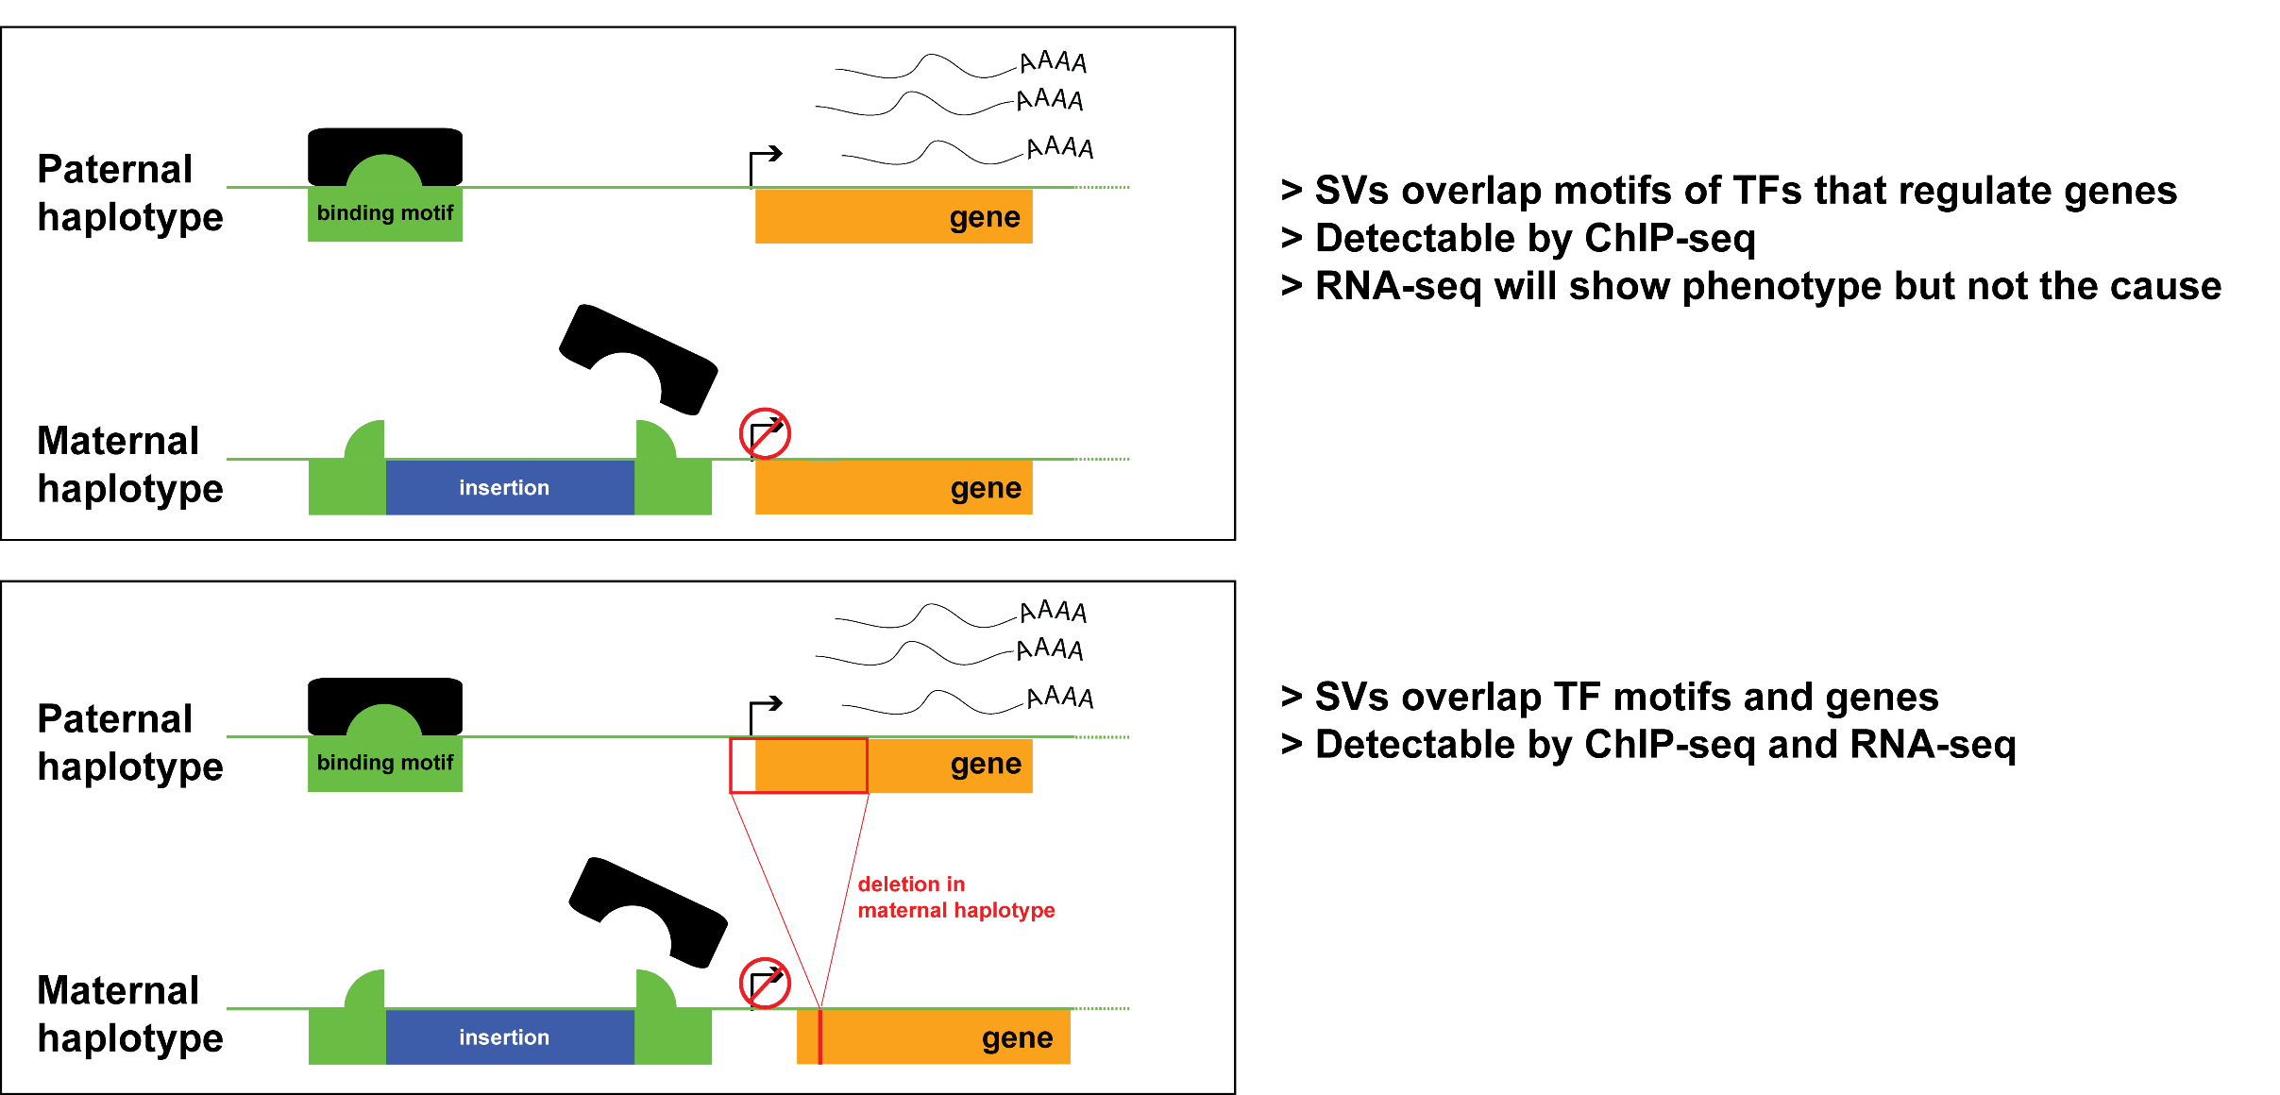
Personal genome can better explain heterozygous effects of SVs

Slide 4
Towards a better genome representation:
Alignment for NA12878 Pol2 ChIP-seq
 | Ref genome | Pgenome: snvs only | Pgenome: snvs + indels only | Pgenome: snvs + indels + SVs
Reads processed | 208,051,087 | 208,051,087 | 208,051,087 | 208,051,087
# reads uniquely aligned | 171,944,588 (82.65%) | 172,591,380 (82.96%) M: 171,965,218 (82.66%) P: 171,969,566 (82.66%) | 172,738,321 (83.03%) M: 171,982,014 (82.66%) P: 171,982,614 (82.66%) | 172,743,175 (83.03%) M: 171,977,765 (82.66%) P: 171,978,147 (82.66%)
# reads that failed to align | 18,279,824 (8.79%) | M: 18,290,611 (8.79%) P: 18,276,409 (8.78%) | M: 18,286,906 (8.79%) P: 18,270,944 (8.78%) | M: 18,293,522 (8.79%) P: 18,277,990 (8.79%)
# reads that multimap | 17,826,675 (8.57%) | M: 17,795,258 (8.55%) P: 17,805,112 (8.56%) | M: 17,782,167 (8.55%) P: 17,797,529 (8.55%) | M: 17,779,800 (8.55%) P: 17,794,950 (8.55%)
Almost 1M increase in reads !

Slide 5
Towards a better genome representation:
Alignment for NA12878 RNA-seq (Kilpinen et al. 2013)
 | Ref genome | Pgenome: snvs only | Pgenome: snvs + indels only | Pgenome: snvs + indels + SVs
Reads processed | 37,558,398 | 37558398 | 37558398 | 37,558,398
# reads uniquely aligned | 25,303,498 (67.37%) | 25,486,837 (67.86%) M: 25,345,119 (67.48%) P: 25,352,964 (67.50%) | 25538449 (68.00%) M: 25,371,892 (67.55%) P: 25,383,016 (67.58%) | 25,568,042 (68.08%) M: 25,394,098 (67.61%) P: 25,412,184 (67.66%)
# reads that failed to align | 8,213,405 (21.87%) | M: 8,195,227 (21.82%) P: 8,195,017 (21.82%) | M: 8,174,209 (21.76%) P: 8,172,957 (21.76%) | M: 8,181,317 (21.78%) P: 8,173,224 (21.76%)
# reads that multimap | 4,041,495 (10.76%) | M: 4,018,052 (10.70%) P: 4,010,417 (10.68%) | M: 4,012,297 (10.68%) P: 4,002,425 (10.66%) | M: 3,982,983 (10.60%) P: 3,972,990 (10.58%)

Slide 6
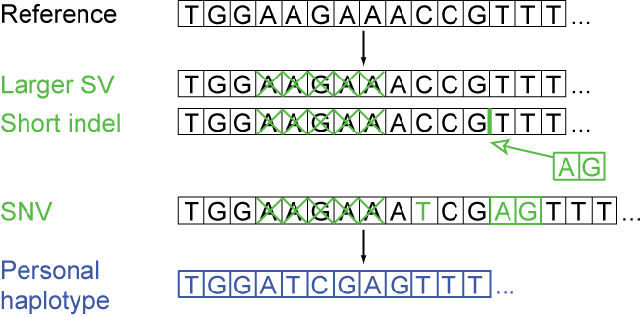
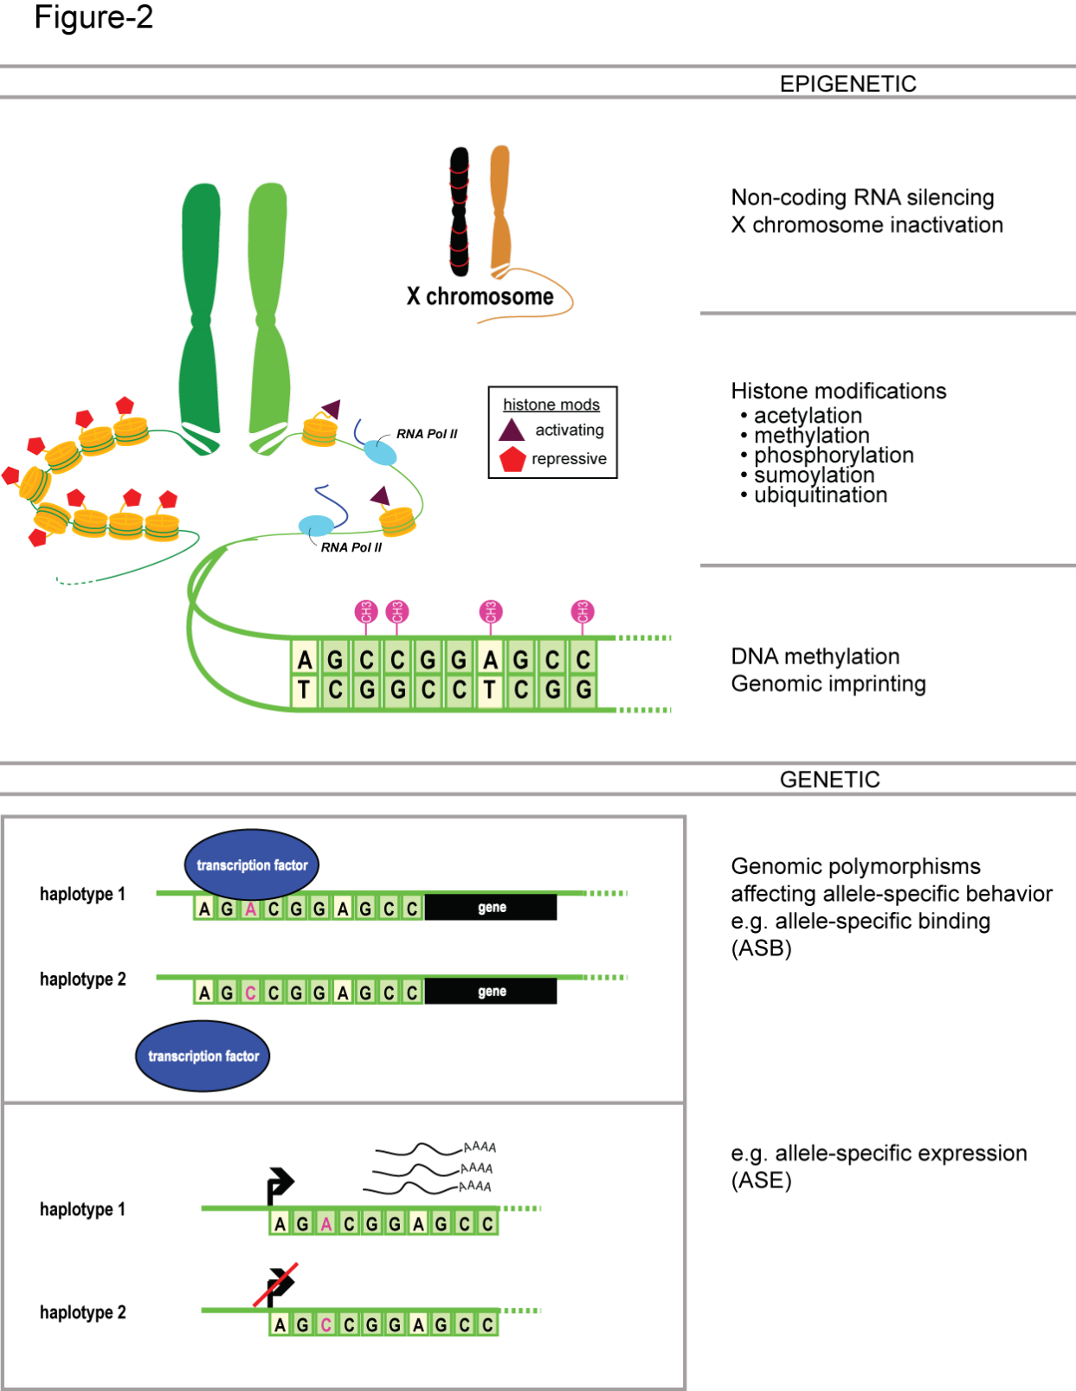
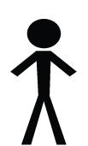
Personal genome construction
M
P
Some factors to consider
choice of reference (e.g. hg19 vs GRCh38)
choice of call set (e.g different versions of 1000KG call sets)
choice of variants (e.g. SVs or indels or SNVs only)
Rozowsky et al. Mol Syst Biol (2012)

Slide 7
Transcriptome mapping
Number of exons
Reference
genome
Pgenome: snvs+indels+svs
Pgenome: snvs+indels
280,123 consensus exons
Oliver Stegle and Jieming Chen

Slide 8
NA12878 RNA-seq (Kilpinen et al.)
 | Ref genome (GRCh37) | Pgenome: snvs + indels only | Pgenome: snvs + indels + SVs
# reads aligned | 37,435,162 | 37,702,108 | 37,707,787
Oliver Stegle and Jieming Chen

Slide 9
Utility of SVs:
Exons with direct SV overlap
Comparing between Pgenome-SVs compared to the Pgenome-snpsIndels
18 exons with a direct SV overlap
→ 6/18 exons were expressed (>10 reads)
→ 4/6 showed substantial changes in expression (≥ 1 fold change) when using the

Slide 10
Overlap of reads over indels and SVs
The SNP-based reference resulted in 535 consensus exons with a profound change in expression compared to the GRCh37 reference (+/- 10 or more reads change, 1 fold change), whereas the SNPs+SVs reference resulted in 525 exons with a similar change in expression compared to the GRCh37 reference genome. The direct comparison between the SNP- and SNPs+SVs-genomes revealed 24 exons with a marked change in expression (+/- 10 or more reads change, 1 fold change), 18 of which were included in the set of 535 exons mentioned above.

