Slide 1

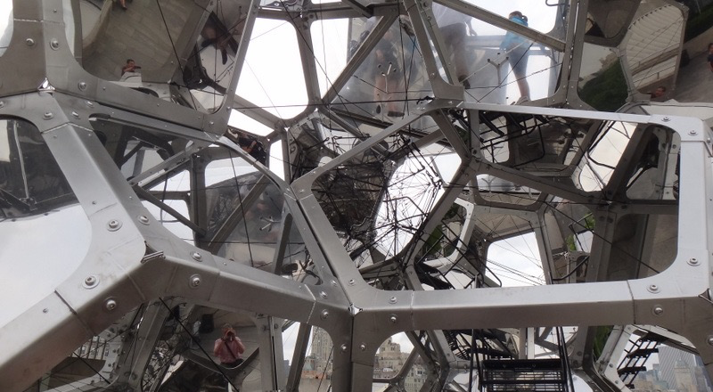
Genomic Privacy:
Intertwined Social & Technical Aspects
1 (c) Mark Gerstein, 2002, Yale, bioinfo.mbb.yale.edu
Mark Gerstein
Yale
See last slide for references & more info.
Notes:
1

Slide 2
Genomic Privacy: Intertwined Social & Technical Issues
Setting the Stage: the Advent of Personal Genomics
The Conundrum of
Genomic Privacy
  Fundamental, inherited info that’s very private vs need for the need for large-scale data-sharing to enable medical research
Current Social & Tech Approaches
  GINA, Consents &
  "Secure" use of dbGAP
  Ways the solutions have been partially "hacked"
  Strawman
  Hybrid Soc-Tech Approach (Licensure + Cloud Enclaves)
RNA-seq – practical problem of effectively sharing much of the info
  Removing SNVs in reads using MRF
  Removing variant info from quantifications + eQTLs
  Further complications: SVs in pervasive transcription?

