Slide 1
Personal genome construction with SVs

Slide 2
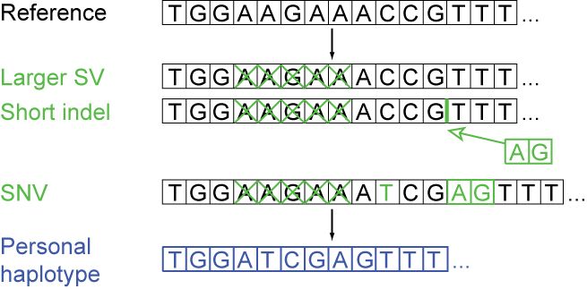
Personal genome construction
M
P
Some factors to consider
choice of reference
choice of call set
choice of variants
order of variants
Rozowsky et al. Mol Syst Biol (2012)

Slide 3
NA12878 POL2 combined (compare read mappings)
 | Ref genome | Pgenome: snvs only | Pgenome: snvs + indels only | Pgenome: snvs + indels + SVs
Reads processed | 208,051,087 | 208,051,087 | 208,051,087 | 208,051,087
# reads uniquely aligned | 171,944,588 (82.65%) | 172,591,380 (82.96%) M: 171,965,218 (82.66%) P: 171,969,566 (82.66%) | M: 171,982,014 (82.66%) P: 171,982,614 (82.66%) | 172,743,175 (83.03%) M: 171,977,765 (82.66%) P: 171,978,147 (82.66%)
# reads that failed to align | 18,279,824 (8.79%) | M: 18,290,611 (8.79%) P: 18,276,409 (8.78%) | M: 18,286,906 (8.79%) P: 18,270,944 (8.78%) | M: 18,293,522 (8.79%) P: 18,277,990 (8.79%)
# reads that multimap | 17,826,675 (8.57%) | M: 17,795,258 (8.55%) P: 17,805,112 (8.56%) | M: 17,782,167 (8.55%) P: 17,797,529 (8.55%) | M: 17,779,800 (8.55%) P: 17,794,950 (8.55%)

Slide 4
NA12878 RNA-seq combined (compare read mappings)
 | Ref genome | Pgenome: snvs only | Pgenome: snvs + indels only | Pgenome: snvs + indels + SVs
Reads processed
# reads uniquely aligned
# reads that failed to align
# reads that multimap

Slide 5
Transcriptome mapping
Number of exons
Ref
Ref+snvs+indels+svs
Ref+snvs+indels
280,123 consensus exons
Oliver Stegle and Jieming Chen

Slide 6
NA12878 RNA-seq (Kilpinen et al.)
 | Ref genome (GRCh37) | Pgenome: snvs + indels only | Pgenome: snvs + indels + SVs
# reads aligned | 37,435,162 | 37,702,108 | 37,707,787
Oliver Stegle and Jieming Chen

Slide 7
Exons with direct SV overlap
18 exons with a direct SV overlap. Six of these 18 exons were expressed (>10 reads) and of these, four exhibited substantial changes in expression (+/- 10 reads, 1 fold change) when using the Pgenome-SVs compared to the Pgenome-snpsIndels

Slide 8
Overlap of reads over indels and SVs
The SNP-based reference resulted in 535 consensus exons with a profound change in expression compared to the GRCh37 reference (+/- 10 or more reads change, 1 fold change), whereas the SNPs+SVs reference resulted in 525 exons with a similar change in expression compared to the GRCh37 reference genome. The direct comparison between the SNP- and SNPs+SVs-genomes revealed 24 exons with a marked change in expression (+/- 10 or more reads change, 1 fold change), 18 of which were included in the set of 535 exons mentioned above.
18 exons with a direct SV overlap. Six of these 18 exons were expressed (>10 reads) and of these, four exhibited substantial changes in expression (+/- 10 reads, 1 fold change) when using the SNPs+SVs-genome compared to the SNPs-genome

