Slide 1
GM
AH
9.29.2015

Slide 2
Genomic Privacy: Introduction
Early studies on Genomic Privacy are on protecting the participants of genomic studies:
  Individuals give consent to participate but request anonymity
    HAPMAP, Personal genome project, 1000 Genomes…
  Privacy risk is about whether an individual’s participation can be raliably predicted or not
  Homer et al showed that existence of a genotyped individuals can be reliably predicted in a mixed pool of DNA samples, where only allele frequencies are known.
    The main idea is that each individual harbors many low frequency alleles, which can be detected statistically
  Another application in forensics: “Take a sample from a crime scene, and check whether a suspect was there or not recently.”

Slide 3
Genomic Privacy (Introduction)
Im et al extended this to QTL studies and shows that given the regression coefficients from a QTL study, an adversary can predict existence of an individual in the study
We classify these “attacks” as “detection of a genome in a mixture” attacks, where the existence of an individual (who is genotyped) is predicted in a pool of samples.
As the size of the genotyping (and phenotyping) datasets changes, the sources of privacy risk also change

Slide 4
Genomic Privacy: Introduction
As the size of datasets increase, and more individuals take part in more and unrelated datasets, the possibility of an attacker to “link” these datasets increase:
Netflix Competition Database and Consequent Attack:
  Netflix released the movie choice and viewing records for 500,000 users, dataset was anonymized by removing the names.
  The dataset was aimed to be a resource for researchers
  Narayanan et al was smarter; they linked the dataset’s records to the records in The Internet Movie Database (IMDb), and revealed sensitive movie viewing/preference information for many individuals (and published it)
    Netflix was sued as a result and had to stop the competition. (Good job Arvind)

Slide 5
Genomic Privacy: Introduction
Similarly, Latanya Sweeney showed that health records of many individuals can be identified by linking the entries in the Group Insurance Commission’s records and the yellow pages, which includes the records for Governer of Massachusetts
Two main properties of the datasets:
  High dimensionality: The data has very high dimensions
    # of SNPs in a genotype dataset
  Sparsity: For each individual, most of the features do not create an issue by themselves
    Most of the SNPs are common, i.e., not give much information for breaching privacy
The privacy breach is caused by pinpoint-ability of an individual when the large set of features are considered together.

Slide 6
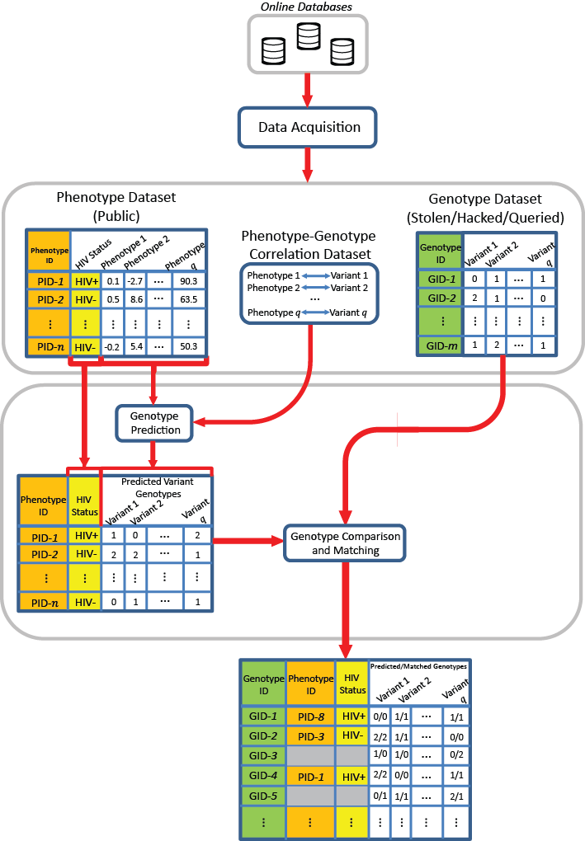
Linking Attack Scenario

Slide 7
Linking Attack Scenario

Slide 8
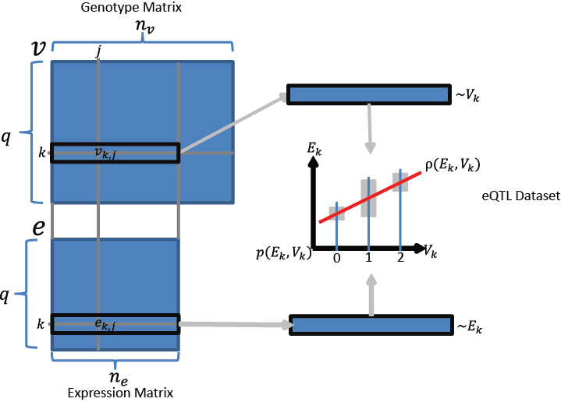
Expression, Genotype and eQTL Datasets

Slide 9

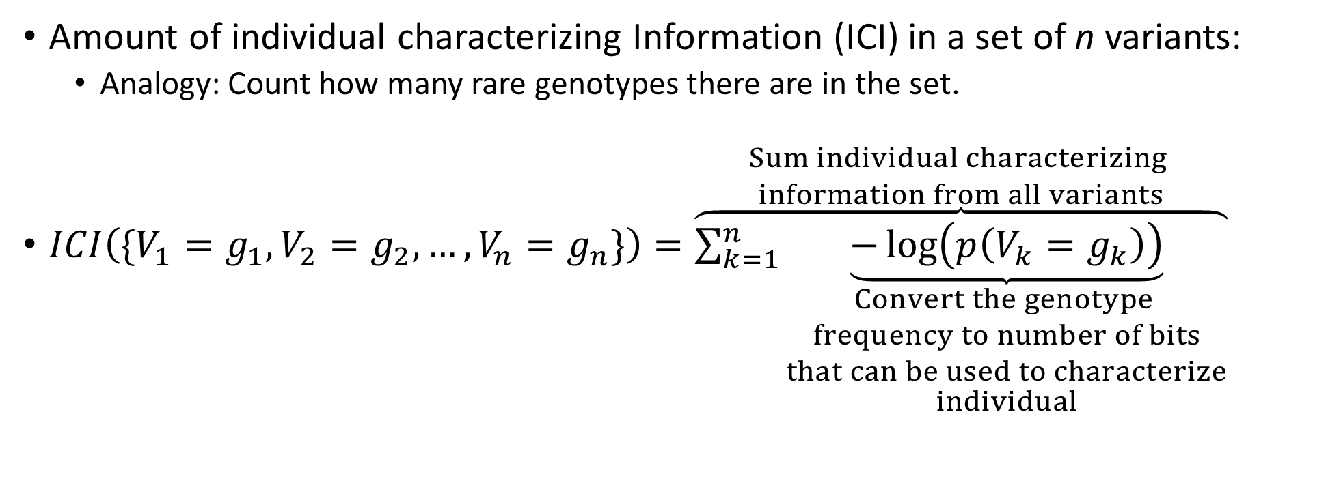
Individual Characterizing Information
Amount of individual characterizing Information (ICI) in a set of n variants:
  Analogy: Count how many rare genotypes there are in the set.
$ICI\left(\{V_{1}=g_{1},V_{2}=g_{2},…,V_{n}=g_{n}\}\right)=\overset{\begin{aligned}Sum individual characterizing \\ information from all variants\end{aligned}}{\overbrace{\sum_{k=1}^{n}{\underset{\begin{aligned}Convert the genotype \\ frequency to number of bits \\ that can be used to characterize \\ individual\end{aligned}}{\underbrace{−\log\left(p\left(V_{k}=g_{k}\right)\right)}}}}}$
  Variant 1
  Genotype
  Variant 2
  Genotype
  Variant n
  Genotype
$$(g_{i}∈\text{\{0,1,}\text{2}\text{\}}\text{)}$$

Slide 10
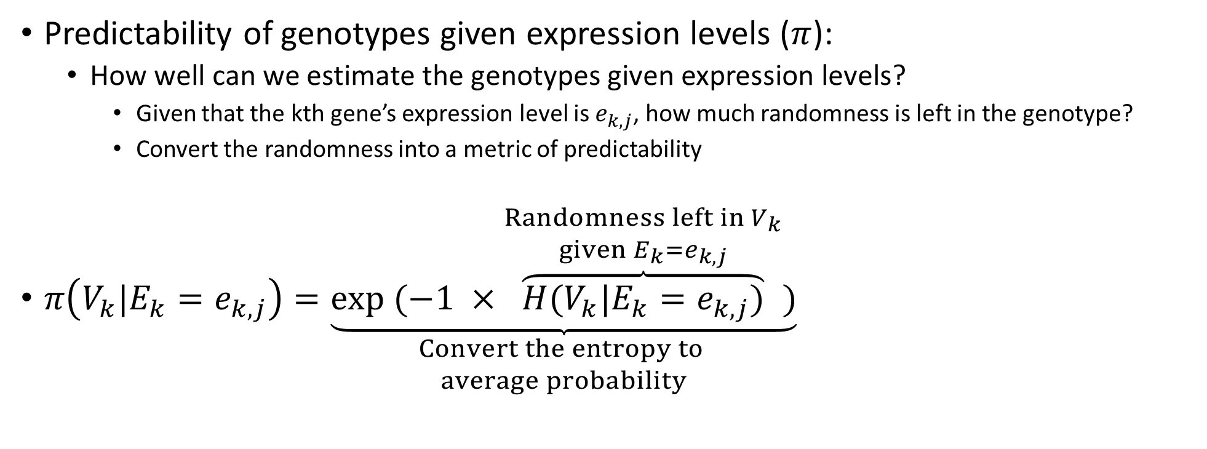
Predictability of Genotypes
Predictability of genotypes given expression levels ($π$):
  How well can we estimate the genotypes given expression levels?
    Given that the kth gene’s expression level is $e_{k,j}$, how much randomness is left in the genotype?
    Convert the randomness into a metric of predictability
$π\left(V_{k}|E_{k}=e_{k,j}\right)=\underset{\begin{aligned}Convert the entropy to \\ average probability\end{aligned}}{\underbrace{exp (−1 ×\overset{\begin{aligned}Randomness left in V_{k} \\ given E_{k}=e_{k,j}\end{aligned}}{\overbrace{H(V_{k}|E_{k}=e_{k,j})}})}}$

Slide 11
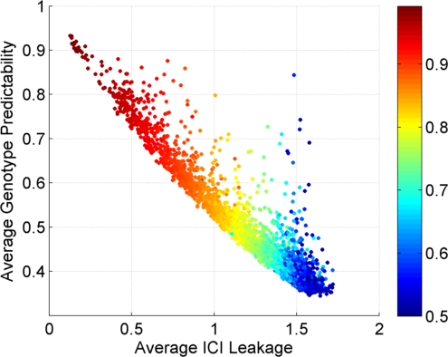
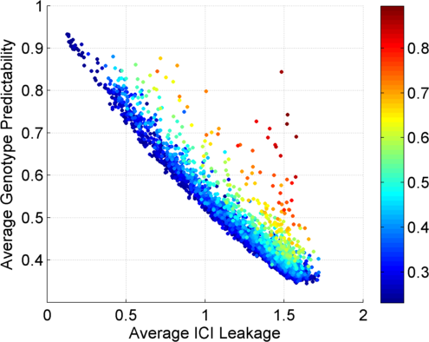
Per eQTL Predictability vs ICI Leakage
Colors by Major Allele Frequency
Colors by Absolute Correlation
Major Allele Frequency
Absolute Correlation
Common eQTLs: Easy to predict; bring low ICI
Less common eQTLs: Harder to predict; bring high ICI

Slide 12
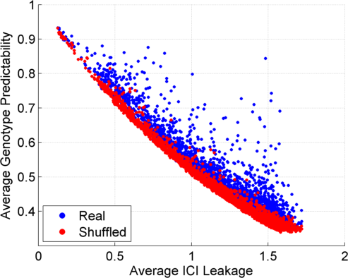
Per eQTL Predictability vs ICI Leakage

Slide 13


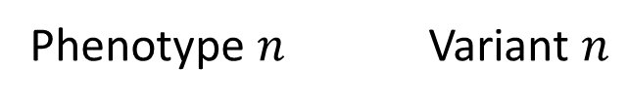

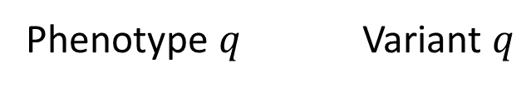


Cumulative Usage of Genotype Predictions
$$ρ_{1}$$
Phenotype 1 Variant 1
Vulnerable Individual
$$ρ_{2}$$
Non-vulnerable Individual
Phenotype 2 Variant 2
…
Increasing Fraction of Individuals with Mispredicted Genotypes
Decreasing Phenotype-Genotype
Correlation and Predictability
Increasing Number of Potentially
Characterizeable Individuals
$$ρ_{k}$$
Phenotype $n$ Variant $n$
…
$$ρ_{q}$$
Phenotype $q$ Variant $q$
$${|ρ}_{1}\left|>{|ρ}_{2}\right|>…>{|ρ}_{q}|$$

Slide 14
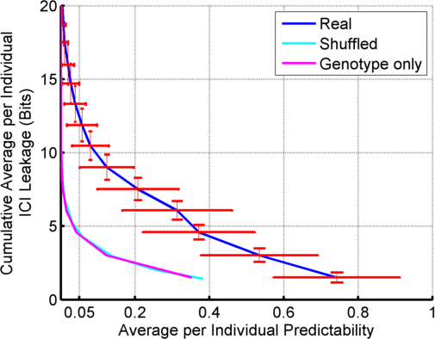
Predictability vs Leakage for Multiple eQTLs

Slide 15
Three Steps of a Linking Attack
Step 1
Step 2
Step 3
Gender, Population, Age
G-P
Correlation
Dataset
Prediction
Methodology
Auxiliary Information
Phenotype and Genotype Selection
Genotype Prediction
Linking
Absolute Value of Correlation
Maximum a Posteriori Genotype
Minimum Distance between Predicted and Individual Genotypes

Slide 16
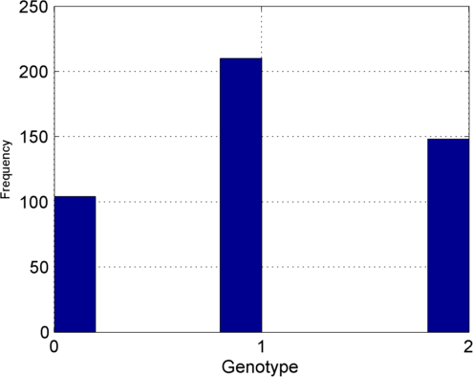
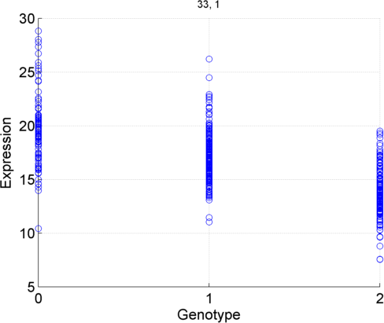
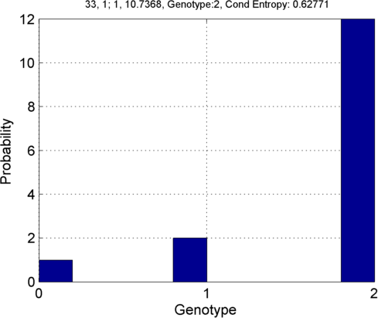




GEUVADIS eQTLs, 1 kG Genotypes and GEUVADIS Expression Levels
Posterior:
  Prior: $p\left(V_{k} \right)$
  Joint: $p\left(V_{k}, E_{k}\right)$
  $$p\left(V_{k} | E_{k}=10\right)$$
$${v′}_{k,j}^{}=2$$

Slide 17
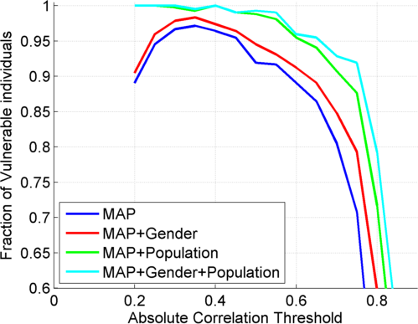
GEUVADIS eQTLs, 1 kG Genotypes and GEUVADIS Expression Levels

Slide 18
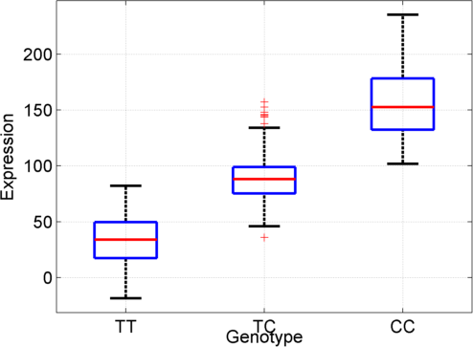
Simplification: Extremity based Genotype Prediction
Negative Extremity
Positive Extremity
Frequency
Expression
Lower expression:
Negative Extremity
Most likely TT
Higher expression:
Positive Extremity
Most likely CC

Slide 19
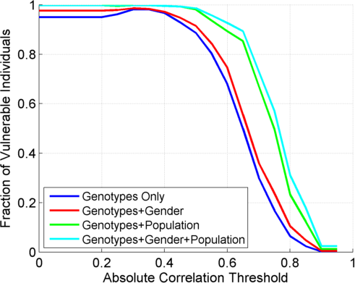
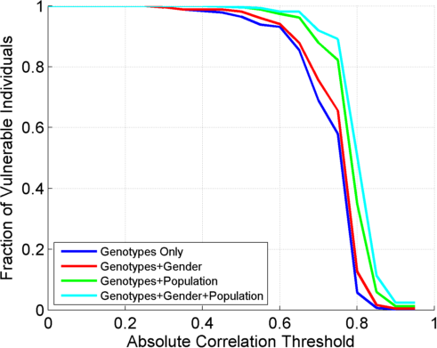
Extremity Based Prediction
All Genotype Matching
Homozygous Genotype Matching

Slide 20
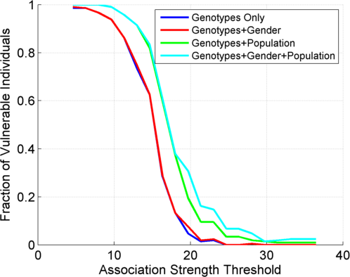
eQTL Training and Testing Datasets Separate

Slide 21
Which 85%?
One logical question is: The risk may seem unimportant when accuracy goes below, for example, 85%.
  Out of 20 individuals, 3 are incorrectly linked; but attacker does not know which 3 those are.
Is there a way for the attacker to evaluate the reliability of the linkings?
  We use first distance gap:
    The difference between the distances of the top and the second top matching individuals can be used as such a metric to evaluate linking reliability:
      Small (High) first distance gap: Low (High) reliability linking

Slide 22
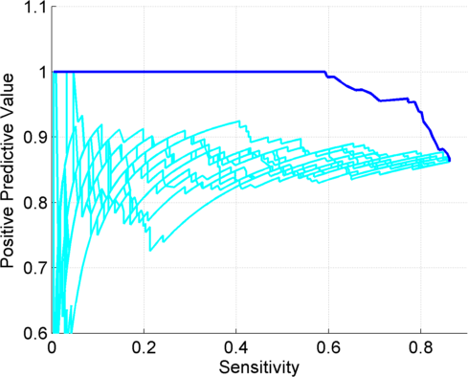
Sensitivity vs PPV for Linkings sorted per First Distance Gap

Slide 23

Put it together..
ICI
QTL Discovery
$$π$$
QTL Identification
Significant
Quantitative
Trait Loci
Leakage vs Predictability Quantification
Risk Assessment
Joint Genotyping
And Phenotyping
Phenotype
Dataset
External
QTL Databases
Genotype
Dataset
Application of
3-step
Linking Attacks
Risk Assessment
Linking
Accuracy
QTL Selection

