Slide 2
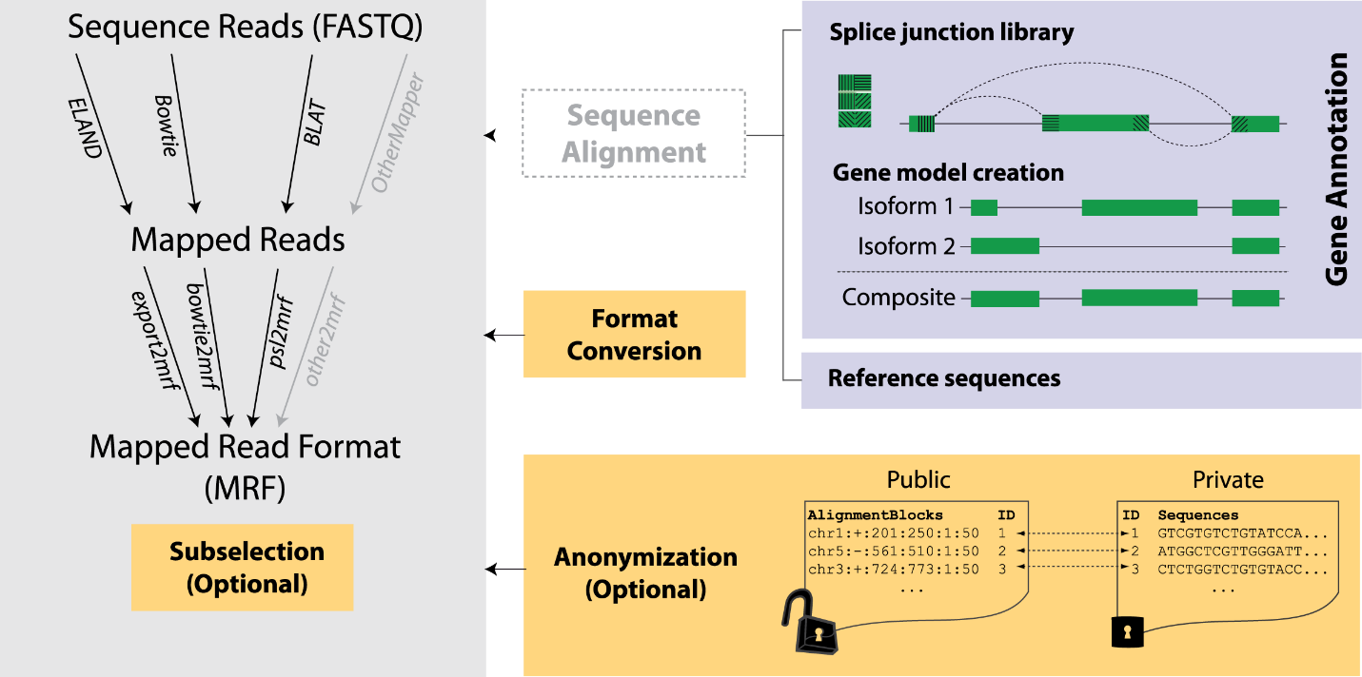

Slide 4
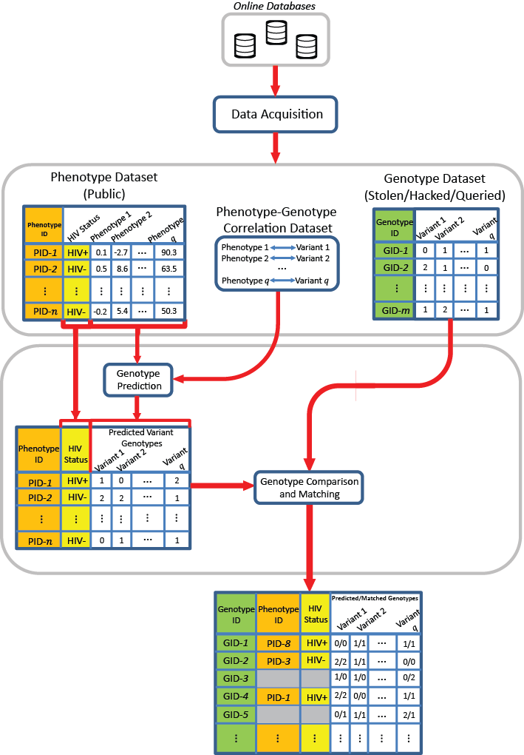
Attack based on quantifications and eQTLs
One can still perform an attack if he/she has access to quantifications.

Slide 5
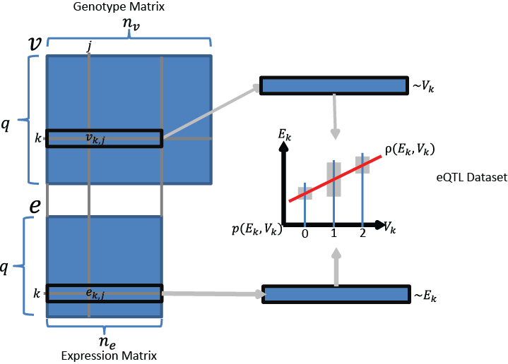

Slide 6
Amount of individual characterizing Information (ICI) in a set of n variants:
Analogy: Count how many rare genotypes there are in the set.
$ICI\left(\{V_{1}=g_{1},V_{2}=g_{2},…,V_{n}=g_{n}\}\right)=\overset{\begin{aligned}Sum individual characterizing \\ information from all variants\end{aligned}}{\overbrace{\sum_{k=1}^{n}{\underset{\begin{aligned}Convert the genotype \\ frequency to number of bits \\ that can be used to characterize \\ individual\end{aligned}}{\underbrace{−\log\left(p\left(V_{k}=g_{k}\right)\right)}}}}}$
Variant 1
Genotype
Variant 2
Genotype
Variant n
Genotype
$$(g_{i}∈\text{\{0,1,}\text{2}\text{\}}\text{)}$$

Slide 7
Amount of individual characterizing Information (ICI) in a set of n variants:
Analogy: Count how many rare genotypes there are in the set.

Slide 8
Predictability of genotypes given expression levels ($π$):
How well can we estimate the genotypes given expression levels?
Given that the kth gene’s expression level is $e_{k,j}$, how much randomness is left in the genotype?
Convert the randomness into a metric of predictability
$π\left(V_{k}|E_{k}=e_{k,j}\right)=\underset{\begin{aligned}Convert the entropy to \\ average probability\end{aligned}}{\underbrace{exp (−1 ×\overset{\begin{aligned}Randomness left in V_{k} \\ given E_{k}=e_{k,j}\end{aligned}}{\overbrace{H(V_{k}|E_{k}=e_{k,j})}})}}$

Slide 9
Predictability of genotypes given expression levels ($π$):
How well can we estimate the genotypes given expression levels?
Given that the kth gene’s expression level is $e_{k,j}$, how much randomness is left in the genotype?
Convert the randomness into a metric of predictability

Slide 10
Merged slides
Amount of individual characterizing Information (ICI) in a set of n variants:
How many rare genotypes there are in the set?
Predictability of genotypes given expression levels ($π$): Given that the kth gene’s expression level is , how much randomness is left in the genotype?

Slide 11
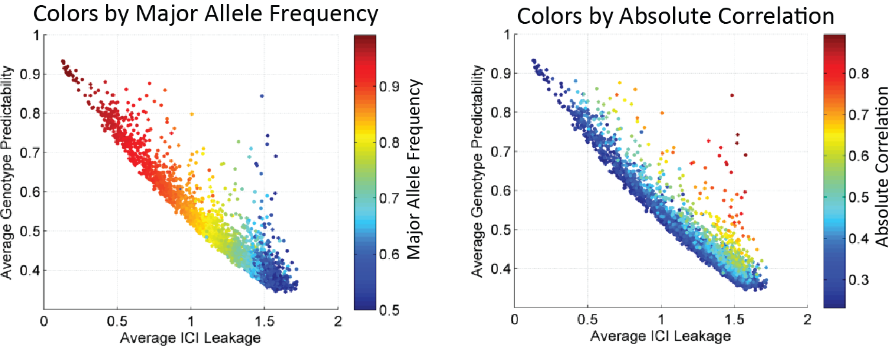
[[Replace w. Equations]]

Slide 12
