Slide 1
Genome Remodelling ~ A Pseudogene Case Study ~

Slide 2
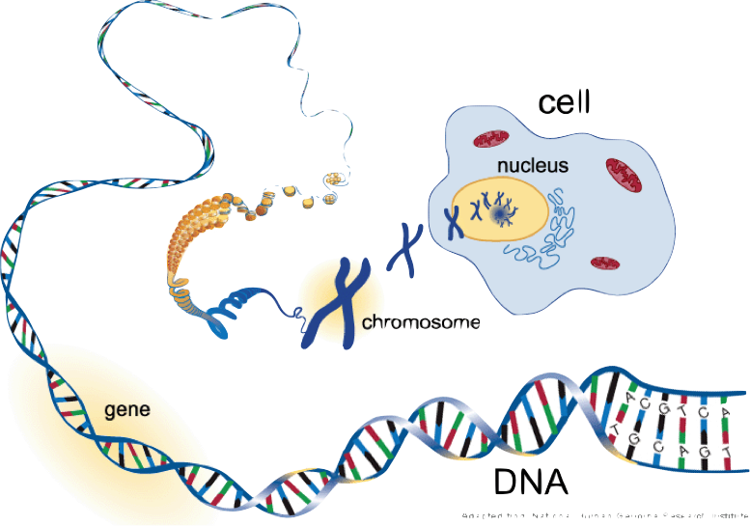
Adapted from National Human Genome Research Institute

Slide 3
How do genomes evolve?

Slide 4
A mutation is a change in the DNA sequence. A natural process, it is the elementary unit of genome evolution.

Slide 5
Consequences of mutations
Changes in gene order -> genome rearrangements
reversal
translocations
fusion
fission
Changes in gene sequence
Point mutations:
duplications
insertions
deletions
Gene gain:
duplication
retrotransposition
Gene loss — deletion
One or more genes per event
Evolution of genome
architecture
Evolution of
genome content

Slide 6
Consequences of mutations
Changes in gene order -> genome rearrangements
reversal
translocations
fusion
fission
Changes in gene sequence
Point mutations:
duplications
insertions
deletions
Gene gain:
duplication
retrotransposition
Gene loss — deletion
One or more genes per event
Evolution of genome
architecture
Evolution of
genome content

Slide 7
Genome rearrangements
Appear when a large piece of chromosome is copied or moved to another location
Have important and usually fatally consequences for the evolution of the organisms
Sequence alignments do not capture genome rearrangements…
… two species may have nearly the same gene sequences, but in a different order.
1
2
3
4
5
1
-5
4
-3
2

Slide 8
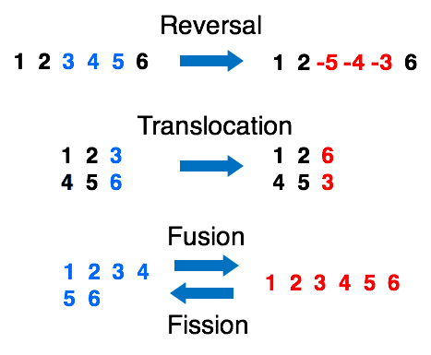
Types of rearrangements

Slide 9
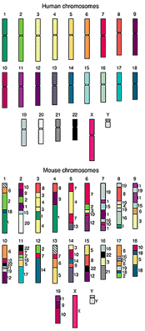
Importance
Genome rearrangements give insights into the genome evolution and species differentiation
The number of rearrangements needed to transform one genome into another can be used to measure the evolutionary distance between the genomes

Slide 10
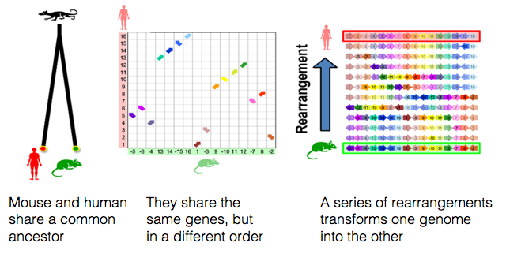
Mouse 2 Human
There are approximately 245 genome rearrangements between mouse and human

Slide 11
Computational challenges
Goal: Given two sequences of genes, find the shortest series of reversals that transforms one into another
Input: Sequences Α and Β
Output: A series of reversals r1,…,rt transforming Α into Β, such that t is minimum
t - reversal distance between Α and Β
drev(Α, Β) - smallest possible value of t, given Α and Β − measure of evolutionary distance
Solution:
greedy sort algorithm - make the locally optimal choice —> not optimum overall
Challenge: —> improve the sorting algorithm
Notes:
A breakpoint is a pair of adjacent elements that are not consecutive

Slide 12
Web tools
GRIMM Web Server
computes signed and unsigned reversal distances between permutations
http://grimm.ucsd.edu/cgi-bin/grimm.cgi
Cinteny
a web server for synteny identification and the analysis of genome rearrangement
http://cinteny.cchmc.org/

Slide 13
Summary - Genome rearrangements
define the genome architecture
4 types: reversal, translocation, fusion, fission
sequence alignment cannot be use to study them
are useful in studying genome evolution
can be used in determining the evolutionary distance between species
computationally analysed using sorting algorithms

Slide 14
Consequences of mutations
Changes in gene order
reversal
translocations
fusion
fission
Changes in gene sequence
Point mutations:
duplications
insertions
deletions
Gene gain:
duplication
retrotransposition
Gene loss — deletion
One or more genes per event
Evolution of genome
arrangements
Evolution of
genome content

Slide 15
Evolution of genome content
Point mutations
Insertion …ATGGCG… → …ATGTGCG…
Deletion …ATGTGCG…→ …ATGGCG…
Substitution …ATGTGCG…→…ATGCGCG…
…ATG--CATGTGCGATGTGCG… …ATGTGCATG-GCGATGCGCG…
DNA sequence alignment showing matches, mismatches, and insertions/deletions

Slide 16
Evolution of genome content
Large scale sequence chances
Ancestral State
1
2
Duplication
1
2
1’
2’
segmental duplication
paralogs
Duplication
1
2
2’
2’’
family

Slide 17
Evolution of genome content
Large scale gene chances
Ancestral State
1
2
Duplication
1
2
1’
2’
2’’
Deletion
1
Insertion
1
Retrotransposition
1
r1

Slide 18
Summary - sequence alterations
define the genome content
various types: duplications, insertions, deletions, retrotranspositions
segmental duplications - large scale duplications
paralogs - 2 genes related by a duplication event
family - group of genes that evolved from a common ancestral gene
sequence alignment is very useful in studying them
gives information about the evolution of gene functions

Slide 19
What happens if the sequence mutation induces a premature stop codon or a frame shifts ?

Slide 20
A pseudogene is born
Pseudogenes are genomic DNA sequences similar to normal genes but non-functional; they are regarded as defunct relatives of functional genes.

Slide 21
Formal properties of pseudogenes
inheritable
homologous to functioning protein coding genes
no longer expressed in the cell
Free to accumulate mutations
Frame shifts & stop codons
Small insertions & deletions

Slide 22
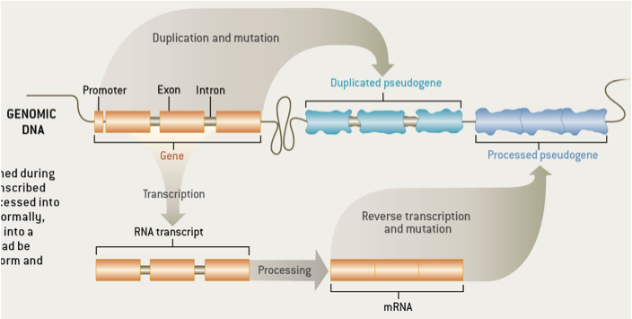
Zoom in - pseudogene formation

Slide 23
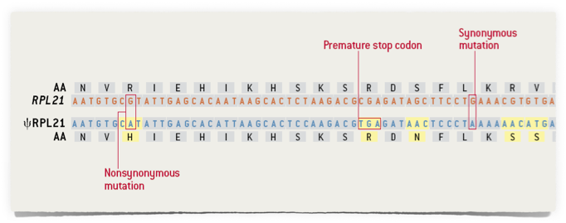
Anatomy of a pseudogene

Slide 24
How do you study pseudogenes?
Manual curation
Automatic pipelines
Genesis
Localisation
Evolution
Family
Activity features
Transcription
Pol2
Chromatin
Upstream sequence
Conservation
Translation
Expression

Slide 25
Annotation
Input:
protein sequence database: SwissProt, Ensembl
genome sequence
repeat masked sequence!
Alignment, filtering & processing:
sequence alignment between reference genome and the protein database —> *tblastn*
remove redundant hits
identify parent genes
Biotype determination:
alignment to parent sequence
—> check the preservation of the intron-exon structure - duplicated
—> polyA tail check - processed
Available pipelines:
PseudoPipe, Retrofinder, RCPedia

Slide 26
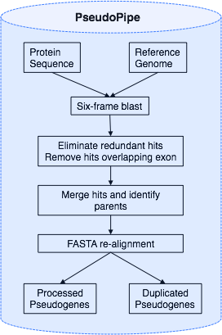
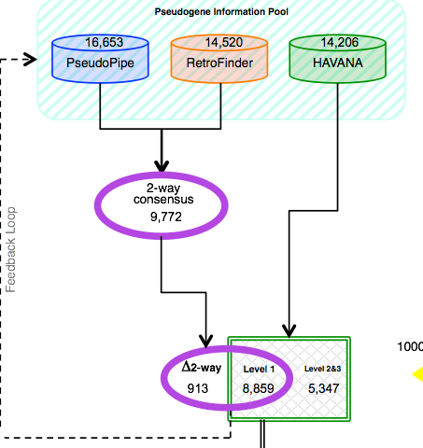
Human pseudogene annotation
http://www.gencodegenes.org

Slide 27
Challenges in pseudogene annotation
Who’s the parent?
High similarity to functional homologs
Highly divergent sequence
A pseudogene annotation is just as good as a the protein coding annotation

Slide 28
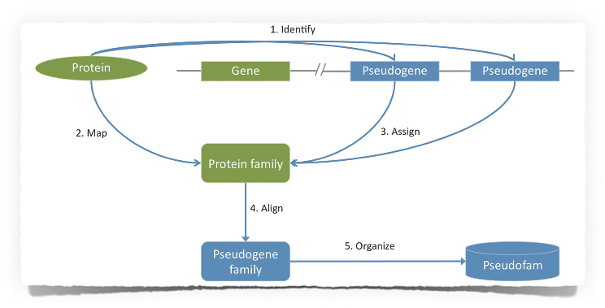
Pseudogene family
One gene can create multiple pseudogenes, both processed and duplicated
A pseudogene family is a group of pseudogenes with parents from the same PFAM protein family
Pseudofam - online database of pseudogene families
uses an ontology to annotate and organise pseudogenes
http://pseudofam.pseudogene.org

Slide 29
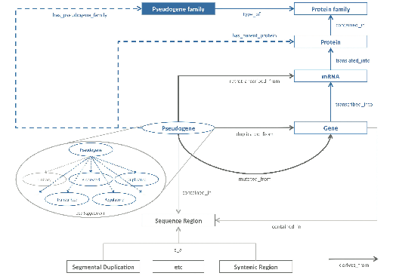
Pseudogene ontology
An ontology
- uses a controlled vocabulary
- provides a conceptualisation of a knowledge domain that is both human and computer comprehensible

Slide 30
Pseudogene transcription
Input:
RNA-seq data
genome annotation
genome mappability map
- for each nucleotide select 75 bp sequences and align them using blast against the rest of the genome
- score nucleotide as 1 if no matching sequences are found
- score nucleotide as 0 if at least 1 matching sequence is found
select pseudogene/ parent gene exonic regions longer than 100 bp with mappability of 1

Slide 31
Pseudogene transcription
Processing:
align reads to the reference genome
select uniquely mapped reads to the pseudogene sequence
quantify the pseudogene transcripts
mapped reads using RPKM Reads Per Kilobase of transcript per Million mapped read
Output:
define expression treshold & select transcribed pseudogenes

Slide 32
Pseudogene transcription
RPKM treshold for defining gene expression in ENCODE data is 5
Using a RPKM threshold of 2, 15% of human pseudogenes are transcribed

Slide 33
Summary - pseudogenes
pseudogene are disabled sequences similar to protein coding genes
through their formation, pseudogene record genome remodelling processes
there are two types of pseudogenes: duplicated and processed
pseudogenes can be grouped into families just like their functional homologues and are organised using ontology relationships
some pseudogenes are transcribed

Slide 34
Questions?

Slide 35
e.g. Turnip vs Cabbage
In 1980s Jeffrey Palmer studied evolution of plant organelles by comparing mitochondrial genomes of the cabbage and turnip
Although cabbages and turnips share a recent common ancestor, they look and taste different
99% similarity between genes but different gene orders
1
2
3
4
5
1
-5
4
-3
2

Slide 36
e.g. Turnip vs Cabbage
1
-5
4
-3
2
1
-5
4
-3
-2
1
-5
-4
-3
-2
1
2
3
4
5

