Slide 1
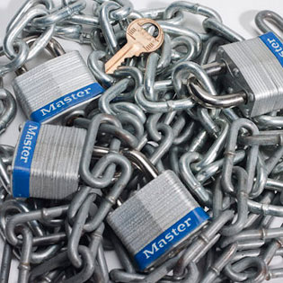
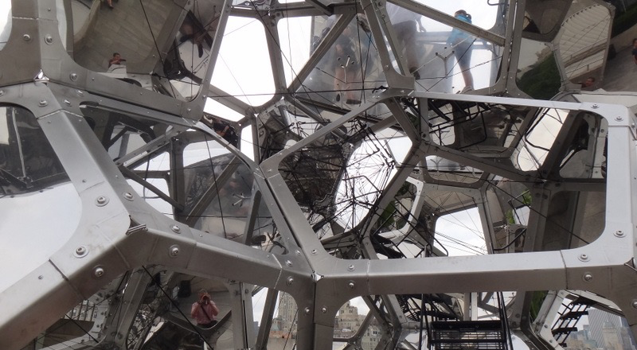
Genomic Privacy:
ADD IN AH’s slide + in the refernce [AH et al. Nat. Meth. (in revision)]
Proposed Social & Technological Solutions to Issues of Data Privacy in Personal Genomics
(Licensure, Secondary Datasets, Enclaves)
Mark Gerstein
Yale
1 (c) Mark Gerstein, 2002, Yale, bioinfo.mbb.yale.edu
Slides freely downloadable from
Lectures.GersteinLab.org
& “tweetable” (via @markgerstein).
See last slide
for references & more info.
Notes:
1

Slide 2
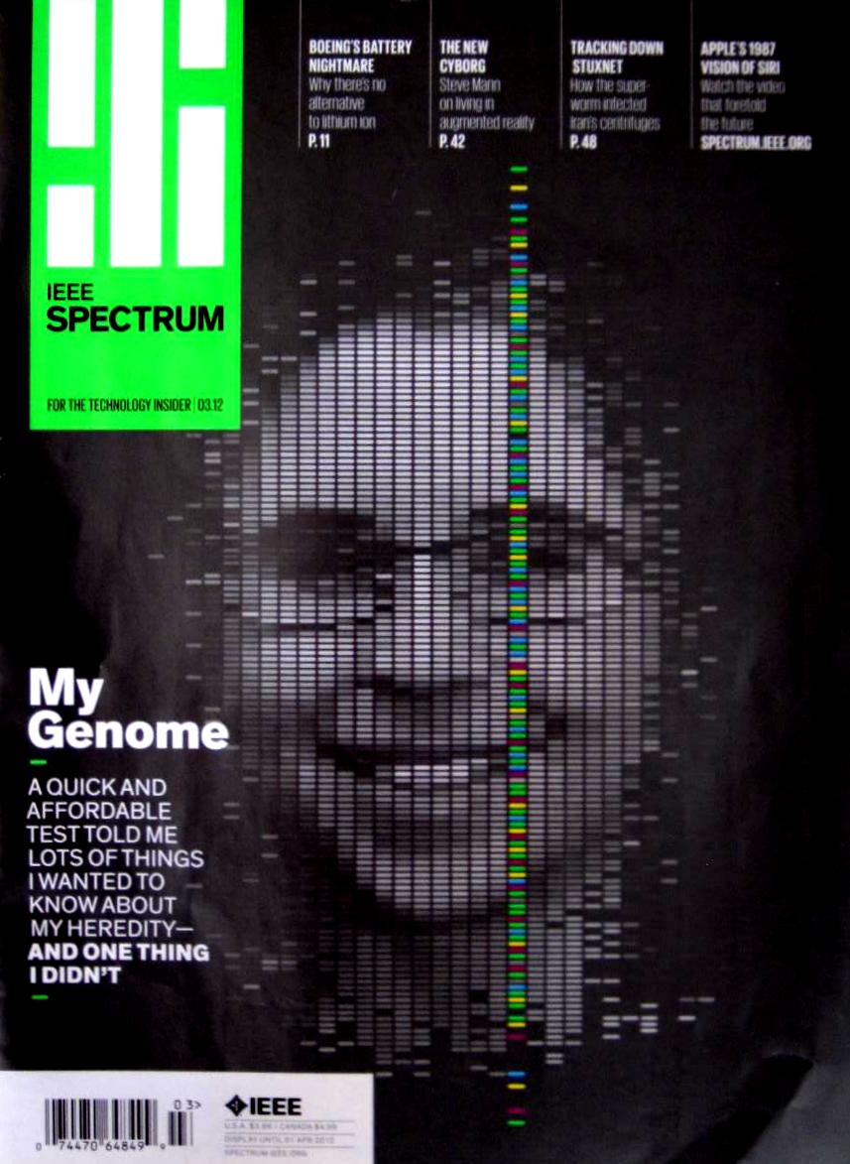
Setting the Stage: the Advent of Personal Genomics
Human Genome sequence in 2000 for ~$3 billion
A Human Genome can be sequenced today for ~$1000
Thousands of SNPs can be interrogated for ~$99

Slide 3
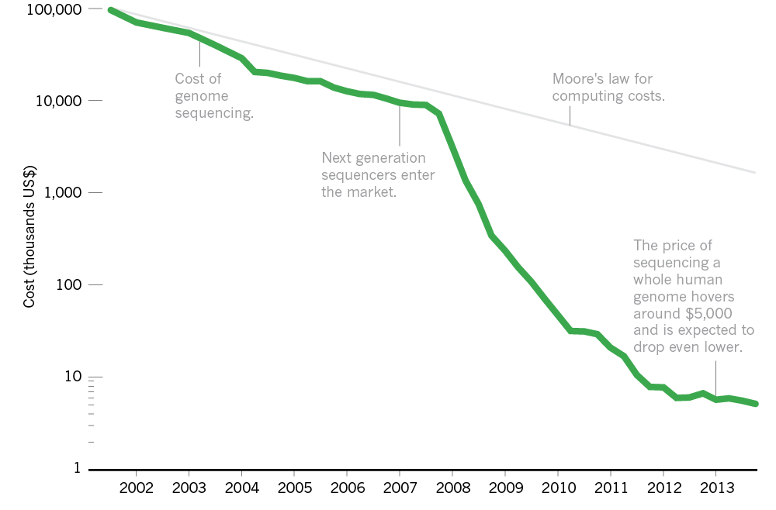
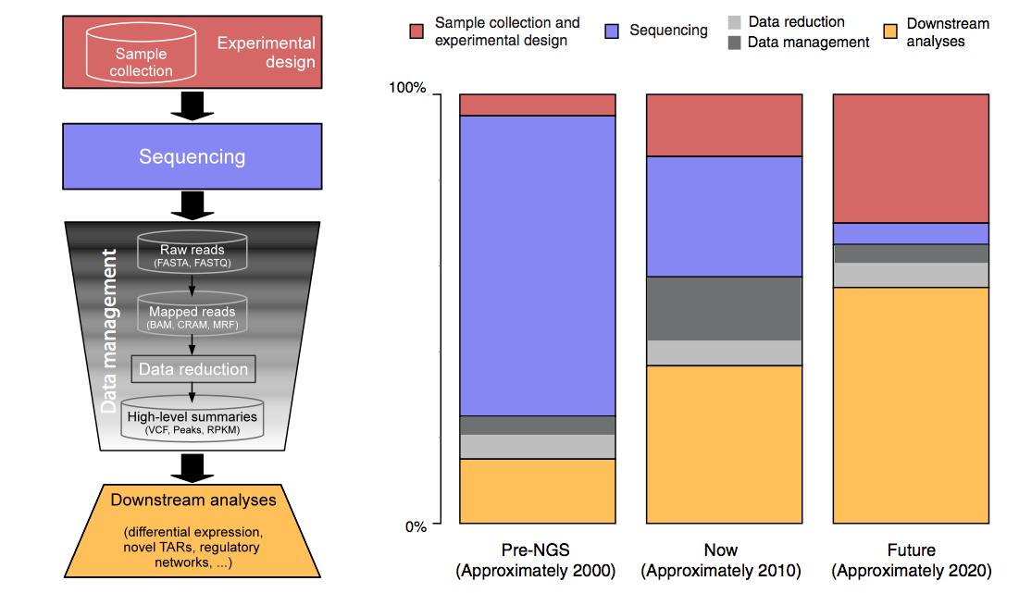
The Explosion of Data in Genomics: the Numbers
$5K
'07
From ‘00 to ~’20,
cost of DNA sequencing expt. shifts from the actual seq. to sample
collection & analysis
[Nature 507, 294; Sboner et al. (‘11) GenomeBiology ]

Slide 4
DTC Genomics
23 & me
Industry spurred by falling prices of sequencing and computation
Major players were Navigenics, DeCode & 23andMe.
23andMe
  has >1M Customers
  $99 per analyiss
  Promotes sharing of Data
  Currently in trouble with the FDA and limited to only recreational (e.g., ancestry related) analysis
  Millions in VC funding

Slide 5
Genomic Privacy: Thoughts on Social & Technical Aspects
Setting the Stage: the Advent of Personal Genomics
The Conundrum of Genomic Privacy
  Fundamental, inherited info v need for data-sharing to enable research
Current Social & Tech Approaches
  GINA, Consents &
  "Secure" use of dbGAP
  Ways the solutions have been "hacked"
  Strawman
  Hybrid Soc-Tech Approach
    Soc: Licensure for genomic researchers
    Enclaves in the cloud
RNA-seq Data – how much information is leaked & how to make it more private?
  Variants in the Reads
    Intelligent data formats mostly splitting private & public info
    (ex of MRF)
  Variants from Quantifications & eQTLs
  Any SVs in pervasive transcription?

Slide 6
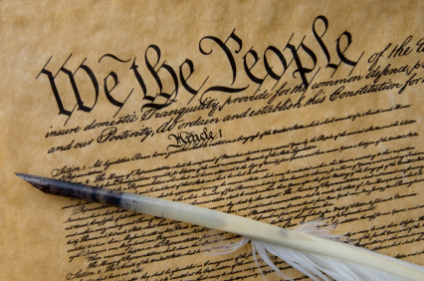
Privacy
  Privacy is a personal and fundamental right guaranteed by the US Constitution
  Privacy Act 1974
  Including:
  Inherent in the limits on the First Amendment is a constitutional right to privacy.
  Fourth Amendment against search and seizure US v Amerson 483 F. 3d 73 (2d Cir. 2007);
  Due Process Clauses of the Fifth and Fifteenth Amendments.

Slide 7
The Conundrum of Genomic Privacy: Is it a Problem?
Yes
Genetic Exceptionalism
Not yet sure of the relevance of the data (but the internet doesn’t forget)
Testing discloses both yours’ and your family’s fundamental data
No
Shifting societal foci
No one really cares about your genes
You might not care
Cost Benefit Analysis: how helpful is identifiable data in genomic research?
Medical res.
[Klitzman & Sweeney ('11), J Genet Couns 20:98l; Greenbaum & Gerstein ('09), New Sci. (Sep 23) ]

Slide 8

The Other Side of the Coin:
Why we should share
Sharing helps speed research
  Large-scale mining of this information is important for medical research
  Privacy is cumbersome, particularly for big data
  Sharing is important for reproducible research
  Sharing is useful for education
The individual (harmed?) v the collective (benefits)
  But do sick patients care about their privacy?
What is acceptable risk? What is acceptable data leakage?
Maybe a we need a few "test pilots"
(ala PGP)?
  Sports stars & celebrities?
[Yale Law Roundtable (‘10). Comp. in Sci. & Eng. 12:8; D Greenbaum & M Gerstein (‘09). Am. J. Bioethics; D Greenbaum & M Gerstein (‘10). SF Chronicle, May 2, Page E-4;
Greenbaum et al. PLOS CB (‘11)]

Slide 9
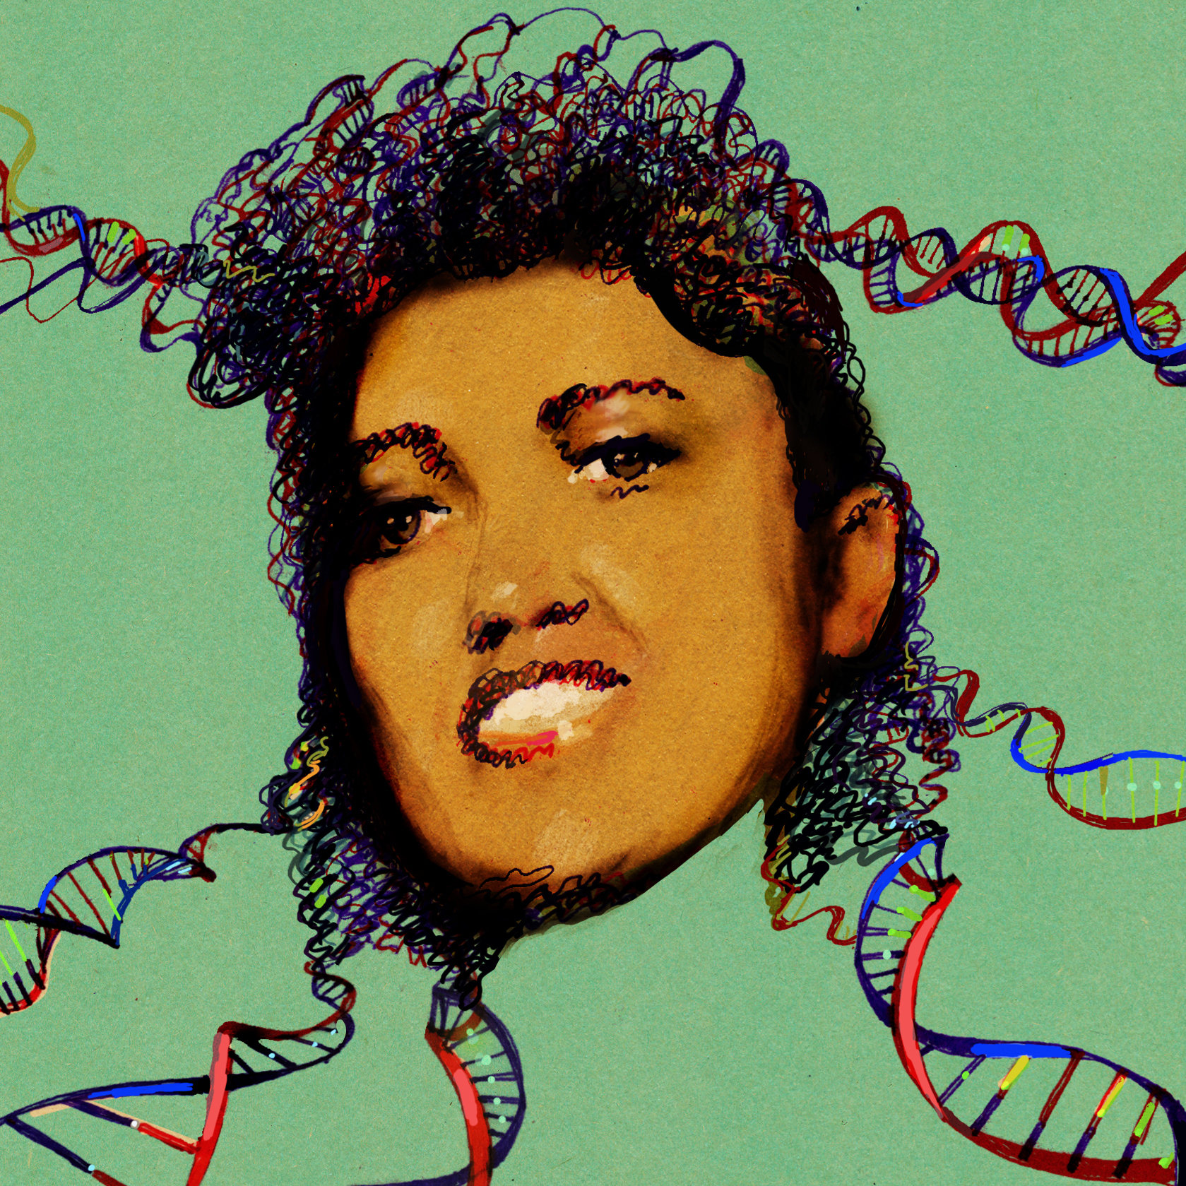
Tricky Privacy Considerations in Personal Genomics
Personal Genomic info. essentially meaningless currently but will it be in 20 yrs? 50 yrs?
  Genomic sequence very revealing about one’s children
  Once put on the web it can’t be taken back
Not clear whether they can be treated with “open data” ethos of circa 2000
Ownership of the data & what consent means (Hela)
  Could your genetic data give rise to a product line?
Large discussion of Identification Risk but what about Characterization Risk
  Finding you were in study X vs identifying that you have trait Y from studying your identified genome
[D Greenbaum & M Gerstein (’08). Am J. Bioethics; D Greenbaum & M Gerstein, Hartford Courant, 10 Jul. '08 ; SF Chronicle, 2 Nov. '08;
Greenbaum et al. PLOS CB (‘11) ; Greenbaum & Gerstein ('13), The Scientist; Photo from NY Times]

Slide 10


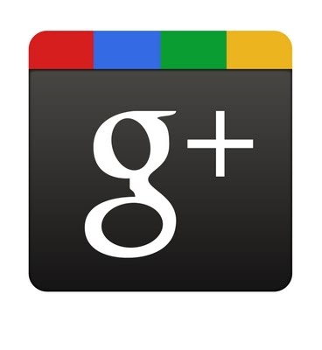
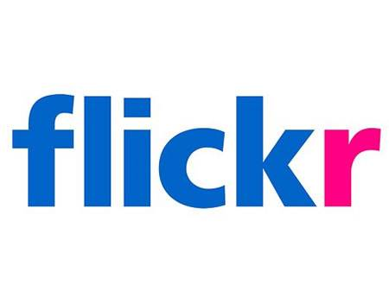








Genomics has similar "Big Data" Issues to the Rest of Society
Sharing & "peer-production" is central to success of many new ventures, with the same risks as in genomics
We confront privacy risks every day we access the internet
(...or is the genome more exceptional & fundamental?)
[Seringhaus & Gerstein ('09), Hart. Courant (Jun 5); Greenbaum & Gerstein ('11), Times (6 Oct)]

Slide 11
Proposed Social & Technological Solutions to Issues of Data Privacy in Personal Genomics
(Licensure, Secondary Datasets, Enclaves)
Current Social & Tech Approaches
  GINA, Consents &
  "Secure" use of dbGAP
  Ways the solutions have been "hacked"
Strawman
Hybrid Soc-Tech Approach
  Soc: Licensure for genomic researchers
  Enclaves in the cloud
  Intelligent data formats mostly splitting private & public info
  (ex of MRF)
Setting the Stage: the Advent of Personal Genomics
The of Conundrum Genomic Privacy
  Fundamental, inherited info v need for data-sharing to enable research

Slide 12

Genetic Information Nondisclosure Act of 2008
Title I relating to Health Insurance
Title II relating to Employment Discrimination
GINA Prohibits:
  group and individual health insurers from using genetic data for determining eligibility or premiums
  insurers from requesting that the insured undergo genetic testing
  employers from using genetic data to may employment decisions
  Employers from requesting genetic data about an employee or their family
12

Slide 13
Current Social & Technical Solutions
Pic on secuirty
Consents
dbGAP distribution of data
Local computes on secure computer
Issues
  Non-uniformity of consents & paperwork
  Encryption & computer security creates burdensome requirements on data sharing & large scale analysis
    Security increasingly becoming harder & harder
    More
    http://archive.gersteinlab.org/papers/e-print/security_data_archiving/preprint.pdf
    +
    + science cover
  Different international norms
[Smith et al ('05), Genome Biol.; Greenbuam et al ('04), Nat. Biotech; Greenbaum & Gerstein ('13), The Scientist]

Slide 14
Proposed Social & Technological Solutions to Issues of Data Privacy in Personal Genomics
(Licensure, Secondary Datasets, Enclaves)
Current Social & Tech Approaches
  GINA, Consents &
  "Secure" use of dbGAP
  Ways the solutions have been "hacked"
Strawman
Hybrid Soc-Tech Approach
  Soc: Licensure for genomic researchers
  Enclaves in the cloud
  Intelligent data formats mostly splitting private & public info
  (ex of MRF)
Setting the Stage: the Advent of Personal Genomics
The of Conundrum Genomic Privacy
  Fundamental, inherited info v need for data-sharing to enable research

Slide 15
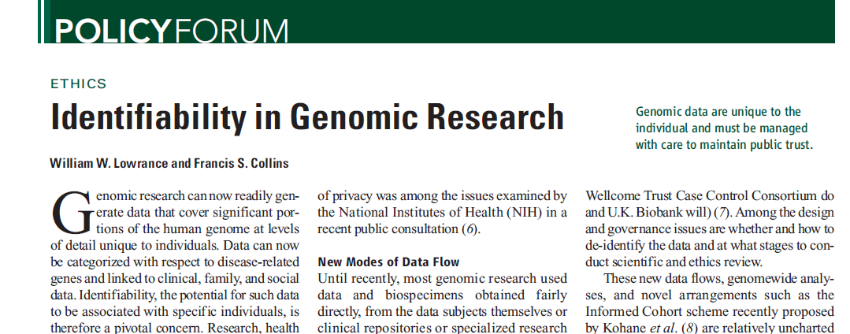
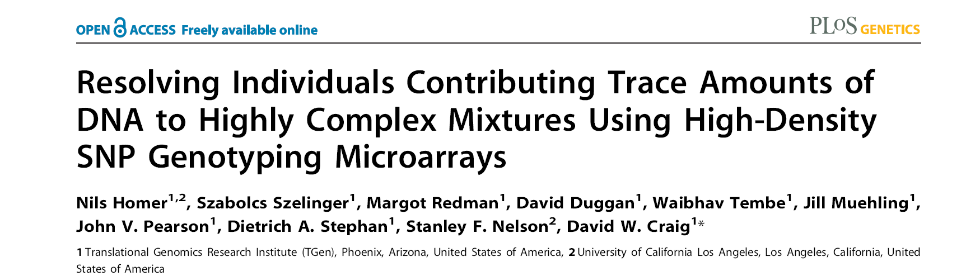
Matching against reference genotype. The number of DNA markers such as single-nucleotide polymorphisms (SNPs) that are needed to uniquely identify a single person is small; Lin et al. estimate that only 30 to 80 SNPs could be sufficient
Linking to nongenetic databases. A second route to identifying genotyped subjects is deduction by linking and then matching geno-type- plus-associated data (such as gender, age, or disease being studied) with data in health-care, administrative, criminal, disaster response, or other databases … If the nongenetic data are overtly identified, the task is straightforward
a framework for accurately and robustly resolving whether individuals are in a complex genomic DNA mixture using high-density single nucleotide polymorphism (SNP) genotyping microarrays.
We demonstrate an approach for rapidly and sensitively determining whether a trace amount (<1%) of genomic DNA from an individual is present within a complex DNA mixture
"Identifying Personal Genomes by Surname Inference,"Gymrek, McGuire, Golan, Halperin, Erlich ('13). Science.
  Identifying anonymized 1000G individuals through DB xref

Slide 16
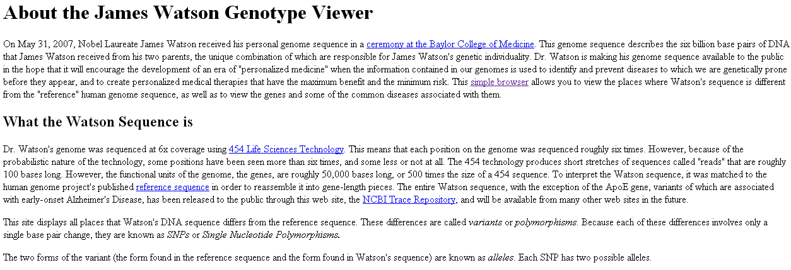
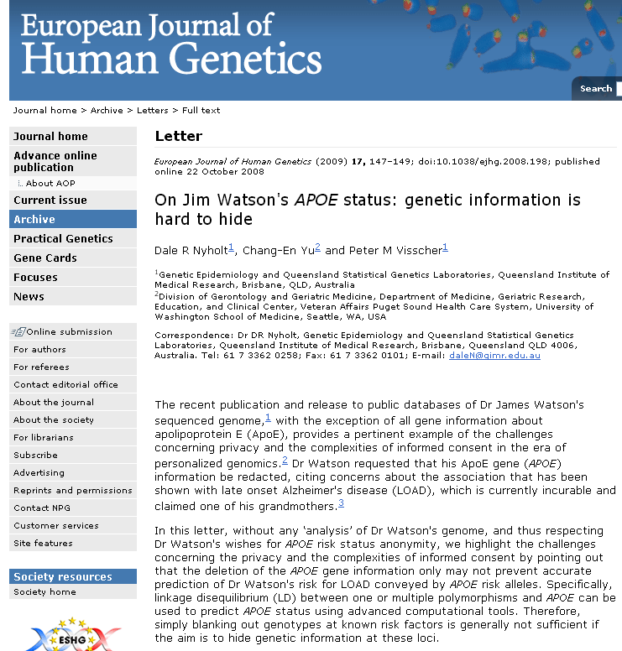
Consolidate into a sinlge slide

Slide 17

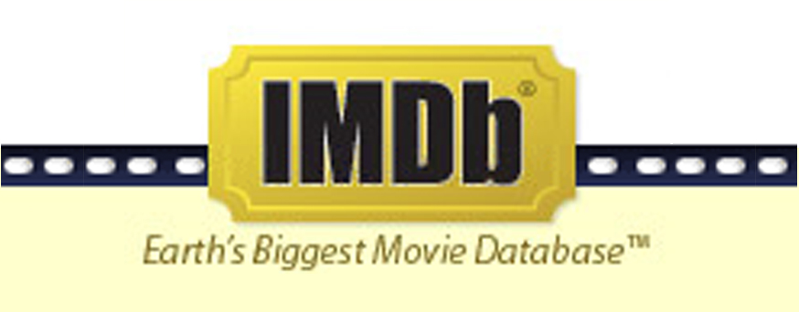
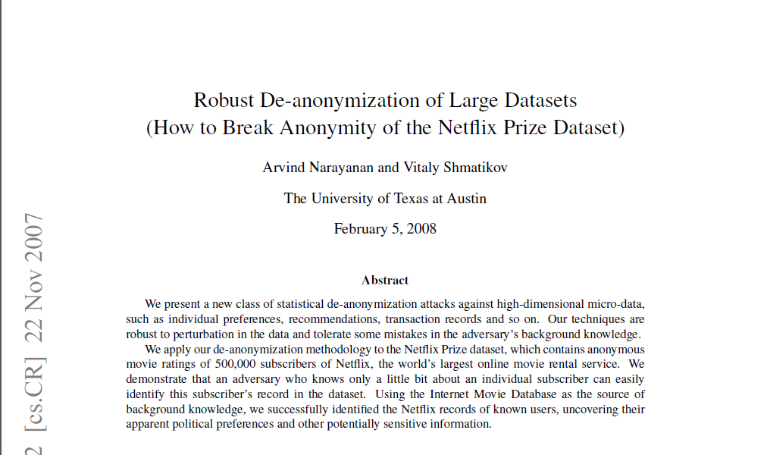
Cross correlated small set of identifiable IMDB movie database rating
records with large set of “anonymized” Netflix customer ratings

Slide 18
Strawman Hybrid Social & Tech Solution?
Fundamentally, researchers have to keep genetic secrets
  Genetic Licensure
Technology to make it easier
  Cloud computing & enclaves
  Selection of stub & "test pilot" datasets for benchmarking
  Careful separation of private & public data
    Lightweight, freely accessible secondary datasets
Technological barriers shouldn't create a social incentive for “hacking”
[D Greenbaum, M Gerstein (‘11). Am J Bioeth 11:39. Greenbaum & Gerstein, The Scientist ('13)]

Slide 19
Proposed Social & Technological Solutions to Issues of Data Privacy in Personal Genomics
(Licensure, Secondary Datasets, Enclaves)
Current Social & Tech Approaches
  GINA, Consents &
  "Secure" use of dbGAP
  Ways the solutions have been "hacked"
Strawman
Hybrid Soc-Tech Approach
  Soc: Licensure for genomic researchers
  Enclaves in the cloud
  Intelligent data formats mostly splitting private & public info
  (ex of MRF)
Setting the Stage: the Advent of Personal Genomics
The of Conundrum Genomic Privacy
  Fundamental, inherited info v need for data-sharing to enable research

Slide 20
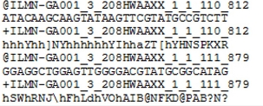
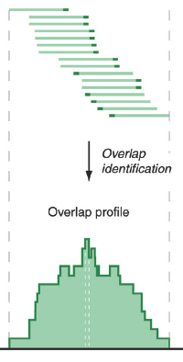
Low-Level Data for RNA-seq
1) Large magnitude of data generated
ENCODE, modENCODE, TCGA, GTEx, Roadmap, etc.
2) mostly it’s about the phenotype (eg cancer gene expr) & not the indivd.
But the indiv. Comes along as collateral
Reads (fasta)
+ quality scores (fastq)
+ mapping (BAM)
Contain variant information in transcribed regions
Reads => Signal (Intermediate file)
[PLOS CB 4:e1000158]

Slide 21
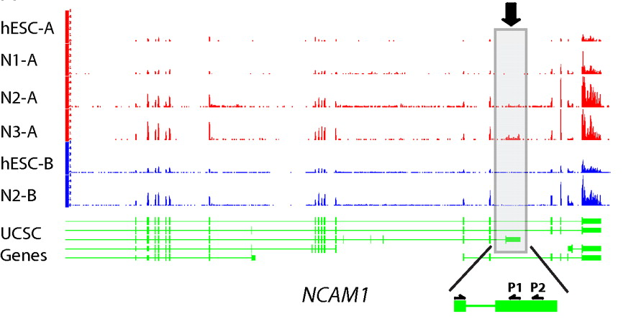
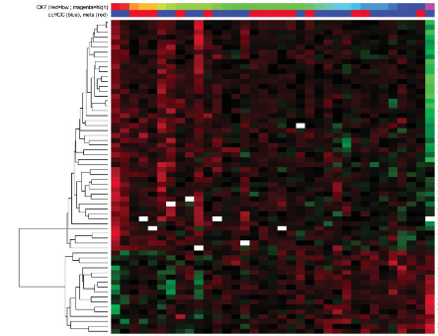
Higher level Information from
RNA-seq:
Avg. signal at exons (RPKMs)
[PNAS 4:107: 5254 ; IJC 123:569]
Signal tracks for two genes are shown. Figure made using UCSC genome browser.
RNA-Seq experiments one would keep: the expression levels (i.e. RPKMs) of ~20,000 genes, ~70,000 transcripts, ~200,000 exons, and ~2 million splices. Also, we would store information on ~15,000 novel Transcriptionally Active Regions (TARs), ~2,000 allele-specific expressed genes, ~50 chimeric transcripts as well as lists of differentially expressed elements between conditions.
Mertz, Kirsten D., Francesca Demichelis, Andrea Sboner, Michelle S. Hirsch, Paola Dal Cin, Kirsten Struckmann, Martina Storz, et al. “Association of cytokeratin 7 and 19 expression with genomic stability and favorable prognosis in clear cell renal cell cancer.” International Journal of Cancer 123, no. 3 (2008): 569-576.
Mapped reads show isoform composition in two different stages.
Du et al (in revision).

Slide 22
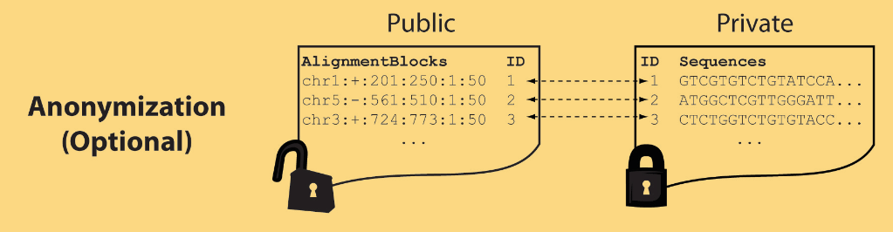
Light-weight formats
Some lightweight format clearly separate public & private info., aiding exchange
Files become much smaller
Distinction between formats to compute on and those to archive with – become sharper with big data
Reads
(linked via ID,
10X larger than
mapping coord.)
Mapping coordinates without variants (MRF)
[Bioinformatics 27: 281]

Slide 23
MRF Examples
chr2:+:601:630:1:30,chr2:+:921:940:31:50
TS
TE
TS
TE
Reference
AlignmentBlock 1
AlignmentBlock 2
10X Compression Ex.
Raw ELAND export file has uncompressed file size: ∼4 GB; total number of reads: ∼20 million; number of mapped reads: ∼12 million .
MRF file is significantly smaller (∼400 MB uncompressed, ∼130 MB compressed with gzip).
BAM file
has a size of ∼1.2 GB.
Splice junction Read
QS
QE/QS
QE
Legend: TS = TargetStart, TE = TargetEnd, QS = QueryStart, QE = QueryEnd
chr9:+:431:480:1:50|chr9:+:945:994:1:50
TS
TE
TS
TE
Reference
AlignmentBlock 1
AlignmentBlock 2
Reference based compression (ie CRAM) is similar but it stores actual variant beyond just position of alignment block
Paired-end Read
QS
QE
QS
QE
Legend: TS = TargetStart, TE = TargetEnd, QS = QueryStart, QE = QueryEnd
[Habegger et al., Bioinformatics (‘11)]

Slide 24
Genomic Privacy: Thoughts on Social & Technical Aspects
Setting the Stage: the Advent of Personal Genomics
The Conundrum of Genomic Privacy
  Fundamental, inherited info v need for data-sharing to enable research
Current Social & Tech Approaches
  GINA, Consents &
  "Secure" use of dbGAP
  Ways the solutions have been "hacked"
  Strawman
  Hybrid Soc-Tech Approach
    Soc: Licensure for genomic researchers
    Enclaves in the cloud
RNA-seq Data – how much information is leaked & how to make it more private?
  Variants in the Reads
    Intelligent data formats mostly splitting private & public info
    (ex of MRF)
  Variants from Quantifications & eQTLs
  Any SVs in pervasive transcription?

Slide 25
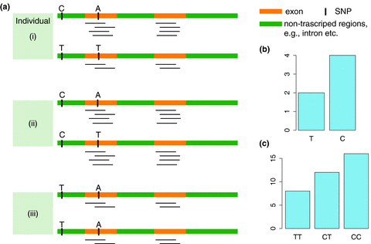
eQTL Mapping Using RNA-Seq Data
eQTLs are genomic loci that contribute to variation in mRNA expression levels
eQTLs provide insights on transcription regulation, and the molecular basis of phenotypic outcomes
eQTL mapping can be done with RNA-Seq data
[Biometrics 68(1) 1–11]
Notes:
A diagram to illustrate the RNA‐seq count variation of one gene due to an cis‐eQTL. (a) RNA‐seq measurements of a hypothetic gene with two exons in three diploid individuals. The target SNP which we test for association has the genotype CT, CC, and TT for the three individuals. There is an SNP on the first exon, which has genotype AT, AT, and AA for the three individuals. ASE can be measured by those sequence reads that overlap with a heterozygous exonic SNP. Therefore we can measure ASE for individuals (i) and (ii). However, association testing by ASE is only possible if the target SNP is heterozygous, thus only individual (i) can be used to test for eQTL by ASE (b) ASE measurements for individual (i). (c) TReC measured for the three individuals across the two exons of this gene.
© IF THIS IMAGE HAS BEEN PROVIDED BY OR IS OWNED BY A THIRD PARTY, AS INDICATED IN THE CAPTION LINE, THEN FURTHER PERMISSION MAY BE NEEDED BEFORE ANY FURTHER USE. PLEASE CONTACT WILEY'S PERMISSIONS DEPARTMENT ON PERMISSIONS@WILEY.COM OR USE THE RIGHTSLINK SERVICE BY CLICKING ON THE 'REQUEST PERMISSION' LINK ACCOMPANYING THIS ARTICLE. WILEY OR AUTHOR OWNED IMAGES MAY BE USED FOR NON-COMMERCIAL PURPOSES, SUBJECT TO PROPER CITATION OF THE ARTICLE, AUTHOR, AND PUBLISHER.

Slide 26
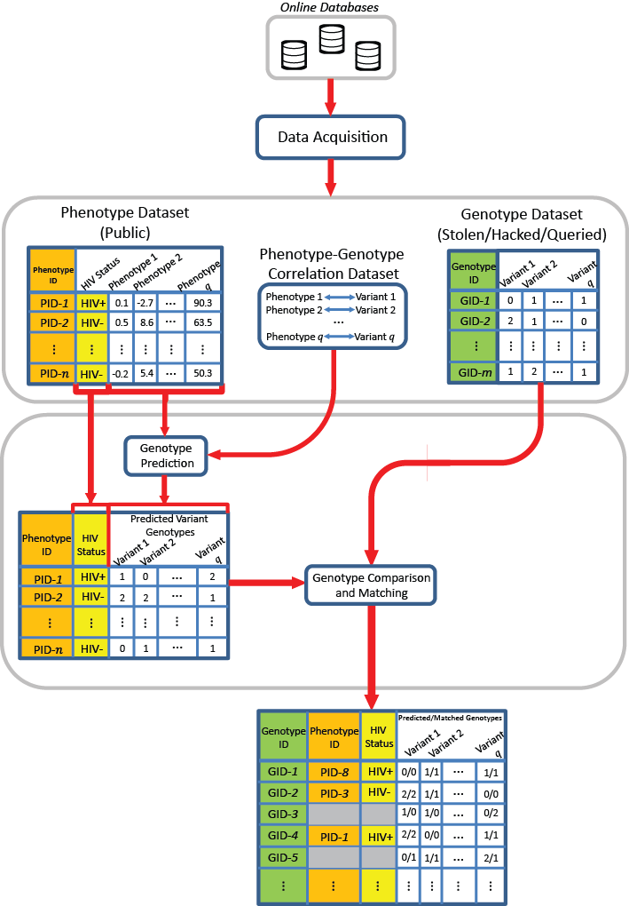
Attack based on quantifications and eQTLs
One can still perform an attack if he/she has access to quantifications.

Slide 27
Linking Attack Scenario

Slide 28
Linking Attack Scenario

Slide 29
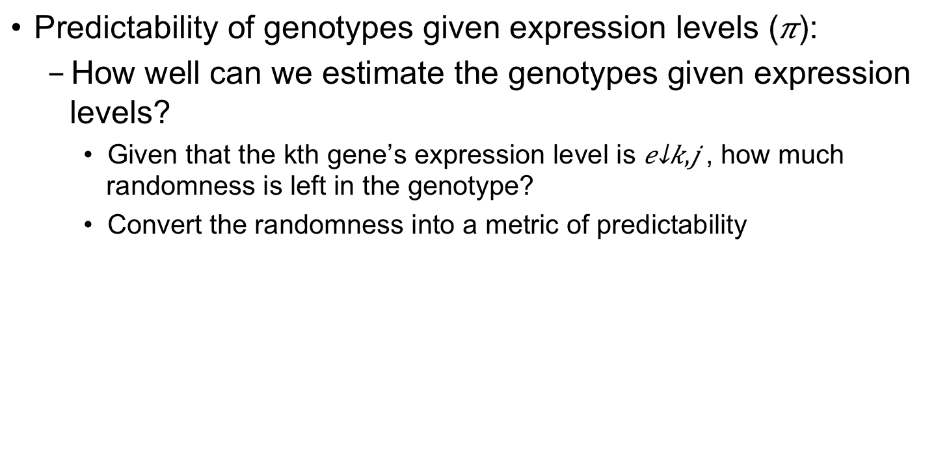
AH onto 1 slide & fix ekj
Quantifying Predictibiltity

Slide 30
Quantifying Amount of Characterizing Information Leaked
Amount of individual characterizing Information (ICI) in a set of n variants:
  Analogy: Count how many rare genotypes there are in the set.

Slide 31
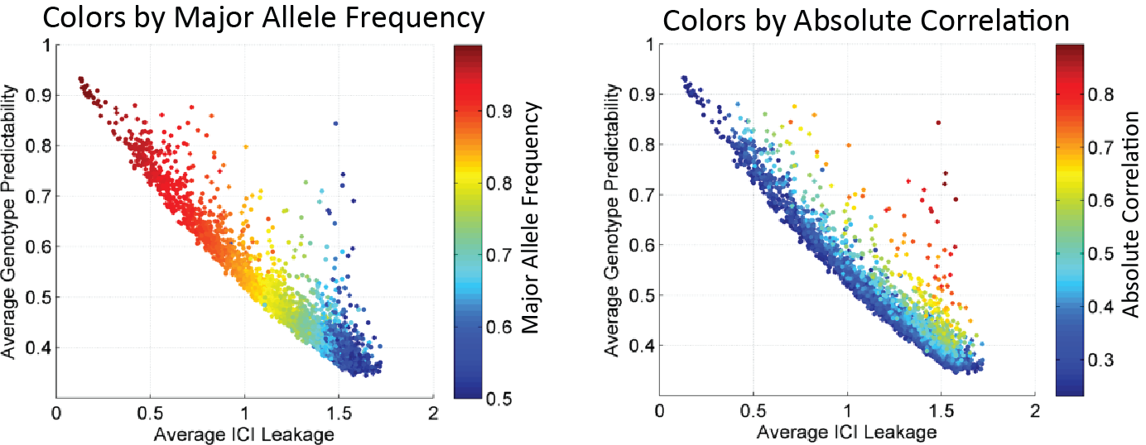
Relating Predictability to ICI Leakage – A few key SNPs with good predictability & Great Leakage.
Perhaps these could removed?

Slide 32
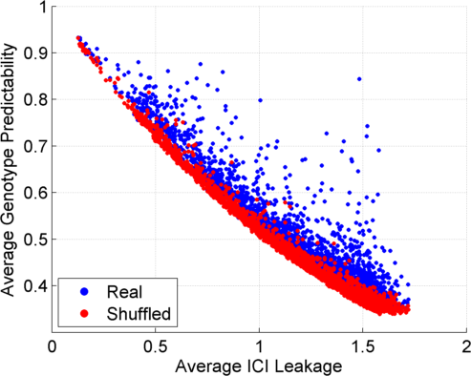
Per eQTL Predictability vs ICI Leakage

Slide 33
Genomic Privacy: Thoughts on Social & Technical Aspects
Setting the Stage: the Advent of Personal Genomics
The Conundrum of Genomic Privacy
  Fundamental, inherited info v need for data-sharing to enable research
Current Social & Tech Approaches
  GINA, Consents &
  "Secure" use of dbGAP
  Ways the solutions have been "hacked"
  Strawman
  Hybrid Soc-Tech Approach
    Soc: Licensure for genomic researchers
    Enclaves in the cloud
RNA-seq Data – how much information is leaked & how to make it more private?
  Variants in the Reads
    Intelligent data formats mostly splitting private & public info
    (ex of MRF)
  Variants from Quantifications & eQTLs
  Any SVs in pervasive transcription?

Slide 34
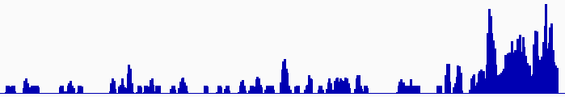
Discovering Transcriptionally Active Regions (novel RNA contigs)
Cluster reads setting minimum-run and maximum gap parameters for newly identified transcribed regions (TARs)
Assess exon discovery rates for known genes and noncoding RNAs
Known exon
Known exon
TAR
TAR
TAR
novel TAR
correct identification
possible exon extension
ENCODE RNA-Seq Data

Slide 35
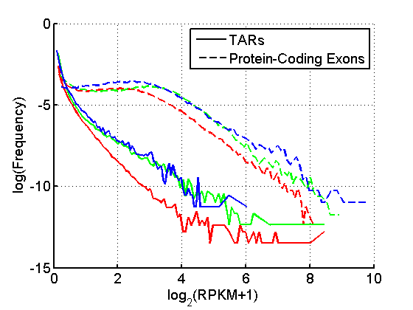
Non-Canonical Transcription
 |  | Human
 |  | Elements | Genome Coverage
 |  |  | Kb | %
mRNAs (exons) |  | 20,007 | 86,560 | 3.0
Pseudogenes |  | 11,216 | 27,089 | 0.95
Total ncRNAs |  | 22,154 | 17,770 | 0.62
Regions Excluding mRNAs, Pseudogenes or Annotated ncRNAs |  | 283,816 | 2,731,811 | 95.5
 | Transcription Detected (TARs) | 708,253 | 916,401 | 32.0
4.5% of human genome are transcribed and associated with standard annotations;
32% of human genome give rise to TARs or non-canonical transcription, i.e., transcription from genomic regions not associated with standard annotations;
Non-canonical transcripts show lower transcription level compared to protein coding transcripts
[Nature 512(7515):445-8]

Slide 36
Non-coding Transcripts Relate to Coding Transcripts
Non-coding transcription may correlate with coding transcription
Potential mapping artifacts: reads from coding regions mapped to non-coding elements or vice versa due to sequence similarity
simplified
Pseudogenes
TARs
[Nature 512(7515):445-8; Genome Biol. 13: R51]

Slide 37
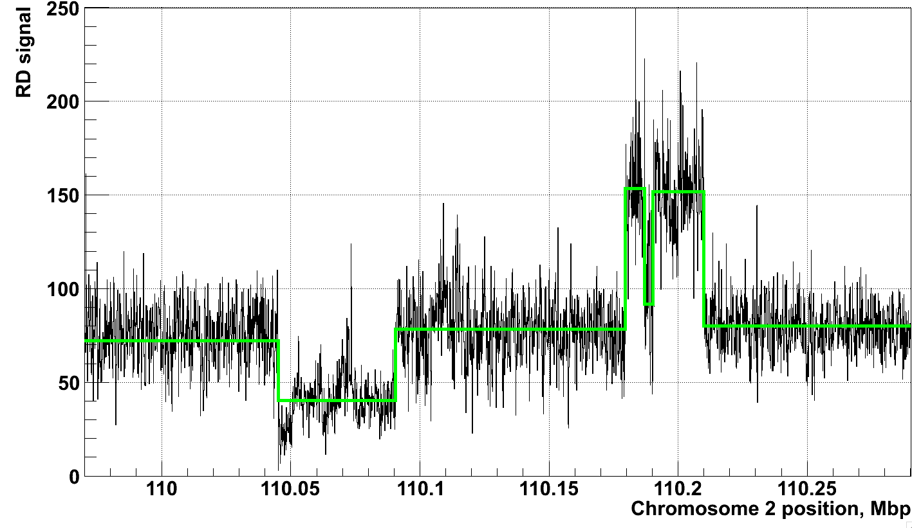
Example of Application of CNVnator to RD data
[Abyzov et al. Gen. Res. (’11)]
NA12878, Solexa 36 bp paired reads, ~30x coverage

Slide 38
Proposed Social & Technological Solutions to Issues of Data Privacy in Personal Genomics
(Licensure, Secondary Datasets, Enclaves)
Current Social & Tech Approaches
  GINA, Consents &
  "Secure" use of dbGAP
  Ways the solutions have been "hacked"
Strawman
Hybrid Soc-Tech Approach
  Soc: Licensure for genomic researchers
  Enclaves in the cloud
  Intelligent data formats mostly splitting private & public info
  (ex of MRF)
Setting the Stage: the Advent of Personal Genomics
The of Conundrum Genomic Privacy
  Fundamental, inherited info v need for data-sharing to enable research

Slide 39
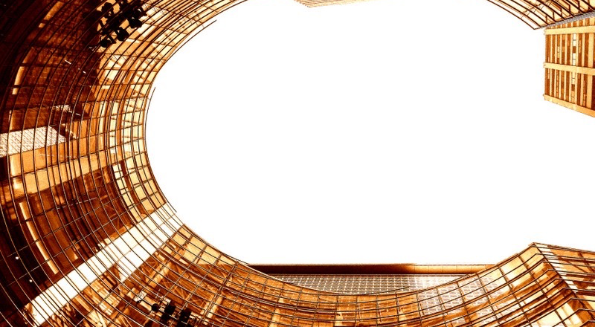
Acknowledgements
papers.gersteinlab.org/subject/privacy
Clean up
Papers on privacy
D GreenbaumPlos cb - A Sboner, XJ Mu
cnvnator
Encode pgenes & cmptxn – key authors – Bp, ah, jr, kky…
privaseq - A Harmanci
Rseqtool L Habegger, A Sboner, TA Gianoulis,
J Rozowsky, A Agarwal, M Snyder

Slide 40
Default Theme
Default Outline Level 1
  Level 2

Slide 41
More Information on this Talk
SUBJECT: Networks
DESCRIPTION:
NOTES:
This PPT should work on mac & PC. Paper references in the talk were mostly from Papers.GersteinLab.org.
PERMISSIONS: This Presentation is copyright Mark Gerstein, Yale University, 2010. Please read permissions statement at http://www.gersteinlab.org/misc/permissions.html . Feel free to use images in the talk with PROPER acknowledgement (via citation to relevant papers or link to gersteinlab.org).
PHOTOS & IMAGES. For thoughts on the source and permissions of many of the photos and clipped images in this presentation see http://streams.gerstein.info . In particular, many of the images have particular EXIF tags, such as kwpotppt , that can be easily queried from flickr, viz: http://www.flickr.com/photos/mbgmbg/tags/kwpotppt .
Notes:
41

Slide 42
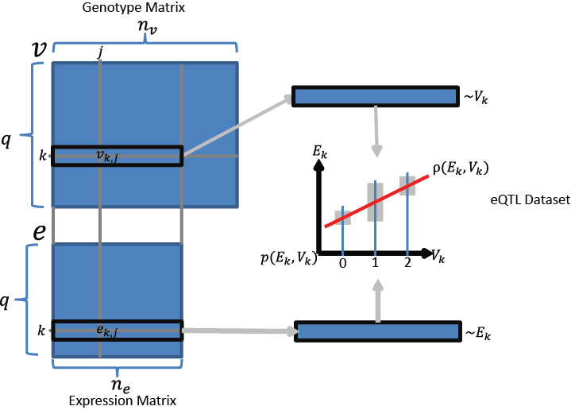

Slide 43
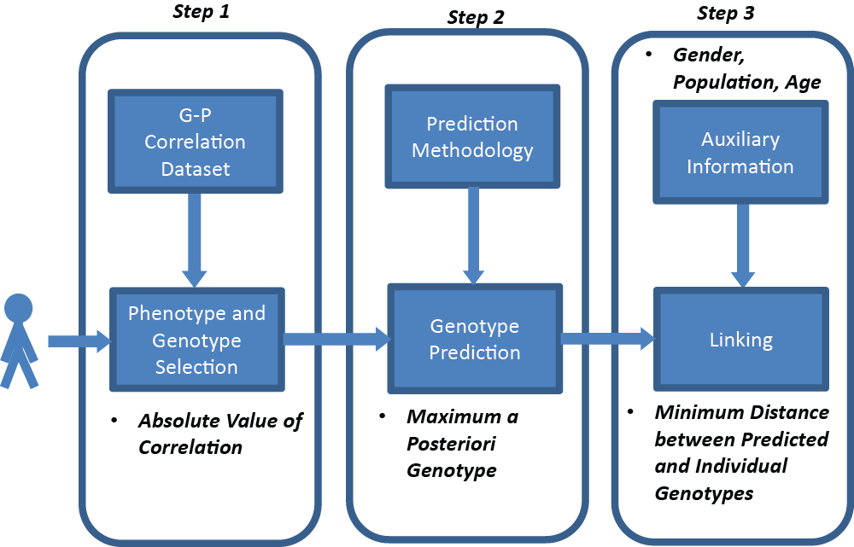

Slide 44
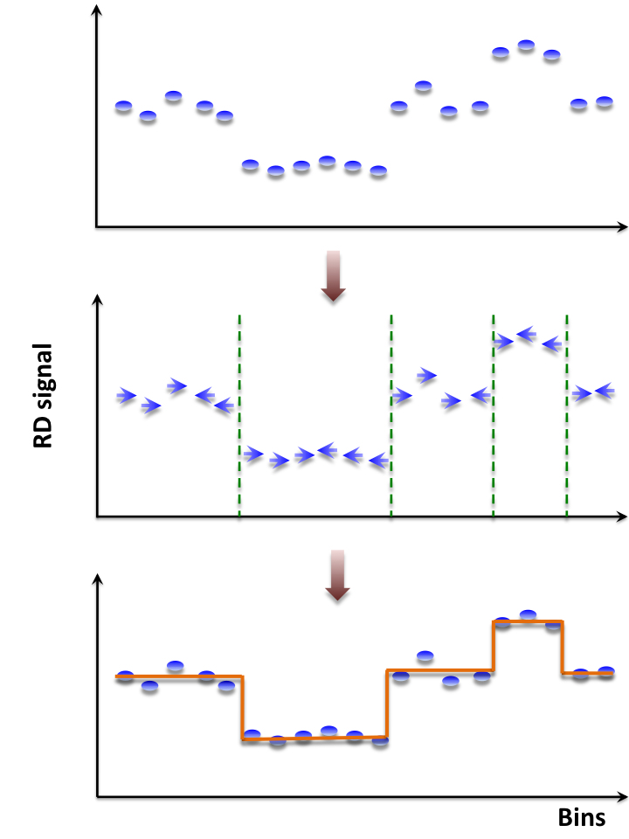
Mean-shift-based (MSB) segmentation: no explicit model
CNVnator
For each bin attraction (mean-shift) vector points in the direction of bins with most similar RD signal
No prior assumptions about number, sizes, haplotype, frequency and density of CNV regions
Not Model-based (e.g. like HMM)
with global optimization, distr. assumption & parms. (e.g. num. of segments).
Achieves discontinuity-preserving smoothing
Derived from image-processing applications
[Abyzov et al. Gen. Res. (’11)]

